Slide 1
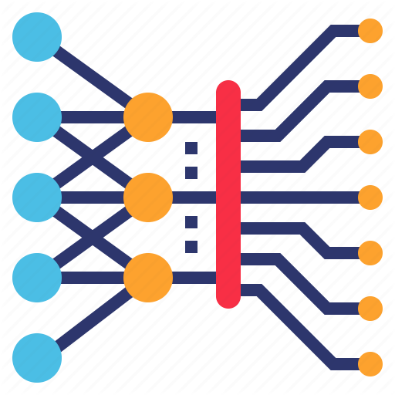
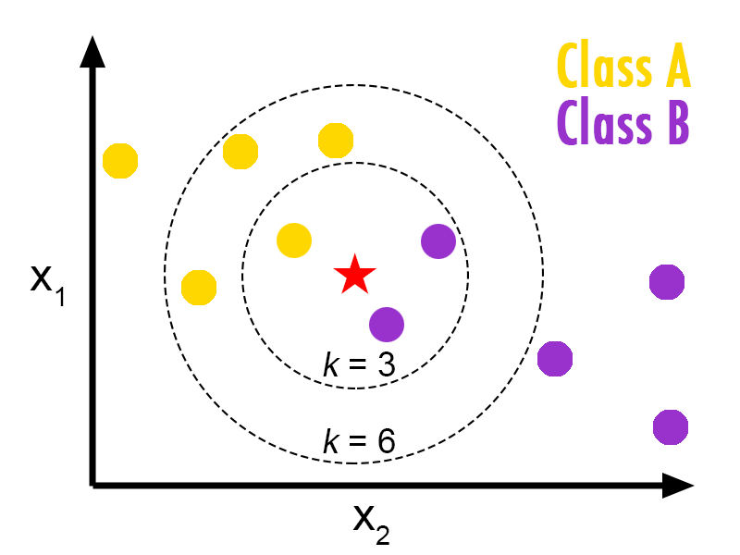


Teachable Machine Building Blocks
Input Images
Predictions
KNN Classifier
MobileNet DNN

Slide 2
Practice Alphabets and Phrases Machine learning Model
Input Images
Prediction
KNN Classifier
MobileNet Feature Extracion

