Slide 1
AI-Generated Visual Content Detection and Media Trust
Class 3 Group 6
2026.6.12

Slide 2
Intro
PART1

Slide 3
Intro
Generative AI can generate photorealistic scenes, readable text, and interface-like layouts.
Realistic AI-synthesized images can increase belief in misinformation.
Can university-level respondents accurately distinguish AI-generated images from real images?
How did their trust ratings differ by image source and category?

Slide 4
Methods
PART2

Slide 5
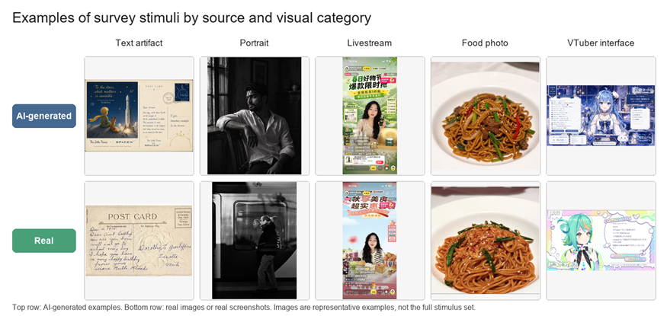
Methods
Small-scale quantitative survey
1.Background characteristics, social media use, AI tool use, and self-rated AI image detection ability.
2. The determination of whether each image is a real one or generated by artificial intelligence, and the rating of the credibility of the image.
3.Four media-trust attitude questions, one attention-check item, and one optional open-ended question about the cues they used

Slide 6
Results
PART3

Slide 7
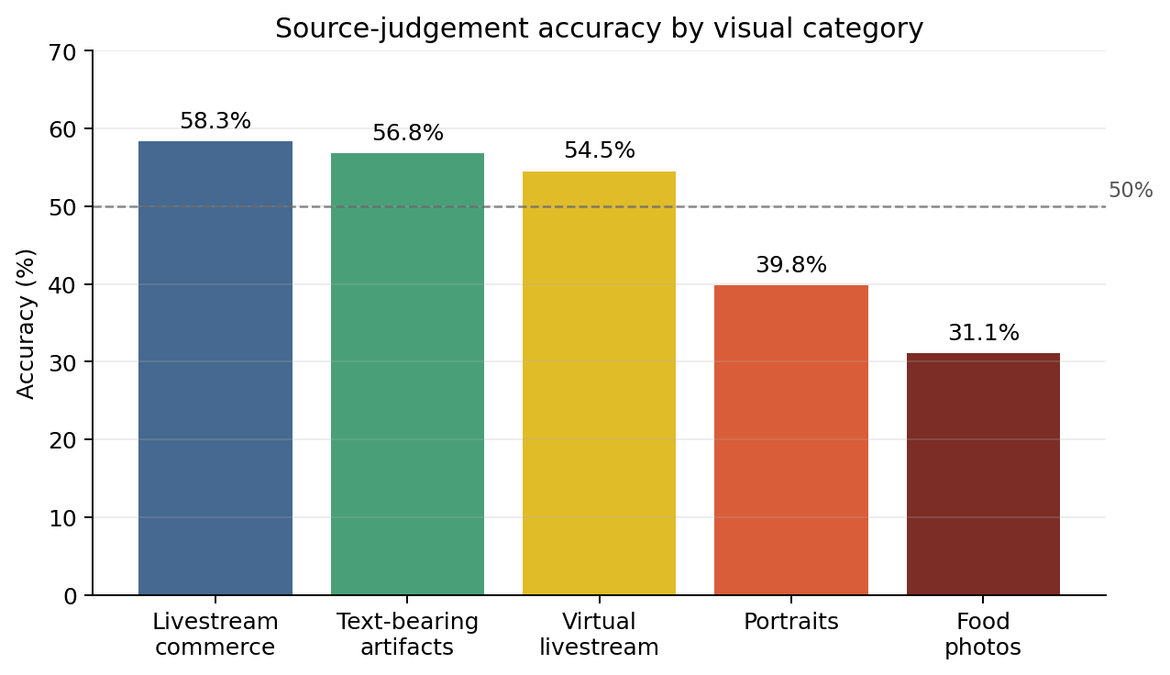
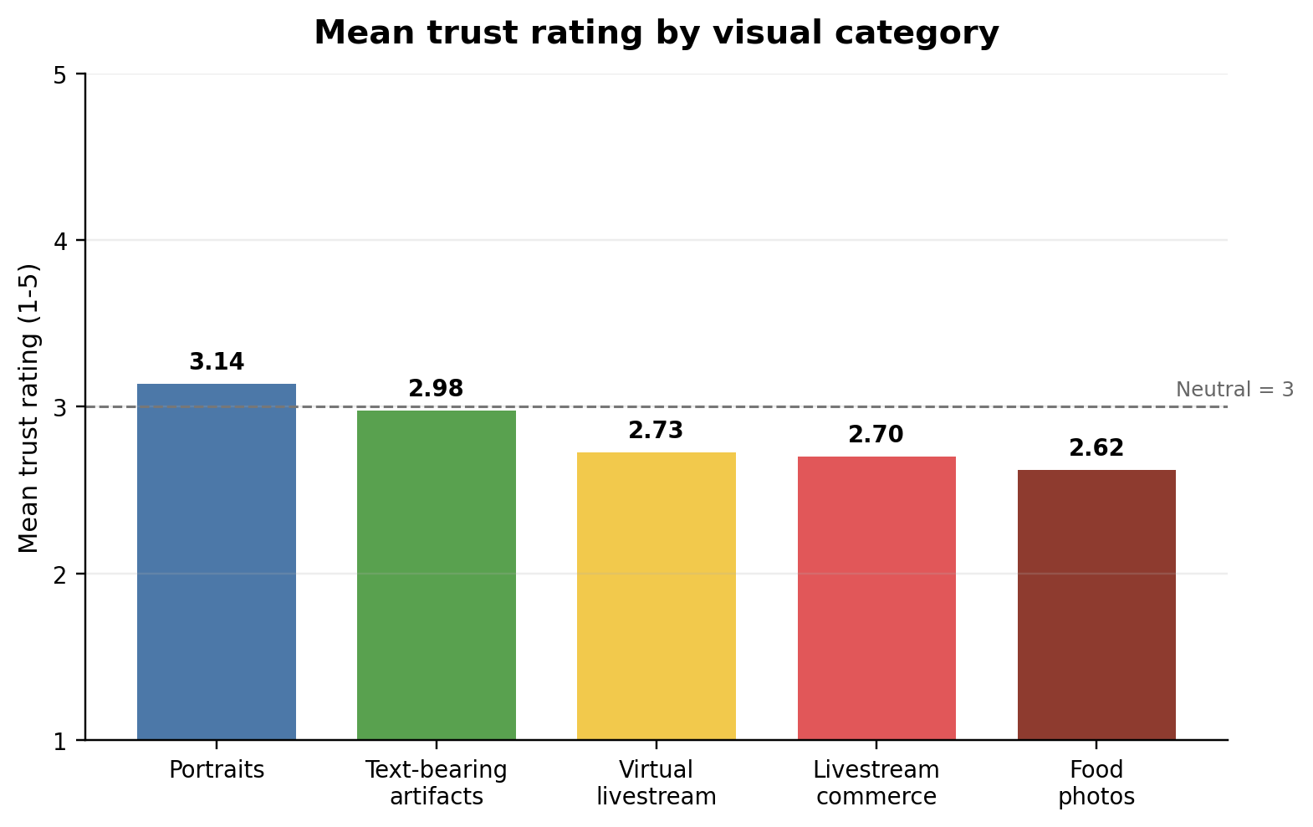
Results
1.Accuracy
AI-generated images (52.9%)
Images or screenshots (41.9%)
2.Trust ratings
AI-generated images (52.9%)
Images or screenshots (41.9%)
3.Attitude
Respondents generally did not agree that online images and screenshots usually reflect reality (M = 2.39)

Slide 8
Discussion
PART4

Slide 9
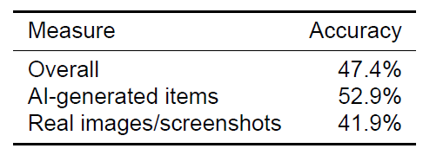
Discussion
Findings
The main finding is that source judgement was unstable. This pattern suggests that respondents were not only fooled by AI-generated images; they also became suspicious of real images.
The category-level results suggest that visual authenticity is becoming difficult to judge, especially when real images look polished or artificial.

Slide 10
Discussion
Possible Reasons
1.Respondents may have used surface visual cues too heavily.
2.The materials were selected purposively.
3.Screenshot-like materials provide contextual cues.

Slide 11
Discussion
Limitations Implications
The survey used a small convenience sample of university-level respondents, so the results should be interpreted as descriptive rather than representative of all social media users.
The stimulus set was purposively selected and contained only 18 images. Differences in image topic, resolution, platform style, and visual quality may have influenced participants’ judgements.
Platforms and educators should not assume that users can reliably identify AI-generated images through visual inspection alone.
Media literacy training should address not only fake photographs but also fake visual contexts, including livestream interfaces, screenshots, comments, prices, and other platform cues that can make synthetic material appear socially credible.

Slide 12
Discussion
Conclusion
The study suggests that ordinary visual judgement is not enough for evaluating AI-generated online images. Respondents showed limited accuracy, moderate trust, and some uncertainty about both real and AI-generated materials. As image-generation tools become better at producing realistic images, readable text, and interface-like screenshots, users may need clearer platform labels, stronger verification habits, and better media literacy training.

