Slide 1
The C++
Programming Language
Lecture 3:
Standard Template Library
&
Generic Programming

Slide 2
Brief Introduction

Slide 3
Generic Programming
Core idea
    Data structures and data types should be independent
    Data structures and algorithms should be independent
    Algorithms and data types should be independent (generic)
STL supports GP well
  Including 2 parts
    Container: vector, list, map, set,… (basic data structures)
    Generic Algorithm: find, sort, merge,… (frequently used operations)

Slide 4
Why?
Writing the same search, sort, or other functionality for all the different data types is tedious and error prone.
Rise the level of abstraction, the source code is just a pattern.
Why not use a solution that allows you to write a function once and then use it for any kind of data?

Slide 5
How?
Container supported the independence between data types and data structures
    list<int>, list<double>
Iterators supported the independence between data structures and algorithms
    sort(vec.begin(), vec.end());
Function templates supported the independence between algorithms and data types
    template <typename ElemType>
    binary_search(const vector<ElemType>&, ElemType&);

Slide 6
From Pointers to Iterators

Slide 7
From pointers to iterators
Request 1:
  Given a vector of integer and an integer value, implement a find() function that if the value exists in vector, return a pointer to it, return 0 otherwise
int* find(const vector<int>& vec, int iValue)
{
for (int iX = 0; iX < vec.size(); iX++)
{
if (vec[iX] == iValue)
{
return &vec[iX];
}
}
return 0;
}

Slide 8
From pointers to iterators (cont.)
Request 2:
  Let the previous find() function support any data types that having test equivalence operator (==) defined
template <typename ElemType>
ElemType* find(const vector<ElemType> &vec, const ElemType &Value)
{
for (int iX = 0; iX < vec.size(); iX++)
{
if (vec[iX] == Value)
{
return &vec[iX];
}
}
return 0;
}

Slide 9
From pointers to iterators (cont.)
Request 3:
  Let the previous find() function also support data elements in arrays
Another overloaded function may solve it, but currently we try to use a single implementation
Design philosophy: Divide and Conquer
    Pass the elements in array to find(), but never let the function be aware of the form of array
    Pass the elements in vector to find(), but never let the function be aware of the form of vector

Slide 10
From pointers to iterators (cont.)
For array, common ways are using pointers and subscription
template <typename ElemType>
ElemType* find(const ElemType* array , int iSize, const ElemType &Value)
{
if ((! array) || size < 1) return 0;
for (int iX = 0; iX < iSize; iX++)
{
if (array[iX] == Value)
{
return &array[iX];
}
}
return 0;
}

Slide 11
From pointers to iterators (cont.)
A better implementation:
    adding a sentinel pointer that pointing to the next address of the last element, which could replace the size parameter
    using pointer dereference to replace subscription
template <typename ElemType>
ElemType* find(const ElemType* first , const ElemType* last , const ElemType &Value)
{
if ((! first) || (! last)) return 0;
for (; first != last; first++)
{
if (*first == Value) return first;
}
return 0;
}

Slide 12
From pointers to iterators (cont.)
For vector, previous function works, because vector can be also sequentially addressed
But a small problem: vector is nullable while array not, following usage will cause runtime error
    vector<string> svec;
    find(&svec[0], &svec[svec.size()], search_value);
We add two supplementary functions for safe

Slide 13
From pointers to iterators (cont.)
template <typename ElemType>
inline ElemType* begin(const vector<ElemType> &vec)
{
return vec.empty() ? 0 :&vec[0];
}
template <typename ElemType>;
inline ElemType* end(const vector<ElemType> &vec)
{
return vec.empty() ? 0 : ++(&vec[vec.size() – 1]);
}
Calling
find(begin(svec), end(svec), search_value);

Slide 14
From pointers to iterators (cont.)
Request 4:
  Let the previous find() function also support the list container in STL
Our arithmetic of pointer in previous function will not work, because the addressing is different
    Array and vector using consecutive memory block (++, --)
    List using linked memory units (->next, ->prev)
To solve it, we must add an abstract layer to encapsulate the low-level pointer actions, thus avoiding user’s direct manipulating with low-level pointers
Iterators – abstract pointers to containers

Slide 15
Iterators
Objects that defined or overloaded the internal operators (++, *, ==, !=), which we could use them as ordinary pointers
Each container provides us with kinds of iterators as its nested types, and also functions to manipulate them

Slide 16
Iterators (cont.)
Definition
    vector<string> svec;
    vector<string>::iterator it; //normal iterator
    vector<string>::const_iterator conit; //read only iterator
    vector<string>::reverse_iterator rit; //reverse iterator
Usage
    for (it = svec.begin(); it != svec.end(); it++)
    cout << *it << ‘ ’;
    cout << it->size() << endl;

Slide 17
Iterators (cont.)
Now we rewrite find() to meet request 4
template <typename IteratorType, typename ElemType>
IteratorType find(IteratorType first , IteratorType last , const ElemType& Value)
{
for (; first != last; first++)
{
if (*first == Value) return first;
}
return last;
}

Slide 18
Iterators (cont.)
And how to use
const int asize = 8;
int ia[asize] = { 1, 1, 2, 3, 5, 8, 13, 21};
vector<int> ivec(ia, ia + asize); //using the array to initialize the vector
list<int> ilist(ia, ia + asize); //using the array to initialize the list
int *pa = find(ia, ia + asize, 1024);
if (pa != ia + asize) //found…
vector<int>::iterator it_v = find(ivec.begin(), ivec.end(), 1024);
if (it_v != ivec.end()) //found…
list<int>::iterator it_l = find(ilist.begin(), ilist.end(), 1024);
if (it_l != ilist.end()) //found…

Slide 19
Iterators (cont.)
Compare the following iterators
int* p = &v[ 0 ];
vector< int >::iterator it1;
vector< int >::const_iterator it2;
vector< string >::iterator it3;
list< int >::iterator it4;
it1 = p; //?
it1 = it2; //?
it1 = it3; //?
it1 = it4; //?

Slide 20
Iterators (cont.)
Linear Range
  In Generic Programming, containers are regarded linear ranges and manipulated via iterators
  The iterator pair [first, last) , is used frequently to represent linear range
  Benefits
    The number of elements in [first, last) is last – first
    [p, p) is eligible to represent a null range

Slide 21
Ways of Traversing a Vector
for (int i = 0; i < v.size(); ++i) // why int?
// do something with v[i] or v.at(i)
for (vector<T>::size_type i = 0; i < v.size(); ++i)
// do something with v[i] or v.at(i)
// longer but always correct
for (vector<T>::iterator p = v.begin(); p != v.end(); ++p)
// do something with *p

Slide 22
Subscript vs. Iterator Vector Traversals
subscript style
  is used in essentially every language
  does not work for lists (in C++ and in most languages)
iterator style
  is used in C (pointers only) and C++
  is used for standard library algorithms
  works for all containers
use subscript style if you need to know the index
prefer size_type over plain int (pedantic but quiets compiler and prevents rare errors)
Notes:
Pendanitc 学究式

Slide 23
Another Way of Traversing a Vector:
Range For
for (vector<T>::value_type x : v)
// do something with x;
// assumes vector implementation includes
// “using value_type T;”
for (auto& x : v)
// do something with x
Use “range for” in this situation:
  very simple loop
  over a single sequence
  you don’t need to access more than one element at a time
  you don’t need to know the position of the current element

Slide 24
Standard STL Containers and Their Usage

Slide 25
Container
Two kinds of containers
    Sequential containers (vector, list, deque)
    Associate containers (map, set, multimap, multiset)
Common operators & functions
    ==, !=
    =
    empty(), size()
    begin(), end()
    insert(), erase(), clear()

Slide 26
Sequential Containers
vector – consecutive memory storing
    High performance in random access and ending element operations
    Low in inserting and deleting inner elements (moving)
    Could be used as stack
list – double linked memory units
    High performance in inserting and deleting on any positions
    Low in random access (traversing)
    Could be used as linked table
deque – consecutive memory storing
    High performance in random access and head and tail elements operations
    Low in inserting and deleting
    Could be used as queue

Slide 27
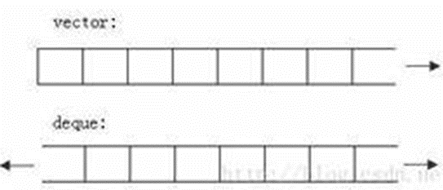

Sequential Containers
deque or vector?
  choose deque over vector if he wants to either add or delete from both the ends like implementing a Queue.
  choose vector if insertion or deletions are required mostly in end like implementing a Stack.
deque or list?
  Deque provides Fast insertions and deletions at both the end and the beginning. Inserting and deleting elements in the middle is relatively slow because all elements up to either of both ends may be moved to make room or to fill a gap.
  In List, inserting and removing elements is fast at each position, including both ends.

Slide 28
Sequential Containers (cont.)
Important member functions
    Constructor and initialization
    push_back(), pop_back(), back() (all 3 containers)
    push_front(), pop_front(), front() (only list & deque)
    insert() and erase()
list<string> slist; //generate empty container
list<string> slist(1024); //generate container with specified size and with default value
list<string> slist(1024, “Hi”); //generate container with specified size and specified value
int a[6] = {1, 2, 3, 4, 5, 6};
list<int> ilist(a, a+6); //using 2 iterators to specify a range of elements as initial value
list<string> slist1(1024, “Hi”);
list<string> slist2(slist1); //generate a new container, copy the elements of an old one as initial values

Slide 29
Sequential Containers (cont.)
iterator insert(iterator position, ElemType Value); //insert a specified value
iterator insert(iterator position, int Count, ElemType Value);//insert a number of values
iterator insert(iterator1 position, iterator2 first, iterator2 last); //insert a range
iterator erase(iterator position);
iterator erase(iterator first, iterator last);

Slide 30
Associate Containers
map, multimap
    An entry is a pair<key, value>, key is an index
    Internal implementation is searching tree, quite efficient
    For map, key must be unique; for multimap, there could be duplicate ones
    Could be used as hash table
set, multiset
    An entry is only a key
    For set, key must be unique; for multiset, there could be duplicate ones
K
V
K
V
K
V
K
V
K
K
K
K

Slide 31
Map Usage
#include<map>
map<string, int> Word; //definition
map<string, int>::iterator it_word;
//accessing value
it_word = Word.begin();
cout << it_word->first << “---” << it_word->second << endl;
Word[“Hello”] = 1; //if key exist, access its value; if not, a new key was inserted
//finding key
if (1 != Word[“Hello”]) //dangerous, new entry may be inserted
it_word = Word.find(“Hello”);
if (it_word != Word.end()) //found it
int cnt = Word.count(“Hello”);
if (0 != cnt) //found it

Slide 32
Usage of Generic Algorithms and
How to Design

Slide 33
Generic Algorithms
Over 70 algorithms independent with containers and data types
    Search: find(), count(), adjacent_find(), find_if(), count_if(), binary_search(), find_first_of()
    Sorting & Ordering: merge(), partial_sort(), partition(), random_shuffle(), reverse(), rotate(), sort()
    Copy, Deletion & Substitution: copy(), remove(), remove_if(), replace(), replace_if(), swap(), unique()
    Relational: equal(), includes(), mismatch()
    Generation & Mutation: fill(), for_each(), generate(), transform()
    Numeric: accumulate(), adjacent_difference(), partial_sum(), inner_product()
    Set: set_union(), set_difference

Slide 34
Generic Algorithms – A simple example
#include<algorithm>
#include<vector>
bool Have_Elem(const vector<int> &vec, int search_value)
{
auto max_iter = max_element(vec.begin(), vec.end());
if (*max_iter < search_value)
{ cout << “No enough elements” << endl;
return false; }
vector<int> temp(vec.size());
copy(vec.begin(), vec.end(), temp.begin()); //copy a new vector for sorting
sort(temp.begin(), temp.end()); //needed for binary search
return binary_search(temp.begin(), temp.end(), search_value);
}

Slide 35
Design a generic algorithm
vector<int> filter(const vector<int> &vec, int threshold)
{
vector<int> nvec;
for (int iX = 0; iX < vec.size(); iX++)
if (vec[iX] < threshold)
nvec.push_back(vec[iX]);
return nvec;
}
Request 5:
  How to modify the above code to make it be capable of user specified comparisons. eg. <, >, <=,…

Slide 36
Design a generic algorithm (cont.)
First solution: using pointer to function
vector<int> filter_ver1(const vector<int> &vec, int threshold, bool (*pred)(int, int))
{
vector<int> nvec;
for (int iX = 0; iX < vec.size(); iX++)
if ( pred(vec[iX], threshold) )
nvec.push_back(vec[iX]);
return nvec;
}
bool less_than(int v1, int v2)
{ return v1 < v2 ? true : false; }
bool greater_than(int v1, int v2)
{ return v1 > v2 ? true : false; }
vector<int> lt_10 = filter_ver1(ivec, 10, less_than); //calling
← The for loop is related to sequential addressing

Slide 37
Design a generic algorithm (cont.)
Function Objects
  Entity objects of certain classes which overloading the function call operator
  Avoiding our own implementation, and more efficient (inline calling)
  Pre-defined function objects:
    6 arithmetic: plus<type>, minus<type>, negate<type>, multiplies<type>, devides<type>, modules<type>
    6 relational: less<type>, less_equal<type>, greater<type>, greater_equal<type>, equal_to<type>, not_equal_to<type>
    3 logical: logical_and<type>, logical_or<type>, logical_not<type>

Slide 38
Design a generic algorithm (cont.)
Usage of function objects
#include <functional>
sort(vec.begin(), vec.end(), greater<int>());
//in descending order, changing the defaults
transform(fibon.begin(), fibon.end(),
triangle.begin(),
fib_x_tri.begin(),
multiplies<int>()); //multiply two sequences’ elements

Slide 39
Design a generic algorithm (cont.)
Function Objects Adaptor – Brings more flexibility
  Binder adaptor – bind the parameter of function object to certain value, thus transform the binary function object to unary function object
    bind1st(less<int>&, 10)
    bind2nd(less<int>&, 10)
  Negator adaptor – negate the return value of function object
    not1( bind2nd(less<int>&, 10) ) – unary
    not2(less<int>&) – binary

Slide 40
Design a generic algorithm (cont.)
Second solution:
    Using function objects to replace pointer to function
    Using generic find_if() to replace container-related addressing
vector<int> filter_ver2(const vector<int> &vec, int threshold, less<int> &lt)
{
vector<int> nvec;
vector<int>::const_iterator it = vec.begin();
while ((it = find_if(it, vec.end(), bind2nd(lt, threshold))) != vec.end())
{
nvec.push_back(*it);
it++;
}
return nvec;
}

Slide 41
Design a generic algorithm (cont.)
Final solution:
    Make it more generic, independent with container and type
template<typename InputIter, typename OutputIter,
typename ElemType, typename Comp>
OutputIter filter(InputIter first, InputIter last,
OutputIter at, const ElemType &thres, Comp pred)
{
while ((first = find_if( first, last, bind2nd( pred, thres ) )) != last)
{
*at++ = *first++;
}
return at;
}
The filter() is a complete generic algorithm now!

Slide 42
Supplement

Slide 43
Iterator Inserters
Imaging the calling of previous filter()
int main
{
int iSize = 8;
int ia[ iSize ] = {12, 8, 4, 13, 65, 3, 0, 20};
vector<int> ivec(ia, ia + iSize);
int ia2[ iSize ];
vector<int> ivec2;
filter(ia, ia+iSize, ia2, 10, less<int>());
filter(ivec.begin(), ivec.end(),
ivec2.begin(), 10, greater<int>());
}
Ok, because the array is assigned space
Will cause runtime error, because
iterator will point to an illegal position
Does this mean we always need to prepare a container of enough size?

Slide 44
Iterator Inserters (cont.)
Of course No!
We could use the Insertion Adapters to avoid using the assignment of containers
Insertion Adaptors
    back_inserter() – will use the push_back() of the container to replace assignment
      unique_copy(vec.begin(), vec.end(), back_inserter(vec2));
    inserter() – will use the insert() to replace assignment, accept two parameters (container and insertion start point)
      unique_copy(vec.begin(), vec.end(), inserter(vec2, vec2.end()));
    front_inserter – will use the push_front() to replace assignment, better for list and deque
      copy(ilist.begin(), ilist.end(), front_inserter(ilist2));

Slide 45
Iterator Inserters (cont.)
Corrected calling
#include <iterator> //required by inserters
int main
{
int iSize = 8;
int ia[ iSize ] = {12, 8, 4, 13, 65, 3, 0, 20};
vector<int> ivec(ia, ia + iSize);
int ia2[ iSize ];
vector<int> ivec2;
filter(ia, ia+iSize, ia2, 10, less<int>()); //array not support insertion adaptor
filter(ivec.begin(), ivec.end(),
back_inserter(ivec2), 10, greater<int>());//OK now, the assignment using iterator //is replaced by insertion
}

Slide 46
Iostream Iterators
Request 6:
  Read a series of string from the standard input device and store them to a vector, output them to the standard device after sorting

Slide 47
Iostream Iterators (cont.)
Common Solution:
#include <iostream>
#include <string>
#include <vector>
#include <algorithm>
using namespace std;
int main
{
string szWord;
vector<string> text;
while (cin >> szWord)
text.push_back(szWord);
sort(text.begin(), text.end());
for (int iX=0; iX < text.size(); iX++)
cout << text[ iX ] << endl;
}

Slide 48
Iostream Iterators (cont.)
Advanced Solution:
#include <iostream>
#include <string>
#include <vector>
#include <algorithm>
#include <iterator>
using namespace std;
int main
{
istream_iterator<string> is(cin);
istream_iterator<string> eof;
vector<string> text;
copy(is, eof, back_inserter(text));
sort(text.begin(), text.end());
ostream_iterator<string> os(cout, “ ”);
copy(text.begin(), text.end(), os);
}
//required by iostream iterators
//a istream_iterator that binding to cin
//no specified binding object, default is end of //file
//os binding to cout, the 2nd para is delimiter

Slide 49
Iostream Iterators (cont.)
Binding to files:
int main
{
ifstream InFile(“in.txt”);
ofstream OutFile(“out.txt”);
if (! InFile || ! OutFile)
{ cerr << “Failed to open files” << endl;
return –1; }
istream_iterator<string> is(InFile);
istream_iterator<string> eof;
//…
ostream_iterator<string> os(OutFile, “ ”);
//…
}

Slide 50
Summary
Generic Programming and STL
Iterators
Containers
Generic algorithm & its design
Iterator inserter & iostream iterators

Slide 51
Coding Examples

Slide 52
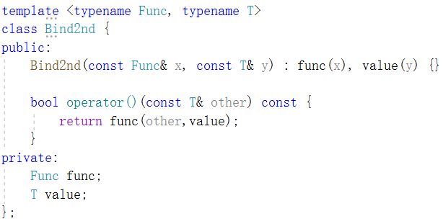
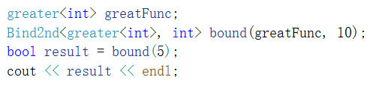
Simplified Adapter - bind2nd

Slide 53
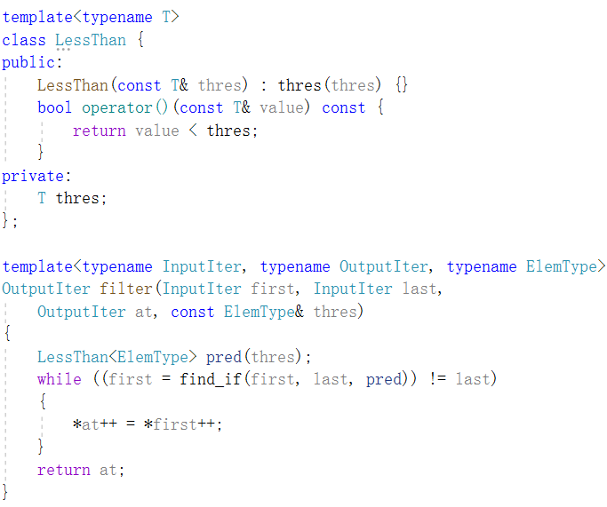
find_if() without binder adapter

Slide 54
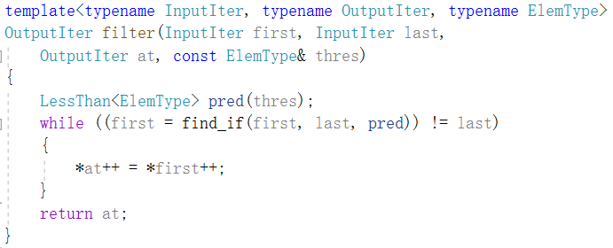
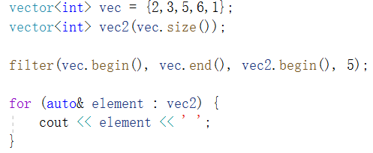
find_if() without binder adapter (cont.)

