Slide 1
The C++
Programming Language
Lecture 1:
From C to C++

Slide 2
Brief Introduction
&
Requirements

Slide 3
Why C++ is very important?
Compliant with C, but better than C
    Protect legacy codes
    More safe
    Easier for debugging
Support data abstraction
Support 4 kinds of Programming and Design style
  Procedure-Based Programming
  Object-Based Programming
  Object-Oriented Programming
    Especially useful in modern project developing
  Generic Programming
    Necessary for excellent programs

Slide 4
Readings In-Depth
“Essential C++” by Stanley B. Lippman
“Thinking in C++” by Bruce Eckel
“The C++ Programming Language(4th edition)” by Bjarne Stroustrup
“STL源码剖析”by 侯捷
“Effective C++” and “More Effective C++” by Scott Meyers
“The Design and Evolution of C++”by Bjarne Stroustrup
“A Tour of C++ (2nd edition)”by Bjarne Stroustrup
“Inside the C++ Object Model” by Stanley B. Lippman

Slide 5

We Need To Know This Guy
Bjarne Stroustrup
--- Godfather of the C++
Designer and original implementer of the C++
Author of “The C++ Programming Language” (4 editions) and “The Design and Evolution of C++”
ACM fellow, AT&T Fellow, AT&T Bell Laboratories Fellow, head of AT&T Lab's Large-scale Programming Research department
Homepage: http://www.stroustrup.com
C++ Resources: http://www.stroustrup.com/C++.html
Tech FAQs: http://www.stroustrup.com/bs_faq.html

Slide 6
Why C++ is very important?
Compliant with C, but better than C
    Protect legacy codes
    More safe
    Easier for debugging
Support data abstraction
Support 4 kinds of Programming and Design style
  Procedure-Based Programming
  Object-Based Programming
  Object-Oriented Programming
    Especially useful in modern project developing
  Generic Programming
    Necessary for excellent programs

Slide 7
High-level Languages
High-level languages represent a giant leap towards easier programming.
The syntax of HL languages is similar to English.
Historically, we divide HL language into two groups:
  Procedural languages
  Object-oriented languages (OOP)
7

Slide 8




Procedural Languages
Early high-level languages are typically called procedural languages.
Procedural languages are characterized by sequential sets of linear commands. The focus of such languages is on structure.
Examples include C, COBOL, Fortran, LISP, Perl, HTML, VBScript etc.
8

Slide 9
Object-Oriented Languages
Most object-oriented languages are high-level languages.
The focus of OOP languages is not on structure, but on modeling data.
Programmers code using “blueprints” of data models called classes.
Example of OOP languages include C++, Visual Basic.NET and Java etc.
9

Slide 10
Differences
Procedural languages
  Every small system has specific starts and ends. There is rigorous relationship between the starts and ends.
  God creates human, how about 7,000 million human?
Object-oriented languages
  God creates human, think the pattern of a human first. The image of a human is abstract. However, a certain human is concrete.
  Use class and object to describe data.

Slide 11
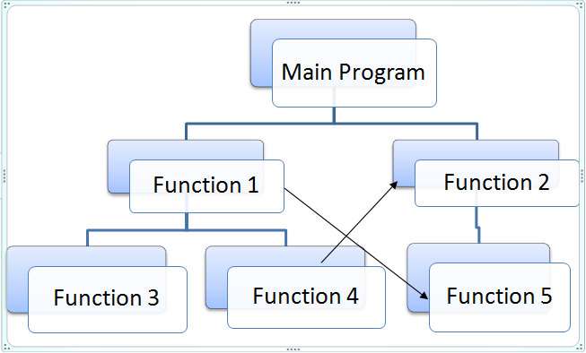
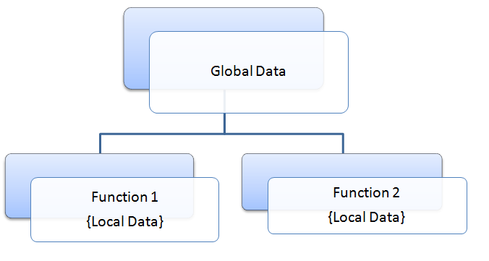
Differences -procedural
11

Slide 12
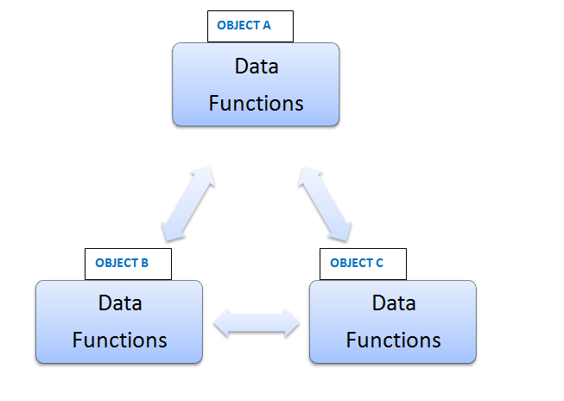
Differences – OO
12
Notes:
Data encapsulation: OOP ties the data closely to a particular class and its objects. There is no need of “global data types” as in POP and hence data will not flow freely around the program. This makes sure there will be no ‘accidental modification’ of critical data.
Code resusability: This simply means, a piece of code written earlier in a program can be used later. This is made possible by a feature of classes named “inheritance”.

Slide 13
C++ Applications
The kernels of the operating systems, e.g., windows, linux and unix are written in C and assembly language, however, the high-level part of them is written by C++.
Create new languages, such as C#, Java, Python etc.
Games, such as “world of warcraft” (魔兽世界）
Scientific researches
Telecommunication
Softwares, such as 3Dmax, CAD, Photoshop, QQ, office
Hack, virus
Search engines, such as google, baidu
XML, HTML parser
13

Slide 14
Coding Style Requirements
-- Naming Conventions
Hungarian Notation
  [GlobalPrefix][TypePrefix]-BaseTag-Name
  [GlobalPrefix]
    C++ member variables start with: m_
    Global variables start with: g_
    Static data members start with: s_
    Classes start with: C
    Interfaces start with: I
  Standard [Prefix]:
    p – A pointer. CHAR* psz;
    rg – An array. DWORD rgType[…];
    pp – A pointer to a pointer. int* ppTop;
    h – A handle. HANDLE hFile;
    ref – A reference to. char Func(string& refResult);

Slide 15
Coding Style Requirements
-- Naming Conventions (cont.)
  Standard “BaseTag”
    void -> v int -> i
    BOOL -> f UINT -> ui
    BYTE -> b CHAR -> ch
    Double -> d float -> fl
    WCHAR -> wch ULONG -> ul
    LONG -> l DWORD -> dw
    HRESULT -> hr fn -> function
    sz -> NULL str USHORT, SHORT, WORD -> w
  Name – Meaningful and Capitalizing every words
  Example
    m_pdTopOfStack
    CTypeLib
    g_fSwitchForDest
    s_szStartingURL

Slide 16
Coding Style Requirements
-- Naming Conventions (cont.)
Let’s have some tries…
A flag indicates whether a C++ object has been initialized:
BOOL m_fInitialized;
A Session ID:
DWORD dwSessionID;
A Pointer to BYTE buffer:
BYTE* pbBuffer;
A global buffer to store logfile filename:
CHAR g_szLogFile[MAX_NUM];
A pointer to a global logfile name:
CHAR* g_pszLogFile;

Slide 17
Coding Style Requirements
-- Code Indentation
4 spaces per indent level
Braces in Statements
Class CExample
{
public:
//member functions declaration
Cexample();
~Cexample();
private:
#ifdef _DEBUG
void TraceValue( int iValue );
#endif
…
};
While (foo)
{
if (NULL == bar)
{
Func1(ad);
}
else
{
Func2(bc);
}
Func3();
}

Slide 18
Useful Concepts Review

Slide 19
Reviewing C in C++
Basic Data Types
Compound Types
Operator (+/==)
Statement (if-else, switch, while-break)
Standard Library (vector, string)

Slide 20
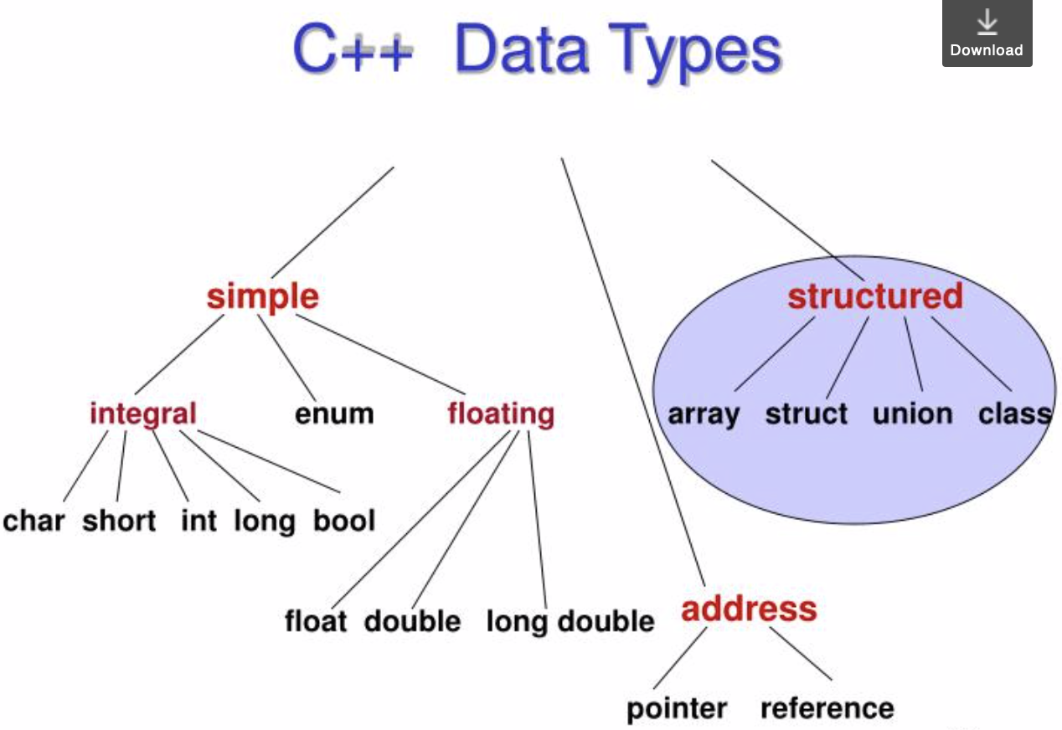
Reviewing C in C++

Slide 21
Numeric data types
Type char represents individual characters and small integers (1 byte).
Type short, int, and long represent integer values (half a machine word, 1 machine word, 1 or more machine words).
Type float, double and long double represent floating point values (1 machine word, 2 machine words, 3 or 4 machine words).
Type char, short, int, and long are also called integral types, which can be signed or unsigned.

Slide 22
Literal constants
Literal constants are values that occur in programs.
We can use prefixes to write literal integer constants in decimal, octal, or hexadecimal notation.
  Decimal (no prefix): 15
  Octal (prefix 0): 015 = 13 (decimal)
  Hexadecimal (prefix 0x): 0x15 = 21 (decimal)
You can specify different types by appending a letter to the literal integer constant.
  e.g., 2344U (unsigned), 1555L (long), 166UL (unsigned long), 3.1415F (float), 6.283L (long double)

Slide 23
Literal constants
A built-in (or primitive) C++ data type is the type bool.
Its only literals are true and false.
Note that the type bool does not exist in C.
In C, we represent the Boolean values true and false by the integers 1 and 0.
We use single quotation marks to write literal character constants. E.g., ‘x’, ‘4’, ‘:’, ‘\n’.
A literal string constant is composed of zero or more characters enclosed in double quotation marks. E.g., “hello”, “x”, “”. “Hi, \nHow are you”.
To use the C++ string type, you must #include <string>
23

Slide 24
structures
A structured data type is a type in which each value is a collection of component items.
The entire collection has a single name, each component can be accessed individually.
Often, we have related information of various types that we’d like to store together for convenient access under the same identifier, for example…
24

Slide 25
struct
struct Student // declares a struct data type
{
string name;
int ID;
int Age;
double Grade;
};
Student student1; //declare variable of Student
student1.Name = "Alice";
student1.ID = 101;
student1.Age = 20;
student1.Grade = 90.5;;
25

Slide 26
Pointer
Pointers Allow for Flexibility
int *pi;
int *pi = &ival;
*pi = 1024;
int *pi = 0;
if (!pi) {
// statement
}

Slide 27
Reviewing C in C++
int main()
{
return 0;
}
int min (int val1, int val2)
{
// function body
}
#include <iostream>
#include <iostream.h>
// statement
cout << “Hello world\n”;
// statement
printf(“Hello world\n”);

Slide 28
Reviewing C in C++
int functionA(int iX, int iY);
int functionA(int iX, int iY) {};
functionA(3,5);
The first is a declaration, the second is a definition (with null statements), the third is an invoking
Declaration of a variable or function can appear many times, while definition only once
iX & iY - parameters, 3 & 5 - arguments
Notes:
函数声明不包含任何函数体，负责使用函数前告诉编译器函数的名称和参数类型，不分配内存或者代码空间，可以声明多次，支持分离编译特性。
函数定义则包含了函数的具体实现，会为函数分配代码空间，在编译阶段会编译成实际代码，所以只能定义一次，否则编译报错。

Slide 29
Reviewing C in C++ (cont.)
int iX; extern int iX;
int functionB(); extern int functionB();
Keyword ‘extern’ means it is only a declaration, its definition is later or external to this file, asking the compiler not to assign memory or generate code
extern int functionB() {}; //---invalid
Notes:
关键字extern支持跨文件使用变量或者函数，声明变量或函数在其他文件中定义，看到extern编译器不为其分配内存或者生成代码，作用是拓展变量或者函数的作用域。
C++更多通过把变量和函数放在头文件，需要的地方包含该头文件。

Slide 30
Reviewing C in C++ (cont.)
int funcA()
{
static int iX = 0;
}
static int iX = 0;
int funcA()
{
…
}
Function can “remember ” iX between calls
But iX is unavailable outside the function, its scope is in this function
iX is a “local global variable” to the file
Its scope is only in this file
Notes:
static local variable：在函数内部定义的变量，与局部变量生命周期不一样，延长至整个程序的执行期；常见用途是可以在函数的不同调用过程中记住变量的值。静态局部变量只能在函数内部访问，函数外部不可见。
static global variable：在函数外部定义的变量：它的生命周期与整个程序执行期一样长，静态全局变量作用域仅限于定义它的文件内部，其他文件无法访问。
extern和static影响变量作用域以及延长变量生命周期。

Slide 31
Reviewing C in C++
Writing Expressions
int max_length = 3; // assignment
int sum = 5 + 3; // arithmetic expression
bool isTrue = (x > 10) && (y < 20); // logistic
int max = (a > b) ? a : b; // conditional expression
int x = 5; int y1 = ++x; // pre-increment
int x = 5; int y2 = x++; // post-increment
Note the operator priority
Notes:
几种常见的表达式：赋值、算数表达式、逻辑表达式、条件表达式、递增递减：
前置形式递增：原值先递增，再被拿来用；y1=6, x=6；
后置形式递增：原值先供给表达式运算，然后才递增。y2=5, x=6.

Slide 32
Reviewing C in C++
Writing Conditional Statements
if ( max_length == 1)
{
// statements
}
else
{
// statements
}
switch (max_length)
{
case 1:
cout << “max_length=1.\n”;
break;
case 2:
cout << “max_length=2.\n”;
break;
default:
cout << “max_length=….\n”;
break;
}
if ( max_length == 1)
cout << “max_length=1.\n”;
else
if (max_length == 2)
cout << “max_length=2.\n”;
else
cout << “max_length is….\n”;
Notes:
如果要控制语句的执行方式，学会去写条件语句和循环语句。

Slide 33
Reviewing C in C++
Writing Loop Statements
int max_length = 3;
int usr_cnt = 0;
while (usr_cnt < max_length)
{
if (usr_guess == next_elem)
break;
usr_cnt++;
}
for ( int i=2; i<seq_size; ++i )
{
// statements;
}

Slide 34
Reviewing C in C++ (cont.)
int main(int argc, char* argv[]) {};
argc passes the number of elements in the argv array, argv[] are the character sub-sequences separated by spaces from the command line
argv[ 0 ] is the path and program name, the real arguments start from argv[ 1 ]
Notes:
main有两个参数，int argc代表命令行参数的个数；char* argv[] 字符指针数组，每个元素指向命令行中以空格分割的字符串。
命令行参数允许用户在命令行提供一些程序执行的配置选项，比如运行图像处理程序，可以在命令行指定输入文件和图片大小。
默认情况argv[0]存放exe文件名和路径，argc=1。从argv[1]开始存储指向命令行参数字符串的指针。
Main返回int，=0成功执行。

Slide 35
From C to C++

Slide 36
Let’s compare these
#include <iostream.h>
void main()
{
int j;
int v[ 5 ] = {1,2,3,4,5};
for (j = 0; j < 5; j++)
{
printf(“%d\n”, v[ j ]);
}
}
#include <vector>
#include <iostream>
using namespace std;
int main()
{
vector< int > v;
for (int j = 0; j < 5; j++)
{
v.push_back(j + 1);
}
for (int j = 0; j < v.size(); j++)
{
cout << v[ j ] << endl;
}
return 0;
}
C Style C++ Style
Notes:
对比C++相比C的新特性：
头文件：C++标准库不带.h扩展名，包含特定的模板类vector，使用命名空间；
数组定义和赋值：定义时不指定大小，通过push_back赋值，因为C++可以实现自动内存管理
输出数组元素：for循环v.size()界定vector的大小，避免越界访问
输出语句：printf要给格式控制符，cout不需要，C++它会提供typeid()函数检测存储数据类型
总结：C++引入很多新的库函数，提供通用的模板类，在兼容C的同时，极大简化了程序开发，提升了性能。

Slide 37
Namespace
The problem: When two variables (or functions) in global scope have the same identifier (name), we get a compile error.
To avoid such name collisions, programmers need to use unique identifiers in their own code.
In C, if you use multiple third-party libraries and there is a name collision, you have three choices:
  get the source code to the libraries and modify and recompile it.
  ask one of the library publishers to rename their identifiers, or
  decide not to use one of the libraries.
37
Notes:
Namespace解决全局作用域中的命名冲突问题

Slide 38
Namespace
Wrap the library to avoid name collision in global scope, a better way than prefixes
int abc_NumOfInstances = 0; namespace abc
int abc_Create(int InstNo); {int NumOfInstances = 0;
int Create(int InstNo);}
std is the namespace wrapping all standard C++ libraries
Notes:
namespace在project和文件里的变量函数之间增加一层：project下面会有若干个namespace，每个namespace包装了对应库的所有标识符，告诉编译器当前作用域使用特定namespace中的标识符。
常见的namespace就是std：包装了C++标准库的所有标识符。

Slide 39
Namespace(cont.)
3 ways to use namespace
    Use prefix style to specify every time
      void f1()
      { abc::Create(NumOfInstances);
      abc::NumOfInstances++}
    Import one symbol to current scope
      void f2()
      { using abc::NumOfInstances;
      Create(NumOfInstances); //Error! Only NumOfInstances is visible, Create not imported
      NumOfInstances++; //OK
      }
    Import all symbols in a namespace to current scope – using directive
      void f3()
      { using namespace abc;
      Create(NumOfInstances); //OK
      NumOfInstances++; //OK
      }
Notes:
如果要调用所创建的namespace里的函数或变量，有几种不同的写法，最简单的就是using 某个namespace，避免冗余的前缀。

Slide 40
Namespace(cont.)
But we suggest the using directive form to expose all names in standard libraries
    using namespace std;

Slide 41
Vector-Except for arrays
Arrays have a number of drawbacks:
  Array size is a fixed constant.
  Passing an array as a parameter to a function is inconvenient, the size of the array must be passed as a separate parameter.
  There is no way to conveniently insert elements at the beginning or in the middle of an array.
  Similarly, it is inconvenient to remove an element from an array.
  You cannot return an array from a function.
41

Slide 42
Vectors
We recommend using the class template <vector>
Features:
    A sequential container
    Can use index to access – []
    Be self-aware of size
    Self-manage memory and increase on demand
Frequent used member functions & operators:
    push_back(), pop_back(), size(), clear(), empty(),
#include <vector> //you must include this header
Using namespace std; //like everything else, vectors live in the std namespace

Slide 43
Vector
template <typename T>
void Vector<T>::push_back(const T& value) {
T* new_p = new T[size + 1];
for (int i = 0; i < size; ++i) {
new_p[i] = p[i];
}
new_p[size++] = value;
delete[] p;
p = new_p;
} // dynamically add elements to vector
template <typename T>
int Vector<T>::get_size() const {
return size;
} // get the current size
template <typename T>
class Vector {
private:
T* p; // pointer to vector
int size; // number of elements
public:
Vector() : p (nullptr), size(0) {}：
void push_back(const T& value);
int get_size() const;
T& operator[](int index);
~Vector() ;
};
Notes:
C++模板类Vector的简化定义：通过看它的内部实现，可以明白为什么它能实现动态的数组管理。
1）template<typename T>表示下面定义的是名为Vector的模板类，通过使用模板，可以使用同一份代码处理不同数据类型的数组。<typename T>负责告诉编译器在实例化模板时使用什么类型替换模板参数T。比如创建一个存储整数的动态数组：Vector<int>，创建一个双精度浮点数的数组：Vector<double>。不必为每种数据类型都编写一个不同的类，提高了代码的重用性和灵活性。
2）data member：T* p: 指针用于指向动态数组，int size: 表示当前存储的元素数量。
Member function: Vector() : p(nullptr), size(0) {}:构造函数，用于初始化Vector类的对象。~Vector():析构函数，用于在对象被销毁时释放动态分配的内存。
push_back(): 用于在向量末尾添加一个元素，并相应地增加size。::类模板的作用域标识符
首先创建一个新的指针，指向新分配的内存块（new在堆上动态分配内存），该内存块容纳比原来多一个元素的数据；
通过遍历p指向的原始内存块，将其中的元素挨个复制到 new_p 指向的新内存块中。
将要添加的新元素 value 复制到新内存块中，并且增加 size 的值。
释放了原来p指向的内存块，因为我们已经将原有的元素复制到了新的内存块中。
将原来的指针 p 指向新的内存块 new_p。
int get_size() const: 用于获取向量中存储的元素数量（size 的值）。
T& operator[](int index): 运算符重载函数，允许使用类似数组访问方式来访问向量中的元素。index表示要访问的元素的索引。

Slide 44
string class
The string class library
    #include < string >
    string myString(“Hello folks!”); // initialize strings
    string myOtherString(myString);
    string myFinalString; //empty string
  Important ops and member functions:
    =, +=, []
    assign(), append(), at()
    empty(), size(), find(), swap()
    c_str();
Notes:
string class library是C++特有的字符串类型，要使用必须首先包括相应的头文件#include<string>
***string可以使用多种方式进行初始化：使用字符串常量初始化；使用现有的字符串对象初始化新的字符串；创建一个空字符串；可以根据需要选择不同的初始化方法。
***在string当中支持一些非常重要的运算符和member function：
运算符：等号赋值做string copy，从右边拷贝给左边的string。+=做的是string cat，把原来的string再加上+=右边的东西形成一个新的string。string也支持用方括弧访问string当中的某一个字符。
函数：assign()将字符串的内容替换为指定的内容。append()将指定内容附加到字符串的末尾。at()访问字符串中特定位置的字符。empty()函数用于检查字符串是否为空。size()获取字符串的大小。Find()就是在字符串当中去查找，swap()就是做字符串交换。
C-string()：string是一个类，跟标准C定义的字符串char* 是两个不同的东西。比如string类型的hello和char*类型的hello：char*的hello在memory中占6个字节，h，e，l，l， o 再加斜杠零，但C++当中一个 string类型的HELLO它的大小肯定要大于6个字节。作为一个类，除了存储hello字符串之外，还要去存size等信息，所以如果去看size of string（”hello”）是大于6个字节的。
所以C++的string会支持一个member function叫做c-string()：做的事情就是从string整个memory当中抽出里面char*的部分，也就只抽取出6个字节：HELLO，斜杠零，把这个东西的起始地址返回给str()这个函数。简单点理解就是把C++的 string类型强制转换成C当中的char*, 使原来C当中的一些库函数仍然可以去使用。

Slide 45
Input and Output (IO)
C’s printing facility is clever but unsafe
char *s; int d; double g;
printf(“%s %d %g”, s, d, g);
Hard for compiler to type check argument types against format string
C++ IO overloads the << and >> operators
cout << s << ‘ ‘ << d << ‘ ‘ << g;
Type safe
45
Notes:
关于C++的输入和输出功能：C语言打印功能使用printf函数，可以使用格式字符串指定要打印的内容及其格式。这种方法存在潜在的安全风险，因为printf函数不会对传递给它的参数类型进行检查。如果格式字符串与实际传递的参数类型不匹配，比如定义一个整数d和字符串指针s。然后printf格式字符串“%s”指示要打印一个字符串，但提供的参数是整数d，这时printf无法正确解释参数， “%s”可能会尝试解释d指向的内存地址是不是个字符串，不同编译器可能产生不同结果，会导致程序崩溃或产生其他未定义的行为。
***C++为了提高安全性，它在<iostream>类里重载了<<和>>操作符，会根据变量的类型自动选择适当的输出格式，使输入输出流的对象cin-cout使用更加安全，减少了因格式字符串错误引起的潜在问题。

Slide 46
C++ IO
Stream: sequence of bytes
  Input: from device (keyboard, disk drive) to memory
  Output: from memory to device (monitor, printer, etc.)
iostream library
  Has header files with hundreds of I/O capabilities
  #include<iostream>
    Standard input (cin)
    Standard output (cout)
    Unbuffered error (cerr)
46
Notes:
输入输出流：流通常指字节序列，是数据在程序和外部设备之间的传输媒介。
***输入是指数据从外部设备（如键盘或磁盘驱动器）传输到计算机内存的过程。
***输出是指将数据从计算机内存传输到外部设备（如显示器或打印机）的过程。
***C++的iostream库提供了用于处理输入和输出的类和函数。要使用iostream库中的输入输出流对象，要在程序开头包括iostream的头文件：cin是C++标准库中的标准输入流对象，cout是标准输出流对象，cerr是C++标准错误输出流对象，它和cout一样将都是错误消息定向输出到屏幕，但它是无缓冲的，消息会立即显示。（cout是要等缓冲区满或者看到换行符）

Slide 47
Streaming File
Output
    #include <fstream>
    ofstream OutFile(“out.txt”); -- Output file
    ofstream OutFile(“out.txt”, ios_base::app); -- (append mode)
  Usage
    OutFile << data;
    On Failure, object will be evaluated as false
      if (! OutFile) { cout << “Open Failed!” << endl;}
47
Notes:
C++中另外一种用于处理输入、输出流的类叫做fstream，fstream是iostream的子类，它继承了iostream的功能，同时增加了对文件进行读写操作的能力。
如果要向文件中写入数据，可以用oftream创建一个文件输出流对象/实例（ofstream是输出流的基类， cout就是ostream的一个实例）。如果要创建的用于输出的文件名已存在，并且我们不希望这个文件中原本的内容被丢弃，而是把新数据增加到该文件中，那我们可以使用附加模式（append mode）来打开文件，也就是给ofstream对象提供第二个参数：ios_base::app；
一旦创建了文件流对象，就可以对它们执行文件操作：要写入数据：使用<<运算符，就可以把输出信息定向到该文件。
***如果文件未能成功打开，文件流对象OutFile会被评估为false，可以使用条件语句检查文件操作是否成功。

Slide 48
Streaming File
Input
    #include <fstream>
    ifstream InFile(“in.txt”); -- Input file
    fstream IOFile(“io.txt”); -- In-&Out-put file
  Usage
    InFile >>data;
    On Failure, object will be evaluated as false
      if (! InFile) { cout << “Open Failed!” << endl;}
48
Notes:
如果要读取一个文件内容，我们就定义一个ifstream的对象，并把文件名“in.txt”传入，同理如果文件未能成功打开，文件流对象InFile就会被评估为false。
***如果想要同时读写一个文件，我们就定义一个fstream的对象。如果去看C++的头文件，fstream其实就是由ofstream 跟ifstream两个部分拼起来的，ifstream（输入文件流）用于从文件读取数据，ofstream（输出文件流）用于向文件写入数据， fstream 综合了两种功能，支持在同一个文件上执行读取和写入操作，这些关于文件的处理都在C ++当中做了新的封装。

Slide 49
Reference
int iX = 1024, iY = 4096;
int &rX = iX;
int* pi = &rX;
rX = iY++;
Reference rX could be regarded as an alias or another name of iX
Could rX represent iY later? --- No!
pi = &iY;//---Only a pointer could do that
Notes:
reference引用类的对象，便于修改对象的成员变量或调用成员函数。
***第一行定义了两个int的变量，ix，iy，分别取不同的值。
***第二行int reference rx代表的含义就是定义了一个reference rX, 它被创建为iX的引用，所谓引用怎么理解？
***看下面这句话：reference可以被视为变量的别名或者另一个名称，reference只是创建一个变量的别名，而不是创建一个新的变量。rX本质上就是ix，它们是相同变量、占用相同内存，可以互换使用。
关于起别名C或C++也有其他语句起到类似的效果，比如typedef这个关键字，用于为已有的数据类型创建别名
typedef int MyInt; //可以使用typedef为int创建一个新的别名：
MyInt num = 10; // 可以使用MyInt来定义变量，就像使用int一样：
typedef并不定义任何新的数据类型，只是给已有的数据类型起一个新的名字。类似的reference它并不产生新的东西，只是给已有的变量起一个别名。所以这里第4行rx=iY++，这时rX就是iX，这行代码相当于是把iY的结果赋值给iX。
***reference与指针：第三行代码定义一个指针int* pi，赋予它已有变量的地址，rX的地址意味着取的是iX的地址，所以第三行定义的指针变量也指向了iX。通过reference代表ix和通过指针*pi代表 ix的区别？
对于reference来说，一旦创建为一个变量的别名之后，就无法再reference其他变量。也就我已经定义了rXreference iX的话，将来就不能再reference iY。但pointer指针可以在不同变量之间进行切换，比如我定义了int* pi = &rX，接着可以再写pi =&iY。
2) 另外一点区别从memory的角度，reference它只是一个aliar，所以reference对内存不会造成任何影响。比如这四行代码从内存的角度来说，ix会占4个字节，iY会占4个字节，然后你定义rX reference ix，这时从memory角并不会为rX分配任何内存，它只是给ix起一个别名叫做rx，memory仍然是占用了 8 个字节。---而定义指针变量时，会为指针变量单独分配内存的，所以*pi会占四个字节，这四个字节里面存的是ix的地址。

Slide 50
Reference
int Swap(int iX, int iY);
int Swap(int* pX, int* pY);
int Swap(int &iX, int &iY);
The first two are passing by value, the last is passing by reference
The first could not modify the value of arguments outside of Swap, while the last two could
Notes:
reference有什么用？常见的应用场景是在swap做交换。采用swap函数作交换涉及问题：通过什么方式把参数传递给swap函数的。***函数的参数传递方式包括传值（pass by value）和传引用（pass by reference）。前两行代码都是Pass by value的方式：
第一行的Swap函数接收两个整数参数iX 和 iY，但它们是通过值传递，只是参数的值传递给函数，而不是参数本身。函数在执行时操作的只是参数的副本，它交换的是形参的东西，而swap一结束所有形参的memory都会被释放，不会影响原始参数的值，所以这时交换并不能起到交换原始变量的效果。
***在C语言中要实现交换可以通过传递指针的方式：让Swap函数接受两个整数指针pX和pY，虽然也是通过值传递，但复制的是参数的地址：函数内部通过*px和*py可以访问和修改指针所指向的变量的值，使swap当中交换的是*pX跟*pY的内容，真正实现两个数的交换。
*** C++可以通过pass by reference的方式，让函数在执行时直接操作原始参数，而不是参数的副本，因为传递的就是实参本身，swap当中交换的也是原本的实参。对比pointer的代码，通过reference传递参数更直观，在函数内部可以像操作普通变量一样操作引用，不需要使用指针操作符*，减少了符号使代码更简洁。
***两种函数参数的传递方式pass by value和pass by reference，在函数调用时内存方面有什么区别？
pass by value函数调用时：编译器首先保存当前函数的现场，然后在栈上为函数的形参分配新的内存空间，接着把实参的值复制到形参当中，再去执行函数体。所以函数在执行过程中操作的是实参副本，任何对参数的修改都只会影响副本，而不会影响原始参数。然后函数体执行完会把返回值拷贝到临时变量的存储区域，等回到函数调用的地方拿到返回值之后，函数参数的副本就会被销毁。
pass by value从memory角度实参和形参需要double size memory，形参大小跟实参大小一样，还需要做一次copy，也就是从实参到形参是单向的值传递。如果实参非常复杂，比如说多维数组，这时pass by value就需要把数组里的每个元素都拷贝一遍，开销是很大的。
pass by reference能够避免上述开销，并不会创建额外的memory，也不需要去做值拷贝，能够极大地提高复杂数据类型在实参和形参传递过程当中带来的开销。这就是为什么在C语言有了pass by value机制的基础上，C++还会引入pass by reference的原因。最常见的用途就是在参数传递时避免内存的双倍开销，使代码更高效，性能更好。

Slide 51
Reference (cont.)
3 Reasons to use passing by reference:
    To modify the objects that passed in the function
    To avoid the cost of copying large objects
    To have more than one return values
struct Matrix { double a[10000][10000] };
int f1(Matrix m);
int f2(Matrix& m);
bool add_even(int a, int b, int& c)
{
if (a%2 == 0 && b%2 == 0)
{
c = a+b; return true;
}
return false;
}
Notes:
用pass by reference的理由三点：
1）用pass by reference可以直接修改实参。
2) 避免做 duplicate memory，降低了开销。
3) 可以返回多个值：在最严格的标准C定义当中，函数返回值是一块特定大小的memory，比如在32位系统中严格定义返回值不能超过一个register的大小（64个bit，8个字节），在这种定义下很难返回多个值。
在C语言中如果要返回多个值，常见的方案 1）用全局变量把返回结果带回来 2）或者在函数中申请在heap（堆）上分配一块内存，堆内存比较大，并且生命周期比栈长（栈中数据生命周期通常与包含它的函数生命周期相同，一旦函数返回，栈上的数据将被释放），而堆上分配的内存直到手动free才能够被释放掉，所以可以通过在heap上分配一块内存，然后返回这个heap的address，从而起到返回多个值的作用。
3）现代C++编译器中会存在返回一个结构体变量达到返回多个值的效果，结构体里有多个成员变量，如果可以返回一个结构体，就意味着可以返回多个值。但最严格的C定义当中返回的大小不能超过64个bit，所以其实return value并不return一个结构体变量。在目前很多的IDE 比如说visual studio，如果代码是返回一个结构体变量编译也是能通过的，这是因为C++对返回值的处理不同，现代编译器中返回值其实并不是放在register里，而是放在一个temporal memory 里, register的大小是固定的，而temporary memory可以自动决定它的大小或者手动分配它的大小，这种情况下就允许返回一个结构体变量。但更多时候返回一个结构体，现代编译器内部的做法都是处理成返回一个结构体的引用，从而返回多个值。
reference可以返回多个值怎么理解？右边的代码add_even: （函数返回值首要任务是代表函数执行是不是成功）返回值是一个booling类型的，代表这两个数字是不是even的数字，如果是就相加然后把结果放到c里，如果 a 跟 b不是两个even的数字就return false。
Add_even函数需要带回两个信息，一个是这个函数执行是否成功，一个是两个数字相加的结果，所以需要返回超过一个的值。这时可以通过 pass by reference，把C作为reference给到函数，a+b的结果相当于直接传给了函数外的实参。当add_even函数调用结束之后，就能够拿到相加的结果（原本实参就存在）以及函数返回的booling，从而通过 reference实现了返回多个值。
总结：返回多个值在C或者C++当中比较复杂。普适的解决方案，在所有编译器下都能运行的方案，无外乎是用1）全局变量把它带出来（但全局变量传递数据不是一个好的解决方案，它维护性差且多线程或并发程序中存在安全问题，所以代码中尽量少用全局变量）。2）或者heap上申请一块memory然后返回heap的地址，但它涉及到手工管理内存，需要决定什么时候释放也是比较复杂的事情。相对来说简单的解决方案是通过reference把多个值放到参数列表里。

Slide 52
Reference
The inner mechanism of reference and pointer may be similar, but they are quite different in usage
Using Reference when you find
  It always represents a non-null object
  And it will not represent any other objects
Using Pointer otherwise
Pointer could be re-assigned values, while reference could not
Notes:
从实现角度reference跟pointer有些相似，都提供了间接访问数据的方式，都可以作为函数参数传递从而修改指向变量的值。
但使用层面上差异非常明显，使用reference注意两点：1）reference 通常是reference一个non-null的object，如果reference一个null的object，编译时并没有为它分配内存，所以reference声明时必须要初始化，否则编译会报错。
2）一旦reference了一个对象之后，就不可以再去reference其它object。
如果需要既可以reference这个，又可以reference 那个的话，要用的是一个pointer而不是reference。
pointer可以去re-assigned它的value，reference 不可以的。

Slide 53
Const (cont.)
int f(int& ri)
{ if (ri = 0) return 0;
return 1; }
If a reference is used for performance in parameters, and will not be changed, using keyword const is recommended (for safe)
  int f(const int& ri);
#define MAX 5000; const int MAX = 5000;
const is also recommended to replace the #define macro, for the visibility in symbol table during compiling
53
Notes:
const也是C++中非常重要的关键字：代表的含义是常量，不可以修改。
Const的作用是什么？
C++支持pass by reference带来的好处是能够防止memory duplication，能够防止copy 等复杂操作，但同时也带来一个缺点， pass by reference意味着可以在函数里面改变原来的object，因为通过reference是直接访问原本的Object。
但很多应用中，我们并不希望改变原来的object，比如：做两个矩阵相加的函数，matrix C=matrix A+matrix B，如果抛开性能不谈，可以把A、B两个矩阵作为实参通过pass by value传进函数，把两个矩阵直接传进去内存开销很大。从性能角度更好的做法就是把矩阵A跟B作为两个reference传进去，但会带来潜在风险：A、B作为reference给进函数，意味着A、B不设防。如果函数代码有问题，把C加出的结果直接写回A，等函数执行完原本A矩阵值已经被改变，A的值被覆盖无法找回，所以从调用的角度是我们不希望的，只是把A、B的值给你拿去用，并不希望你改写我。
当我们以reference传递参数时就会大量使用const。例子：函数f只是用来判断ri是不是等于0，但并不希望ri原本的值被改变。我们既希望通过reference传递参数来获得性能优势，又希望确保不会意外修改传递的参数值，这时就可以使用const 关键字来声明不可修改的引用参数。
比如（const int& ri）表示将ri的引用作为参数传递给函数f，关键字 const会告诉编译器函数f不能修改参数 ri 的值，如果函数尝试修改ri的值，编译器就会报错，这样就同时确保了代码的性能和安全性。所以 const一个 reference作为函数的参数是C++中大量使用的。
const也可以不放在参数列表里，用const定义一个常量：const int Max=5000。C++中也会使用#define定义宏常量：#define MAX 5000; 有什么区别？
从最终效果而言一眼，区别主要在于编译阶段Max对编译器是不是仍然可见。如果是#define，作为一个预编译语句在开始编译源代码之前，就会对#define的预处理指令进行处理，也就是说#define定义的MAX在真正进行编译之前就已经被替换为5000，编译阶段Max在符号表中并不会出现。
如果是const int Max=5000，在编译阶段编译器仍然能够看得到Max，知道MAX是所谓const变量，MAX是一个 visible name，它会出现在符号表中, 可以提供更多的类型信息，编译器也会检查类型匹配问题。对于编译器来说，意味着虽然它是一个变量名，但处理方案跟常量一样，它的值=是5000不可以再变，
在C++中使用const定义常量是一种更安全、更易维护的方式，特别是把const和reference组合起来是常见的一种函数参数的传递方式。

Slide 54
Const (cont.)
Overview of the const
    const int*p =&i;
    int const* p =&i;
    int* const p =&i;
    const int* const p=&i;
    const X& X::clone();
    int X::f() const;
54
Notes:
const也经常跟指针放在一起使用。复习：这里前三个定义当中哪两行一样？
const跟pointer 放在一起无外乎两个概念，1）表示pointer是const的，意味着比如p等于取地址i，将来再对p进行赋值让它等于其他地址p=&a就会有问题，它是一个const pointer，定义完就不能再修改。2）还有一种概念是说指针所指向的对象是constant，也就是说*p不可以再改，比如p=取地址i，那么i的内容不可以修改。两种概念不一样。
前三行的定义对应两种概念，一种是p的值不可以再改，还有一种是*p的值/指向对象的值不可以再改。怎么判断？一种简单的方法是visual studio尝试是不是可以改变*p的值，如果定义之后*p的值还可以改变，就意味着const的是pointer，如果*p的值不可以改变，就意味着const的是pointer所指向的object。
再一种判断方法是看*星号出现的位置，*前面的东西代表Pointer指向的类型：
const int* p = &i; 这里*前面是const int，表示指针p指向的是一个常量整数，也就指向的object是不可以修改的，意味着可以通过指针p访问整数i，但不能通过p修改i的值，因为i 是个整数常量。
int const* p = &i; 第二行与第一行效果相同，关键字const同样适用于int，这里指针p指向一个常量整数。int const和const int是一样的作用。
int* const p =&I; 第三行写法const紧跟p，修饰的是p，表示p是一个常量指针，这种情况不能修改p所指向的地址（不能将p指向其他object），但可以通过p访问并修改i的值。
第四行*左右两个const，代表指针变量是constant ，并且指针变量所指向的东西也是constant。
第5行表示一个类X的成员函数clone()，它返回一个常量引用（const X&）。意味着你可以通过clone访问对象X，但不能修改对象的状态。
第6行在函数后面加const，代表这个类成员函数f()是常量成员函数，常量成员函数意味着它不能修改成员变量，整个函数只能做读的操作，从而提高了代码的安全性和可读性。

Slide 55
Class
class CExap class CExap
{ {
public: public:
int m_iX; int m_iX;
}; };
CExap v; CExap* v;
v.m_iX = 0; v->m_iX = 0;
. is after an object, -> is after a pointer (or iterator)
55
Notes:
C++中支持class，有点类似C语言中支持的structure结构体，可以通过两种方式去访问类的data member或者member function，一种是通过对象加点的方式，另一种也可以通过箭头的方式，如果是箭头的访问方式，箭头左边的对象一定是一个pointer或者iterator（这个概念后面再谈）。

Slide 56
Summary
Important concepts in C, still useful in C++
C++ coding style
Namespace
Vector class template
String & streaming file class library
Reference
56

