Slide 1
Image Search
School of Computer Science and Technology
TongJi University

Slide 2
Five-stage search framework
A five-stage search framework help to coordinate design practices and satisfy the needs of all users
Formulation
Initiation of action
Review of results
Refinement
Use
Five-stages can be repeated until users’ needs are met
If users’ are unsatisfied with the results, they should be able to have additional options and change their queries easily
Notes:
Formulation: Expressing the search
Initiation of action: Launching the search
Review of results: Reading messages and outcome
Refinement: Formulating the next step
Use: Compiling or disseminating insight

Slide 3
Formulation
Use simple and advance search
Limit the search using structured fields such as year, media, or location
Recognize phrases to allow entry of names, such as “George Washington”
Permit variants to allow relaxation of search constraints (e.g. phonetic variations)
Control the size of the initial result set
Use scoping of source carefully
Provide suggestions, hints, and common sources

Slide 4
Initiation of action
Explicit actions are initiated by buttons with consistent labels (such as “Search”)
Implicit actions are initiated by changes to a parameter and update results immediately
Guide users to successful or past queries with auto-complete

Slide 5
Review of results
Keep search terms and constrains visible
Provide an overview of results (e.g. total number)
Categorize results using metadata (by attribute value, topics, etc.)
Provide descriptive previews of each result item
Highlight search terms in results
Allow examination of selected items
Provide visualizations when appropriate (e.g. maps or timelines)
Allow adjustment of the size of the result set and which fields are displayed
Allow change of sequencing (alphabetical, chronological, relevance ranked, etc.)

Slide 6
Refinement
Guide users in progressive refinement with meaningful messages
Make changing of search parameters convenient
Provide related searches
Provide suggestions for error correction (without forcing correction)

Slide 7
Use
Imbed actions in results when possible
Allow queries, setting, and results to be saved, annotated, and sent to other applications
Explore collecting explicit feedback (ratings, reviews, like, etc.)

Slide 8

Examples – Web search
Formulation and Initiation
Choose scope
Input keywords
Initiate the action

Slide 9
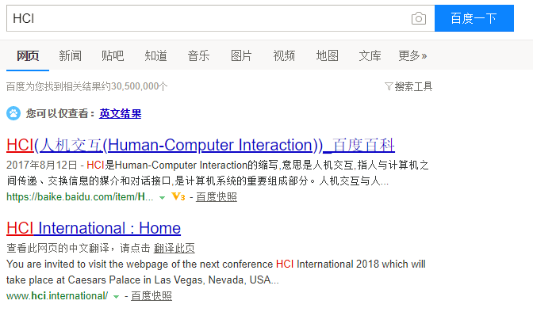
Examples – Web search
Review of results
Search term
Overview
Suggestions
Highlight search terms
descriptive previews
Source

Slide 10
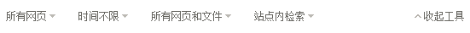
Examples – Web search
Refinement
Change search parameters

Slide 11
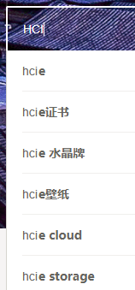


Examples – Image search
Auto-completion
Formulation and Initiation
Initiate the action
Input keywords
Suggestions
Search using pictures

Slide 12
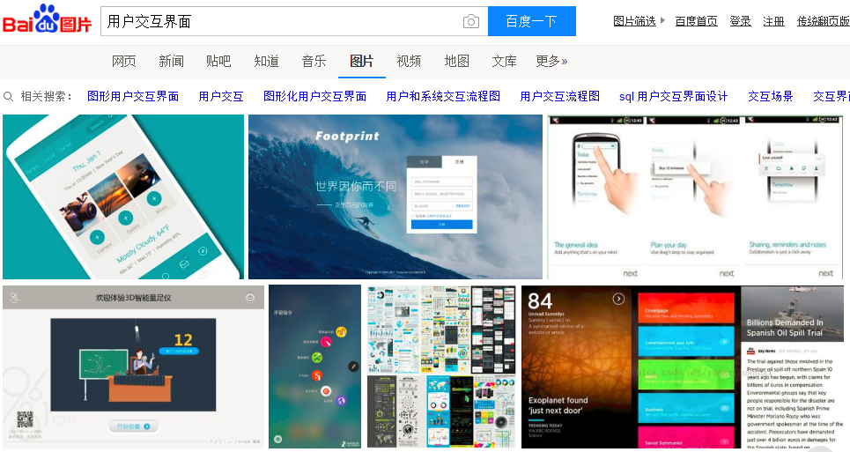
Examples – Image search
Review of results
Search term
Suggestions

Slide 13

Examples – Image search
Change search parameters
Refinement

Slide 14
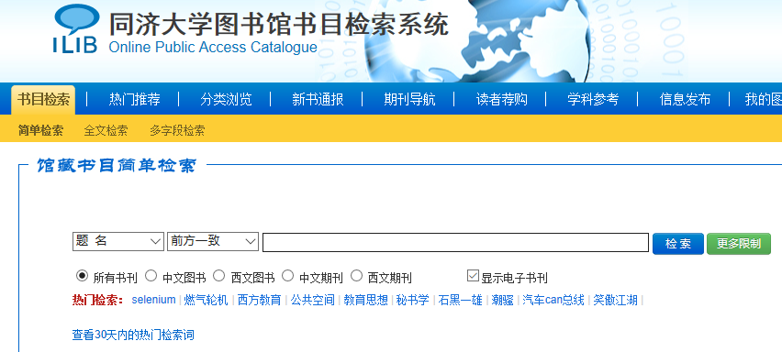
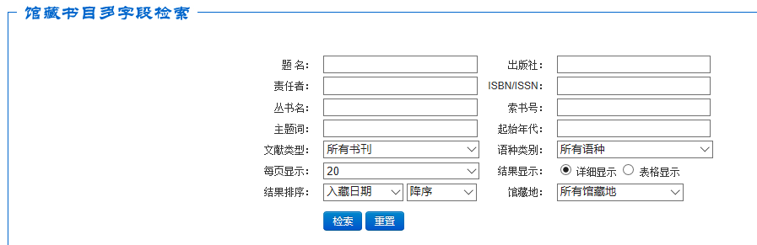
Examples – Document search
Formulation and Initiation
Simple search
Advanced search

Slide 15
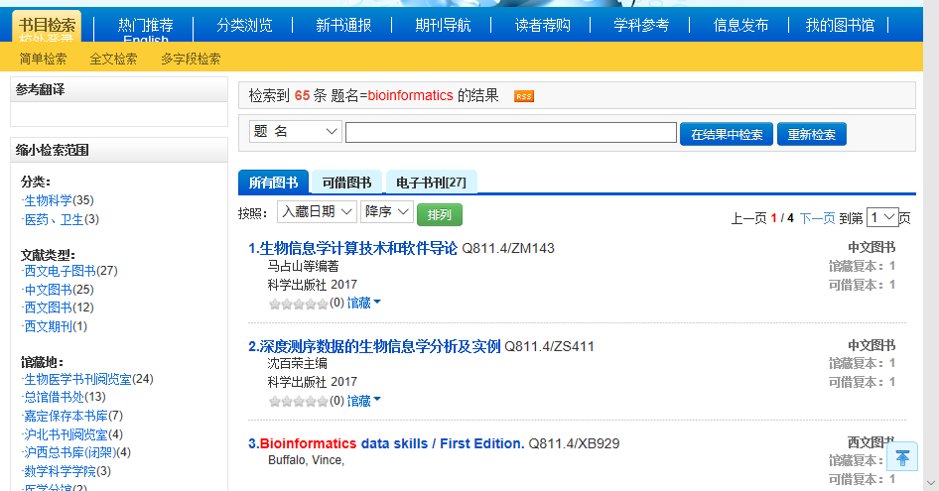
Examples – Document search
Review of results
Overview
Categorize results using metadata
Change of sequencing
Highlight search terms

Slide 16
Examples – Document search
Refinement
Progressive refinement

Slide 17
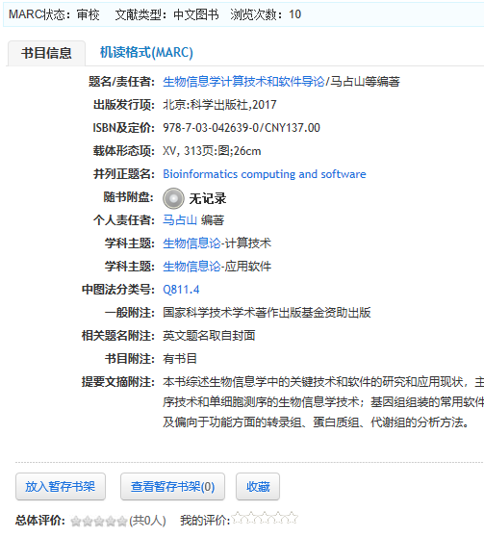
Examples – Document search
Use
Possible actions
Feedback

Slide 18
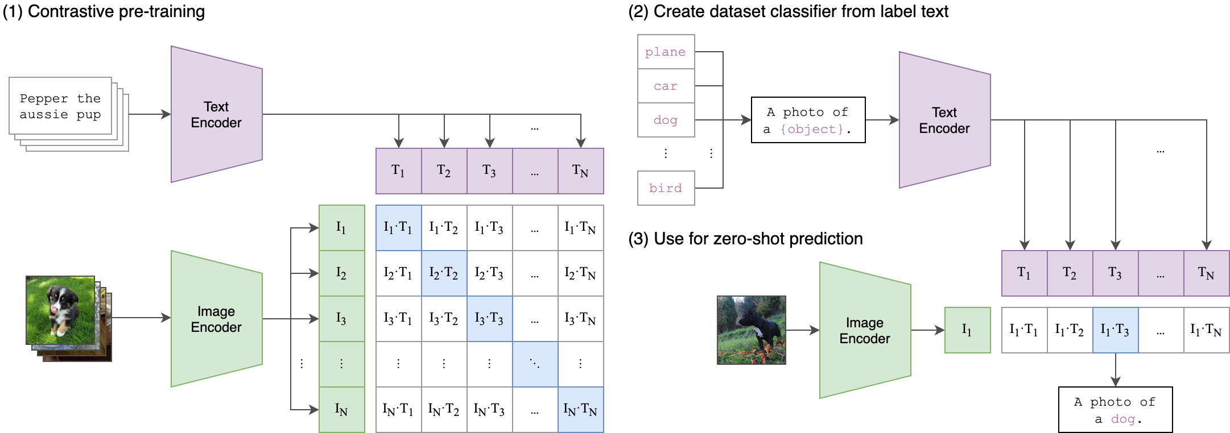
CLIP
CLIP (Contrastive Language-Image Pre-Training) is a neural network trained on a variety of (image, text) pairs.

Slide 19

Upstash Vector
Upstash Vector is a serverless vector database designed for high-performance vector search at scale.
https://upstash.com/docs/vector/overall/getstarted/

Slide 20
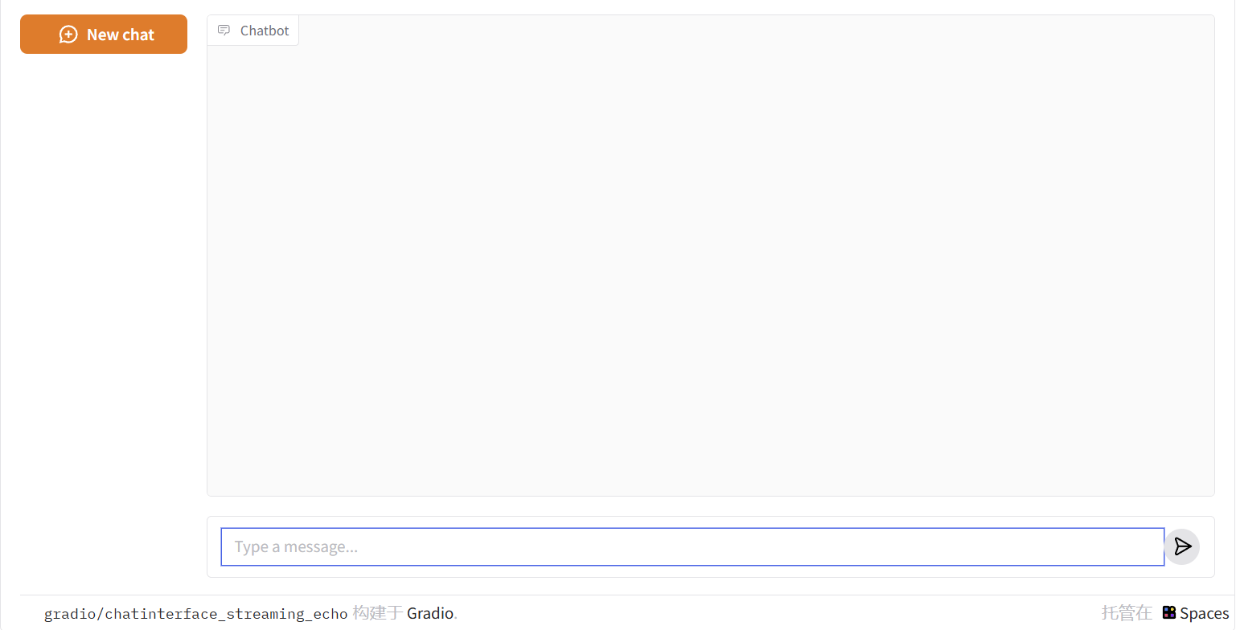

gradio framework
A Python library for quickly creating and sharing user interfaces for machine learning models. It simplifies the process of building a user interface (UI).
Supports multiple types of input and output components, such as text boxes, image uploaders, sliders, and more.

Slide 21
Five-stage search framework
A five-stage search framework help to coordinate design practices and satisfy the needs of all users
Formulation
Initiation of action
Review of results
Refinement
Use
Five-stages can be repeated until users’ needs are met
If users’ are unsatisfied with the results, they should be able to have additional options and change their queries easily
Notes:
Formulation: Expressing the search
Initiation of action: Launching the search
Review of results: Reading messages and outcome
Refinement: Formulating the next step
Use: Compiling or disseminating insight

Slide 22
Assignment
构建一个图像搜索的可视化页面
推荐使用Gradio + Upstash Vector + CLIP
可使用的数据集不限，请在报告部分简要介绍你所使用的数据集
（一个可能的选择：https://github.com/marcusklasson/GroceryStoreDataset）
构建的用户可视化页面时，需要满足以下内容（总分5分）
图像搜索功能
以文字搜索图像：用户能够使用文字进行图像搜索，并得到按相似度排序的结果（2分）
以图像搜索图像：用户能够使用图像进行图像搜索，并得到按相似度排序的结果（2分）
用户可以使用（如下载或者收藏）检索到的图片（1分）
参考： https://colab.research.google.com/drive/1y7ZBBxzEOAeSRDhyOeTxIJADxBC-0Fue
https://zhuanlan.zhihu.com/p/21699582502，http://imagesearch.idatacoding.cn/

Slide 23
Assignment
The searching interface has the following features:
It contains an input box to upload an image/description text (Formulation); 1分
Users can preview the query in the searching window (Formulation);1分
It has a search button (Initiation); 1分
Provide an overview of the results (e.g. the total number of results) (Review); 1分
Allow changing search parameters (e.g. change the number of returned images) when reviewing results (Refinement); 1分
Users can take some actions, e.g. add selected images to a favorite list or download (Use); 1分

Slide 24
Report
The report should answer the following questions (in English)，总分5分:
简要介绍所使用的数据集来源，数据集的规模和内容。 1分
你设计的图像搜索界面是如何反映出Five-Stage Search Framework的？ 1分
在设计图像搜索界面时，不同输入方式（文字/图片）对用户操作流程有何影响？如何使这两种方式对用户同样友好？ 1分
报告至多不超过6页（不含封面等，只算正文部分），written in English， 1分
Submit your work (code and report)
Prepare a readme file to illustrate how to run your program
Compress all the codes and the report into a zip file: ID_name_lab3.zip
Submitted to canvas.tongji.edu.cn

Slide 25
Report
Deadline，晚交一天扣1分
2026年6月2日23:59
2人一组，完成上述任务

