Slide 1

Chapter 7 Wireless and
Mobile Networks
A note on the use of these PowerPoint slides:
We’re making these slides freely available to all (faculty, students, readers). They’re in PowerPoint form so you see the animations; and can add, modify, and delete slides (including this one) and slide content to suit your needs. They obviously represent a lot of work on our part. In return for use, we only ask the following:
If you use these slides (e.g., in a class) that you mention their source (after all, we’d like people to use our book!)
If you post any slides on a www site, that you note that they are adapted from (or perhaps identical to) our slides, and note our copyright of this material.
For a revision history, see the slide note for this page.
Thanks and enjoy! JFK/KWR
All material copyright 1996-2023
J.F Kurose and K.W. Ross, All Rights Reserved
Computer Networking: A Top-Down Approach 8th edition Jim Kurose, Keith Ross Pearson, 2020
Notes:
Version History
8.0 (May 2020)
All slides reformatted for 16:9 aspect ratio
All slides updated to 8th edition material
Use of Calibri font, rather that Gill Sans MT
Add LOTS more animation throughout
lighter header font
4G/5G material completely updated; older 2/2.5/3G removed
8.2 (July 2023). Changes from 8.0:
minor updates and additional, including removing master/slave Bluetooth language
expansion, better graphics on wireless link characteristics
expanded, significant revisions of 4G/5G material (but not mobility)

Slide 2
Wireless and Mobile Networks: context
more wireless (mobile) phone subscribers than fixed (wired) phone subscribers (10-to-1 in 2019)!
more mobile-broadband-connected devices than fixed-broadband-connected devices devices (5-1 in 2019)!
4G/5G cellular networks now embracing Internet protocol stack, including SDN
two important (but different) challenges
wireless: communication over wireless link
mobility: handling the mobile user who changes point of attachment to network

Slide 3

Chapter 7 outline
Introduction
Wireless
Wireless Links and network characteristics
WiFi: 802.11 wireless LANs
Cellular networks: 4G and 5G
Mobility
Mobility management: principles
Mobility management: practice
4G/5G networks
Mobile IP
Mobility: impact on higher-layer protocols

Slide 4



















Elements of a wireless network
wired network
infrastructure

Slide 5





Elements of a wireless network
wireless hosts
laptop, smartphone, IoT
run applications
may be stationary (non-mobile) or mobile
wireless does not always mean mobility!
wired network
infrastructure

Slide 6

Elements of a wireless network
base station
typically connected to wired network
relay - responsible for sending packets between wired network and wireless host(s) in its “area”
e.g., cell towers, 802.11 access points
wired network
infrastructure

Slide 7
Elements of a wireless network
wireless link
typically used to connect mobile(s) to base station, also used as backbone link
multiple access protocol coordinates link access
various transmission rates and distances, frequency bands
wired network
infrastructure

Slide 8
Characteristics of selected wireless links
14 Gbps
802.11ax
10 Gbps
5G
3.5 Gbps
802.11ac
802.11 af,ah
600 Mbps
802.11n
4G LTE
54 Mbps
802.11g
11 Mbps
802.11b
2 Mbps
Bluetooth
Indoor
Outdoor
Midrange
outdoor
Long range
outdoor
10-30m
50-200m
200m-4Km
4Km-15Km

Slide 9
Elements of a wireless network
infrastructure mode
base station connects mobiles into wired network
handoff: mobile changes base station providing connection into wired network
wired network
infrastructure

Slide 10
Elements of a wireless network
ad hoc mode
no base stations
nodes can only transmit to other nodes within link coverage
nodes organize themselves into a network: route among themselves

Slide 11
Wireless network taxonomy
single hop
multiple hops
host connects to base station (WiFi, cellular) which connects to larger Internet
host may have to relay through several wireless nodes to connect to larger
Internet: mesh net
infrastructure
(e.g., APs)
no base station, no connection to larger Internet (Bluetooth, ad hoc nets)
no base station, no connection to larger Internet. May have to relay to reach other a given wireless node MANET, VANET
no
infrastructure

Slide 12
Chapter 7 outline
Introduction
Wireless
Wireless links and network characteristics
WiFi: 802.11 wireless LANs
Cellular networks: 4G and 5G
Mobility
Mobility management: principles
Mobility management: practice
4G/5G networks
Mobile IP
Mobility: impact on higher-layer protocols

Slide 13
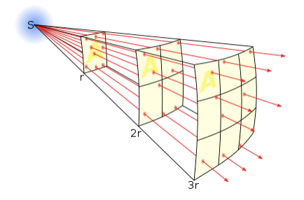
Wireless link characteristics: fading (attenuation)
Wireless radio signal attenuates (loses power) as it propagates (free space “path loss”)
Free space path loss ~ (fd)²
f: frequency
d: distance
higher frequency or longer distance
larger free space
path loss
Notes:
Wikipedia figure

Slide 14




Wireless link characteristics: multipath
multipath propagation: radio signal reflects off objects ground, built environment, arriving at destination at slightly different times
reflected path
line of sight
(LOS) path
reflected path

Slide 15
Wireless link characteristics: multipath
multipath propagation: radio signal reflects off objects ground, built environment, arriving at destination at slightly different times
Coherence time:
amount of time bit is present in channel to be received
influences maximum possible transmission rate, since coherence times can not overlap
inversely proportional to
frequency
receiver velocity
transmitted
pulses
time
received
LOS pulse
received
multipath
pulses
received
multipath
pulses
received
LOS pulse
received
pulse
time
T_{c}: coherence time

Slide 16
Wireless link characteristics: noise
interference from other sources on wireless network frequencies: motors, appliances
SNR: signal-to-noise ratio
larger SNR – easier to extract signal from noise (a “good thing”)
SNR versus BER tradeoff
given physical layer: increase power -> increase SNR->decrease BER
SNR may change with mobility: dynamically adapt physical layer (modulation technique, rate)
10⁻¹
10⁻²
10⁻³
BER
10⁻⁴
10⁻⁵
10⁻⁶
10⁻⁷
10
20
30
40
SNR(dB)
QAM256 (8 Mbps)
QAM16 (4 Mbps)
BPSK (1 Mbps)

Slide 17

Wireless link characteristics: hidden terminals
Hidden terminal problem
B, A hear each other
B, C hear each other
A, C can not hear each other means A, C unaware of their interference at B
Attenuation also causes “hidden terminals”
B, A hear each other
B, C hear each other
A, C can not hear each other interfering at B
C
A
B
C
B
A
C’s signal
strength
A’s signal
strength
space

Slide 18
Chapter 7 outline
Introduction
Wireless
Wireless links and network characteristics
CDMA: code division multiple access
WiFi: 802.11 wireless LANs
Bluetooth

Slide 19
Code Division Multiple Access (CDMA)
unique “code” assigned to each user; i.e., code set partitioning
all users share same frequency, but each user has own “chipping” sequence (i.e., code) to encode data
allows multiple users to “coexist” and transmit simultaneously with minimal interference (if codes are “orthogonal”)
encoding: inner product: (original data) X (chipping sequence)
decoding: summed inner-product: (encoded data) X (chipping sequence)

Slide 20
CDMA encode/decode
channel output Z_{i,m}
Z_{i,m}= d_{i}.c_{m}
data
bits
d₀ = 1
1
1
1
1
1
d₁ = -1
1
1
1
-
-
-
-
1
-
-
-
1
-
1
1
1
1
1
sender
1
1
slot 1
channel
output
slot 0
channel
output
1
1
1
1
1
code
1
1
-
-
-
1
-
1
1
1
-
-
-
1
-
1
1
1
slot 1
slot 0
M
D_{i} = Σ Z_{i,m}.c_{m}
m=1
receiver
M
received
input
1
1
1
1
1
1
1
1
d₀ = 1
-
-
-
-
1
-
-
-
1
-
1
1
1
1
1
1
d₁ = -1
1
slot 1
channel
output
slot 0
channel
output
1
1
1
1
1
code
1
1
-
-
-
1
-
1
1
1
-
-
-
1
-
1
1
1
slot 1
slot 0
… but this isn’t really useful yet!

Slide 21
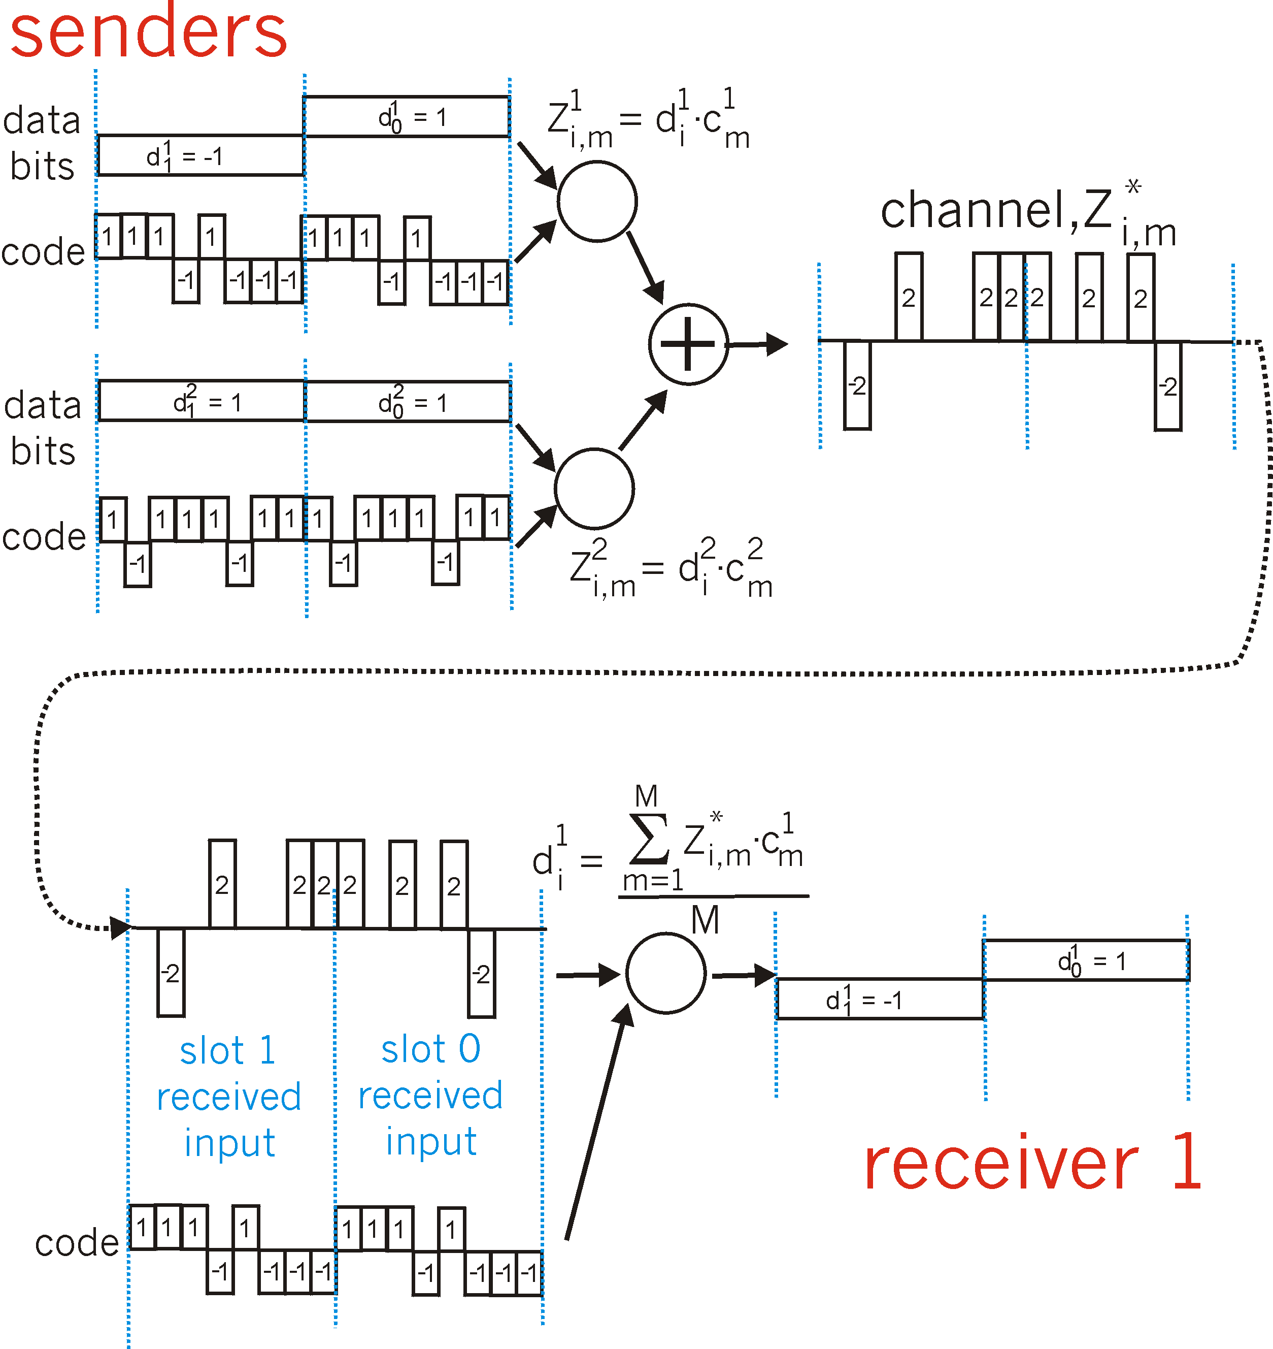
CDMA: two-sender interference
channel sums together transmissions by sender 1 and 2
Sender 1
Sender 2
using same code as sender 1, receiver recovers sender 1’s original data from summed channel data!
… now that’s useful!

Slide 22
Chapter 7 outline
Introduction
Wireless
Wireless links and network characteristics
WiFi: 802.11 wireless LANs
Cellular networks: 4G and 5G
Mobility
Mobility management: principles
Mobility management: practice
4G/5G networks
Mobile IP
Mobility: impact on higher-layer protocols

Slide 23
IEEE 802.11 Wireless LAN
IEEE 802.11 standard | Year | Max data rate | Range | Frequency
802.11b | 1999 | 11 Mbps | 30 m | 2.4 Ghz
802.11g | 2003 | 54 Mbps | 30m | 2.4 Ghz
802.11n (WiFi 4) | 2009 | 600 | 70m | 2.4, 5 Ghz
802.11ac (WiFi 5) | 2013 | 3.47Gpbs | 70m | 5 Ghz
802.11ax (WiFi 6) | 2020 (exp.) | 14 Gbps | 70m | 2.4, 5 Ghz
802.11af | 2014 | 35 – 560 Mbps | 1 Km | unused TV bands (54-790 MHz)
802.11ah | 2017 | 347Mbps | 1 Km | 900 Mhz
all use CSMA/CA for multiple access, and have base-station and ad-hoc network versions

Slide 24




802.11 LAN architecture
Internet
wireless host communicates with base station
base station = access point (AP)
Basic Service Set (BSS) (aka “cell”) in infrastructure mode contains:
wireless hosts
access point (AP): base station
ad hoc mode: hosts only
switch
or router
BSS 1
BSS 2

Slide 25
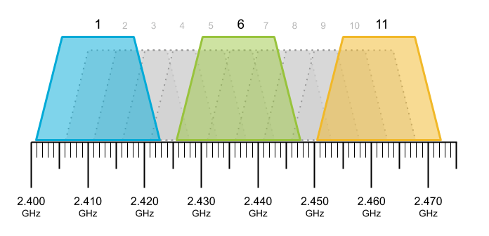
802.11: Channels
spectrum divided into channels at different frequencies
AP admin chooses frequency for AP
interference possible: channel can be same as that chosen by neighboring AP!
Example: 2.4 GHz
Notes:
recall that 802.11 operates in the frequency range of 2.4 GHz to 2.4835 GHz. Within this 85 MHz band, 802.11 defines 11 partially overlapping channels.

Slide 26
802.11: Association
arriving host: must associate with an AP
scans channels, listening for beacon frames containing AP’s name (SSID) and MAC address
selects AP to associate with
then may perform authentication [Chapter 8]
then typically run DHCP to get IP address in AP’s subnet
BSS

Slide 27
802.11: passive/active scanning
BBS 1
BBS 2
BBS 1
BBS 2
1
1
AP 2
AP 1
1
AP 2
2
2
2
AP 1
3
3
4
H1
H1
passive scanning:
beacon frames sent from APs
association Request frame sent: H1 to selected AP
association Response frame sent from selected AP to H1
active scanning:
Probe Request frame broadcast from H1
Probe Response frames sent from APs
Association Request frame sent: H1 to selected AP
Association Response frame sent from selected AP to H1

Slide 28




IEEE 802.11: multiple access
avoid collisions: 2⁺ nodes transmitting at same time
802.11: CSMA - sense before transmitting
don’t collide with detected ongoing transmission by another node
802.11: no collision detection!
difficult to sense collisions: high transmitting signal, weak received signal due to fading
can’t sense all collisions in any case: hidden terminal, fading
goal: avoid collisions: CSMA/CollisionAvoidance
A
B
C
C
B
A’s signal
strength
C’s signal
strength
A
space

Slide 29
IEEE 802.11 MAC Protocol: CSMA/CA
802.11 sender
1 if sense channel idle for DIFS then
transmit entire frame (no CD)
sender
receiver
DIFS
2 if sense channel busy then
start random backoff time
timer counts down while channel idle
transmit when timer expires
if no ACK, increase random backoff interval, repeat 2
data
SIFS
802.11 receiver
if frame received OK
return ACK after SIFS (ACK needed due to hidden terminal problem)
ACK

Slide 30
Avoiding collisions (more)
idea: sender “reserves” channel use for data frames using small reservation packets
sender first transmits small request-to-send (RTS) packet to BS using CSMA
RTSs may still collide with each other (but they’re short)
BS broadcasts clear-to-send CTS in response to RTS
CTS heard by all nodes
sender transmits data frame
other stations defer transmissions

Slide 31

Collision Avoidance: RTS-CTS exchange
A
B
AP
RTS(A)
RTS(B)
reservation collision
RTS(A)
CTS(A)
CTS(A)
time
DATA (A)
defer
ACK(A)
ACK(A)

Slide 32
802.11 frame: addressing
2
2
6
6
6
2
6
0 - 2312
4
frame
control
duration
address
1
address
2
address
3
seq
control
address
4
payload
CRC
Address 1: MAC address of wireless host or AP to receive this frame
Address 4: used only in ad hoc mode
Address 3: MAC address of router interface to which AP is attached
Address 2: MAC address
of wireless host or AP
transmitting this frame

Slide 33
802.11 frame: addressing
Internet
H1
R1
802.3 Ethernet frame
R1 MAC addr
H2 MAC addr
MAC dest addr
MAC source addr
AP MAC addr
H1 MAC addr
R1 MAC addr
address 1
address 2
address 3
802.11 WiFi frame

Slide 34
802.11 frame: addressing
duration of reserved
transmission time (RTS/CTS)
frame sequence # (for reliable data transfer)
2
2
6
6
6
2
6
0 - 2312
4
frame
control
duration
address
1
address
2
address
3
seq
control
address
4
payload
CRC
2
2
4
1
1
1
1
1
1
1
1
protocol
version
type
subtype
to
AP
from
AP
more
frag
retry
power
mgt
more
data
WEP
rsvd
frame type (RTS, CTS, ACK, data)

Slide 35
802.11: mobility within same subnet
H1 remains in same IP subnet: IP address can remain same
switch: which AP is associated with H1?
self-learning (Ch. 6): switch will see frame from H1 and “remember” which switch port can be used to reach H1
BBS 1
H1
BBS 2

Slide 36
802.11: advanced capabilities
Rate adaptation
base station, mobile dynamically change transmission rate (physical layer modulation technique) as mobile moves, SNR varies
10⁻¹
10⁻²
10⁻³
BER
10⁻⁴
10⁻⁵
10⁻⁶
1. SNR decreases, BER increase as node moves away from base station
10⁻⁷
10
20
30
40
SNR(dB)
2. When BER becomes too high, switch to lower transmission rate but with lower BER
QAM256 (8 Mbps)
QAM16 (4 Mbps)
BPSK (1 Mbps)
operating point

Slide 37
802.11: advanced capabilities
power management
node-to-AP: “I am going to sleep until next beacon frame”
AP knows not to transmit frames to this node
node wakes up before next beacon frame
beacon frame: contains list of mobiles with AP-to-mobile frames waiting to be sent
node will stay awake if AP-to-mobile frames to be sent; otherwise sleep again until next beacon frame

Slide 38
Chapter 7 outline
Introduction
Wireless
Wireless links and network characteristics
CDMA: code division multiple access
WiFi: 802.11 wireless LANs
Bluetooth

Slide 39
Personal area networks: Bluetooth
less than 10 m diameter
replacement for cables (mouse, keyboard, headphones)
ad hoc: no infrastructure
2.4-2.5 GHz ISM radio band, up to 3 Mbps
master controller / client devices:
master polls clients, grants requests for client transmissions
C
P
P
radius of
coverage
M
C
C
P
P
M
master controller
client device
parked device (inactive)
C
P

Slide 40
Personal area networks: Bluetooth
TDM, 625 μsec sec. slot
FDM: sender uses 79 frequency channels in known, pseudo-random order slot-to-slot (spread spectrum)
other devices/equipment not in piconet only interfere in some slots
parked mode: clients can “go to sleep” (park) and later wakeup (to preserve battery)
bootstrapping: nodes self-assemble (plug and play) into piconet
C
P
P
radius of
coverage
M
C
C
P
P
M
master controller
client device
parked device (inactive)
C
P

Slide 41
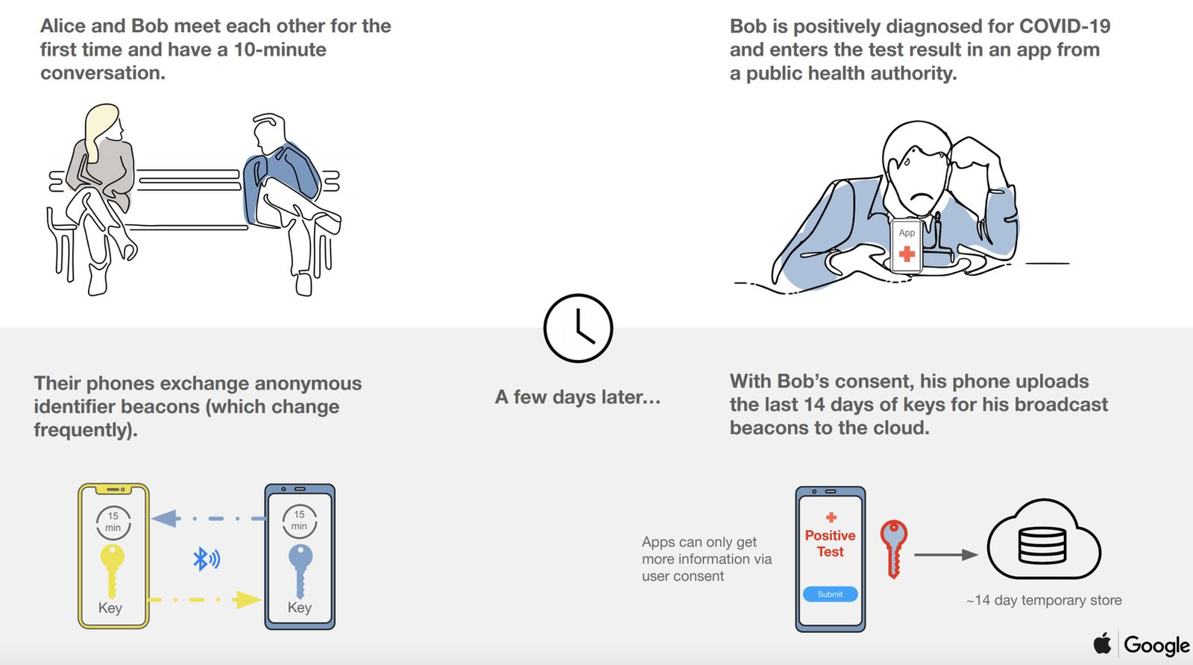
Pandemic + Bluetooth
Source: https://www.macrumors.com/guide/exposure-notification/

Slide 42
Chapter 7 outline
Introduction
Wireless
Wireless links and network characteristics
WiFi: 802.11 wireless LANs
Cellular networks: 4G and 5G
Mobility
Mobility management: principles
Mobility management: practice
4G/5G networks
Mobile IP
Mobility: impact on higher-layer protocols

Slide 43
4G/5G cellular networks
the solution for wide-area mobile Internet
widespread deployment/use:
more mobile-broadband-connected devices than fixed-broadband-connected devices devices (5-1 in 2019)!
4G availability: 97% of time in Korea (90% in US)
transmission rates up to 100’s Mbps
technical standards: 3rd Generation Partnership Project (3GPP)
wwww.3gpp.org
4G: Long-Term Evolution (LTE)standard

Slide 44
4G/5G cellular networks
similarities to wired Internet
edge/core distinction, but both belong to same carrier
global cellular network: a network of networks
widespread use of protocols we’ve studied: HTTP, DNS, TCP, UDP, IP, NAT, separation of data/control planes, SDN, Ethernet, tunneling
interconnected to wired Internet
differences from wired Internet
different wireless link layer
mobility as a 1st class service
user “identity” (via SIM card)
business model: users subscribe to a cellular provider
strong notion of “home network” versus roaming on visited nets
global access, with authentication infrastructure, and inter-carrier settlements

Slide 45

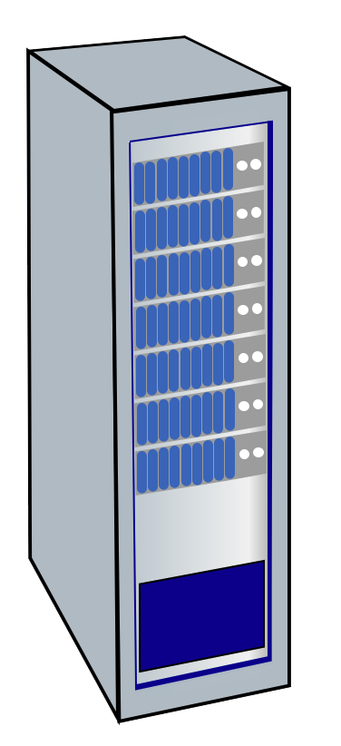


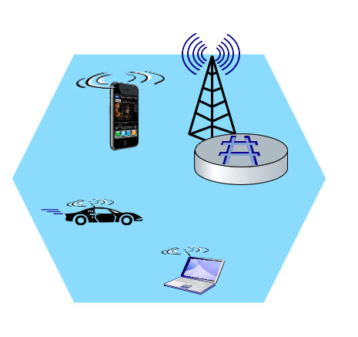
Elements of 4G LTE architecture
Mobile device:
smartphone, tablet, laptop, IoT, ... with 4G LTE radio
64-bit International Mobile Subscriber Identity (IMSI), stored on SIM (Subscriber Identity Module) card
LTE jargon: User Equipment (UE)
Mobility Management Entity (MME)
Home Subscriber Service (HSS)
Mobile device
(UE)
Base station
(eNode-B)
to
Internet
PDN gateway (P-GW)
…
Serving Gateway (S-GW)
radio access
network
all-IP Enhanced Packet Core (EPC)

Slide 46
Elements of 4G LTE architecture
Base station:
at “edge” of carrier’s network
manages wireless radio resources, mobile devices in its coverage area (“cell”)
coordinates device authentication with other elements
similar to WiFi AP but:
active role in user mobility
coordinates with nearly base stations to optimize radio use
LTE jargon: eNode-B
Mobility Management Entity (MME)
Home Subscriber Service (HSS)
Mobile device
(UE)
Base station
(eNode-B)
to
Internet
PDN gateway (P-GW)
…
Serving Gateway (S-GW)

Slide 47
Radio Access Network: 4G radio
Mobile device
(UE)
Base station
(eNode-B)
connects device (UE) to a base station (eNode-B)
multiple devices connected to each base station
many different possible frequencies bands, multiple channels in each band
popular bands: 600, 700, 850, 1500, 1700, 1900, 2100, 2600, 3500 MHz
separate upstream and downstream channels
sharing 4G radio channel among users:
OFDM: Orthogonal Frequency Division Multiplexing
combination of FDM, TDM
100’s Mbps possible per user/device
Notes:
G-defined subbands are narrow (e.g., 15 kHz)

Slide 48
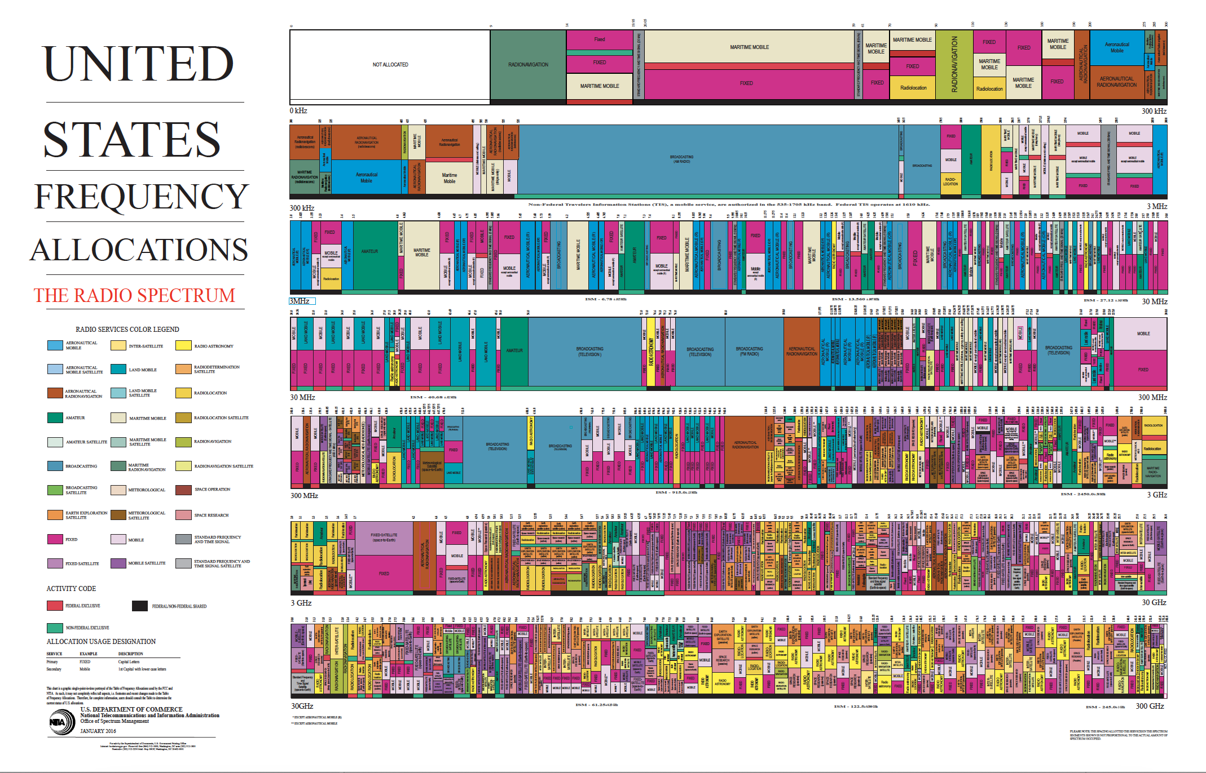
Spectrum
CBRS
Notes:
8 orders of magnitude: 9 Khz to 300 Ghz

Slide 49
OFDMA: time division (LTE)
Subcarrier frequencies
time (symbols)

Slide 50
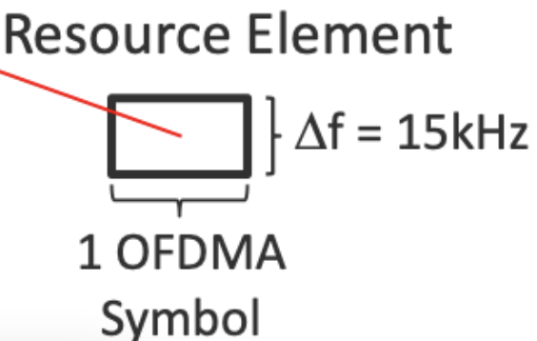
OFDMA: time division (LTE)
Physical Resource Block (PRB ): blocks of 7x12=84 resource elements
unit of transmission scheduling
Subcarrier frequencies
time to transmit one OFDM symbol on subcarrier frequency

Slide 51
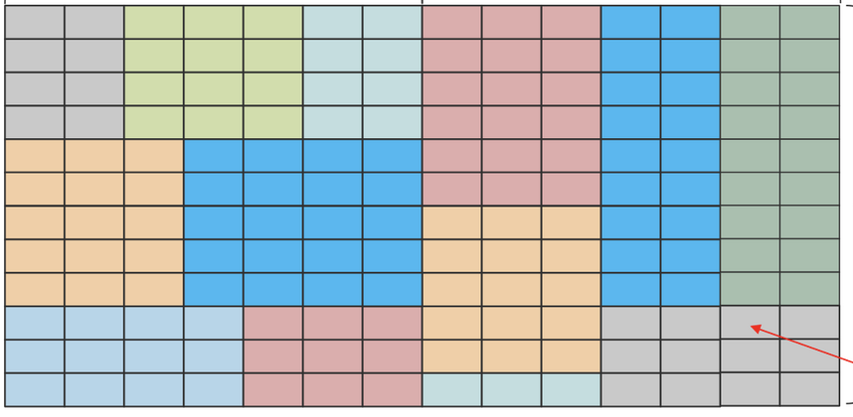
OFDMA:
Transmission Time Interval (TTI): 1 ms
PRB
PRB
Transmission scheduling example:
Send to 7 UEs in 7 blocks of REs in one PRB
Subcarrier frequencies
UE₁
UE₂
UE₃
UE₄
UE₅
UE₆
UE₇
time (symbols)

Slide 52
Elements of 4G LTE architecture
Home Subscriber Service
stores info about mobile devices for which the HSS’s network is their “home network”
works with MME in device authentication
Mobility Management Entity (MME)
Home Subscriber Service (HSS)
Mobile device
(UE)
Base station
(eNode-B)
to
Internet
PDN gateway (P-GW)
…
Serving Gateway (S-GW)

Slide 53
Elements of 4G LTE architecture
Serving Gateway (S-GW), PDN Gateway (P-GW)
lie on data path from mobile to/from Internet
P-GW
gateway to mobile cellular network
Looks like nay other internet gateway router
provides NAT services
other routers:
extensive use of tunneling
Mobility Management Entity (MME)
Home Subscriber Service (HSS)
Mobile device
(UE)
Base station
(eNode-B)
to
Internet
PDN gateway (P-GW)
…
Serving Gateway (S-GW)

Slide 54
Elements of 4G LTE architecture
Mobility Management Entity
device authentication (device-to-network, network-to-device) coordinated with mobile home network HSS
Mobility Management Entity (MME)
Home Subscriber Service (HSS)
Mobile device
(UE)
Base station
(eNode-B)
to
Internet
PDN gateway (P-GW)
mobile device management:
device handover between cells
tracking/paging device location
path (tunneling) setup from mobile device to P-GW
…
Serving Gateway (S-GW)

Slide 55
LTE: data plane control plane separation
HSS
control plane
new protocols for mobility management , security, authentication (later)
base station
MME
P-GW
S-GW
data plane
new protocols at link, physical layers
base station
S-GW
P-GW
extensive use of tunneling to facilitate mobility
IP tunnels

Slide 56
LTE data plane protocol stack: first hop
LTE link layer protocols:
Packet Data Convergence: header compression, encryption
Radio Link Control (RLC) Protocol: fragmentation/reassembly, reliable data transfer
Medium Access: requesting, use of radio transmission slots (OFDM)
Application
Transport
IP
IP
Packet Data
Convergence
Packet Data
Convergence
Link
Radio Link
Radio Link
Medium Access
Medium Access
Physical
Physical
data
plane
base station
S-GW
P-GW

Slide 57
LTE data plane protocol stack: packet core
tunneling:
mobile datagram encapsulated using GPRS Tunneling Protocol (GTP), sent inside UDP datagram to S-GW
S-GW re-tunnels datagrams to P-GW
supporting mobility: only tunneling endpoints change when mobile user moves
GTP-U
GTP-U
GTP-U
UDP
UDP
UDP
IP
IP
IP
IP
Packet Data
Convergence
Radio Link
link
link
link
Medium Access
Physical
Physical
Physical
Physical
\
base station
S-GW
P-GW

Slide 58
LTE data plane: associating with a BS
1
2
3
data
plane
base station
S-GW
P-GW
1
BS broadcasts primary synch signal every 5 ms on all frequencies
BSs from multiple carriers may be broadcasting synch signals
2
mobile finds a primary synch signal, then locates 2nd synch signal on this freq.
mobile then finds info broadcast by BS: channel bandwidth, configurations; BS’s cellular carrier info
mobile may get info from multiple base stations, multiple cellular networks
3
mobile selects which BS to associate with (e.g., preference for home carrier)
4
more steps still needed to authenticate, establish state, set up data plane

Slide 59
LTE mobiles: sleep modes
ZZZZ...
data
plane
as in WiFi, Bluetooth: LTE mobile may put radio to “sleep” to conserve battery:
light sleep: after 100’s msec of inactivity
wake up periodically (100’s msec) to check for downstream transmissions
deep sleep: after 5-10 secs of inactivity
mobile may change cells while deep sleeping – need to re-establish association

Slide 60
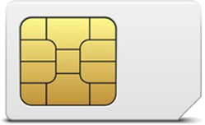
Global cellular network: a network of IP networks
home network HSS:
identify & services info, while in home network and roaming
Home
Subscriber
Server
home mobile
carrier network
P-GW
public Internet
and
inter-carrier IPX
all IP:
carriers interconnect with each other, and public internet at exchange points
legacy 2G, 3G: not all IP, handled otherwise
…
…
in home network
P-GW
SIM card: global identify info in home network
visited mobile
carrier network
…
roaming in visited network

Slide 61
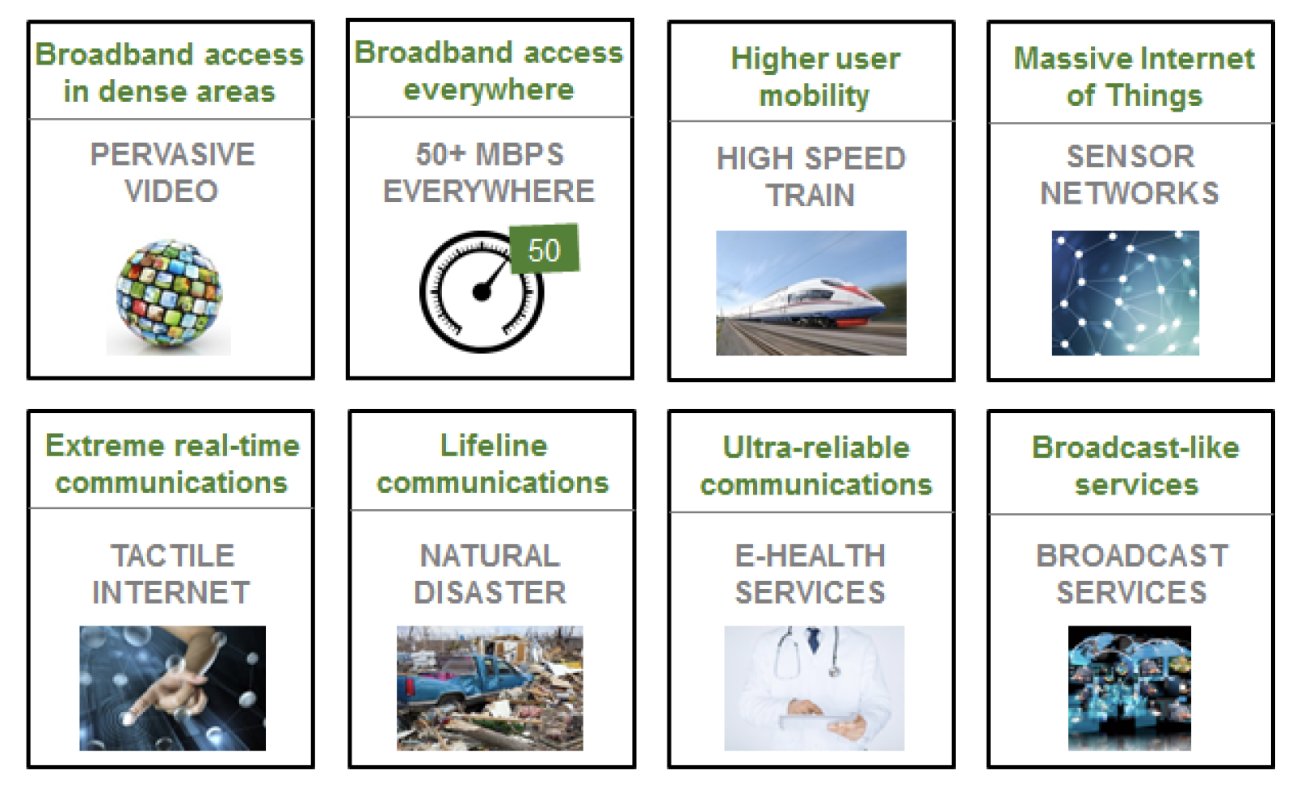
On to 5G: motivation
From Next Generation Mobile Networks (NGMS) alliance: 2020 white paper
Hype/wishes need to be separated from reality or likely nearer-term reality

Slide 62
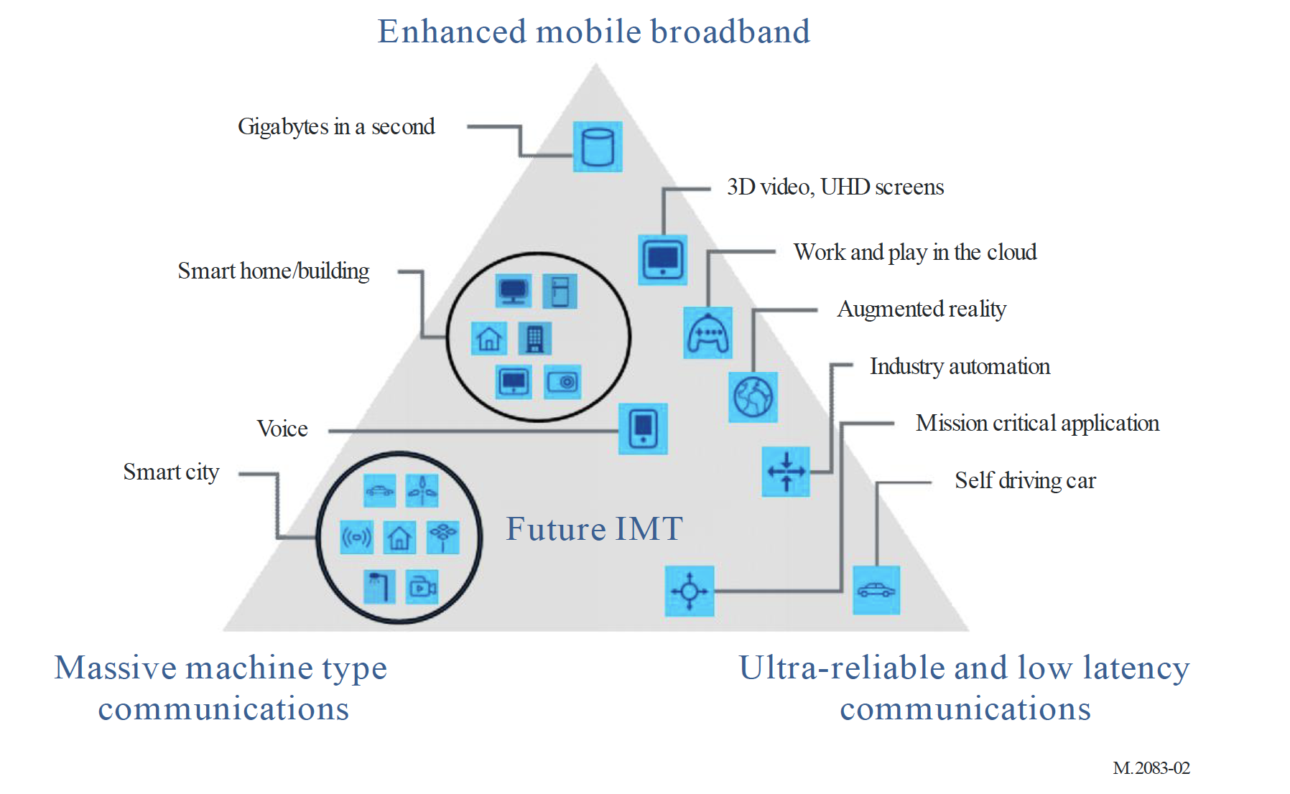
On to 5G: motivation
“initial standards and launches have mostly focused on enhanced Mobile Broadband, 5G is expected to increasingly
enable new business models and countless new use cases, in particular those of massive Machine Type Communications and Ultra-reliable and Low Latency Communications.”
Figure: from Recommendation ITU-R M.2083-0 (2015)

Slide 63
On to 5G: motivation
eMBB
Industry verticals:
Manufacturing
Constructions
Transport
Health
Smart communities
Education
Tourism
Agriculture
Finance
mMTC
URLLC
K. Schwab, “The Fourth Industrial Revolution,” World Economic Forum.

Slide 64
On to 5G: Radio
goal: 10x increase in peak bitrate, 10x decrease in latency, 100x increase in traffic capacity over 4G
5G NR (new radio):
two frequency bands: FR1 (450 MHz–6 GHz) and FR2 (24 GHz–52 GHz): millimeter wave frequencies
not backwards-compatible with 4G
MIMO: multiple directional antennae
millimeter wave frequencies: much higher data rates, but over shorter distances
pico-cells: cells diameters: 10-100 m
massive, dense deployment of new base stations required

Slide 65
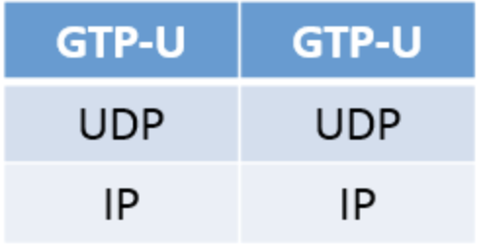
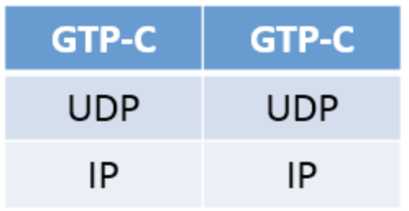



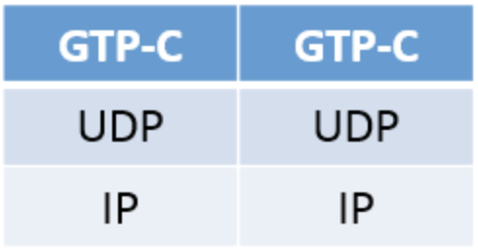
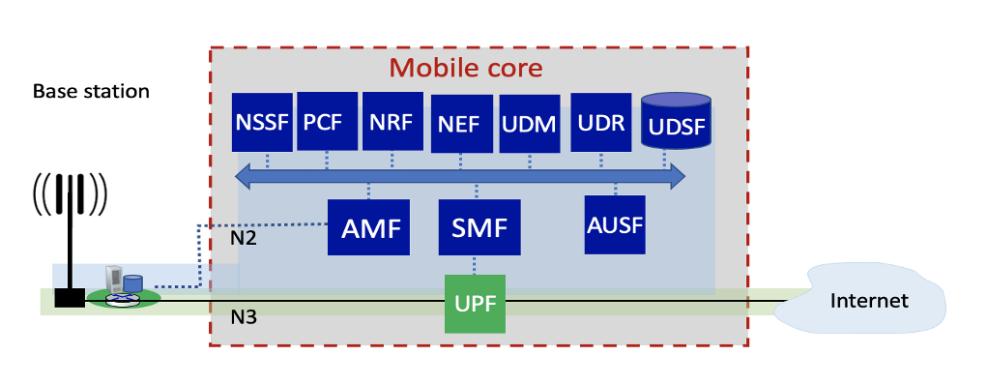
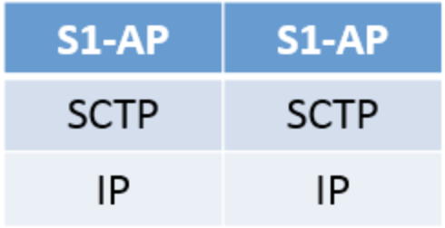
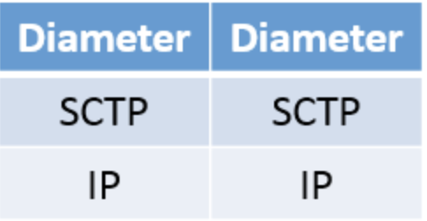
On to 5G: SDN-like architecture
Serving gateway (S-GW)
PDN gateway (P-GW)
public Internet
and
inter-carrier IPX
4G mobile core:
boxes and protocols
Mobility Management Entity (MME)
Home Subscriber Service (HSS)
public Internet
and
inter-carrier IPX
5G: microservice-like architecture
Notes:
stream control transmission protocol (STCP)

Slide 66
Functional elements: communication, computation, data
User control, Mobile Core implemented in “edge” data center (DC)
RAN
RAN
Far Edge DC
Far Edge DC
UE
UE
Edge DC
Core DC
Edge DC
Mobile Core
Mobile Core
RAN
RAN
Far Edge DC
Far Edge DC
UE
UE
Edge Network
Operator A
Global Core
Edge Network
Operator B

Slide 67
Control plane: resource control
Real-time (< ms)
Near real-time (> ms)
Non real-time (>> ms)
control plane
RAN
RAN
Far Edge DC
Far Edge DC
UE
UE
Edge DC
Core DC
Edge DC
Mobile Core
Mobile Core
RAN
RAN
Far Edge DC
Far Edge DC
UE
UE
Edge Network
Operator A
Global Core
Edge Network
Operator B

Slide 68
User plane: resources, as used by users (application)
User plane
“local breakout”
within one operator
multi-operator end-end edge/core
edge/core
RAN
RAN
Far Edge DC
Far Edge DC
UE
UE
Edge DC
Core DC
Edge DC
Mobile Core
Mobile Core
RAN
RAN
Far Edge DC
Far Edge DC
UE
UE
Edge Network
Operator A
Global Core
Edge Network
Operator B

Slide 69
On beyond 5G?
“6G” not obviously next: “NextG” and “Beyond 5G” heard more often than “6G”
5G on an evolutionary path (like the Internet)
agility: cloud technologies (SDN) mean new features can be introduced rapidly, deployed continuously
customization: change can be introduced bottom-up (e.g., by enterprises and edge cloud partners with Private 5G)
No need to wait for standardization
No need to reach agreement (among all incumbent stakeholders)

Slide 70
Chapter 7 outline
Introduction
Wireless
Wireless links and network characteristics
WiFi: 802.11 wireless LANs
Cellular networks: 4G and 5G
Mobility
Mobility management: principles
Mobility management: practice
4G/5G networks
Mobile IP
Mobility: impact on higher-layer protocols

Slide 71
What is mobility?
spectrum of mobility, from the network perspective:
no mobility
high mobility
device moves
between networks, but
powers down
while moving
device moves within same AP in
one provider
network
device moves among APs in
one provider
network
device moves
among multiple
provider networks,
while maintaining
ongoing connections
We’re interested in these!

Slide 72
Mobility challenge:
content
provider
network
If a device moves from one network another:
How will the “network” know to forward packets to the new network?
datacenter
network
Verizon
public Internet
client moves from Verizon to AT&T
AT&T

Slide 73
Mobility approaches
let network (routers) handle it:
routers advertise well-known name, address (e.g., permanent 32-bit IP address), or number (e.g., cell #) of visiting mobile node via usual routing table exchange
Internet routing could do this already with no changes! Routing tables indicate where each mobile located via longest prefix match!

Slide 74
Mobility approaches
let network (routers) handle it:
routers advertise well-known name, address (e.g., permanent 32-bit IP address), or number (e.g., cell #) of visiting mobile node via usual routing table exchange
Internet routing could do this already with no changes! Routing tables indicate where each mobile located via longest prefix match!
not
scalable
to billions of
mobiles
let end-systems handle it: functionality at the “edge”
indirect routing: communication from correspondent to mobile goes through home network, then forwarded to remote mobile
direct routing: correspondent gets foreign address of mobile, send directly to mobile

Slide 75

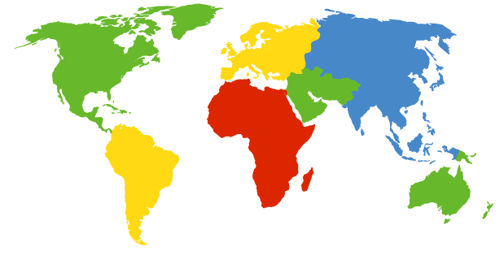

Contacting a mobile friend:
I wonder where Alice moved to?
Consider friend frequently changing locations, how do you find him/her?
search all phone books?
expect her to let you know where he/she is?
call his/her parents?
Facebook!
The importance of having a “home”:
a definitive source of information about you
a place where people can find out where you are

Slide 76
Home network, visited network: 4G/5G
home network:
(paid) service plan with cellular provider, e.g., Verizon, Orange
home network HSS stores identify & services info
Home
Subscriber
Server
home mobile
carrier network
P-GW
public Internet
and
inter-carrier IPX
…
…
in home network
visited network:
any network other than your home network
service agreement with other networks: to provide access to visiting mobile
P-GW
SIM card: global identify info including home network
visited mobile
carrier network
…
roaming in visited network

Slide 77
Wireless, mobility: impact on higher layer protocols
logically, impact should be minimal …
best effort service model remains unchanged
TCP and UDP can (and do) run over wireless, mobile
… but performance-wise:
packet loss/delay due to bit-errors (discarded packets, delays for link-layer retransmissions), and handover loss
TCP interprets loss as congestion, will decrease congestion window un-necessarily
delay impairments for real-time traffic
bandwidth a scare resource for wireless links

Slide 78
Chapter 7 summary
Wireless
Wireless Links and network characteristics
WiFi: 802.11 wireless LANs
Cellular networks: 4G and 5G
Mobility
Mobility management: principles
Mobility management: practice
4G/5G networks
Mobile IP
Mobility: impact on higher-layer protocols

