Slide 1




Erol Halim Presents:
2D ARCADE GOLF GAME

Slide 2
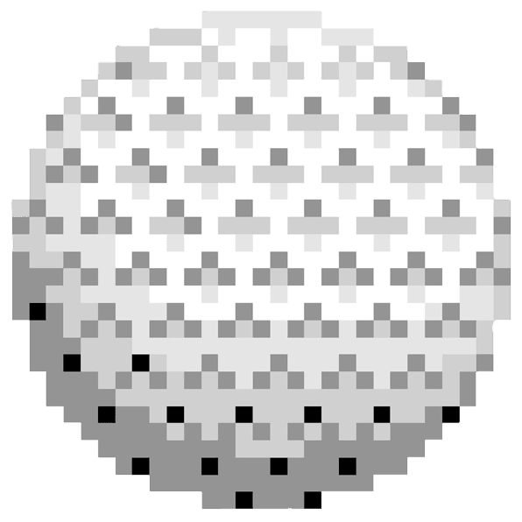
Go Golf is graphical 2d arcade golf game inspired by flash, mobile and SNES era games, such as Coffee Golf
The game includes various features
including:
  Physics based trajectory and collisions systems
  Multiple game modes- 3 holes, 5 holes and random
  GUI with pixel art style
  A leaderboard system to keep track of player performances after a match
  A store, wallet system and skin selection
  To create account that stores users' previous data and encrypts their passwords using Superencipherment cipher
  Level Editor

Slide 3



The game will built with the use of various programming languages and modules
Programming Languages
Python (OOP, Libraries)
SQL (Relational databases)
Python is interpreter language, that use OOP. Which allows the creations of objects that may share or not share attributes or methods between them or contain them in with their life cycle dependent on their implementation
Modules
PyGame (Game engine)
Pickle (Store list elements)
SQLlite3 (Relational databases)
Logger (Testing)
The game will use PyGame, a small game engine, that will be used to create a GUI for the game and allowing easy interaction between the user and code

Slide 4
SQL is a declarative programming language, that can be used to create relational databases. With the use of SQLlite3 module, it makes easy to make queries to the table from the game
Programming Languages
Python (OOP, Libraries)
SQL (Relational databases)
Modules
This allows us to create separate tables within a database to store everything from username, passwords, coins, strokes and unlocked skins
PyGame (Game engine)
Pickle (Store list elements)
SQLlite3 (Relational databases)
Logger (Testing)

Slide 5
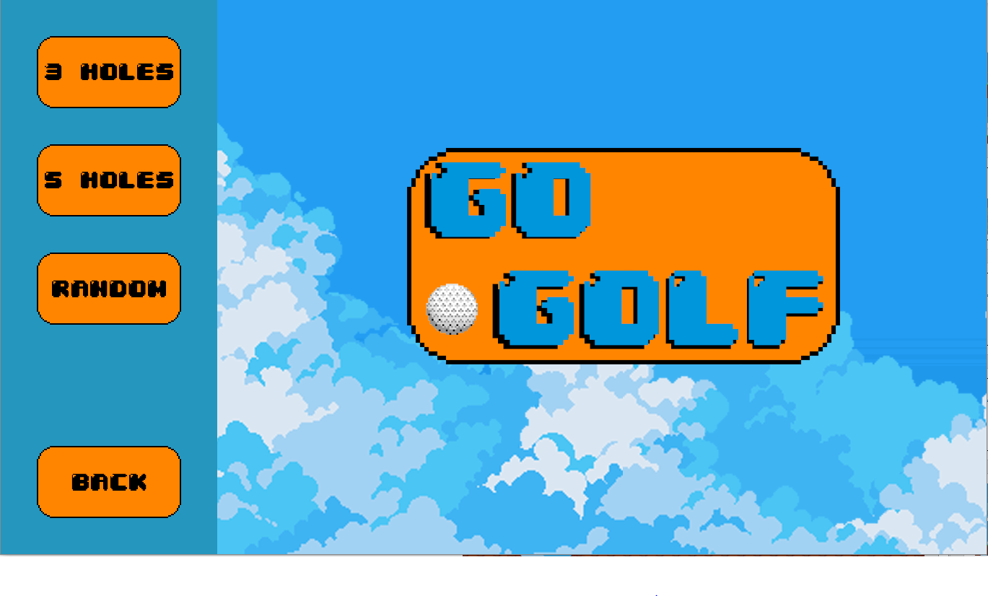
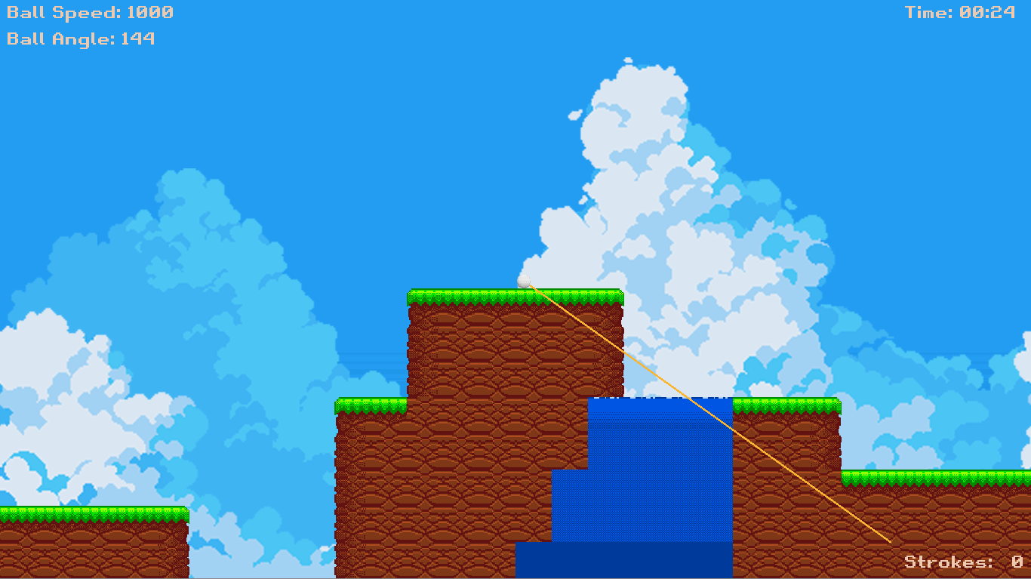
Depending on the game mode, the player will either play either three, five pre-selected levels or one random level
Once mode selected. The player will spawn at the starting point of the level. Each level will have between 3-5 holes, which user need to hit
The game uses an algorithms based on total strokes and time to calculate a score. The higher the amount strokes and time, the worse the score.
Before player shoots, they allowed to look around the level
Once ready, press enter to lock and centre camera onto ball. After the game will allow you to select ball speed and angle dependent on the cursor position. To shoot right click

Slide 6
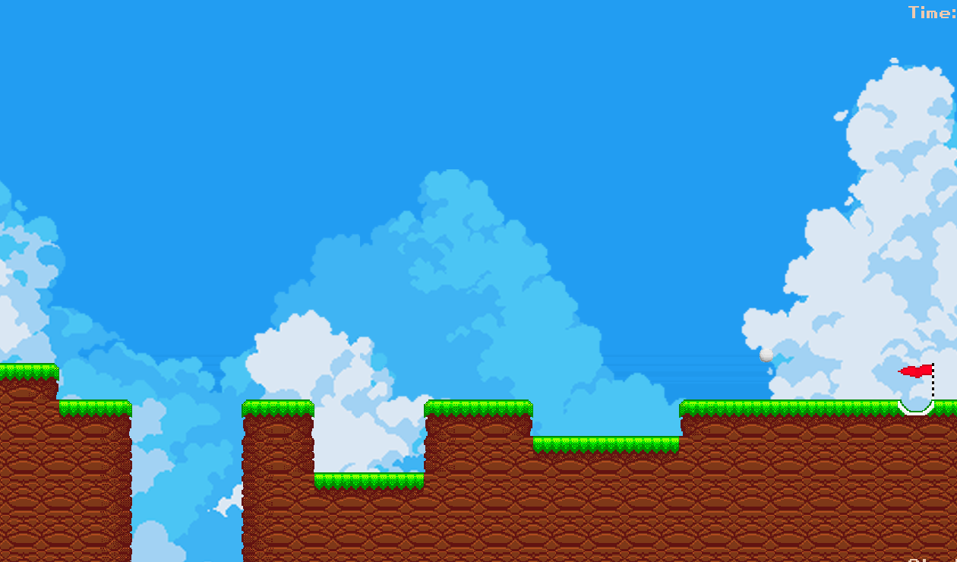
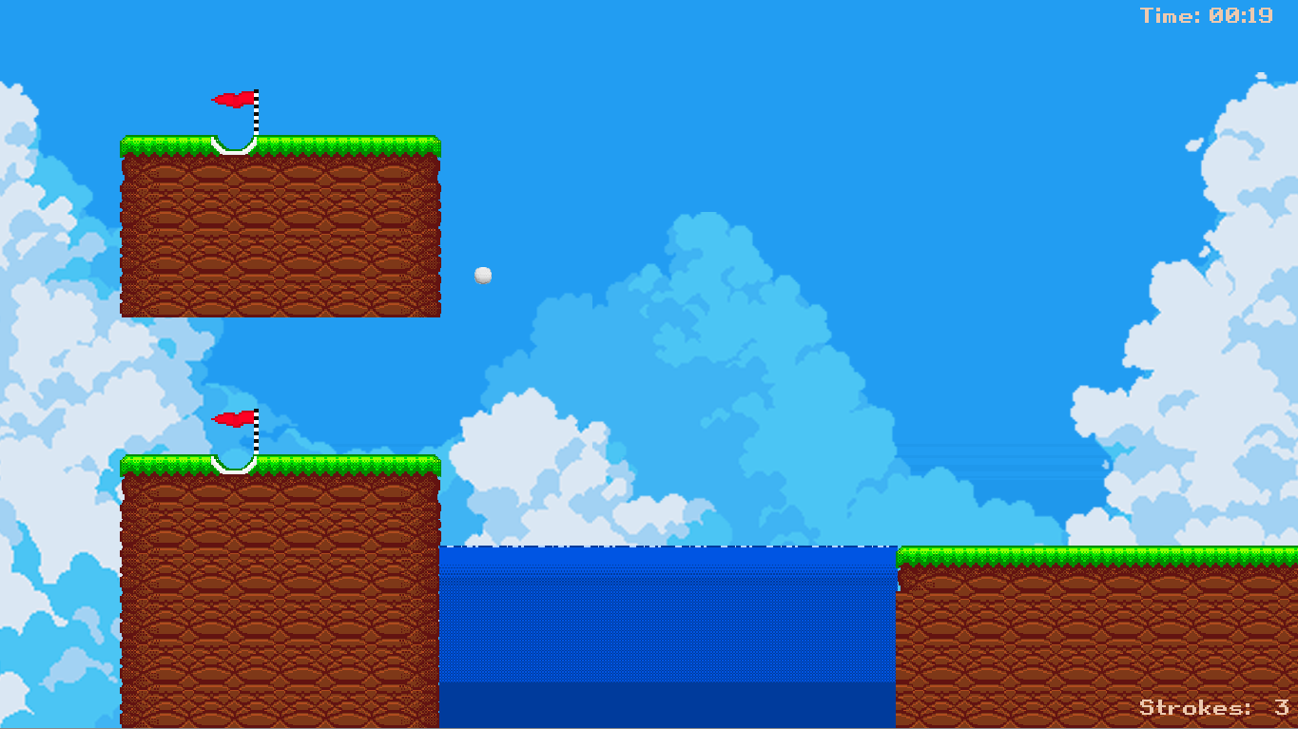
After each shot player allowed to repeat last few steps and prepare their next shot
Once ball has gone into the hole, the ball set back spawn and the level keeps going
If all holes have been entered, the strokes and time are saved, and the next level loaded

Slide 7

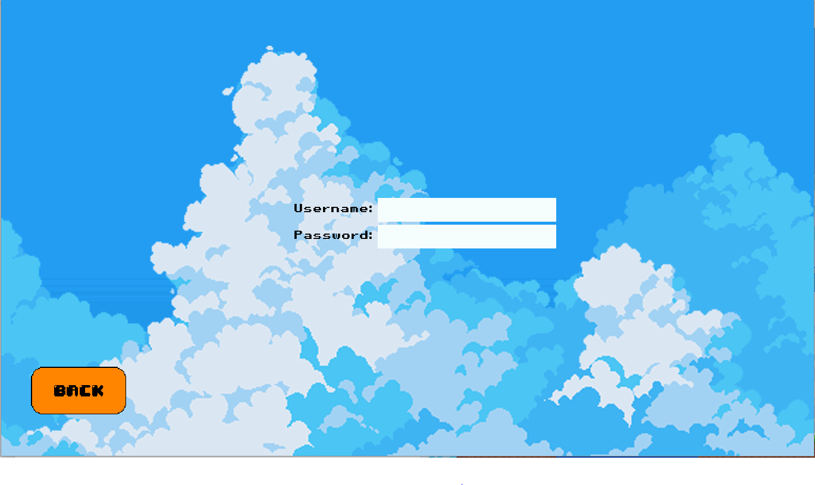
Press sign up, then player allowed to type in username and password. Username and passwords are only allowed to max of 8 characters
If username already taken it, the game will give you error. Else it store username and encrypt the password through XOR cipher and then Ceaser cipher, then store it
LOGIN INTO ACCOUNT
Press login, the player allowed to type in username and password.
If correct, user logs into the account, else they given error message of what went wrong

Slide 8
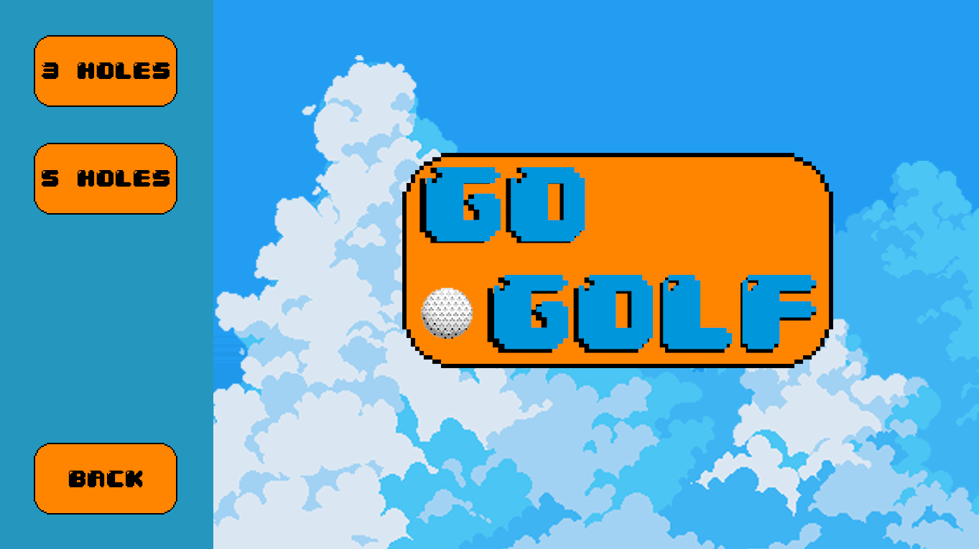
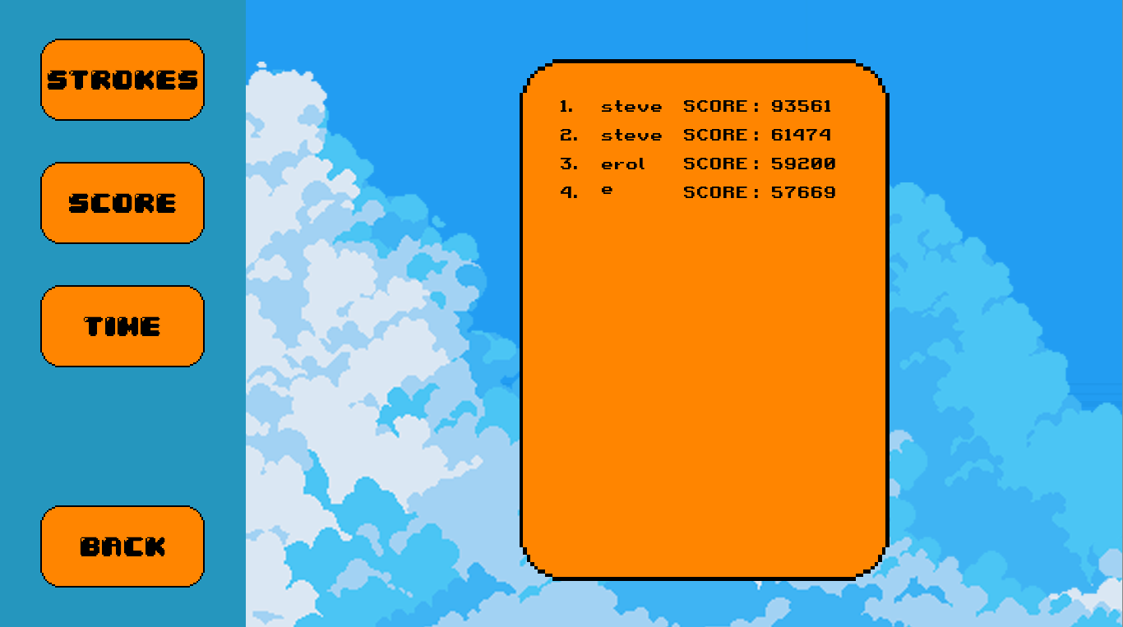
Leaderboard system is used to display all previous games played from either 3 holes or 5 holes game mode
The leaderboard can filter between each game score, stokes and time

Slide 9
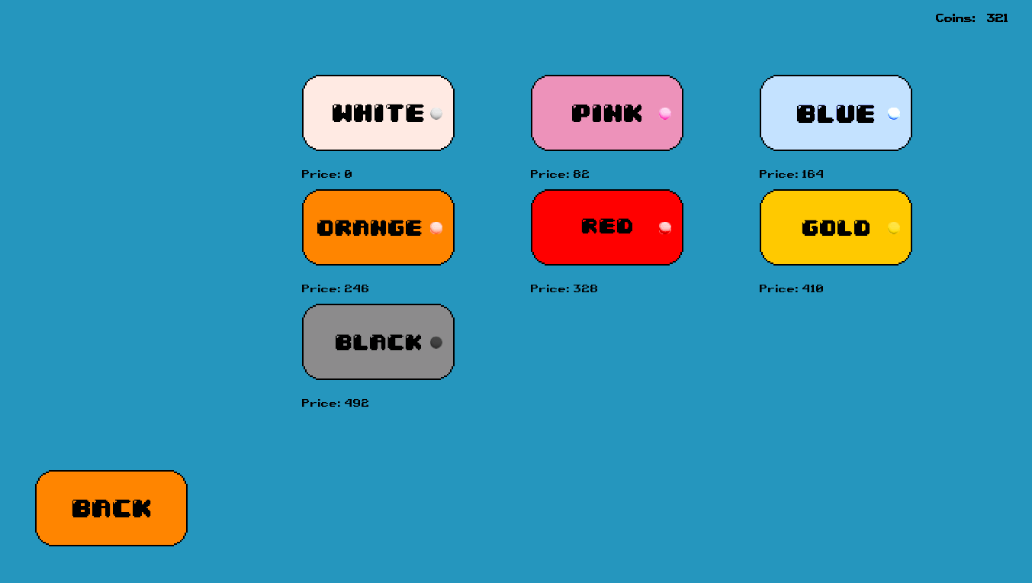
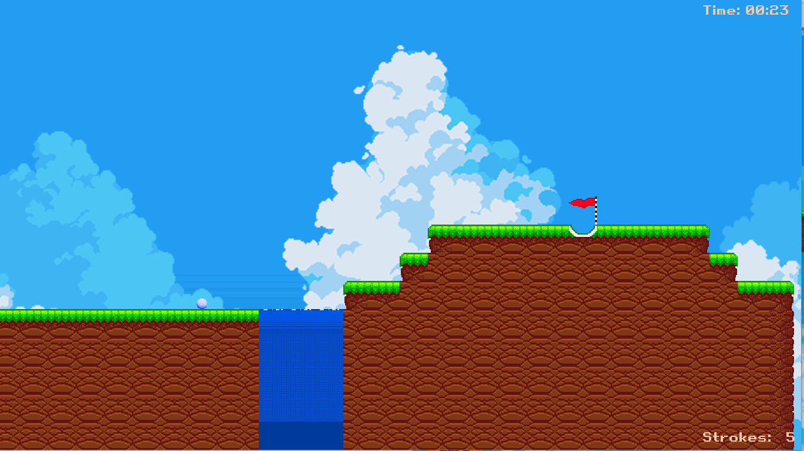
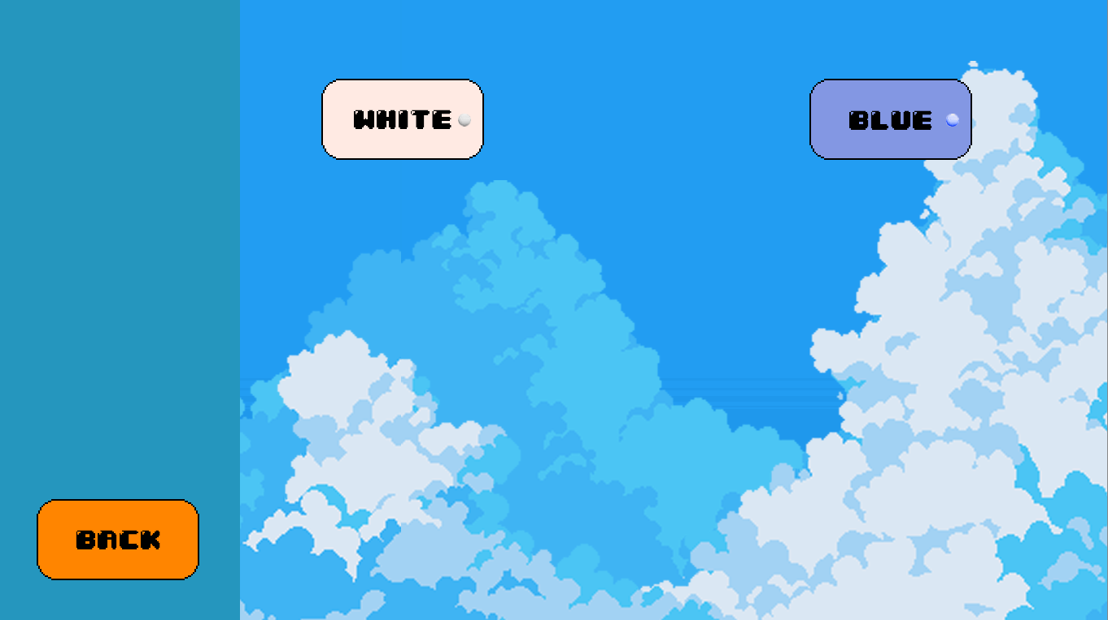
Coins can be earned through gameplay, each level completed is worth 16 coins. Amount earnt are fixed and do not change with score. Coins are only assigned to the player account that is currently playing
Coins can be used to purchases golf ball skins, which after purchase are saved to the user account only and cannot be purchased again by the same player
Skins then can be selected and used in game

Slide 10
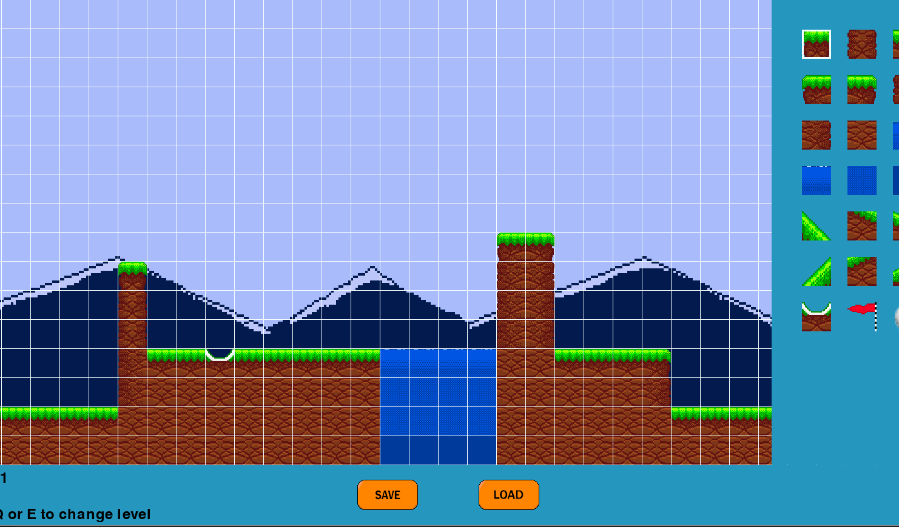
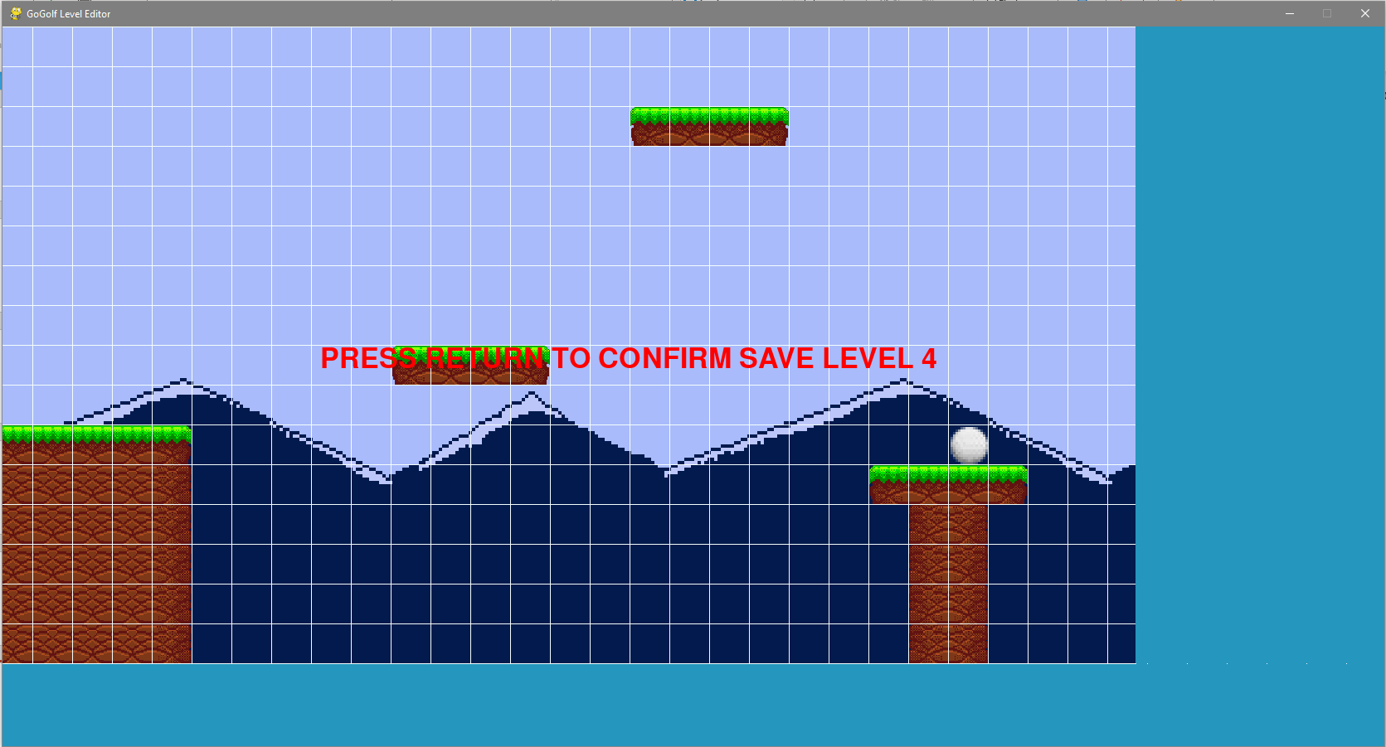
Level Editor is used to create levels for the game
The level editor uses a grid system for placement of all images, so it track and get consistent placement of images, that are saved into 2D array.
To use the editor, just press image you want to use and place it into your desired grid
There is 16 possible rows and 150 columns for each level. Grid size is determined by the size of screen
After creating the level, it will be saved using the pickle module and loaded through the save module
The level editor was based on youtuber called coding with Russ Level Editor tutorial but rewritten with heavier use of OOP and altered for this game use

Slide 11

AIM OF THE PROJECT
To be able use OOP to create object, to interact with each other
To add all mentioned features into a working build
To write clear and easy to read code
To try to get most performance out of using an interpreter language with game engine that more software dependent
Create engaging repayable game
To attempt to create a 3NF database
To reuse code when necessary
To be able to implement necessary abstract data structures such as queues or stack

Slide 12
LIVE DEMO OR VIDEO

Slide 13
ANY QUESTIONS

