Slide 1
My Project
Eris Mustafa

Slide 2
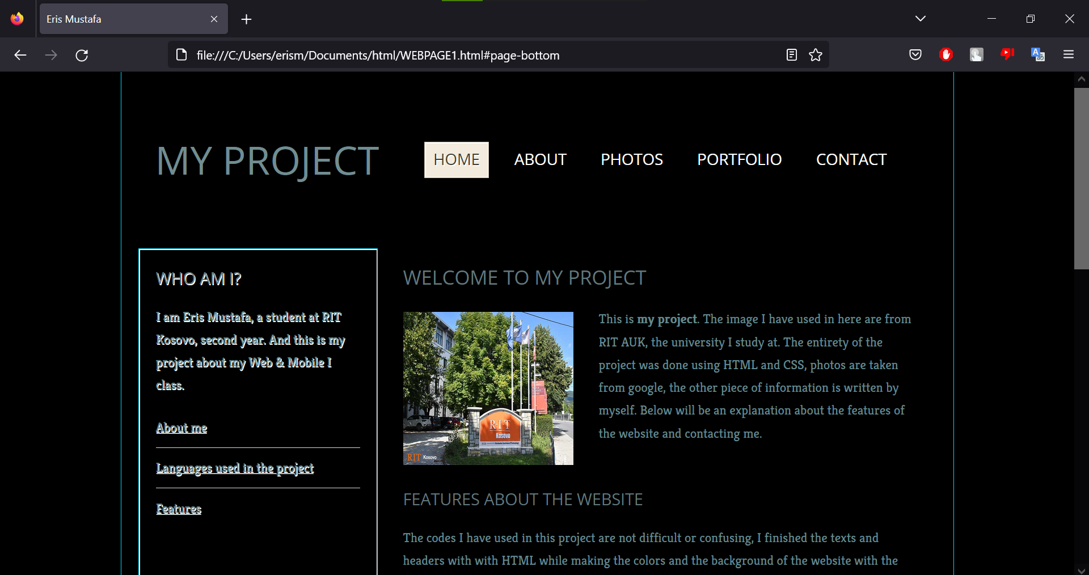
Introduction
My website intro
and homepage
Four key sections
‘About’
‘Photos’
‘Portofolio’
‘Contact’

Slide 3
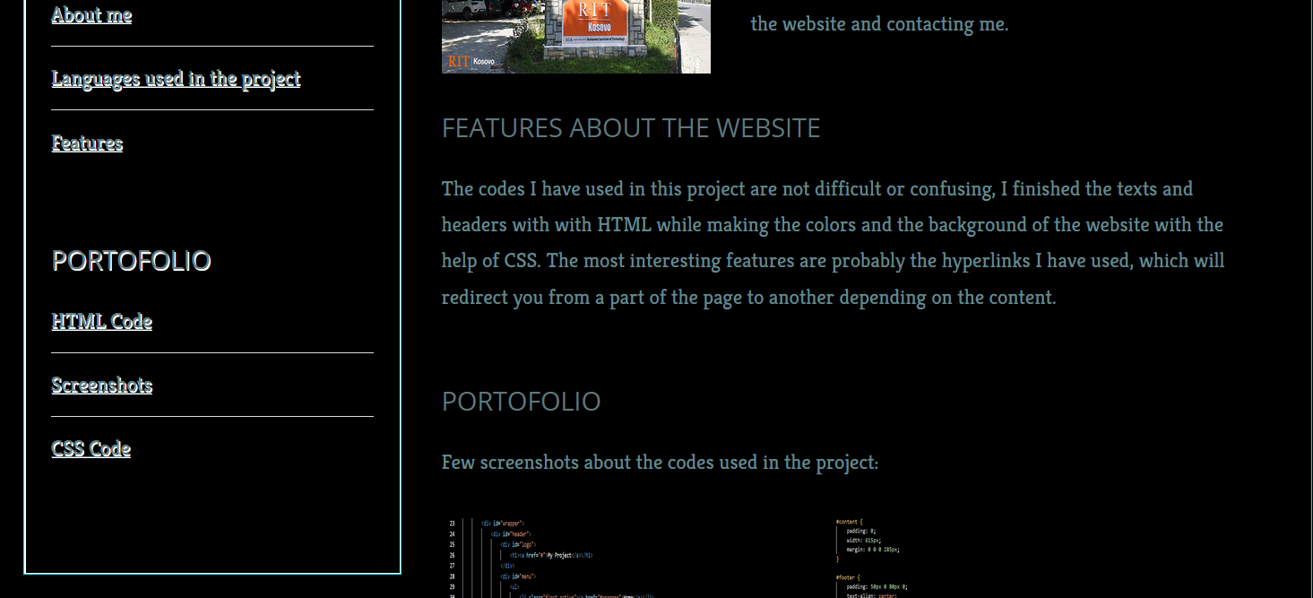
The Code Behind My Project
What languages
did I use in the
project
Interesting
features

Slide 4

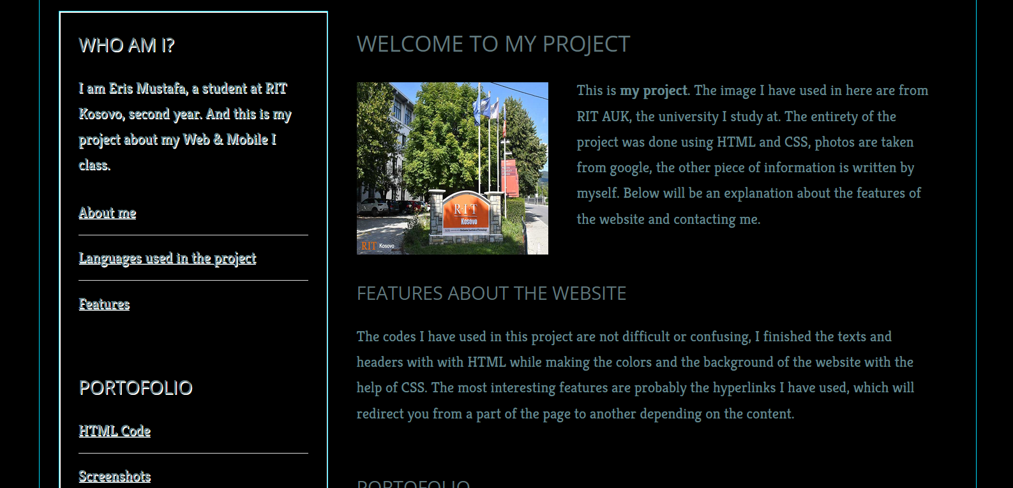
Hyperlink
What is hyperlink
Why did I use it
Example of a hyperlink
in my website

Slide 5
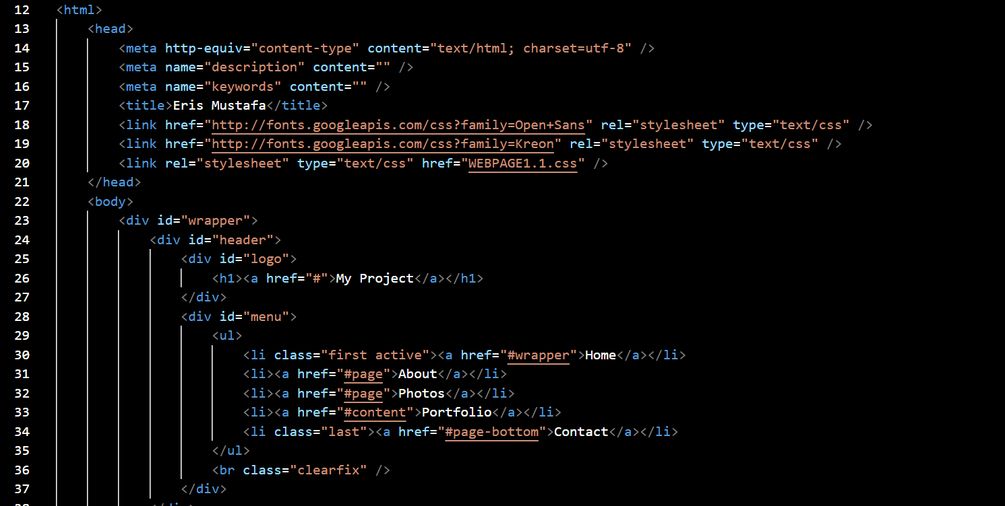
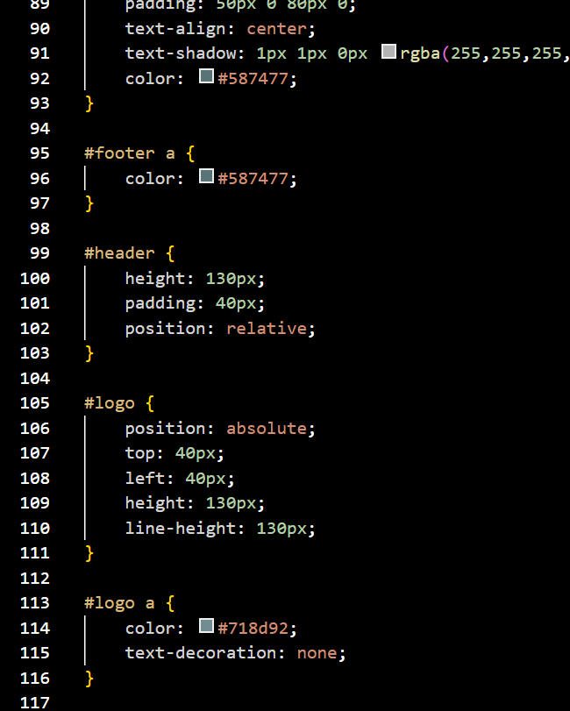
Portofolio

Slide 6
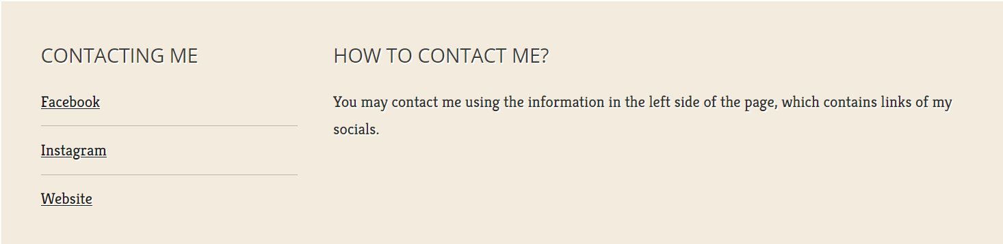
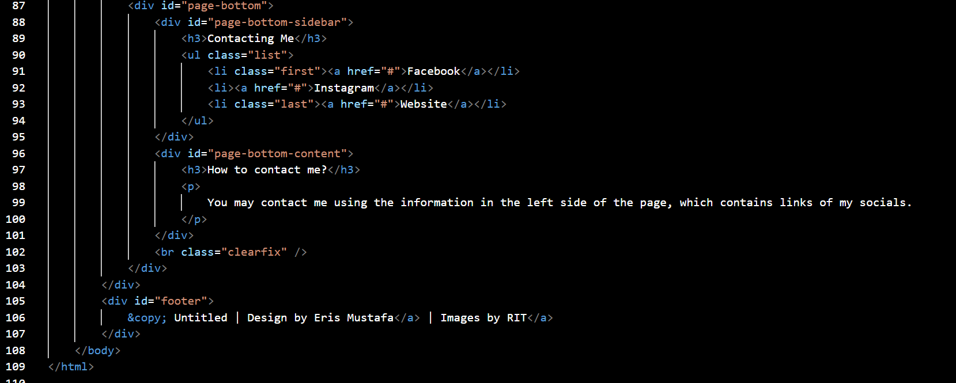
Contact
Contacting me:

Slide 7
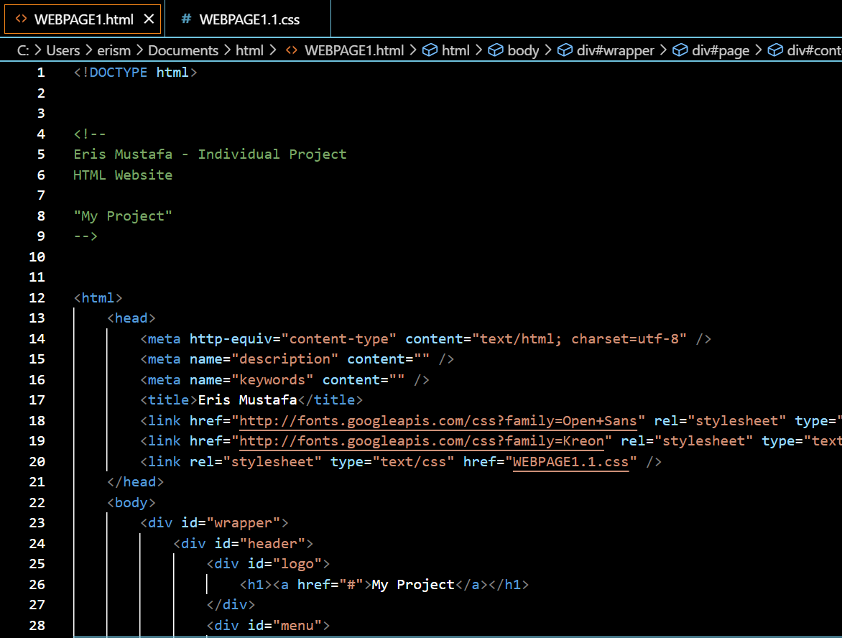
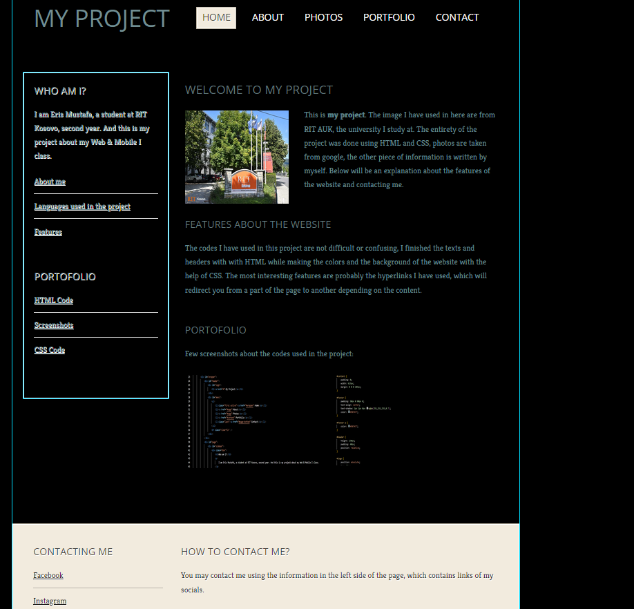
The end:

