Slide 1
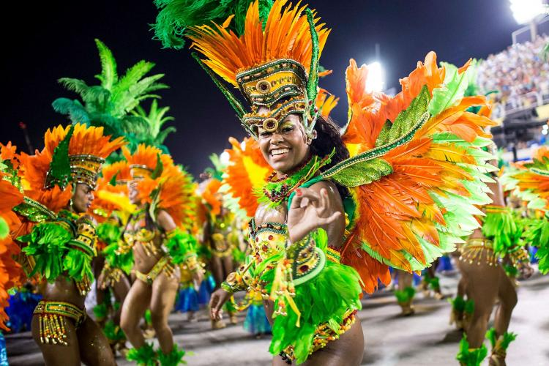
Team Samba Michael Fromm, Christian Lemke, Antoine Maurino, Mihaela Hanea, Sebastian Wagner Supervisor: Evgeniy Faerman
Status report
Sprint 3

Slide 2
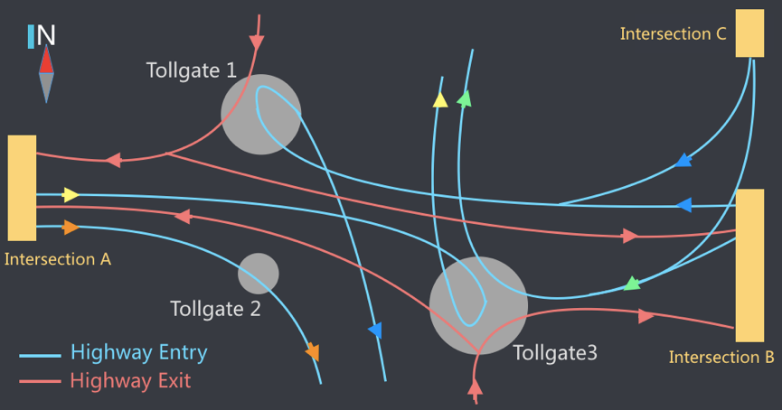
Small Data – Background
Goal: Highway tollgates traffic flow prediction
Task: Estimate the average travel time from intersections to tollgates

Slide 3
Sprint 3 -Tasks
Develop input web GUI
Save input data to backend
Save data from backend to DB
Start flink cluster from node.js
Specification of IO json files
Create DB and make it available
Flink Master->Worker mapping
Make ourselves familiar with tensorflow
Wiki page for server configuration
General ML models for the flink worker
Save best ML model to the DB
Visualize the results on the web
Fix ML models from the last sprint
Fix vector generation from the last sprint

Slide 4
Architecture

Slide 5
Sprint 3 - Review
Successes
Pipeline is nearly finished
In the last sprint we can focus on optimizing / adding features
Issues
Had a lot of interface problems (wrong paths on server etc.) between the units
We had problems with the .csv files

Slide 6
Sprint 4 - Tasks
Implement models in Tensorflow to facilitate use of neural networks in next Sprint

Slide 7
DEMO

Slide 8
Thanks for your attention!

