Slide 1

CHORDIFY
Emily Naftalin
Data Scientist

Slide 2
Are you a song writer?

Slide 3
You are now!
With Chordify, anyone who can write English words can compose a song!

Slide 4
How Chordify works:
Enter your favorite words or phrases into the custom interface.
The system returns appropriate chord suggestions.
Take the suggested chords, apply your custom tempo and instrumentation, and write a killer song using your own words!
1
2
3

Slide 5
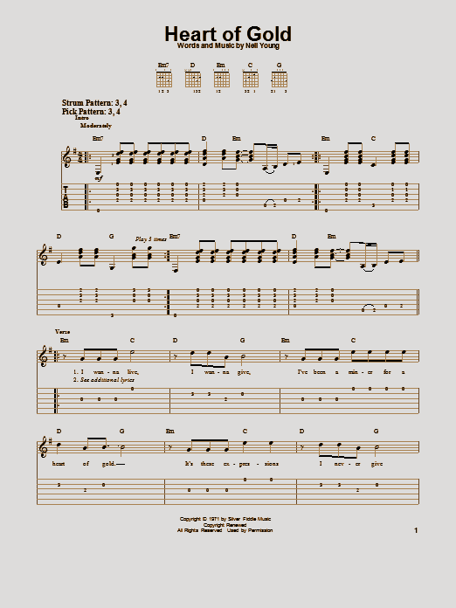

What are you saying?
Common songs in a minor key:
Led Zeppelin: Stairway to Heaven (Am)
The Animals: House of the Rising Sun (Am)
Neil Young: Heart of Gold (Em)

Slide 6
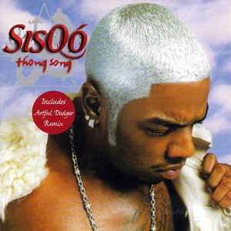

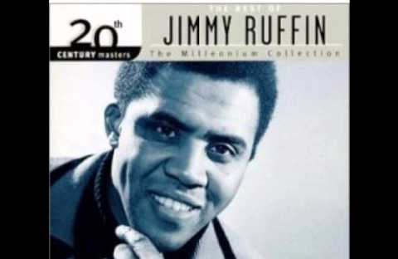
Oh! Now you have my attention...
Songs with key changes:
Sisqo: The Thong Song
Belinkie: Build Me Up, Buttercup
Jimmy Ruffin: What Becomes of the Broken-Hearted?
Bonnie Lee Tyler: Total Eclipse of the Heart
Notes:
The Thong Song: But I think it’s the greatest key change ever because it does more than any other of its kind what all over-the-top pop song key changes aspire to do — it forces emotional significance on moments and lyrics that cannot bear it otherwise. The thing you have to remember about the Thong Song is that the basic loop starts with a dissonant chord. (i.e. the music for “Baby make your booty go/ Baby make your booty goooo” sounds much more anxious than the music for “Baby make your booty show/ that thong, tha-thong thong thong.”)
What Becomes of the Broken Heartedgoes from Bb Major to C Major, which is as cheesy a modulation as you could hope for. But damn if the songwriters don’t work for it.

Slide 7
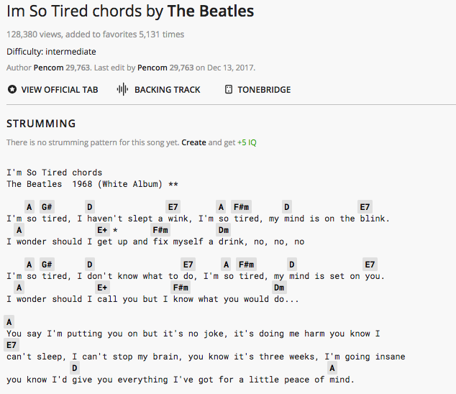
Methodology
8,000 songs
Line-by-line analysis
Phrase vs. chord change
Guitar tabs and chords
Rock, pop, country, folk

Slide 8


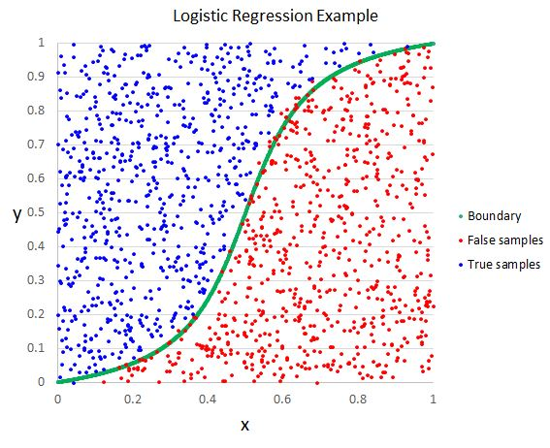

Technologies
Python
PyMongo
Selenium
BeautifulSoup
MatPlotLib
Natural Language Processing
Tf-Idf Vectorization
Logistic Regression

Slide 9
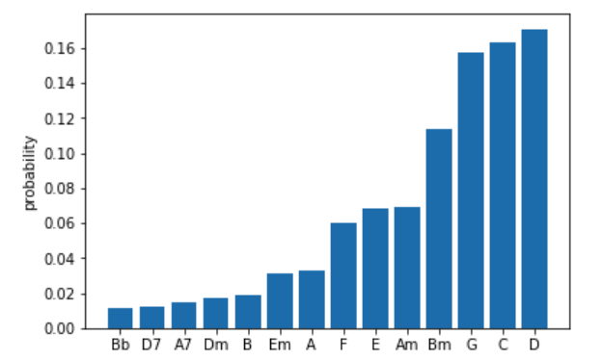
Relative Chord Probabilities: Line-by-line
Chords list = A, B, C, D, E, F, G, A7, D7, Em, Am, Bm, Dm, Bb
Line: “I haven’t slept a wink.”
Song: “I’m so tired”
Artist: The Beatles

Slide 10
Line-by-line Chord Probability Analysis

Slide 11
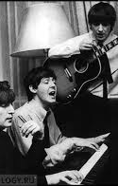
Results
Line | Predicted Chord | Actual Chord
I’m so tired | G | A, G#7
I haven’t slept a wink | D | D, E
My mind is on the blink | C | D, E
I wonder should I get up | C | A, E
And fix myself a drink | G | F#m, Dm
I don’t know what to do | Bm | D, E
My mind is set on you | C | D, E
I wonder should I call you | C | A, E
But I know what you’d do | F | F#m
You’d say I’m putting you on | F | A
But it’s no joke | C | A
It’s doing me harm | C | A
You know I can’t sleep | G | E
I can’t stop my brain | G | E
You know it’s three weeks | G | E
I’m going insane | C | E
You know I’d give you everything I’ve got | G | D
For a little peace of mind | D | D, A
“I’m So Tired”
The Beatles

Slide 12
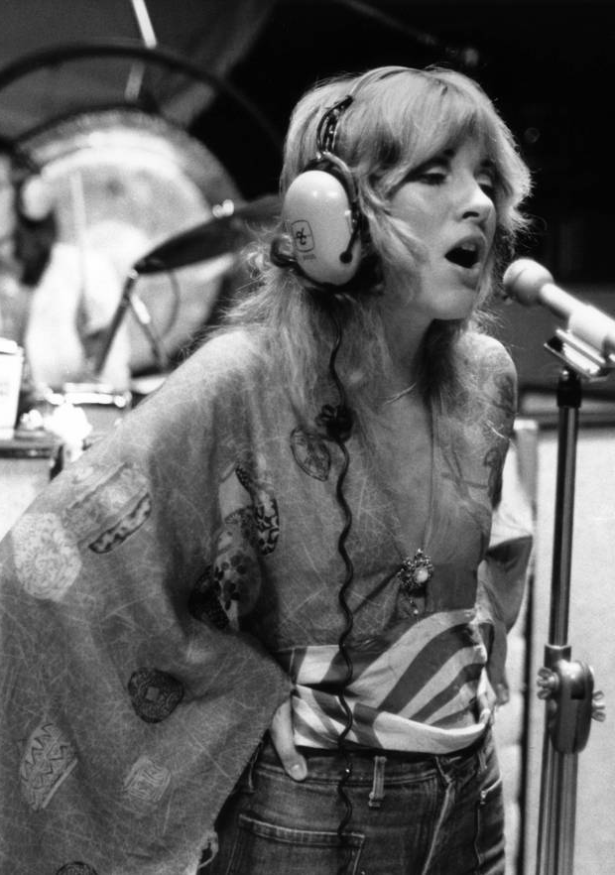
Results
Line | Predicted Chord | Actual Chord
I took my love | C | C
I took it down | G | Am7
I climbed a mountain | C | C
I turned around | C | Am7, C
I saw my reflection | C | C
In the snow covered hills | C | Am7, C
Until the landslide brought me down | G | C, Am7
Mirror in the sky | C | C
What is love? | Bm | Am7
Can the child with my heart | G | C
Rise above? | Am | Am7
Can I sail through | G | C
The changing ocean tides | C | Am7, C
Can I handle the seasons of my life? | G | C, Am7, B
I’ve been afraid of changing | C, G | G
Because I built my life | C | C
Around you | D | Am, D7
“Landslide”
Fleetwood Mac

Slide 13
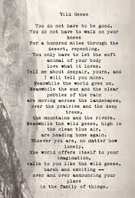
Let’s try it out!
Our first song:
A favorite a poem

Slide 14
Wild Geese (poem by Mary Oliver): Chords
Line | Chord | Line | Chord
You do not have to be good. | D | over the prairies and the deep trees, | G
You do not have to walk on your knees | F | the mountains and the rivers. | G
For a hundred miles through the desert, repenting. | C, C | Meanwhile the wild geese, high in the clean blue air, | G
You only have to let the soft animal of your body | G | are heading home again. | G
love what it loves. | Bm | Whoever you are, no matter how lonely, | G
Tell me about your despair, yours, and I will tell you mine. | C | the world offers itself to your imagination, | D
Meanwhile the world goes on. | C | calls to you like the wild geese, harsh and exciting -- | G
Meanwhile the sun and the clear pebbles of the rain | C | over and over announcing your place | G
are moving across the landscapes, | G | in the family of things. | C

Slide 15
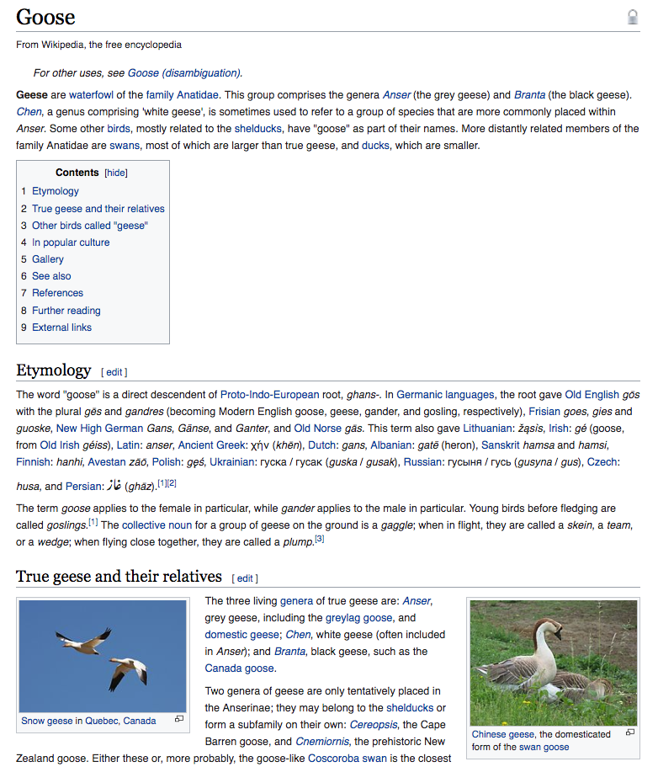
Let’s try it again!
Our second song:
A favorite wikipedia page

Slide 16
Geese (Waterfowl): Chords
Line | Chord | Line | Chord
Geese are waterfowl of the family Anatidae. | G | Paired geese are more dominant and feed more | C
More distantly related members of the family Anatidae are swans | C | two factors that result in more young | C
most of which are larger than true geese | G | The term goose applies to the female in particular | C
and ducks, which are smaller. | G | while gander applies to the male in particular | C
Geese are monogamous, | G | Young birds before fledging are called goslings | G
living in permanent pairs throughout the year | C | The collective noun for a group of geese on the ground is a gaggle | C
however, unlike most other permanently monogamous animals | G | when in flight, they are called a skein, a team, or a wedge | D, G
they are territorial only during the short nesting season | C | when flying close together, they are called a plump | G, D

Slide 17
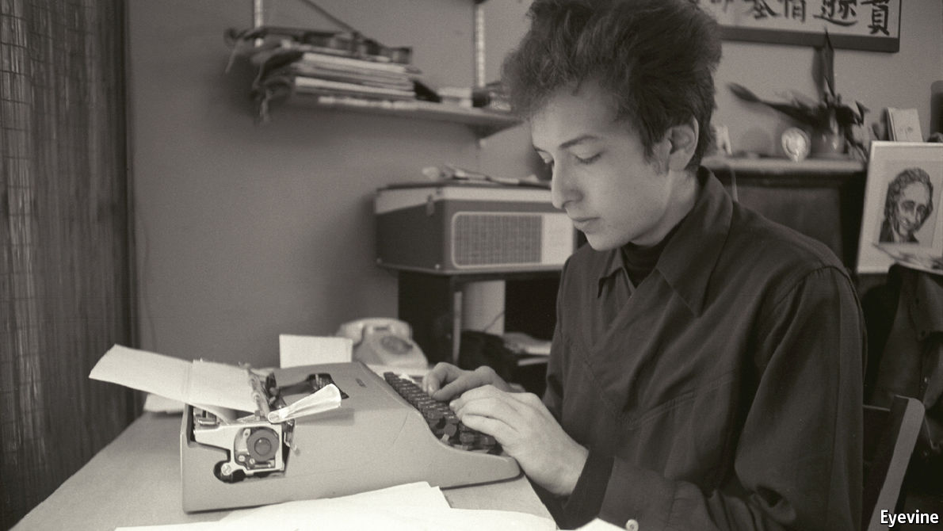
Next Steps :
Improve accuracy
Incorporate music theory
Chord change timing
Transpose for capos
Sentiment Analysis
Genre generator
Recommend similar artist

Slide 18
THANK YOU!
Questions?
Emily Naftalin
emily.naftalin@gmail.com
github.com/EmFib
www.linkedin.com/in/emily-naftalin/

