Slide 1
UNIVERSITY OF VERONA
DEPARTMENT OF COMPUTER SCIENCE · BACHELOR'S DEGREE PROGRAM
BACHELOR'S THESIS
Learning, coordination and generalization in Multi-Agent Reinforcement Learning: a comparison between IPPO, MAPPO and MASAC
CANDIDATE
SUPERVISOR
Emanuele Girardello
Prof. Alessandro Farinelli
VR500077
CO-SUPERVISOR
Dott. Ing. Daniele Meli
ACADEMIC YEAR 2025/2026

Slide 2
PROBLEM ADDRESSED
00
Coordination and generalization
CONTEXT
Multiple autonomous agents must coordinate in a shared environment, without communication or a central controller.
CHALLENGES
Non-stationarity agents' behavior changes at every update, the target to optimize keeps moving.
Coordination without communication, no central controller.
Generalization across multiple agents and different topologies.
Coordination and generalization in MARL
01

Slide 3
PROBLEM ADDRESSED
01
Research question and objective
Approaches: decentralized (IPPO), centralized (MAPPO), off-policy (MASAC): how do they differ in training performance and generalization ability?
Objective: training on a fixed configuration, zero-shot evaluation on increasing densities and on a never-before-seen topology.
IN THIS PRESENTATION
The limits of the MLP architecture and the impact of limiting observation size on generalization ability.
Similarities and differences in performance between a centralized and a decentralized approach.
The failure of an off-policy MASAC approach in a non-stationary, chaotic environment with discrete actions.
Coordination and generalization in MARL
02

Slide 4
MARL AND MAMDP
02
The general framework: Markov Game
MDP extended to multiple actors
⟨ S, N, {Aₙ}, P, {Rₙ}, γ, μ ⟩
NON-STATIONARITY
S
finite number of states
In MARL multiple agents learn simultaneously in the same environment. Each agent is part of the others' environment.
N
finite number of agents
Aₙ
actions of the single agent · joint action A = A₁ × … × Aₙ
P
transition, depends on the joint action: S × A₁ × ⋯Aₙ → Δ(S)
From the individual's perspective, the environment becomes
non-stationary: the dynamics of the environment change at every update
Rₙ
reward for each agent: S × A₁ × ⋯Aₙ → [−1, 1]
γ
discount factor
μ
∈ Δ(S), initial state distribution
Coordination and generalization in MARL
03

Slide 5
MARL AND MAMDP
03
Our case: Partially Observable Markov Game
Partial observability
each agent does not see the global state S, but only a local observation Oₙ. The Markov Game becomes a multi-agent POMDP.
⟨ S, N, {Aₙ}, P, {Rₙ}, {Oₙ}, γ ⟩
Decentralized execution
each agent decides based only on its own observation, without a central controller.
Same type of objective (reaching the destination), but each agent optimizes its own return. Global welfare is a consequence, not the target.
FORMAL DESCRIPTION
Individual objective
General-sum game with partial observability and decentralized execution, in which cooperation must emerge , it is not imposed by the reward signal.
Individual reward
Rₙ : S × A₁ × ⋯ Aₙ → [−1,1] no shared reward.
Coordination and generalization in MARL
04

Slide 6
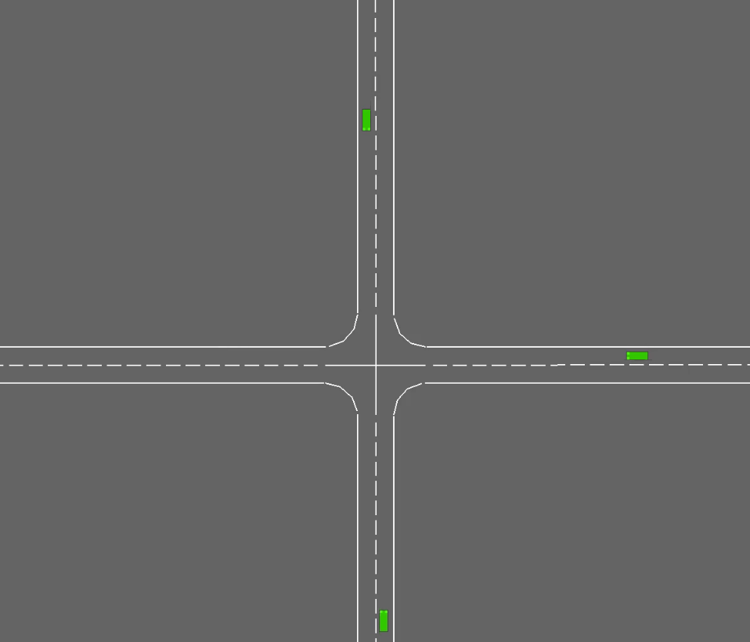
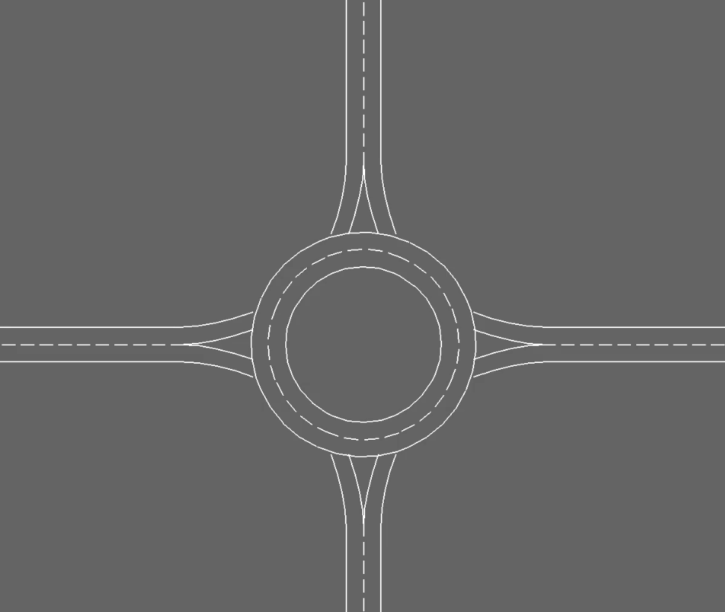
DOMAIN
04
Highway-Env
decision-making for autonomous driving · minimalist
NB · UNSIGNALED SCENARIOS
no explicit right-of-way logic
Intersection
CHAOTIC · REACTIVE
Roundabout
STRUCTURED · SOCIAL
Gap acceptance. Decision reactive and local. Low interdependence.
Yielding right of way. Cooperative decision: immediate cost for collective benefit. High interdependence.
Coordination and generalization in MARL
05

Slide 7
DOMAIN
05
Training configuration
INTERSECTION · 3 AGENTS
→
training only on the intersection
→
3 agents
→
random start and destination points at every reset
→
roundabout used only in evaluation (cross-domain test)
ZERO-SHOT EVALUATION
As the density of vehicles increases
As the topology varies (roundabout introduced)
Coordination and generalization in MARL
06

Slide 8
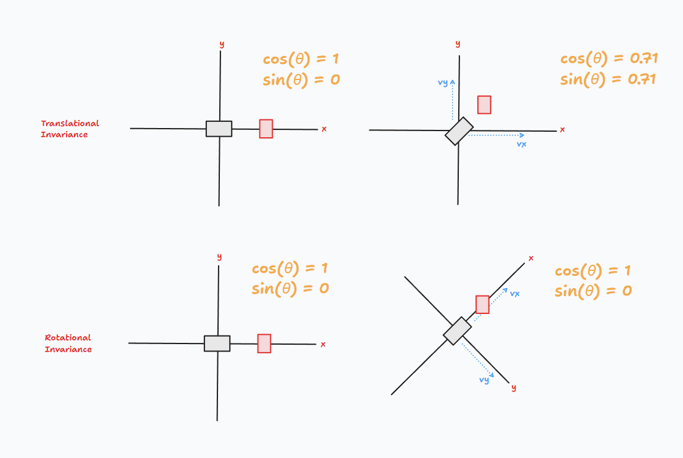
DOMAIN
06
Observations
Kinematics V × F
V = 3
ego + 2 nearest vehicles, 360° vision. Beyond 3 vehicles → partial observability.
F = 8
presence · x · y · vx · vy cos_h · sin_h (heading) cos_d · sin_d (goal)
Completely relative to the ego → translational and rotational invariance.
In evaluation with density of 4+ agents, the size stays 3: each agent becomes blind beyond the 2 nearest vehicles.
Coordination and generalization in MARL
07

Slide 9
DOMAIN
07
Actions and reward
ACTIONS
SPARSE REWARDS
Discrete, high-level · no steering control, only acceleration
Normalized to [−1, 1]
arrived_reward
0 SLOWER
slow down
+50
collision_reward
−50
1 IDLE
maintain
step_penalty
−0.05
2 FASTER
accelerate
Speed: [0, 1.5, 3, 4.5, 6] m/s
Individual reward, no team signal: cooperation is not incentivized by a reward.
Coordination and generalization in MARL
08

Slide 10
EXPERIMENTAL PROTOCOL
08
Implementation of the Centralized Critic
EXECUTION · DECENTRALIZED
TRAINING · CENTRALIZED
→
Framework: Ray RLlib, standard for distributed RL
local obs o_{i}
s = [o₁ ‖ o₂ ‖ o₃]
→
IPPO = default multi-agent implementation of PPO
↓
↓
→
MAPPO = custom class CentralizedCriticModel (PyTorch)
Actor π(a_{i} | o_{i})
Critic V(s)
FORWARD()
↓
↓
logits = self.actor(obs)
action a_{i}
advantage → actor update
value = self.critic(global_state)
Global state: used only in training
Local observations only: used in training and execution
Coordination and generalization in MARL
07

Slide 11
EXPERIMENTAL PROTOCOL
09
Shared baseline
IPPO and MAPPO share the same hyperparameters: the only difference is the critic.
Search via Optuna.
MASAC: hyperparameters from literature standards. Manual tuning, less exhaustive.
MASAC
IPPO · MAPPO
gamma = 0.975
gamma = 0.975
train_batch_size_per_learner = 512
clip_param = 0.2
actor_lr = 1e-4 critic_lr = 3e-4
lr = 3e-4 entropy_coeff = 0.01
alpha_lr = 1e-4 initial_alpha = 0.1
num_steps_sampled_before_learning_starts = 20000
use_gae = True lambda = 0.95
target_entropy = 0.8 tau = 0.005
buffer_capacity = 500000
The only difference between IPPO and MAPPO is the critic: same code, same hyperparameters.
Coordination and generalization in MARL
09

Slide 12
EXPERIMENTAL PROTOCOL
10
Reproducibility and evaluation
REFERENCE METRICS
REPRODUCIBILITY
IPPO / MAPPO (on-policy) vf_loss · episode_return_mean · entropy
3
seed different: statistical validity, variance measurement
episodes per density level, with identical seeds for IPPO, MAPPO and MASAC
MASAC (off-policy) alpha_loss · critic_loss · actor_loss · episode_return_mean
200
→
evaluation with greedy actions
Common success rate and crash rate per density level
Coordination and generalization in MARL
10

Slide 13
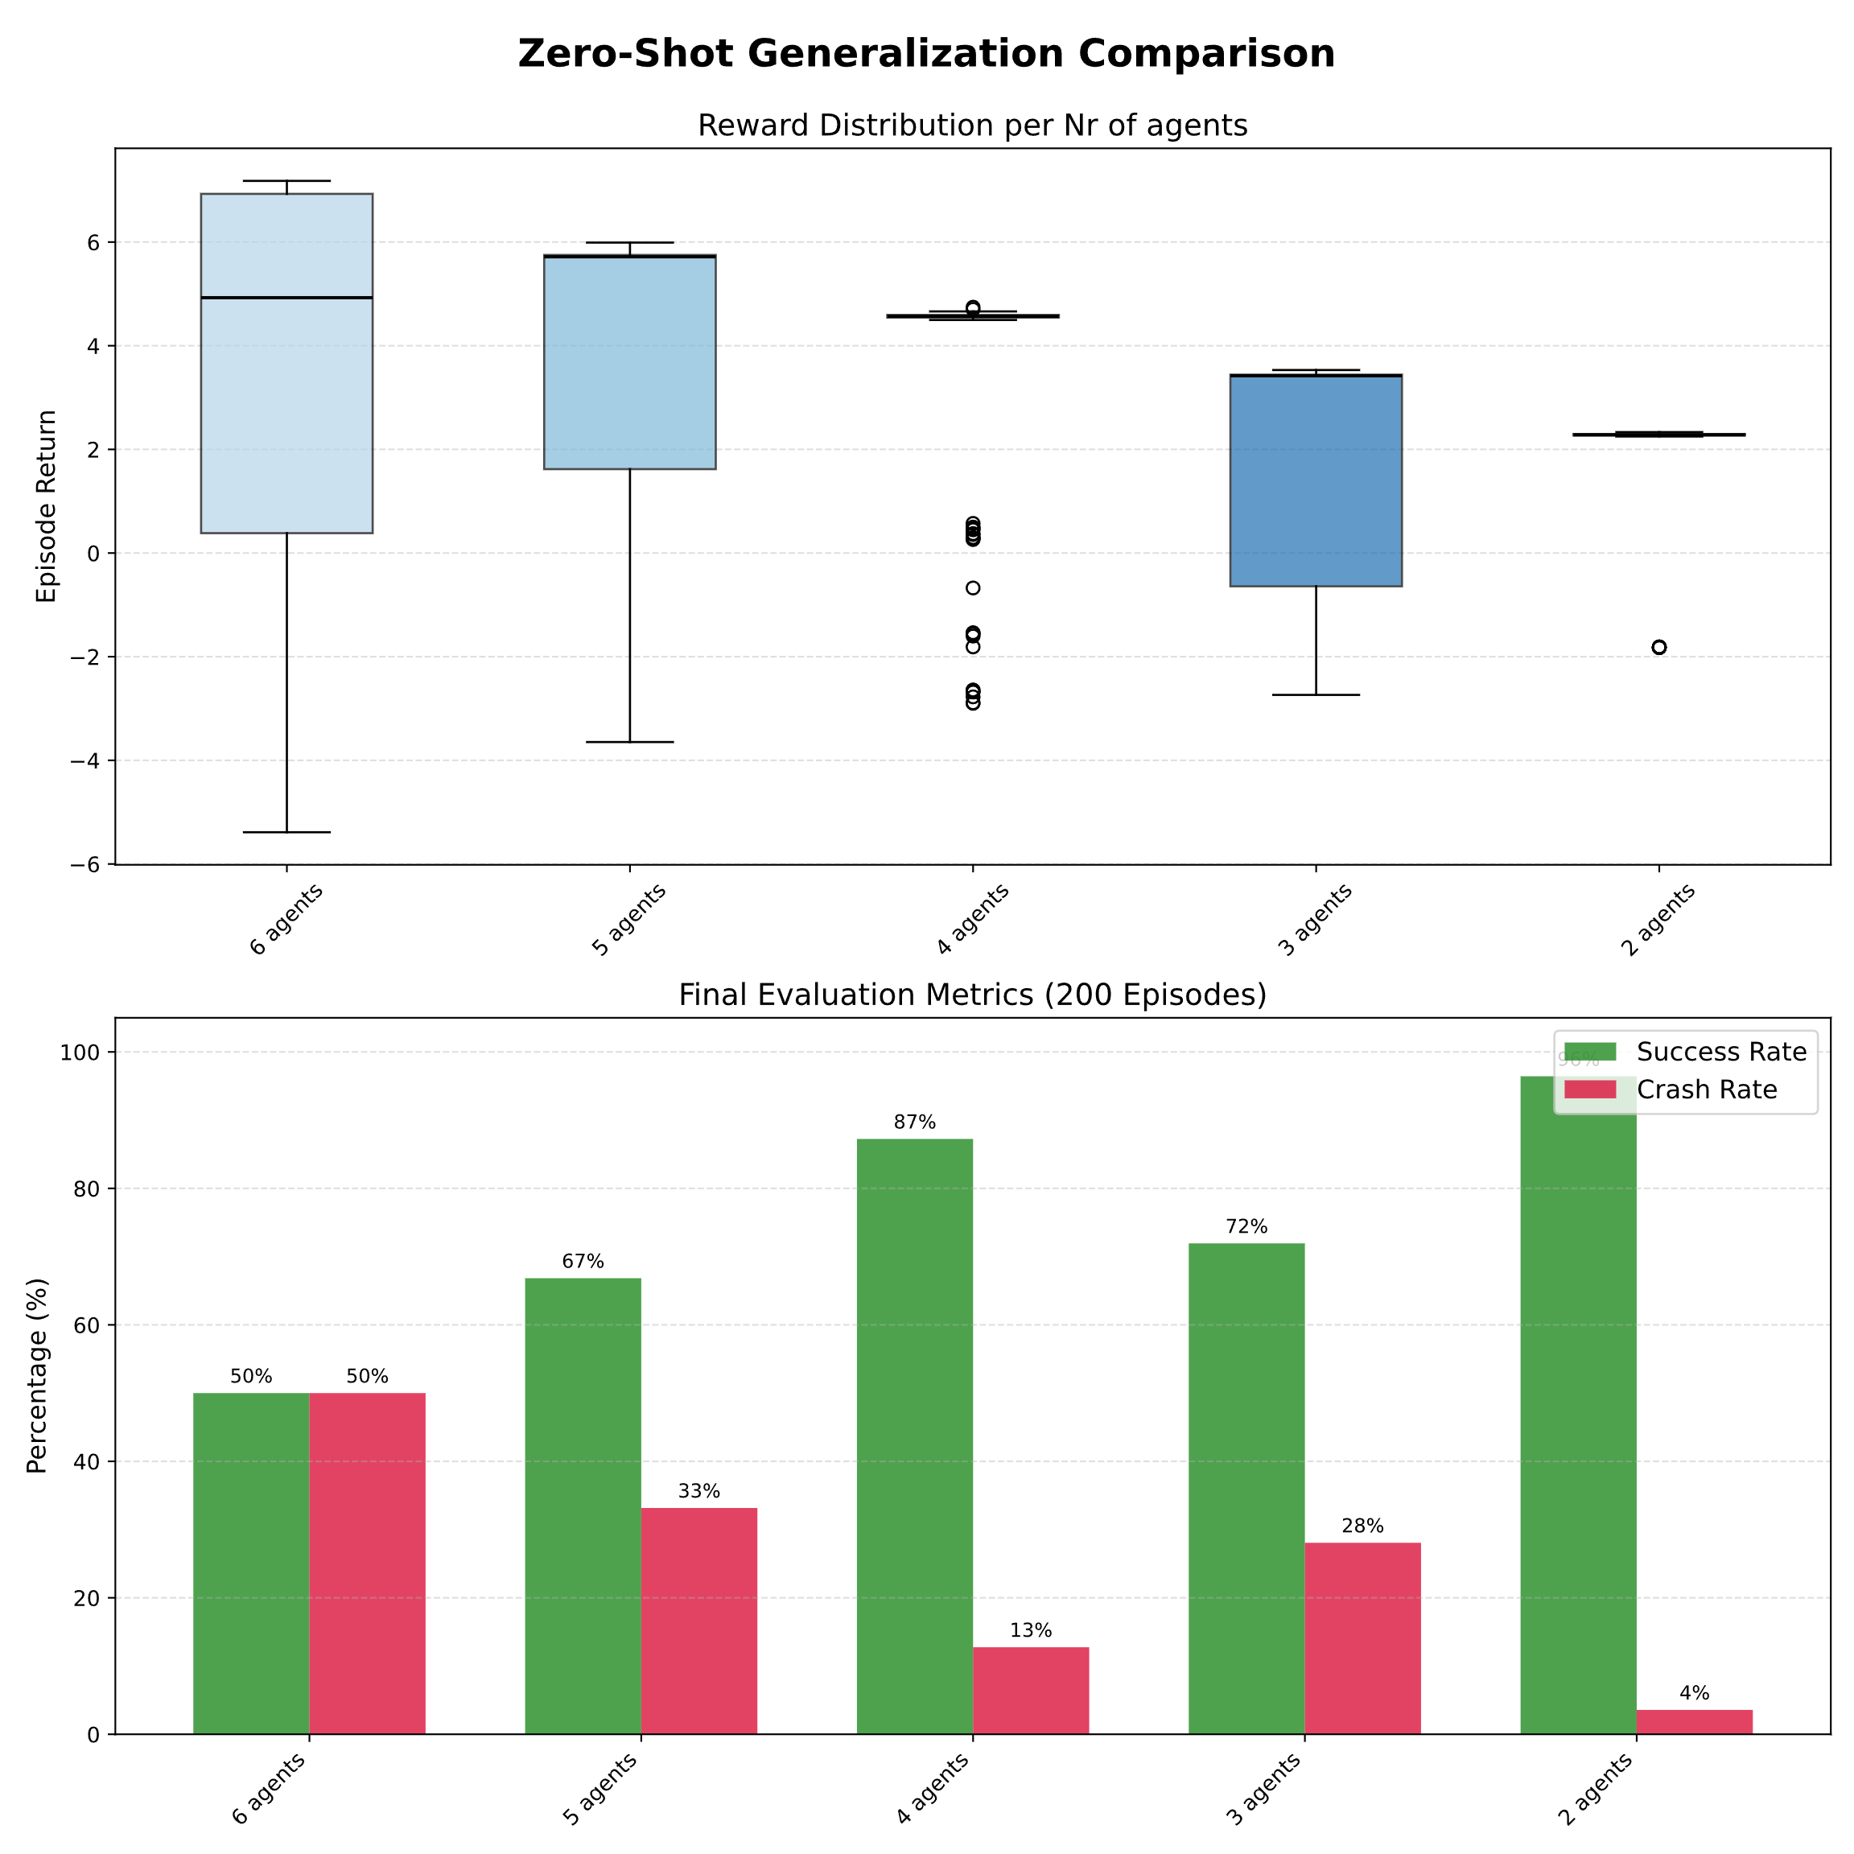
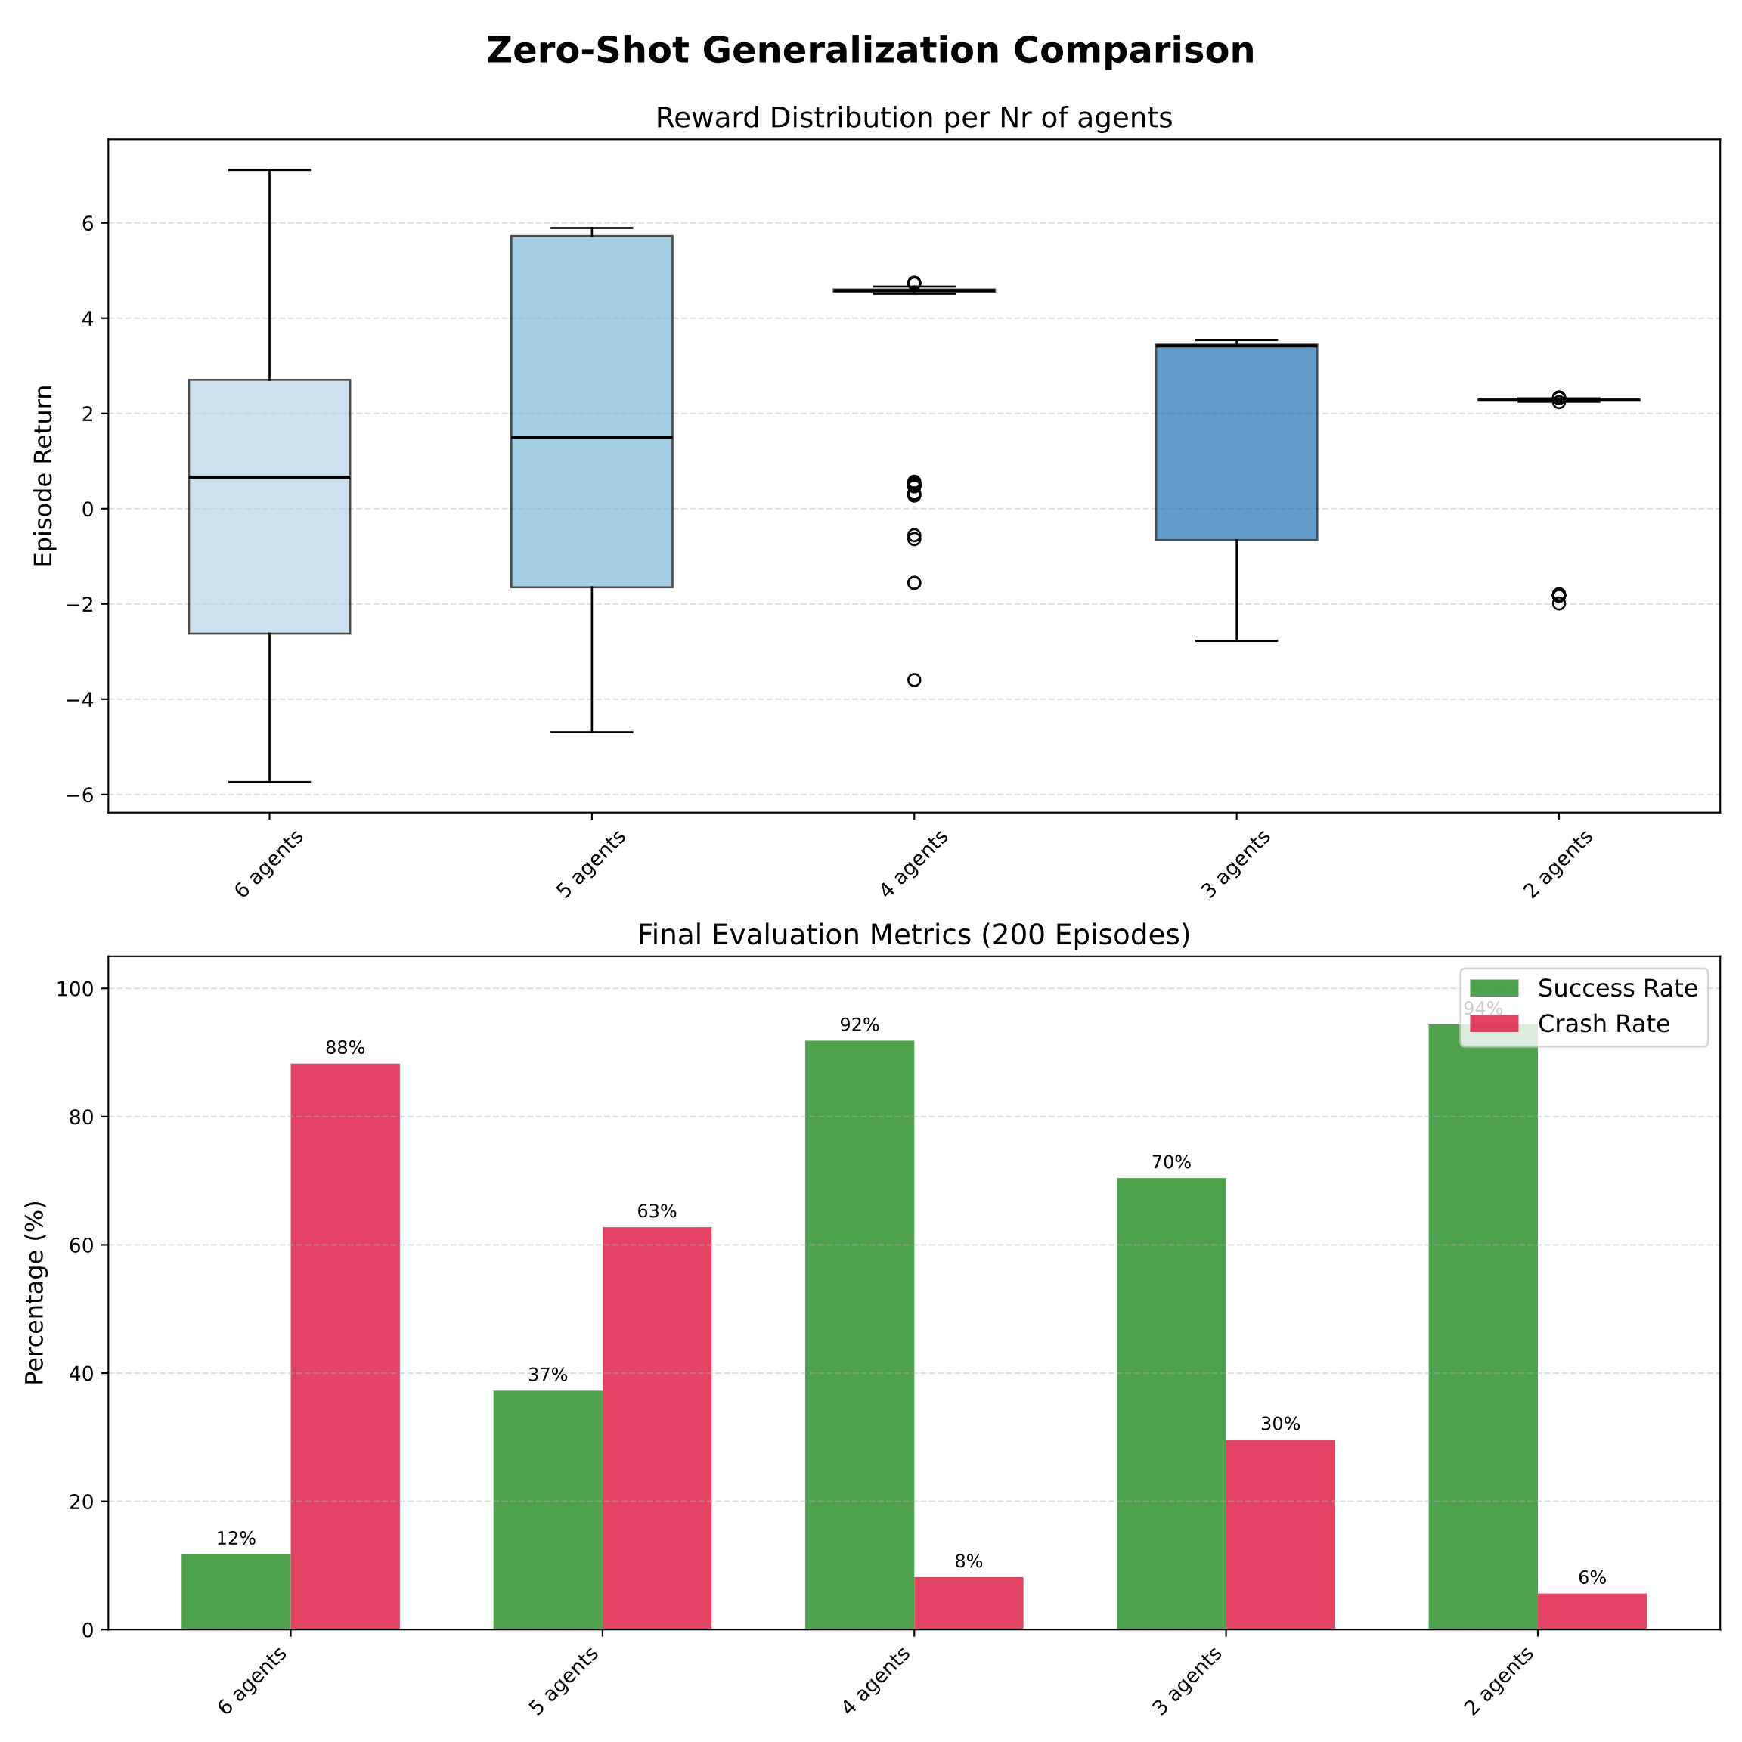
Truncation vs zero-padding: the MLP's limit
11
RESULT 1
vehicles_count = 4
truncated observation
vehicles_count = 6
slots trained to zero
Rows always valid → gradual and predictable degradation.
Zero slots filled by real vehicles → sharp degradation.

Slide 14
RESULTS
Results MASAC

Slide 15
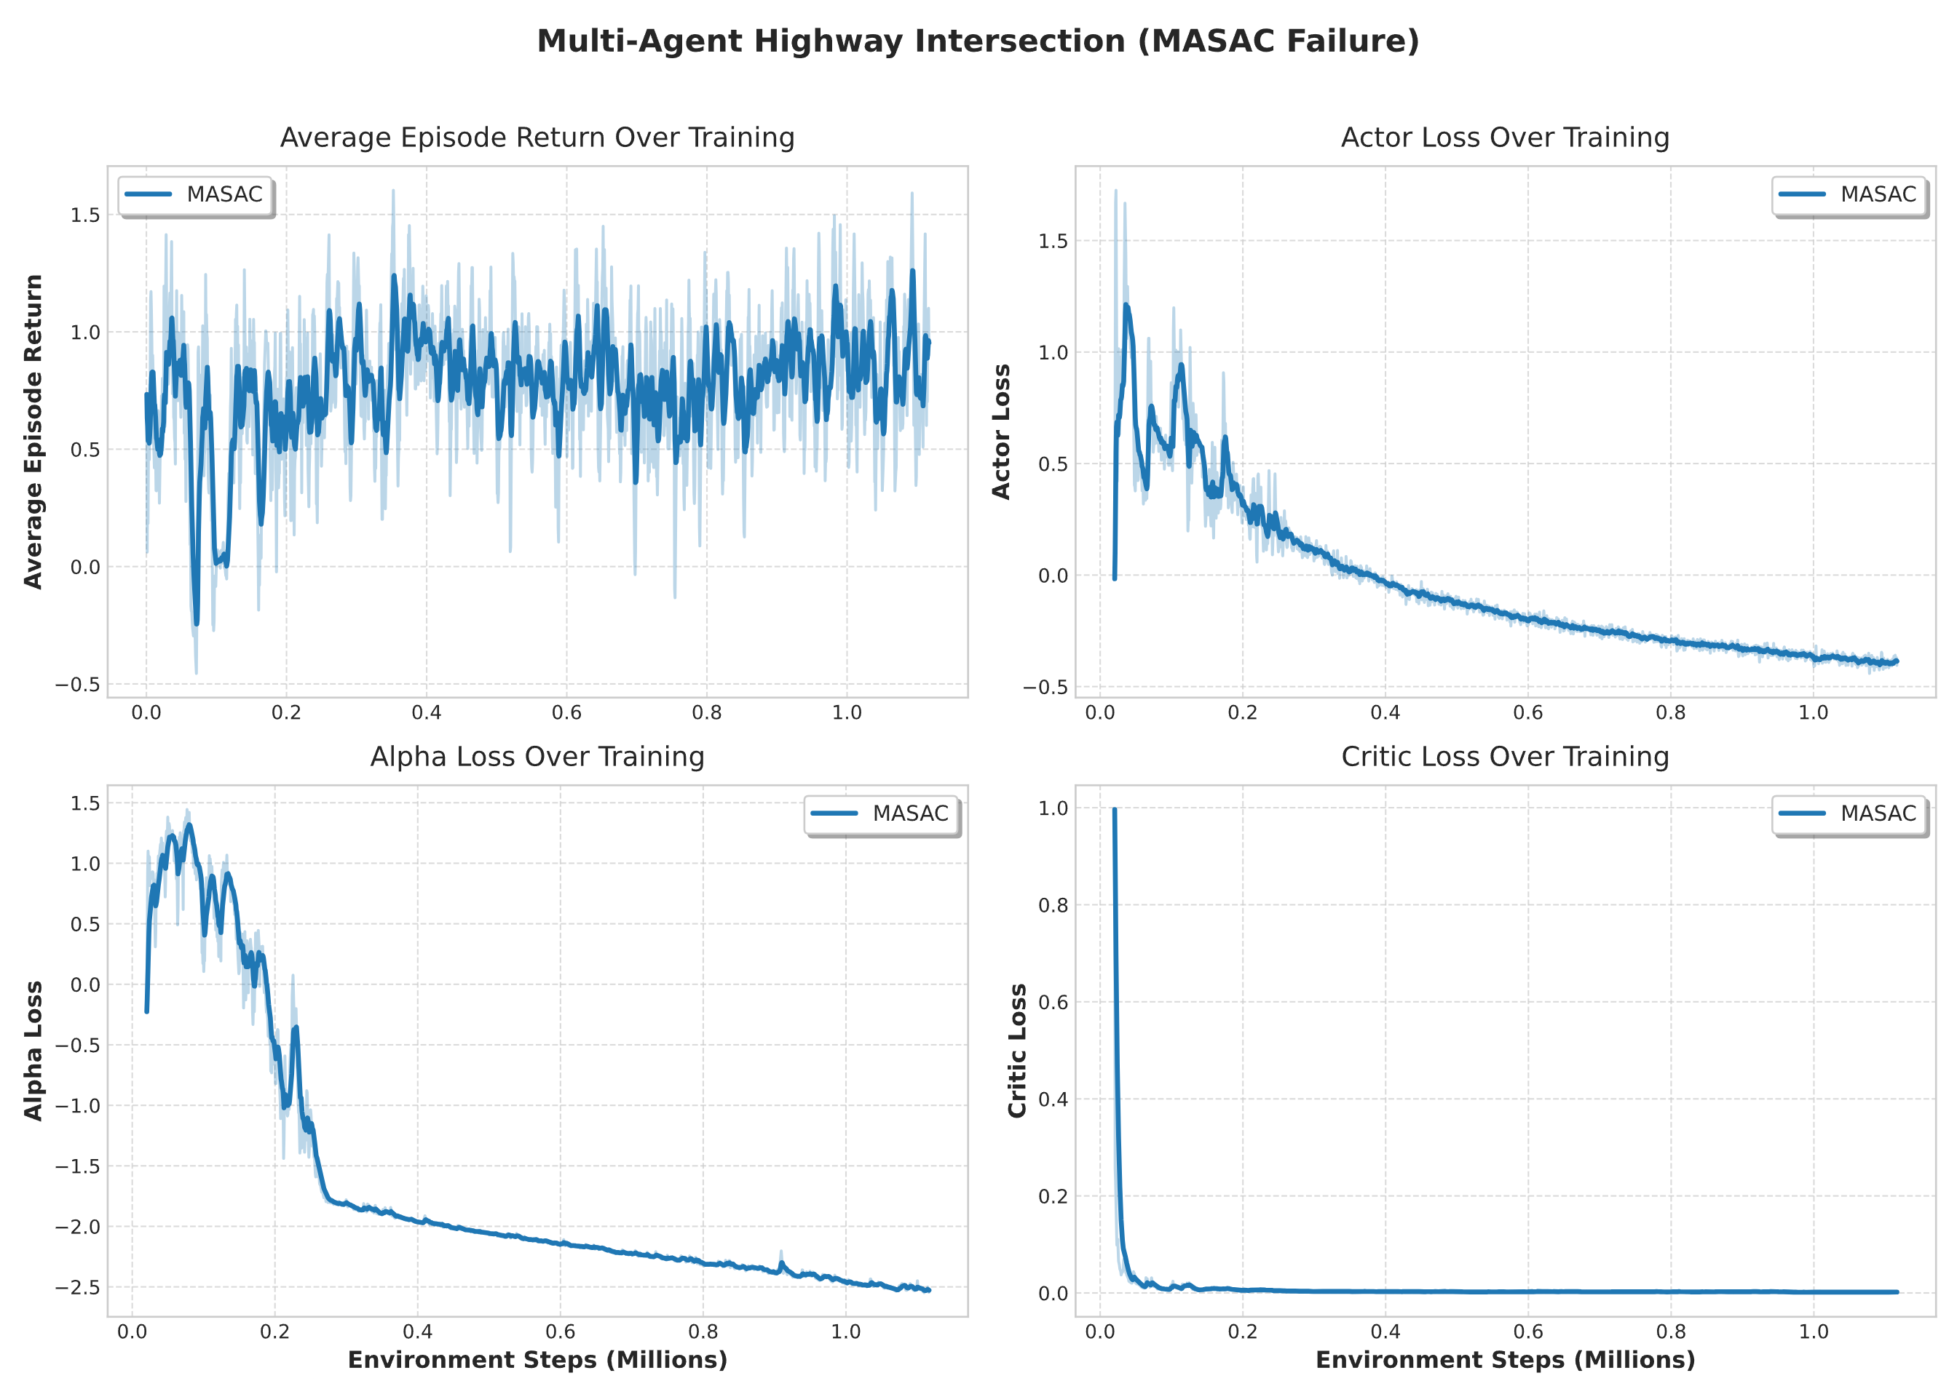
RESULT 2 · MASAC
The off-policy does not converge: instability
12
alpha_loss flattens out
Exploration is not rewarded, fatal for MASAC; suboptimal policy
MAX SUCCESS RATE
~76%
Suboptimal policy
return · alpha / critic / entropy loss, 3 agents

Slide 16
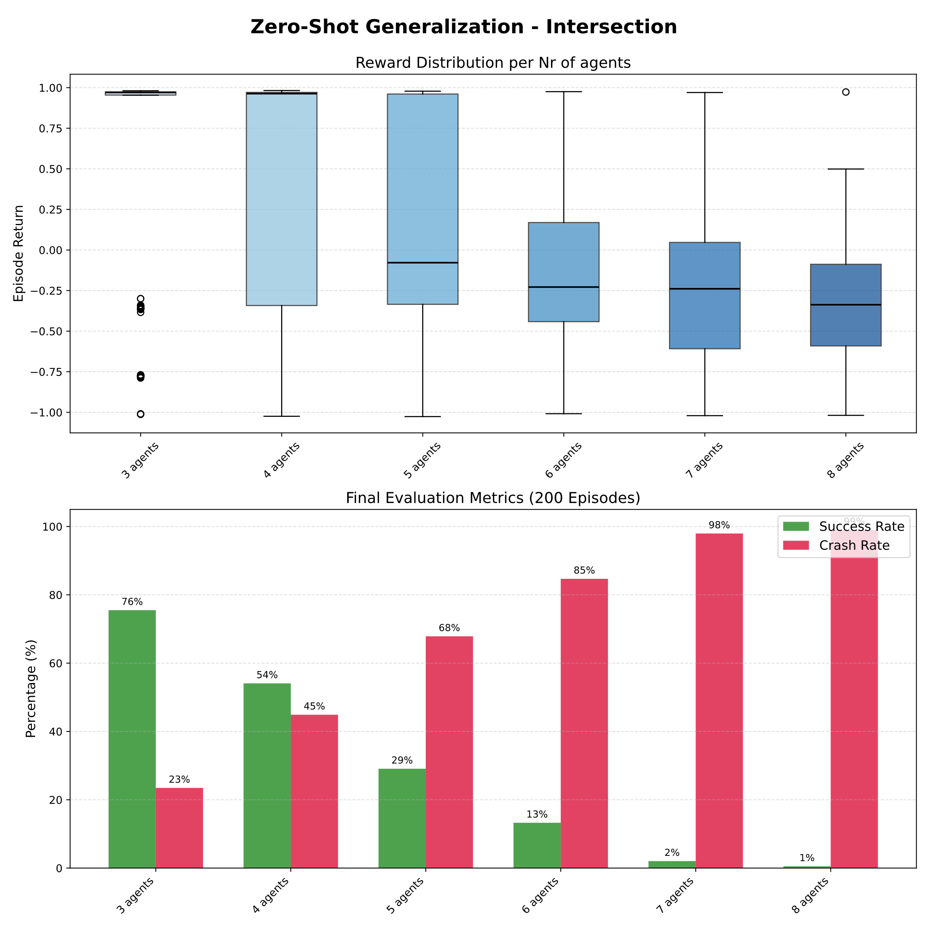
RESULT 2 · MASAC
MASAC: zero-shot generalization
13

Slide 17
RESULTS
Results IPPO vs MAPPO

Slide 18
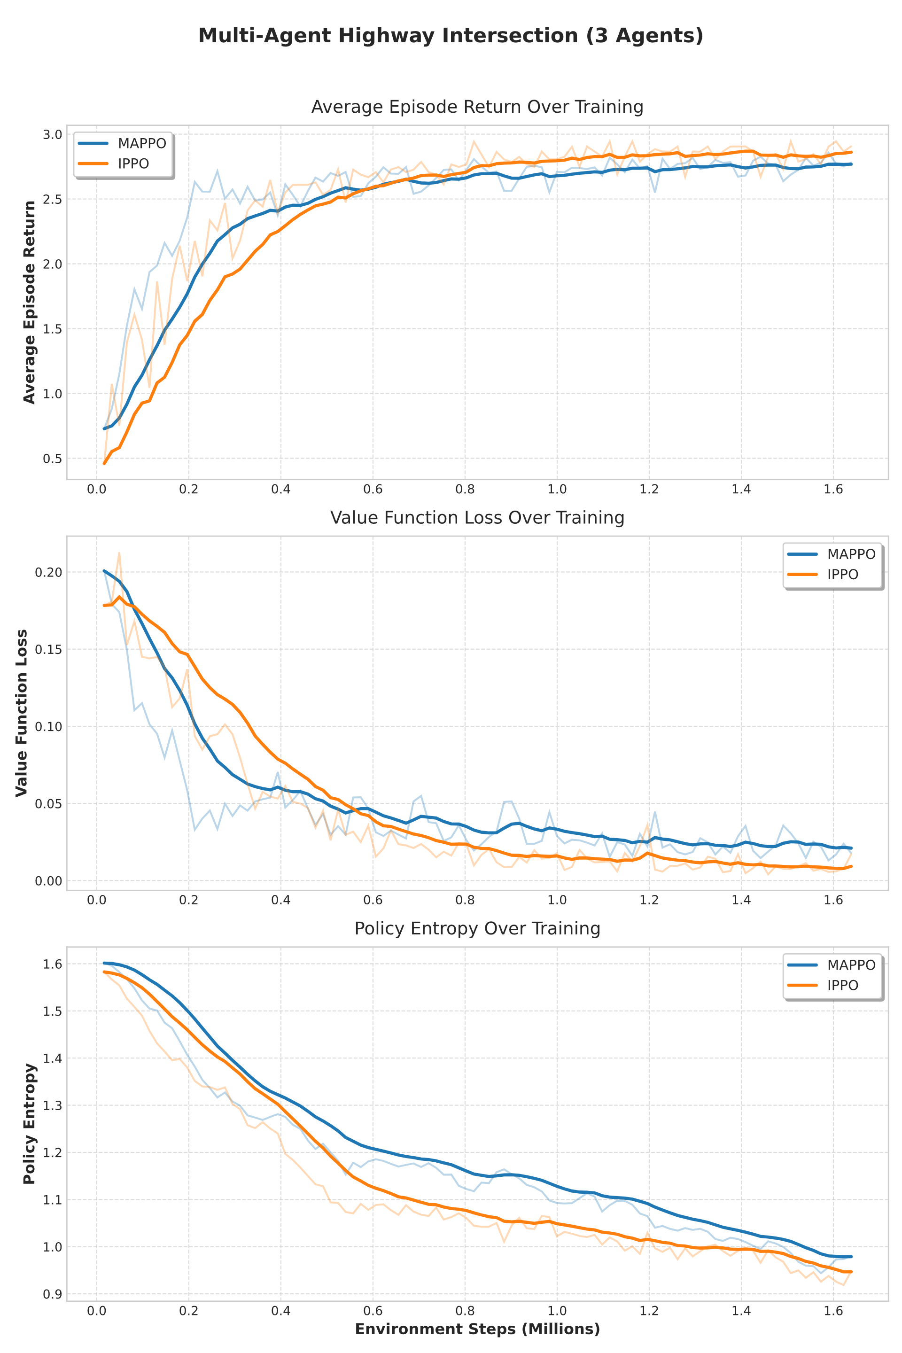
RESULT 3 · REPRODUCIBILITY
Both on-policy methods converge
14
MAPPO
IPPO
FINAL SUCCESS RATE (3 SEEDS)
IPPO
MAPPO
≈ 0.97
≈ 0.97
•
Reliable convergence across all 3 seeds.
•
Final performance is substantially equivalent on the training intersection.
Return · VF-loss · entropy — 3 seeds, intersection

Slide 19
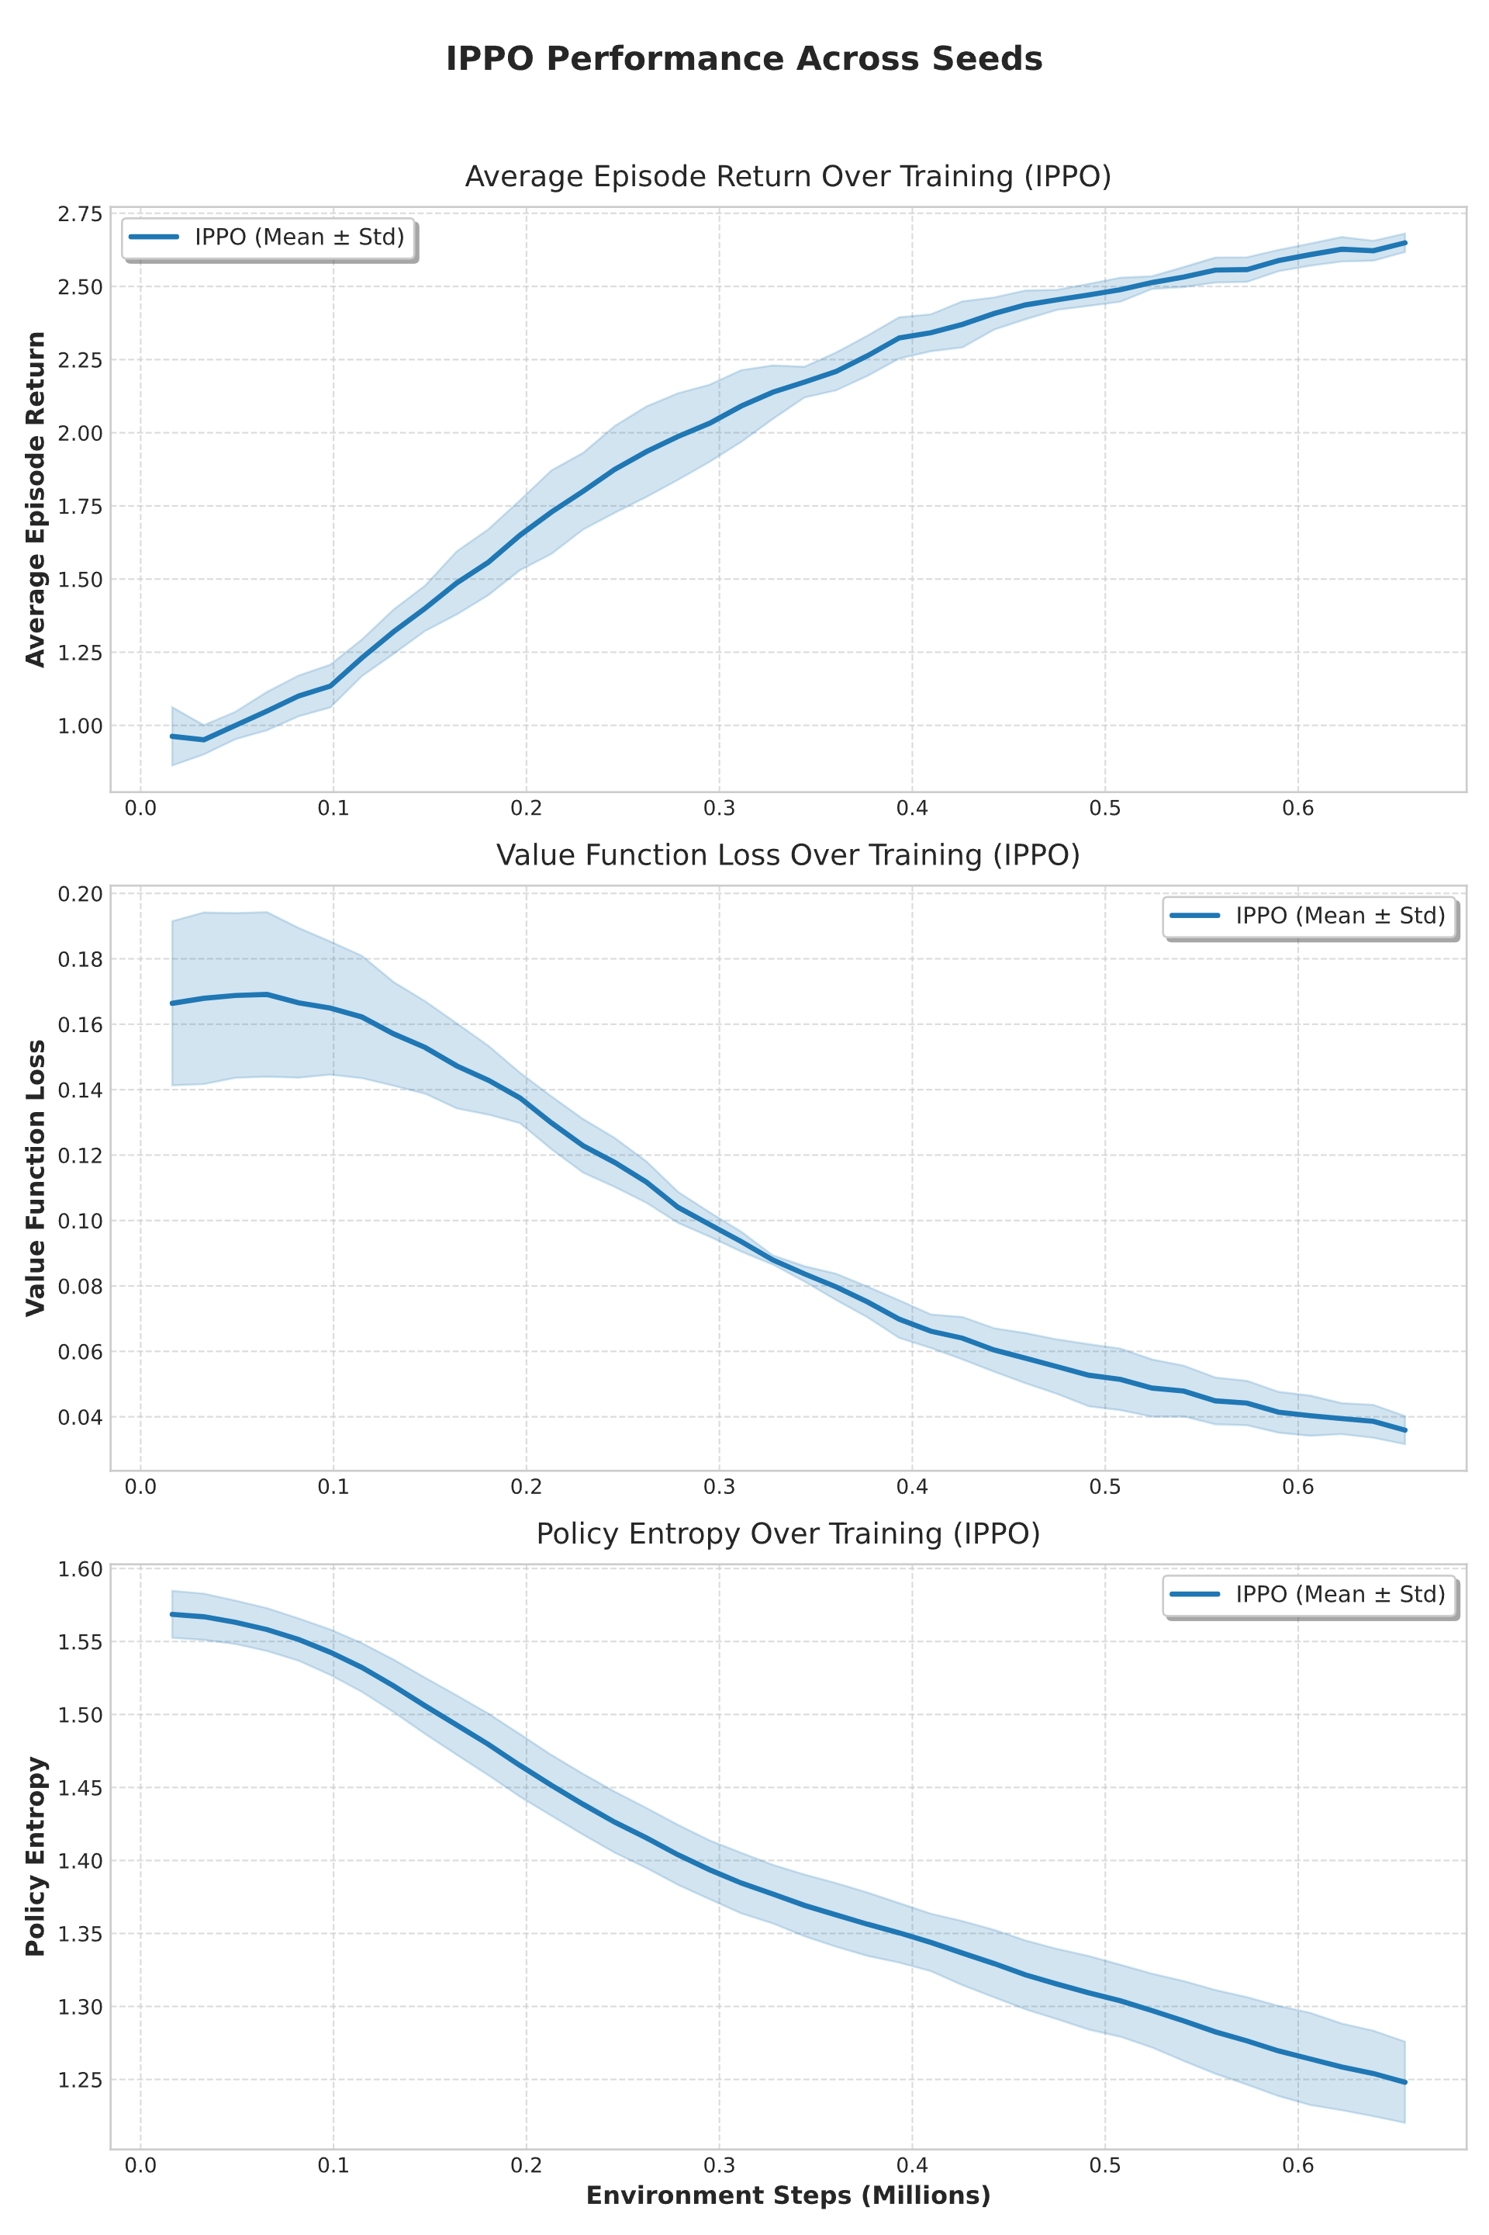
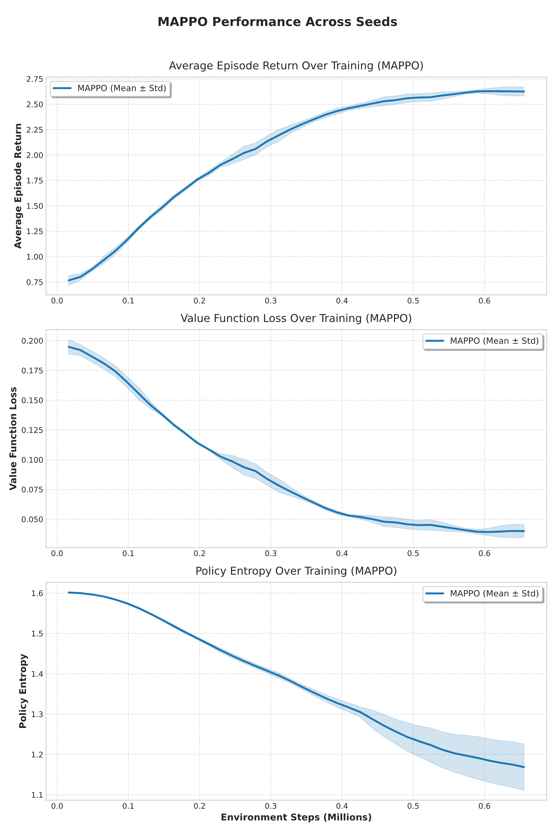
RESULT 3 · COST OF THE DECENTRALIZED CRITIC
IPPO's local critic is more sensitive to the seed
15
IPPO
decentralized
MAPPO
centralized
INITIAL VF-LOSS STD
IPPO
MAPPO
≈ 0.023
≈ 0.010
~2.3×
IPPO is more sensitive to the seed: estimating value from local observations under non-stationarity is harder.

Slide 20
IPPO vs MAPPO
Evaluation on Intersection

Slide 21
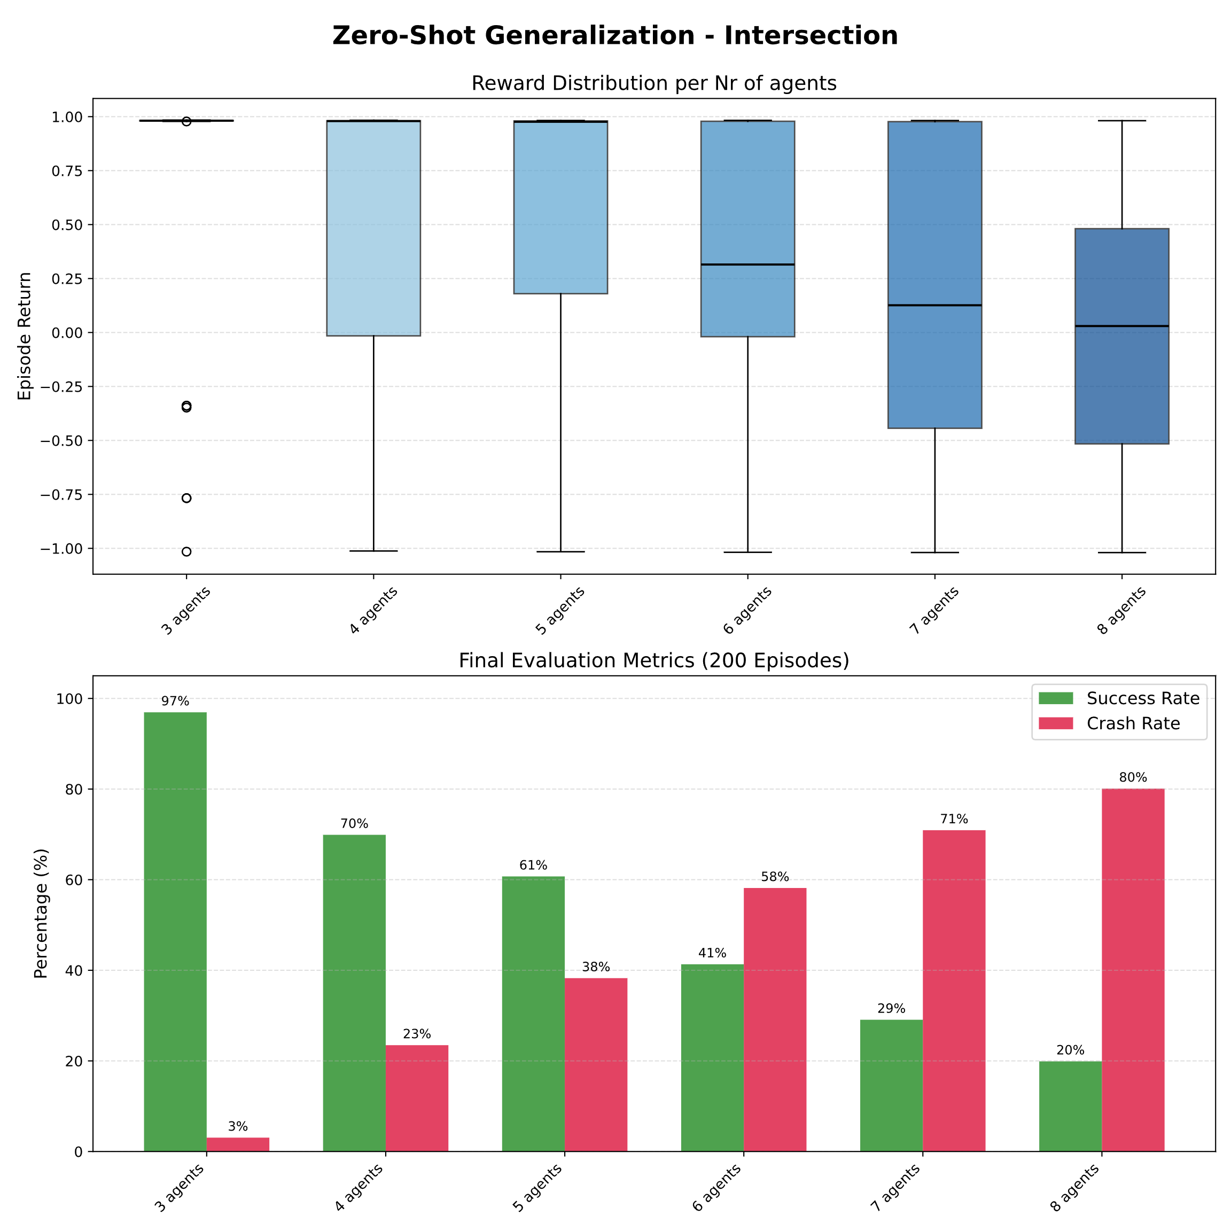
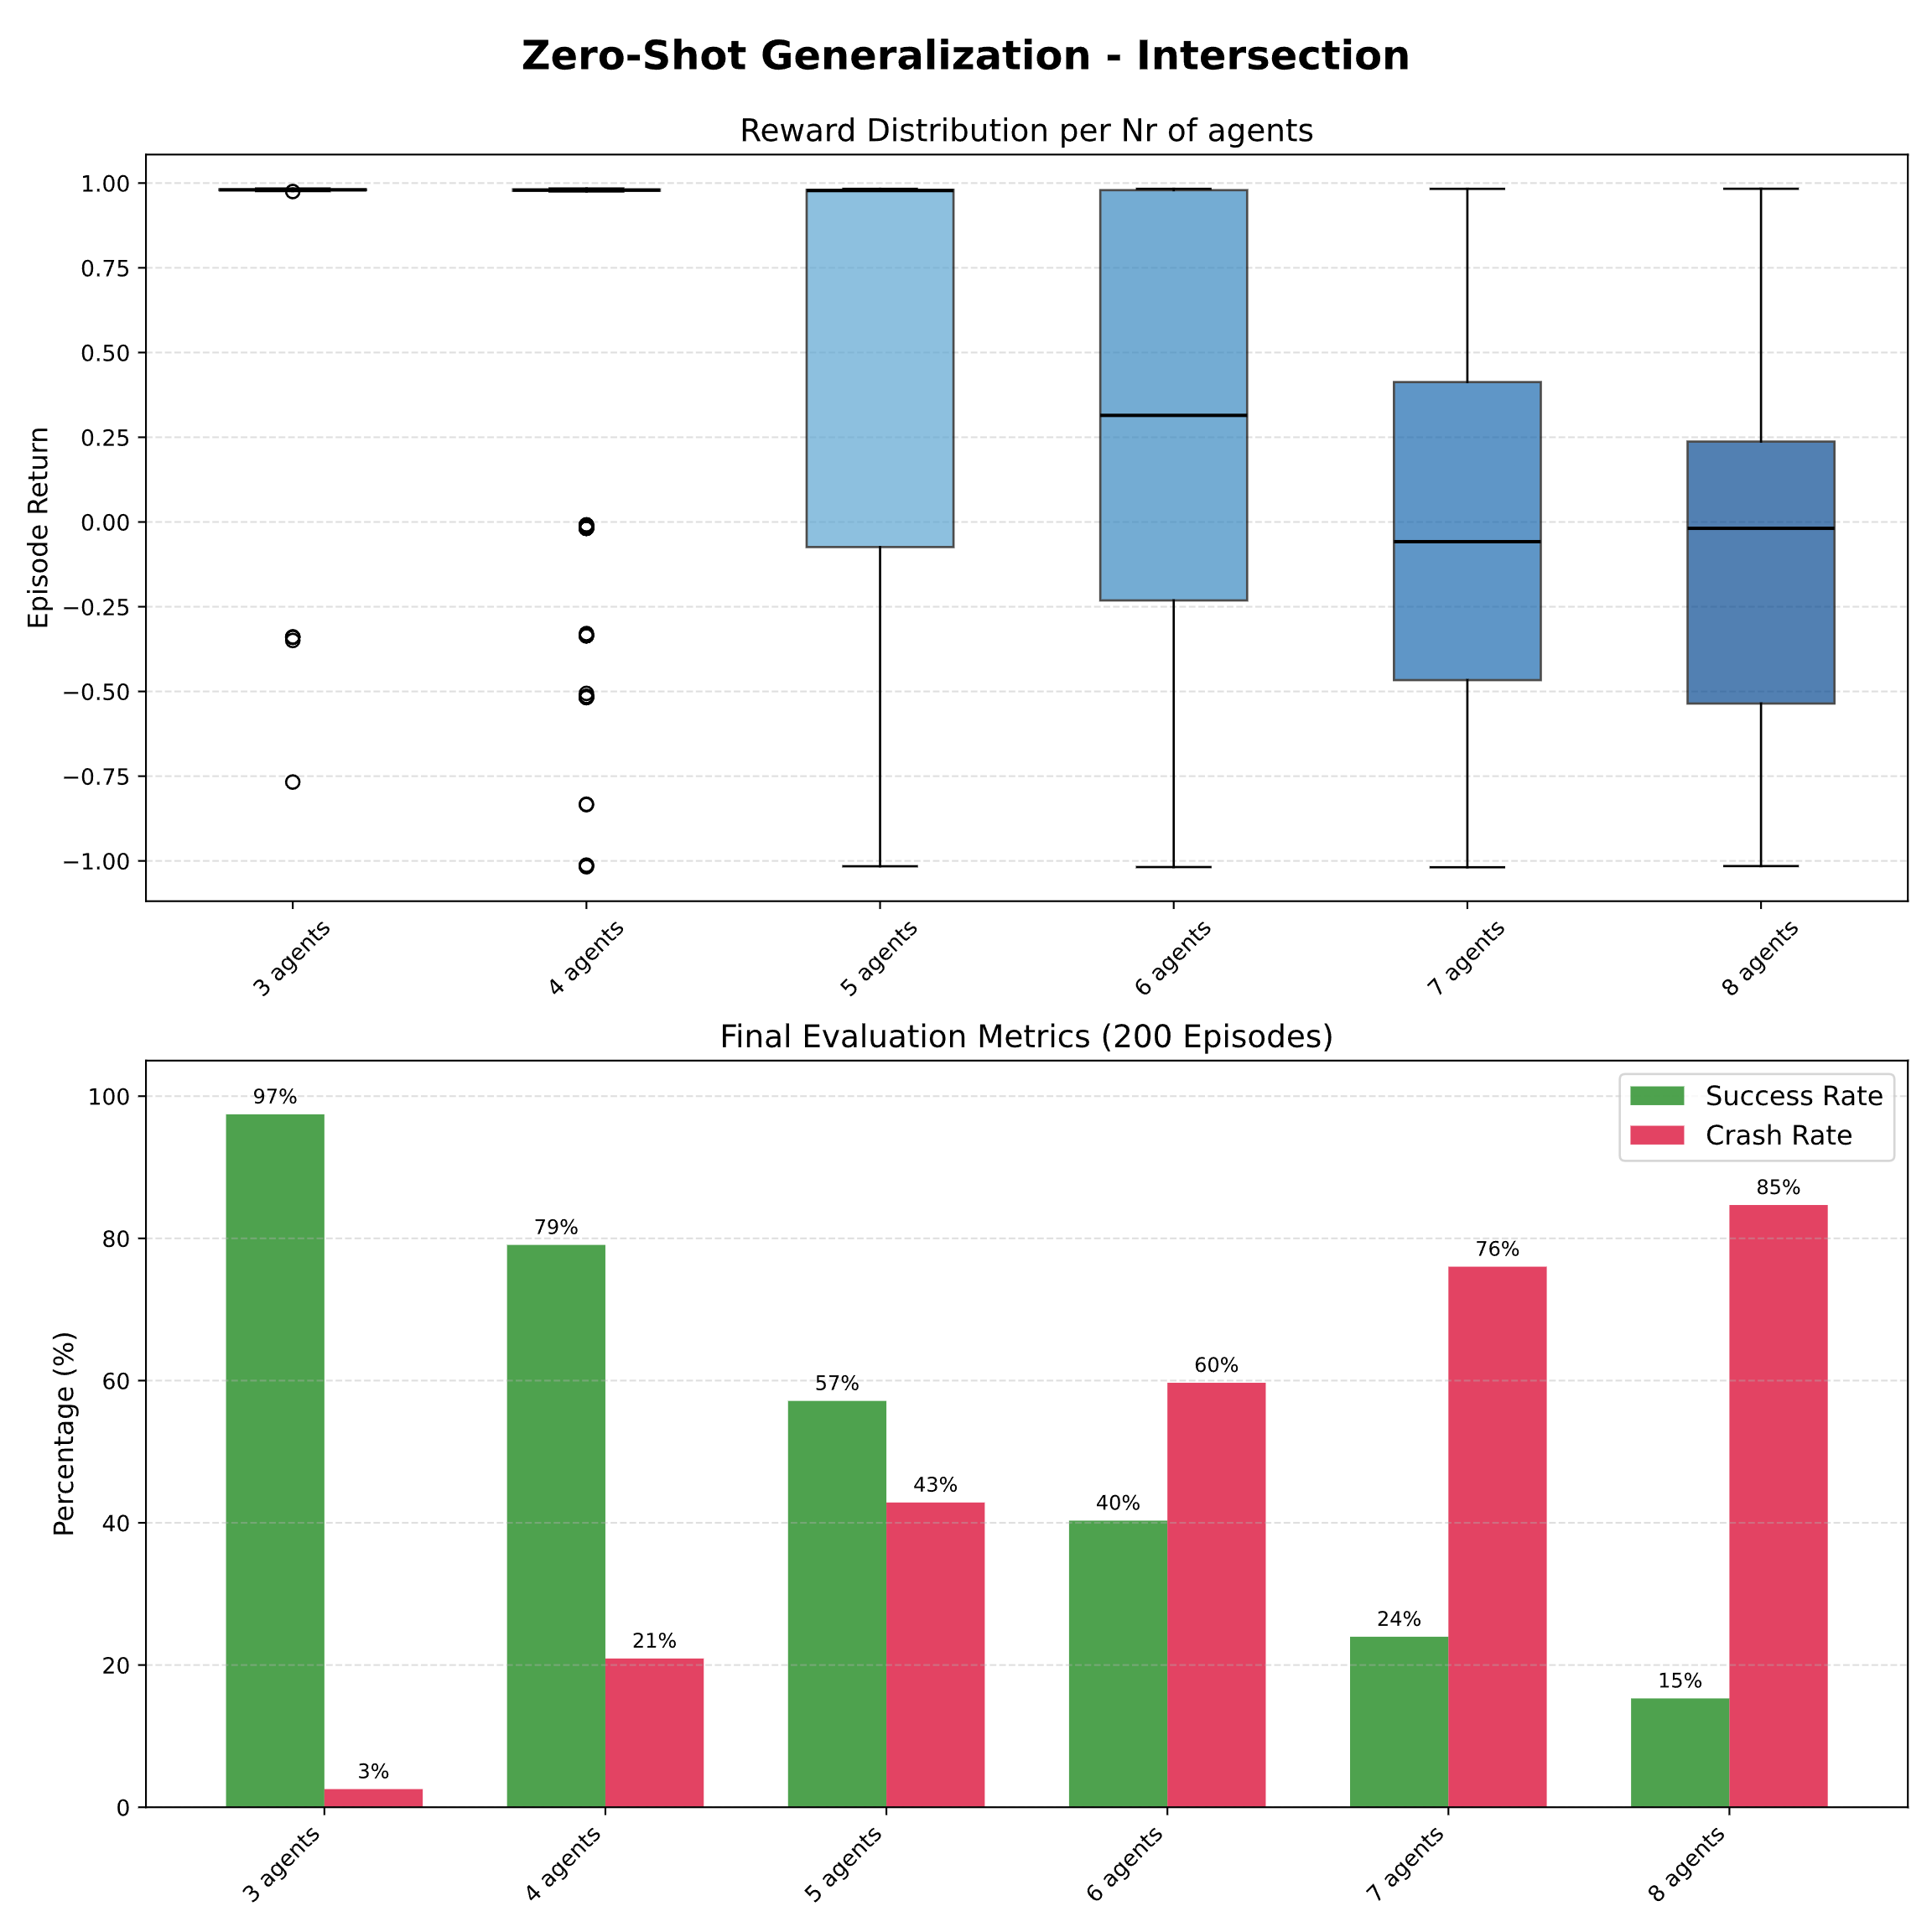
RESULT 4 · SCALABILITY: INTERSECTION
On the intersection the two methods are equivalent
16
IPPO
MAPPO
The centralized critic brings no advantage where reacting to the local state is enough. [1] de Witt et al. 2020 · [2] Yu et al. 2022, equivalence on part of SMAC.

Slide 22
RESULT 4 · BEHAVIOR: INTERSECTION
Crossing behavior compared
17
IPPO
MAPPO
At low density both cross reliably. As the number of vehicles increases, even the best policies end up colliding: the intersection remains chaotic and reactive.

Slide 23
IPPO vs MAPPO
Evaluation on Roundabout

Slide 24
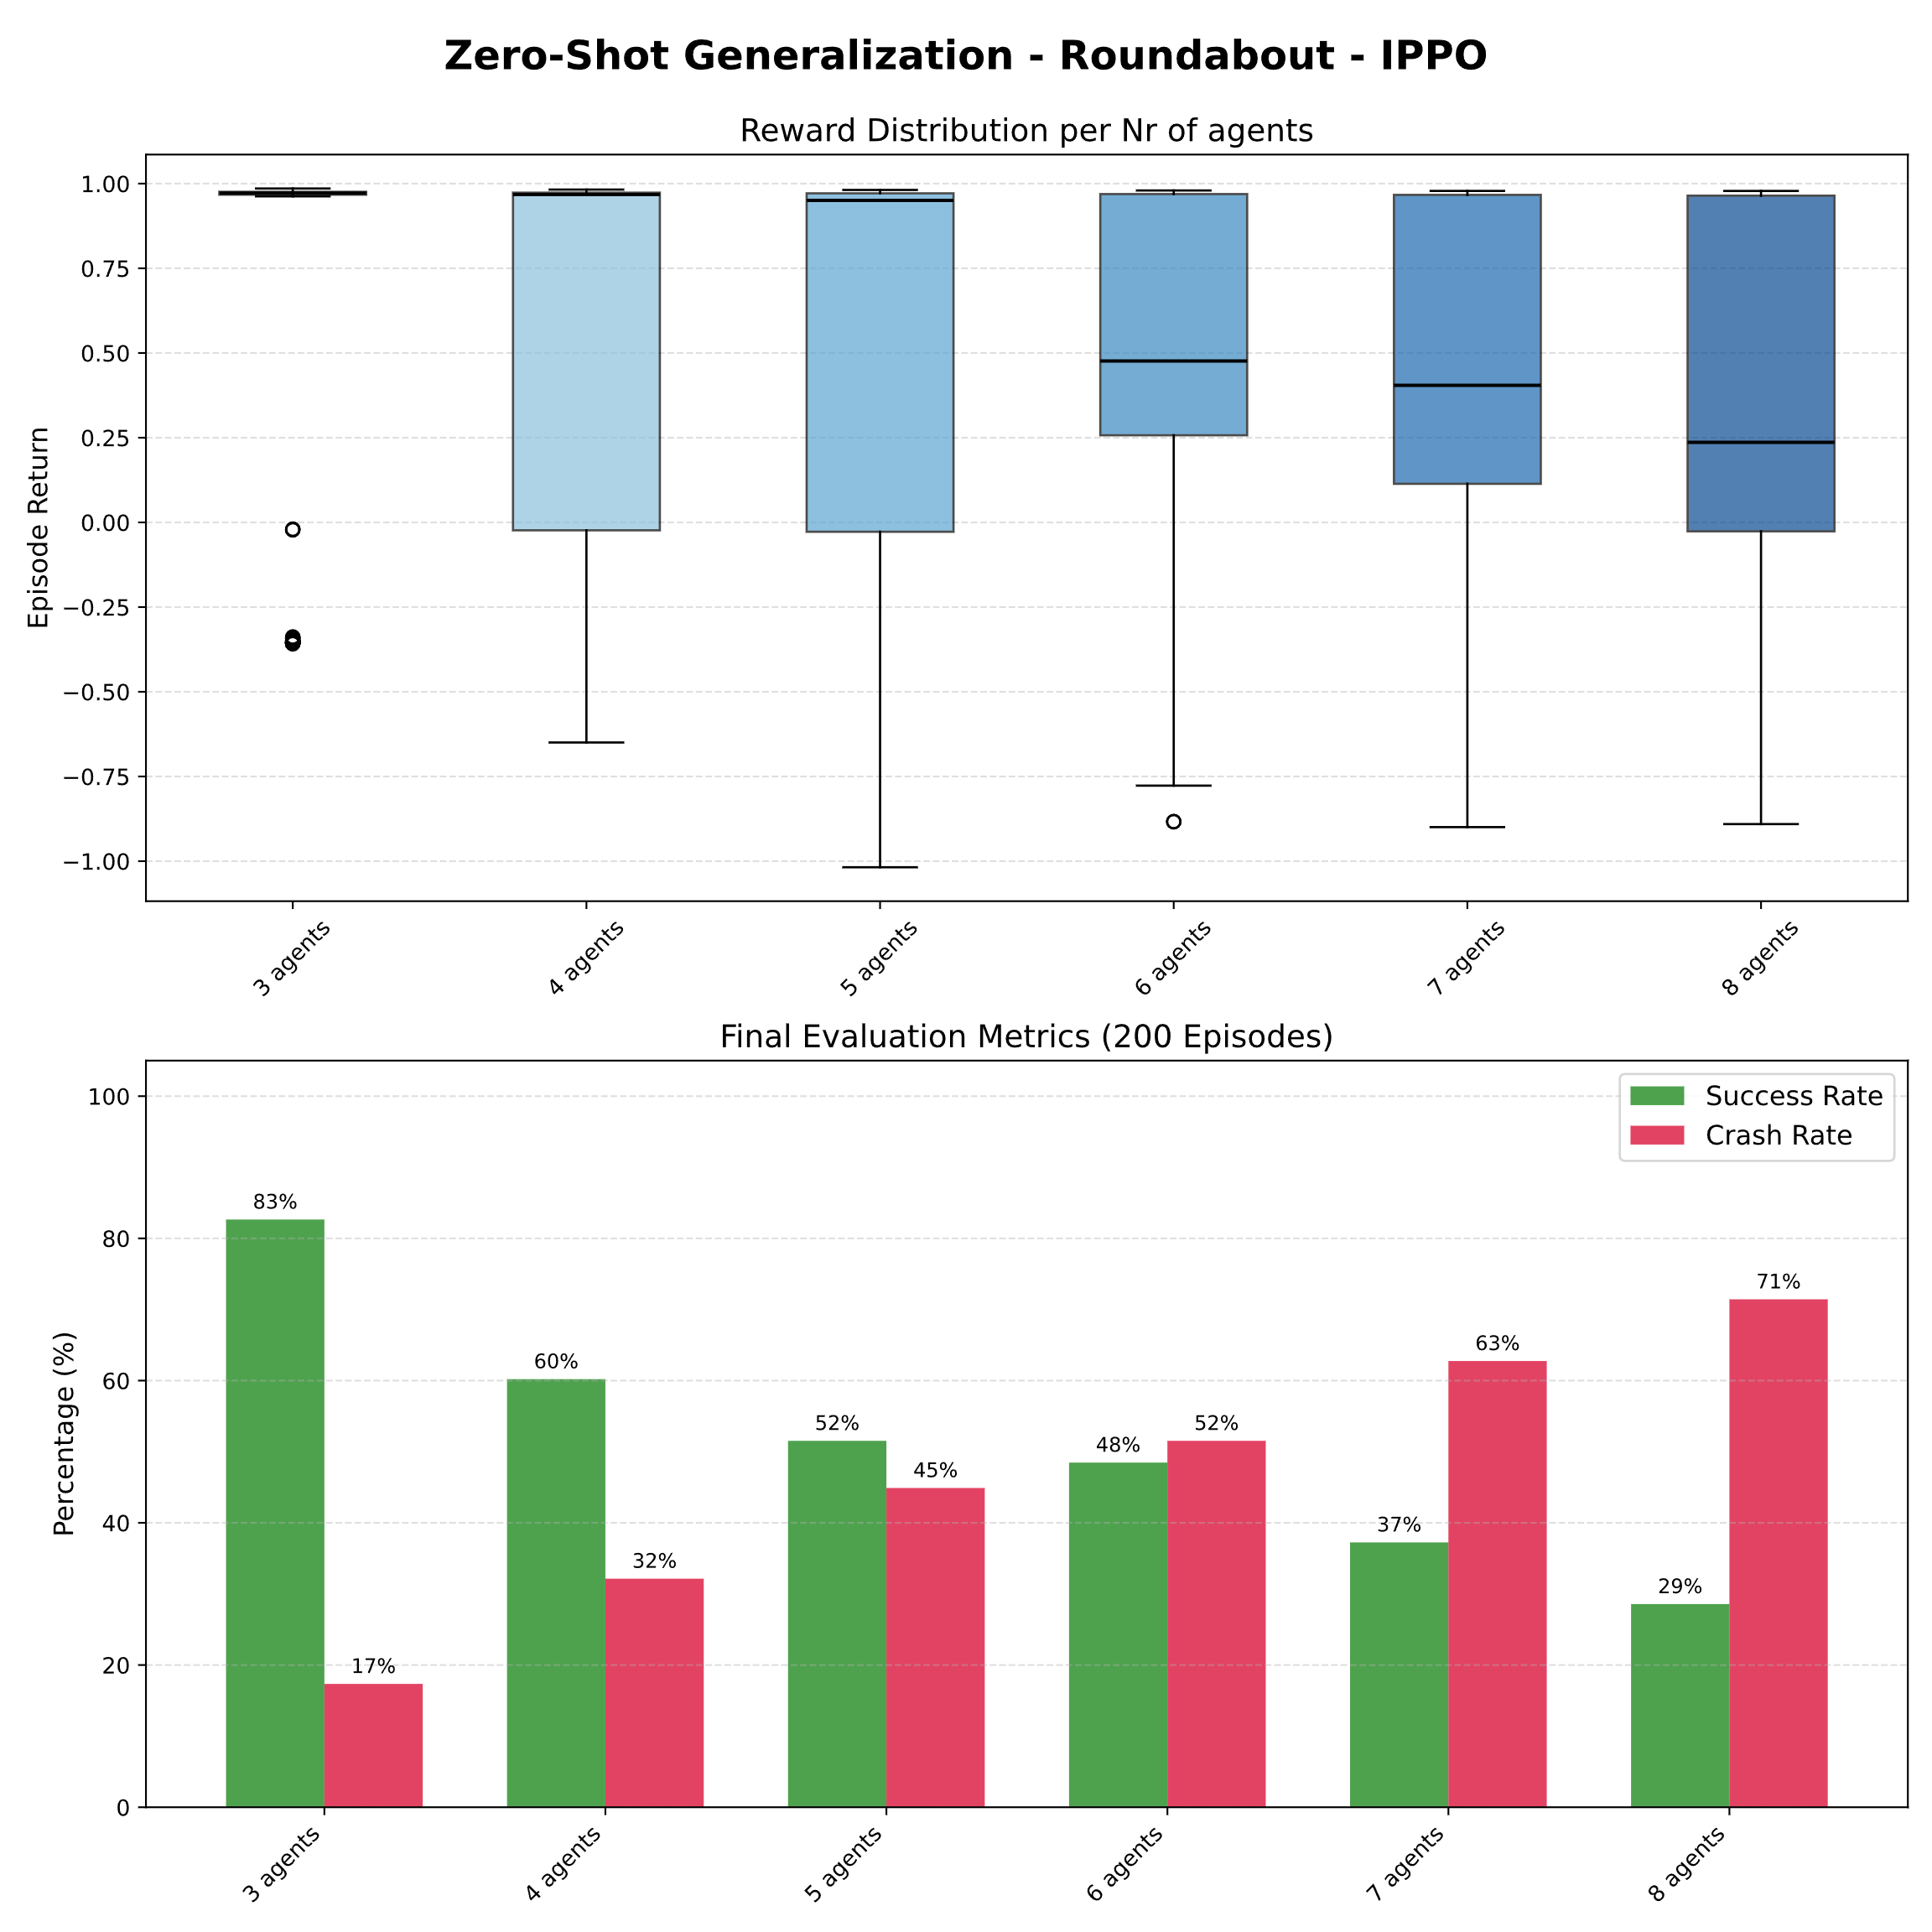
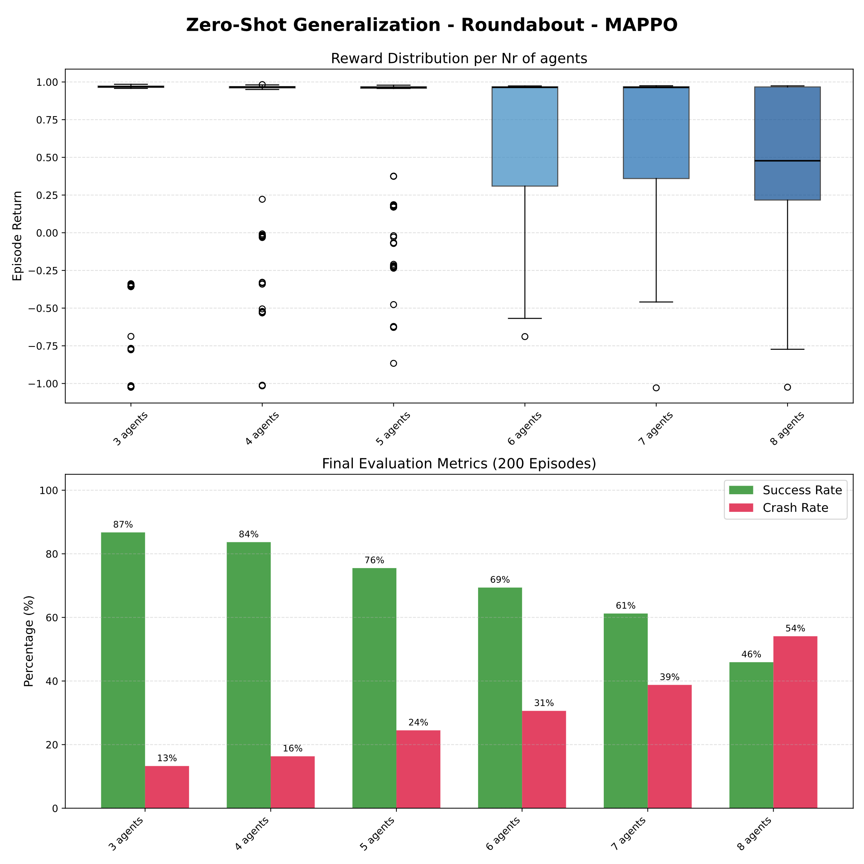
RESULT 5 · CROSS-DOMAIN: ROUNDABOUT
On the roundabout MAPPO dominates: cooperation transfers
18
IPPO
selfish → congestion
MAPPO
yields right of way
MAPPO dominates at every density; IPPO competes for the gap and collides. Cooperation emerges from the critic, not from the reward.

Slide 25
RESULT 5 · BEHAVIOR: ROUNDABOUT
IPPO collides, MAPPO yields right of way
19
IPPO
selfish → collision
MAPPO
yields right of way → success
The roundabout requires yielding: MAPPO has internalized this behavior from the centralized critic, IPPO insists on the gap and collides.

Slide 26
SUMMARY
20
MAPPO vs IPPO comparison
Intersection
Roundabout
chaotic · reactive
structured · social
IPPO
Equivalent to MAPPO, with slightly more robustness at high density.
Selfish policy → causes congestion.
DTDE
MAPPO
The Critic Centralized brings no advantage
Transfers cooperation.
CTDE
the advantage of the critic centralized is problem-dependent.
Coordination and generalization in MARL
20

Slide 27
CONCLUSIONS
21
Conclusions
1
The off-policy method tested is not suitable for our discrete, chaotic environment. Provisional verdict, requires further verification.
2
On the intersection the centralized critic brings no advantage : the two on-policy methods are equivalent, IPPO is sufficient.
3
MAPPO is essential for transferable social behavior : the critic teaches a cooperative semantics that generalizes to the roundabout.
4
The advantage of the centralized critic emerges only where cooperation matters . The price of decentralization: noisier value estimation in early training.
Coordination and generalization in MARL
21

Slide 28
LIMITATIONS
22
Limitations in the results
01
02
03
The limit of the MLP
Fixed training density
MASAC not optimized
Fixed-size, order-sensitive input. Truncating to the k nearest neighbors makes the agent blind beyond k. All density results are constrained by this.
Training always uses 3 agents. A curriculum over the number of agents was explored, but it is not the basis of the final comparison.
A fair verdict on the off-policy method would require a dedicated hyperparameter search. For this reason the judgment remains provisional.
→ a size-invariant and permutation-invariant model is the next step.
Coordination and generalization in MARL
22

Slide 29
REFERENCES
23
Essential bibliography
[1]
C. Schröder de Witt et al. -- Is Independent Learning All You Need in the StarCraft Multi-Agent Challenge?
arXiv:2011.09533 · 2020
[2]
C. Yu et al. -- The Surprising Effectiveness of PPO in Cooperative Multi-Agent Games
NeurIPS 2022 · arXiv:2103.01955
Coordination and generalization in MARL
23

Slide 30
REPOSITORY
24
Code and materials: GitHub repository
https://github.com/EmGira/Highway-env-MARL
Thank you for your attention.
Coordination and generalization in MARL
24

