Slide 1


Linux and Git
Emerging Technologies
Spring 2020 – January 28th

Slide 2

Welcome to the First Official Meeting
Meetings will be Tuesdays
6-7PM in Westgate E201
Our Exec Team:
President: Collin Kleest
VP: Griffin Sullivan
Treasurer: Daniel Mitchell
Chief of Operations: Kyle Kacala
Communications will be hosted in Slack and Email

Slide 3
Today’s Overview
Raspberry Pi
Go over the Raspberry Pi, and Emerging technologies
Linux History
Brief history and info about Linux
Linux Commands
Run through some basics Linux commands on the Pi’s
Git History
Brief history and info about Git
GitHub Demo
Make your own repository and push a file to it

Slide 4
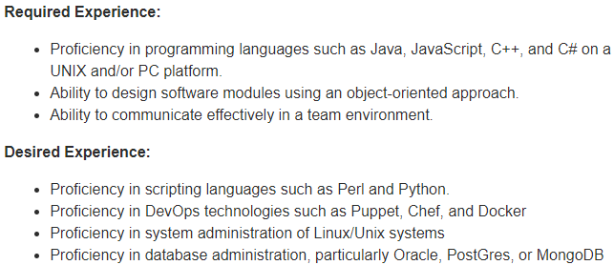
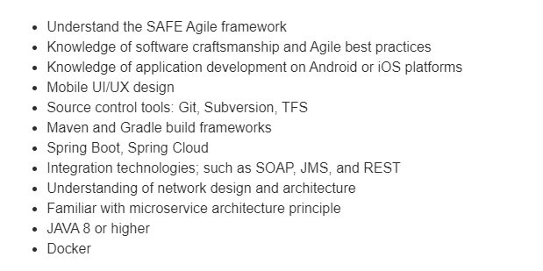
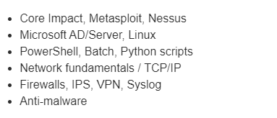
Why Emerging Tech, Linux, RPi?
Raytheon Software Engineer
DropBox Software
Simplicity IT Security Analyst

Slide 5
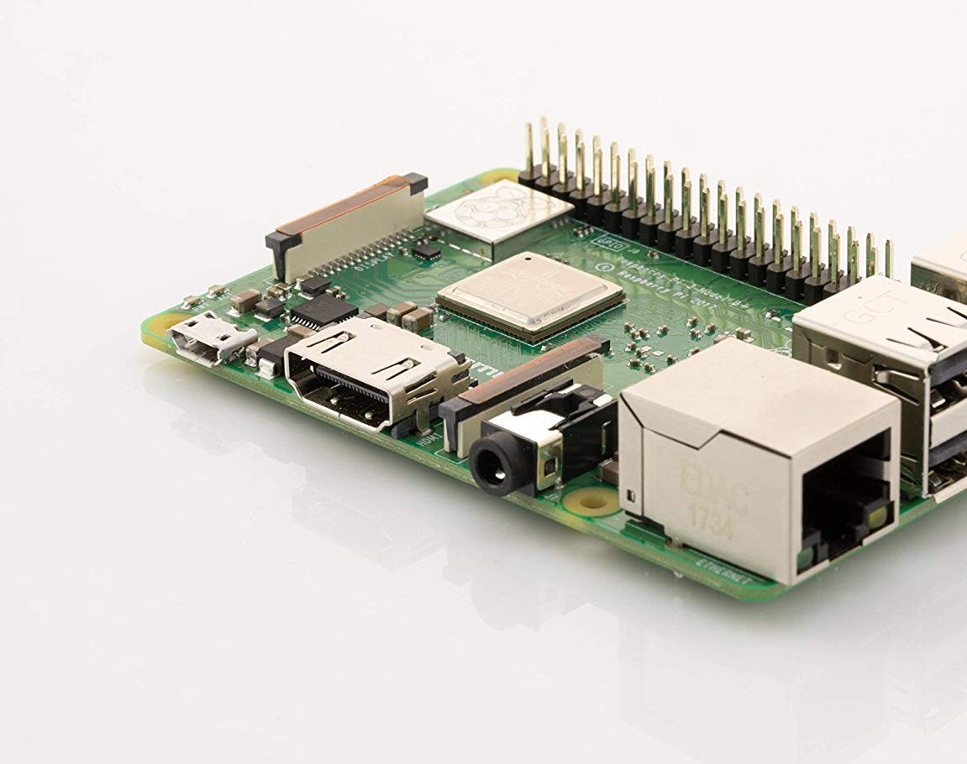
The Raspberry Pi
40 GPIO Pins
Used to control sensors, lights, other additional hardware
GPIO = General Purpose Input / Output
HDMI
WiFi & Bluetooth on board
Micro USB for Power
3.5mm headphone jack
four USB ports, and one gigabit ethernet jack

Slide 6
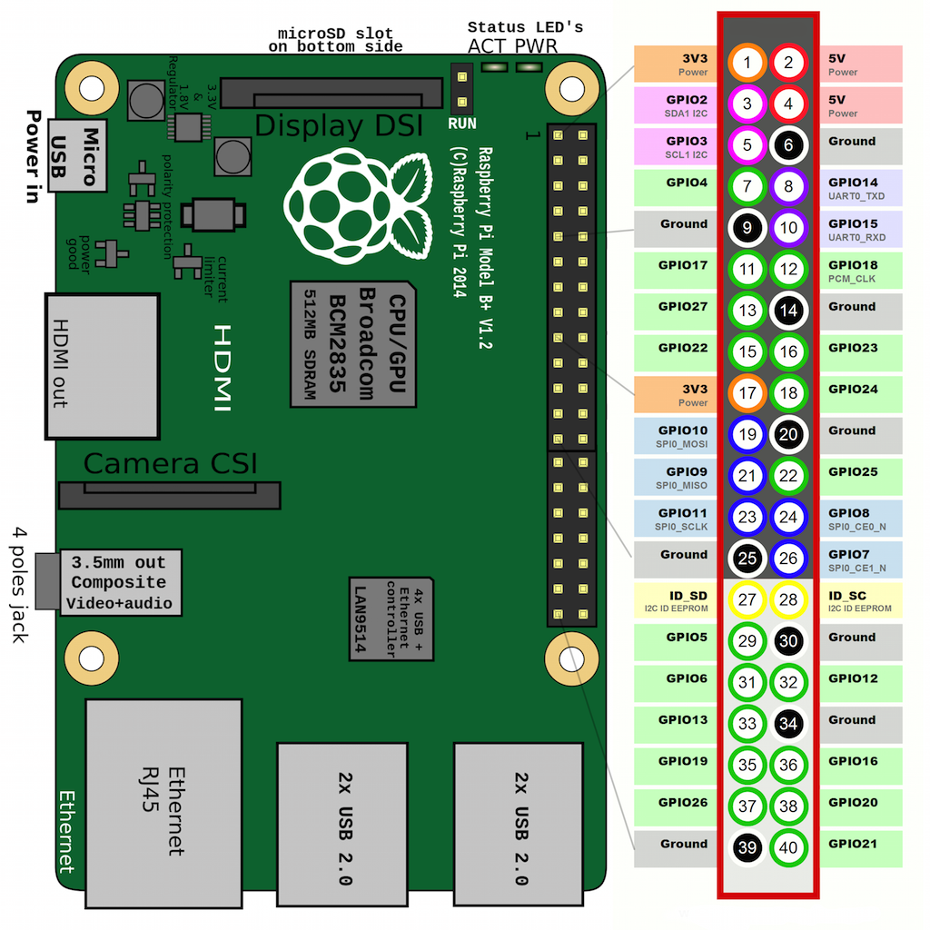
The GPIO Pins
These are used to control additional hardware, you can program hardware to do what you want.
Motion detector, temperature monitor, water detection
Connected with GPIO cables

Slide 7
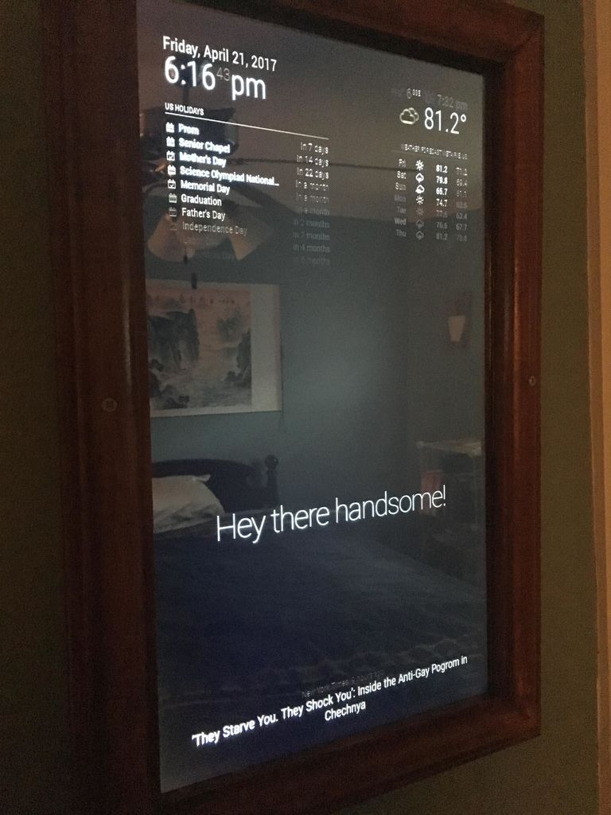
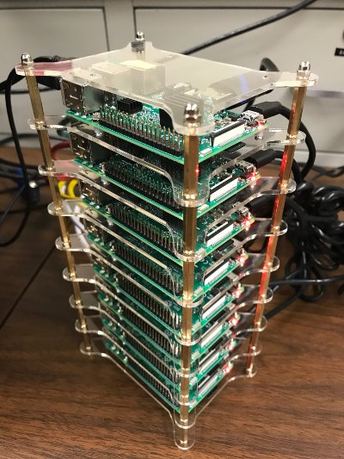


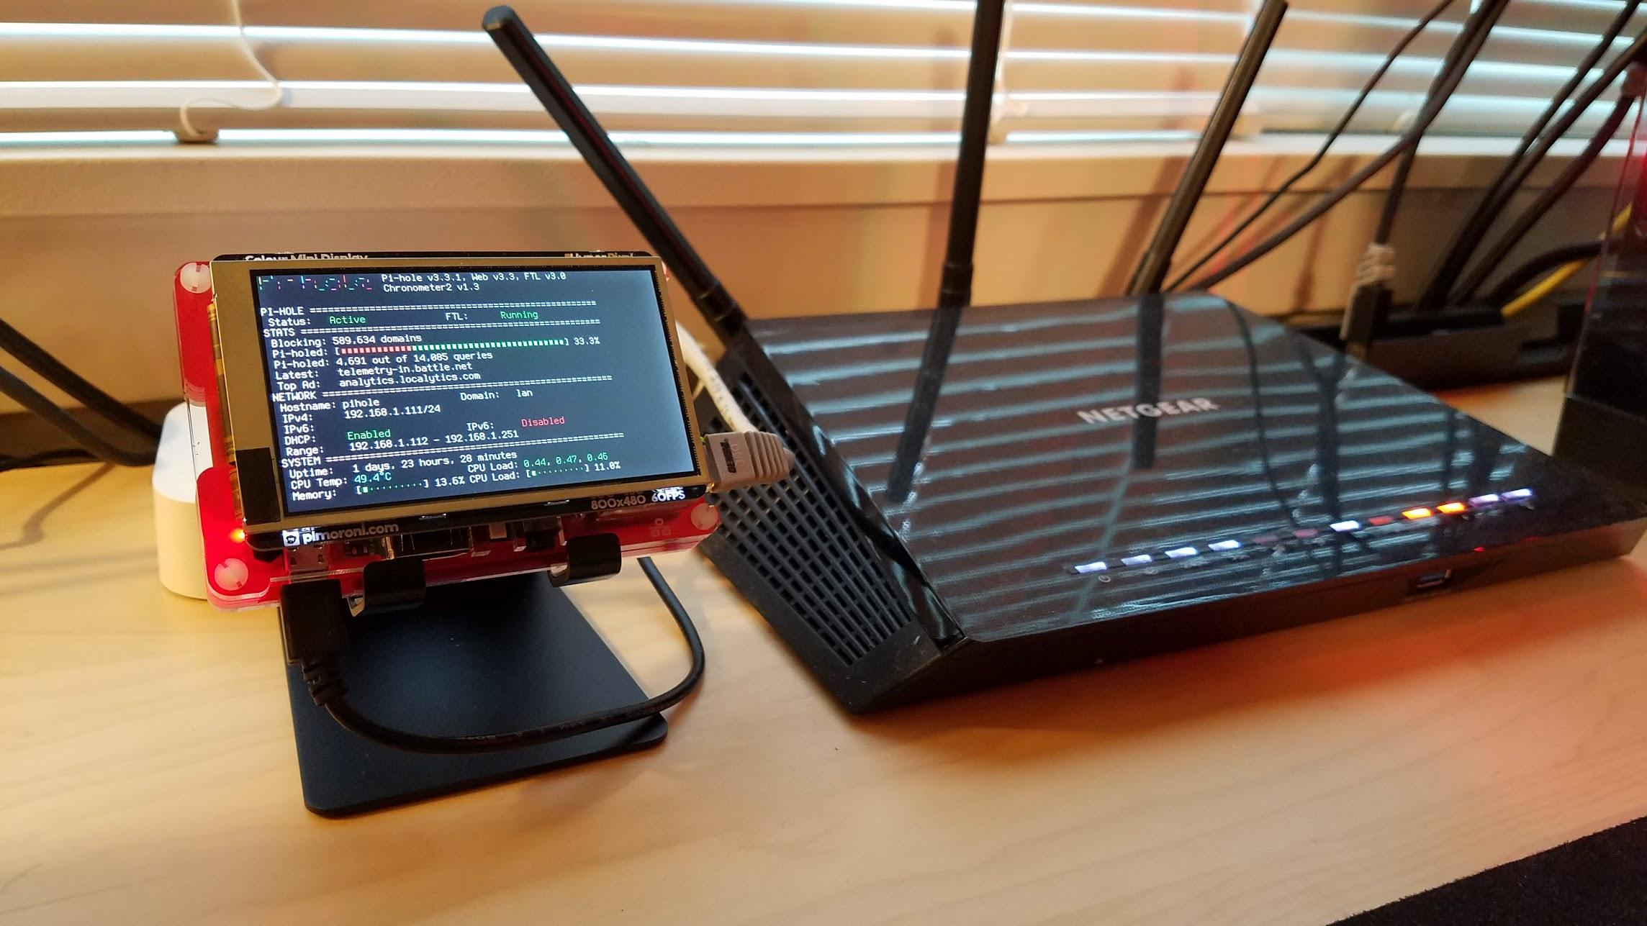
Raspberry Pi in Action

Slide 8
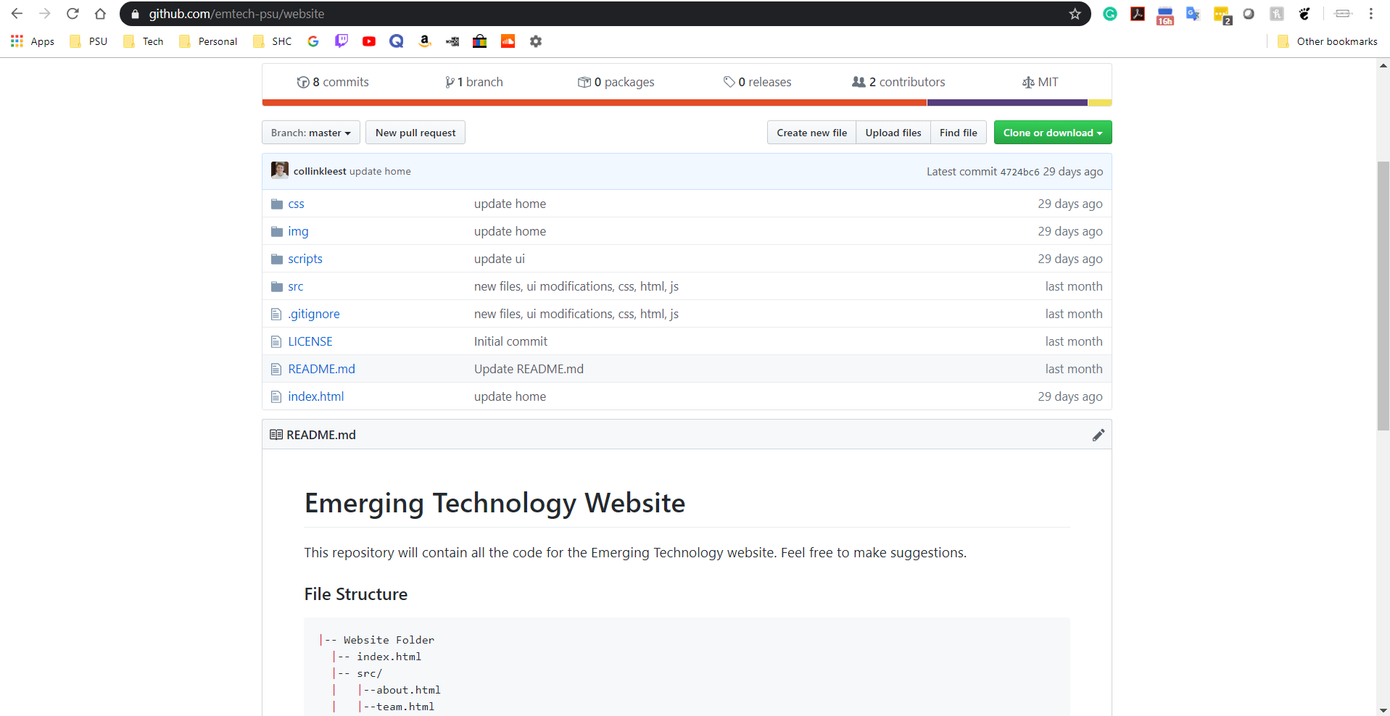
Website
Into front end development, or web design?
Open Source
Would love help with development
https://github.com/emtech-psu/website
Project for semester

Slide 9

What is Linux?
The most popular open-source operating system
Allows anyone to create and use distributions
Each distribution are specific operating systems for any device
The official brand character of the Linux kernel

Slide 10
What is a Distribution?
Distro: a Linux distribution is a different version of the Linux kernel (OS core) just like different versions of MacOS or Windows
Every distro has different terminal commands, utilities, and graphical programs
You could technically make your own distro for whatever you need based off the Linux kernel

Slide 11
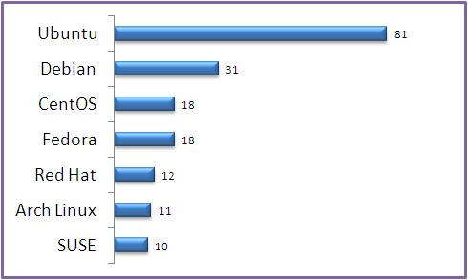
Most Popular Distros by %
Fun Fact:
Android and Chrome OS are Linux distributions

Slide 12
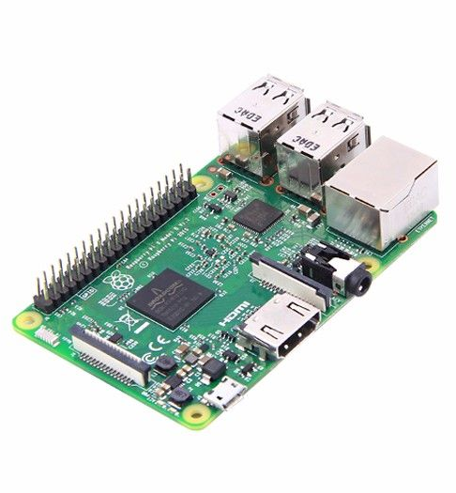
Why learn Linux?
The Raspberry Pi runs on its own version of the Debian distro called Raspbian
You must be able to use Linux effectively to work with a Pi
Many companies prefer using Linux on different development teams
The best OS for creating your own projects because its highly personalized

Slide 13

Where did Linux come from?
Linux Torvalds created the Linux kernel
In 1980s Finland there was not much access to software; made his own
Released the Linux kernel in 1991

Slide 14
Now Let’s Do Some Basic Commands

Slide 15

What is Git
Most widely used version control system in the world
Allows people to upload a version of software into an online repository where other people can make changes
Most repositories require people to be approved and their changes to be reviewed

Slide 16
What’s a Repository?
“Repo”: a folder for your project
Houses the files and stores each file’s revision history

Slide 17
What’s the Difference Between Git and GitHub?
Git
Version control system to manage code history
The “tool”
GitHub
Cloud-based hosting service for Git repositories
Let’s programmers collaborate on projects and organize Git repos
The “service for projects that use Git”

Slide 18

Where Did Git Come From?
Linus Torvalds, the creator of Linux, released Git in 2005
To help programmers work on different versions of the Linux kernel
Open-source projects and group collaboration need Git
It is now used by millions of people from personal projects to enterprise software

Slide 19
Let’s Make a Repo!

Slide 20

Survey

