Slide 1
WELCOME TO MY PRESENTATION PRESENTATED BY: EMA AKTHER TRAINEE ID:10 BATCH:IS-10 PROGRAM:EDGE COURSE:IT SUPPORT FOR OFFICE MANAGEMENT
SUBMITTED TO:
MD.FAHMIDUR RAHMAN SAKIB
LECTURER AT DEPARTMENT OF CSE
METROPOLITAN UNIVERSITY

Slide 2
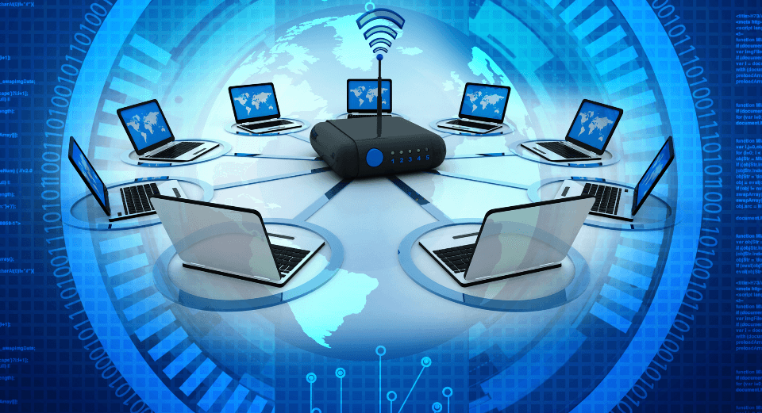
What is data communication? Everything you need to know

Slide 3
There are two terms in ‘data communication’, namely data and communication. Data can be anything, such as text, audio, videos, images, and multimedia files, and communication is the process of sending or receiving data. Therefore, the terms ‘data communication’ collectively refers to the exchange of data between two devices.

Slide 4
Components of Data Communication:
ender: A sender is any device that has the ability to send data over a network. Laptops, mobile phones, desktops, smartwatches, video recorders, etc. are devices that can act as a sender.
Receiver: A receiver is any device that has the ability to receive data over a network. Devices like a computer system, printer, laptop, mobile phone, television, etc. can act as a receiver.
Message: A message is a piece of information that the sender wants to transmit to the receiver over a network. It can be in the form of a text, number, image, audio, videos, etc.
Transmission Medium or Communication Channel: A communication media is a path through which the message transmits between the sender and the receiver. It is also called a link or medium, which can be wired or wireless. Popular examples of communication media are an ethernet cable, satellite link, telephone cable, television cable, etc.
Protocols: Protocols are the set of rules that the sender and receiver need to follow in order to ensure successful communication.

Slide 5
Measuring Capacity of Transmission Media:
1. Bandwidth
The bandwidth of a specific channel is the range of frequencies available to transmit data through that channel. The higher the bandwidth, the greater the data transfer rate. It is measured in Hertz (Hz).
2. Data Transfer Rate
Data transfers in the form of signals between the sender and the receiver through a channel. Also, each signal carries one or more bits of data. The data transfer rate is the maximum number of bits that get transmitted between the sender and the receiver in one second. We often refer to it as a bit rate, which is measured in bits per second (bps).

Slide 6
Types of Data Communication
Simplex Communication
Half-Duplex Communication
Full-Duplex Communication

Slide 7
Full-Duplex Communication
1. Guided Transmission Media
2. Unguided Transmission Media

Slide 8
Types of Data Communication Protocols
A protocol is a set of rules that the sender, receiver, and all intermediate devices must follow. Protocols play a vital role in data communication since they ensure consistency in sending and receiving messages.
1. HyperText Transfer Protocol (HTTP)
2. File Transfer Protocol (FTP)
3. Simple Mail Transfer Protocol (SMTP)
4. Transmission Control Protocol (TCP)

Slide 9
THANKS

