Slide 1
Frames and Transformations

Slide 2
Installation Update

Slide 3
(base) conda activate afab19
(afab19) conda update compas compas_fab --yes
(afab19) python -m compas_rhino.install
(afab19) python -m compas_fab.rhino.install -v 6.0
Notes:
Open Anaconda prompt

Slide 4
(afab19) python
>>> import compas_fab
>>> compas_fab.__version__
'0.10.0'
>>> exit()

Slide 5
→ and pull the lates changes of the afab_course

Slide 6
Agenda
Frames
Transformations

Slide 7
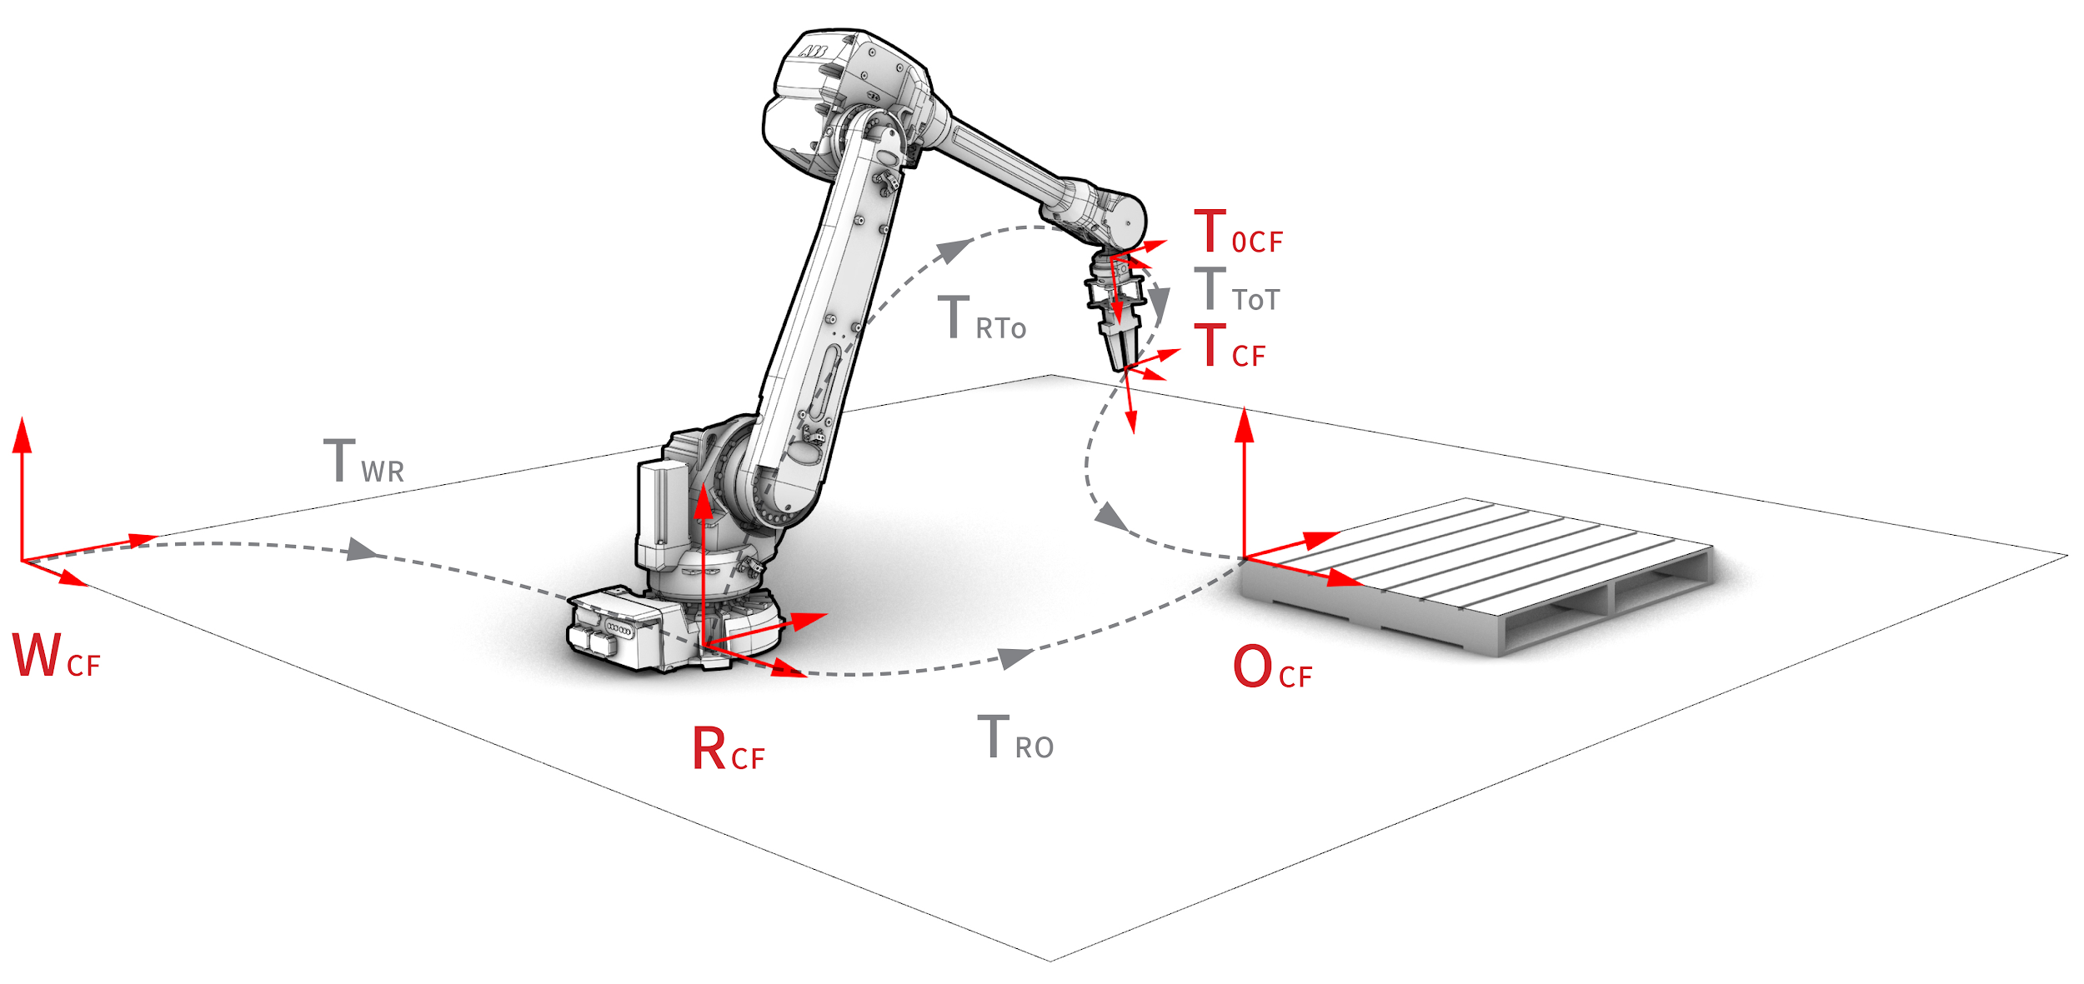
Robot coordinate frames
World (WCF)
Robot (RCF)
Tool0 (T0CF)
Tool (TCF)
Object (OCF)
Notes:
To coordinate the robot motions in a cartesian coordinate space (as opposed to other spaces such as the joint space), we have to define a set of coordinate frames.

Slide 8
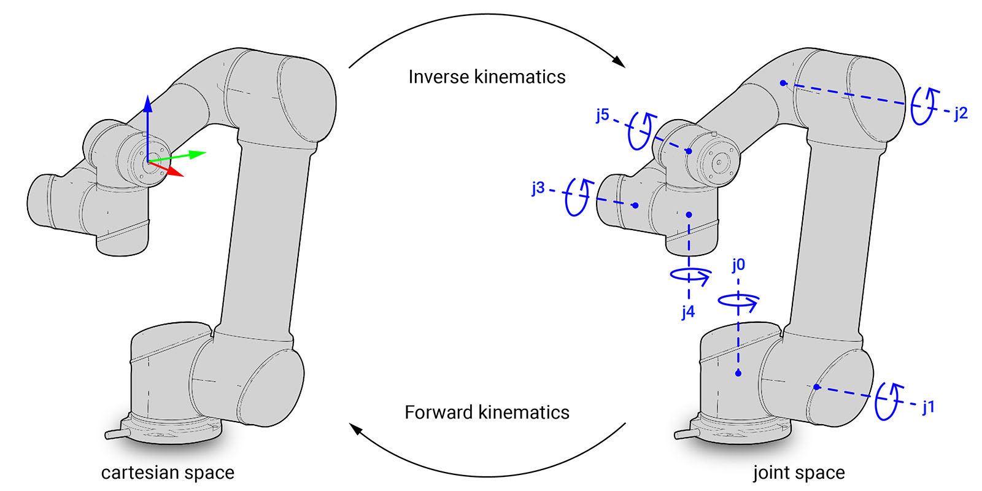
Cartesian vs joint space
Notes:
Then, the typical industrial robot can be controlled in two spaces: joint space and cartesian space.
MoveJ – move the robot linear in joint space
MoveL or MoveC – move the robot linear/circular in cartesian space (ee-velocity)
For MoveL you specify a desired pose for the end-effector AND a desired Cartesian path. To find the necessary joint positions along the desired Cartesian path, the robot controller must calculate the inverse position and velocity kinematics of the robot.

Slide 9
Examples
Please open Rhino & gh file:
afab_course\05_robotic_fabrication_basics\examples\00_frame_and_transformation.3dm
afab_course\05_robotic_fabrication_basics\examples\00_frame_and_transformation.ghx

