Slide 1

MediGuide AI: AI-Powered Medical Symptom Assessment
A LangChain and OpenAI-powered application for structured, safety-focused preliminary health guidance.

Slide 2


The Problem: Unreliable Health Information
Unstructured Self-Diagnosis
Patients turn to random websites when experiencing symptoms, encountering contradictory and unverified information.
Anxiety & Confusion
Unreliable results amplify worry and leave patients unsure of what steps to take next.
The Gap
A responsible, structured guidance system is needed — one that informs without overstepping clinical boundaries.

Slide 3

What is MediGuide AI?
MediGuide AI is an intelligent Streamlit application powered by LangChain and OpenAI LLM that guides patients through a structured symptom assessment.
Patient Inputs Accepted
Age, gender, symptoms, duration, and severity
Existing conditions, medications, and additional notes
What It Produces
Structured, safety-focused preliminary guidance
Clear disclaimer: never claims a confirmed diagnosis

Slide 4
Learning Objectives
01
02
Integrate OpenAI Models
Design Reusable Prompts
Use ChatOpenAI to connect to OpenAI chat models.
Work with PromptTemplate and ChatPromptTemplate.
03
04
Structure Messages
Force JSON Output
Use SystemMessage, HumanMessage, and AIMessage.
Instruct the model to return exact JSON schema and parse it safely.
05
06
Build Pipelines & Stream
Apply Caching
Create reusable LLMChain pipelines; stream output for responsive UX.
Implement InMemoryCache and SQLiteCache to reduce cost and latency.

Slide 5






Technology Stack
Python 3.10+
LangChain
Core programming language for the entire application.
langchain, langchain-openai, langchain-community, langchain-core
OpenAI
Streamlit
Model provider — e.g. gpt-4o-mini — for language model inference.
User interface framework for interactive, data-driven web apps.
python-dotenv
Caching
Secrets management via .env file to keep API keys safe.
InMemoryCache for speed; SQLiteCache for persistence across sessions.

Slide 6
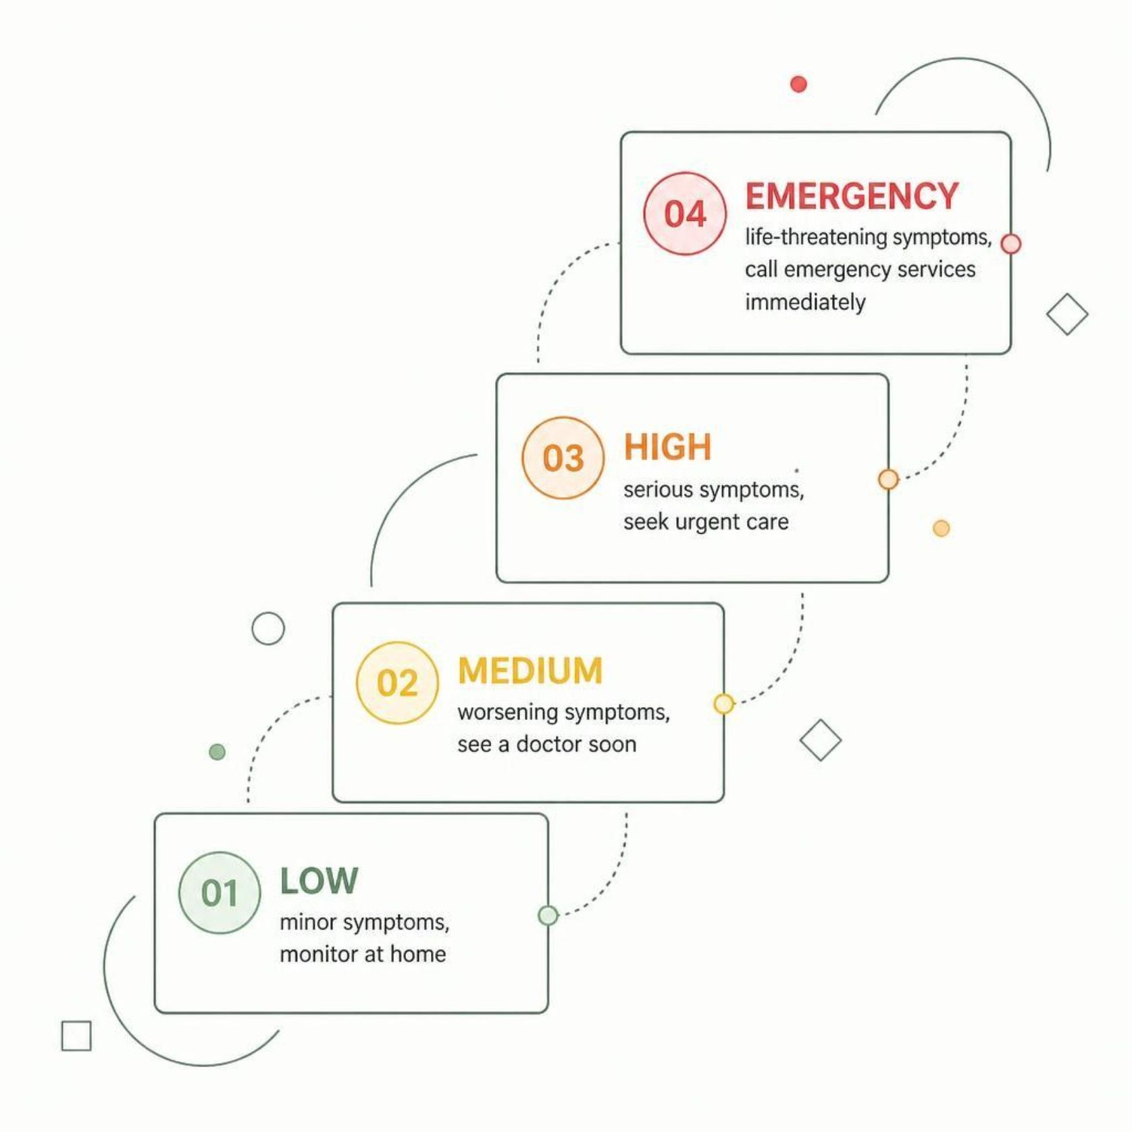
Key Features & Requirements
Inputs Collected
Age, gender, symptoms, duration, severity
Existing conditions, medications, and notes
JSON Response Fields
Summary, possible conditions, urgency level
Next steps, doctor questions, warning signs
Additional Capabilities
Live streaming narrative into the UI
Caching to speed up repeated requests
Medical disclaimer on every relevant screen

Slide 7
LangChain Concepts to Implement
ChatOpenAI
Messages
Integrate the OpenAI chat model as the LLM backbone.
Structure conversations using System, Human, and AI message types.
PromptTemplate
ChatPromptTemplate
Reusable single-string templates with dynamic variables.
System + Human conversation templates with embedded safety rules.
Structured JSON
LLMChain + Streaming
Instruct the model to return an exact JSON schema; parse safely.
Build reusable assessment pipeline; stream output via .stream().

Slide 8


Project Architecture
File Breakdown
app.py — Streamlit UI (run this file)
src/config.py — Settings and form options
src/prompts.py — PromptTemplate, ChatPromptTemplate, JSON schema
src/chains.py — ChatOpenAI, LLMChain, streaming logic
src/cache_manager.py — In-memory and SQLite caching
src/utils.py — Safe JSON parsing and helpers
app.py
chains.py
config.py
prompts.py
requirements.txt, .env.example, and README.md must be included at the project root.

Slide 9
Caching Strategy: InMemoryCache vs SQLiteCache
InMemoryCache
SQLiteCache
Stored in RAM — fastest possible retrieval
Does not survive app restart
Best for a single active session
Stored in a .db file on disk
Fast with slight overhead; survives restarts
Best for reusing results across sessions
Register the cache once with set_llm_cache() — LangChain checks it automatically before every model call. Submitting the same form twice should be visibly faster the second time.

Slide 10




Safety, Testing & Submission
Safety Requirements
Testing Scenarios
Submission Checklist
Clearly labelled as educational only — no confirmed diagnoses
EMERGENCY urgency level urges calling emergency services immediately
Low urgency: runny nose
Medium urgency: fever + cough
High urgency: chest pain
Cache validation, empty input handling, multi-language support
GitHub repo with all source files and working requirements.txt
.env.example and README with setup instructions
Screen recording or live demo
Well-commented, modular code throughout

