Slide 1

Exploratory Data Analysis
G2M insight for Cab investment Firm
10/19/22

Slide 2
Agenda
Executive Summary
Problem Statement
Approach
EDA
EDA Summary
Recommendations

Slide 3
Executive Summary
Client:
XYZ is a private firm in US. It is planning to invest in the cab industry and as per their Go-to-Market(G2M) strategy they want to understand the market before taking final decision.
Objective:
Several data sets have been provided so that insights can be given to XYZ on Yellow Cab and Pink Cab Companies.
The analysis has been completed by exploring the data, forecasting profit, and giving a recommendation for the most profitable investment for XYZ private firm.

Slide 4
Problem Statement
Find the Most profitable Cab Company and the Attributes which Bring Profit between the Yellow Cab Company and the Pink Cab Company.
Several hypothesis have been explored to learn more regarding profit of the companies with the given data:
There is significant difference of profit with the cab companies when considering age of the customer.
Cities have a significant influence on profits for cab companies.
Cost of the trip influences cab riding.
Number of users and shorter distance traveled causes a difference in price of cab rides.
Geographical area and their seasons can impact the number of cab rides.

Slide 5



Approach
The following 4 data sets were given
They were combined into a masterdata set
containing data from 1/31/206-12/31/2018.
They originally contained 17 features.
Features were added from the data set so that 45 existed after combining the set and calculating additional info.
Transaction_ID.csv
Cab_Data.csv
Customer_ID.csv
City.csv
MasterData

Slide 6
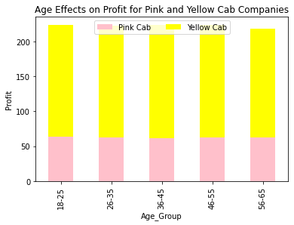
The Effect of Age on the Profit of Each Company
Ages were grouped together to compare how much profit is made for each age group.
There was not a large difference for each age group.
Yellow cab generated the largest profit for each age group.

Slide 7
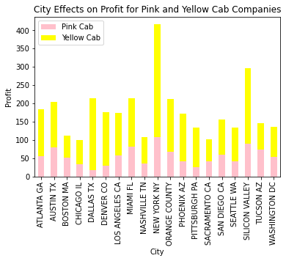
Cities Impact on Profit
Profit was explored for each city.
The Yellow Cab company had a greater profit in all cities except Tucson Arizona.
The Yellow and Pink Cab were very close in profit in Austin Texas.
New York City and Silicon Valley have the highest Profit for cab companies, but the Yellow Cab company dominates in those areas.

Slide 8
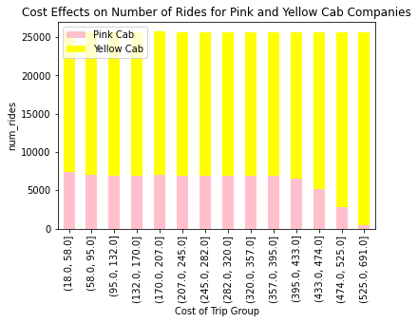
Does Cost Affect Number of Rides?
The cost does not seem to have major impact on number of rides until the cost is over 433 dollars for The Pink Cab only.
Cost for Yellow cabs seem to be higher than the Pink Cab.
The number of rides for the Pink Cab decreases a lot when prices are 525 dollars and over.

Slide 9
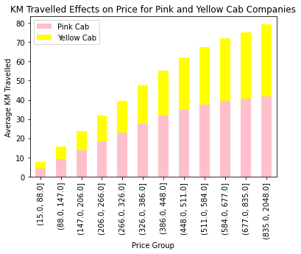
The Effects of KM Travelled in the Price Paid
The mean KM travelled is shown as the dependent variable of this bar graph. The price is grouped so that the distance travelled can be compared to the price.
As the price increases, the average km goes up. The pink cabs seem to travel further than the yellow cab.
Yellow cabs seem to be more popular in larger cities where cab rides may be shorter in KM. But the profit for Yellow cab is higher.

Slide 10
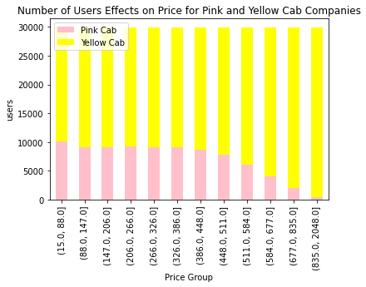
Number of Users Effects on Price
The Yellow Cab Company Prices increase when the number of users is higher.
The number of users for the Pink Cab Company decreases when the Price is higher.
The Yellow cab company is able to profit more from higher prices and higher users for each high price.

Slide 11
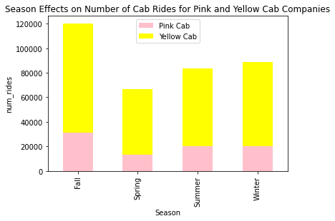
Do Seasons Affect the Number of Car Rides
More people ride cabs in the fall than any other season.
Spring has less cab riders than other seasons.
They Yellow Cab has a greater fluctuation in the number of rides. This is probably due to the fact that it is used more in cities with extreme weather changes.

Slide 12

Recommendations
XYZ should invest in the Yellow Cab Company.
The Yellow Cab Company has higher profits than the Pink Cab Company.
They Yellow Cab Company:
Gets higher profit for all age groups.
Gets higher profit in all cities except for Tucson, AZ.
Gets higher profits in all seasons but some seasons are more popular than others.
It is not as profitable for longer distance rides but that is not a big problem since they are used more in cities with larger populations such as NYC.
Users who take Yellow Cab are willing to pay higher amounts of money to ride with them.

Slide 13
Thank You

