Slide 1

Exploratory Data Analysis
Insight for Bank Marketing Campaign Data
12/8/22

Slide 2
Agenda
Executive Summary
Problem Statement
Approach
EDA
EDA Summary
Recommendations

Slide 3
Executive Summary
Client:
ABC Bank wants to use ML model to shortlist customer whose chances of buying the product is more so that their marketing channel (telemarketing, SMS/email marketing etc) can focus only on those customers whose chances of buying the product is more.
Objective:
Use Machine Learning to shortlist customer whose chances of buying the product is more so that their marketing channel (telemarketing, SMS/email marketing etc) can focus only to those customers whose chances of buying the product is more. This will save resource and their time (which is directly involved in the cost ( resource billing)).

Slide 4
Problem Statement
ABC Bank wants to sell it's term deposit product to customers and before launching the product they want to develop a model which help them in understanding whether a particular customer will buy their product or not (based on customer's past interaction with bank or other Financial Institution).

Slide 5
Problem Statement
Bank wants to use ML model to shortlist customer whose chances of buying the product is more so that their marketing channel (tele marketing, SMS/email marketing etc) can focus only to those customers whose chances of buying the product is more.
This will save resource and their time ( which is directly involved in the cost ( resource billing)).
Develop model with Duration and without duration feature and report the performance of the model.
Duration feature is not recommended as this will be difficult to explain the result to business and also it will be difficult for business to campaign based on duration.

Slide 6
Approach
The data set given is bank-full.csv
It contains 16 features.
The data had no replications
The data had no missing values.
The data did have many outliers.
Since there were many outliers I considered the log of the numerical data and ways of incorporating the median in some calculations so that outliers do not affect the problem as much.

Slide 7
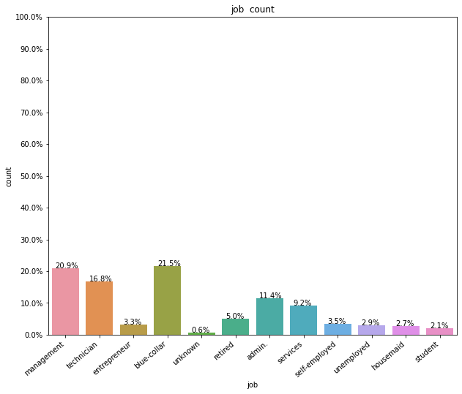
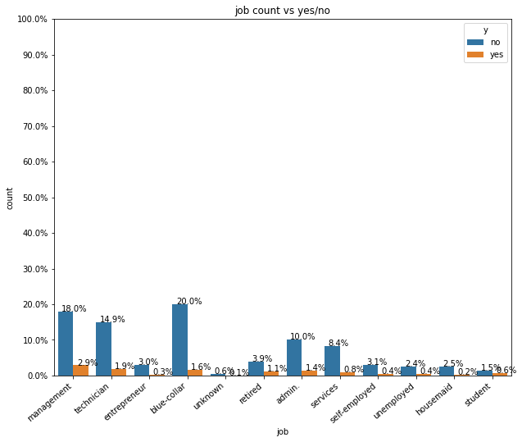
Customers with the job blue-collar were more likely to subscribe

Slide 8
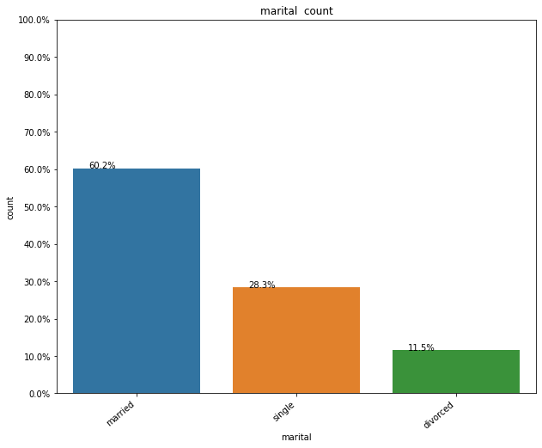
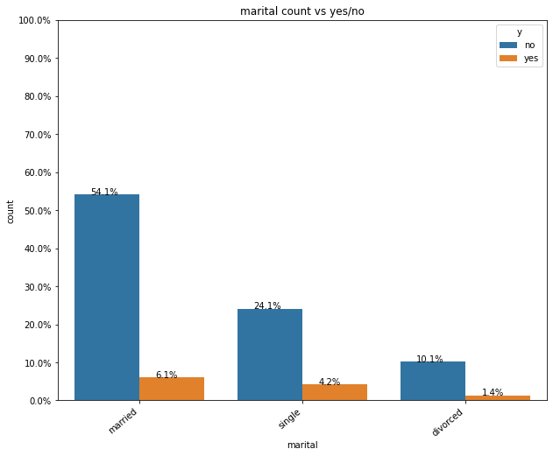
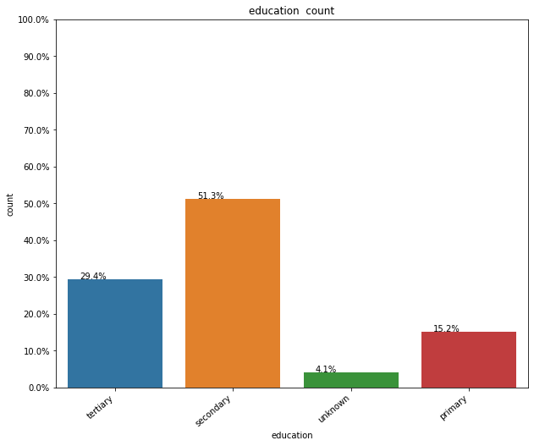
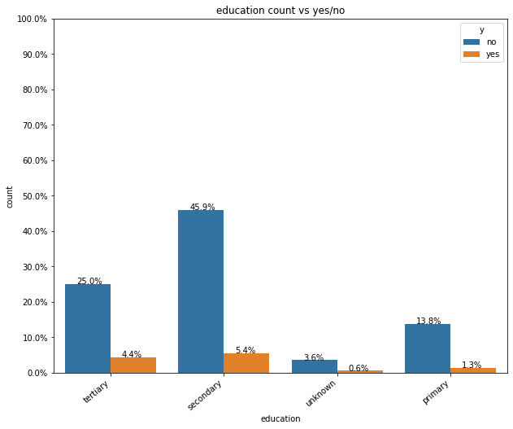
Customers with the marital status "married" are more likely to subscribe and not to subscribe. This is because most customers are married.
Customers with a secondary education are more likely to suscribe and not subscribe. Most customers have a secondary education.

Slide 9
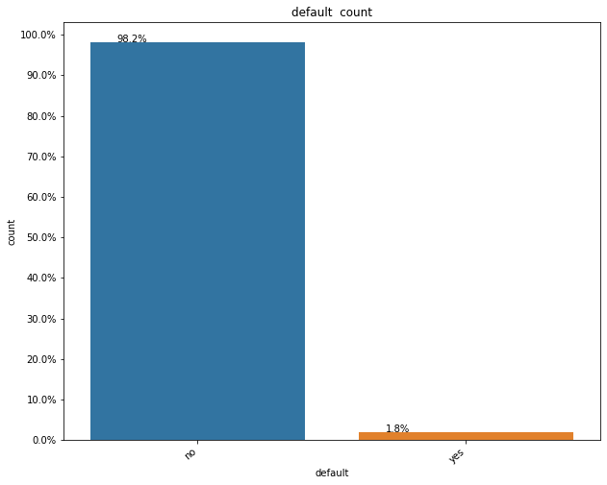
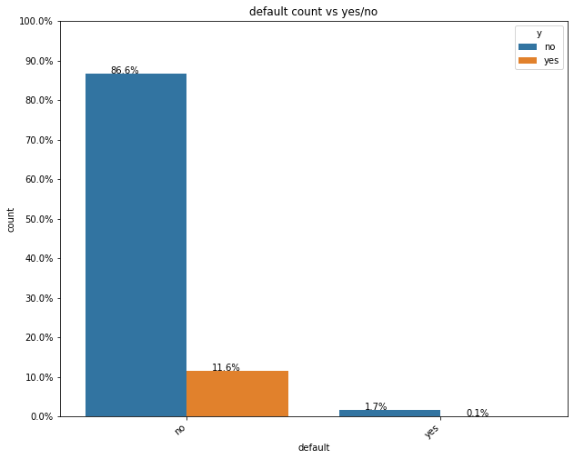
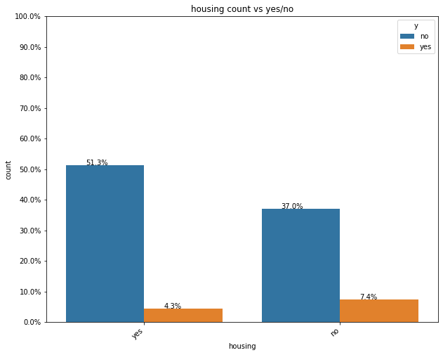
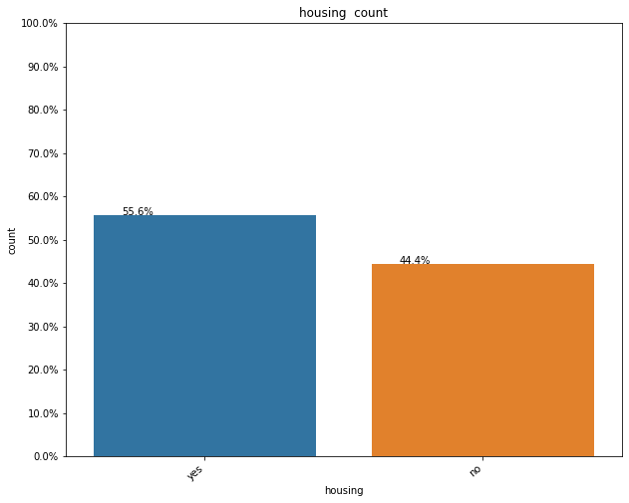
Most customers do not have defaulted credit so they are more likely to subscribe as well as not subscribe. But most of them subscribe.
Those with a housing loan are more likely to subscribe.

Slide 10
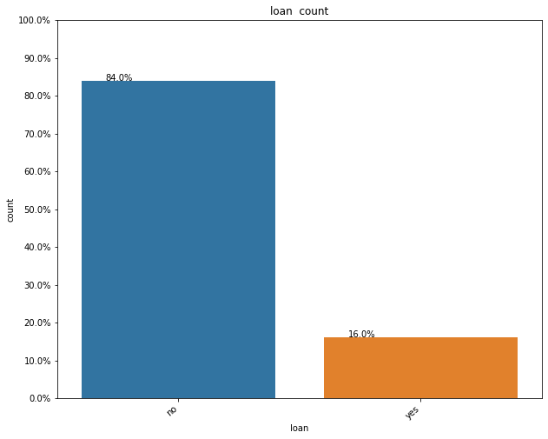
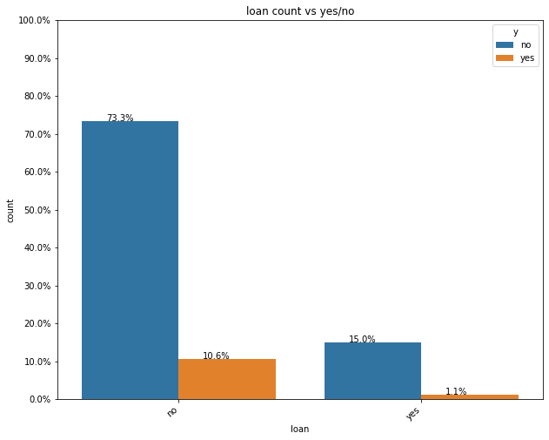
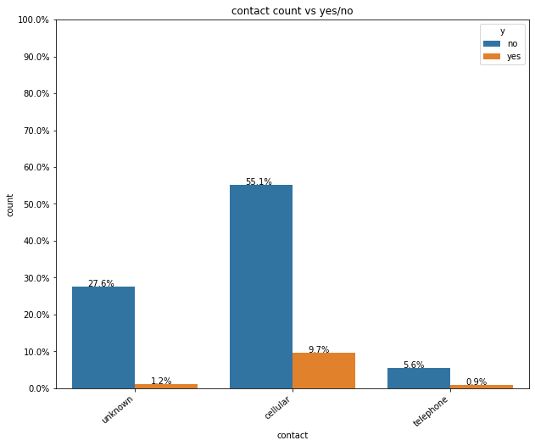
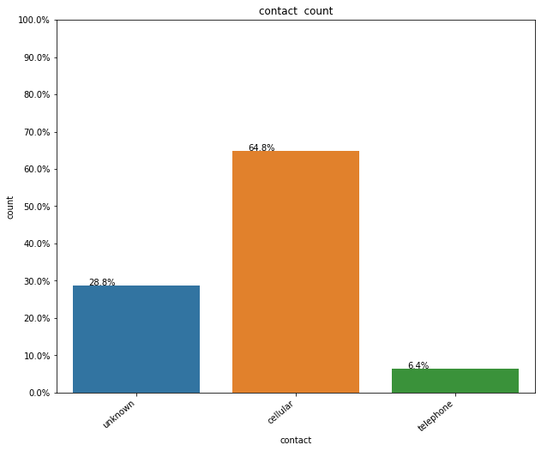
Most customers do not have a personal loan so they are more likely to subscribe if they do not have a personal loan.
Most customers have cell phones.

Slide 11
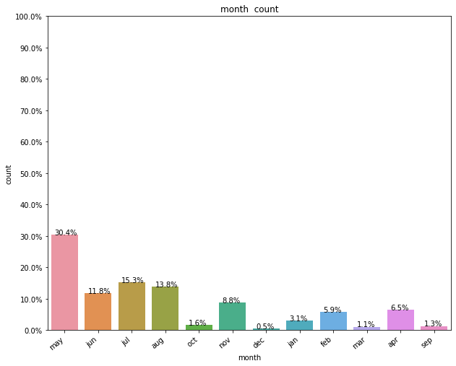
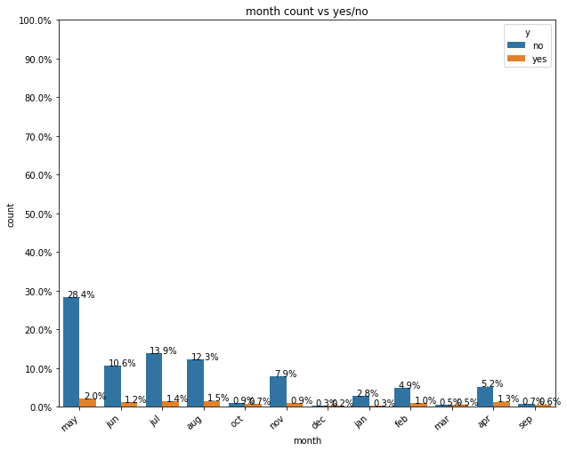
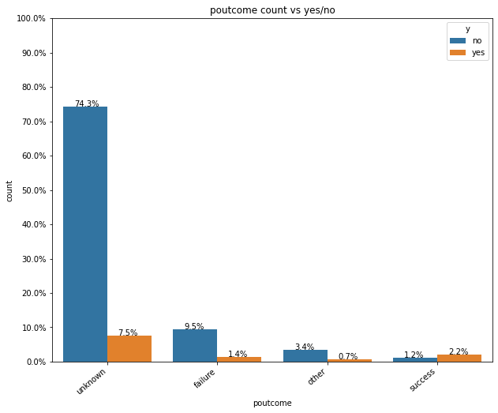
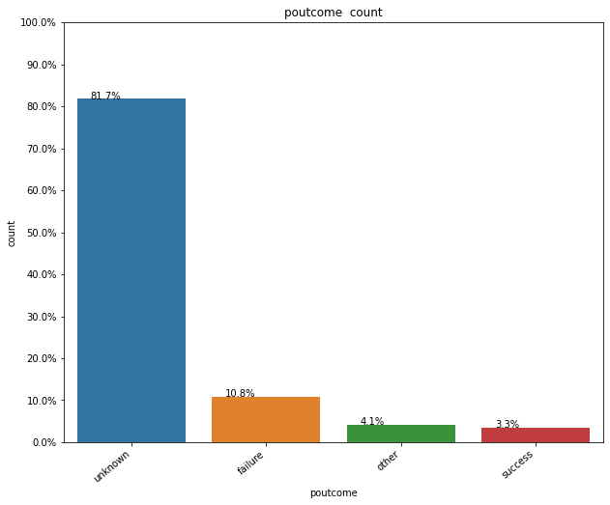
Most customers were contacted last in May.
Most customers have a previous outcome of unknown.

Slide 12
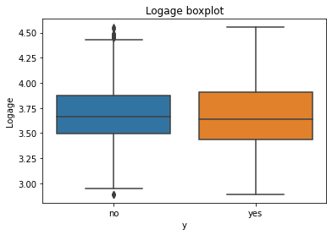
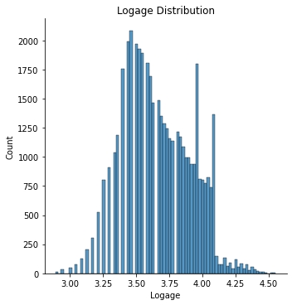
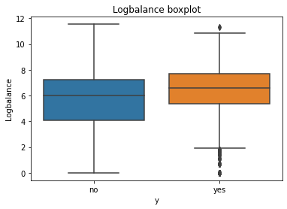
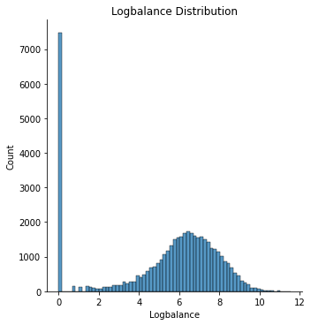
From the boxplot we see the median age of the customer who did and did not subscribe is 37-39. With so much overlap age is not necessarily a good indicator of customers and their subscription choices.
From the distribution we see that most of the customers are between 30-45.
The median for balance is about the same for customers who subscribe as well as those who do not subscribe.
There is a lot of overlap so balance does not seem useful.

Slide 13
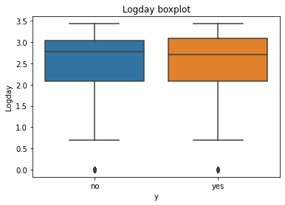
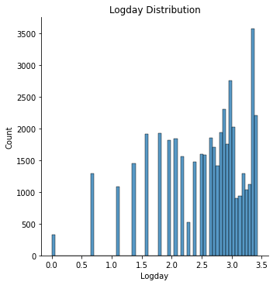
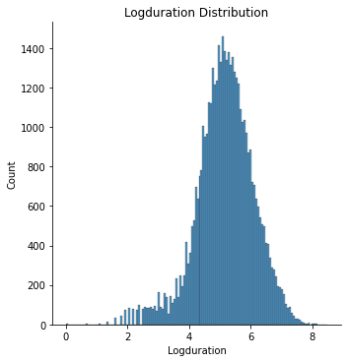
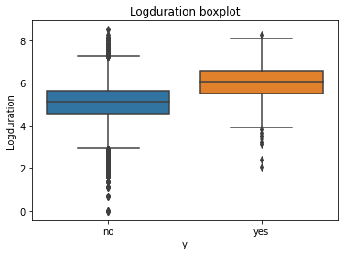
The median for the day customers subscribe or do not subscribe is between 15-16.
The distribution shows the most customers are between days 5 and 20. With so much overlap the day does not seem useful.
The duration has very little overlap so it will be useful in indicating subscription choices

Slide 14
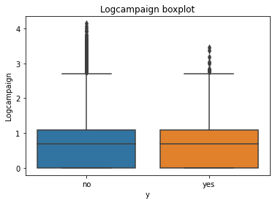
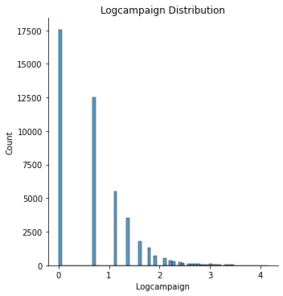
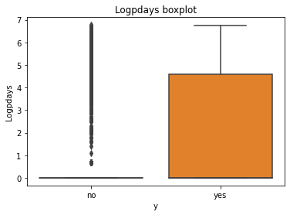
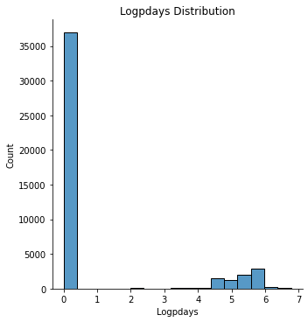
The campaign and pdays has very little overlap so they will be useful in indicating subscription choices

Slide 15
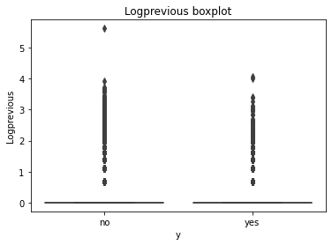
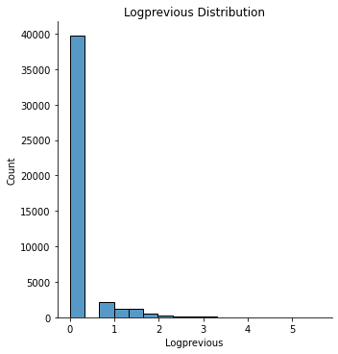
The customers fall between 0-0.25 for previous.

Slide 16
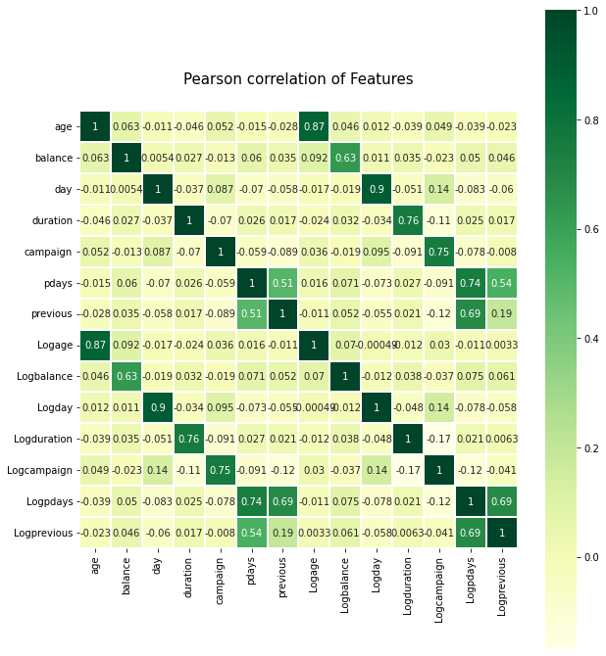
Previous and pdays have the highest correlation. They have a positive correlation of 0.69.

Slide 17
Recommendations
Previous and pdays have the highest correlation.
The campaign and pdays has very little overlap so they will be useful in indicating subscription choices.
The duration has very little overlap so it will be useful in indicating subscription choices.

