Slide 1
Professional Practices
“The Structure of Organizations”

Slide 2
Contents
Organization
Legal Forms of Organizations
Sole proprietorship
Partnership
Corporation
Structure of Organization
Companies
SMEs

Slide 3
Organization
“An organized group of people with a particular purpose, such as a business or government department.”

Slide 4
Organization
It is impossible to live in a civilized society without close contact with many large organizations such as
Schools
Universities
Government departments
Health service
Commercial and industrial companies
Notes:
Despite huge variety, there are many ways in which they resemble each other.

Slide 5
Legal Form of Organization
The legal form of organization in business plan is used to decide how the organization will function, how roles will be arranged and assigned, and how relationships will work.

Slide 6
Legal Form of Organization
Organizations should also be given legal existence separate from that of its proprietors....and that is done through a process known as “Incorporation”.
After adopting any specific legal configuration, organizations take different legal forms.
Three basic legal forms of organization are Sole Proprietorship; Partnerships and Corporations.
Notes:
Why?
Making ionto a body

Slide 7
Legal Form of Organization
Sole Proprietorship
The vast majority of small businesses start out as sole proprietorships.
These firms are owned by one person, usually the individual who has day-to-day responsibility for running the business.
Sole proprietorships own all the assets of the business and the profits generated by it.
They also assume complete responsibility for any of its liabilities or debts.
In the eyes of the law and the public, you are one in the same with the business.

Slide 8
Legal Form of Organization
Partnerships
In a Partnership, two or more people share ownership of a single business.
Like proprietorships, the law does not distinguish between the business and its owners.
The Partners should have a legal agreement that sets forth how decisions will be made, profits will be shared, disputes will be resolved, how future partners will be admitted to the partnership or what steps will be taken to dissolve the partnership when needed.
They also must decide up front how much time and capital each will contribute, etc.

Slide 9
Legal Form of Organization
Corporations
A corporation is an organization—usually a group of people or a company—authorized by the state to act as a single entity and recognized as such in law for certain purposes
A Corporation, chartered by the state in which it is headquartered, is considered by law to be a unique entity, separate and apart from those who own it.
A Corporation can be taxed; it can be prosecuted; it can enter into contractual agreements.
The owners of a corporation are its shareholders.
The shareholders elect a board of directors to oversee the major policies and decisions.
The corporation has a life of its own and does not dissolve when ownership changes.
Notes:
Examples

Slide 10
Structure of Organization
An organizational structure is a hierarchical outline of a company's roles, teams, and employees. Organizational structures describe what employees do, whom they report to, and how decisions are made across the business.
The organizational structure also determines how information flows between levels within the company.

Slide 11
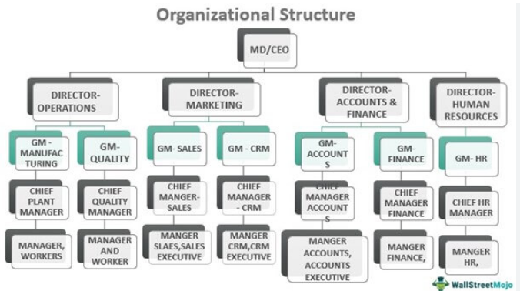
For Example

Slide 12
Companies
A company is a legal entity made up of an association of people.
Company members share a common purpose, and unite in order to focus their various talents and organize their collectively available skills or resources to achieve specific, declared goals.
Notes:
Difference between organization and company?
A company is any form of business whether it is small or large. Generally the term "company" indicates a particular kind of business dealing in a specific product.
An organisation is the larger form and generally comprises of a number of companies. Simply, a company is an organization, but an organization is not just a company.

Slide 13
Companies
The essence of a company is that it enjoys an independent existence as a legal person.
Ownership of the company is divided into a number of shares.
An individual or another company may own one or more shares.
Individuals who own shares in a company are known as the shareholders or members of the company.

Slide 14
Companies
Public companies are allowed to offer their share to the public and their names must end with the word “Public limited company”.
A public company has a minimum paid up capital of Rs. 5 lacs.
There is no limit for the number of members.
Notes:
But not necessarily do so....

Slide 15
Companies
A private company cannot offer its shares to the public and its name must end with the word “limited”.
It has a minimum paid up capital of Rs. 1 lakh.
It has limited members up to 200.
It prohibits any invitation from public for subscription to shares and any acceptance of deposits from persons other than members or directors.

Slide 16
Difference
The major difference between the two is that: An organization works for the greater good and has a common shared purpose. A company's primary goal is to earn a profit through commercial business activities.

Slide 17
SMEs
SME’s are the key elements for the economic engine of countries.
SMEs are defined differently in the legislation across countries, and specifically based on policy targets.
Generally, SME defined as a business entity and categorized on employment strength, asset values or sale values.
Group | No. of Workers | Annual turnover
Micro | 1-5 | 20 Million
Small | 6-20 | 75 Million
Medium | 21-50 | 400 Million
Large | 51+ | More than 400 Million
Pakistan has emerged as the rapid growing economy in Asia.
Even though the large scale manufacturing registered 15.4% growth but SMEs are the core issue in the country’s progress and especially for the prosperity of masses that are surviving with low scale income due to which Pakistan ranks 135th out of 174 countries of HDI. SMEs in Pakistan is of vital importance.
Notes:
(zhōng xiǎo qǐ yè) Akhter believes that SMEs are pillars for economic growth and competitiveness.
japan less than 100 workforce and less than 100 million yen annual turn over and China varies sector wise, < 100 staff, is SMEs.
SMEs are central to the efforts to achieve environmental sustainability and more inclusive growth. SMEs will be the main source of poverty reduction in Pakistan that will create the value and innovation for the country in the days to come. The thing that really needs serious attention is to adopt suitable ICT.

Slide 18
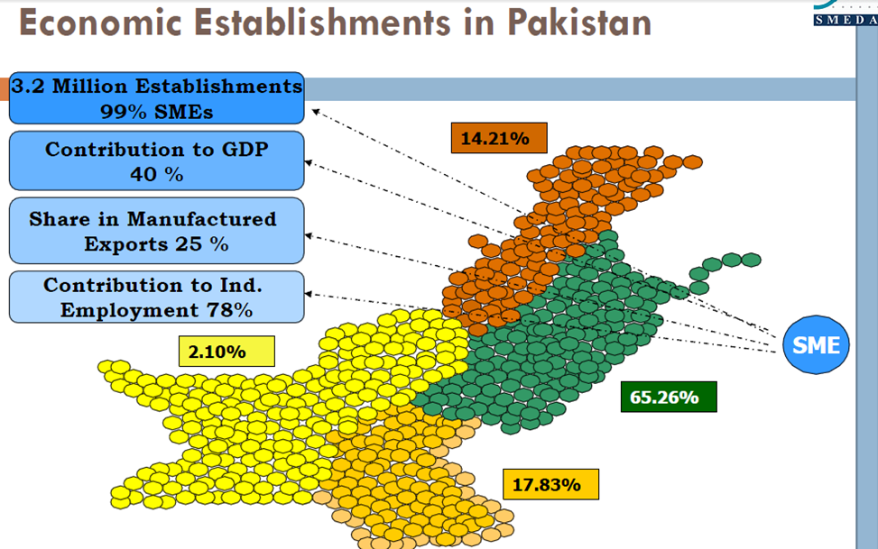
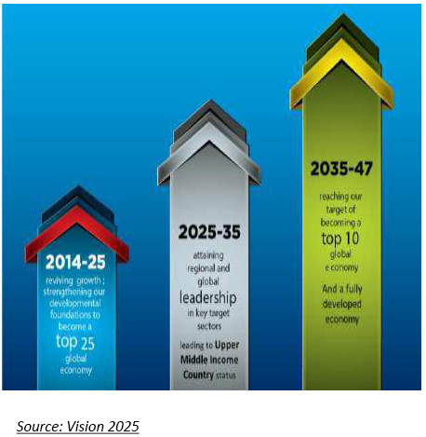
SMEs Contributions
Notes:
Since the SMEs constitute nearly 99% of all the enterprises in Pakistan and share in the annual GDP is 40%, approximately, 25% share in manufacturing exports and 78% share in individual employment of the country. SMEs’ contributions also depend on their access to strategic resources, such as skills, knowledge networks, and finance.
Vision 2025 is an action plan given by govt. pakista, that focus to develop 8 sectors. SMEs is on the priorty.

Slide 19
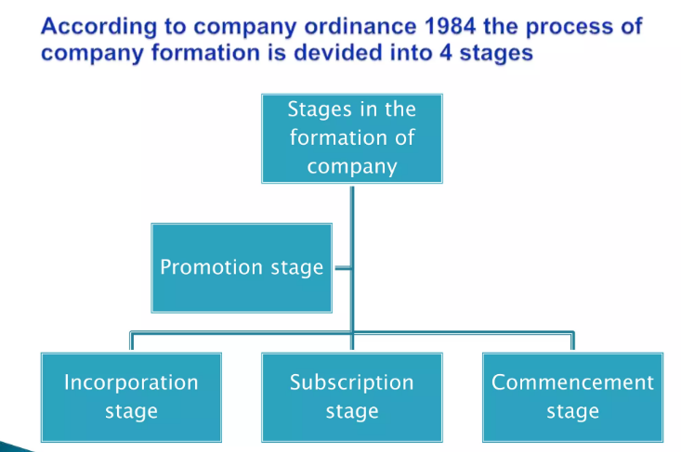

Slide 20
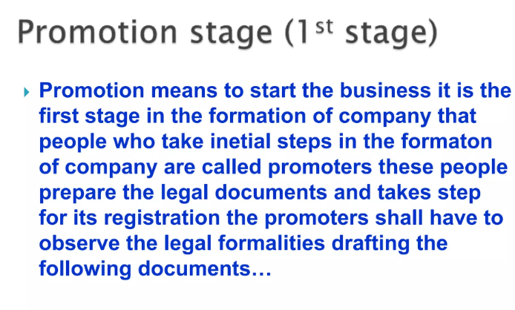

Slide 21
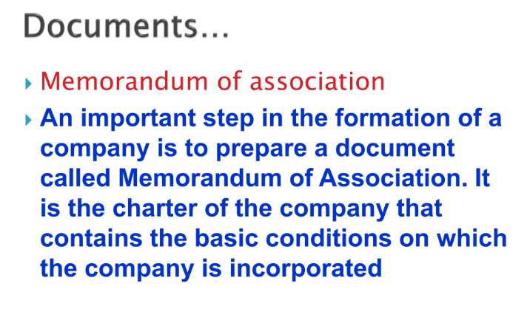

Slide 22
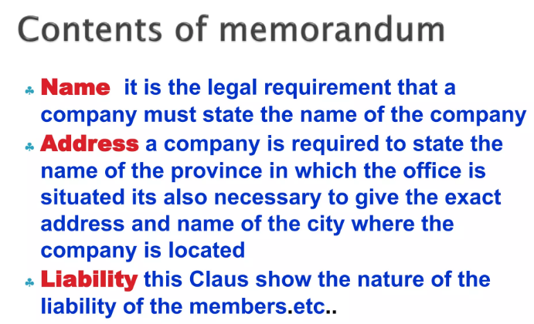

Slide 23
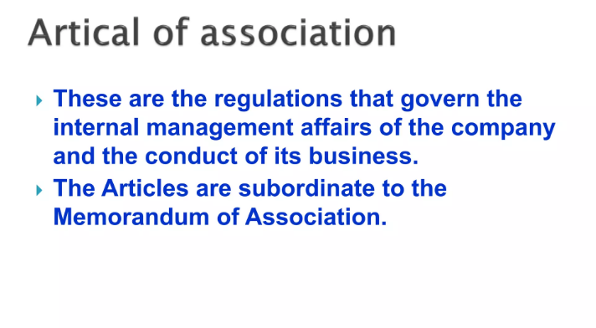

Slide 24
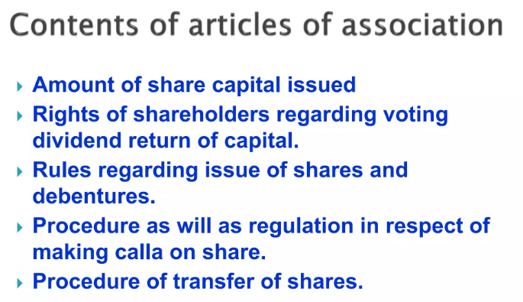

Slide 25
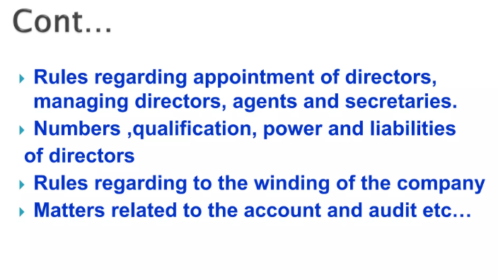

Slide 26
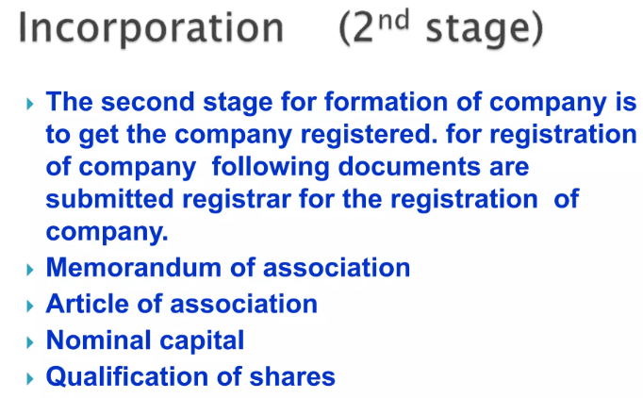
Notes:
Qualification shares are the minimum number of shares a person must own, as provided in the articles of the company, in order to qualify to become a director of the company.

Slide 27
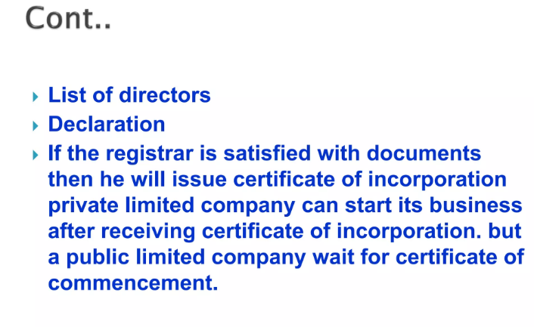

Slide 28
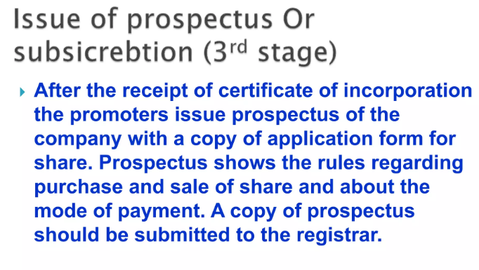

Slide 29
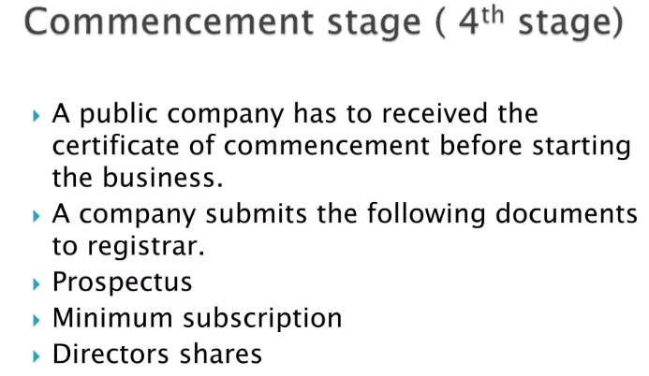

Slide 30
