Slide 1
Professional Practices
“Anatomy of a Software House”

Slide 2
Anatomy
Anatomy is study of
Structure
Organization
Internal working
Hierarchy chart
Notes:
A study of structure and internal working of something.

Slide 3
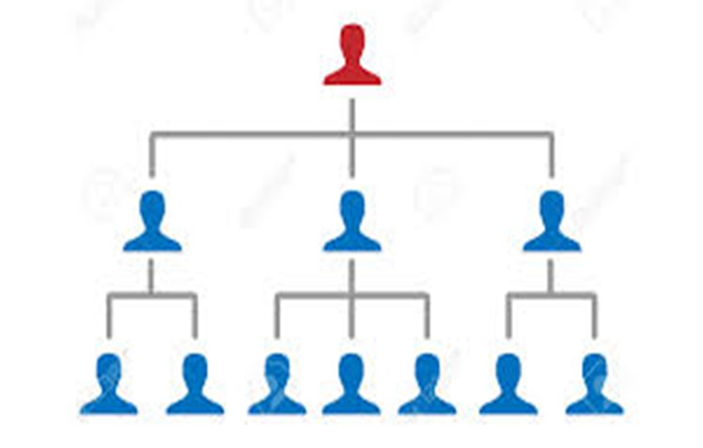
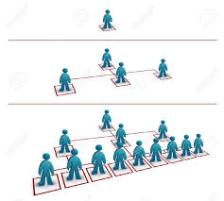
Anatomy may look like

Slide 4

Or like this… There are teams out there!

Slide 5
Software House
“A software house is a company that primarily provides software products. These companies may specialize in business or consumer software or software-as-a-service (SaaS) products. The common definition is that the company is mainly interested in developing and distributing software products”
Usually, the product lifecycle of software houses consists of three stages known as design, coding, and testing.
Notes:
Designing consists of both technical specifications and user interface.
Coding is a language written using protocol of language to develop apps, software's, etc.
Software testing is the process of evaluating and verifying that a software product or application does what it is supposed to do.

Slide 6
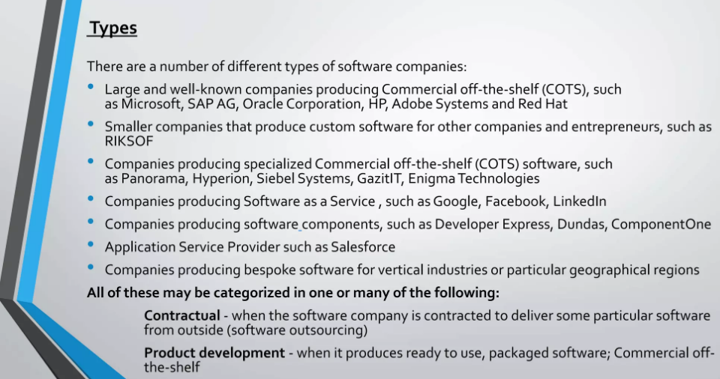

Slide 7
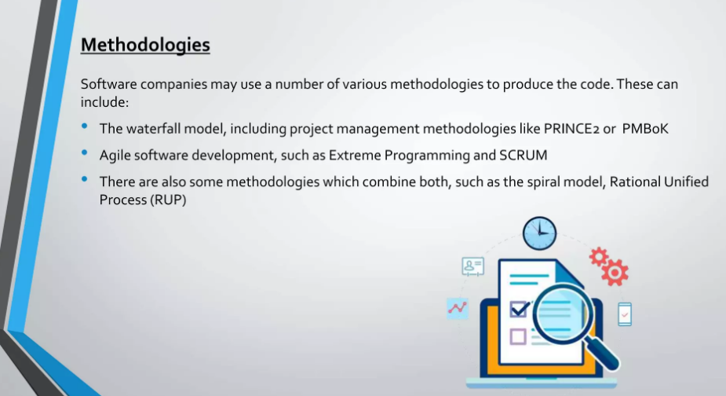

Slide 8
P@SHA
P@SHA/PASHA is a functional trade body and registered association for the IT industry in Pakistan, primarily to promote and develop the software and services industry in Pakistan and to protect the rights of its members.

Slide 9
SW House Product
Web designing service
Mobile Apps Development
Custom Software Development
Ecommerce Development
Software Quality Assurance
Online Applications
IT Consultancy & Support Service etc

Slide 10
TOP Ten SW Companies in Pak:
https://www.icreativez.com/software-companies-in-pakistan.aspx
Explore the above link and find Portfolio , Anatomy of Software Houses, Legal Forms,. ETC.

Slide 11
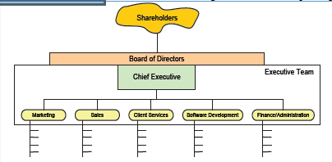
Anatomy of a software House

Slide 12
Shareholders
Owners of the company
Elect the board of directors
Vote on issues
Same for private and public companies
Notes:
A shareholder is any person, company, or institution that owns shares in a company's stock. A company shareholder can hold as little as one share.
The shareholders of a company are effectively the company's financial supporters. They provide finance to a company by purchasing shares in the company, and thus become shareholders – and part owners of the company.
The number of shares decides their percentage of ownership

Slide 13
Board of Directors
Represent shareholders interests
Governing the organization by establishing broad policies and setting out strategic objectives.
Selecting, appointing, supporting and reviewing the performance of the chief executive Officer
Terminating the chief executive Officer.

Slide 14
Board of Directors
Ensure the availability of adequate financial resources
Approve annual budgets
Accountable to the stakeholders for the organization's performance
Set the salaries, compensation and benefits of senior management

Slide 15
Chief Executive Officer
Appointed by the board of directors
Communicate, on behalf of the company, with shareholders, government entities, and the public
Lead the development of the company’s short- and long-term strategy
Create and implement the company or organization’s vision and mission
Evaluate the work of other executive leaders within the company.

Slide 16
Executive Team
Vp level officers; Managed by CEO
In charge of day to day functional areas
Meet regulararly to coordinate strategy, budget etc
Manage the Group's business as a whole
Have extensive authorities within their individual areas of responsibility and have the duty to develop the company's operations in line with the targets set by the Board of Directors and the CEO.

Slide 17
Marketing
Create awareness of and develop the brand you're marketing
Communicate with target audiences and build and develop customer relationships
Help with marketing plans, advertising, direct marketing and campaigns.

Slide 18
Sales
Conduct market research to identify selling possibilities and evaluate customer needs
Actively seek out new sales opportunities through cold calling, networking and social media
Set up meetings with potential clients and listen to their wishes and concerns
Notes:
Cold calling is the solicitation of business from potential customers who have had no prior contact with the salesperson conducting the call. Cold calling is an attempt to convince potential customers to purchase either the salesperson's product or service.

Slide 19
Sales
Prepare and deliver appropriate presentations on products/ services
Create frequent reviews and reports with sales and financial data
Ensure the availability of stock for sales
Negotiate/close deals and handle complaints or objections

Slide 20
Client Services
Develop and maintain existing client relationships.
Interact and correspond with prospective clients.
Identify, develop and maintain relations with potential clients to drive billed revenue for attaining set revenue targets.
Develop and execute yearly formal business plan for assigned territory.

Slide 21
Software Development
Develop, manage and prepare best software development team.
Provide project management and technical leadership for every aspect of software.
Prepare lifecycle for different projects inclusive of research, design, development, evaluation, testing along with delivery.

Slide 22
Software Development
Supervise architecture plus lead efforts to develop technical roadmap of all projects.
Establish and stimulate software development standards and processes along with best practices for delivery of scalable and high quality software.
Perform closely with Engineers, Developers and Product Management throughout organization to influence product development assisting or improving products.

Slide 23
Finance and Admin
Overall responsibility for all aspects of financial management and control.
Effective financial reporting in a timely, accurate, relevant and informative manner.
General administration duties.

