Slide 1
Django
Presenters:
Emad Aghayi
Anne Martine Augustine

Slide 2
What is Django?
A web development framework for Python
Is for perfectionists with deadline
Suitable for
Dynamic and database driven websites
Content based websites
Ex: Craigslist, Google AppEngine
Named after famous Guitarist “Django Reinhardt”
Open sourced and first version released 2008

Slide 3
Architecture
MVT Architecture and MVC Design Patern
Model: describes data strucure
Views: controls what a user sees
Template: How a user sees it
Controller: Django framework, URL parsing

Slide 4
Important Modules
CRUD interface
Authentication
Form handler
Session manager
localiziation

Slide 5
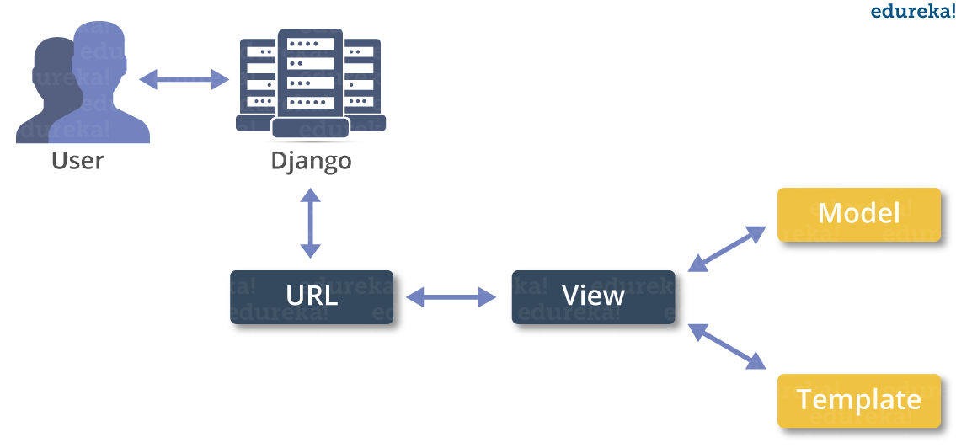
Django Architecture
[1]: https://www.edureka.co/blog/django-tutorial/

Slide 6
Why Django? Advantages
MVC design pattern: modulate the code
Auto web admin to ease the website administration
Avoid code duplication by HTML template (DRY Principle)
Schema and setting is in python

Slide 7
Demo
Steps:
Create a project
Start the application
Create the database
Define setting in Setting.py
Define models, templates, views
Create URL mapping
Deployment

Slide 8
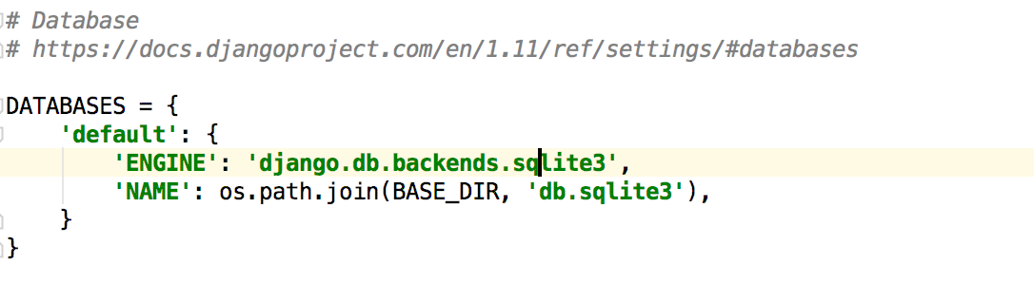
Demo …
You can do steps 1, 2 very easily vie PyCharm IDE
Step3: Database configuration is done in Setting.py file

Slide 9
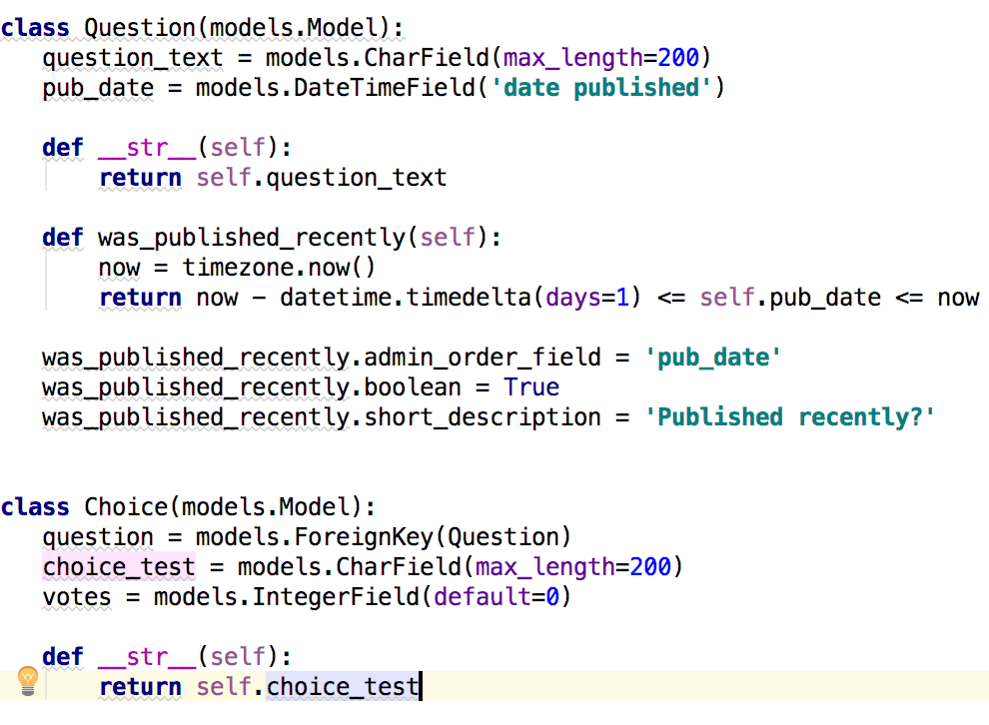
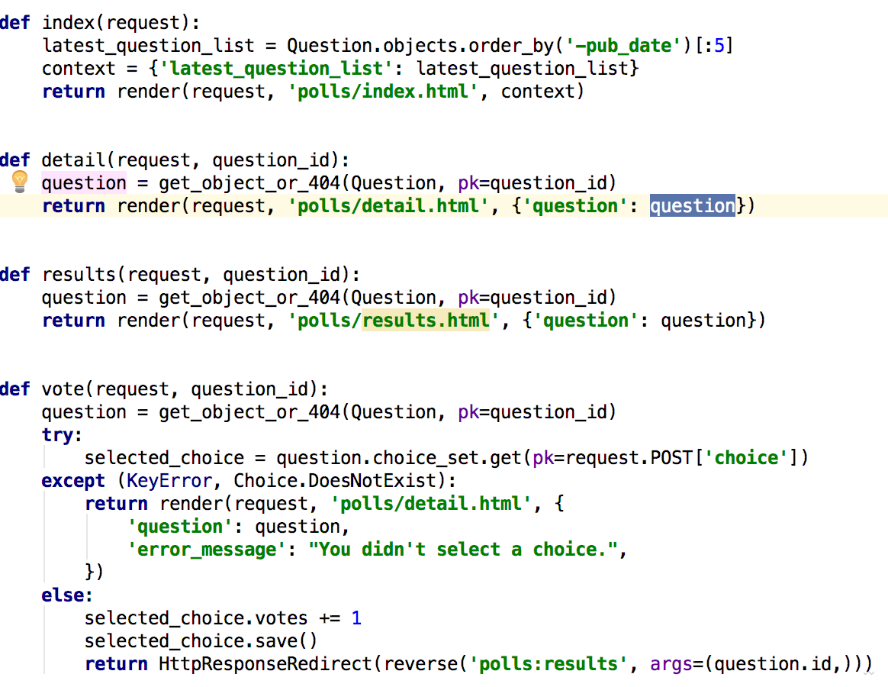
Demo…
Step5: Define Model Step5: Define View

Slide 10
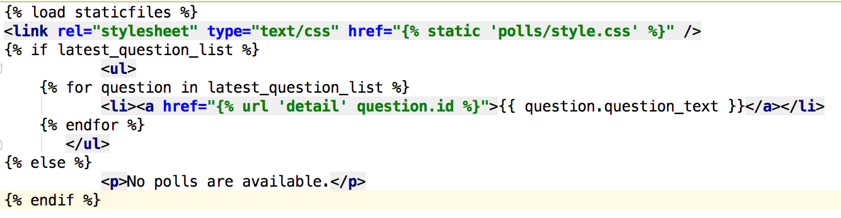
Demo …
Step 5: Define Template

Slide 11
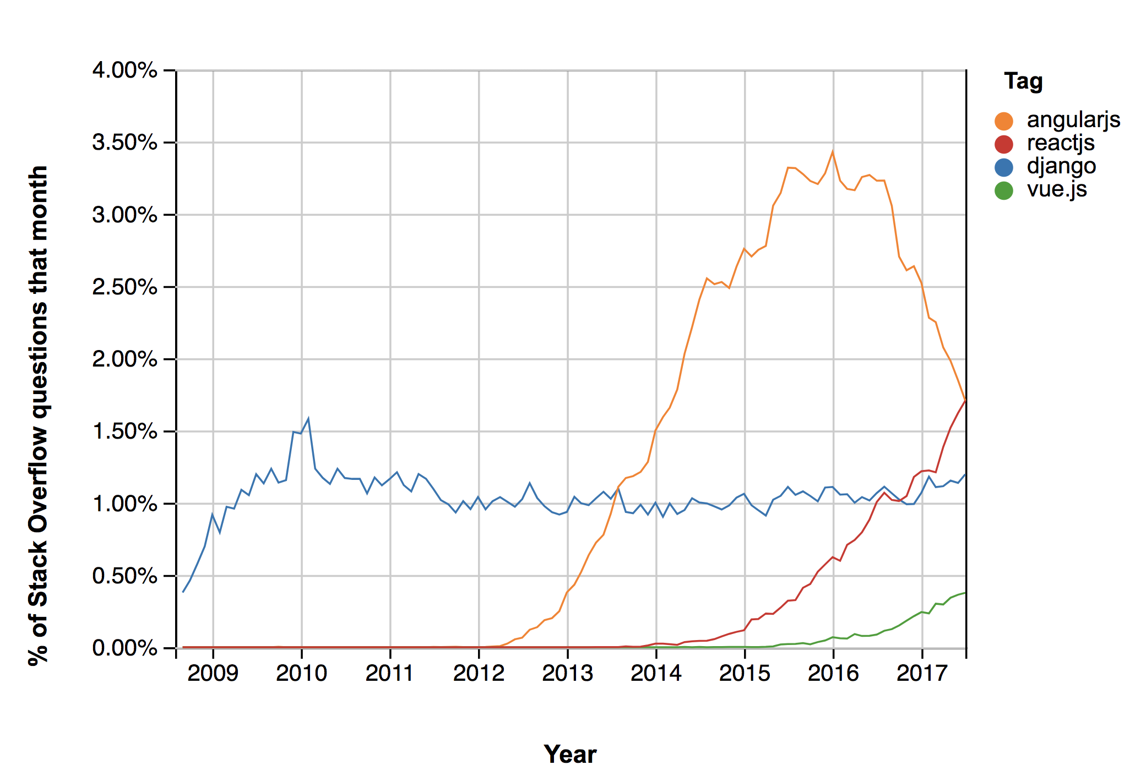
Stack Overflow Trends

Slide 12
Sum-up
Advantages (+)
Fast: Thus it becomes an ideal solution for developers having a primary focus on deadlines.
Fully Loaded: It works in a way that includes dozens of extras to help with user authentication, site maps, content administration, RSS feeds and much more such things.
Scalable
Disadvantages(-)
Uses routing pattern specify its URL
Django is too monolithic
Everything is based on Django ORM.
Knowledge of full system is required to work.

Slide 13
Question
Information for learning Django:
A website for finding more information about Django
https://www.djangoproject.com
A simple web app on the GitHub
https://github.com/eaghayi/Polls
Refrences
https://www.jetbrains.com/help/pycharm/step-4-creating-and-running-your-first-django-project.html

