Slide 1
pyABC: Likelihood-free Inference
Emad Alamoudi, Yannik Schaelte and Jan Hasenauer
Interdisciplinary Research Unit Mathematics and Life Sciences, University of Bonn
COMBINE 2020 - 05.10.2020

Slide 2
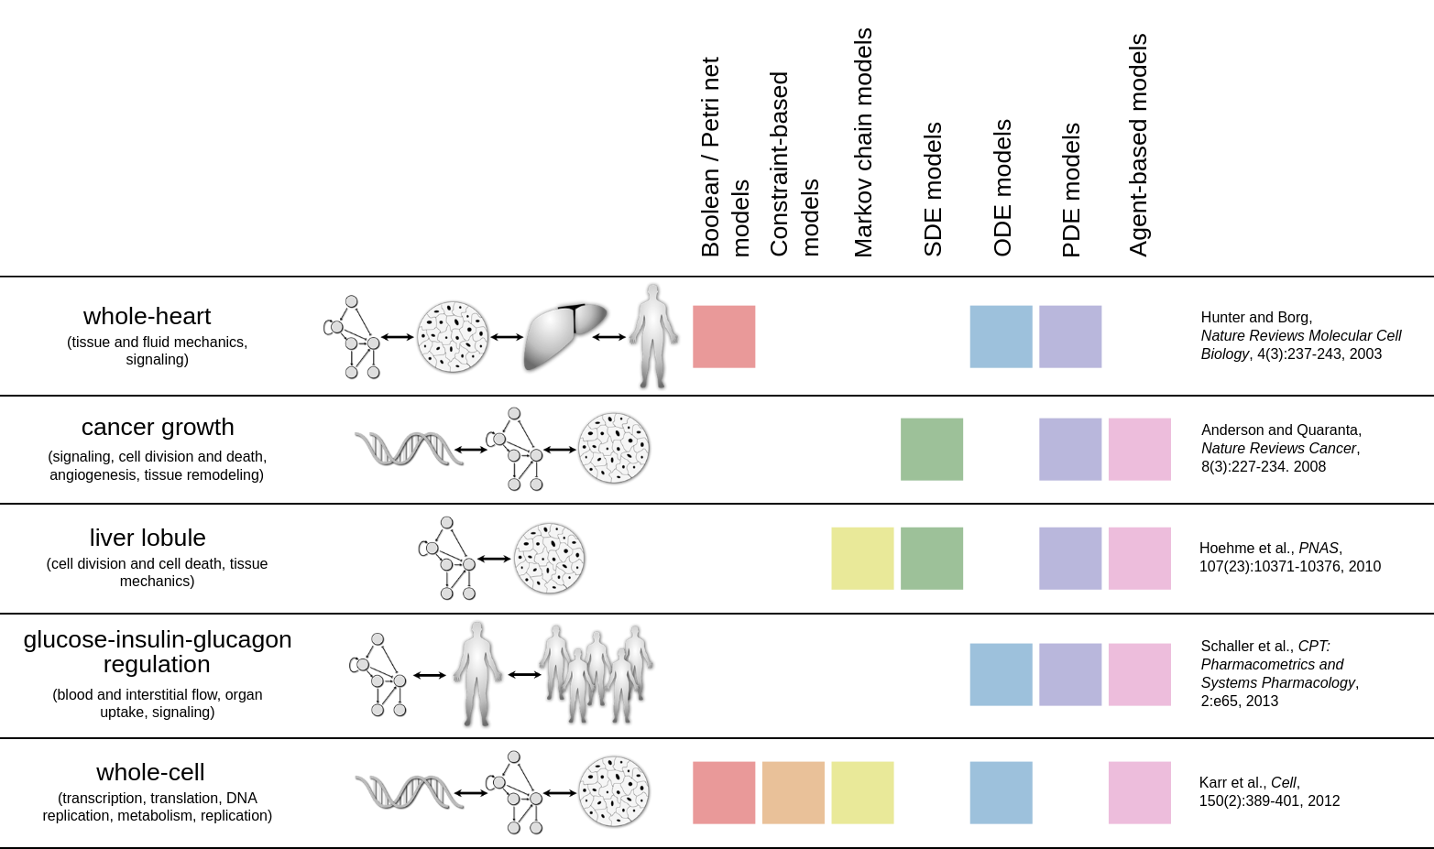
Hasenauer et al., J. Coup. Sys. and Mult. Dyn. 2015
likelihood p(D|θ)
How to infer parameters for complex stochastic models?
<number>

Slide 3


Approximate Bayesian Computation (ABC)
What is ABC?
Replace calculating likelihood by the comparison between the observed and simulated data
Comparison between measurement and simulation
likelihood
posterior
prior
π(y_{obs}|θ) π(θ)
π(θ|y_{obs}) =
π(y_{obs})
When to use ABC?
Likelihood function is expensive or intractable
But, still possible to simulate the data y ~ π(y|θ)
Often the case for complex stochastic models
evidence
<number>

Slide 4

<number>

Slide 5
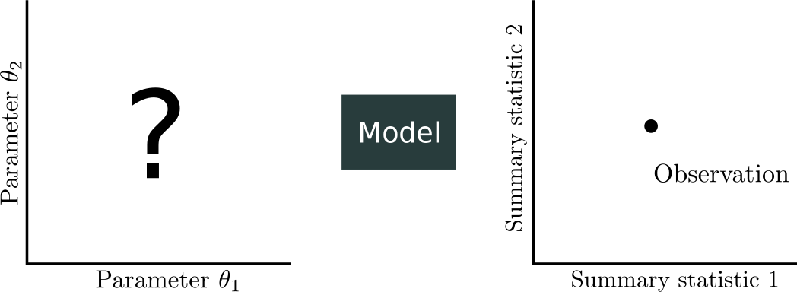
<number>

Slide 6
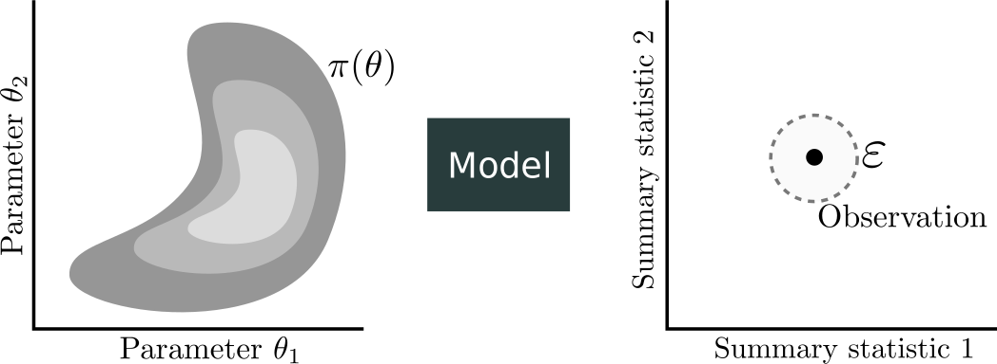
<number>

Slide 7
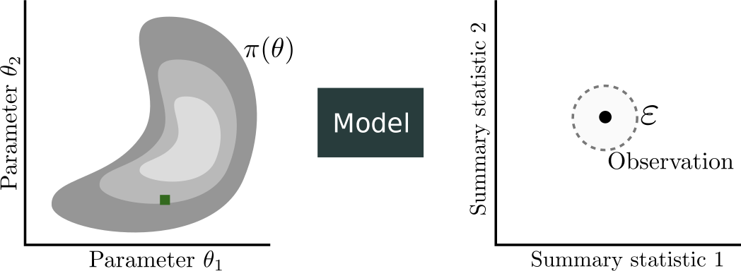
<number>

Slide 8

<number>

Slide 9
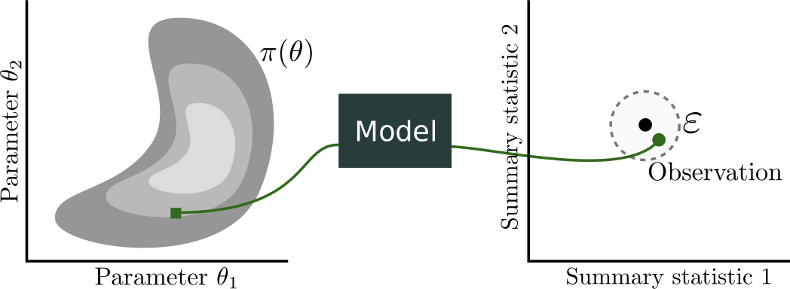
<number>

Slide 10
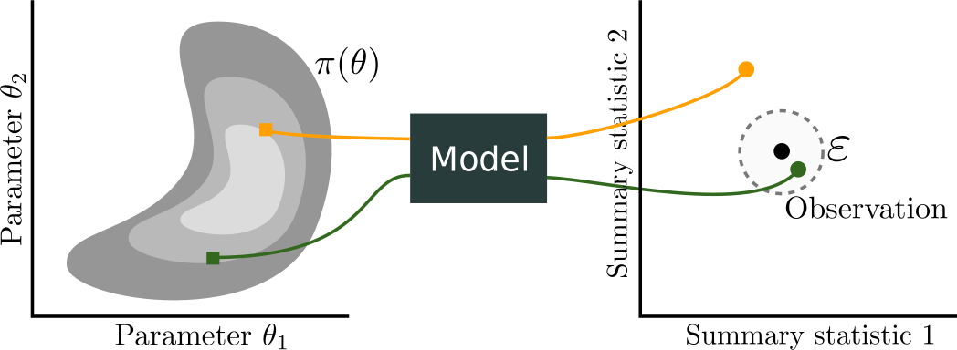
<number>

Slide 11
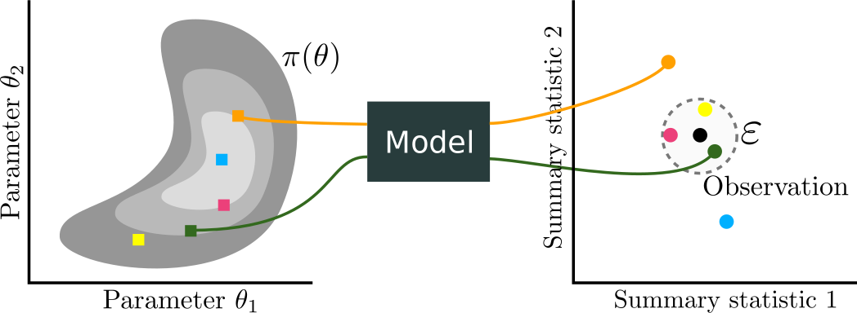
<number>

Slide 12
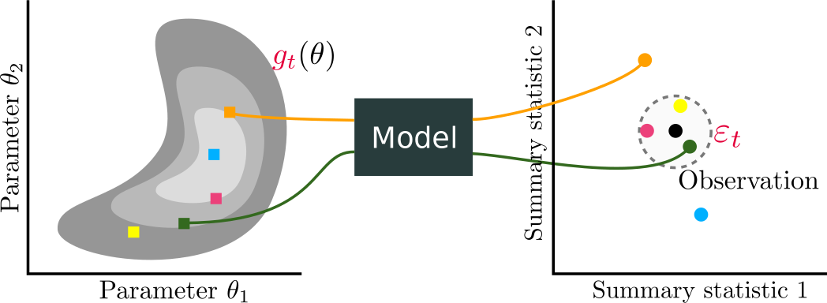
<number>

Slide 13

<number>

Slide 14
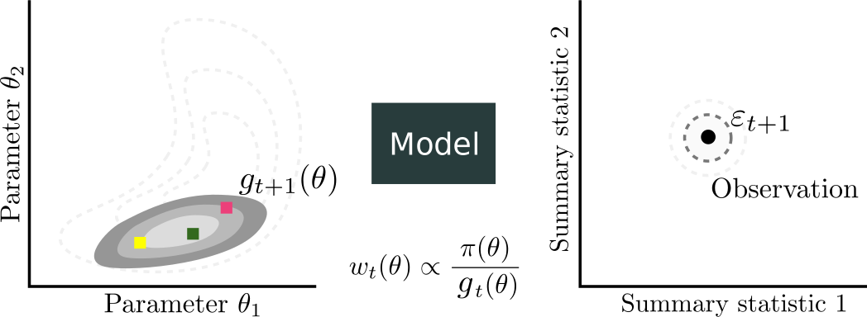
<number>

Slide 15

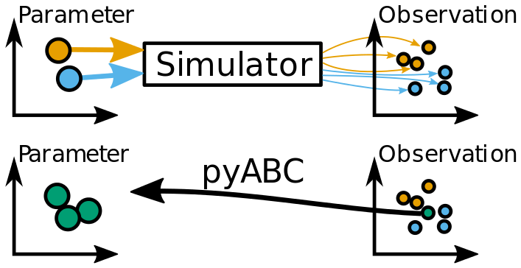

Parameter inference - pyABC
Implement Approximate Bayesian Computing (ABC), and uses an efficient ABC-SMC approach
Goal of ABC:
Infer parameters θ given data y_{obs}, i.e. analyze the posterior distribution
Framework for distributed, scalable, and likelihood-free inference
Already equipped with many handy algorithms:
Adaptive distances, population sizes, transitions kernel
Early rejection
...
Available at: github.com/icb-dcm/pyabc
<number>

Slide 16
What’s new?
Exact inference (Schälte et al.,Bioinformatics, 2020)
Adaptive distance functions
Adaptive transitions for discrete parameters
Support of PEtab
<number>

Slide 17

What we will do?
Fit stochastic chemical reaction kinetics with pyABC
Perform model selection between two competing models
Example
Chemical reaction
Access the example at:
https://bit.ly/36qGOFn
<number>

Slide 18
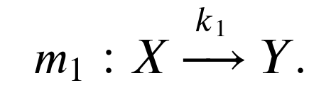
Example: The model
We consider the Markov jump process model 𝑚₁ for conversion of (chemical) species 𝑿 to species 𝒀:
￼
The model has a single rate parameter 𝑘₁
Simulation was carried out using simple Gillespie simulator
<number>

Slide 19
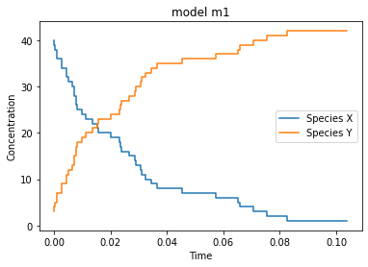
Example: Models simulation
Let’s draw one stochastic simulation from model using 𝑘₁= 1.5 in log10 scale
<number>

Slide 20
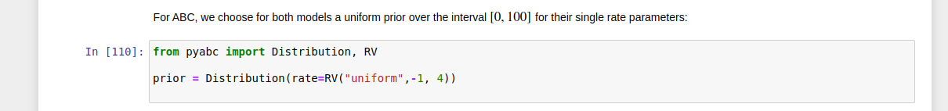
Example: Prior
Using log10 scale for parameter space
Uniform prior over the interval [-1,4] for the rate parameter
<number>

Slide 21
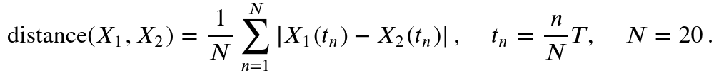
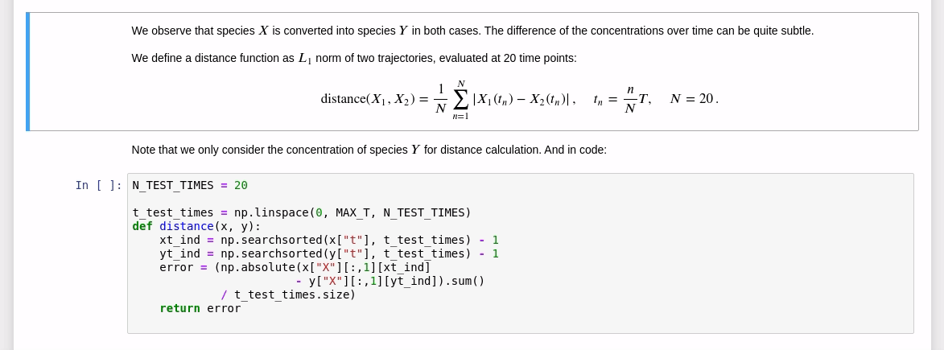
Example: Distance function
Distance function is L₁ norm of two trajectories, evaluated at 20 time points:
<number>

Slide 22
Distance function
Gillespie
Prior
Measurement data
Stopping criterion
<number>

Slide 23
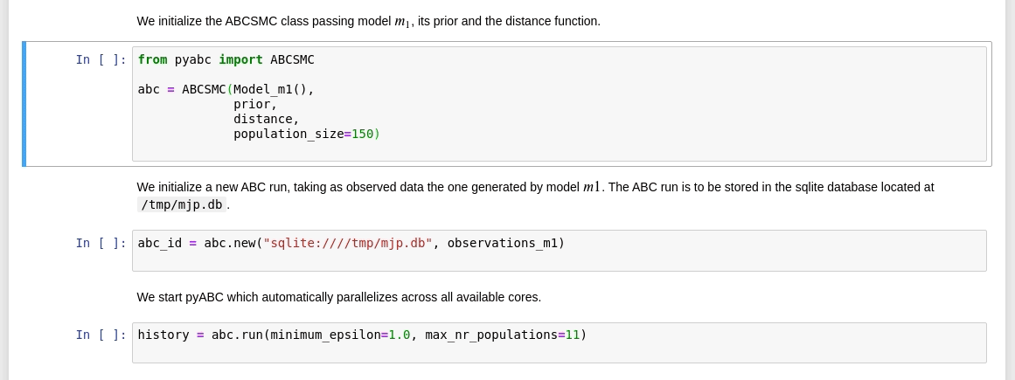
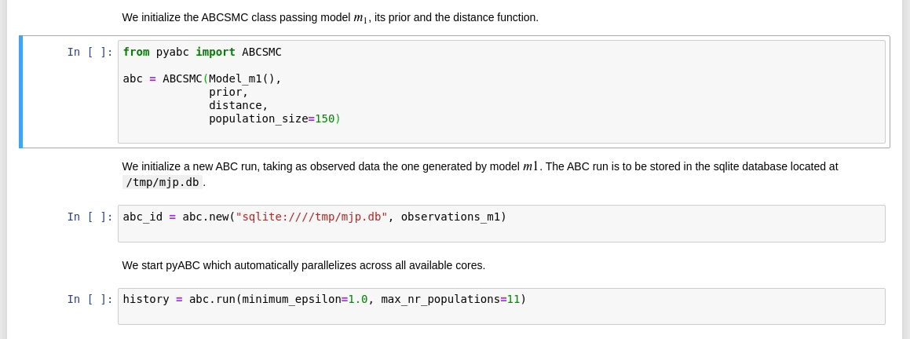
Example: Fitting process
<number>

Slide 24

Example: Model selection
Another Markov jump process models 𝑚₂ for the same conversion of the chemical species:
Inherits the initial concentration from model 𝑚₁
Encoded in pre = [1, 1] and post = [0, 2]
<number>

Slide 25
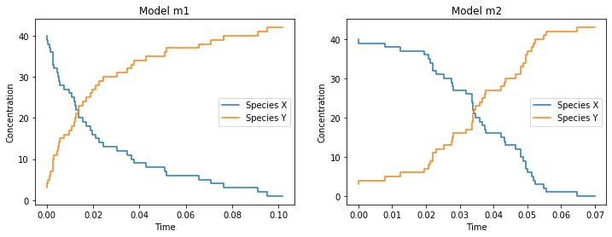
Example: Models simulation
Let’s now draw one stochastic simulation from model using 𝑘₁= 1.5, 𝑘₂= 0.3617 in log10 scale
<number>

Slide 26

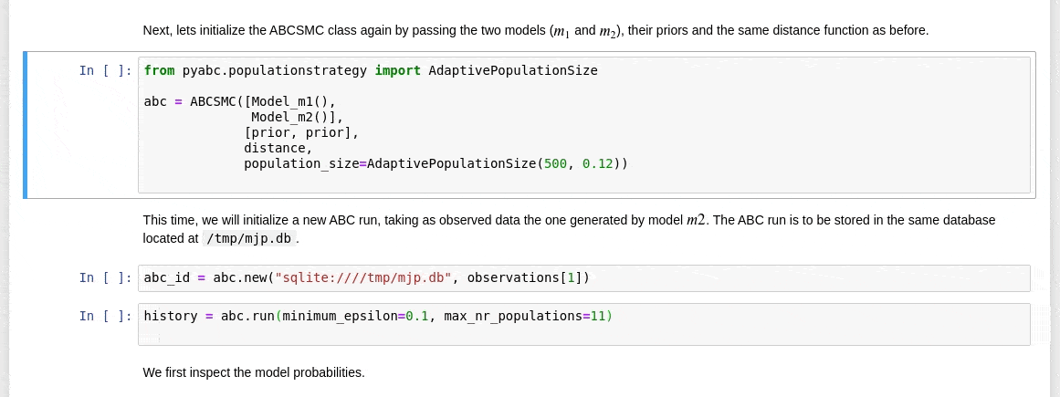
Example: Fitting multiple models
Klinger, et al.,International Conference on Computational Methods in Systems Biology, 2017.
<number>
Notes:
Adapt the population size according to the mean coefficient of variation
error criterion, as detailed in [#klingerhasenaueradaptive]_ .
This strategy tries to respond to the shape of the
current posterior approximation by selecting the population size such
that the variation of the density estimates matches the target
variation given via the mean_cv argument.
Parameters
----------
start_nr_particles:
Number of particles in the first populations
mean_cv:
The error criterion. Defaults to 0.05.
A smaller value leads generally to larger populations.
The error criterion is the mean coefficient of variation of
the estimated KDE.

Slide 27
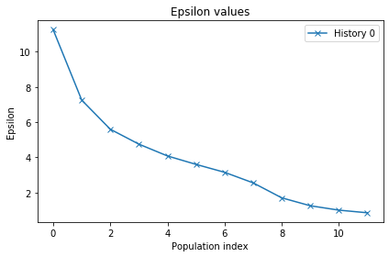
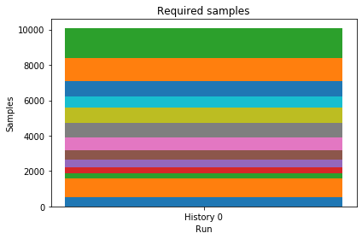
Example: Additional visualization
<number>

Slide 28
Summary
Parameter estimation when we cannot evaluate the likelihood is challenging
ABC allows for reliable statistical inference
Samples from an approximation of the true posterior
pyABC provides a user-friendly, flexible, and scalable framework
already used in multiple applications
<number>

Slide 29
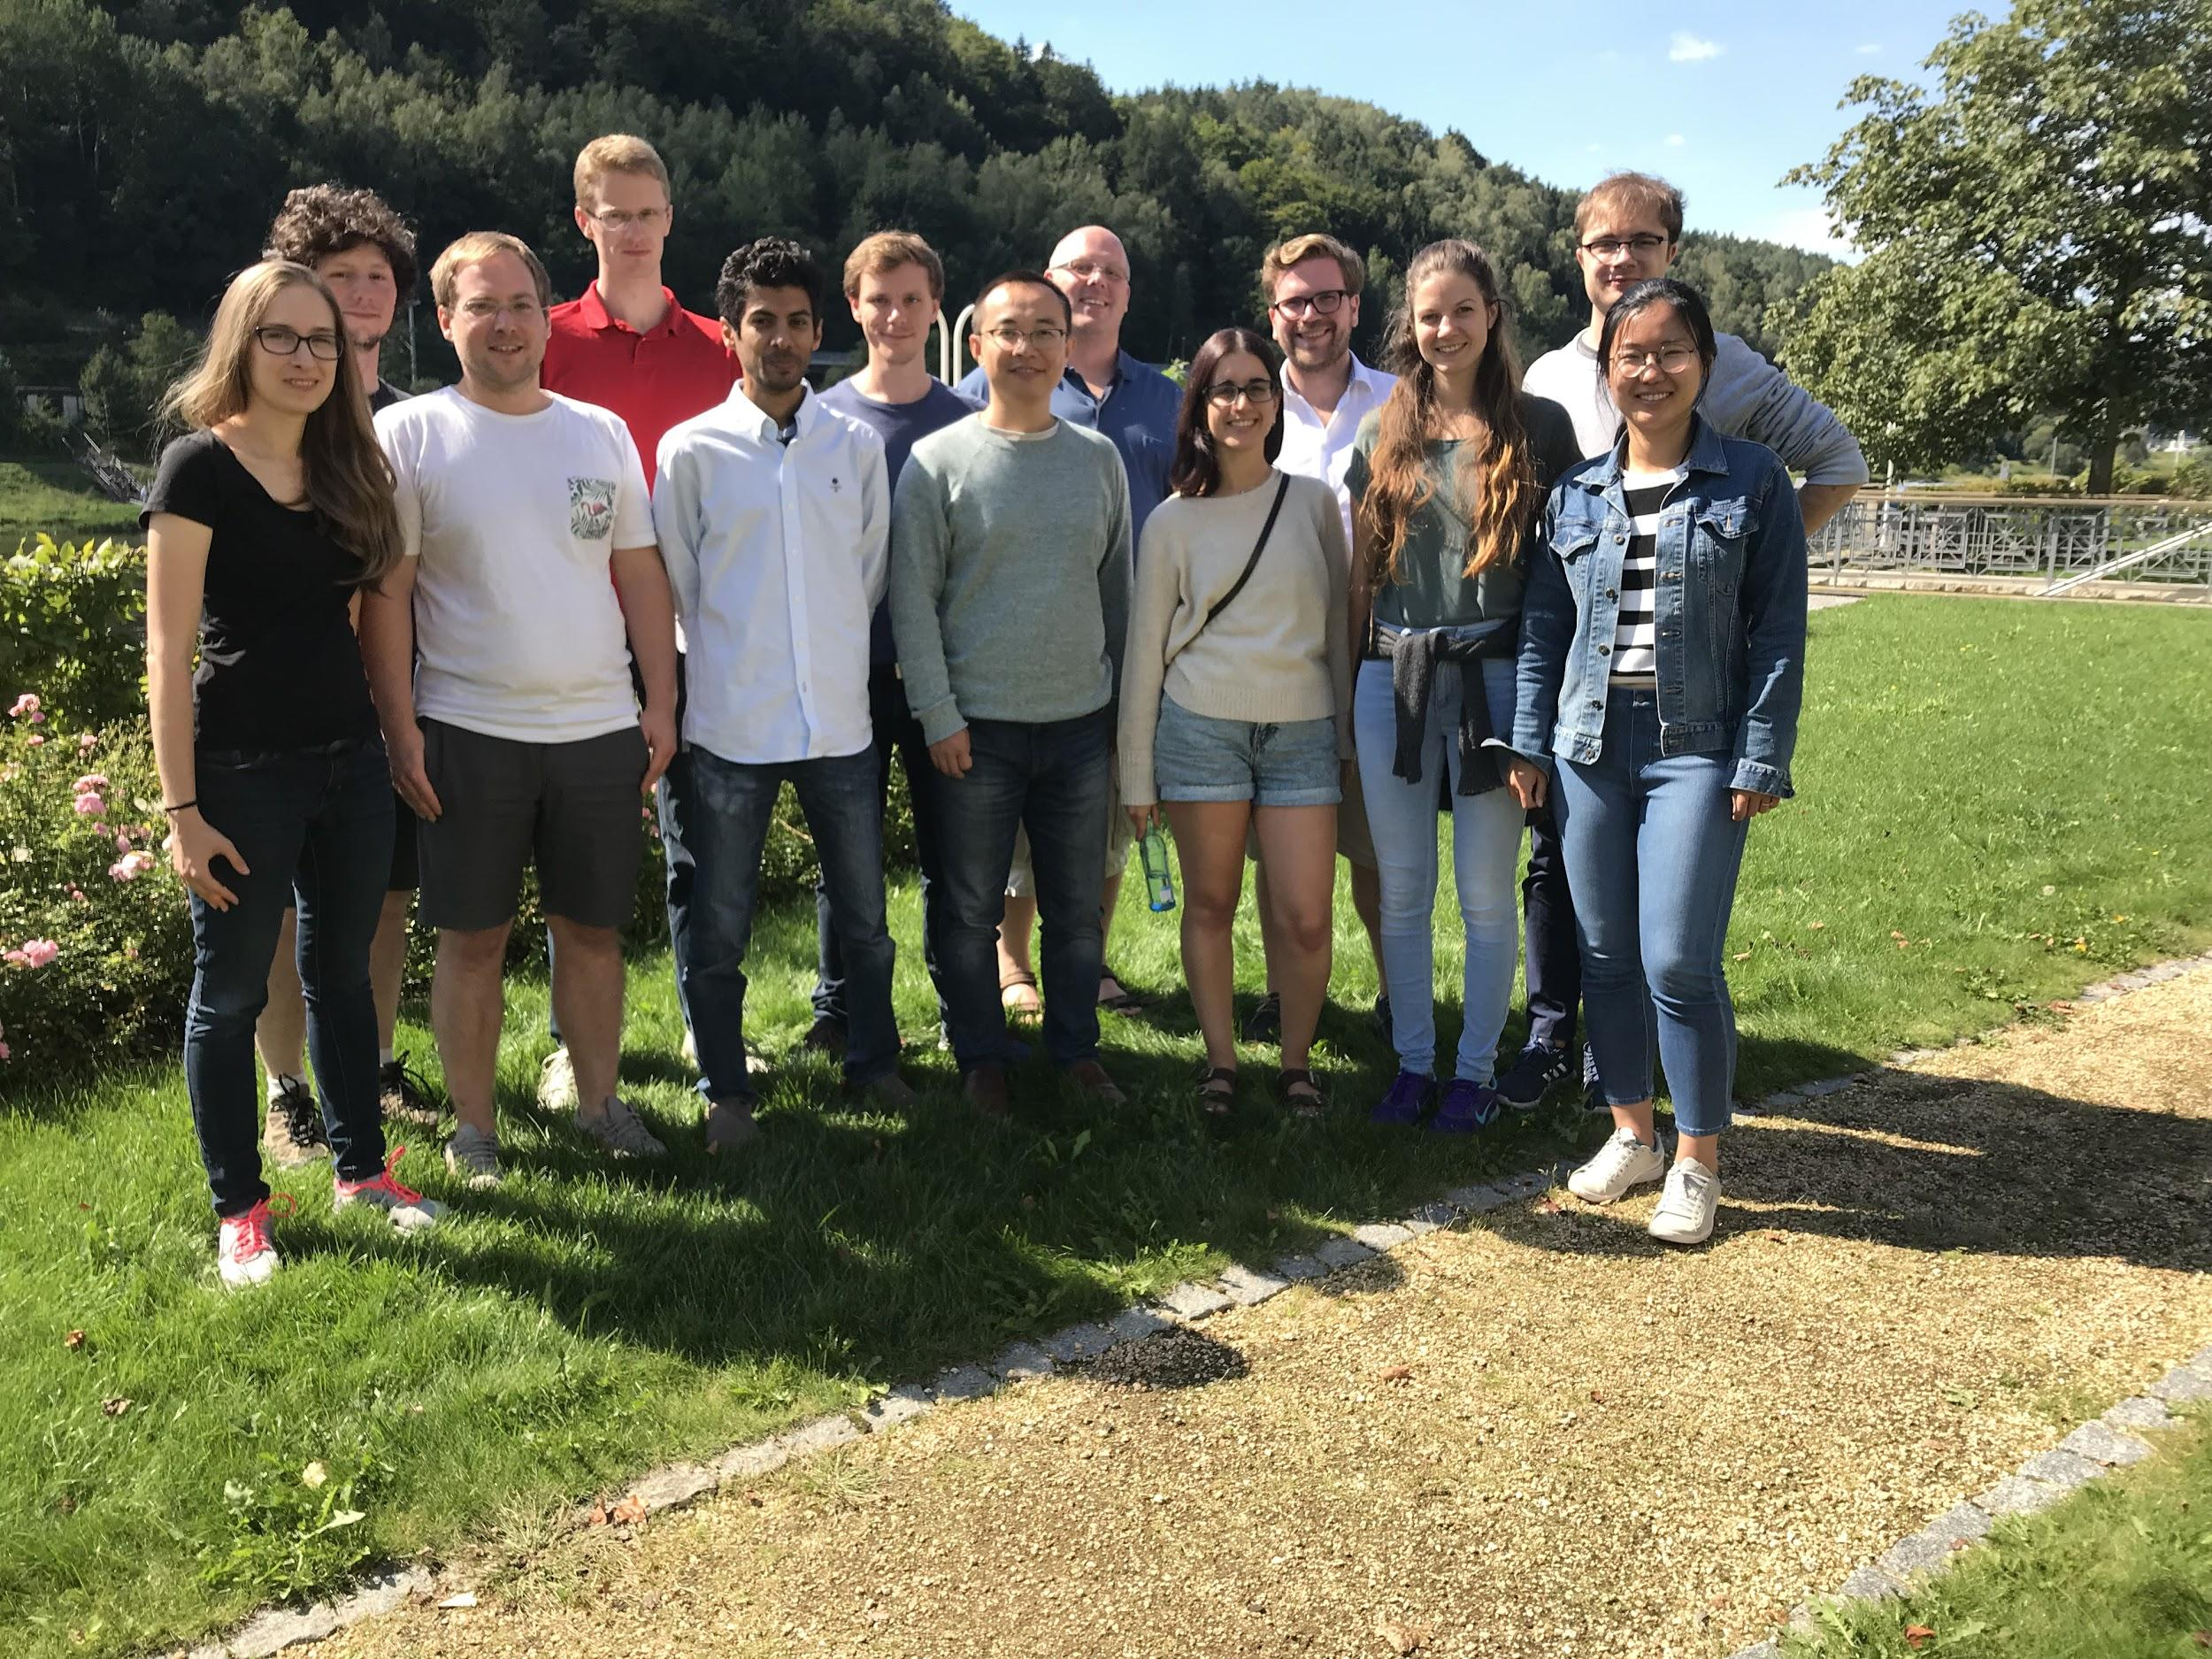

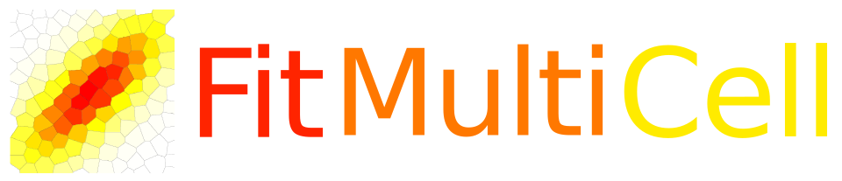



Acknowledgments
Thanks to: Jan Hasenauer, Yannik Schaelte, Elba Raimúndez Álvarez, and the FitMultiCell team
<number>

Slide 30
Thanks
Questions?
<number>

