Slide 1
Essentials of
Systems Analysis and Design
Sixth Edition
Joseph S. Valacich
Joey F. George
Jeffrey A. Hoffer
Appendix A
Object-Oriented Analysis and Design
A.1

Slide 2
Learning Objectives
Key terms
  Association
  Class diagram
  Event
  Object
  Object class
  Operation
  Sequence diagram
  State
  State transition
  Unified Modeling Language (UML)
  Use case
A.2

Slide 3
Learning Objectives (continued)
Discuss the concepts and principles underlying the object-oriented approach
Learn to develop requirements models using use-case diagrams
Learn to use class diagrams to develop object models of the problem domain
Learn to develop requirements models using state and sequence diagrams
A.3

Slide 4
The Object-Oriented Modeling Approach
Benefits
  The ability to tackle more challenging problem domains
  Improved communication among users, analysts, designers, and programmers
  Reusability of analysis, design, and programming results
  Increased consistency among the models developed during object-oriented analysis, design, and programming
A.4

Slide 5
The Object-Oriented Modeling Approach (continued)
Object-Oriented Systems Development Life Cycle
  Process of progressively developing representation of a system component (or object) through the phases of analysis, design, and implementation
  The model is abstract in the early stages
  As the model evolves, it becomes more and more detailed
A.5

Slide 6
The Object-Oriented Systems Development Life Cycle
Analysis Phase
  Model of the real-world application is developed showing its important properties
  Model specifies the functional behavior of the system independent of implementation details
Design Phase
  Analysis model is refined and adapted to the environment
Implementation Phase
  Design is implemented using a programming language or database management system
A.6

Slide 7
The Object-Oriented Systems Development Life Cycle (continued)
Unified Modeling Language (UML)
  A notation that allows the modeler to specify, visualize and construct the artifacts of software systems, as well as business models
  Techniques and notations
    Use cases
    Class diagrams
    State diagrams
    Sequence diagrams
A.7

Slide 8
Use-Case Modeling
Applied to analyze functional requirements of the system
Performed during the analysis phase to help developers understand functional requirements of the system without regard for implementation details
Use Case
  A complete sequence of related actions initiated by an actor
Actor
  An external entity that interacts with the system
A.8

Slide 9
Use-Case Modeling
Use cases represent complete functionality of the system
Use cases may participate in relationships with other use cases
Use cases may also use other use cases
A.9

Slide 10
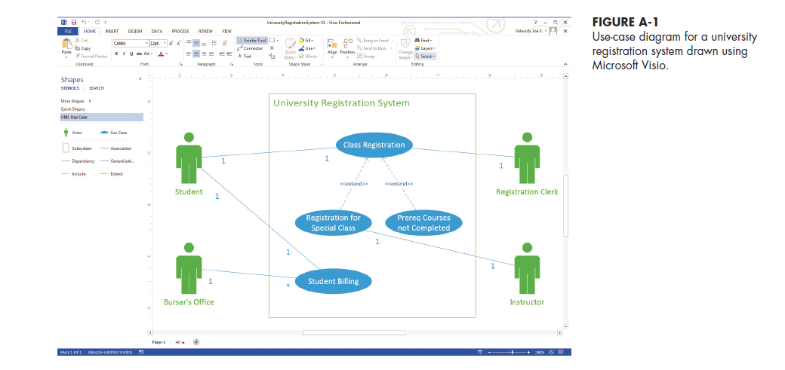
A.10

Slide 11
Object Modeling:
Class Diagrams
Object
  An entity that has a well-defined role in the application domain, and has state, behavior, and identity
State
  A condition that encompasses an object’s properties and the values those properties have
Behavior
  A manner that represents how an object acts and reacts
Object Class
  A set of objects that share a common structure and a common behavior
A.11

Slide 12
Object Modeling:
Class Diagrams (continued)
Class Diagram
  Class is represented as a rectangle with three compartments
  Objects can participate in relationships with objects of the same class
A.12

Slide 13
Object Modeling:
Object Diagrams
Object Diagram
  A graph of instances that are compatible with a given class diagram; also called an instance diagram
  Object is represented as a rectangle with two compartments
Operation
  A function or service that is provided by all the instances of a class
Encapsulation
  The technique of hiding the internal implementation details of an object from its external view
A.13

Slide 14
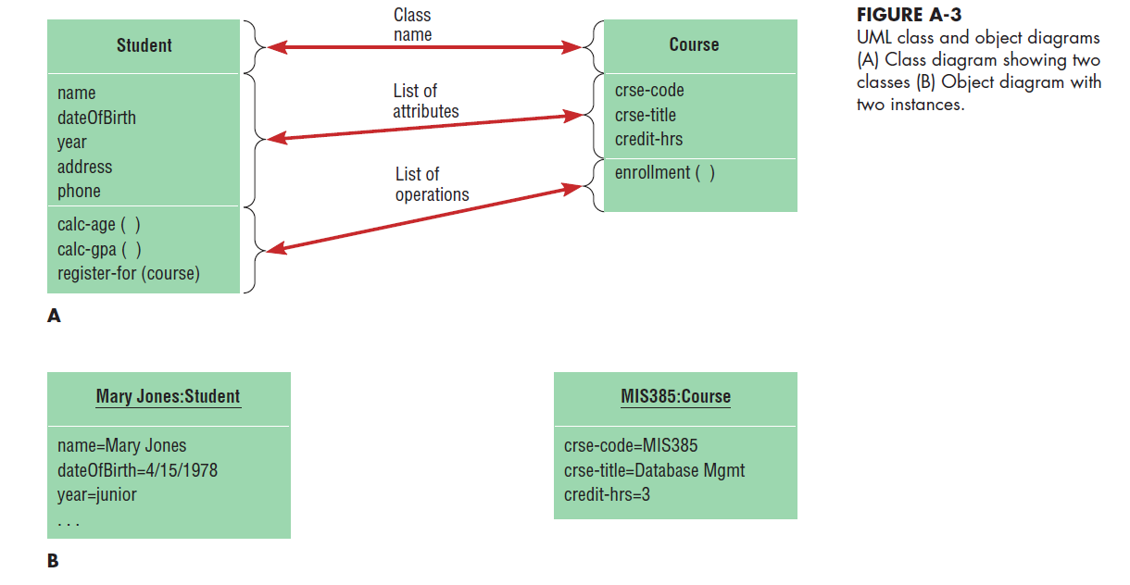
A.14

Slide 15
Representing Associations
Association
  A relationship between object classes
  Degree may be unary, binary, ternary or higher
  Depicted as a solid line between participating classes
Association Role
  The end of an association where it connects to a class
  Each role has multiplicity, which indicates how many objects participate in a given association relationship
A.15

Slide 16
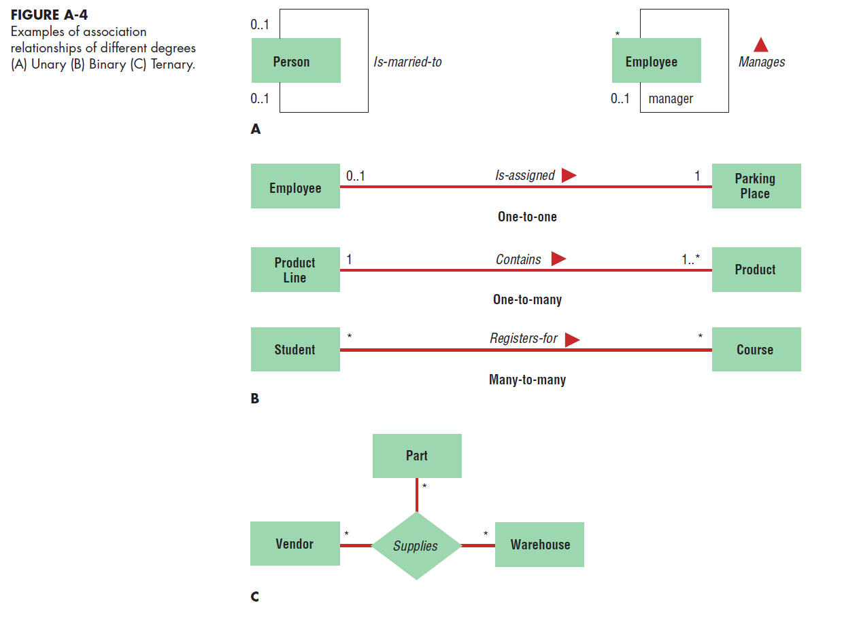
A.16

Slide 17
Representing Generalization
Generalization
  Abstraction of common features among multiple classes, as well as their relationships, into a more general class
Subclass
  A class that has been generalized
Superclass
  A class that is composed of several generalized subclasses
A.17

Slide 18
Representing Generalization (continued)
Discriminator
  Shows which property of an object class is being abstracted by a generalization relationship
Inheritance
  A property in which a subclass inherits the features from its superclass
Abstract Class
  A class that has no direct instances but whose descendents may have direct instances
Concrete Class
  A class that can have direct instances
A.18

Slide 19
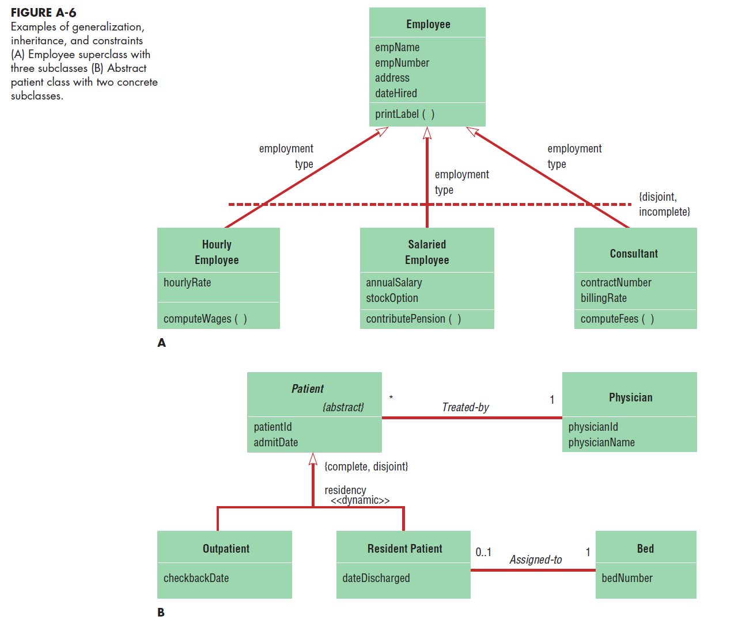
A.19

Slide 20
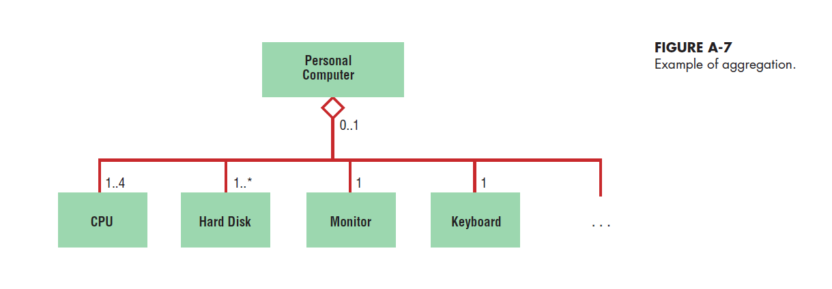
Representing Aggregation
Aggregation
  A part-of relationship between a component object and an aggregate object
  Example: Personal computer
    Composed of CPU, Monitor, Keyboard, etc.
A.20

Slide 21
Dynamic Modeling:
State Diagrams
State
  A condition during the life of an object during which it satisfies some conditions, performs some actions or waits for some events
  Shown as a rectangle with rounded corners
State Transition
  The changes in the attributes of an object or in the links an object has with other objects
  Shown as a solid arrow
  Diagrammed with a guard condition and action
Event
  Something that takes place at a certain point in time
A.21

Slide 22
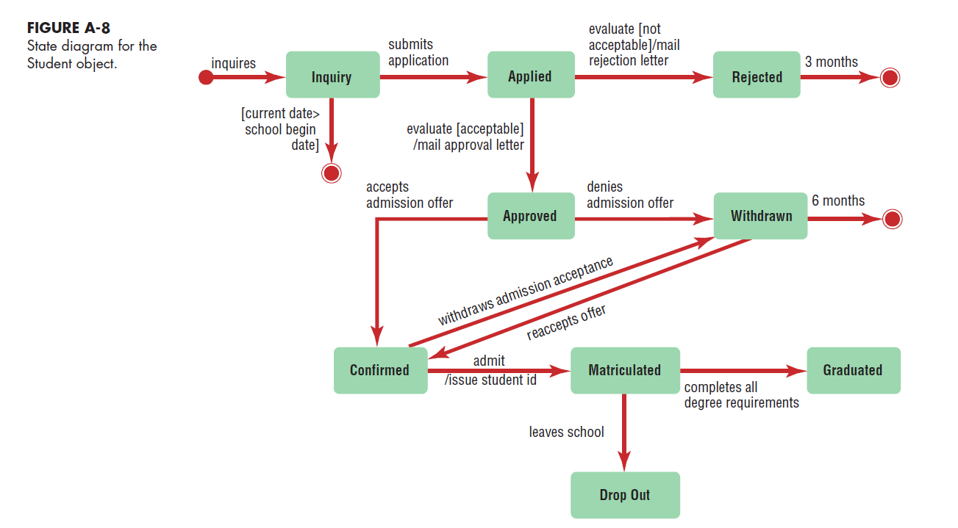
A.22

Slide 23
Dynamic Modeling:
Sequence Diagrams
Sequence Diagram
  A depiction of the interaction among objects during certain periods of time
Activation
  The time period during which an object performs an operation
Messages
  Means by which objects communicate with each other
A.23

Slide 24
Dynamic Modeling: Sequence Diagrams (continued)
Synchronous Message
  A type of message in which the caller has to wait for the receiving object to finish executing the called operation before it can resume execution itself
Simple Message
  A message that transfers control from the sender to the recipient without describing the details of the communication
A.24

Slide 25
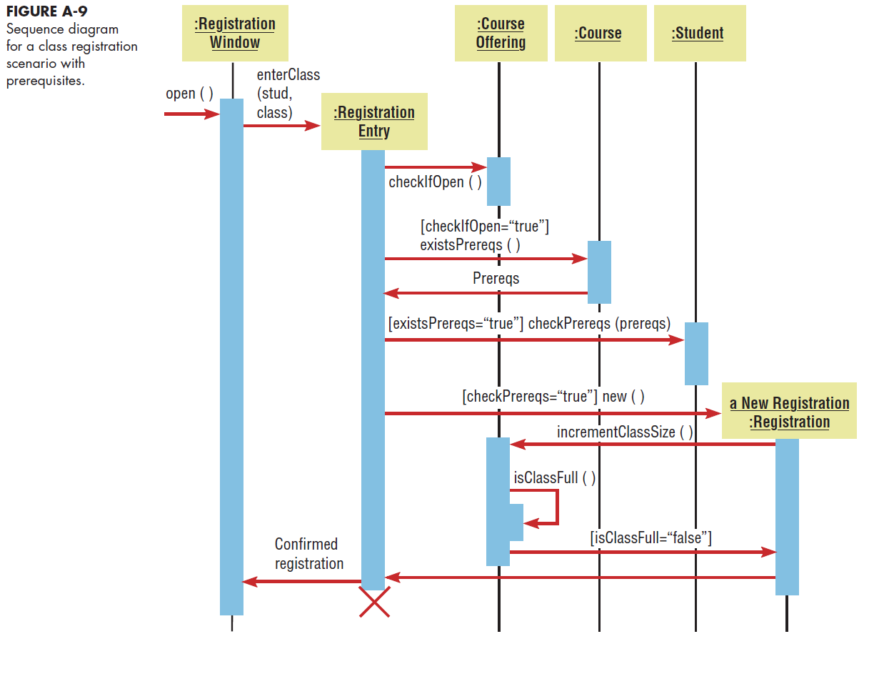
A.25

Slide 26
Moving to Design
Start with existing set of analysis model
Progressively add technical details
Design model must be more detailed than analysis model
Component Diagram
  A diagram that shows the software components or modules and their dependencies
Deployment Diagram
  A diagram that shows how the software components, processes and objects are deployed into the physical architecture of the system
A.26

Slide 27
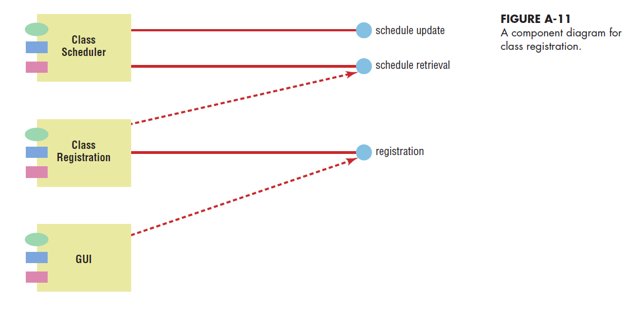
A.27

Slide 28
Summary
Object-Oriented Modeling Approach
  Benefits
  Unified Modeling Language
    Use cases
    Class diagrams
    State diagrams
    Sequence diagrams
Use Case Modeling
A.28

Slide 29
Summary (continued)
Object Modeling: Class Diagrams
  Associations
  Generalizations
  Aggregation
Dynamic Modeling: State Diagrams
Dynamic Modeling: Sequence Diagrams
Moving to Design
A.29

Slide 30

All rights reserved. No part of this publication may be reproduced, stored in a retrieval system, or transmitted, in any form or by any means, electronic, mechanical, photocopying, recording, or otherwise, without the prior written permission of the publisher. Printed in the United States of America.
Copyright © 2015 Pearson Education, Inc.
Publishing as Prentice Hall

