Slide 1
Essentials of
Systems Analysis and Design
Sixth Edition
Joseph S. Valacich
Joey F. George
Jeffrey A. Hoffer
Appendix B
Agile Methodologies
B.1

Slide 2
Learning Objectives
Define Agile Methodologies
Explain when to use Agile Methodologies and when to use engineering-based approaches to systems development
Define eXtreme Programming
Discuss the Agile Methodology approach to systems requirements determination, design specifications, and the combination of coding and testing
B.2

Slide 3
The Trend to Agile Methodologies
Three Phases of Systems Analysis Since Inception
  Undisciplined (Developer as Artist)
    Lack of documentation and development tools
    High degree of dependence upon developer for maintenance
  Developer as Engineer
    Documentation
    Rigorous testing
    Structured tools and techniques
    Computer-based tools
B.3

Slide 4
The Trend to Agile Methodologies (continued)
Three Phases of Systems Analysis Since Inception (continued)
  Agile Methodologies
    Object-oriented approach
    Sacrifices milestones and multiple phases
    Close cooperation between developers and clients
    Many life cycle phases combined into one
    Multiple rapid releases of software
B.4

Slide 5
Agile Methodologies
Many Different Methodologies under Umbrella
  Crystal family of methodologies
  Adaptive Software Development
  Scrum
  Feature Driven Development
  eXtreme Programming
Agile Manifesto Developed in February 2001 (Figure B-1)
  Three Key Principles:
    Focus on adaptive rather than predictive methodologies
    Focus on people rather than roles
    Self-adaptive process
B.5

Slide 6
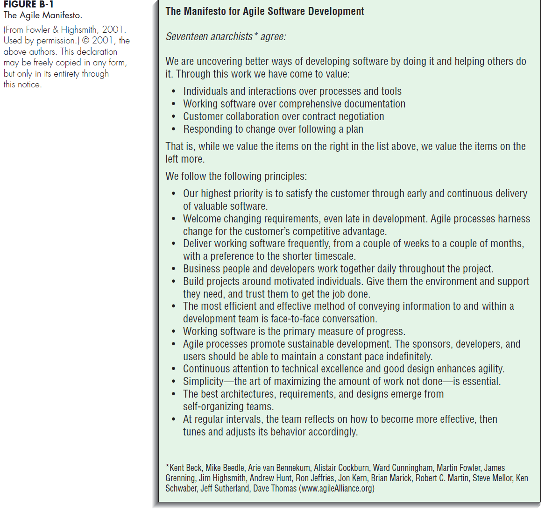
B.6

Slide 7
Agile Methodologies(continued)
Engineering Methodologies Do Not Fit Well with Software Development
  Engineering requirements are well understood; software requirements often are not
  In many engineering projects, design is only 15 percent of project; in software engineering, design can be as much as 50 percent
Agile Methodologies Embrace Change and Deal with Lack of Predictability
  Iterative development
    Provides feedback to customers and developers alike
  Focus on individuals
  Adaptive software development process
    Process can be refined and improved as software is developed
Agile Methodologies are Recommended for Projects That Involve:
  Unpredictable or dynamic requirements
  Responsible and motivated developers
  Customers who understand and will get involved
Engineering Approach is Recommended when:
  Project involves more than 100 people
  Project is operating under fixed-price or fixed-scope contract
B.7

Slide 8
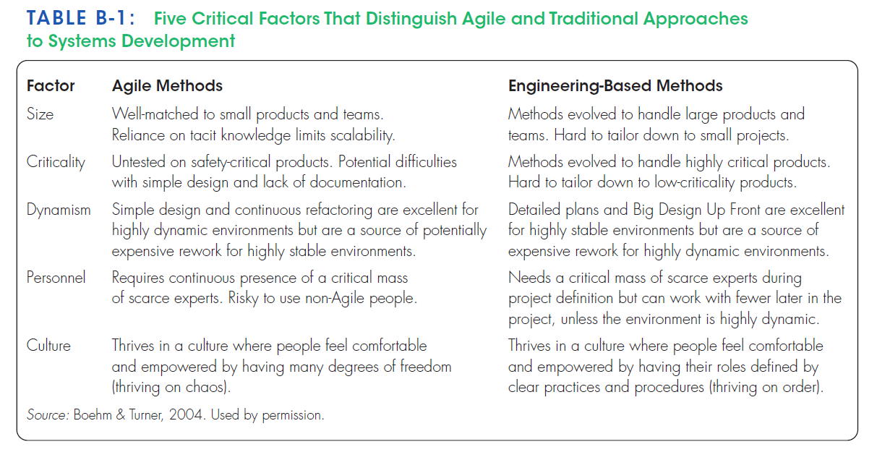
B.8

Slide 9
eXtreme Programming
One Example of Agile Methodologies
Distinguished by:
  Short development cycles
  Incremental planning approach
  Focus on automated tests
  Reliance on evolutionary approach to development
  Use of two-person (pair) programming teams
  Customer on-site during development process
Relates to Design Specifications
  Planning, design, analysis, and construction are fused together into a single phase of activity
  Systems requirements are captured and presented in a unique way
  Programmers who write code also write the tests
Pair Programming
  All programming is done by two people working together
  Includes coding and testing
  Advantages
    More communication among developers
    Higher levels of productivity
    Higher quality code
    Reinforcement of other practices, such as code and test discipline
B.9

Slide 10
Requirements Determination
Continual User Involvement
  Traditional Approach
    Users involved in early stage
    User signs off at project completion
    Often, system business processes changed during development
      System many times did not adequately address user’s needs
  Iterative Process of User Feedback
Agile Usage-Centered Design
  Process of eight steps
  See Table B-2
  Most effective steps:
    Venting session
    Use of 3 x 5 cards
B.10

Slide 11
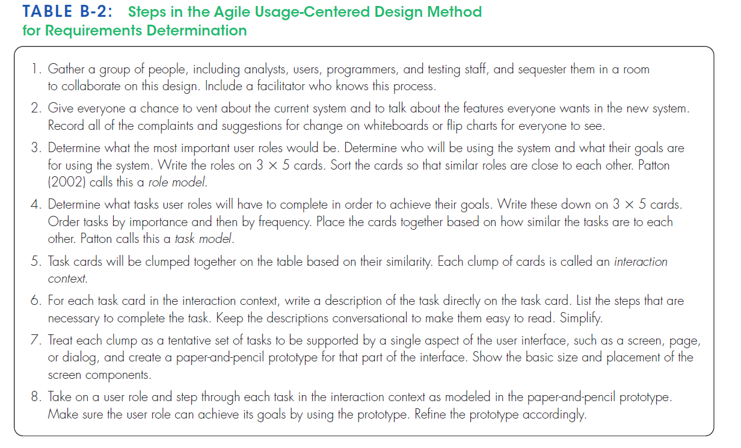
B.11

Slide 12
Requirements Determination (continued)
The Planning Game
  Players
    Business (Customers)
    Development
  Game pieces are story cards
    Created by Business
    Contain description of a feature or procedure
    Each card is dated and numbered
  Three Phases
    Exploration
      Business creates a story card
      Development responds with a time estimate
    Commitment
      Business sorts cards into three stacks: essential, non-essential but add value, and nice to have
      Development sorts story cards according to risk
      Business selects cards that will be used in next release
    Steering
      Business sees how development is progressing
      Plan is adjusted accordingly
      Can take place as often as once every three weeks
B.12

Slide 13
Requirements Determination (continued)
The Planning Game (continued)
  Iteration Planning Game
    Follows planning game
    Played only by programmers
    Uses task cards
    Same three phases
      Exploration
        Programmers convert story cards to task cards
      Commitment
        Programmers accept responsibility for tasks
        Balance workloads
      Steering
        Write code and test
        Integrate into product
    Takes place between steering phase meetings of planning game
B.13

Slide 14
Design Specifications
eXtreme Programming Employs Two Techniques to Continually Improve Quality of Design
  Simple Design
    Four constraints
      The system must communicate everything that you want it to communicate
      The system must contain no duplicate code
      The system should have the fewest possible classes
      The system should have the fewest possible methods
  Refactoring
    Process of simplifying a system after new features have been added
B.14

Slide 15
Implementation
Traditional systems development involves an implementation phase
In eXtreme Programming and Other Agile Methodologies, implementation is complete once testing has been done
B.15

Slide 16
Summary
Trend to Agile Methodologies
eXtreme Programming as an Example
  Continual user involvement
  Agile-Centered approach
  Pair programming
  The Planning Game
B.16

Slide 17

All rights reserved. No part of this publication may be reproduced, stored in a retrieval system, or transmitted, in any form or by any means, electronic, mechanical, photocopying, recording, or otherwise, without the prior written permission of the publisher. Printed in the United States of America.
Copyright © 2015 Pearson Education, Inc.
Publishing as Prentice Hall

