Slide 1
Essentials of
Systems Analysis and Design
Sixth Edition
Joseph S. Valacich
Joey F. George
Jeffrey A. Hoffer
Chapter 1
The Systems Development Environment
1.1

Slide 2
Learning Objectives
Define information systems analysis and design
Describe the role of the systems analyst in information systems development
Describe the information systems development life cycle (SDLC)
1.2

Slide 3
Learning Objectives (continued)
List alternatives to the systems development life cycle, including a description of the role of computer aided software engineering (CASE) tools in systems development
1.3

Slide 4
Chapter Preview
Systems Analysis is a proven method to help a business utilize information to its fullest capacity
Systems Development Life Cycle (SDLC)
  Central to Information Systems Development
1.5

Slide 5
What is Information Systems Analysis and Design?
A method used by companies to create and maintain systems that perform basic business functions
Main goal is to improve employee efficiency by applying software solutions to key business tasks
A structured approach must be used in order to ensure success
1.6

Slide 6
What is Information Systems Analysis and Design? (continued)
Systems Analysts perform analysis and design based upon:
  Understanding of organization’s objectives, structure and processes
  Knowledge of how to exploit information technology for advantage
Fig 1-1 illustrates the Systems Development Life Cycle, a four-phased approach used throughout this text
1.7

Slide 7
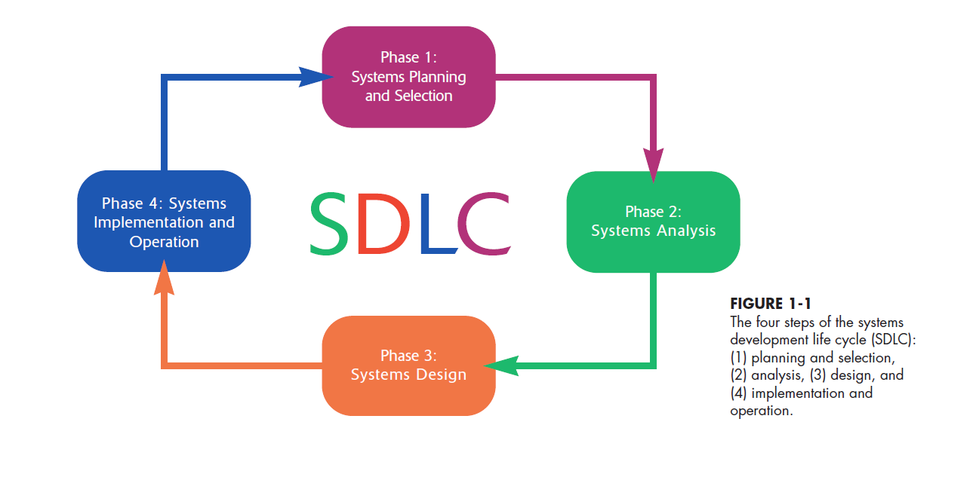
1.7

Slide 8
Systems Analysis and Design: Core Concepts
Major goal: to improve organizational systems by developing or acquiring application software and training employees in its use
Application software, or a system, supports organizational functions or processes
1.8

Slide 9
Systems Analysis and Design: Core Concepts (continued)
System: Turns data into information and includes:
  Hardware and system software
  Documentation and training materials
  Job roles associated with the system
  Controls to prevent theft or fraud
  The people who use the software to perform their jobs
Figure 1.2 illustrates all the components of a system
1.9

Slide 10
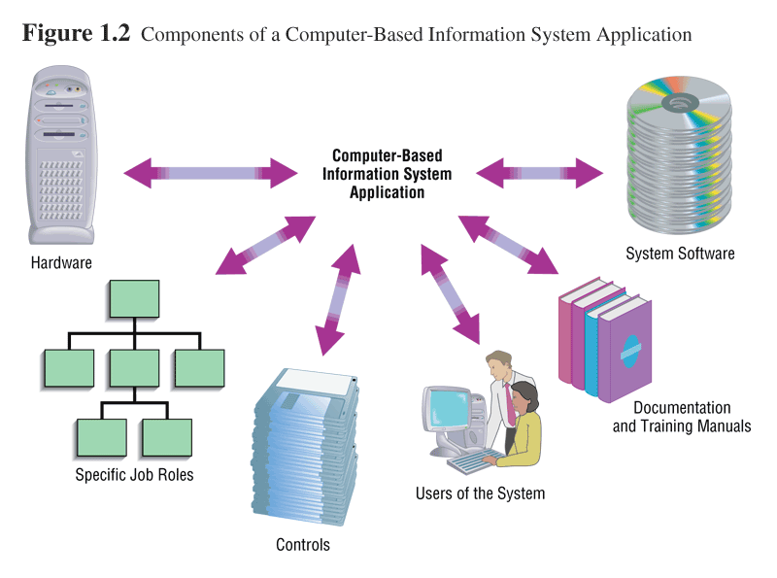
1.10

Slide 11
Software Engineering Process
A process used to create an information system
Consists of:
  Methodologies
    A sequence of step-by-step approaches that help develop the information system
  Techniques
    Processes that the analyst follows to ensure thorough, complete, and comprehensive analysis and design
  Tools
    Computer programs that aid in applying techniques
1.11

Slide 12
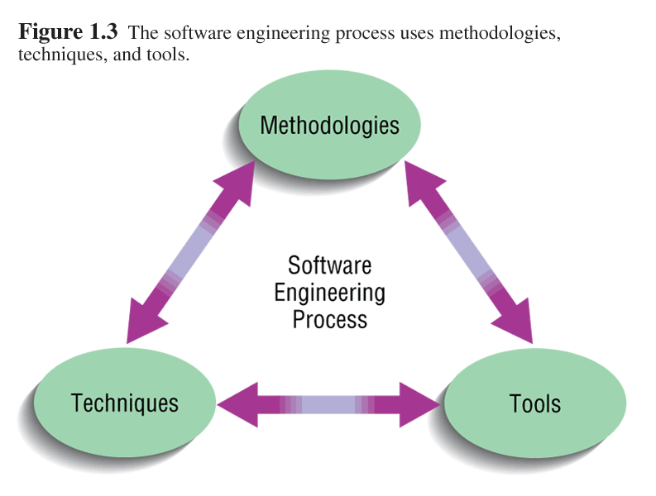
1.12

Slide 13
System
A system is an interrelated set of business procedures used within one business unit working together for a purpose
A system has nine characteristics
A system exists within an environment
A boundary separates a system from its environment
1.13

Slide 14
Characteristics of a System
Components
Interrelated Components
Boundary
Purpose
Environment
Interfaces
Constraints
Input
Output
1.14

Slide 15
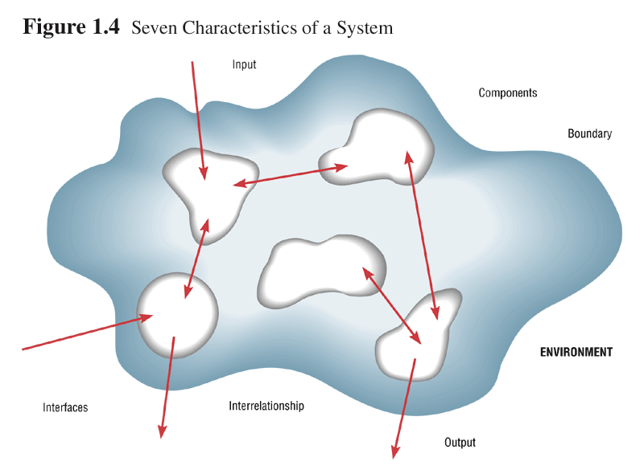
1.15

Slide 16
Important System Concepts
Decomposition
  The process of breaking down a system into smaller components
  Allows the systems analyst to:
    Break a system into small, manageable and understandable subsystems
    Focus on one area at a time, without interference from other areas
    Concentrate on component pertinent to one group of users without confusing users with unnecessary details
    Build different components at independent times and have the help of different analysts
1.16

Slide 17
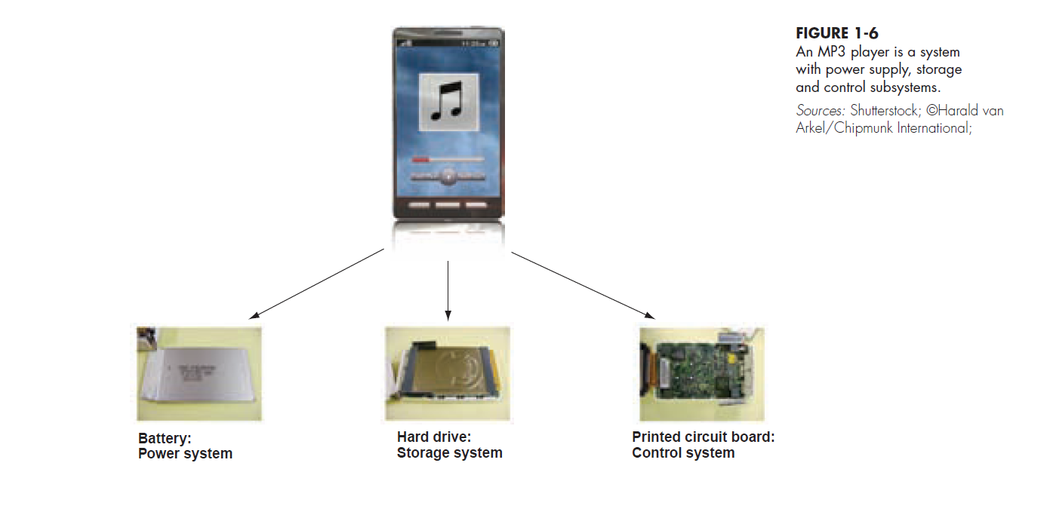
1.17

Slide 18
Important System Concepts (continued)
Modularity
  Process of dividing a system into modules of a relatively uniform size
  Modules simplify system design
Coupling
  Subsystems that are dependent upon each other are coupled
Cohesion
  Extent to which a subsystem performs a single function
1.18

Slide 19
A Modern Approach to Systems Analysis and Design
Systems Integration
  Allows hardware and software from different vendors to work together
  Enables procedural language systems to work with visual programming systems
  Visual programming environment uses client/server model
1.19

Slide 20
Your Role in Systems Development
Study problems and needs of an organization
Determine best approach to improving organization through use of:
  People
  Methods
  Information technology
Help system users and managers define their requirements for new or enhanced information systems
1.20

Slide 21
Developing Information Systems and the Systems Development Life Cycle
Systems Development Methodology
  A standard process followed in an organization to conduct all the steps necessary to
    analyze
    design
    implement
    and maintain information systems.
1.21

Slide 22
Developing Information Systems and the Systems Development Life Cycle (continued)
Systems Development Life Cycle
  Series of steps used to manage the phases of development for an information system
  Consists of four phases:
    Planning and Selection
    Analysis
    Design
    Implementation and Operation
1.22

Slide 23
Developing Information Systems and the Systems Development Life Cycle (continued)
  Phases are not necessarily sequential
  Each phase has a specific outcome and deliverable
  Every company customizes the life-cycle model to its individual needs
1.23

Slide 24
Phases of the Systems Development Life Cycle
1. Systems Planning and Selection
  Two Main Activities
    Identification of need
    Investigation and determination of scope
2. Systems Analysis
  Study of current procedures and information systems
    Determine requirements
    Generate alternative designs
    Compare alternatives
    Recommend best alternative
1.24

Slide 25
Phases of the Systems Development Life Cycle (continued)
3. System Design
  Logical Design
    Concentrates on business aspects of the system
  Physical Design
    Technical specifications
4. System Implementation and Operation
  Implementation
    Hardware and software installation
    Programming
    User Training
    Documentation
1.25

Slide 26
Phases of the Systems Development Life Cycle (continued)
System Implementation and Operation (continued)
    System changed to reflect changing conditions
    System obsolescence
1.26

Slide 27
Alternative Approaches to Development
Prototyping
  Building a scaled-down working version of the system
  Advantages:
    Users are involved in design
    Captures requirements in concrete form
1.27

Slide 28
Alternative Approaches to Development (continued)
Computer-Assisted Software Engineering (CASE) Tools
  Automated software tools used by systems analysts to develop information systems
  Can be used throughout SDLC
  Product and tool integration is provided through a repository
1.28

Slide 29
Alternative Approaches to Development (continued)
  General types of CASE tools
    Diagramming tools
    Computer display and report generators
    Analysis tools
    Repository
    Documentation generators
    Code generators
1.29

Slide 30
Alternative Approaches to Development (continued)
Joint Application Design (JAD)
  Users, Managers and Analysts work together for several days
  System requirements are reviewed
  Structured meetings
Rapid Application Development (RAD)
  Utilizes prototyping to delay producing system design until after user requirements are clear
1.30

Slide 31
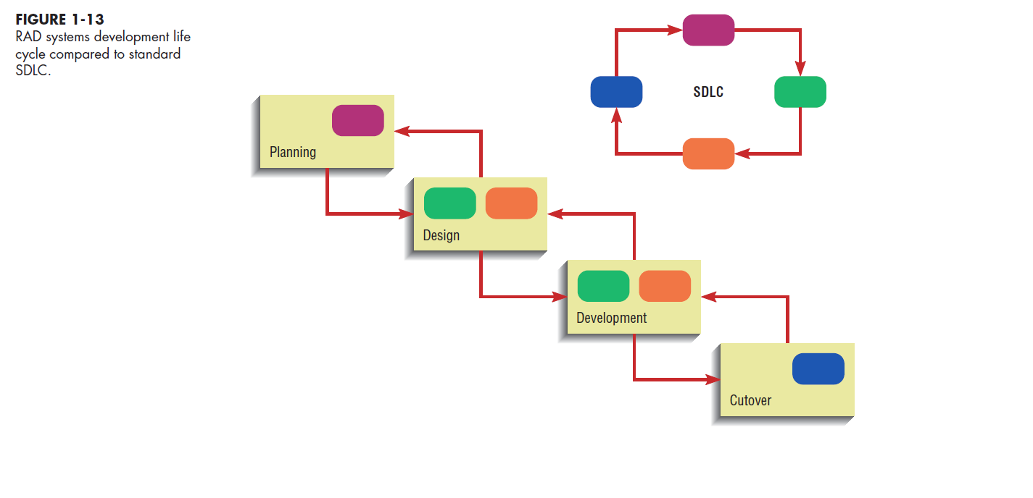
1.31

Slide 32
Approaches to Development (continued)
Participatory Design (PD)
  Emphasizes role of the user
  Entire user community can be involved in design
Agile Methodologies
  Focuses on
    Adaptive methodologies
    People instead of roles
    Self-adaptive development process
1.32

Slide 33
Summary
Information systems analysis and design
  Process of developing and maintaining an information system
Modern approach to systems analysis
  Process-oriented
  Data-oriented
1.33

Slide 34
Summary (continued)
Role of Systems Analyst
Systems Development Life Cycle (SDLC)
  Systems Planning and Selection
  Systems Analysis
  Systems Design
  Systems Implementation
1.34

Slide 35
Summary (continued)
Alternatives to Systems Development Life Cycle
  Prototyping
  Rapid Application Development (RAD)
  CASE
  Joint Application Design (JAD)
  Participatory Design (PD)
  Agile Methodologies
1.35

Slide 36

All rights reserved. No part of this publication may be reproduced, stored in a retrieval system, or transmitted, in any form or by any means, electronic, mechanical, photocopying, recording, or otherwise, without the prior written permission of the publisher. Printed in the United States of America.
Copyright © 2015 Pearson Education, Inc.
Publishing as Prentice Hall

