Slide 1
Essentials of
Systems Analysis and Design
Sixth Edition
Joseph S. Valacich
Joey F. George
Jeffrey A. Hoffer
Chapter 6
Structuring System Requirements:
Process Modeling
6.1

Slide 2
Learning Objectives
Explain process modeling
Discuss data-flow diagramming mechanics, definitions, and rules
Discuss balancing data-flow diagrams
Discuss the use of data-flow diagrams as analysis tools
Examine decision tables used to represent process logic
6.2

Slide 3
Process Modeling
Graphically represents the processes that capture, manipulate, store, and distribute data between a system and its environment and among system components
Data-flow Diagrams (DFD)
  Graphically illustrate movement of data between external entities and the processes and data stores within a system
6.3

Slide 4
Process Modeling (continued)
Modeling a System’s Process
  Utilize information gathered during requirements determination
  Structure of the data is also modeled in addition to the processes
Deliverables and Outcomes
  Set of coherent, interrelated data-flow diagrams
6.4

Slide 5
Process Modeling (continued)
Deliverables and Outcomes (continued)
  Context data-flow diagram (DFD)
    Scope of system
  DFDs of current system
    Enable analysts to understand current system
  DFDs of new logical system
    Technology independent
    Show data flows, structure and functional requirements of new system
6.5

Slide 6
Process Modeling (continued)
Deliverables and Outcomes (continued)
  Project dictionary and CASE repository
Data-flow Diagramming Mechanics
  Four symbols are used
    See Figure 6-3
  Developed by Gane and Sarson
6.6

Slide 7
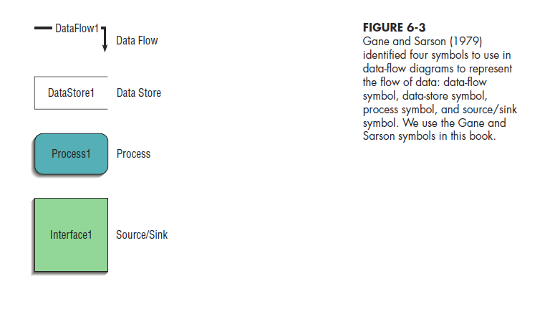
6.7

Slide 8
Data-Flow Diagramming Mechanics
Data Flow
  Depicts data that are in motion and moving as a unit from one place to another in the system
  Drawn as an arrow
  Select a meaningful name to represent the data
6.8

Slide 9
Data-Flow Diagramming Mechanics (continued)
Data Store
  Depicts data at rest
  May represent data in
    File folder
    Computer-based file
    Notebook
  Drawn as a rectangle with the right vertical line missing
  Label includes name of the store as well as the number
6.9

Slide 10
Data-Flow Diagramming Mechanics (continued)
Process
  Depicts work or actions performed on data so that they are transformed, stored, or distributed
  Drawn as a rectangle with rounded corners
  Number of process as well as names are recorded
6.10

Slide 11
Data-Flow Diagramming Mechanics (continued)
Source/Sink
  Depicts the origin and/or destination of the data
  Sometimes referred to as an external entity
  Drawn as a square symbol
  Name states what the external agent is
  Because they are external, many characteristics are not of interest to us
6.11

Slide 12
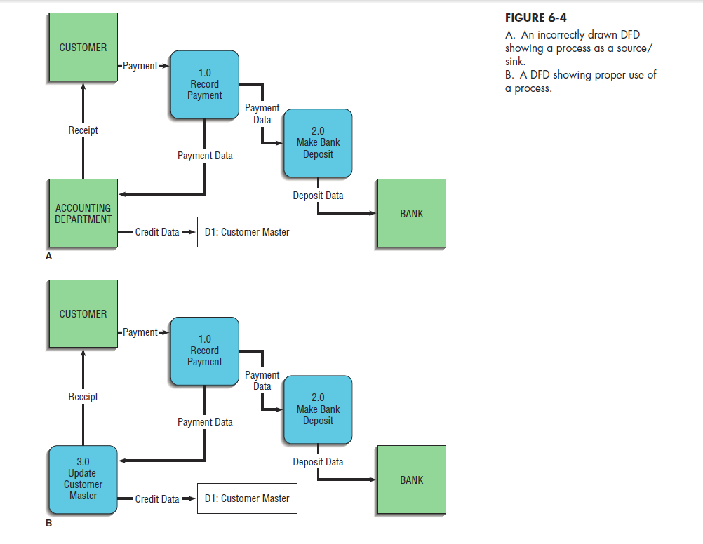
6.12

Slide 13
Data-Flow Diagramming Definitions
Context Diagram
  A data-flow diagram of the scope of an organizational system that shows the system boundaries, external entities that interact with the system and the major information flows between the entities and the system
Level-O Diagram
  A data-flow diagram that represents a system’s major processes, data flows, and data stores at a higher level
6.13

Slide 14
Developing DFDs:
An Example
Hoosier Burger’s Automated Food Ordering System
Context Diagram (Figure 6-5) contains no data stores
6.14

Slide 15
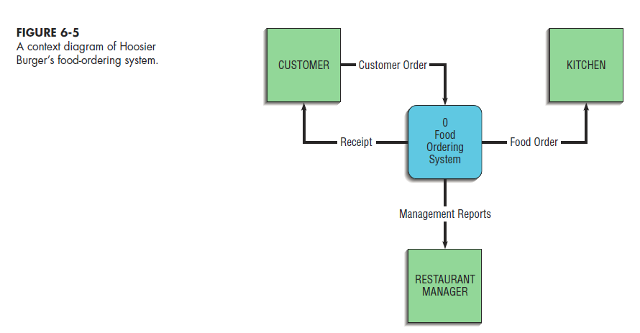
6.15

Slide 16
Developing DFDs:
An Example (continued)
Next step is to expand the context diagram to show the breakdown of processes (Figure 6-6)
6.16

Slide 17
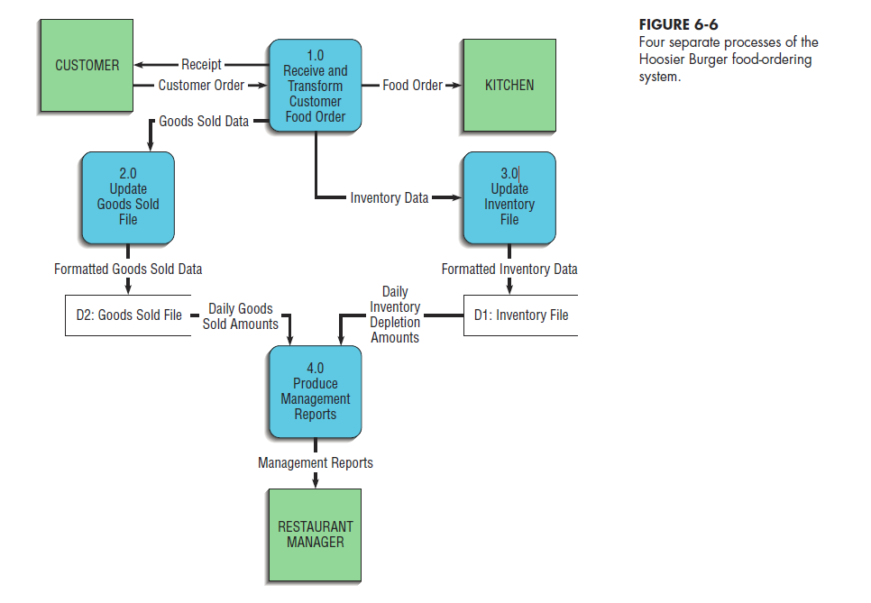
6.17

Slide 18
Data-Flow Diagramming Rules
Basic rules that apply to all DFDs:
  Inputs to a process are always different than outputs
  Objects always have a unique name
    In order to keep the diagram uncluttered, you can repeat data stores and data flows on a diagram
6.18

Slide 19
Data-Flow Diagramming Rules (continued)
Process
  No process can have only outputs (a miracle)
  No process can have only inputs (black hole)
  A process has a verb phrase label
Data Store
  Data cannot be moved from one store to another
  Data cannot move from an outside source to a data store
  Data cannot move directly from a data store to a data sink
  Data store has a noun phrase label
Source/Sink
  H. Data cannot move directly from a source to a sink
  I. A source/sink has a noun phrase label
6.19

Slide 20
Data-Flow Diagramming Rules (continued)
Data Flow
  A data flow has only one direction of flow between symbols
  A fork means that exactly the same data go from a common location to two or more processes, data stores, or sources/sinks
  A join means that exactly the same data come from any two or more different processes, data stores or sources/sinks to a common location
  A data flow cannot go directly back to the same process it leaves
  A data flow to a data store means update
  A data flow from a data store means retrieve or use
  A data flow has a noun phrase label
6.20

Slide 21
Decomposition of DFDs
Functional Decomposition
  Act of going from one single system to many component processes
  Repetitive procedure
  Lowest level is called a primitive DFD
Level-n Diagrams
  A DFD that is the result of n nested decompositions of a series of subprocesses from a process on a level-0 diagram
6.21

Slide 22
Balancing DFDs
When decomposing a DFD, you must conserve inputs to and outputs from a process at the next level of decomposition
  This is called balancing
Example: Hoosier Burgers
  In Figure 6-5, notice that there is one input to the system; the customer order
  Three outputs:
    Customer receipt
    Food order
    Management reports
6.22

Slide 23
Balancing DFDs (continued)
Example (Continued)
  Notice Figure 6-6. We have the same inputs and outputs
  No new inputs or outputs have been introduced
  We can say that the context diagram and level-0 DFD are balanced
6.23

Slide 24
Balancing DFDs
An Unbalanced Example
  In context diagram, we have one input to the system, A and one output, B
  Level-0 diagram has one additional data flow, C
  These DFDs are not balanced
6.24

Slide 25
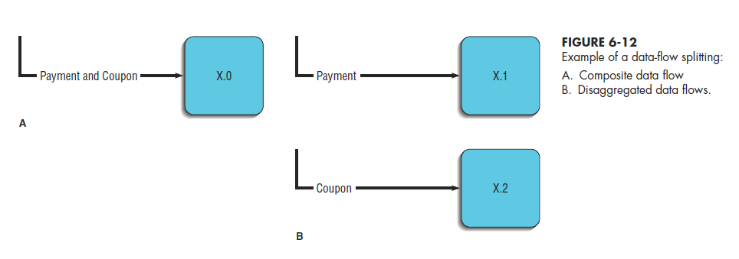
Balancing DFDs
We can split a data flow into separate data flows on a lower level diagram
6.25

Slide 26
Balancing DFDs
Four Additional Advanced Rules
6.26

Slide 27
Guidelines for Drawing DFDs
Completeness
  DFD must include all components necessary for the system
  Each component must be fully described in the project dictionary or CASE repository
Consistency
  The extent to which information contained on one level of a set of nested DFDs is also included on other levels
6.27

Slide 28
Guidelines for Drawing DFDs (continued)
Timing
  Time is not represented well on DFDs
  Best to draw DFDs as if the system has never started and will never stop
Iterative Development
  Analyst should expect to redraw diagram several times before reaching the closest approximation to the system being modeled
6.28

Slide 29
Guidelines for Drawing DFDs (continued)
Primitive DFDs
  Lowest logical level of decomposition
  Decision has to be made when to stop decomposition
6.29

Slide 30
Guidelines for Drawing DFDs (continued)
Rules for stopping decomposition:
  When each process has been reduced to a single decision, calculation or database operation
  When each data store represents data about a single entity
  When the system user does not care to see any more detail
6.30

Slide 31
Guidelines for Drawing DFDs (continued)
Rules for stopping decomposition: (continued)
  When every data flow does not need to be split further to show that data are handled in various ways
  When you believe that you have shown each business form or transaction, online display and report as a single data flow
  When you believe that there is a separate process for each choice on all lowest-level menu options
6.31

Slide 32
Using DFDs as Analysis Tools
Gap Analysis
  The process of discovering discrepancies between two or more sets of data-flow diagrams or discrepancies within a single DFD
Inefficiencies in a system can often be identified through DFDs
6.32

Slide 33
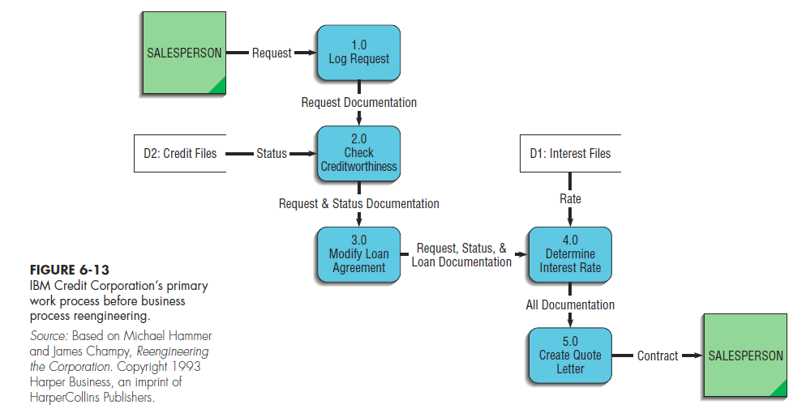
Using DFDs in Business Process Reengineering
Example: IBM Credit
Credit approval process is required six days before Business Process Reengineering (see Fig 6-13)
6.33

Slide 34
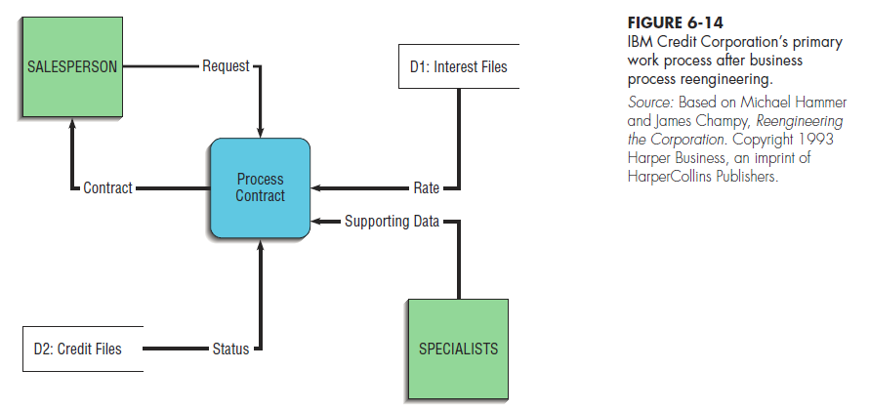
Using DFDs in Business Process Reengineering (continued)
After Business Reprocess Engineering, IBM was able to process 100 times the number of transactions in the same amount of time
6.34

Slide 35
Logic Modeling
Data-flow diagrams do not show the logic inside the processes
Logic modeling involves representing internal structure and functionality of processes depicted on a DFD
Utilizes Decision Tables
6.35

Slide 36
Modeling Logic with
Decision Tables
A matrix representation of the logic of a decision
Specifies the possible conditions and the resulting actions
Best used for complicated decision logic
6.36

Slide 37
Modeling Logic with
Decision Tables (continued)
Consists of three parts:
  Condition stubs
    Lists condition relevant to decision
  Action stubs
    Actions that result for a given set of conditions
  Rules
    Specify which actions are to be followed for a given set of conditions
6.37

Slide 38
Modeling Logic with
Decision Tables (continued)
Indifferent Condition
  Condition whose value does not affect which action is taken for two or more rules
Standard procedure for creating decision tables:
  Name the conditions and values each condition can assume
  Name all possible actions that can occur
  List all possible rules
  Define the actions for each rule (See Figure 6-17)
  Simplify the decision table (See Figure 6-18)
6.38

Slide 39
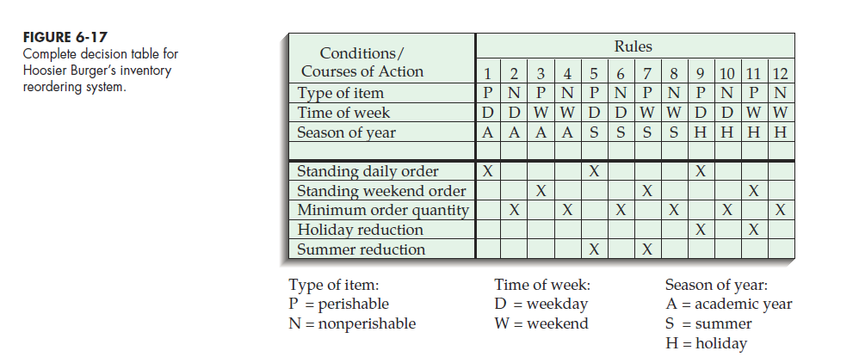
6.39

Slide 40
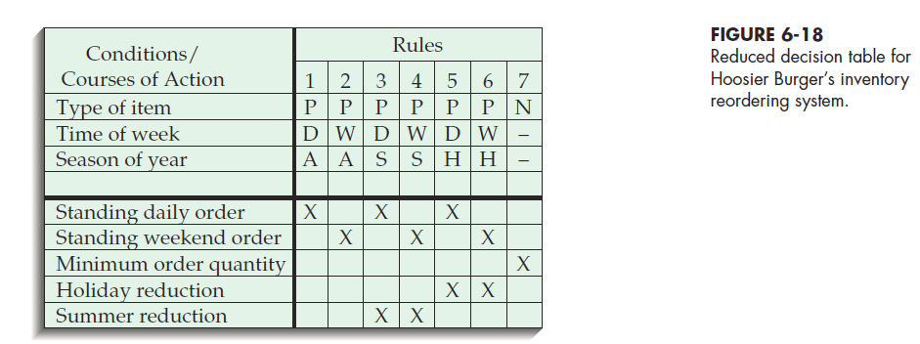
6.40

Slide 41
Process Modeling for
Electronic Commerce Application
Process modeling for electronic commerce projects is no different than other projects
See Pine Valley Furniture example; Table 6-4
6.41

Slide 42
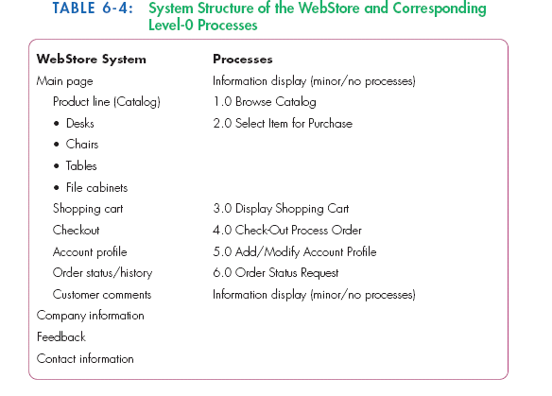
6.42

Slide 43
Summary
Data-flow Diagrams (DFD)
  Symbols
  Rules for creating
  Decomposition
  Balancing
DFDs for Analysis
DFDs for Business Process Reengineering (BPR)
Logic Modeling
  Decision Tables
Process Modeling for the Internet
6.43

Slide 44

All rights reserved. No part of this publication may be reproduced, stored in a retrieval system, or transmitted, in any form or by any means, electronic, mechanical, photocopying, recording, or otherwise, without the prior written permission of the publisher. Printed in the United States of America.
Copyright © 2015 Pearson Education, Inc.
Publishing as Prentice Hall

