Slide 1
Introduction to Bioinformatics
Project Presentation
Group 4

Slide 2
Introduction
Breast cancer is one of the most common malignant diseases among women, with a high incidence and mortality rate worldwide. Despite advances in treatment, the heterogeneity of breast cancer presents significant challenges in diagnosis, prognosis, and therapy.
Biomarkers play a crucial role in improving breast cancer detection, predicting patient outcomes, and guiding personalized treatments. Identifying reliable biomarkers helps classify tumors, determine disease progression, and optimize therapeutic strategies.
Traditional biomarkers such as ER (Estrogen Receptor), PR (Progesterone Receptor), and HER2 are widely used but have limitations:
  They fail to fully capture tumor heterogeneity.
  Some subtypes, like triple-negative breast cancer (TNBC), lack targeted biomarkers, making treatment challenging.
  Many biomarkers provide limited predictive power for treatment response.

Slide 3
Objective
Identify novel biomarkers for breast cancer using RNA-Seq gene expression analysis and machine learning techniques.
Select the most relevant genes based on differential expression and feature importance.
Perform further analysis on selected genes using specialized databases:
  GEPIA, UALCAN, GeneCards, bc-GenExMiner, cBioPortal, Kaplan-Meier Plotter, and Reactome.

Slide 4
Analyzing RNA-seq Data
Collecting RNA-seq Data from TCGA
Preprocessing of RNA-seq Data
Differential Expression Analysis
Identifying Key Genes Using Random Forest Algorithm

Slide 5
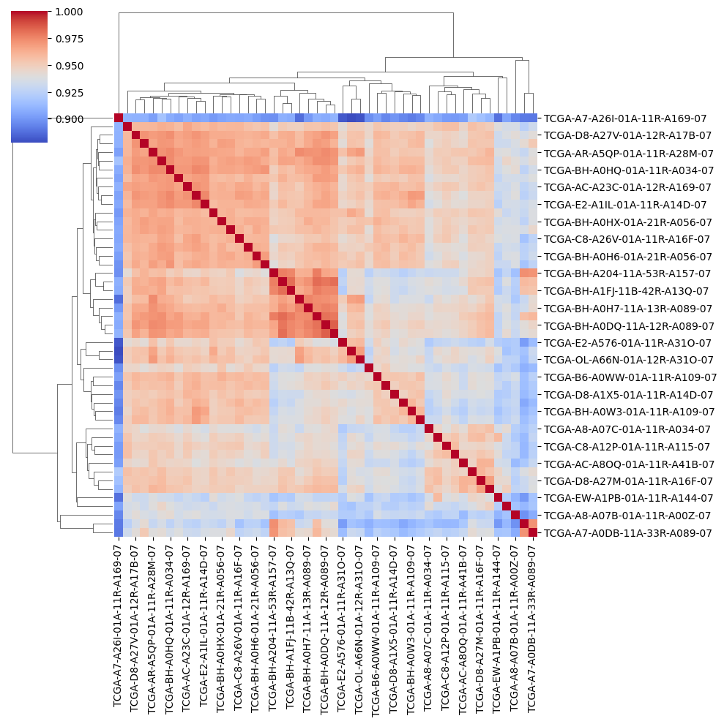
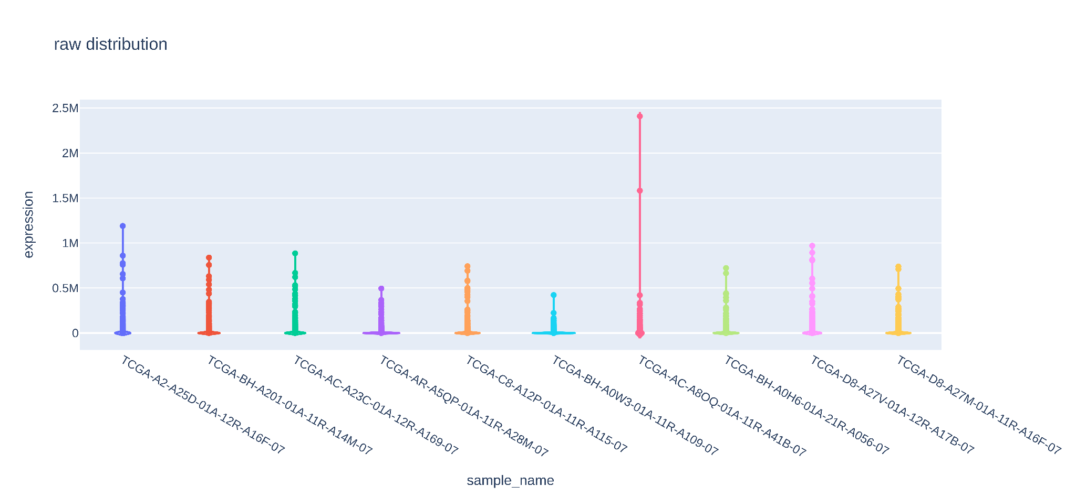
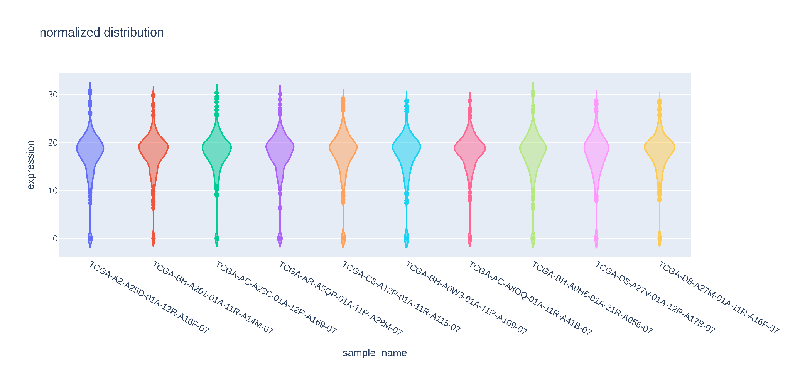
Preprocessing
Raw RNA-Seq data requires preprocessing to remove biases.
UQ-FPKM
Log2 Transform

Slide 6
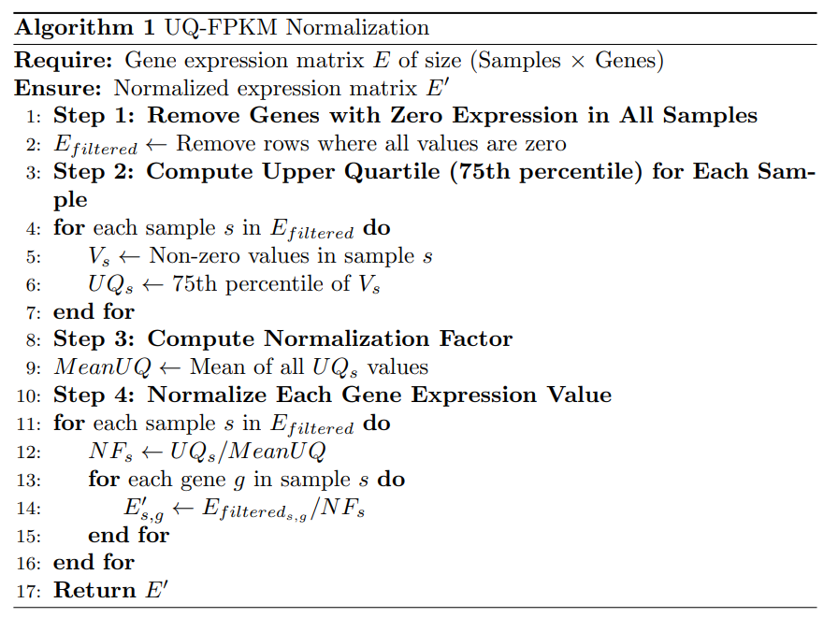
UQ-FPKM
Reducing Sensitivity to Highly Expressed Genes
Avoiding Zero-Inflation Bias in Low-Expression Genes
Improved Cross-Sample Comparability

Slide 7
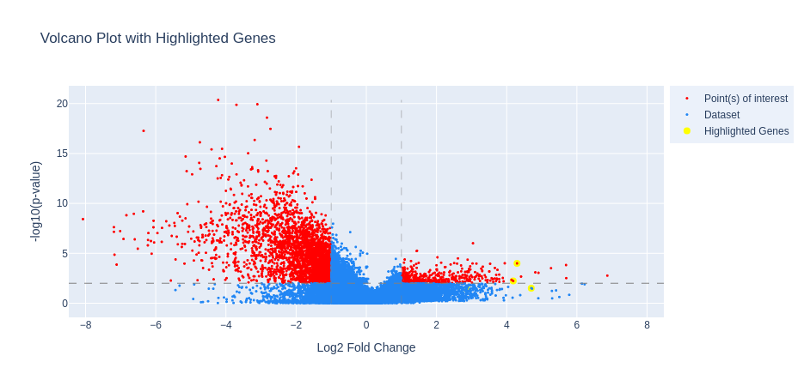
Differential Expression Analysis
Identifies genes with significant expression differences between cancerous and healthy tissues.
|log fc| > 1 & |log fc| < -1
False Discovery Rate < 0.01

Slide 8
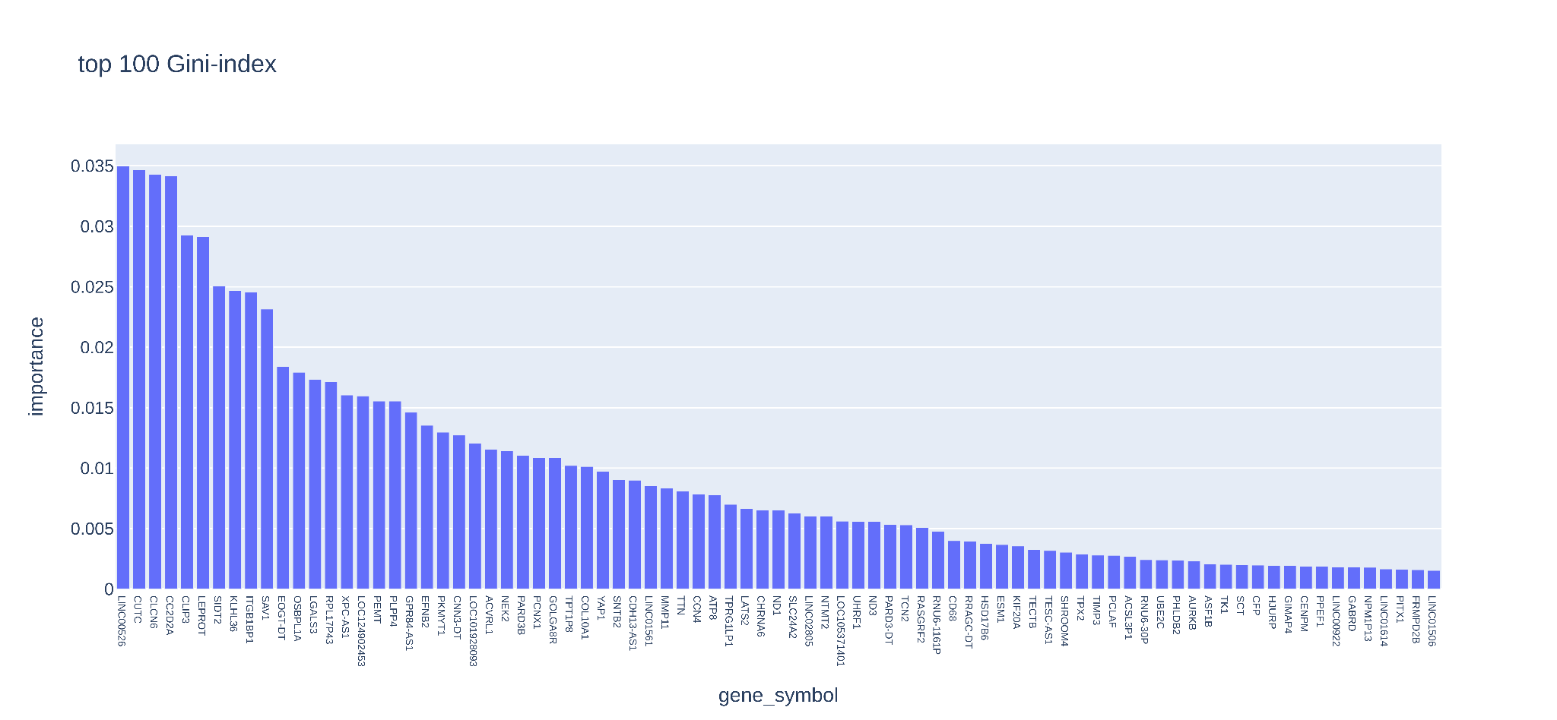
Identifying Key Genes Using Random Forest Algorithm
distinguishing between cancerous and healthy samples based on gene expression.
The Gini Index measures each gene’s contribution to classification accuracy.
Top-100 genes are selected for further analysis.

Slide 9
Beyond Expression – Functional and Clinical Insights
Differential expression alone is not enough to confirm a gene as a biomarker.
Further analysis is required to:
  Validate clinical relevance (association with survival, treatment response).
  Understand biological function (pathways and molecular interactions).
  Assess genomic alterations (mutations, copy number variations).
We use multiple databases to ensure biomarker reliability.

Slide 10
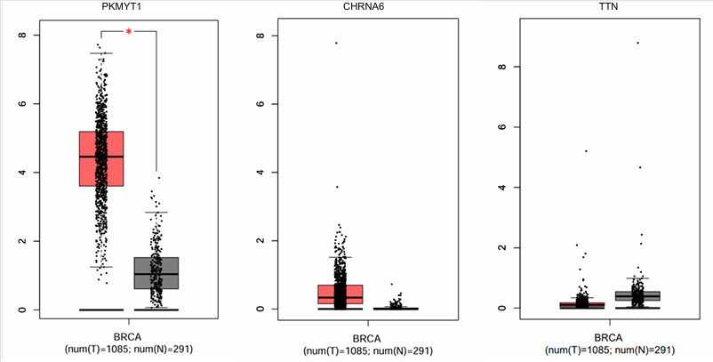
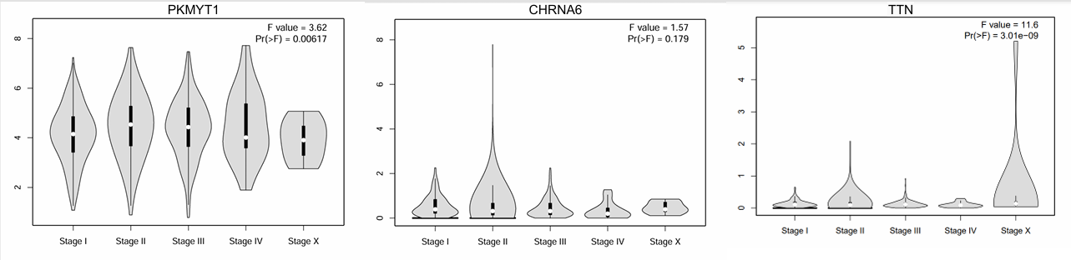
GEPIA & UALCAN – Further Expression Analysis
Provide gene expression data from TCGA and GTEx for both normal and cancerous tissues.
Allow various comparisons based on:
  Age, gender, nodal status, and cancer stages.
  Tumor vs. normal expression levels.
  Survival analysis.

Slide 11
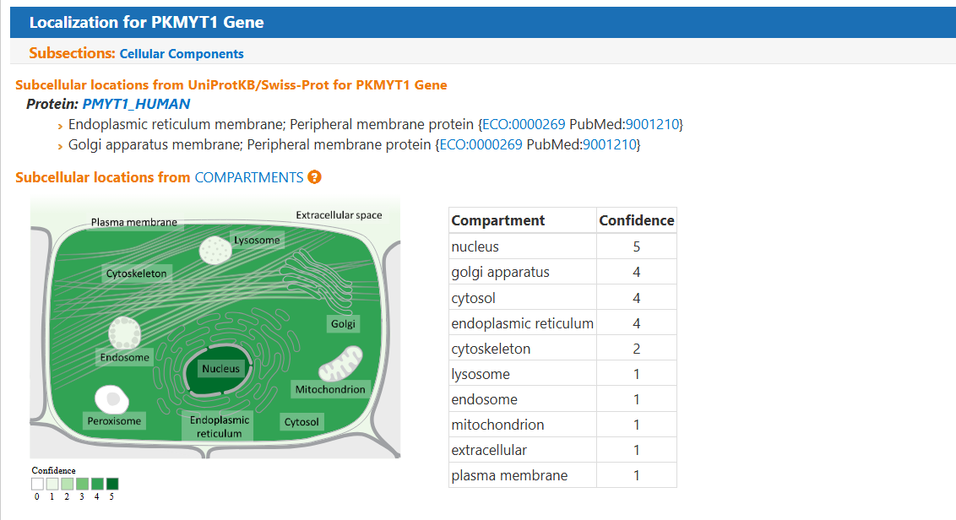
GeneCards - Prediction of subcellular localization
Aggregates gene function, protein interactions, and disease associations.
Used to analyze subcellular localization of selected genes.
Identifies potential therapeutic targets based on cellular positioning.
  Membrane proteins: Good drug targets (e.g., antibodies).
  Nuclear/cytoplasmic proteins: May influence cell signaling and gene regulation.

Slide 12
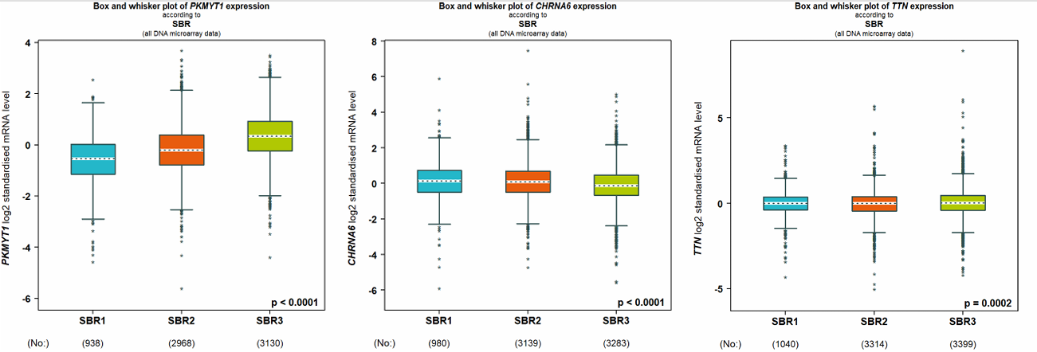
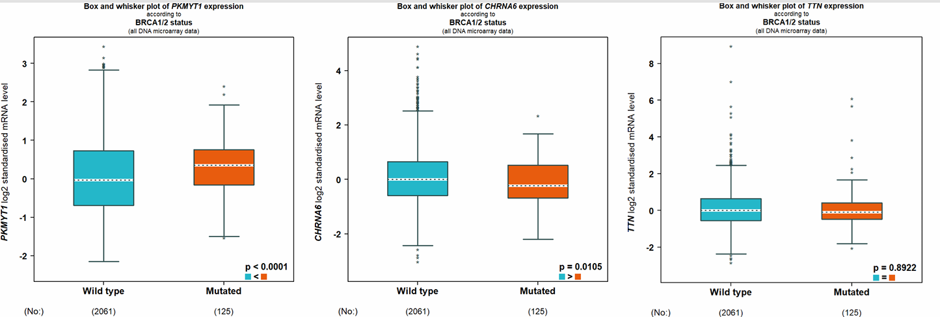
bc-GenExMiner - Clinico‑pathological Parameters
Focuses on breast cancer-specific gene expression.
Provides analysis based on:
  SBR (Scarff-Bloom-Richardson) grading system, assessing tumor differentiation.
  BRCA1/2 mutation status, crucial for hereditary breast cancer risk.
Helps identify genes linked to tumor aggressiveness and prognosis.

Slide 13
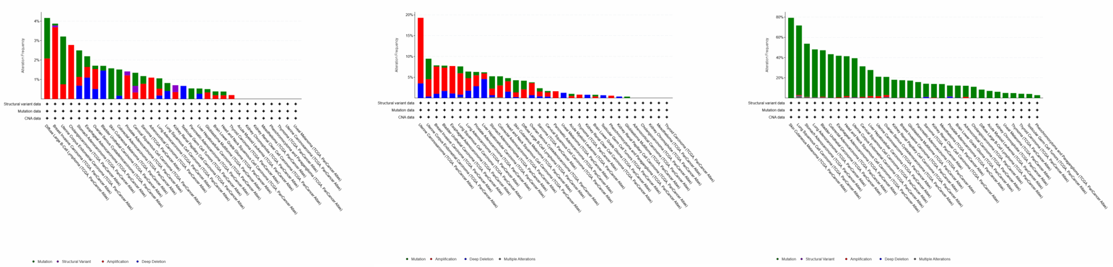
cBioPortal – Genetic Alterations & Somatic Mutations
Provides insights into genetic alterations in selected genes.
Analyzes mutations, copy number variations, and deep deletions.
Helps determine whether genomic changes drive cancer progression.

Slide 14
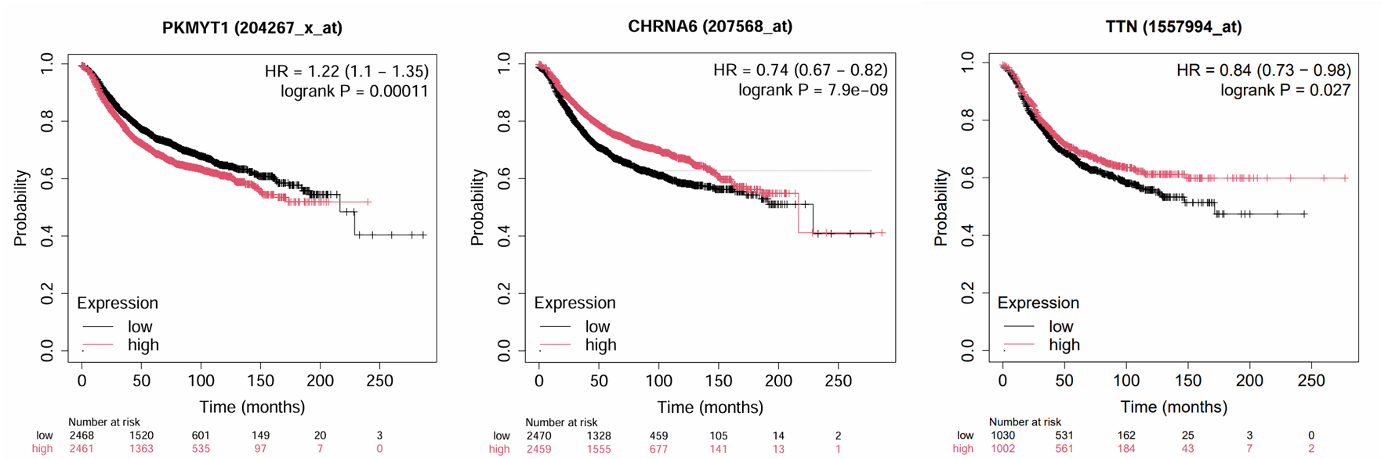
Kaplan-Meier Plotter – Survival Analysis
Examines the association between gene expression and patient survival.
Uses Kaplan-Meier survival curves to compare outcomes based on gene expression levels.
Identifies potential prognostic biomarkers that influence disease progression.

Slide 15
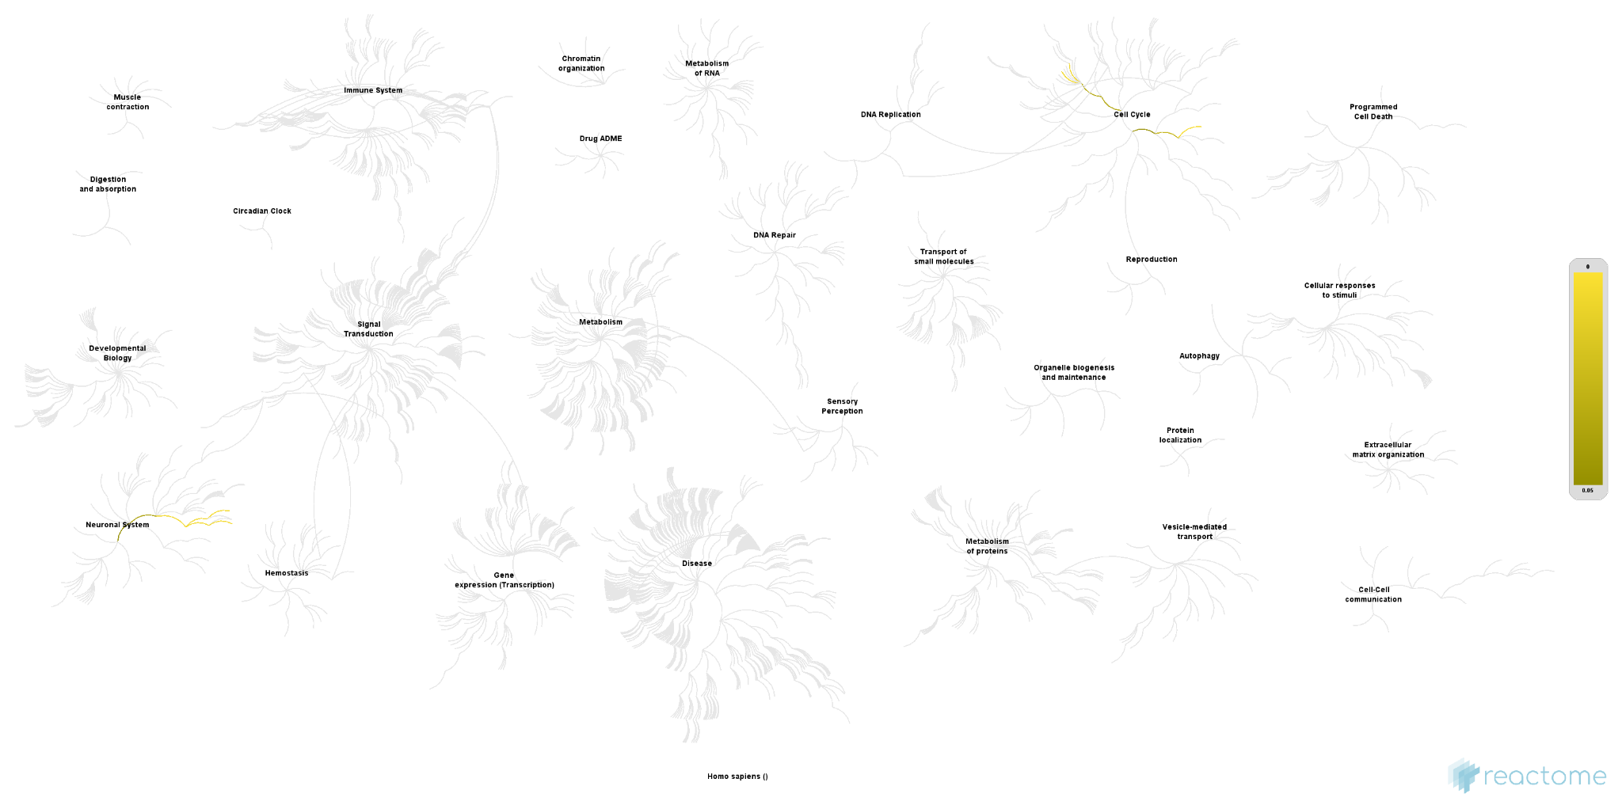
Reactome – Understanding Pathways
Understanding pathways helps identify key regulatory genes involved in tumor development.
Reactome Maps selected genes to known signaling and metabolic pathways.
It also Helps determine whether a gene plays a critical role in cancer biology.

Slide 16
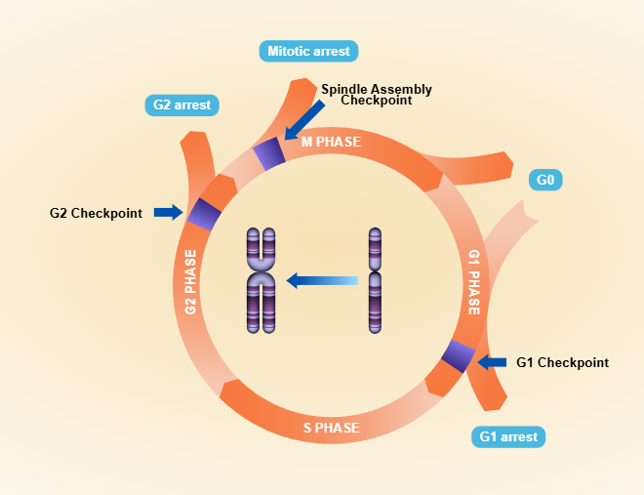
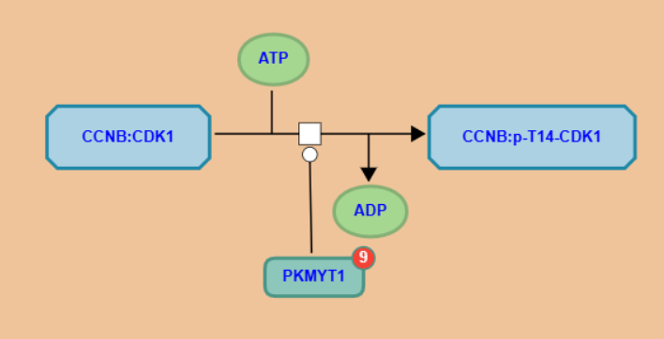
Cont.

Slide 17


