Slide 1
Chapter 5
Methods

Slide 2

Introduction to Methods
Passing Arguments to a Method
More About Local Variables
Returning a Value from a Method
Problem Solving with Methods
5-<number>

Slide 3

Methods are commonly used to break a problem down into small manageable pieces. This is called divide and conquer.
Methods simplify programs. If a specific task is performed in several places in the program, a method can be written once to perform that task, and then be executed anytime it is needed. This is known as code reuse.
5-<number>

Slide 4

A void method is one that simply performs a task and then terminates.
System.out.println("Hi!");
A value-returning method not only performs a task, but also sends a value back to the code that called it.
double number = Math.pow(4,3);
5-<number>

Slide 5

To create a method, you must write a definition, which consists of a header and a body.
The method header, which appears at the beginning of a method definition, lists several important things about the method, including the method’s name.
The method body is a collection of statements that are performed when the method is executed.
5-<number>

Slide 6

Header
public static void displayMesssage()
{
System.out.println("Hello");
}
Body
5-<number>

Slide 7

Method Modifiers
Return Type
Method Name
Parentheses
public static void displayMessage ()
{
System.out.println("Hello");
}
5-<number>

Slide 8
Method modifiers
  public—method is publicly available to code outside the class
  static—method belongs to a class, not a specific object.
Return type—void or the data type from a value-returning method
Method name—name that is descriptive of what the method does
Parentheses—contain nothing or a list of one or more variable declarations if the method is capable of receiving arguments.
5-<number>

Slide 9

A method executes when it is called.
The main method is automatically called when a program starts, but other methods are executed by method call statements.
displayMessage();
Notice that the method modifiers and the void return type are not written in the method call statement. Those are only written in the method header.
Examples: SimpleMethod.java, LoopCall.java, CreditCard.java, DeepAndDeeper.java
5-<number>

Slide 10

A method should always be documented by writing comments that appear just before the method’s definition.
The comments should provide a brief explanation of the method’s purpose.
The documentation comments begin with /** and end with */.
5-<number>

Slide 11

Values that are sent into a method are called arguments.
  System.out.println("Hello");
  number = Math.pow(4,3);
The data type of an argument in a method call must correspond to the variable declaration in the parentheses of the method declaration. The parameter is the variable that holds the value being passed into a method.
By using parameter variables in your method declarations, you can design your own methods that accept data this way. See example: PassArg.java
5-<number>

Slide 12
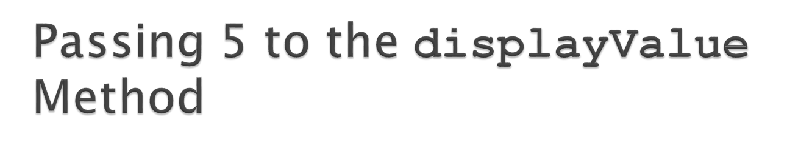
displayValue(5);
public static void displayValue(int num)
{
System.out.println("The value is " + num);
}
The argument 5 is copied into the parameter variable num.
The method will display The value is 5
5-<number>

Slide 13
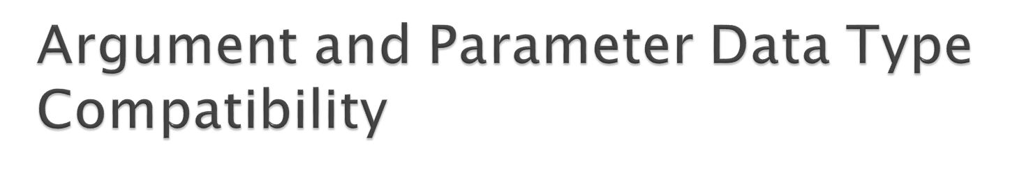
When you pass an argument to a method, be sure that the argument’s data type is compatible with the parameter variable’s data type.
Java will automatically perform widening conversions, but narrowing conversions will cause a compiler error.
double d = 1.0;
displayValue(d);
Error! Can’t convert double to int
5-<number>

Slide 14

The argument 5 is copied into the num1 parameter.
The argument 10 is copied into the num2 parameter.
showSum(5, 10);
public static void showSum(double num1, double num2)
{
  double sum; //to hold the sum
  sum = num1 + num2;
  System.out.println("The sum is " + sum);
}
NOTE: Order matters!
5-<number>

Slide 15

In Java, all arguments of the primitive data types are passed by value, which means that only a copy of an argument’s value is passed into a parameter variable.
A method’s parameter variables are separate and distinct from the arguments that are listed inside the parentheses of a method call.
If a parameter variable is changed inside a method, it has no affect on the original argument.
See example: PassByValue.java
5-<number>

Slide 16
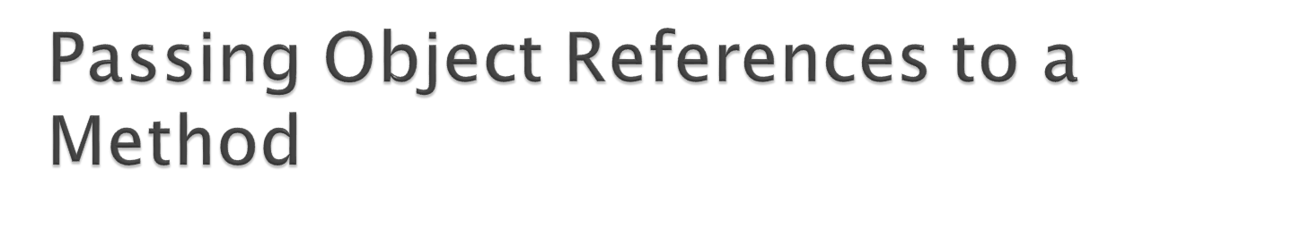
Recall that a class type variable does not hold the actual data item that is associated with it, but holds the memory address of the object. A variable associated with an object is called a reference variable.
When an object such as a String is passed as an argument, it is actually a reference to the object that is passed.
5-<number>

Slide 17

Both variables reference the same object
showLength(name);
public static void showLength(String str)
{
System.out.println(str + " is " + str.length() + " characters long.");
str = "Joe" // see next slide
}
“Warren”
address
The address of the object is copied into the str parameter.
address
5-<number>

Slide 18

Strings are immutable objects, which means that they cannot be changed. When the line
str = "Joe";
is executed, it cannot change an immutable object, so creates a new object.
See example: PassString.java
The name variable holds the address of a String object
address
“Warren”
The str variable holds the address of a different String object
address
“Joe”
5-<number>

Slide 19

A local variable is declared inside a method and is not accessible to statements outside the method.
Different methods can have local variables with the same names because the methods cannot see each other’s local variables.
A method’s local variables exist only while the method is executing. When the method ends, the local variables and parameter variables are destroyed and any values stored are lost.
Local variables are not automatically initialized with a default value and must be given a value before they can be used.
See example: LocalVars.java
5-<number>

Slide 20

Data can be passed into a method by way of the parameter variables. Data may also be returned from a method, back to the statement that called it.
double num = Math.pow(4,3);
Two integers 4 and 3 are passed into the pow method.
The double value 64.0 is returned from the method and assigned to the num variable.
5-<number>

Slide 21
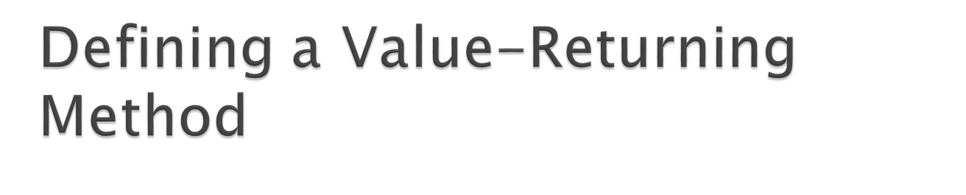
public static int sum(int num1, int num2)
{
int result;
result = num1 + num2;
return result;
}
Return type
The return statement causes the method to end execution and it returns a value back to the statement that called the method.
This expression must be of the same data type as the return type
5-<number>

Slide 22

total = sum(value1, value2);
  public static int sum(int num1, int num2)
  {
  int result;
  result = num1 + num2;
  return result;
  }
20
40
60
5-<number>

Slide 23

Sometimes we need to write methods to test arguments for validity and return true or false
  public static boolean isValid(int number)
  {
  boolean status;
  if(number >= 1 && number <= 100)
  status = true;
  else
  status = false;
  return status;
  }
  Calling code:
  int value = 20;
  if(isValid(value))
  System.out.println("The value is within range");
  else
  System.out.println("The value is out of range");
5-<number>

Slide 24
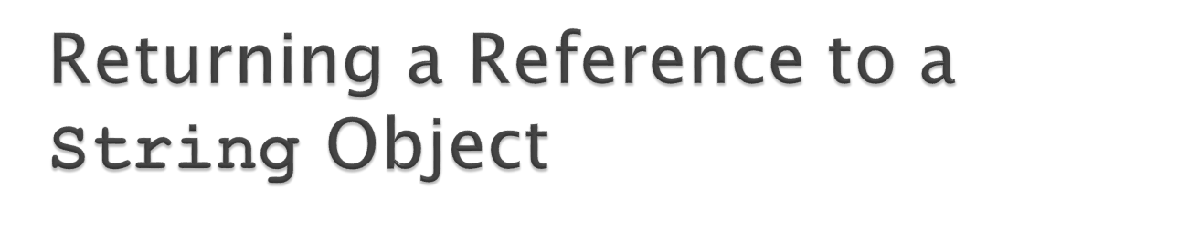
customerName = fullName("John", "Martin");
public static String fullName(String first, String last)
{
String name;
name = first + " " + last;
return name;
}
See example:
ReturnString.java
address
Local variable name holds the reference to the object. The return statement sends a copy of the reference back to the call statement and it is stored in customerName.
“John Martin”
5-<number>

Slide 25

A large, complex problem can be solved a piece at a time by methods.
The process of breaking a problem down into smaller pieces is called functional decomposition.
See example: SalesReport.java
If a method calls another method that has a throws clause in its header, then the calling method should have the same throws clause.
5-<number>

Slide 26

Note that the main and getTotalSales methods in SalesReport.java have a throws IOException clause.
All methods that use a Scanner object to open a file must throw or handle IOException.
You will learn how to handle exceptions in Chapter 11.
For now, understand that Java required any method that interacts with an external entity, such as the file system to either throw an exception to be handles elsewhere in your application or to handle the exception locally.
5-<number>

