Slide 1
Diamond Price Project
Shai Projects 2023/2024

Slide 2
Understand the problem
Imagine that you want to buy a diamond for your wife to express how sorry you are about the dish you broke last night, unfortunately, this is your first time buying a diamond, and there are many frauds who want to earn money from your idiot personality. but you're lucky for having friends like Emad and Abdullah, they know how to predict diamond prices using machine learning algorithms and tell you if the diamond is in the price range or not.
So let’s start solving the problem

Slide 3
Understand the data
We have data with 10 columns :-
Id x :- length in mm Y :- width in mm Z :- depth in mm Carat :- weight of the diamond Table :- width of top of diamond
Depth :- total depth percentage Cut :- quality of the cut Clarity :- measurement of how clear the diamond is Color Price :- The price of the diamond and this is our target value

Slide 4
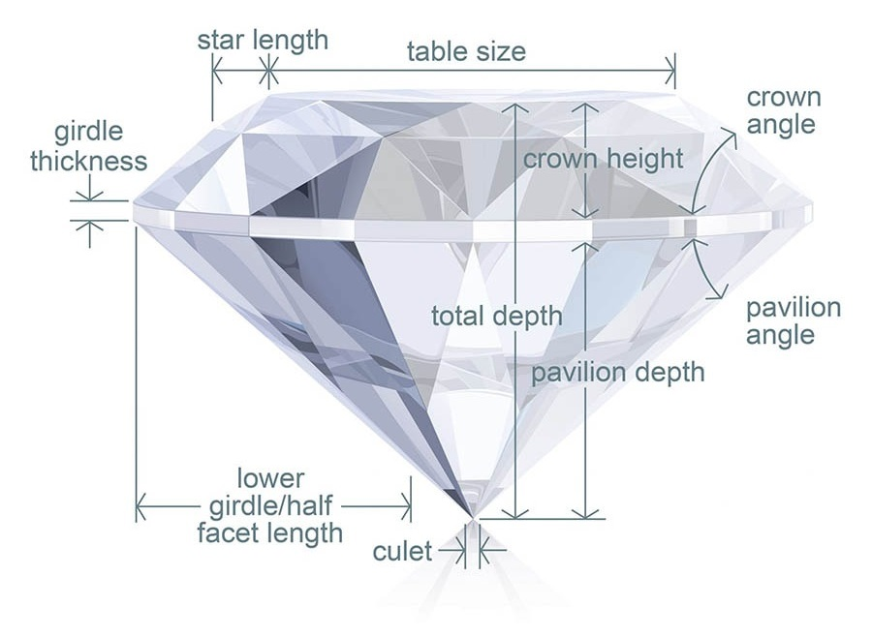
Diamond properties

Slide 5
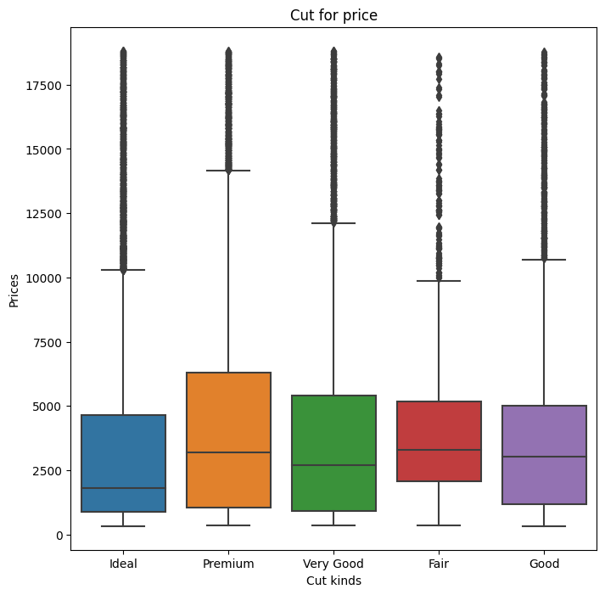
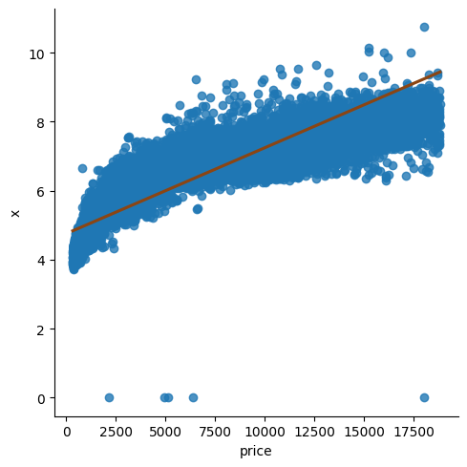
Visualizations
We create plots to understand the relationships between target var and predictor and the predictors themselves
Cut vs Price
length vs price

Slide 6
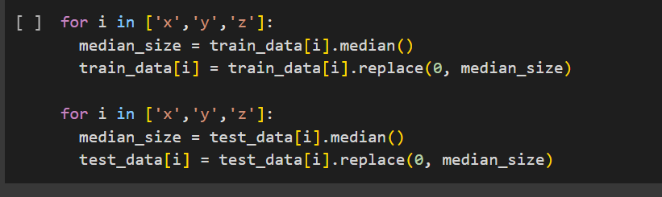
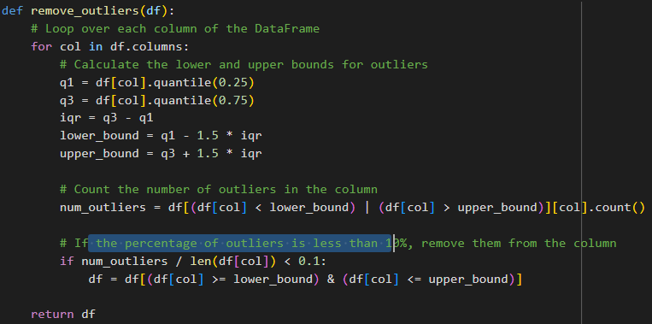
Data cleaning
We have 0 value on x,y and z which dosn’t make sense at all so we’ll replace them with the median
This data set have a lot off outliers we will dorp it if they represent less or equal 0.1 of the data. We can’t apply this in the competion

Slide 7
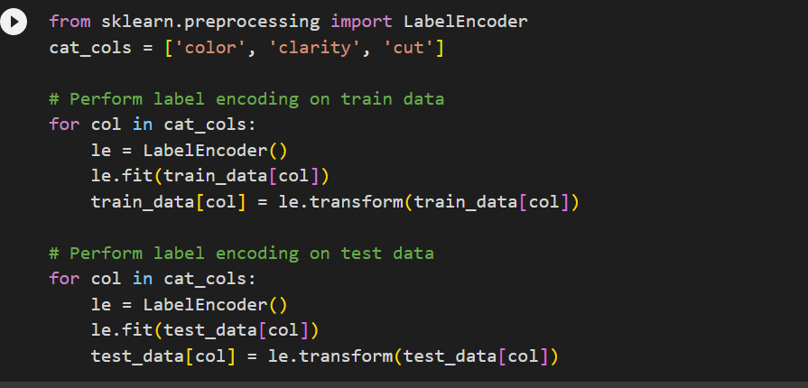
Dealing With Categorical Features
in our problem we have Three Categorical features that we need to deal with every one of them is ordinal so we can encode them using label encoding technique

Slide 8
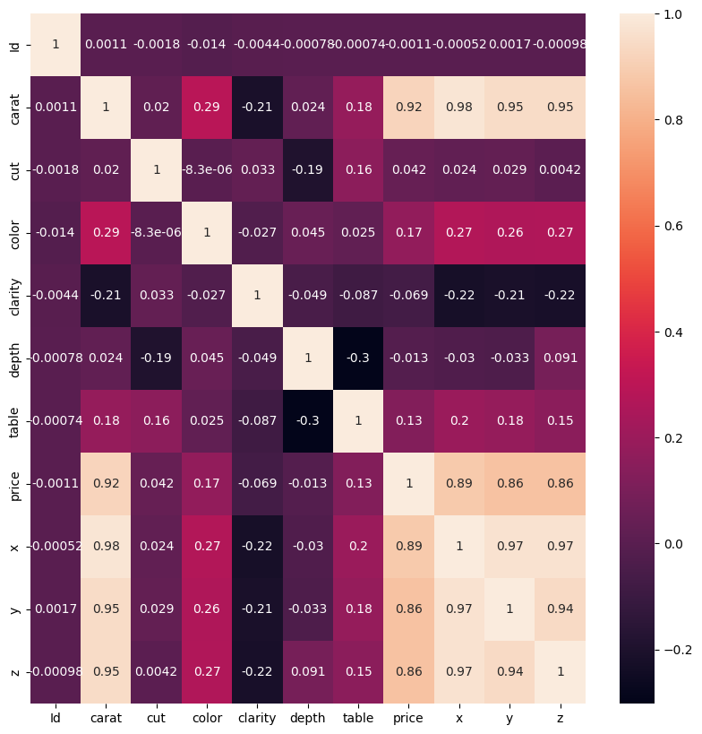
Correlations between features

Slide 9
Gains from Corr heatmap
X , y ,z and carat have high correlation with the target (price) so they’ll be important in our project (or one of them)
X, y, z and carat have high correlation with each other so we can drop them and keep one .
table , clarity , Id and cut have very low correlation with the target(price) so we can drop them too. In our case because we don’t have real data we don’t want to make this changes .

Slide 10
Splitting the data
We try two ways of working in this project first one we consider that the test_data from the competition is the test data .
Second one we try to use split test from sklearn

Slide 11
Selecting our model
Our problem is predict price(numerical) and we have data with labels so we have supervised learning and regression task . So we’ll try the regression models we know :-
Linear Model
Decision Tree Model
Random Forest Regressor Model
Lasso
Kneighbor Regressor
CVR
XGBoost Regressor

Slide 12
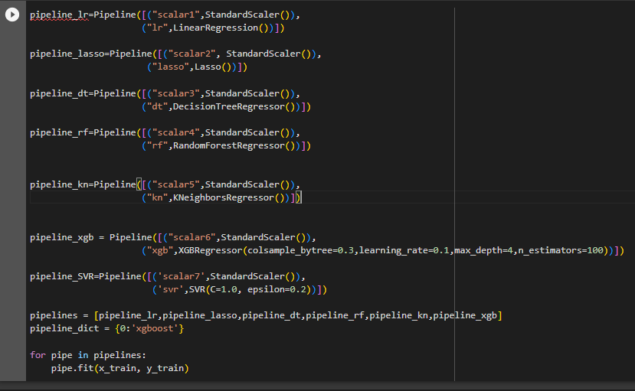
Transformation and training pipeline

Slide 13
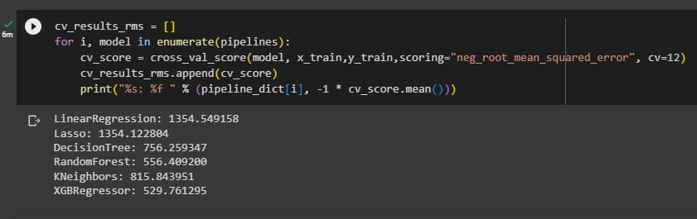
Evaluation and results

Slide 14
Chose and Fine tune the parameter
After we see all results from the models we have tried , we see that the xgboost gives us best results in cross validation technique, So we decide to work on xgboost hyperparameter to gain better results .
Working on hyperparameter can done by :-
GridSearch RandomizedSearch
We chose randomizedSearch algorithm

Slide 15
Thank You
We wish you can buy good diamond for your wife .
Emad Allahham
Abdullah Almaharmeh

