Slide 1
Scientific Computing lecture # 3

Slide 2
Summary from Previous Week
What Is MATLAB?
MATLAB (MATrix LABoratory)
high-performance language for technical computing
computation, visualization, and programming in an easy-to-use environment

Slide 3
Summary from Previous Week
Typical uses include:
Math and computation
Algorithm development
Modelling, simulation, and prototyping
Data analysis, exploration, and visualization
Scientific and engineering graphics
Application development, including Graphical User Interface building

Slide 4
Why MATLAB
A good choice for vision program development because:
Easy to do very rapid prototyping
Quick to learn, and good documentation
A good library of image processing functions
Excellent display capabilities
Widely used for teaching and research in universities and industry
Another language to impress your boss with !

Slide 5
Why not MATLAB
Has some drawbacks:
Slow for some kinds of processes
Not geared to the web
Not designed for large-scale system development

Slide 6
MATLAB Components
MATLAB consists of:
The MATLAB language
a high-level matrix/array language with control flow statements, functions, data structures, input/output, and object-oriented programming features.
The MATLAB working environment
the set of tools and facilities that you work with as the MATLAB user or programmer, including tools for developing, managing, debugging, and profiling
Handle Graphics
the MATLAB graphics system. It includes high-level commands for two-dimensional and three-dimensional data visualization, image processing, animation, and presentation graphics

Slide 7
MATLAB Components
The MATLAB function library.
a vast collection of computational algorithms ranging from elementary functions like sum, sine, cosine, and complex arithmetic, to more sophisticated functions like matrix inverse, matrix eigenvalues, Bessel functions, and fast Fourier transforms as well as special image processing related functions
The MATLAB Application Program Interface (API)
a library that allows you to write C and Fortran programs that interact with MATLAB. It include facilities for calling routines from MATLAB (dynamic linking), calling MATLAB as a computational engine, and for reading and writing MAT-files.

Slide 8
Matrices

Slide 9
Matrices
Rows and columns are always numbered starting at 1
Matlab matrices are of various types to hold different kinds of data (usually floats or integers)
A single number is really a 1 x 1 matrix in Matlab!
Matlab variables are not given a type, and do not need to be declared
Any matrix can be assigned to any variable

Slide 10
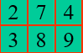


Matrices
Building matrices with [ ]:
A = [2 7 4] A = [2 7 4; 3 8 9]
A = [2; 7; 4] B= [ A A ]

Slide 11
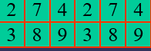
Matrices
Building matrices with [ ]:
A = [2 7 4] A = [2 7 4; 3 8 9]
A = [2; 7; 4] B= [ A A ]

Slide 12
Matrices

Slide 13
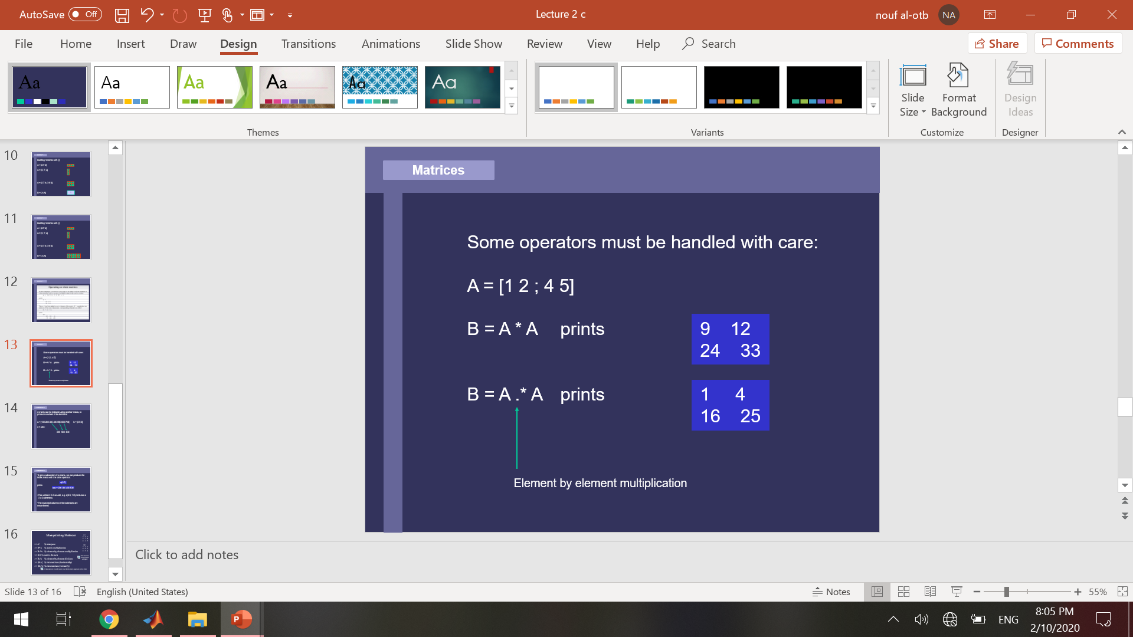
Matrices
Some operators must be handled with care:
A = [1 2 ; 4 5]
B = A * A prints
B = A .* A prints
Element by element multiplication

Slide 14
Submatrices
A matrix can be indexed using another matrix, to produce a subset of its elements:
a = [100 200 300 400 500 600 700] b = [3 5 6]
c = a(b):
300 500 600
To get a subsection of a matrix, we can produce the index matrix with the colon operator:
a (2 : 5)
Prints: ans= 200 300 400 500
This works in 2-D as well, e.g. c(2:3, 1:2) produces a 2 x 2 submatrix.
The rows and columns of the submatrix are renumbered.

Slide 15

Manipulating Matrices
>> A ' % transpose
>> B*A % matrix multiplication
>> B.*A % element by element multiplication
>> B/A % matrix division
>> B./A % element by element division
>> [B A] % Join matrices (horizontally)
>> [B; A] % Join matrices (vertically)
Create matrices A and B and try out the matrix operators in this slide
A =
3 2 1
5 1 0
2 1 7
B =
1 3 1
4 9 5
2 7 2
B =
1 3 1
4 9 5
2 7 2

Slide 16
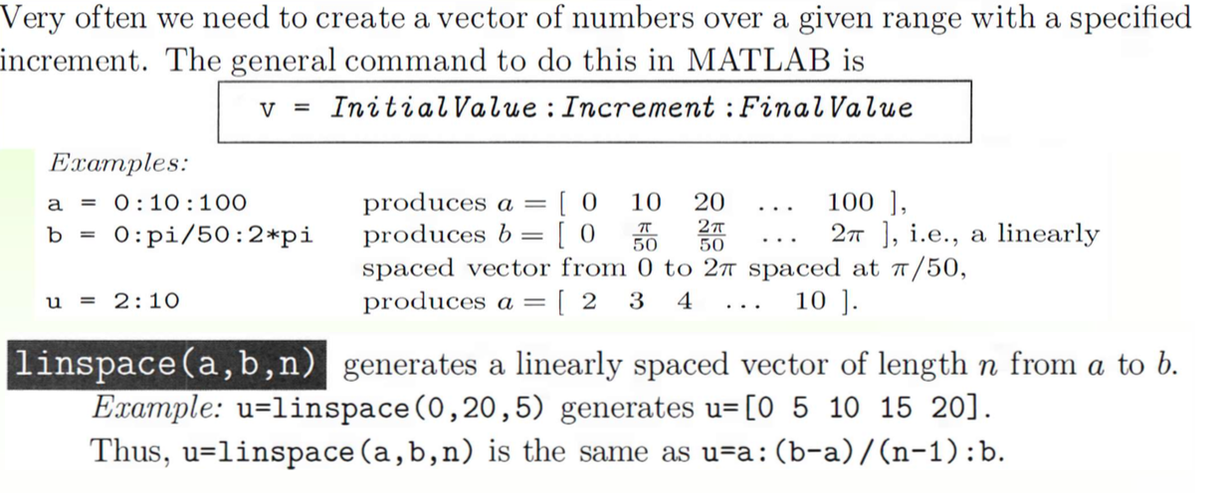
The colon “:” Operator and the function linspace

Slide 17
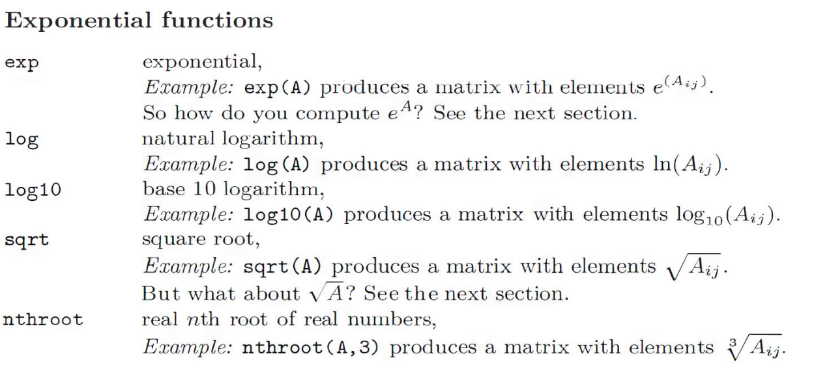
Elementary math functions

Slide 18
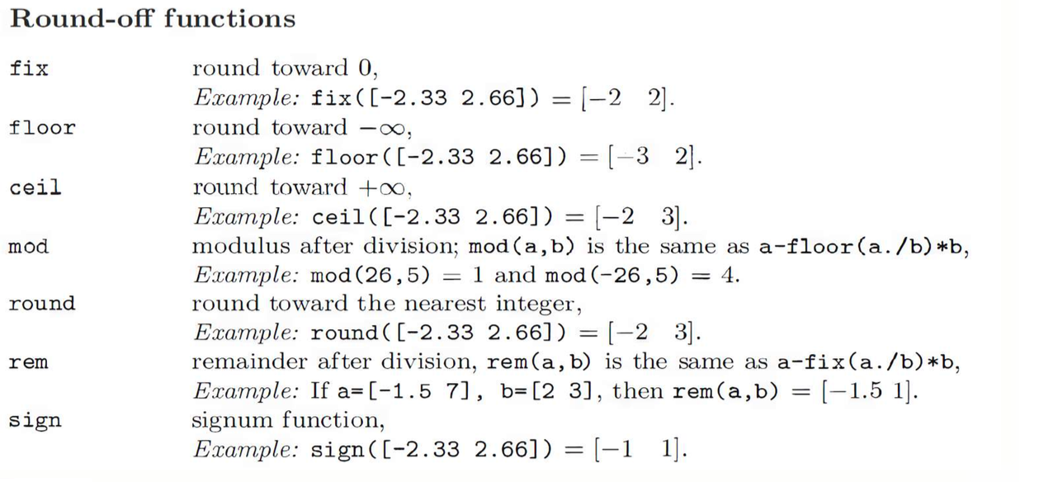
Elementary math functions

Slide 19
Any Questions

