Slide 1
SCIENTIFIC COMPUTING
LECTURE # 7
1

Slide 2
User-defined functions
Introduction
M-Files
Syntax of user-defined functions
Calling user-defined functions

Slide 3
Introduction
Functions are M-files that can accept input arguments and return output arguments.
The names of the M-file and of the function should be the same.
Functions operate on variables within their own workspace, separate from the workspace you access at the MATLAB command prompt.
3

Slide 4
M-Files
M-Files are text files containing MATLAB code.
Use the MATLAB Editor or another text editor to create a file containing the same statements you would type at the MATLAB command line.
Save the file under a name that ends in .m.
4

Slide 5
M-Files Cont.
There are two kinds of M-files:
Scripts
which do not accept input arguments or return output arguments.
They operate on data in the workspace.
Functions
which can accept input arguments and return output arguments.
Internal variables are local to the function.
5

Slide 6
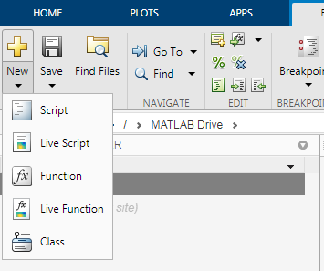
M-Files Cont.
6

Slide 7
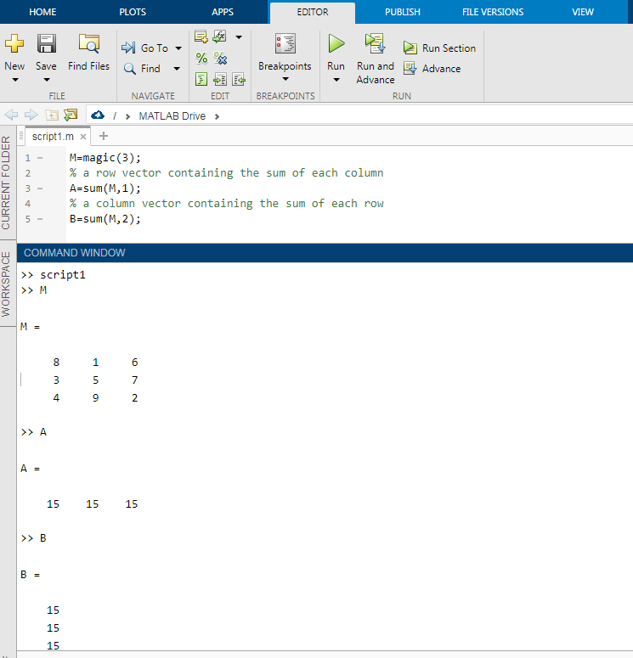
Script Example
Write the statements at new script named script1.m
7

Slide 8
Script Example
Click run to execute script statements
8

Slide 9
Script Example
The statements are executed but nothing appears at command window
if we type the variable name the values appear
9

Slide 10
Syntax of user-defined functions
function returnVar = name ( parameters )
body
end
Names should follow the same rules as variable names
10

Slide 11
User-defined function(Example)
function volume = boxVolume ( paperW , paperL )
height = 2;
length = paperL – 4;
width = paperW – 4;
volume = length * width * height;
end
11

Slide 12
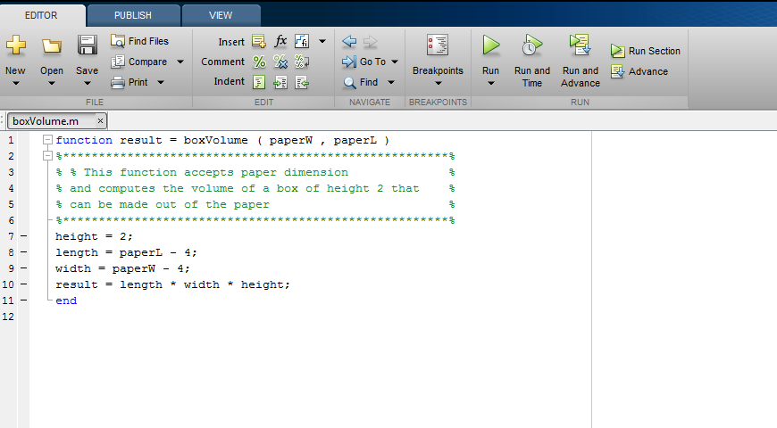
Function in m-file editor
Matching function name and
File name
12

Slide 13
Function in m-file editor
Function documnetation – will be
displayed if you run the command
>> help boxVolumns
13

Slide 14
Function in m-file editor
Notice that function code does not
start with clear and clc
14

Slide 15
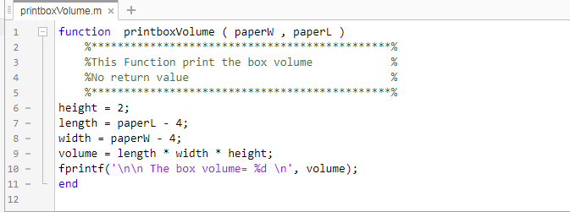
Function in m-file editor
Some functions do not return any output
Example : A modified version of boxVolume that calculates and prints the volume
There is no output variable and = sign
before the function name
15

Slide 16
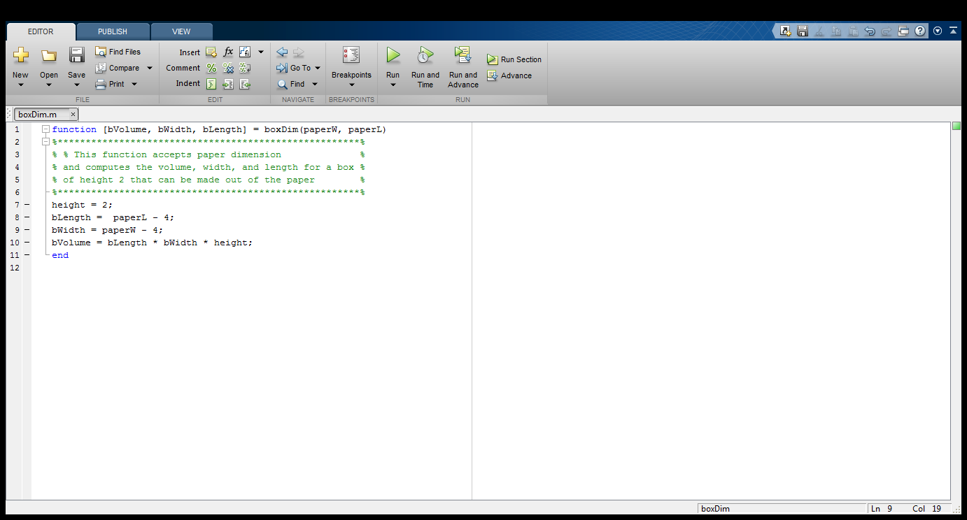
Function in m-file editor
Some functions return more than one output
Example : A function that returns all computed dimensions in the box volume problem
Function returns a vector of variables
16

Slide 17
Calling user-defined functions
Save it in a file with name same as the function name ends with .m (Ex. boxVolume.m ).
Make sure the file is in the current directory or in a directory on the path.
Call it from the command line or a script.
17

Slide 18
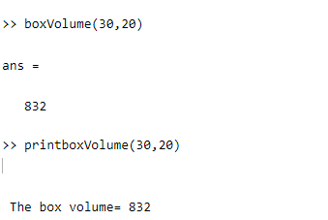
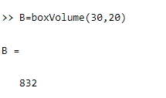
Calling user-defined functions
This function does not return value but display the result
Variable B that will receive function output
18

Slide 19
Any Questions

