Slide 1
Scientific Computing lecture # 9 if statements

Slide 2
What’s the use of relational and logical operators?
Examples:
Given a set of genes and their expressions, get all genes with expression higher than a specific level.
In a pass fail course, give all students with total grade >= 60 a letter grade P and students with total grade < 60 a letter grade of F.
Schedule payday for employees based on the first letter of their last names.
Set the room A/C temperature based on the time of the day.

Slide 3
How to make use of relational and logical operators?
Programming constructs /functions that makes use of relational and logical operators
if statements
find function
loops

Slide 4
Today we will look at selections through
if statements
Input 1
______
______
______
______
______
______
______
______
______
Input 2
______
______
______
______
______
______
______
______
______

Slide 5
The if statement syntax
if condition
commands
end

Slide 6
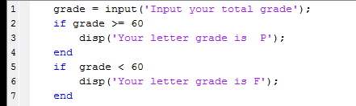
if statement example
Program LetterGrade
condition
command(s)
>> LetterGrade
Worksapce

Slide 7
if statement example
Program LetterGrade
Red arrow points to
current command
>> LetterGrade
Input your total grade
Worksapce
Grade = 85
Worksapce

Slide 8
if statement example
Program LetterGrade
true
>> LetterGrade
Input your total grade 85
Worksapce
Grade = 85
Worksapce
grade 85

Slide 9
if statement example
Program LetterGrade
>> LetterGrade
Input your total grade 85
Your letter grade is P
Worksapce
Grade = 85
Worksapce
grade 85

Slide 10
if statement example
Program LetterGrade
false
>> LetterGrade
Input your total grade 85
Your letter grade is P
Worksapce
Grade = 85
Worksapce
grade 85

Slide 11
if statement example
Program LetterGrade
skip
>> LetterGrade
Input your total grade 85
Your letter grade is P
Worksapce
Grade = 85
Worksapce
grade 85

Slide 12
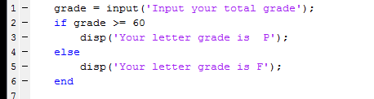
if-else statement example
Program LetterGrade2 : a better version of LetterGrade
>> LetterGrade2
Worksapce

Slide 13
if-else statement example
Program LetterGrade2: a better version of LetterGrade
>> LetterGrade2
Input your total grade
Worksapce
Grade = 85
Worksapce

Slide 14
if-else statement example
Program LetterGrade2: a better version of LetterGrade
true
>> LetterGrade2
Input your total grade 85
Worksapce
Grade = 85
Worksapce
grade 85

Slide 15
if-else statement example
Program LetterGrade2: a better version of LetterGrade
>> LetterGrade2
Input your total grade 85
Your letter grade is P
Worksapce
Grade = 85
Worksapce
grade 85

Slide 16
if-else statement example
Program LetterGrade2: a better version of LetterGrade
Automatically
skip
No condition to check, i.e. faster code
>> LetterGrade2
Input your total grade 85
Your letter grade is P
Worksapce
Grade = 85
Worksapce
grade 85

Slide 17
if-else statement example
Program LetterGrade2: a better version of LetterGrade
>> LetterGrade2
Input your total grade 85
Your letter grade is P
>> LetterGrade2
Worksapce
grade 85

Slide 18
if-else statement example
Program LetterGrade2: a better version of LetterGrade
>> LetterGrade2
Input your total grade 85
Your letter grade is P
>> LetterGrade2
Input your total grade
Worksapce
grade 85
Worksapce
Grade = 85

Slide 19
if-else statement example
Program LetterGrade2: a better version of LetterGrade
false
>> LetterGrade2
Input your total grade 85
Your letter grade is P
>> LetterGrade2
Input your total grade 55
Worksapce
Grade = 85
Worksapce
grade 55

Slide 20
if-else statement example
Program LetterGrade2:a better version of LetterGrade
skip
>> LetterGrade2
Input your total grade 85
Your letter grade is P
>> LetterGrade2
Input your total grade 55
Worksapce
Grade = 85
Worksapce
grade 55

Slide 21
if-else statement example
Program LetterGrade2: a better version of LetterGrade
>> LetterGrade2
Input your total grade 85
Your letter grade is P
>> LetterGrade2
Input your total grade 55
Your letter grade is F
Worksapce
Grade = 85
Worksapce
grade 55

Slide 22
if-else statement example
Program LetterGrade2: a better version of LetterGrade
What if
someone entered an invalid input (-ve grade for example)?
or
there were more than two cases to cover (you want to give A, B, C, D, F grades)

Slide 23
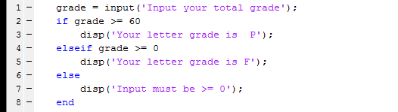
if-elseif statement
What if
someone entered an invalid input (-ve grade for example)?
or
there were more than two cases to cover (you want to give A, B, C, D, F grades)

Slide 24
General if syntax
Every if statement must have if, condition,
consequent
if condition1
consequent1
elseif condition2
consequent2
else
alternate
end

Slide 25
General if syntax
if condition1
consequent1
elseif condition2
consequent2
else
alternate
end
You can have as many elseif parts as you need.

Slide 26
General if syntax
if condition1
consequent1
elseif condition2
consequent2
else
alternate
end
The final else part is not necessary, but always a good idea.

Slide 27
General if syntax
if condition1
consequent1
elseif condition2
consequent2
else
alternate
end
The end word is necessary.

Slide 28
Exercise 1
if (a > b & b > 3)
c = 3;
elseif (b > 5)
c = 4;
else
c = 5;
end;
disp(c)
a = 16
b = 4
What is the value of c that will be displayed?
A) 3
B) 4
C) 5

Slide 29
Exercise 2
if (a > b & b > 3)
c = 3;
elseif (b > 5)
c = 4;
else
c = 5;
end;
disp(c)
a = 3
b = 4
What is the value of c that will be displayed?
A) 3
B) 4
C) 5

Slide 30
Exercise 3
if (a > b & b > 3)
c = 3;
end
if (b < 5)
c = 4;
else
c = 5;
end;
disp(c)
a = 16
b = 4
What is the value of c that will be displayed?
A) 3
B) 4
C) 5

Slide 31
Exercise 4
score = 95
What will this code display
A) D
B) A
C) Not good…
What’s wrong with this code???
if (score > 55)
disp( ‘D’ )
elseif (score > 65)
disp( ‘C’)
elseif (score > 80)
disp( ‘B’ )
elseif (score > 93)
disp( ‘A’ )
else
disp( ‘Not good…’ )
end

Slide 32
Exercise 4 - modified
score = 95
What will this code display
A) D
B) A
C) Not good…
if (score > 93)
disp( ‘A’ )
elseif (score > 80)
disp( ‘B’)
elseif (score > 70)
disp( ‘C’ )
elseif (score > 60)
disp( ‘D’ )
else
disp( ‘F’ )
end

Slide 33
if statements and vectors
We know the following
>> X = [70 60 50]
>> X >= 60
ans =
1 1 0

Slide 34
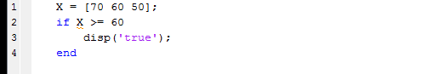
if statements and vectors
true will not be displayed because the condition is not true for every element in the vector
if statements are best fit for scalar values

Slide 35
Any Questions

