Slide 1
C++ Programming: From Problem Analysis to Program Design, Fifth Edition
Chapter 11: Classes and Data Abstraction

Slide 2
Download textbook
Read through
Try examples using Dev C++
Try End of chapter problems
Do that in groups

Slide 3
Classes
Class: collection of a fixed number of components (members)
Definition syntax:
Defines a data type, no memory is allocated
Don’t forget the semicolon after closing brace

Slide 4
Classes (cont'd.)
Class member can be a variable or a function
If a member of a class is a variable
It is declared like any other variable
In the definition of the class
You cannot initialize a variable when you declare it
If a member of a class is a function
Function prototype is listed
Function members can (directly) access any member of the class

Slide 5
Classes (cont'd.)
Three categories of class members
private (default)
Member cannot be accessed outside the class
public
Member is accessible outside the class
protected

Slide 6
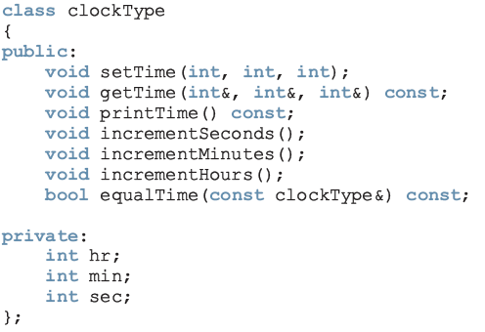
Classes (cont'd.)
const: formal parameter can’t modify
the value of the actual parameter
These functions cannot modify the member variables of a variable of type clockType
private members,
can’t be accessed from outside the class

Slide 7
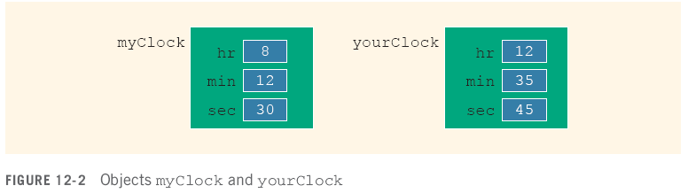
Variable (Object) Declaration
Once a class is defined, you can declare variables of that type
clockType myClock;
clockType yourClock;
A class variable is called a class object or class instance

Slide 8
Accessing Class Members
Once an object is declared, it can access the public members of the class
Syntax:
The dot (.) is the member access operator
If object is declared in the definition of a member function of the class, it can access the public and private members

Slide 9
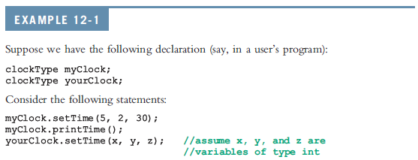


Accessing Class Members (cont’d.)

Slide 10
Built-in Operations on Classes
Most of C++’s built-in operations do not apply to classes
Arithmetic operators cannot be used on class objects unless the operators are overloaded
You cannot use relational operators to compare two class objects for equality
Built-in operations valid for class objects:
Member access (.)
Assignment (=)

Slide 11
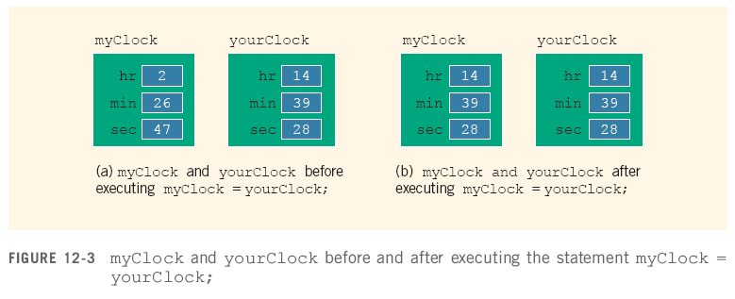
Assignment Operator and Classes

Slide 12
Functions and Classes
Objects can be passed as parameters to functions and returned as function values
As parameters to functions
Objects can be passed by value or by reference
If an object is passed by value
Contents of data members of the actual parameter are copied into the corresponding data members of the formal parameter

Slide 13
Reference Parameters and Class Objects (Variables)
Passing by value might require a large amount of storage space and a considerable amount of computer time to copy the value of the actual parameter into the formal parameter
If a variable is passed by reference
The formal parameter receives only the address of the actual parameter

Slide 14
Reference Parameters and Class Objects (Variables) (cont'd.)
Pass by reference is an efficient way to pass a variable as a parameter
Problem: when passing by reference, the actual parameter changes when formal parameter changes
Solution: use const in the formal parameter declaration

Slide 15
Implementation of Member Functions
Scope resolution operator

Slide 16
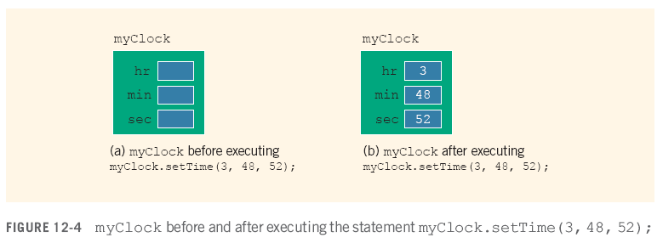
Implementation of Member Functions (cont'd.)

Slide 17
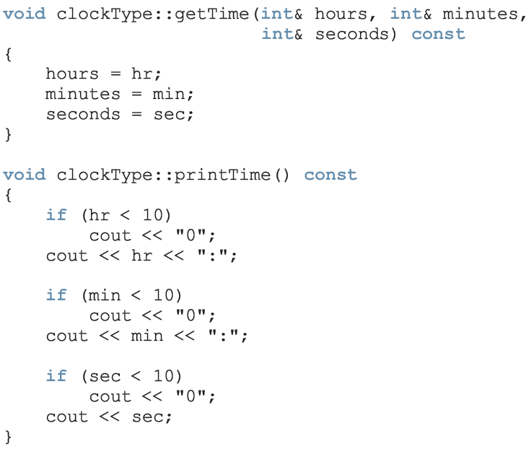
Implementation of Member Functions (cont'd.)

Slide 18
Implementation of Member Functions (cont'd.)

Slide 19
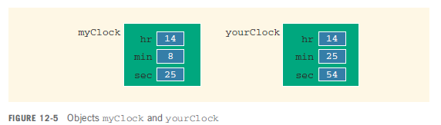
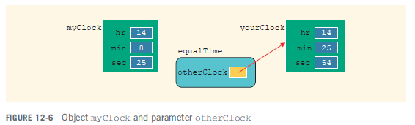
Implementation of Member Functions (cont'd.)

Slide 20
Implementation of Member Functions (cont'd.)
Once a class is properly defined and implemented, it can be used in a program
A program that uses/manipulates the objects of a class is called a client of that class
When you declare objects of the class clockType, every object has its own copy of the member variables (hr, min, and sec)
Variables such as hr, min, and sec are called instance variables of the class
Every object has its own instance of the data

Slide 21
Order of public and private Members of a Class
C++ has no fixed order in which you declare public and private members
By default all members of a class are private
Use the member access specifier public to make a member available for public access

Slide 22
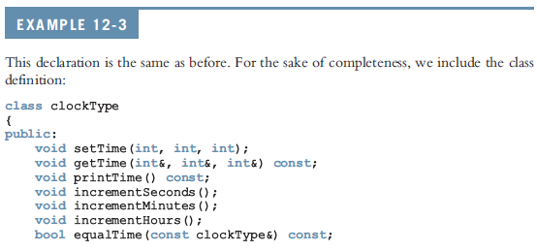

Order of public and private Members of a Class (cont'd.)

Slide 23
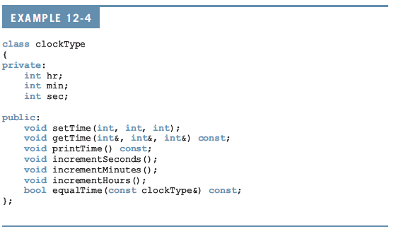
Order of public and private Members of a Class (cont'd.)

Slide 24
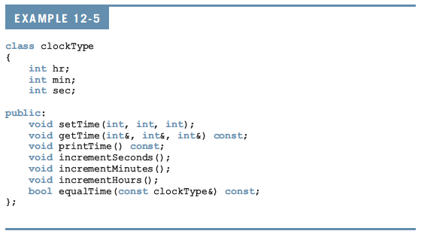
Order of public and private Members of a Class (cont'd.)

Slide 25
Constructors
Use constructors to guarantee that data members of a class are initialized
Two types of constructors:
With parameters
Without parameters (default constructor)
The name of a constructor is the same as the name of the class
A constructor has no type

Slide 26
Constructors (cont'd.)
A class can have more than one constructor
Each must have a different formal parameter list
Constructors execute automatically when a class object enters its scope
They cannot be called like other functions
Which constructor executes depends on the types of values passed to the class object when the class object is declared

Slide 27
Constructors (cont'd.)

Slide 28
Constructors (cont'd.)
Can be replaced with:
setTime(hours, minutes, seconds);

Slide 29
Invoking a Constructor
A constructor is automatically executed when a class variable (object) is declared

Slide 30
Invoking the Default Constructor
To invoke the default constructor:
Example:
clockType yourClock;

Slide 31

Invoking a Constructor with Parameters
Syntax:
The number of arguments and their type should match the formal parameters (in the order given) of one of the constructors
Otherwise, C++ uses type conversion and looks for the best match
Any ambiguity leads to a compile-time error

Slide 32
Constructors and Default Parameters
If you replace the constructors of clockType with the constructor in Line 1, you can declare clockType objects with zero, one, two, or three arguments as follows:
clockType clock1; //Line 2
clockType clock2(5); //Line 3
clockType clock3(12, 30); //Line 4
clockType clock4(7, 34, 18); //Line 5

Slide 33
Classes and Constructors: A Precaution
If a class has no constructor(s), C++ provides the default constructor
However, object declared is still uninitialized
If a class includes constructor(s) with parameter(s), but not the default constructor
C++ does not provide the default constructor

Slide 34
Destructors
Destructors are functions without any type
The name of a destructor is the character '~' followed by class name
For example:
~clockType();
A class can have only one destructor
The destructor has no parameters
The destructor is automatically executed when the class object goes out of scope

