Slide 1

C++ Programming: From Problem Analysis to Program Design, Fifth Edition
Chapter 8: The class string &
File input output Handling

Slide 2
Download textbook
Read through
Try examples using Dev C++
Try End of chapter problems
Do that in groups

Slide 3
string Type
To use the data type string, the program must include the header file string
The statement:
string name = "William Jacob";
declares name to be a string variable and also initializes name to "William Jacob"
The first character, 'W', is in position 0
The second character, 'i', is in position 1
name is capable of storing any size string

Slide 4
string Type (cont'd.)
Binary operator + and the array subscript operator [], have been defined for the data type string
+ performs the string concatenation operation
Example:
str1 = "Sunny";
str2 = str1 + " Day";
stores "Sunny Day" into str2

Slide 5
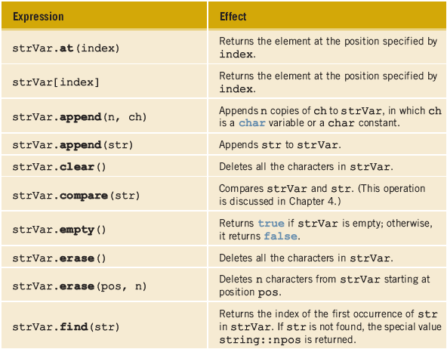

Slide 6
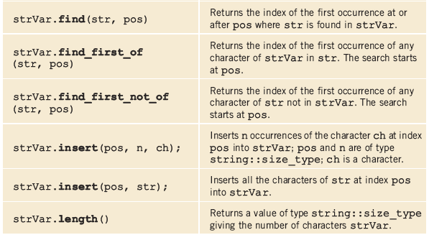

Slide 7

Additional string Operations

Slide 8
A Glimpse at Classes Strings as a pre-defined C++ Class

Slide 9
Classes
Class: collection of a fixed number of components (members)
Definition syntax:
Defines a data type, no memory is allocated
Don’t forget the semicolon after closing brace

Slide 10
Classes (cont'd.)
Class member can be a variable or a function
If a member of a class is a variable
It is declared like any other variable
In the definition of the class
You cannot initialize a variable when you declare it
If a member of a class is a function
Function prototype is listed
Function members can (directly) access any member of the class

Slide 11
Classes (cont'd.)
Three categories of class members
private (default)
Member cannot be accessed outside the class
public
Member is accessible outside the class
protected

Slide 12
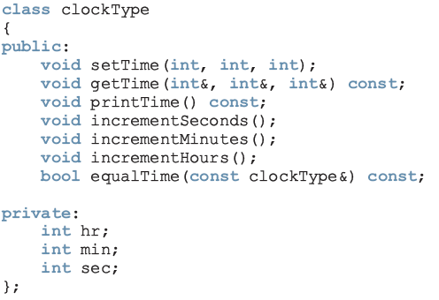
Classes (cont'd.)

Slide 13
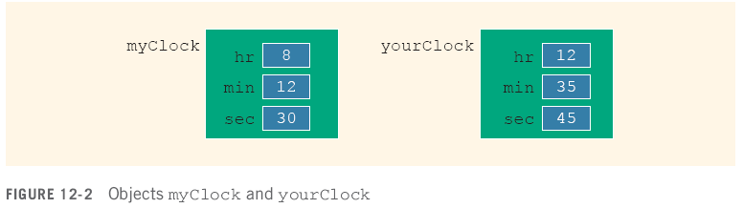
Variable (Object) Declaration
Once a class is defined, you can declare variables of that type
clockType myClock;
clockType yourClock;
A class variable is called a class object or class instance

Slide 14
Accessing Class Members
Once an object is declared, it can access the public members of the class
Syntax:
The dot (.) is the member access operator
If object is declared in the definition of a member function of the class, it can access the public and private members

Slide 15
Back to the String Class A pre-defined Class in C++

Slide 16
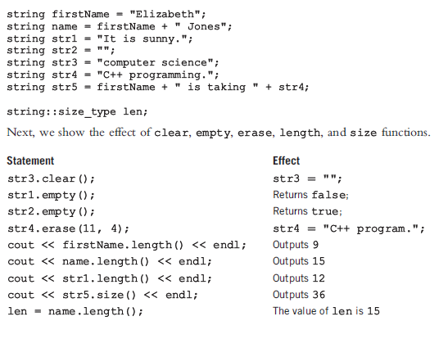
Example 8-14 clear, empty, erase, length, & size FUNCTIONS
Example 8-14
P463

Slide 17
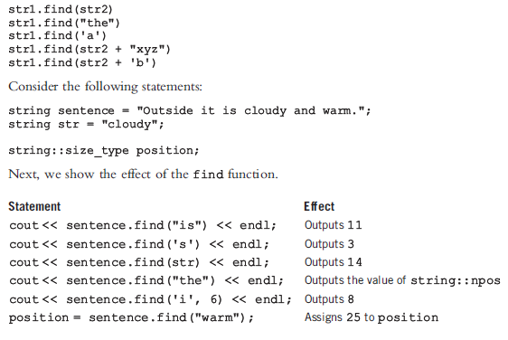
Example 8-15 find FUNCTION
Example 8-15
P465

Slide 18
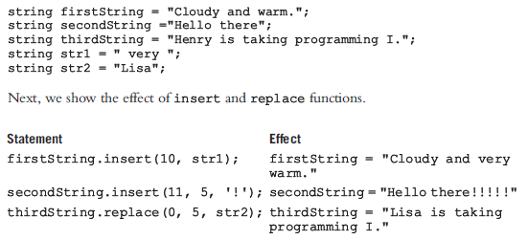
Example 8-16 insert & replace FUNCTIONS
Example 8-16
P467

Slide 19

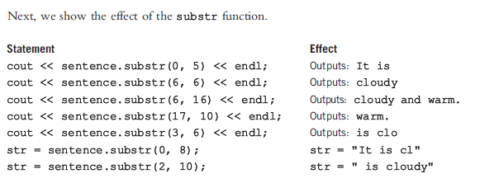
Example 8-17 substr FUNCTION
Example 8-17
P468

Slide 20
Programming Challenge
Write a program that read your full name (first and last) in one string using getline() function, and then prints back your last name.

Slide 21
#include <iostream>
#include<string>
using namespace std;
int main()
{
int Pos, lnamePos, lnameLength;
string name;
string lname;
cout<<"Enter you first name and last name: ";
getline(cin, name);

Slide 22
Pos=name.find(' ');
lnamePos= Pos+1;
lnameLength=name.length()-lnamePos;
lname=name.substr(lnamePos, lnameLength);
cout<<"\n Your last name is: "<<lname<<endl<<endl<<endl;
system("PAUSE");
return 0;
}

Slide 23
File input output handling A quick Overview
File: area in secondary storage to hold info
File I/O is a five-step process
Include fstream header
Declare file stream variables
Associate the file stream variables with the input/output sources
Use the file stream variables with >>, <<, or other input/output functions
Close the files

Slide 24
Programming Example P163 – in Text
Write a program that reads a student name followed by five test scores from a file. The program should output the student name, the five test scores, and the average test score to a file. Output the average test score with two decimal places. The data to be read is stored in a file called test.txt. The output should be stored in a file called testavg.out.
Input a file, test.txt, containing the student name and the five test scores. A sample input is:
Andrew Miller 87.50 89 65.75 37 98.50
Output The student name, the five test scores, and the average of the five test scores, saved to a file, testavg.txt.

Slide 25
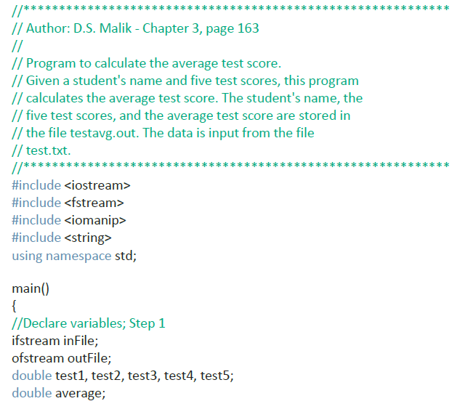

Slide 26
