Slide 1

C++ Programming: From Problem Analysis to Program Design, Fifth Edition
Chapter 6: User-Defined Functions I

Slide 2
Download textbook
Read through
Try examples using Dev C++
Try End of chapter problems
Do that in groups

Slide 3
Introduction
Functions are like building blocks
They allow complicated programs to be divided into manageable pieces
Some advantages of functions:
A programmer can focus on just that part of the program and construct it, debug it, and perfect it
Different people can work on different functions simultaneously
Can be re-used (even in different programs)
Enhance program readability

Slide 4
Introduction (cont'd.)
Functions
Called modules
Like miniature programs
Can be put together to form a larger program

Slide 5
Predefined Functions
In algebra, a function is defined as a rule or correspondence between values, called the function’s arguments, and the unique value of the function associated with the arguments
If f(x) = 2x + 5, then f(1) = 7, f(2) = 9, and f(3) = 11
1, 2, and 3 are arguments
7, 9, and 11 are the corresponding values

Slide 6
Predefined Functions (cont'd.)
Some of the predefined mathematical functions are:
sqrt(x)
pow(x, y)
floor(x)
Predefined functions are organized into separate libraries
I/O functions are in iostream header
Math functions are in cmath header

Slide 7
Predefined Functions (cont'd.)
pow(x,y) calculates x^{y}
pow(2, 3) = 8.0
Returns a value of type double
x and y are the parameters (or arguments)
The function has two parameters
sqrt(x) calculates the nonnegative square root of x, for x >= 0.0
sqrt(2.25) is 1.5
Type double

Slide 8
Predefined Functions (cont'd.)
The floor function floor(x) calculates largest whole number not greater than x
floor(48.79) is 48.0
Type double
Has only one parameter

Slide 9
Predefined Functions (cont'd.)

Slide 10
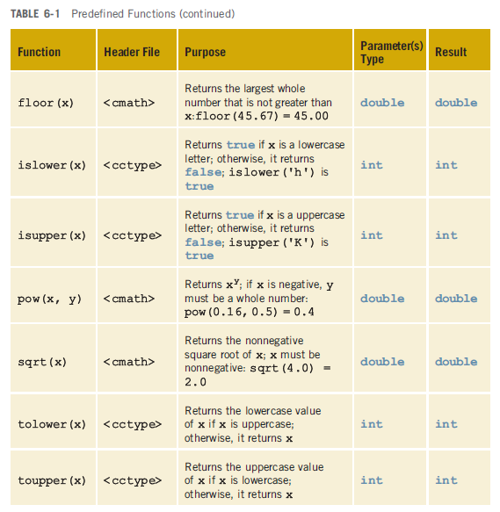
Predefined Functions (cont'd.)

Slide 11
Example 6-1

Slide 12
Example 6-1 sample run:
12

Slide 13
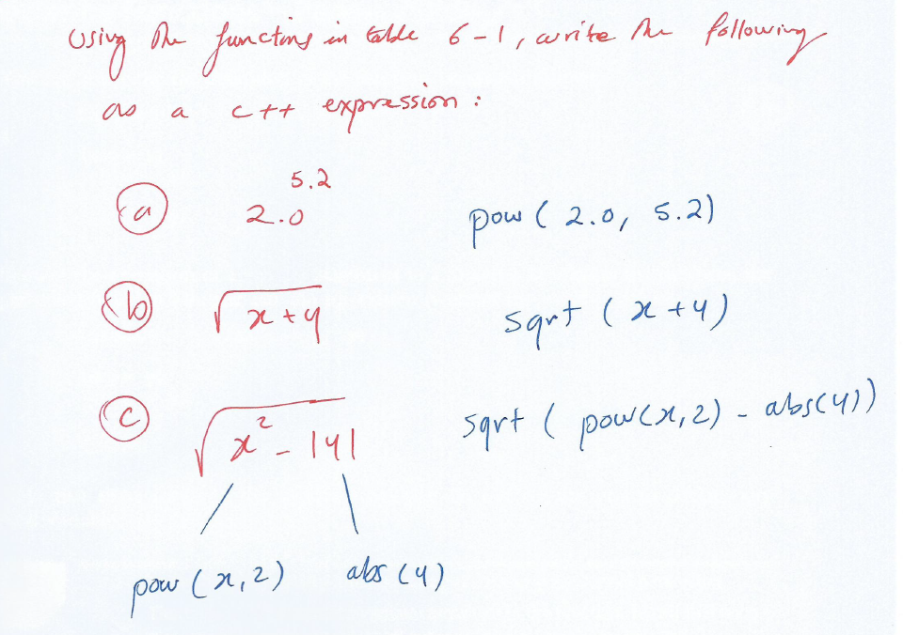
Examples
12
Using the predefined functions in Table 6-1, write the following as C++ expressions:

Slide 14
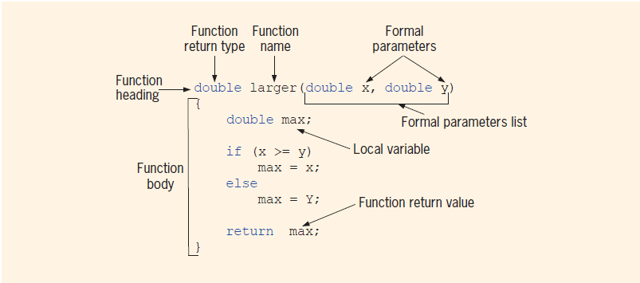
User-Defined Functions Various Parts of a Function

Slide 15
User-Defined Functions
Value-returning functions: have a return type
Return a value of a specific data type using the return statement
Void functions: do not have a return type
Do not use a return statement to return a value

Slide 16
Value-Returning Functions
To use these functions you must:
Include the appropriate header file in your program using the include statement
Know the following items:
Name of the function
Number of parameters, if any
Data type of each parameter
Data type of the value returned: called the type of the function

Slide 17
Value-Returning Functions (cont'd.)
Because the value returned by a value-returning function is unique, must:
Save the value for further calculation
Use the value in some calculation
Print the value
A value-returning function is used in an assignment or in an output statement

Slide 18
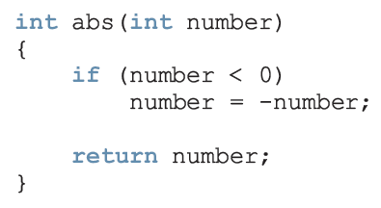
Value-Returning Functions (cont'd.)

Slide 19
Value-Returning Functions (cont'd.)
Heading: first four properties above
Example: int abs(int number)
Formal Parameter: variable declared in the heading
Example: number
Actual Parameter: variable or expression listed in a call to a function
Example: x = pow(u, v)

Slide 20
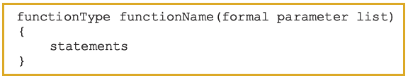
Syntax: Value-Returning Function
Syntax:
functionType is also called the data type or return type

Slide 21
Syntax: Formal Parameter List

Slide 22
Function Call

Slide 23
Syntax: Actual Parameter List
The syntax of the actual parameter list is:
Formal parameter list can be empty:
A call to a value-returning function with an empty formal parameter list is:

Slide 24
Return Statement
Once a value-returning function computes the value, the function returns this value via the return statement
It passes this value outside the function via the return statement

Slide 25
Syntax: return Statement
The return statement has the following syntax:
In C++, return is a reserved word
When a return statement executes
Function immediately terminates
Control goes back to the caller
When a return statement executes in the function main, the program terminates

Slide 26
Syntax: return Statement (cont’d.)

Slide 27
Function Prototype
Function prototype: function heading without the body of the function
Syntax:
It is not necessary to specify the variable name in the parameter list
The data type of each parameter must be specified

Slide 28
Example 6-2 P332 in Text
Write a program that uses functions: larger, compareThree, and main to determine the larger/largest of two or three numbers

Slide 29
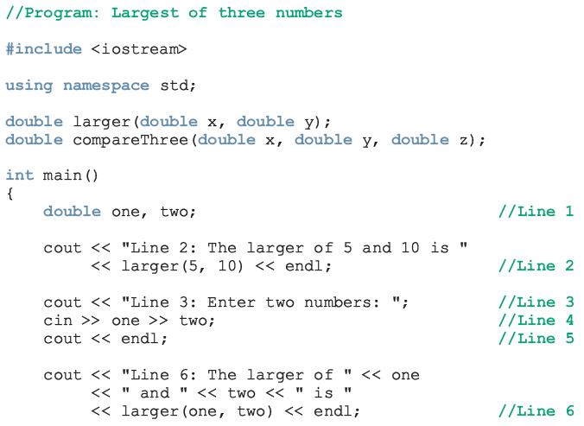
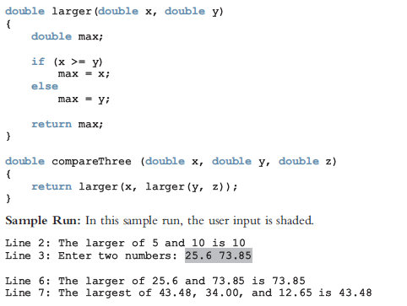
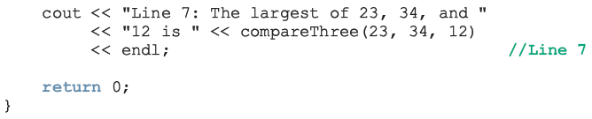
Function Prototype (cont'd.)

Slide 30
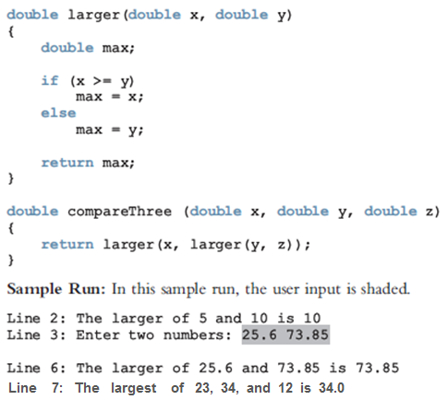
Function Prototype (cont'd.)

Slide 31

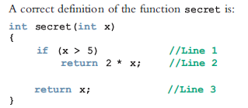
Value-Returning Functions: Some Peculiarity

Slide 32
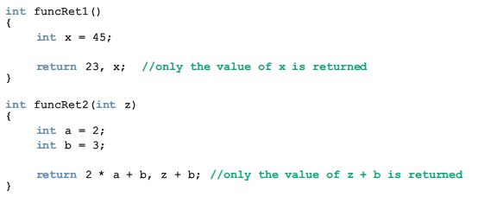
Value-Returning Functions: Some Peculiarity (cont'd.)

Slide 33
Question Challenge
Write a program that reads two numbers to find their sum. Re-write the program using a function called Add.

Slide 34
Example 6-3 P335 in Text
Write a function courseGrade that reads a course score to find the grade.

Slide 35
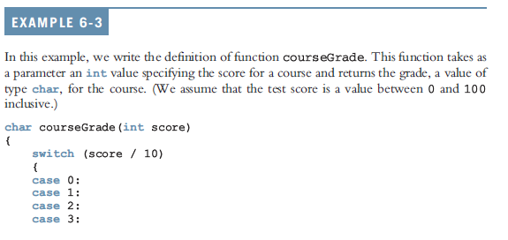
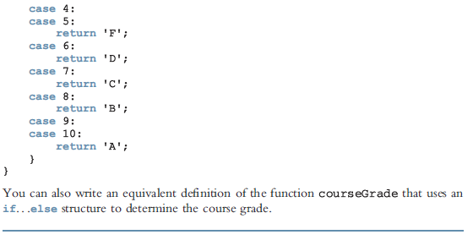
Value-Returning Functions:
More Examples

Slide 36
Example 6-3, Continued
Think of the full C++ program that asks the student for his course Score, and then uses the function courseGrade to
find the grade.

Slide 37
Value-Returning Functions:
More Examples
1- Prototype,
Char courseGrade(int score);
2- In main(),
Cout<<“enter your score: “;
Cin>>score;
Then
Cout<<“your grade is: “<<courseGrade(score) ;
Or
Char Grade;
Grade=courseGrade(score)
Cout<<“your grade is “<<Grade;
3-Write the body of the function

Slide 38
Flow of Execution
Execution always begins at the first statement in the function main
Other functions are executed only when they are called
Function prototypes appear before any function definition
The compiler translates these first
The compiler can then correctly translate a function call

Slide 39
Flow of Execution (cont'd.)
A function call results in transfer of control to the first statement in the body of the called function
After the last statement of a function is executed, control is passed back to the point immediately following the function call
A value-returning function returns a value
After executing the function the returned value replaces the function call statement

Slide 40
CHAPTER REVIEW Question Challenge P342 in Text
Think of the full C++ program that uses the function larger to determine the largest number from a set of 5 numbers
-Group Work-

Slide 41
