Slide 1
Software Security Touchpoints

Slide 2
Security Engineering
Reduce the need for reactive technologies (e.g., intrusion detection) by safer products
Need for:
Software developers
Operations people
Administrators
Users
Executives
Why do these people
need Security Engineering?

Slide 3
Software Security Touchpoints
Best Practices
Both White Hat (constructive) and Black Hat (destructive) activities
Throughout the SDLC
How do you think about security?
Which is more important? White hat or Black hat
type of activities?

Slide 4
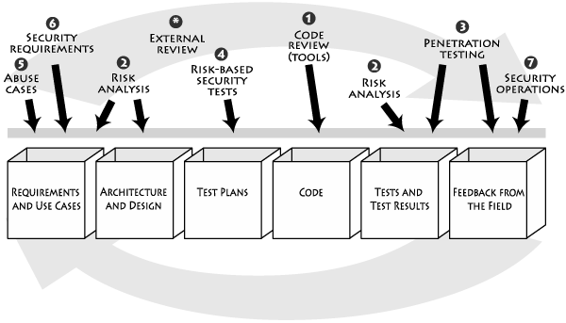
Application of Touchpoints

Slide 5
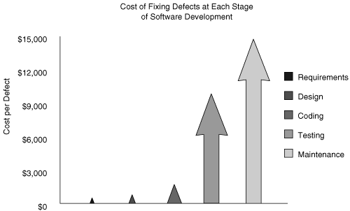
Cost of fixing defect at each stage

Slide 6
Application of Touchpoints
External Review
3. Penetration Testing
1. Code Review
(Tools)
6. Security Requirements
4. Risk-Based
Security Tests
2. Risk Analysis
7. Security
Operations
5. Abuse cases
2. Risk Analysis
Requirement and
Use cases
Architecture
and Design
Test Plans
Code
Tests and
Test Results
Feedback from
the Field

Slide 7
Code Review (Tool)
Artifact: Code
Implementation bugs
Static Analysis tools
White Hat

Slide 8
Application of Touchpoints
External Review
3. Penetration Testing
1. Code Review
(Tools)
6. Security Requirements
4. Risk-Based
Security Tests
2. Risk Analysis
7. Security
Operations
5. Abuse cases
2. Risk Analysis
Requirement and
Use cases
Architecture
and Design
Test Plans
Code
Tests and
Test Results
Feedback from
the Field
Notes:
.

Slide 9
Architectural Risk Analysis
Artifact: Design and specification
System must be coherent and present a uniform security front
Document assumptions and identify possible attacks
Both at specification-based architecture stage and class-hierarchy design stage
White hat

Slide 10
Application of Touchpoints
External Review
3. Penetration Testing
1. Code Review
(Tools)
6. Security Requirements
4. Risk-Based
Security Tests
2. Risk Analysis
7. Security
Operations
5. Abuse cases
2. Risk Analysis
Requirement and
Use cases
Architecture
and Design
Test Plans
Code
Tests and
Test Results
Feedback from
the Field

Slide 11
Penetration Testing
Artifact: system in its environment
Understanding fielded software in its environment
Information supplied by architectural risk analysis
Who does it?
Black Hat

Slide 12
Application of Touchpoints
External Review
3. Penetration Testing
1. Code Review
(Tools)
6. Security Requirements
4. Risk-Based
Security Tests
2. Risk Analysis
7. Security
Operations
5. Abuse cases
2. Risk Analysis
Requirement and
Use cases
Architecture
and Design
Test Plans
Code
Tests and
Test Results
Feedback from
the Field

Slide 13
Risk-Based Security Testing
Artifact: unit and system
Strategies:
Testing of security functionality (standard functional testing)
Risk-based security testing (attack pattern, risk analysis, abuse cases)
Attacker’s mindset
White Hat + Black Hat

Slide 14
Application of Touchpoints
External Review
3. Penetration Testing
1. Code Review
(Tools)
6. Security Requirements
4. Risk-Based
Security Tests
2. Risk Analysis
7. Security
Operations
5. Abuse cases
2. Risk Analysis
Requirement and
Use cases
Architecture
and Design
Test Plans
Code
Tests and
Test Results
Feedback from
the Field

Slide 15
Abuse Cases
Artifact: requirements and use cases
Describe system behavior under attack
Explicit coverage of
What should be protected
From whom
For how long
White Hat + Black Hat

Slide 16
Application of Touchpoints
External Review
3. Penetration Testing
1. Code Review
(Tools)
6. Security Requirements
4. Risk-Based
Security Tests
2. Risk Analysis
7. Security
Operations
5. Abuse cases
2. Risk Analysis
Requirement and
Use cases
Architecture
and Design
Test Plans
Code
Tests and
Test Results
Feedback from
the Field

Slide 17
Security Requirements
Artifact: Requirements
Security explicitly worked into the requirements level
Both functional security and emergent characteristics
White Hat

Slide 18
Application of Touchpoints
External Review
3. Penetration Testing
1. Code Review
(Tools)
6. Security Requirements
4. Risk-Based
Security Tests
2. Risk Analysis
7. Security
Operations
5. Abuse cases
2. Risk Analysis
Requirement and
Use cases
Architecture
and Design
Test Plans
Code
Tests and
Test Results
Feedback from
the Field

Slide 19
Security Operations
Artifact: fielded system
Monitoring system usage
Combines both network centric and software specific operations
White Hat

Slide 20
Application of Touchpoints
External Review
3. Penetration Testing
1. Code Review
(Tools)
6. Security Requirements
4. Risk-Based
Security Tests
2. Risk Analysis
7. Security
Operations
5. Abuse cases
2. Risk Analysis
Requirement and
Use cases
Architecture
and Design
Test Plans
Code
Tests and
Test Results
Feedback from
the Field

Slide 21
External Analysis
Evaluate security by outside members
Why?
Advantages/disadvantages

Slide 22
When to Apply Security?
Economical consideration: early is better
Effectiveness of touchpoints:
Economics
Which software artifacts are available
Which tools are available
Cultural changes
Bad: reactive strategy → need: secure development

Slide 23
Best Practices
Earlier the better
Change “operational” view to secure software
Best practices: expounded/presented by experts and adopted by practitioners

Slide 24
Worst Practices to Avoid
From T. Demopoulos, “Worst Practices in Developing Secure Software
Assuming only “important’ SW needs to be secure
Emphasizing hitting deadlines over “good code”
Having IT make all risk management decisions
Not considering security during the entire SDLC
Assuming the SW won’t be attacked
Not doing any security testing
Not planning for failure
Counting on “security through obscurity”
Disallowing bad input instead of only allowing good input
SW that is not secure by default
Coding your own cryptography

Slide 25
Who Should Care?
Developers
Architects
Other builders
Operations people
Do not start with security people.
Start with software people.

Slide 26
Questions?

