Slide 1
Introduction to Data Structures

Slide 2
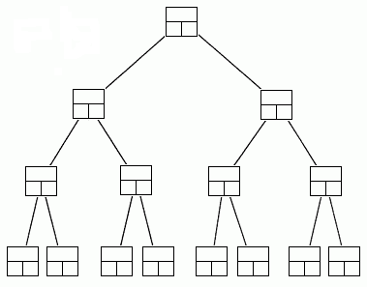
Data Structures
A data structure is a scheme for organizing data in the memory of a computer.
Some of the more commonly used data structures include lists, arrays, stacks, queues, heaps, trees, and graphs.
Binary Tree

Slide 3
Data Structures
The way in which the data is organized affects the performance of a program for different tasks.
Computer programmers decide which data structures to use based on the nature of the data and the processes that need to be performed on that data.
Binary Tree

Slide 4
What will you learn?
What are some of the common data structures
What are some ways to implement them
How to analyze their efficiency
How to use them to solve practical problems

Slide 5
Data Structure Example Applications
How does Google quickly find web pages that contain a search term?
What’s the fastest way to broadcast a message to a network of computers?
How does your operating system track which memory (disk or RAM) is free?

Slide 6
• It’s an agreement about: 1. How to store a collection of objects in memory, 2. What operations we can perform on that data, 3. The algorithms for those operations, and 4. How time and space efficient those algorithms are. Ex. vector in C++: 1. Stores objects sequentially in memory 2. Can access, change, insert or delete objects 3. Algorithms for insert & delete will shift items as needed 4. Space: O(n), Access/change = O(1), Insert/delete = O(n)
What is a Data Structure Anyway?

Slide 7
Abstract Data Types (ADT)
Data storage & operations encapsulated by an ADT.
ADT specifies permitted operations as well as time and space guarantees.
User unconcerned with how it’s implemented.

