Slide 1
Tree Data Structures

Slide 2
Trees Data Structures
Tree
Nodes
Each node can have 0 or more children
A node can have at most one parent
Binary tree
Tree with 0–2 children per node
Tree
Binary Tree

Slide 3
Trees
Terminology
Root ⇒ no parent
Leaf ⇒ no child
Interior ⇒ non-leaf
Height ⇒ distance from root to leaf
Root node
Interior nodes
Height
Leaf nodes

Slide 4
Binary Search Trees
Key property
Value at node
Smaller values in left subtree
Larger values in right subtree
Example
X > Y
X < Z
X
Y
Z

Slide 5
Binary Search Trees
left
data
right
Examples
5
10
10
2
45
5
30
5
45
30
2
25
45
2
25
30
10
25
Binary search trees
Not a binary search tree

Slide 6
Iterative Search of Binary Tree
Node *Find( Node *n, int key) {
while (n != NULL) {
if (n->data == key) // Found it
return n;
if (n->data > key) // In left subtree
n = n->left;
else // In right subtree
n = n->right;
}
return null;
}
Node * n = Find( root, 5);
left
data
right

Slide 7
Example Binary Searches
Find ( root, 2 )
root
10
5
10 > 2, left
5 > 2, left
2 = 2, found
5 > 2, left
2 = 2, found
5
30
2
45
2
25
45
30
10
25

Slide 8
Example Binary Searches
Find (root, 25 )
10
5
10 < 25, right
30 > 25, left
25 = 25, found
5 < 25, right
45 > 25, left
30 > 25, left
10 < 25, right
25 = 25, found
5
30
2
45
2
25
45
30
10
25

Slide 9
Types of Binary Trees
Degenerate – only one child
Complete (Full)– always two children
Balanced – “mostly” two children
more formal definitions exist, above are intuitive ideas
Degenerate binary tree
Balanced binary tree
Complete binary tree

Slide 10
Binary Trees Properties
Degenerate
Height = O(n) for n nodes
Similar to linked list
Balanced
Height = O( log(n) ) for n nodes
Useful for searches
Height = O(n) for n
O(n)=3
Height = O( log(n) )=O(log(6))=2
Degenerate binary tree
Balanced binary tree

Slide 11
Binary Search Properties
Time of search
Proportional to height of tree
Balanced binary tree
O( log(n) ) time
Degenerate tree
O( n ) time
Like searching linked list / unsorted array

Slide 12
Binary Search Tree Construction
How to build & maintain binary trees?
Insertion
Deletion
Maintain key property (invariant)
Smaller values in left subtree
Larger values in right subtree

Slide 13
Binary Search Tree – Insertion
Algorithm
Perform search for value X
Search will end at node Y (if X not in tree)
If X < Y, insert new leaf X as new left subtree for Y
If X > Y, insert new leaf X as new right subtree for Y
Observations
O( log(n) ) operation for balanced tree
Insertions may unbalance tree

Slide 14
Example Insertion
Insert ( 20 )
10
10 < 20, right
30 > 20, left
25 > 20, left
Insert 20 on left
5
30
2
25
45
20

Slide 15
Binary Search Tree – Deletion
Algorithm
Perform search for value X
If X is a leaf, delete X
Else // must delete internal node
a) Replace with largest value Y on left subtree
OR smallest value Z on right subtree
b) Delete replacement value (Y or Z) from subtree
Observation
O( log(n) ) operation for balanced tree
Deletions may unbalance tree

Slide 16
Example Deletion (Leaf)
Delete ( 25 )
10
10
10 < 25, right
30 > 25, left
25 = 25, delete
5
30
5
30
2
25
45
2
45

Slide 17
Example Deletion (Internal Node)
Delete ( 10 )
10
5
5
5
30
5
30
2
30
2
25
45
2
25
45
2
25
45
Replacing 10 with largest value in left subtree
Replacing 5 with largest value in left subtree
Deleting leaf

Slide 18
Example Deletion (Internal Node)
Delete ( 10 )
10
25
25
5
30
5
30
5
30
2
25
45
2
25
45
2
45
Replacing 10 with smallest value in right subtree
Deleting leaf
Resulting tree

Slide 19
Balanced Search Trees
Kinds of balanced binary search trees
height balanced vs. weight balanced
“Tree rotations” used to maintain balance on insert/delete
Non-binary search trees
2/3 trees
each internal node has 2 or 3 children
all leaves at same depth (height balanced)
B-trees
Generalization of 2/3 trees
Each internal node has between k/2 and k children
Each node has an array of pointers to children
Widely used in databases

Slide 20
Other (Non-Search) Trees
Parse trees
Convert from textual representation to tree representation
Textual program to tree
Used extensively in compilers
Tree representation of data
E.g. HTML data can be represented as a tree
called DOM (Document Object Model) tree
XML
Like HTML, but used to represent data
Tree structured

Slide 21
Parse Trees
Expressions, programs, etc can be represented by tree structures
E.g. Arithmetic Expression Tree
A-(C/5 * 2) + (D*5 % 4)
+
- %
A * * 4
/ 2 D 5
C 5

Slide 22
Preoder, Inorder, Postorder
In Preorder, the root
is visited before (pre)
the subtrees traversals
In Inorder, the root is
visited in-between left
and right subtree traversal
In Postorder, the root
is visited after (pre)
the subtrees traversals
Preorder Traversal:
Visit the root
Traverse left subtree
Traverse right subtree
Inorder Traversal:
Traverse left subtree
Visit the root
Traverse right subtree
Postorder Traversal:
Traverse left subtree
Traverse right subtree
Visit the root

Slide 23
Tree Traversal
+
- %
A * * 4
/ 2 D 5
C 5
Goal: visit every node of a tree
in-order traversal
Void inOrder () {
if (left != NULL) {
cout << left->inOrder(); }
cout << data << endl;
if (right != NULL) right->inOrder()
}
Output: A – C / 5 * 2 + D * 5 % 4
To disambiguate: print brackets

Slide 24
Tree Traversal (contd.)
+
- %
A * * 4
/ 2 D 5
C 5
pre-order and post-order:
Void preOrder () {
cout << data << endl;
if (left != NULL) left->preOrder ();
if (right != NULL) right->preOrder ();
}
Output: + - A * / C 5 2 % * D 5 4
void postOrder () {
if (left != NULL) left->preOrder ();
if (right != NULL) right->preOrder ();
cout << data << endl;
}
Output: A C 5 / 2 * - D 5 * 4 % +

Slide 25
More Illustrations for Traversals
Assume: visiting a node
is printing its label
Preorder:
1 3 5 4 6 7 8 9 10 11 12
Inorder:
4 5 6 3 1 8 7 9 11 10 12
Postorder:
4 6 5 3 8 11 12 10 9 7 1
1
3
7
5
8
9
10
4
6
11
12

Slide 26
More Illustrations for Traversals (Contd.)
Assume: visiting a node
is printing its data
Preorder: 15 8 2 6 3 7
11 10 12 14 20 27 22 30
Inorder: 2 3 6 7 8 10 11
12 14 15 20 22 27 30
Postorder: 3 7 6 2 10 14
12 11 8 22 30 27 20 15
15
8
20
2
11
27
6
10
12
22
30
3
7
14

Slide 27
Exercise
Draw the binary search tree that would result from the insertion of the following integer keys:
14 58 18 10 99 52 33 69 74 17

Slide 28
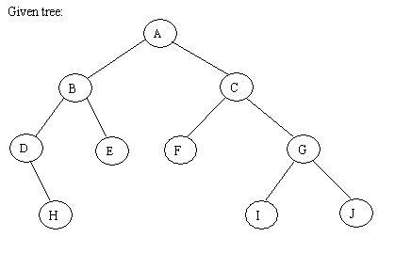
Exercise

Slide 29
Application of Traversal Sorting a BST
Observe the output of the inorder traversal of the BST example one slide earlier
It is sorted
This is no coincidence
As a general rule, if you output the keys (data) of the nodes of a BST using inorder traversal, the data comes out sorted in increasing order

Slide 30
Array Representation of Full Trees and Almost Complete Trees
A binary tree and almost complete binary trees, can be represented by an array A of the same length as the number of nodes
A[k] is identified with node of label k
That is, A[k] holds the data of node k
Advantage:
no need to store left and right pointers in the nodes ➔ save memory
Direct access to nodes: to get to node k, access A[k]

Slide 31
Illustration of Array Representation
Notice: Left child of A[5] (of data 11) is A[2*5]=A[10] (of data 18), and its right child is A[2*5+1]=A[11] (of data 12).
Parent of A[4] is A[4/2]=A[2], and parent of A[5]=A[5/2]=A[2]
15
8
20
2
11
30
27
13
6
18
12
15
8
20
2
11
30
27
13
6
18
12
1
2
3
4
5
6
7
8
9
10
11

Slide 32
Priority Queues –Heaps

Slide 33
Recall Queues
FIFO: First-In, First-Out
Some contexts where this seems right?
Some contexts where some things should be allowed to skip ahead in the line?
Notes:
Cars:
Rotation of the lights controlling who gets to go
HOV lanes in on-ramps, Emergency Vehicles
Processor Scheduling:
Not all “fair shares” are equal

Slide 34
Heap or Priority Queue that Allow Line Jumping
Need a new ADT
Operations: Insert an Item, Remove the “Best” Item
6 2
15 23
12 18
45 3 7
insert
deleteMin

Slide 35
Priority Queue ADT
PQueue data : collection of data with priority
PQueue operations
insert
deleteMin
PQueue property: for two elements in the queue, x and y, if x has a lower priority value than y, x will be deleted before y
Notes:
We need a new ADT for this. One that returns the best (which we’ll generally define as lowest priority value) node next.
I’m often going to represent priority queues as collections of priorities; remember that they are collections of data with priorities. MOREOVER, some priority queues don’t even need priorities, just the ability to compare priorities. (all of the ones we’ll talk about fall in this category).

Slide 36
Applications of the Priority Queue
Select print jobs in order of decreasing length
Forward packets on routers in order of urgency
Select most frequent symbols for compression
Sort numbers, picking minimum first
Anything greedy
Notes:
There are, of course, gobs of applications for priority queues. Here are just a few.

Slide 37
Potential Implementations
O(1)/O(N)worst-array full,
should say WHY, might
reject on full instead.
O(N) – to find value
 | insert | deleteMin
Unsorted list (Array) | O(1) | O(n)
Unsorted list (Linked-List) | O(1) | O(n)
Sorted list (Array) | O(n) | O(1)*
Sorted list (Linked-List) | O(n) | O(1)
O(1)
O(N) – to find value
O(log N) to find loc w. Bin search, but O(N) to move vals
O(1) to find val, but O(N) to move vals, (or O(1) if in reverse order)
O(N) to find loc, O(1) to do the insert
O(1)
O(N)
O(N)
Plus – good memory usage
O(log N) close to O(1) 1.67 levels on average
O(log N)
Binary Heap
Notes:
We are going to do an insert = O(log N) worst case, O(1) on average (on average 1.67 levels)

Slide 38
Heap Properties
Structure Property
Ordering Property
Notes:
Describe these for a binary search tree.
For an AVL tree.

Slide 39
Heap Structure Property
A binary heap is a complete binary tree.
Complete binary tree – binary tree that is completely filled, with the possible exception of the bottom level, which is filled left to right.
Examples:
Since they have this regular structure property,
we can take advantage of that to store them in a compact manner.
Notes:
Since they have this regular structure property, we can take advantage of that to store them in a compact manner.
If I asked to you store a plain old binary tree in an array, how would you do it?

Slide 40
Heap Type based on Heap Order Property
Min-Heap
Max-Heap

Slide 41
Min-Heap
A heap (or min-heap to be precise) is an almost complete binary tree where
Every node holds a data value (or key)
The key of every node is ≤ the keys of the children
Note:
A max-heap has the same definition except that the
Key of every node is >= the keys of the children

Slide 42
Min-Heap Order Property
Heap order property: For every X, the value in the parent of X is less than (or equal to) the value in X.
This is the order for a MIN heap – could do the same for a max heap.
10
10
20
80
20
80
40
60
85
99
30
15
50
700
not a heap
This is a PARTIAL order (diff than BST)
For each node, its value is less than all of its descendants (no distinction between left and right)
Notes:
Tree is PARTIALLY ORDERED.
For each node: its value is less than value of all of its descendants.
This is the definition for a MIN heap – could do the same for a max heap.

Slide 43
Example of a Min-heap
5
8
20
15
11
30
27
33
16
18
12

Slide 44
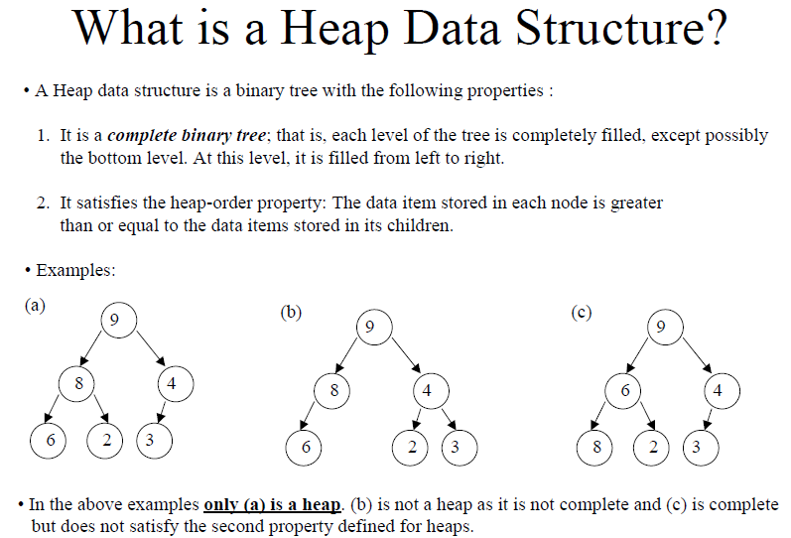
Max-heap

Slide 45
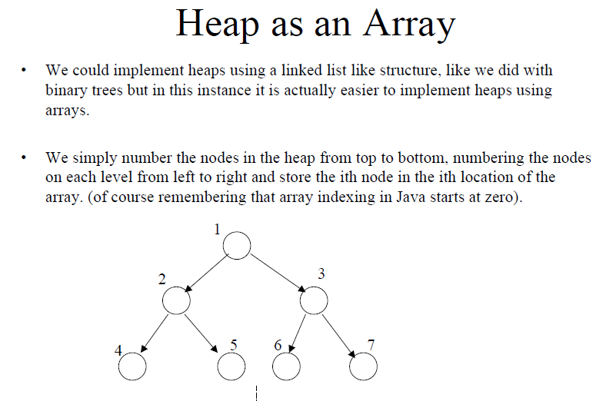

Slide 46
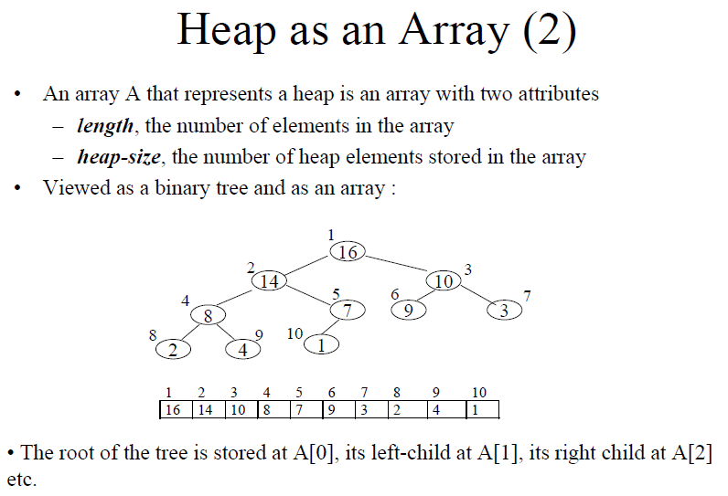

Slide 47
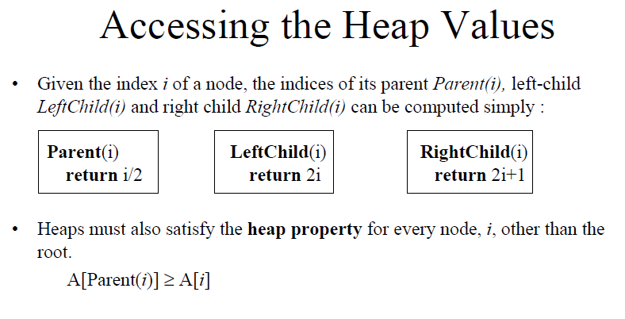
Therefore, the largest element (max-heap) in a heap is stored at the root, and the subtrees rooted at a node contain smaller values than does the node itself.

Slide 48
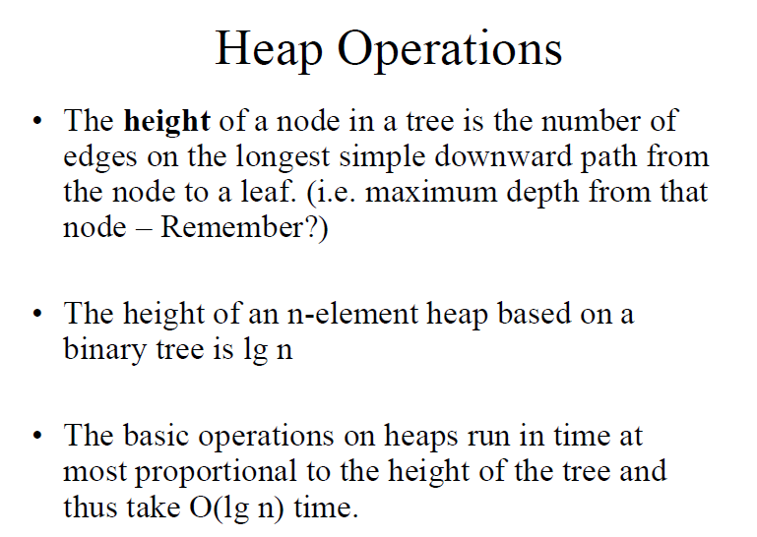
Height of a Heap

Slide 49
Operations on Heaps
Delete the minimum value and return it. This operation is called deleteMin.
Insert a new data value
Applications of Heaps:
A heap implements a priority queue, which is a queue
that orders entities not a on first-come first-serve basis,
but on a priority basis: the item of highest priority is at
the head, and the item of the lowest priority is at the tail
Another application: sorting, which will be seen later

Slide 50
Heap Operations
How?
findMin:
insert(val): percolate up.
deleteMin: percolate down.
Is the tree unique?
Swap 85 and 99.
Swap 700 and 85?
10
20
80
40
60
85
99
50
700
65
Notes:
Is the tree unique?
Swap 85 and 99.
Swap 700 and 85?

Slide 51
DeleteMin in Min-heaps
The minimum value in a min-heap is at the root!
To delete the min, you can’t just remove the data value of the root, because every node must hold a key
Instead, take the last node from the heap, move its key to the root, and delete that last node
But now, the tree is no longer a heap (still almost complete, but the root key value may no longer be ≤ the keys of its children

Slide 52
Heap – Deletemin
Basic Idea:
Remove root (that is always the min!)
Put “last” leaf node at root
Find smallest child of node
Swap node with its smallest child if needed.
Repeat steps 3 & 4 until no swaps needed.
Max # of exchanges? = O(log N), there is a good chance goes to bottom
Notes:
If I < = both children, then you are done.
How long does step 1 take?
QUESTION: Max number of exchanges is ? O(log N) – must percolate all the way to the bottom level.
In fact this is often the case, you just took the value from the bottom, there is a good chance it has to go down to the lowest level. O(log N)
Optimization in the book – bubble up an EMPTY space down, and then do a swap (reduces the # of swaps).

Slide 53
DeleteMin: percolate down
Max # of exchanges? = O(log N),
There is a good chance goes to bottom (started at bottom) vs. insert
- Could also use the percolate empty bubble down
10
20
15
40
60
85
99
50
700
65
65
20
15
40
60
85
99
50
700
Notes:
Deletemein

Slide 54
Illustration of First Stage of deletemin
5
8
20
8
20
15
11
30
27
15
11
30
27
16
18
12
33
16
18
12
33
12
12
8
20
20
8
15
11
30
27
30
15
11
27
33
16
18
16
33
18

Slide 55
Restore Heap (Heapify)
To bring the structure back to its “heapness”, we restore the heap
Swap the new root key with the smaller child.
Now the potential bug is at the one level down. If it is not already ≤ the keys of its children, swap it with its smaller child
Keep repeating the last step until the “bug” key becomes ≤ its children, or the it becomes a leaf

Slide 56
Illustration of Restore-Heap
12
8
8
20
12
20
15
11
30
27
15
11
30
27
33
16
18
33
16
18
8
11
20
15
12
30
27
33
16
18
Now it is a correct heap

Slide 57
DeleteMin Code (Optimized)
Object deleteMin() {
assert(!isEmpty());
returnVal = Heap[1];
size--;
newPos =
percolateDown(1,
Heap[size+1]);
Heap[newPos] =
Heap[size + 1];
return returnVal;
}
int percolateDown(int hole,
Object val) {
while (2*hole <= size) {
left = 2*hole;
right = left + 1;
if (right ≤ size &&
Heap[right] < Heap[left])
target = right;
else
target = left;
if (Heap[target] < val) {
Heap[hole] = Heap[target];
hole = target;
}
else
break;
}
return hole;
}
Θ(log n) worst/ave case
Notes:
Note that there are three things going on here:
1. find the smaller child
2. if the smaller child is still smaller than the moving value, move the smaller child up
3. otherwise, we’ve found the right spot, and stop.
Runtime log N (worst case and average)

Slide 58
Heap – Insert(val)
Basic Idea:
Put val at “next” leaf position
Percolate up by repeatedly exchanging node until no longer needed
How long does this take?
How long does this take? – max # of exchanges = O(log N)
On “average” only need to move up 1.67 levels so get O(1)
Notes:
How long does step 1 take?
QUESTION: Max number of exchanges is ? O(log N) – must percolate up to root.
On average, analysis shows that you tend to only need to move up 1.67 levels, so get O(1) on average.
Optimization in the book – bubble up an EMPTY space, and then do a swap (reduces the # of swaps).

Slide 59
Insert: percolate up
Now insert 90. (no swaps, even though 99 is larger!)
Now insert 7.
10
20
80
40
60
85
99
50
700
65
15
Optimization, bubble up an empty space to reduce # of swaps
10
15
80
40
20
85
99
50
700
65
60
Notes:
Now insert 90. (no swaps, even though 99 is larger!)
Now insert 7.

Slide 60
Insert Code (optimized)
void insert(int o) {
if(!isFull());
size++;
newPos = percolateUp(size,o);
Heap[newPos] = o;
}
int percolateUp(int hole,
int val) {
while (hole > 1 &&
val < Heap[hole/2])
Heap[hole] = Heap[hole/2];
hole /= 2;
}
return hole;
}
Θ(log n) worst case
Θ(1) on average: only have to go up a few levels
Notes:
Notice that this code is a _lot_ easier.
Runtime: log N worst case, but constant on average
(only have to go up a few levels)

Slide 61
Heap Insertion
Insert 6

Slide 62
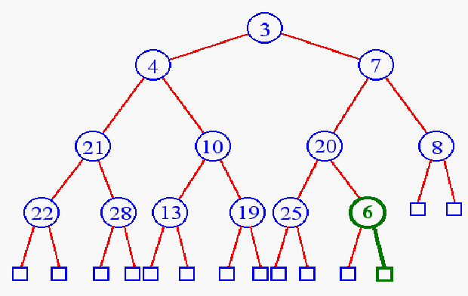
Heap Insertion
Add key in next available position

Slide 63
Heap Insertion
Begin Unheap

Slide 64
Heap Insertion

Slide 65
Heap Insertion
Terminate unheap when
reach root
key child is greater than key parent

Slide 66
Building a Heap
0 1 2 3
10 11 12
12
5
11
3
10
6
9
4
8
1
7
2
Red nodes need to percolate down
Notes:
Let’s try pretending it’s a heap already and just fixing the heap-order property.
The red nodes are the ones that are out of order.
Question: which nodes MIGHT be out of order in any heap?

Slide 67
Building Heaps
What are the two properties of a heap?
Structure Property
Order Property
How do we work on heaps?
Fix the structure
Fix the order

Slide 68
BuildHeap: Floyd’s Method
0 1 2 3
10 11 12
12
5
11
3
10
6
9
4
8
1
7
2
Add elements arbitrarily to form a complete tree.
Pretend it’s a heap and fix the heap-order property!
12
Red nodes need to percolate down
5
11
3
10
6
9
4
8
1
7
2
Notes:
Let’s try pretending it’s a heap already and just fixing the heap-order property.
The red nodes are the ones that are out of order.
Question: which nodes MIGHT be out of order in any heap?

Slide 69
Buildheap pseudocode
private void buildHeap() {
for ( int i = currentSize/2; i > 0; i-- )
percolateDown( i );
}
runtime:

Slide 70
BuildHeap: Floyd’s Method
0 1 2 3
10 11 12
12
5
11
Red nodes need to percolate down
3
10
6
9
4
8
1
7
2
Notes:
Let’s try pretending it’s a heap already and just fixing the heap-order property.
The red nodes are the ones that are out of order.
Question: which nodes MIGHT be out of order in any heap?

Slide 71
BuildHeap: Floyd’s Method
12
5
11
3
10
2
9
4
8
1
7
6

Slide 72
BuildHeap: Floyd’s Method
12
12
5
11
5
11
3
10
2
9
3
1
2
9
4
8
1
7
6
4
8
10
7
6

Slide 73
BuildHeap: Floyd’s Method
12
12
5
11
5
11
3
10
2
9
3
1
2
9
4
8
1
7
6
12
4
8
10
7
6
5
2
3
1
6
9
4
8
10
7
11

Slide 74
BuildHeap: Floyd’s Method
12
12
5
11
5
11
3
10
2
9
3
1
2
9
4
8
1
7
6
4
8
10
7
6
12
12
5
2
1
2
3
1
6
9
3
5
6
9
4
8
10
7
11
4
8
10
7
11

Slide 75
Finally…
- Runtime bounded by sum
of heights of nodes, which
is linear. O(n)
- How many nodes at height 1, and height 2, up to root,
- See text, Thm. 6.1
p. 194 for detailed proof.
1
3
2
4
5
6
9
12
8
10
7
11
Notes:
How long does this take? Well, everything above the fringe might move 1 step.
Everything height 2 or greater might move 2 steps.
Most nodes move only a small number of steps
→ the runtime is O(n).
(see text for proof)
Full sum = (I=0 to height) SUM (h-I) * 2^i

Slide 76
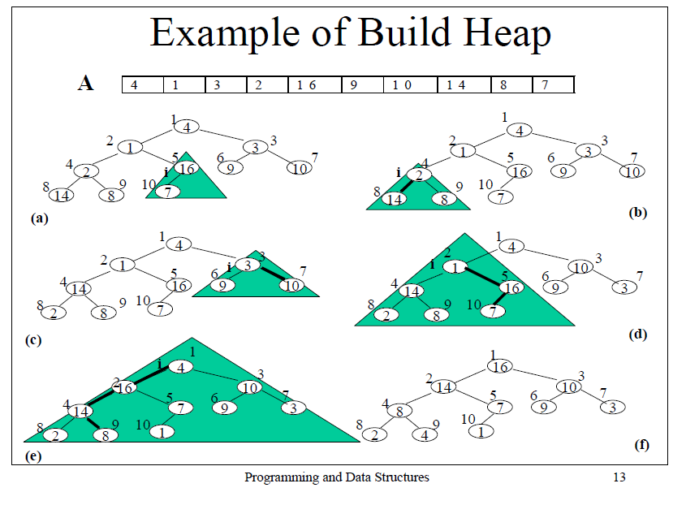

Slide 77
More on Heap

Slide 78
Heaps (Ref. www.cse.unt.edu/~rada/CSCE3110/Lectures/Heaps.ppt )
A heap is a binary tree T that stores a key-element pairs at its internal nodes
It satisfies two properties:
MinHeap: key(parent) ≤ key(child)
[OR MaxHeap: key(parent) ≤ key(child)]
all levels are full, except
the last one, which is
left-filled

Slide 79
What are Heaps Useful for?
To implement priority queues
Priority queue = a queue where all elements have a “priority” associated with them
Remove in a priority queue removes the element with the smallest priority
insert
removeMin

Slide 80
Heap or Not a Heap?

Slide 81
Heap Properties
A heap T storing n keys has height h = ⎣log(n + 1)⎦, which is O(log n)

Slide 82
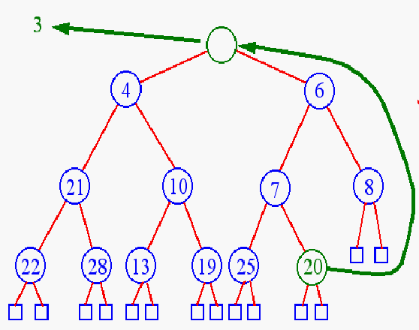
Heap Removal
Remove element
from priority queues?
removeMin( )

Slide 83
Heap Removal
Begin downheap

Slide 84
Heap Removal

Slide 85
Heap Removal

Slide 86
Heap Removal
Terminate downheap when
reach leaf level
key parent is greater than key child

Slide 87
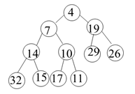
Exercise
Rearrange the heap after deleting the root.

Slide 88

Exercise
Build the heap for the following items in the array.

