Slide 1
Search Algorithms
Sequential Search (Linear Search)
Binary Search

Slide 2
Sequential Search
A sequential search of a list/array begins at the beginning of the list/array and continues until the item is found or the entire list/array has been searched

Slide 3
Sequential search
The sequential search is used whenever the list is not ordered.

Slide 4
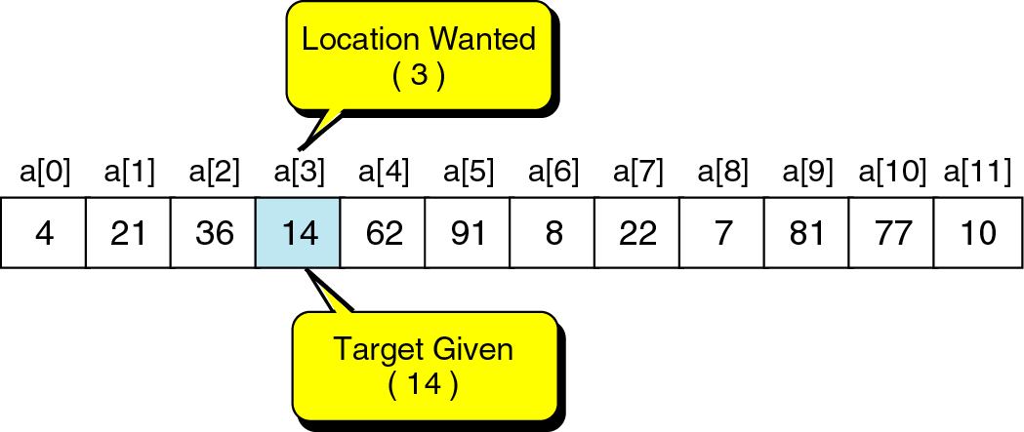
Searching
The process used to find the location of a target among a list of objects.
e.g., where is 14?

Slide 5
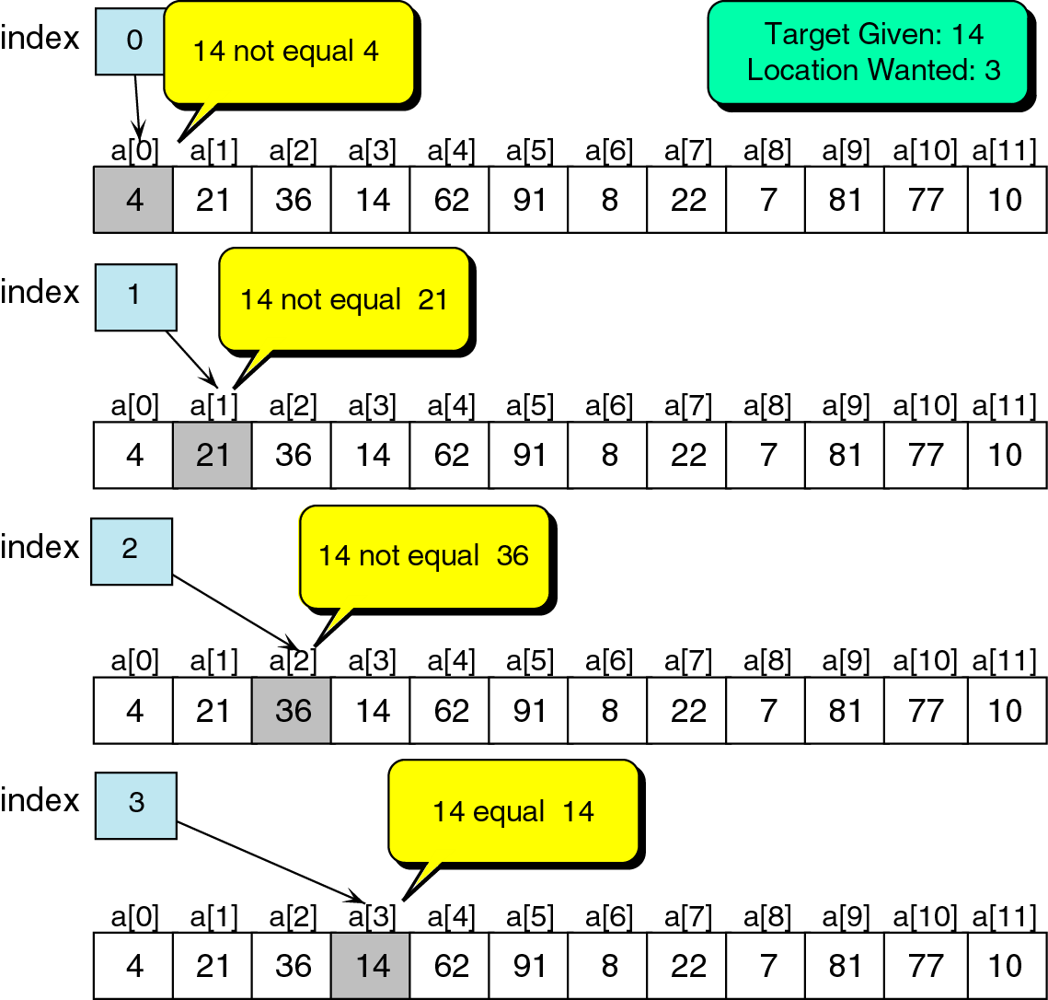
Successful search of an unordered list

Slide 6
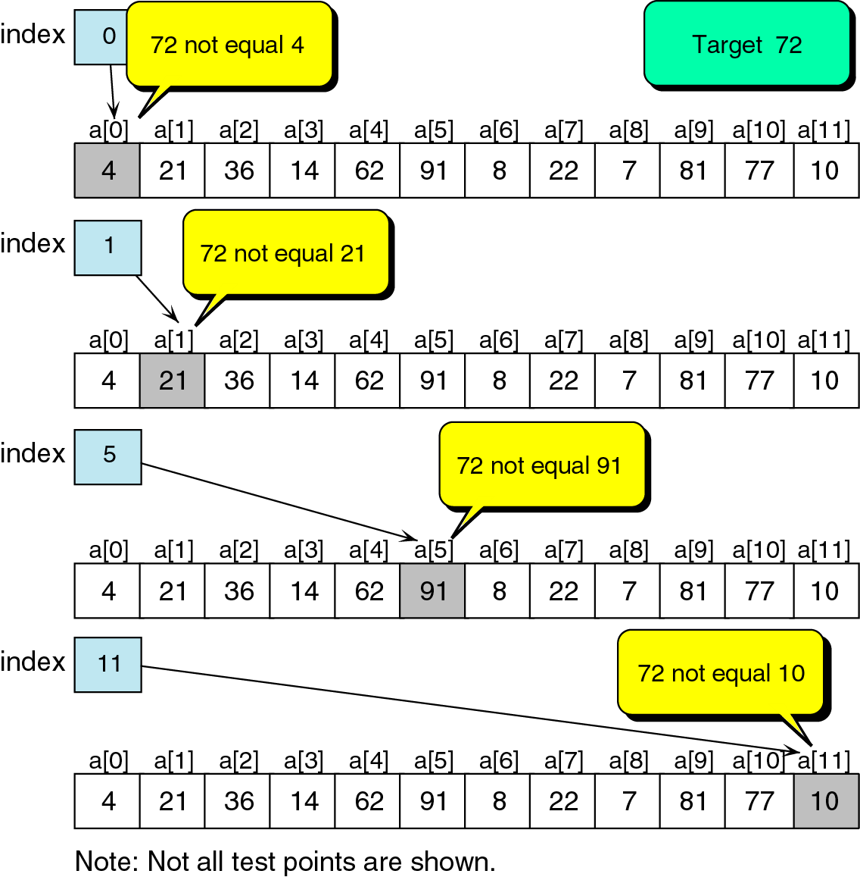
Unsuccessful search in unordered list

Slide 7
Sequential Search
int LinSearch(int x[ ], int n, int item){
for(int i=0;i<n;i++){
if(x[i]==item) return i;
else return -1;
}
}

Slide 8
Search Algorithms

Slide 9
Binary Search O(log2 n)
A binary search looks for an item in a list using a divide-and-conquer strategy

Slide 10
Binary Search
Binary search algorithm assumes that the items in the array being searched are sorted
The algorithm begins at the middle of the array in a binary search
If the item for which we are searching is less than the item in the middle, we know that the item won’t be in the second half of the array
Once again we examine the “middle” element
The process continues with each comparison cutting in half the portion of the array where the item might be

Slide 11

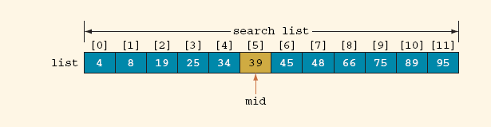
Binary Search Algorithm (Cont’d)
Determine whether 75 is in the list
Array list with twelve (12) elements
Search list, list[0] … list[11]

Slide 12
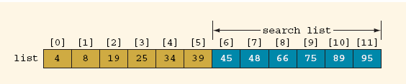
Binary Search Algorithm (Cont’d)
Search list, list[6] … list[11]

Slide 13
Binary Search: middle element
left + right
mid =
2

Slide 14
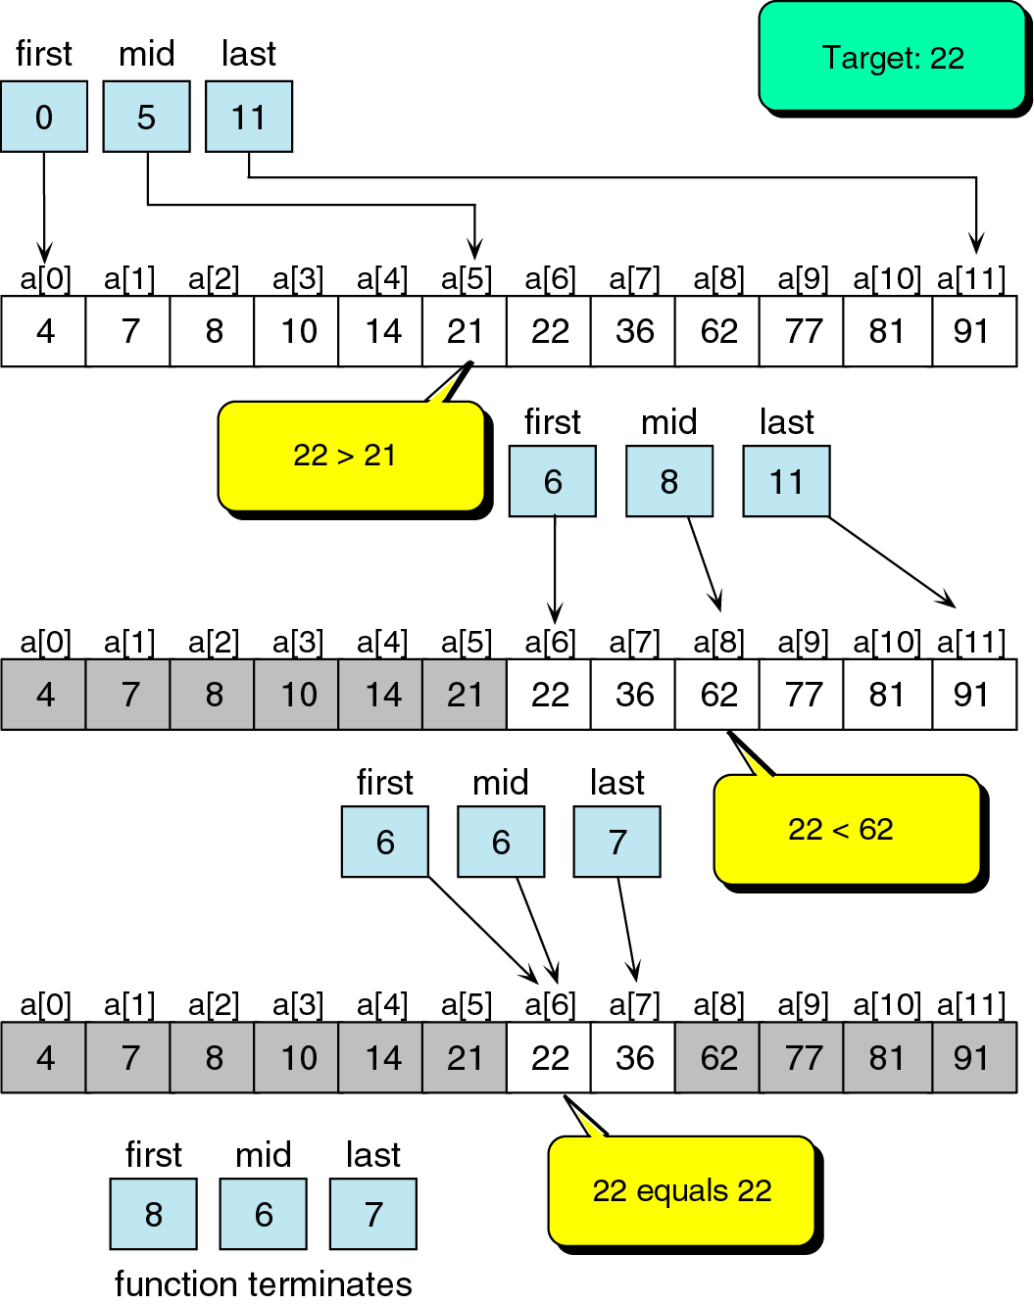
Binary search example

Slide 15
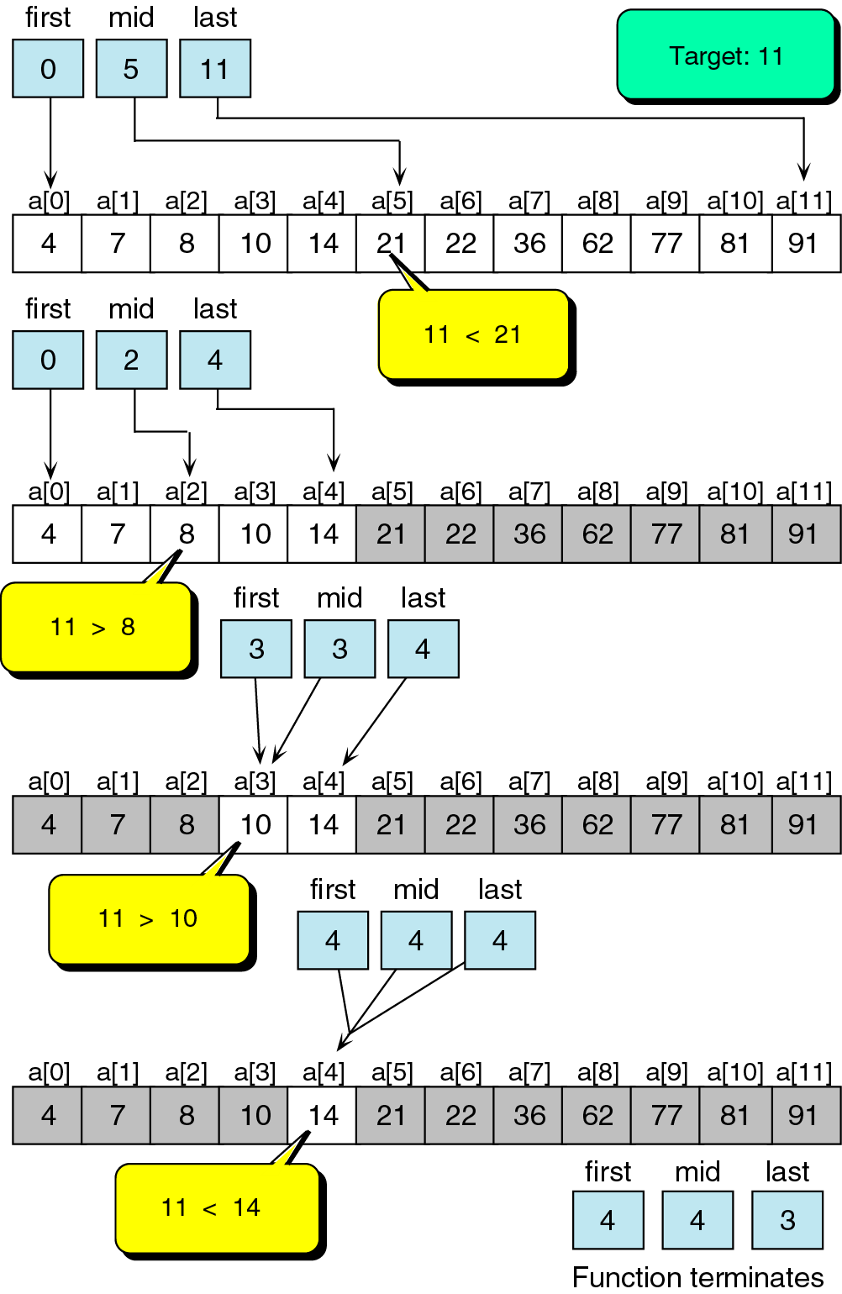
Unsuccessful binary search example

Slide 16
Binary Search
boolean BinSearch(int list[ ], int n, int item, int index){
int left=0; int right=n-1; int mid;
while(left<=right){
mid=(left+right)/2;
if(item> list [mid])
{ left=mid+1; }
else if(item< list [mid])
{right=mid-1;}
else{
Item= list [mid];
index=mid;
return true;
}
}// while
return false; }

Slide 17
Binary Search

