Slide 1
Software Security Touchpoints

Slide 2
Security Engineering
Reduce the need for reactive technologies (e.g., intrusion detection) by safer products
Need for:
Software developers
Operations people
Administrators
Users
Executives
Why do these people
need Security Engineering?
Notes:
What is security engineering?
Security engineering in concerned with how to develop and maintain systems that resist malicious attacks intended to damage the computer-based system or its data.
Goal: security engineers aim to reduce the need for reactive technologies (e.g., intrusion detection) by safer products
These people need security engineering:
Software developers
Operations people
Administrators
Users
Executives
Why do these people need Security Engineering?
To make more dependable systems, we need to secure over systems from malicious attacks as well as problems resulting from accidental mistakes in the development process.
This has become a priority for both businesses and individuals as more and more criminals try to exploit networked systems for illegal purposes.
Software security touchpoints are based on good software engineering and involve explicitly pondering security throughout the software life cycle.

Slide 3
Software Security Touchpoints
Best Practices
Both White Hat (constructive) and Black Hat (destructive) activities
Throughout the SDLC
How do you think about security?
Which is more important? White hat or Black hat
type of activities?
Notes:
Attaining software security means applying a number of lightweight best practices throughout the software lifecycle more than it means the application of security features like cryptography
Software Security Touchpoints These lightweight best practices are applied to various software artifacts.
These security best practices applied to both white-hat and black-hat activities.
These best practices are applied throughout the entire system development life cycle.
White-hat hackers:
Good guys
Do not use their skill for illegal purpose
Computer security experts and help to protect from black-hats
Black-hat hackers:
Bad guys
Use their skill maliciously for personal gain
Hack banks, steal credit cards, …

Slide 4
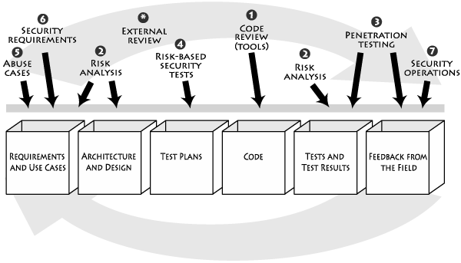
Application of Touchpoints
Notes:
Software Security Touchpoints These lightweight best practices are applied to various software artifacts.
The practices are numbered according to effectiveness and importance.
Software security touchpoints are based on good software engineering and involve explicitly pondering security throughout the software lifecycle.
This means knowing and understanding common risks (including language-based implementation bugs and architectural flaws),
designing for security and subjecting all software artifacts to thorough,
objective risk analyses and testing.
"Software Security Touchpoints" specifies one set of touchpoints and shows how software practitioners can apply them to the various software artifacts produced during software development.
This means understanding how to work security engineering into requirements, architecture, design, coding, testing, validation, measurement and maintenance.

Slide 5
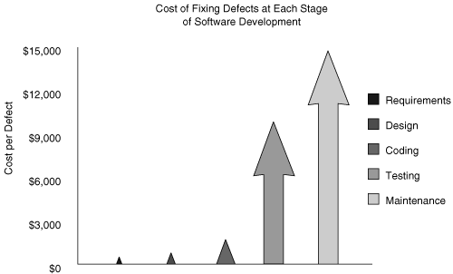
Cost of fixing defect at each stage

Slide 6
Application of Touchpoints
External Review
3. Penetration Testing
1. Code Review
(Tools)
6. Security Requirements
4. Risk-Based
Security Tests
2. Risk Analysis
7. Security
Operations
5. Abuse cases
2. Risk Analysis
Requirement and
Use cases
Architecture
and Design
Test Plans
Code
Tests and
Test Results
Feedback from
the Field

Slide 7
Code Review (Tool)
Artifact: Code
Implementation bugs
Static Analysis tools
White Hat
Notes:
All software projects produce at least one artifact: source code.
At the code level, the focus is on implementation bugs, especially those that static analysis tools that scan source code for common vulnerabilities can discover.
Code review is a necessary practice, but not sufficient for achieving secure software.
Security bugs (especially in C and C++) are a real problem, but architectural flaws cause just as much damage.

Slide 8
Application of Touchpoints
External Review
3. Penetration Testing
1. Code Review
(Tools)
6. Security Requirements
4. Risk-Based
Security Tests
2. Risk Analysis
7. Security
Operations
5. Abuse cases
2. Risk Analysis
Requirement and
Use cases
Architecture
and Design
Test Plans
Code
Tests and
Test Results
Feedback from
the Field
Notes:
.

Slide 9
Architectural Risk Analysis
Artifact: Design and specification
System must be coherent and present a uniform security front
Document assumptions and identify possible attacks
Both at specification-based architecture stage and class-hierarchy design stage
White hat
Notes:
At the design and architecture level, a system must be coherent and present a unified security front.
Designers, architects and analysts should clearly document assumptions and identify possible attacks.
At both the specifications-based architecture stage and at the class-hierarchy design stage, risk analysis is a necessity.
At this point, security analysts uncover and rank architectural flaws so that mitigation can begin.
Disregarding risk analysis at this level leads to costly problems down the road.
Note that risks appear during all stages of the software lifecycle, so a constant risk analysis thread is highly recommended.

Slide 10
Application of Touchpoints
External Review
3. Penetration Testing
1. Code Review
(Tools)
6. Security Requirements
4. Risk-Based
Security Tests
2. Risk Analysis
7. Security
Operations
5. Abuse cases
2. Risk Analysis
Requirement and
Use cases
Architecture
and Design
Test Plans
Code
Tests and
Test Results
Feedback from
the Field

Slide 11
Penetration Testing
Artifact: system in its environment
Understanding fielded software in its environment
Information supplied by architectural risk analysis
Who does it?
Black Hat
Notes:
Penetration testing is also useful, especially if an architectural risk analysis is driving the tests.
It provides a good understanding of fielded software in its real environment, but any such testing that doesn't take the software architecture into account probably won't uncover anything interesting about software risk.
Software that fails during the kind of canned black-box testing is truly bad.
Thus, passing penetration test reveals little about your actual security, but failing a canned penetration test indicates that you're in very deep trouble indeed.

Slide 12
Application of Touchpoints
External Review
3. Penetration Testing
1. Code Review
(Tools)
6. Security Requirements
4. Risk-Based
Security Tests
2. Risk Analysis
7. Security
Operations
5. Abuse cases
2. Risk Analysis
Requirement and
Use cases
Architecture
and Design
Test Plans
Code
Tests and
Test Results
Feedback from
the Field

Slide 13
Risk-Based Security Testing
Artifact: unit and system
Strategies:
Testing of security functionality (standard functional testing)
Risk-based security testing (attack pattern, risk analysis, abuse cases)
Attacker’s mindset
White Hat + Black Hat
Notes:
Security testing must include two strategies:
testing security functionality with standard functional testing techniques,
and risk-based security testing based on attack patterns.
A good security test plan does both.

Slide 14
Application of Touchpoints
External Review
3. Penetration Testing
1. Code Review
(Tools)
6. Security Requirements
4. Risk-Based
Security Tests
2. Risk Analysis
7. Security
Operations
5. Abuse cases
2. Risk Analysis
Requirement and
Use cases
Architecture
and Design
Test Plans
Code
Tests and
Test Results
Feedback from
the Field

Slide 15
Abuse Cases
Artifact: requirements and use cases
Describe system behavior under attack
Explicit coverage of
What should be protected
From whom
For how long
White Hat + Black Hat
Notes:
Building abuse cases is a great way to get into the mind of the attacker.
Similar to use cases, abuse cases describe the system's behavior under attack; building abuse cases requires explicit coverage of what should be protected, from whom, and for how long.

Slide 16
Application of Touchpoints
External Review
3. Penetration Testing
1. Code Review
(Tools)
6. Security Requirements
4. Risk-Based
Security Tests
2. Risk Analysis
7. Security
Operations
5. Abuse cases
2. Risk Analysis
Requirement and
Use cases
Architecture
and Design
Test Plans
Code
Tests and
Test Results
Feedback from
the Field

Slide 17
Security Requirements
Artifact: Requirements
Security explicitly worked into the requirements level
Both functional security and emergent characteristics
White Hat
Notes:
Security must be considered explicitly at the requirements level.
Good security requirements cover both overt(clear) functional security (say, the use of applied cryptography) and emergent characteristics (best captured by abuse cases and attack patterns).

Slide 18
Application of Touchpoints
External Review
3. Penetration Testing
1. Code Review
(Tools)
6. Security Requirements
4. Risk-Based
Security Tests
2. Risk Analysis
7. Security
Operations
5. Abuse cases
2. Risk Analysis
Requirement and
Use cases
Architecture
and Design
Test Plans
Code
Tests and
Test Results
Feedback from
the Field

Slide 19
Security Operations
Artifact: fielded system
Monitoring system usage
Combines both network centric and software specific operations
White Hat
Notes:
Battle-scarred operations personnel carefully monitor fielded systems during use for security attacks.
Attacks do occur, regardless of the strength of design and implementation, so monitoring software behavior is an essential defensive technique.
Knowledge gained by understanding attacks and exploits should be cycled back into software development.

Slide 20
Application of Touchpoints
External Review
3. Penetration Testing
1. Code Review
(Tools)
6. Security Requirements
4. Risk-Based
Security Tests
2. Risk Analysis
7. Security
Operations
5. Abuse cases
2. Risk Analysis
Requirement and
Use cases
Architecture
and Design
Test Plans
Code
Tests and
Test Results
Feedback from
the Field

Slide 21
External Analysis
Evaluate security by outside members
Why?
Advantages/disadvantages
Notes:
Bonus touchpoint. External analysis (outside the design team) is often a necessity when it comes to security.
Why?
Software security touchpoints are best applied by people not involved in the original design and implementation of the system.

Slide 22
When to Apply Security?
Economical consideration: early is better
Effectiveness of touchpoints:
Economics
Which software artifacts are available
Which tools are available
Cultural changes
Bad: reactive strategy → need: secure development

Slide 23
Best Practices
Earlier the better
Change “operational” view to secure software
Best practices: expounded/presented by experts and adopted by practitioners

Slide 24
Worst Practices to Avoid
From T. Demopoulos, “Worst Practices in Developing Secure Software
Assuming only “important’ SW needs to be secure
Emphasizing hitting deadlines over “good code”
Having IT make all risk management decisions
Not considering security during the entire SDLC
Assuming the SW won’t be attacked
Not doing any security testing
Not planning for failure
Counting on “security through obscurity”
Disallowing bad input instead of only allowing good input
SW that is not secure by default
Coding your own cryptography

Slide 25
Who Should Care?
Developers
Architects
Other builders
Operations people
Do not start with security people.
Start with software people.

Slide 26
Questions?

