Slide 1
Stacks & Queues

Slide 2
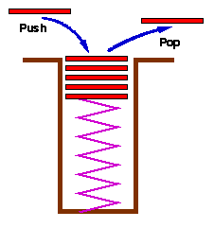
Introduction to Stacks and Queues
Widely used data structures
Ordered List of element
Easy to implement
Easy to use

Slide 3
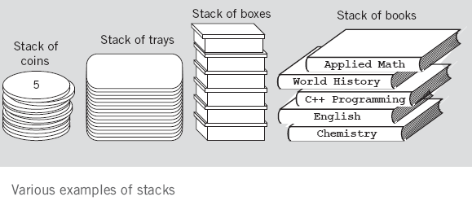
Stacks ADT
A stack is an ordered group of homogeneous items (elements), in which the removal and addition of stack items can take place only at the top of the stack.
A stack is a LIFO “last in, first out” structure.

Slide 4
Push and Pop
Primary operations: Push and Pop
Push
Add an element to the top of the stack
Pop
Remove the element at the top of the stack
empty stack
push an element
push another
pop
top
B
top
top
top
A
A
A

Slide 5
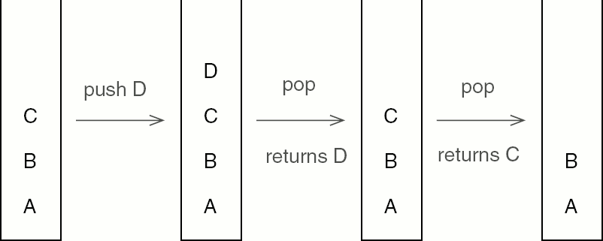
The Stack
Notes:
5

Slide 6
Implementation of Stacks
Any list implementation could be used to implement a stack
Arrays (static: the size of stack is given initially)
Linked lists (dynamic: never become full)
We will explore implementations based on array

Slide 7
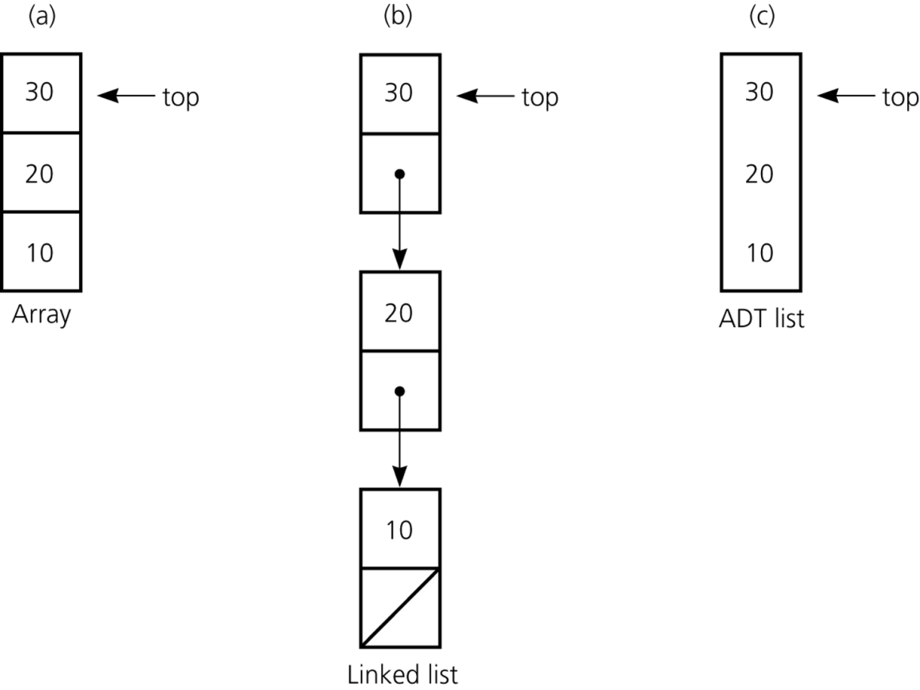
Implementations of the ADT Stack
Implementation of the ADT stack that use a) an array; b) a linked list;

Slide 8
The Stack Operation
Insertions and deletions follow the last-in first-out (LIFO) scheme
Main stack operations:
push(value): inserts value
pop(): removes and returns the last inserted element
Auxiliary stack operations:
top(): returns the last inserted element without removing it
size(): returns the number of elements stored
isEmpty(): a Boolean value indicating whether no elements are stored
isFull() (a Boolean value indicating whether a stack is full or not)
8

Slide 9
Pushing and popping
0 1 2 3 4 5 6 7 8 9
stk:
17
23
97
44
top = 3
If the bottom of the stack is at location 0, then an empty stack is represented by top = -1
To add (push) an element, :
Increment top and store the element in stk[top],
To remove (pop) an element, :
Get the element from stk[top] and decrement top,

Slide 10
Stack Implementation using Array
Attributes of Stack
MAXSIZE : the max size of stack
top: the index of the top element of stack
Stack S: point to an array which stores elements of stack
Operations of Stack
IsEmpty: return true if stack is empty, return false otherwise
IsFull: return true if stack is full, return false otherwise
Top: return the element at the top of stack
Push: add an element to the top of stack
Pop: delete the element at the top of stack
DisplayStack: print all the data in the stack

Slide 11
Stack Implementation
#define MAX 10
int top=-1
int stk[MAX];

Slide 12
For Inserting an Item into the Stack S:
Function PUSH(ITEM)
Step 1: {Check for stack overflow}
If TOP==MAXSIZE then
Prints(‘Stack full’)
Return
else
Step 2: {Increment pointer top}
TOP=TOP+1
Step 3: {Insert ITEM at top of the Stack}
stk[TOP]=ITEM
Return
void Push()
{
if(top==(MAX-1))
std::cout<<"\n\nThe stack is full";
else
{
std::cout<<"\n\nEnter an element:";
std::cin>>item;
top++;
stk[top]=item;
std::cout<<"\n\nElement pushed successfully\n";
}
}

Slide 13
Algorithm for Deletion of an Item from the Stack S
Function POP()
Step 1: {Check for stack underflow}
If TOP==0 then
Prints(‘Stack underflow’)
Return
Step 2:
{Return former top element of stack}
ITEM=(stk[TOP]);
Step 3: {Decrement pointer TOP}
TOP=TOP-1
Prints(‘Deleted item is:’,item);
Return
void Pop()
{
if(top==-1)
std::cout<<"\n\nThe stack is empty";
else
{
item=stk[top];
top--;
std::cout<<"\n\nThe deleted element is:"<<item;
}
}

Slide 14
Algorithm to display the items of a Stack S
Function DISPLAY()
Step 1: {Check for stack underflow}
If TOP==0 then
Prints(‘stack is empty’)
Return
Step 2: {display stack elements until TOP value}
Prints(stk[TOP])
TOP=TOP-1

Slide 15
Algorithm to display top item of the Stack S
Function TOP()
Step 1: {Check for stack underflow}
If TOP=0 then
Prints(‘stack is empty’)
Return
Step 2: {display TOP value into the Stack}
Prints(stk[TOP])

Slide 16
Exercise
Describe the output of the following series of stack operations
Push(8)
Push(3)
Pop()
Push(2)
Push(5)
Pop()
Pop()
Push(9)
Push(1)
empty stack
top

Slide 17
Checking for Balanced Braces
A stack can be used to verify whether a program contains balanced braces
An example of balanced braces
abc{defg{ijk}{l{mn}}op}qr
An example of unbalanced braces
abc{def}}{ghij{kl}m

Slide 18
Checking for Balanced Braces
Requirements for balanced braces
Each time you encounter a “}”, it matches an already encountered “{”
When you reach the end of the string, you have matched each “{”

Slide 19
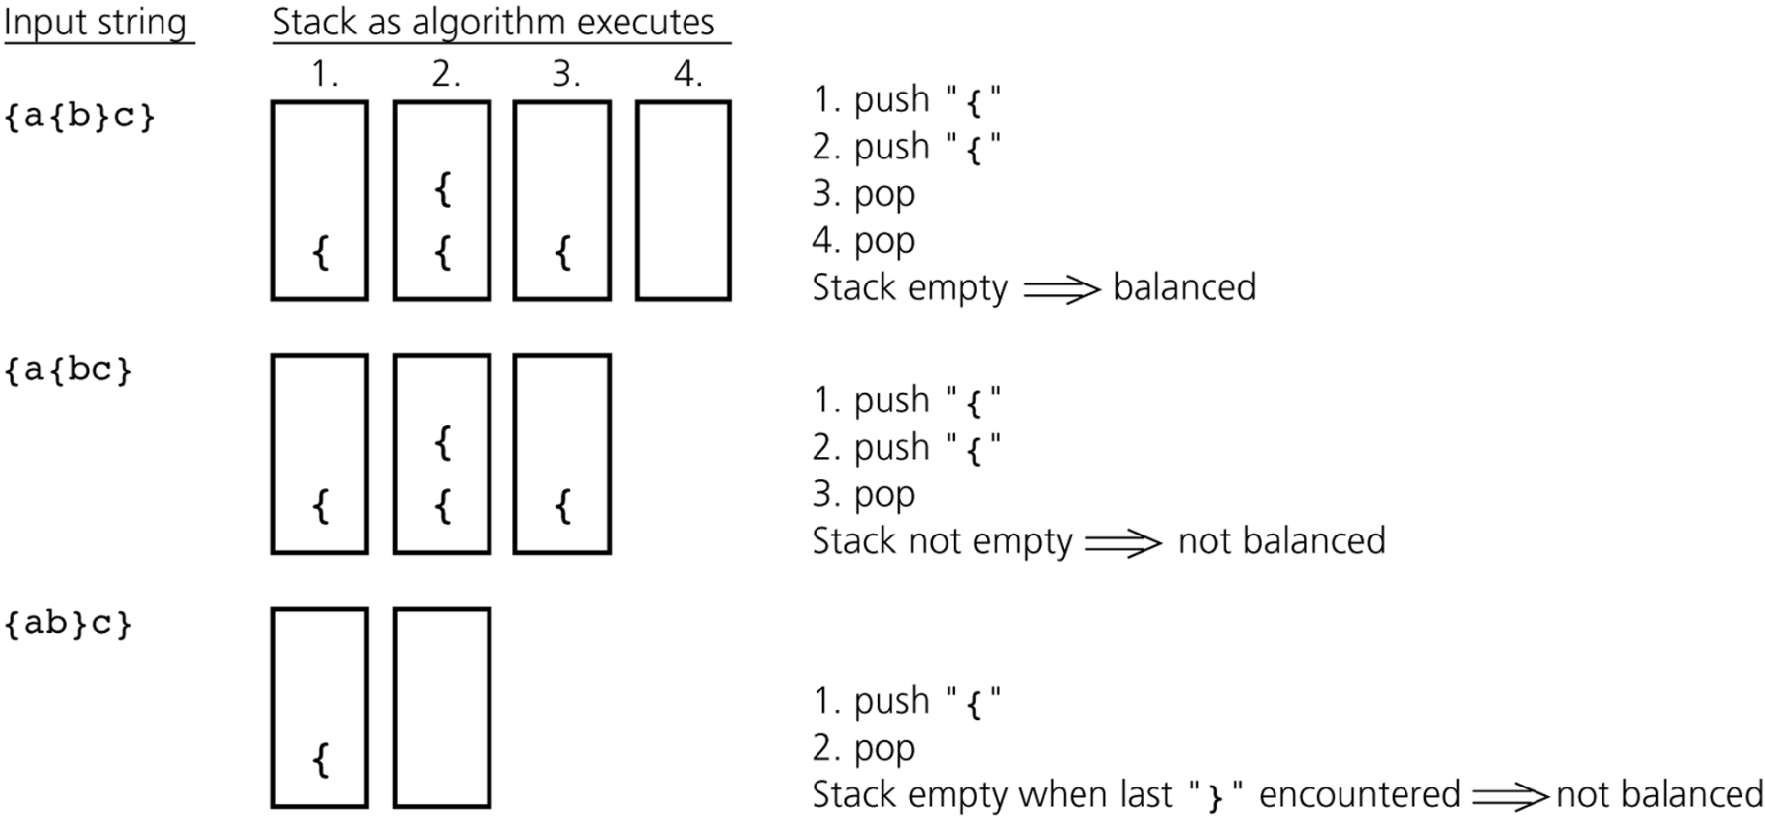
Checking for Balanced Braces

Slide 20
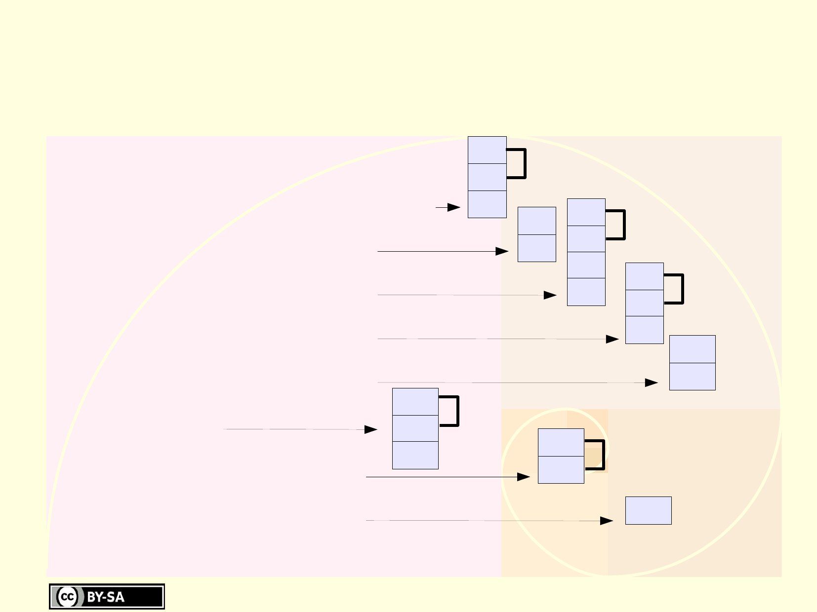
Use of Stack: evaluation of expression
●
6+(((5+4)*(3*2))+1) = ?
– push(6),push(5),push(4)
– push(pop()+pop())
– push(3),push(2)
– push(pop()*pop())
– push(pop()*pop())
– push(1)
– push(pop()+pop()) 6
4
5
6
+
9
6
2
3
9
6
*
6
9
6
*
54
6
1
+
54
55
6
+
–
push(pop()+pop())
61
66

Slide 21
Expression notation
●
●
Infix
operators are in between their operands
(3+2)*5 = 25 ­­> Needs parenthesis
Postfix (HP calculators)
operators are after their operands
3 2 + 5 * = 25
Prefix
operators are before their operands
* + 3 2 5 = 25
–
●
●
–
●
–
●

Slide 22
Infix and Postfix Expressions
The way we are used to writing expressions is known as infix notation
Postfix expression does not require any precedence rules
3 2 * 1 + is postfix of 3 * 2 + 1
Evaluate the following postfix expressions and write out a corresponding infix expression:
2 3 2 4 * + * 1 2 3 4 ^ * +
1 2 - 3 2 ^ 3 * 6 / + 2 5 ^ 1 -
Notes:
22

Slide 23
Stack: Evaluating Postfix Expressions
A postfix calculator
When an operand is entered, the calculator
Pushes it onto a stack
When an operator is entered, the calculator
Applies it to the top two operands of the stack
Pops the operands from the stack
Pushes the result of the operation on the stack

Slide 24
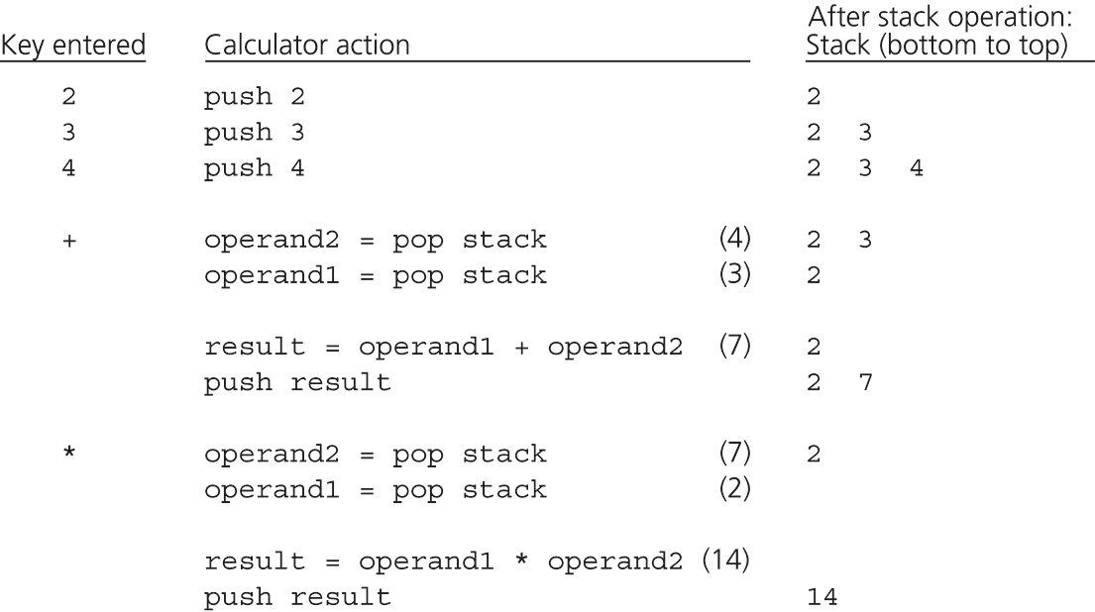
Evaluating Postfix Expressions
The action of a postfix calculator when evaluating the expression 2 * (3 + 4)

Slide 25
Evaluating Postfix Expressions
A pseudocode algorithm
for (each character ch in the string){
if (ch is an operand)
push value that operand ch represents onto stack
else{ // ch is an operator named op
// evaluate and push the result
operand2 = top of stack
pop the stack
operand1 = top of stack
pop the stack
result = operand1 op operand2
push result onto stack
}
}

Slide 26
Infix to Postfix
26
Convert the following equations from infix to postfix:
2 ^ 3 ^ 3 + 5 * 1
2 3 3 ^ ^ 5 1 * +
11 + 2 - 1 * 3 / 3 + 2 ^ 2 / 3
11 2 + 1 3 * 3 / - 2 2 ^ 3 / +
Problems:
parentheses in expression
Notes:
26

Slide 27
Infix to Postfix Conversion
27
Requires operator precedence parsing algorithm
parse v. To determine the syntactic structure of a sentence or other utterance
Operands: add to expression
Close parenthesis: pop stack symbols until an open parenthesis appears
Operators:
Pop all stack symbols until a symbol of lower precedence appears. Then push the operator
End of input: Pop all remaining stack symbols and add to the expression
Notes:
27

Slide 28
Simple Example
Infix Expression: 3 + 2 * 4
PostFix Expression:
Operator Stack:
28
Notes:
28

Slide 29
Simple Example
Infix Expression: + 2 * 4
PostFix Expression: 3
Operator Stack:
29
Notes:
29

Slide 30
Simple Example
Infix Expression: 2 * 4
PostFix Expression: 3
Operator Stack: +
30
Notes:
30

Slide 31
Simple Example
Infix Expression: * 4
PostFix Expression: 3 2
Operator Stack: +
31
Notes:
31

Slide 32
Simple Example
Infix Expression: 4
PostFix Expression: 3 2
Operator Stack: + *
32
Notes:
32

Slide 33
Simple Example
Infix Expression:
PostFix Expression: 3 2 4
Operator Stack: + *
33
Notes:
33

Slide 34
Simple Example
Infix Expression:
PostFix Expression: 3 2 4 *
Operator Stack: +
34
Notes:
34

Slide 35
Simple Example
Infix Expression:
PostFix Expression: 3 2 4 * +
Operator Stack:
35
Notes:
35

Slide 36
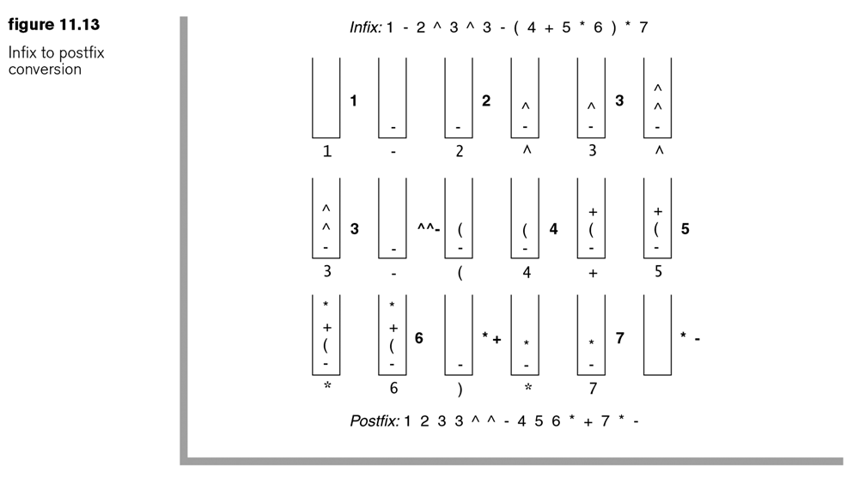
Evaluation using stack
1 - 2 ^ 3 ^ 3 - ( 4 + 5 * 6 ) * 7
Show algorithm in action on above equation
36
Notes:
36

Slide 37
Application: A Search Problem
Saudi Airline Company (SAAir)
For each customer request, indicate whether a sequence of SAAir flights exists from the origin city to the destination city
The flight map for SAAir is a graph
Adjacent vertices are two vertices that are joined by an edge
A directed path is a sequence of directed edges

Slide 38
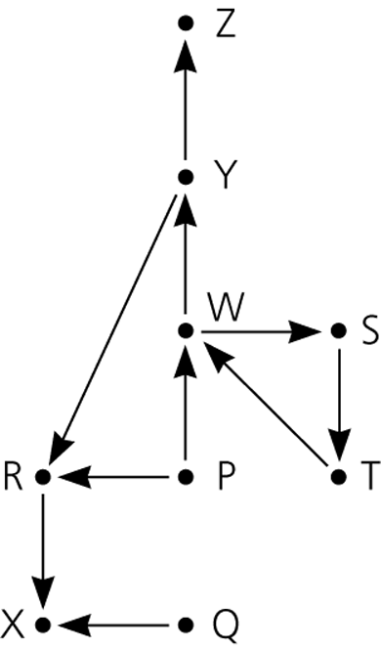
Application: A Search Problem
Flight map for SAAir

Slide 39
A Nonrecursive Solution That Uses a Stack
The solution performs an exhaustive search
Beginning at the origin city, the solution will try every possible sequence of flights until either
It finds a sequence that gets to the destination city
It determines that no such sequence exists
Backtracking can be used to recover from a wrong choice of a city

Slide 40
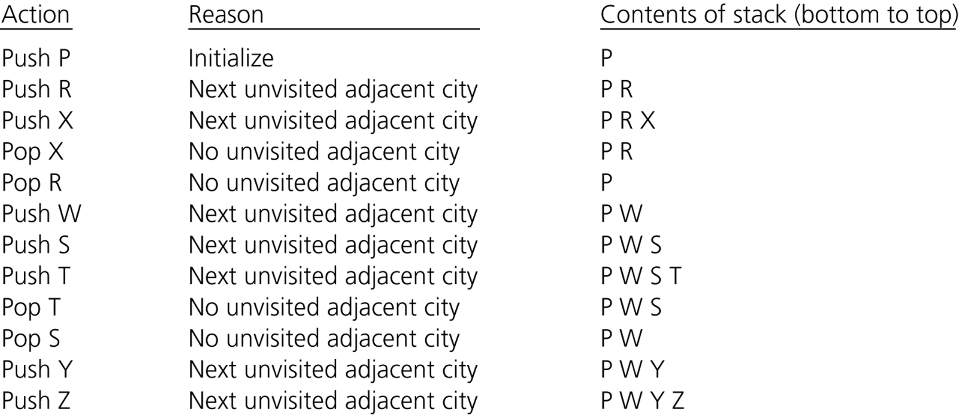
A Nonrecursive Solution That Uses a Stack
A trace of the search algorithm, given the flight map in Figure

Slide 41
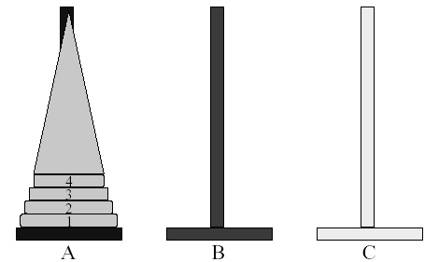
Application: Towers of Hanoi
Read the ancient Tower of Brahma ritual (p. 285)
n disks to be moved from tower A to tower C with the following restrictions:
Move 1 disk at a time
Cannot place larger disk on top of a smaller one
41

Slide 42
Towers of Hanoi
Move n(4) disks from pole A to pole C
such that a disk is never put on a smaller disk
A
A
B
C
B
C

Slide 43
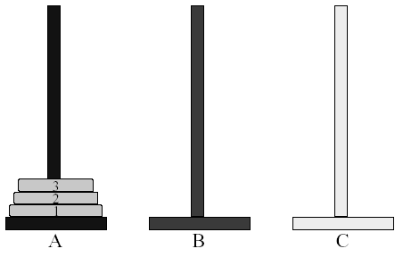
Let’s solve the problem for 3 disks
43

Slide 44
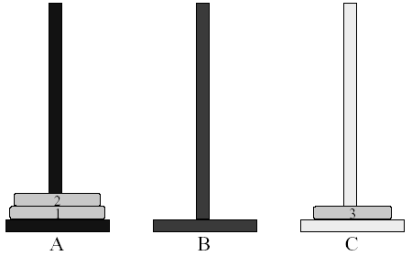
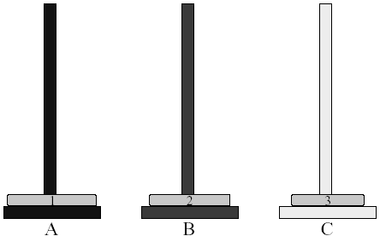
Towers of Hanoi (1, 2)
44

Slide 45
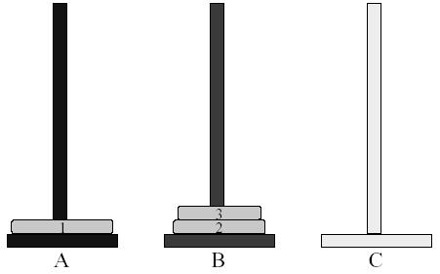
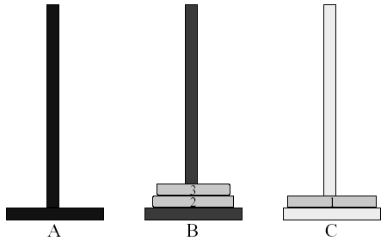
Towers of Hanoi (3, 4)
45

Slide 46
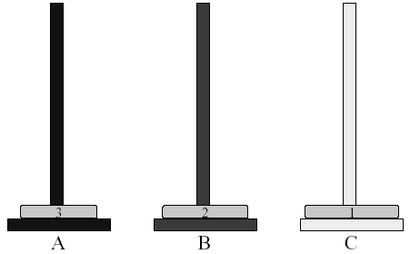
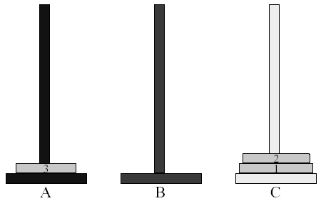
Towers of Hanoi (5, 6)
46

Slide 47
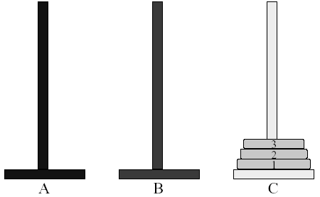
Towers of Hanoi (7)
47
So, how many moves are needed for solving 3-disk Towers of Hanoi problem?
➔ 7

Slide 48
Queue Overview
Queue ADT
Basic operations of queue
Enqueuing, dequeuing etc.
Implementation of queue
Array
Linked list

Slide 49
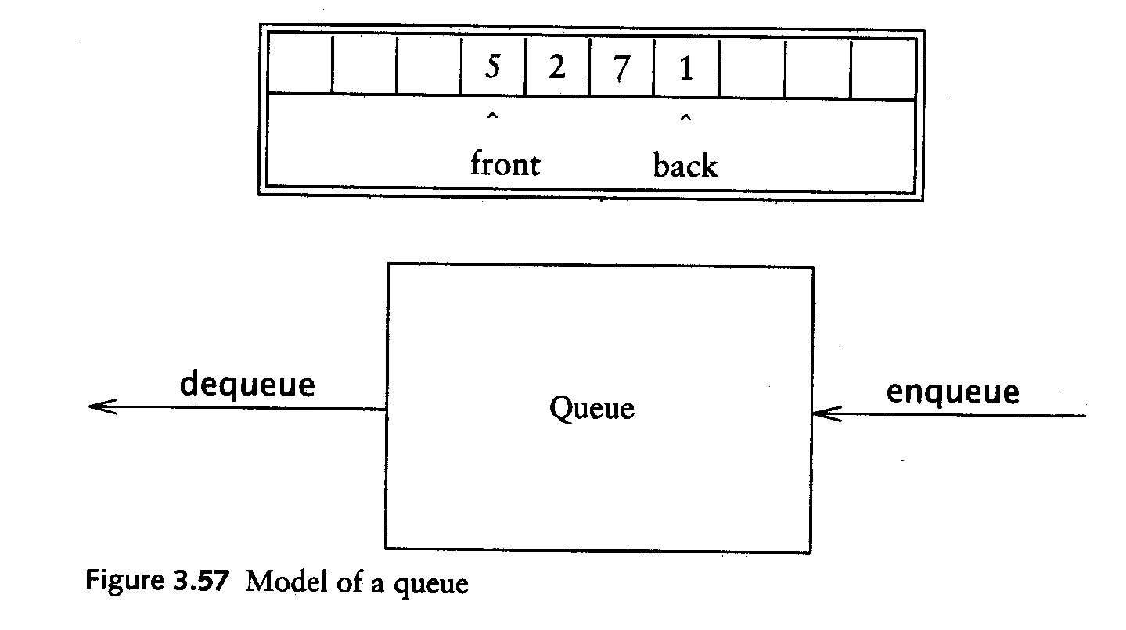
Queue ADT
Like a stack, a queue is also a list. However, with a queue, insertion is done at one end, while deletion is performed at the other end.
Accessing the elements of queues follows a First In, First Out (FIFO) order.
Like customers standing in a check-out line in a store, the first customer in is the first customer served.

Slide 50
Enqueue and Dequeue
Primary queue operations: Enqueue and Dequeue
Like check-out lines in a store, a queue has a front and a rear.
Enqueue – insert an element at the rear of the queue
Dequeue – remove an element from the front of the queue
Remove (Dequeue)
Insert (Enqueue)
front
rear

Slide 51
Implementation of Queue
Just as stacks can be implemented as arrays or linked lists, so with queues.
Dynamic queues have the same advantages over static queues as dynamic stacks have over static stacks

Slide 52
Queue Implementation of Array
There are several different algorithms to implement Enqueue and Dequeue
Naïve way
When enqueuing, the front index is always fixed and the rear index moves forward in the array.
rear
rear
rear
3
3
6
3
6
9
front
front
front
Enqueue(3)
Enqueue(6)
Enqueue(9)

Slide 53
Queue Implementation of Array
Naïve way (cont’d)
When dequeuing, the front index is fixed, and the element at the front the queue is removed. Move all the elements after it by one position. (Inefficient!!!)
rear
rear
rear = -1
6
9
9
front
front
front
Dequeue()
Dequeue()
Dequeue()

Slide 54
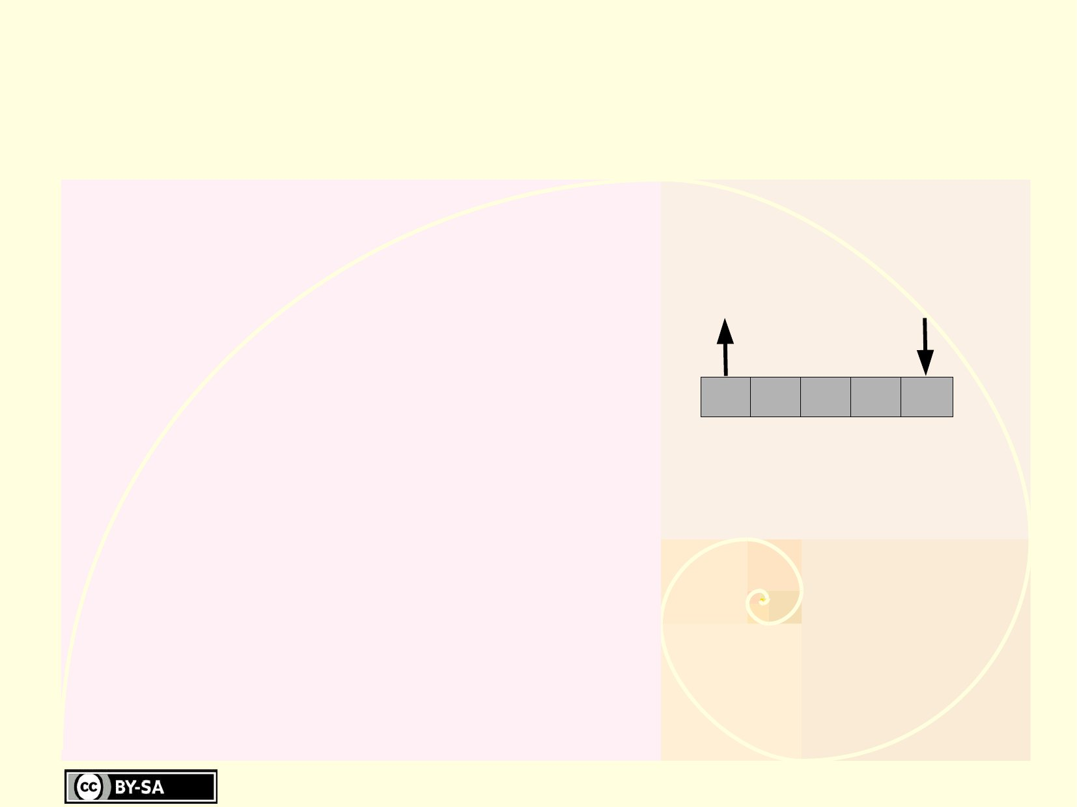
Queues
Q=(a0,...,an­1)
●
a0 is the front of the queue
an­1is the rear of the queue
–
Deletion
Insertion
–
a0
a1
a2
a3
a4
Rear
ai is behind ai­1 (0<i<n)
Front
Insertions take place at the rear
–
●
●
Deletions take place at the front
First In First Out (FIFO) list
Example: queue of persons
●
–
70

Slide 55
Queue Interface
Basic operations
●
enqueue()
Dequeue()
–
–
isEmpty()
Optional Operation
isFull() (when the queue as a maximum capacity)
Basic implementation using an array
How to prevent a queue to become full?
–
●
–
●
–

Slide 56
Queue Implementation
int front=0,rear=0;
int q[MAX], ele;
rear
Remove (Dequeue)
Insert (Enqueue)
front

Slide 57
Insert (Enqueue) Functions
void Insert()
{
if(rear==MAX)
cout<<"\nQueue is full";
else
{
cout<<"\nEnter an element:";
cin>>ele;
q[rear]=ele;
rear++;
cout<<"\nElement inserted successfully\n";
}
}
rear
Remove (Dequeue)
Insert (Enqueue)
front

Slide 58
Insert (Enqueue) Functions
void Delete()
{
if(front==rear)
cout<<"\nQueue is empty";
else
{
ele=q[front];
front++;
cout<<"The deleted element is:"<<ele;
}
}
rear
Remove (Dequeue)
Insert (Enqueue)
front

Slide 59
Insert (Enqueue) Functions
void Display()
{
if(front==rear)
cout<<"\nQueue is empty";
else
{
cout<<"\nThe elements in the queue are:";
for(i=front;i<rear;i++)
cout<<q[i]<<" ";
}
}
rear
Remove (Dequeue)
Insert (Enqueue)
front

Slide 60
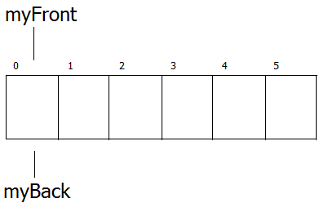
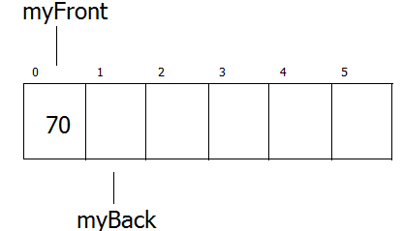
Queue Operation
Empty Queue
Enqueue(70)
Front
Rear
Front
Rear

Slide 61
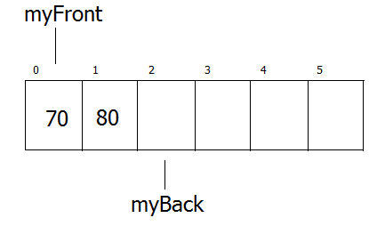
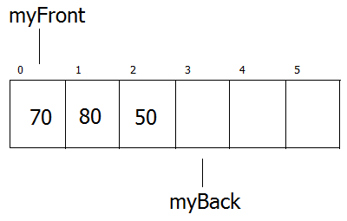
Queue Operation
Front
Enqueue(80)
Enqueue(50)
Rear
Front
Rear

Slide 62
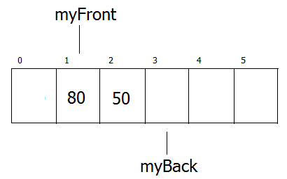
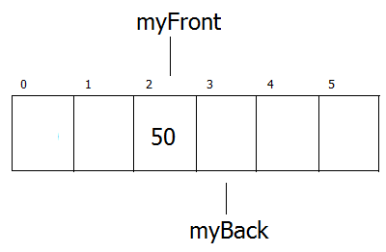
Queue Operation
Front
Dequeue()
Dequeue()
Rear
Front
Rear

Slide 63
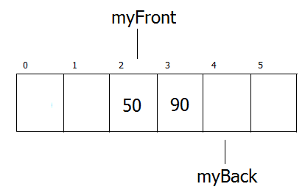
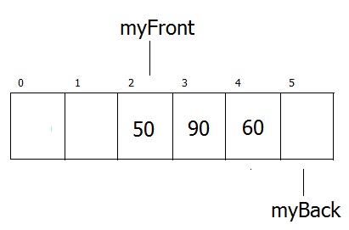
Queue Operation
Front
Enqueue(90)
Enqueue(60)
Rear
Front
Rear

Slide 64
Exercise
Suppose we have a stack S and a queue Q. What are final values in the stack S and in the Q after the following operations? Show contents of both S and Q at each step indicated by the line.
Stack S;
Queue Q;
int x, y;
S.push(10);
S.push(20);
S.push(S.pop()+S.pop());
Q.enqueue(10);
Q.enqueue(20);
Q.enqueue(S.pop());
S.push(Q.dequeue()+Q.dequeue());

Slide 65
Exercise
Suppose we have an integer-valued stack S and a queue Q. Draw the contents of both S and Q at each step indicated by the line. Be sure to identify which end is the top of S and the front of Q.
Stack S;
Queue Q;
S.push(3);
S.push(2);
S.push(1);
Q.enqueue(3);
Q.enqueue(2);
Q.enqueue(1);
int x = S.pop();
Q.enqueue(x);
x = Q.dequeue();
Q.enqueue(Q.dequeue());
S.push(Q.peek());
// peek() function reads the front of a queue without deleting it

Slide 66
Exercise
What will be the content of queues Q1, Q2, and Stack S, after the following code segment?
Stack S;
Queue Q1, Q2;
int x, y, z;
Q1.Enqueue(9);
Q1.Enqueue(6);
Q1.Enqueue(9);
Q1.Enqueue(1);
Q1.Enqueue(7);
Q1.Enqueue(5);
Q1.Enqueue(1);
Q1.Enqueue(2);
Q1.Enqueue(8);
while(!Q1.isEmpty())
{
x = Q1.Dequeue();
if (x == 1)
{
z = 0;
while(!S.isEmpty())
{
y = S.pop();
z = z + y;
}
Q2.Enqueue(z);
}
Else
S.push(x);
}

Slide 67
Assume that you have a stack S, a queue Q, and the standard stack - queue operations: push, pop, enqueue and dequeue. Assume that print is a function that prints the value of its argument. Execute, in top-to-bottom order, the operations below and answer the following questions.
push(S, ‘T’);
enqueue(Q, ‘I’);
push(S,dequeue(Q));
enqueue(Q, ‘I’);
enqueue(Q, ‘G’);
print(dequeue(Q));
enqueue(Q, T);
push(S, ‘I’);
push(S, dequeue(Q));
print(pop(S));
enqueue(Q, pop(S));
push(S, ‘O’);
print(pop(S));
enqueue(Q, ‘O’);
print(dequeue(Q));
enqueue(Q, pop(S));
push(S, dequeue(Q));
print(pop(S));
print(pop(S));

