Slide 1
Pointers

Slide 2
Pointer (Contents)
How does a memory look like ?
Operators used in Pointers.
Syntax for Pointers.
Pointer Assignment.
Pointer Arithmetic.
Pointer Example.
Predict the Output.

Slide 3
How does a memory look like ?
Address Locations
For a float number (4 bytes)
Staring address X1000
X1000
X1004
X1008
X100c
x1010
X1000
X1001
X1002
X1003

Slide 4
Computer Memory
Each variable is assigned a memory slot (the size depends on the data type) and the variable’s data is stored there
Memory address:
1020
1022
1032
…
…
100
…
1022
…
a
Variable a’s value, i.e., 100, is
stored at memory location 1022
int a = 100;

Slide 5
Pointer Variable
Pointer variables
Contain memory addresses as their values
Normal variables contain a specific value (direct reference)
Pointers contain address of a variable that has a specific value (indirect reference)
Indirection – referencing a pointer value
count
7
countPtr
count
7

Slide 6
Pointer Variable
A pointer variable is a variable used to store the address of a memory cell.
We can use the pointer to reference this memory cell
Memory address:
1020
1024
1032
…
…
100
…
1024
…
integer
pointer

Slide 7
Syntax for pointers
(pointer type declaration)
type *identifier ;
Example
char *cp ;
int *ip ;
double *dp ;
int **p; // pointer to pointer

Slide 8
Operators used in Pointers
*
Data
Address
&
(Value of)
(Address of)

Slide 9
Address Operator &
The "address of " operator (&) gives the memory address of the variable
Usage: &variable_name
Memory address:
1020
1024
…
…
100
…
…
…
a
int a = 100;
//get the value,
cout << a; //prints 100
//get the memory address
cout << &a; //prints 1024

Slide 10
Address Operator &
Memory address:
1020
1024
1032
…
88
100
…
…
…
a
b
#include <iostream>
using namespace std;
void main(){
int a, b;
a = 88;
b = 100;
cout << "The address of a is: " << &a << endl;
cout << "The address of b is: " << &b << endl;
}
Result is:
The address of a is: 1020
The address of b is: 1024

Slide 11
Pointer Variables
The value of pointer p is the address of variable a
A pointer is also a variable, so it has its own memory address
Memory address:
1020
1024
1032
…
88
100
…
1024
…
a
p
int a = 100;
int *p = &a;
cout << a << " " << &a <<endl;
cout << p << " " << &p <<endl;
Result is:
100 1024
1024 1032

Slide 12
Example Operator *
We can access to the value stored in the variable pointed to by using the dereferencing operator (*),
Memory address:
1020
1024
1032
…
88
100
…
1024
…
a
p
int a = 100;
int *p = &a;
cout << a << endl;
cout << &a << endl;
cout << p << " " << *p << endl;
cout << &p << endl;
Result is:
100
1024
1024 100
1032

Slide 13
Pointer Assignment
int i = 1;
int *ip ; //pointer declaration
ip = &i ; //pointer assignment
*ip = 3 ; //pointer assignment

Slide 14
int i; int *ip ; ip = &i ; *ip = 3 ;
Address of ‘i’
ip =
Value of ‘i’
x100c
‘x100c
‘i=3’
variable
i
3
X1000 x1004 x1008 x100c x1010 x1014

Slide 15
Example of Pointer
#include<iostream.h>
Void main()
{
int i=3;
int *j;
j=&i;
cout<<i;
cout<<*j;
}

Slide 16
int i=3;
int *j;
j = &i;
Create an integer variable ‘i’ and initialize it to 3
Create a pointer variable ‘j’- create value of ‘j’
Initialize the pointer value of ‘j’ to the address of ‘i’
_{variables}
Int *j
Int i
Memory
3
x100c
X1000 x1004 x1008 x100c x1010 x1014

Slide 17
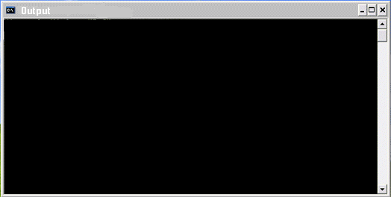
Output screen
cout<<i;
cout<<*j
i=3
We know j=&i
So → *j=*(&i) value of (address of i)
(i.e.) value in address (x100c)
*j=3
variables
Int *j
Int i
Memory
3
3
x100c
X1000 x1004 x1008 x100c x1010 x1014

Slide 18
More Example
Declaring a pointer means only that it is a pointer: int *p;
int a = 100, b = 88, c = 8;
int *p1 = &a, *p2, *p3 = &c;
p2 = &b; // p2 points to b
p2 = p1; // p2 points to a
b = *p3; //assign c to b
*p2 = *p3; //assign c to a
cout << a << b << c;
Result is:
8 8 8

Slide 19
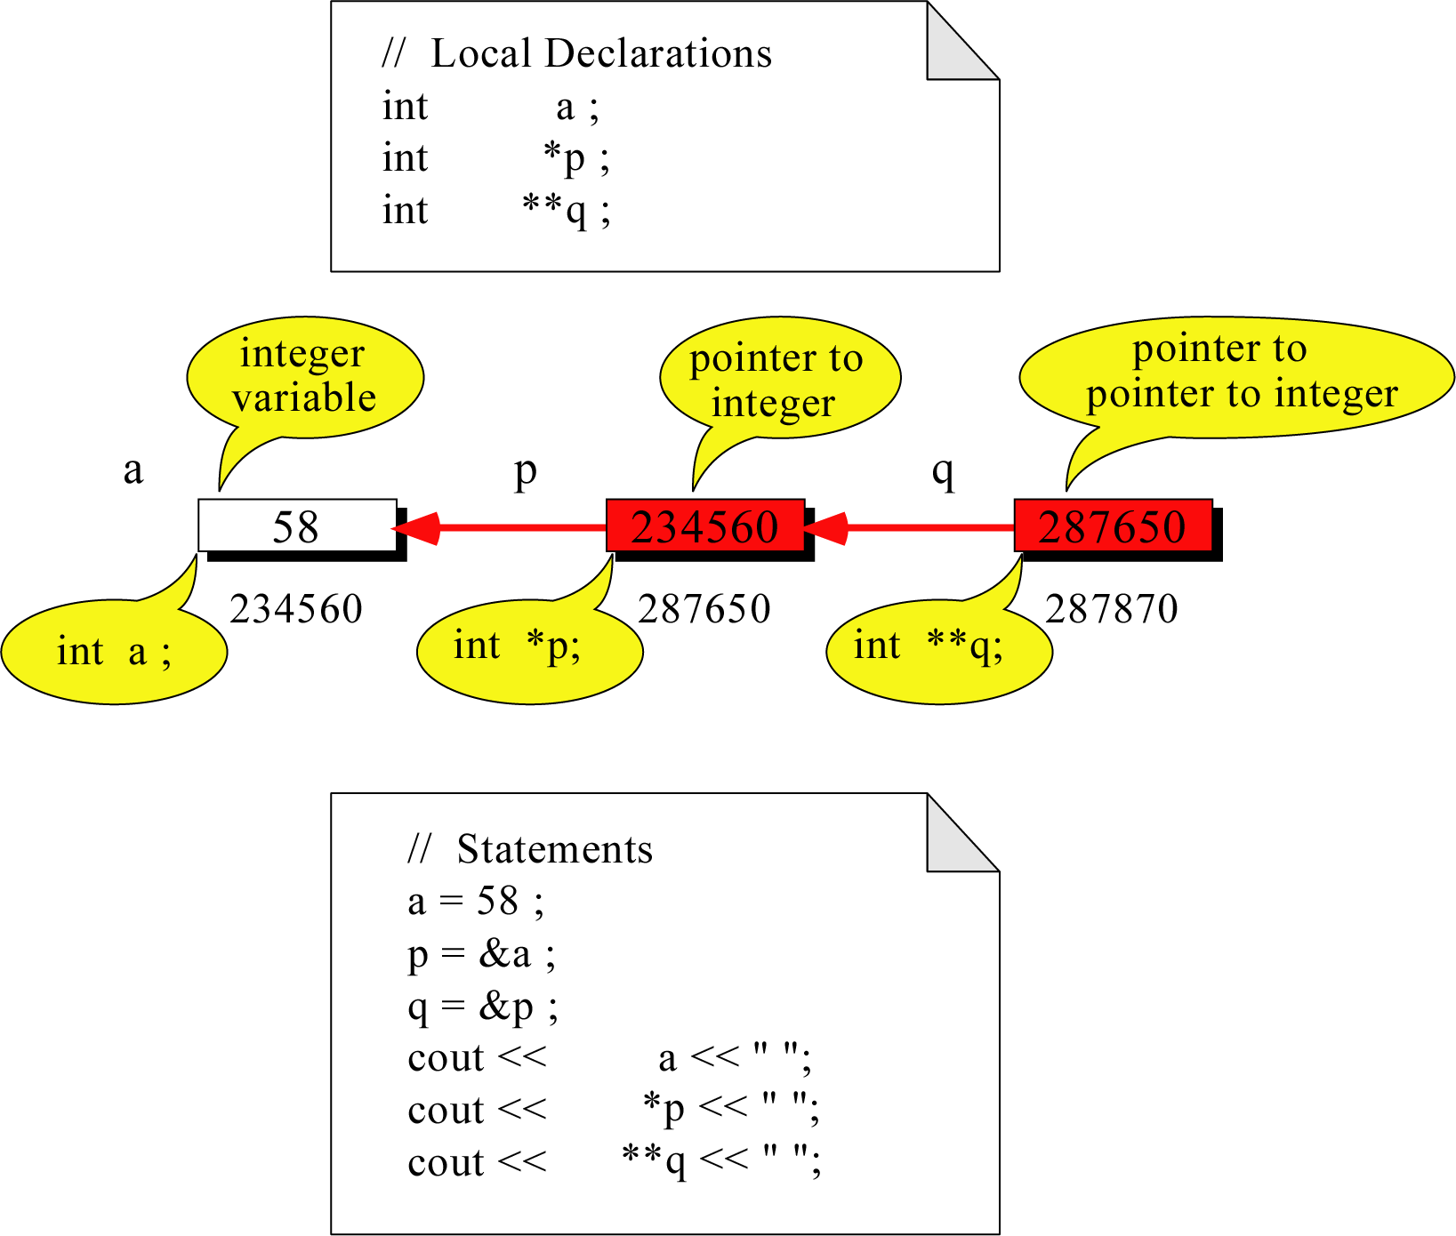
Pointer to Pointer
What is the output?
58 58 58

Slide 20
Pointers in Function arguments
Memory Layout
The code
void doubleIt(int x, int *p)
{
*p = 2 * x;
}
int main(int argc, const char * argv[])
{
int a = 16;
doubleIt(9, &a);
return 0;
}
Box diagram
main
16
p (8200)
8192
a
doubleIt
x (8196)
9
a (8192)
16
main
doubleIt
x
9
a gets 18
p
Notes:
Note the signature of main() – it’s an array parameter. And, like other examples we’ve given, it takes the number of elements as a parameter. Why?

Slide 21
Pointers in Function arguments
Arguments are passed by value, thus only a copy is passed.
void swap_wrong(int x, int y)
{
int temp;
temp = x;
x = y;
y = temp;
}
in swap_wrong
in swap
x:
10
px:
4397
y:
20
py:
9643
void swap(int *px, int *py)
{
int temp;
temp = *px;
*px = *py;
*py = temp;
}
temp:
temp:
in caller:
a:4397
10
int a = 10, b = 20;
swap_wrong(a, b);
cout << a << b;
swap(&a, &b);
cout << a << b;
b:9643
20

Slide 22
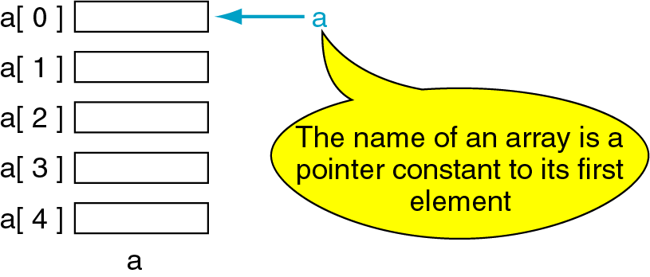
Pointers and Arrays
The name of an array points only to the first element not the whole array.
1000
1004
1008
1012
1016

Slide 23
Array Name is a pointer constant
#include <iostream>
using namespace std;
void main (){
int a[5];
cout << "Address of a[0]: " << &a[0] << endl
<< "Name as pointer: " << a << endl;
}
Result:
Address of a[0]: 0x0065FDE4
Name as pointer: 0x0065FDE4

Slide 24
Dereferencing An Array Name
This element is called a[0] or *a
#include <iostream>
using namespace std;
void main(){
int a[5] = {2,4,6,8,22};
cout << *a << " "
<< a[0];
} //main
a[0]
2
a
a[1]
4
a[2]
6
a[3]
8
a[4]
22
a

Slide 25

Array Names as Pointers
To access an array, any pointer to the first element can be used instead of the name of the array.
We could replace *p by *a
#include <iostream>
using namespace std;
void main(){
int a[5] = {2,4,6,8,22};
int *p = a;
cout << a[0] << " "
<< *p;
}
a
p
a[0]
2
2 2
a[1]
4
a[2]
6
a[3]
8
a[4]
22
a

Slide 26
Examples
int x = 70, y = 80, z[4] = {10, 20, 30, 40 };
int *ip; // int pointer ip
ip = &x; // ip is assigned to address of x
*ip = 200; // content of ip is assigned to 200
y = *ip; // y is assigned to content of ip
ip = &z[2];
*ip = *ip + 20; // same as *ip += 20;
y = *ip+1;
70
x :
4892
200
80
200
y :
4894
51
Z, Z[0] :
4896
10
Z[1] :
4898
20
30
Z[2] :
4900
50
Z[3] :
4902
40
????
4892
ip :
4904
4900

Slide 27
Pointer Examples
int x = 100;
int *p1 = &x;
cout << "&x == " << &x << " x == " << x << endl
<< "p1 == " << p1 << " *p1 == " << *p1 << endl;
*p1 += 20;
cout << "&x == " << &x << " x == " << x << endl
<< "p1 == " << p1 << " *p1 == " << *p1 << endl;
Output
&x == 0x7fff7e60f41c x == 100
p1 == 0x7fff7e60f41c *p1 == 100
&x == 0x7fff7e60f41c x == 120
p1 == 0x7fff7e60f41c *p1 == 120

Slide 28

Pointer Arithmetic
Lets take this example program
#include<stdio.h>
void main()
{
int a [5]={1,2,3,4,5} , b , *pt ;
pt = &a[0];
pt = pt + 4 ;
b=a[0] ;
b+=4 ;
}
b = 1
b=1+4
b= 5
a[0]
a[1]
a[2]
a[3]
a[4]
X1000 x1004 x1008 x100c x1010
pt
a[0]
a[1]
a[2]
a[3]
a[4]
b
X1000 x1004 x1008 x100c x1010

Slide 29
Brain Work
#include <stdio.h>
main ()
{
int i;
int * ia;
i = 10;
ia = &i;
cout<<ia;
cout<<i;
cout<<*ia;
*ia = 50;
cout<<i;
}
1000
1002
1004
1006

Slide 30
Predict the output of this code
Void main()
{
int num=10;
Int *pnum=NULL; pnum = &num; *pnum += 20; cout<<“Number =“<<num<<endl; cout<<"Pointer Number = “<<*pnum<<endl;
}

Slide 31
Number = 10
Pointer Number = 30

Slide 32
Work to your Brain
int a[10] = {1,2,3,4,5,6,7,8,9,12} ,*p, *q , i;
p = &a[2];
q = &a[5];
i = *q - *p;
cout<<“The value of i is”<< i;
i = *p - *q;
cout<<“The value of i is %d”<< i;
a[2] = a[5] = 0;
cout<<“The value of i is %d”<< i;

Slide 33
The value of i is 3
The value of i is -3
The value of i is -3

Slide 34
Work to your Brain
#include<iostream.h>
void main()
{
int a[10] = { 2,3,4,5,6,7,8,9,1,0 }, *p, *q;
p = &a[2];
q = p + 3;
p = q - 1;
p++;
cout<<"The value of p and q are"<<*p<<*q;
}

Slide 35
The value of p and q are : 7 , 7

Slide 36
Work to your Brain
int main()
{
int x[2]={1,2},y[2]={3,4};
int *small,*big;
small=&x[0];
big=&y[0];
min_max(&small,&big);
cout<<“small%d big%d“<<*small<<*big;
return 0;
}
min_max(int *a,int *b)
{
a++;
b++;
return (*a,*b);
}

Slide 37
Small 2 big 4

Slide 38
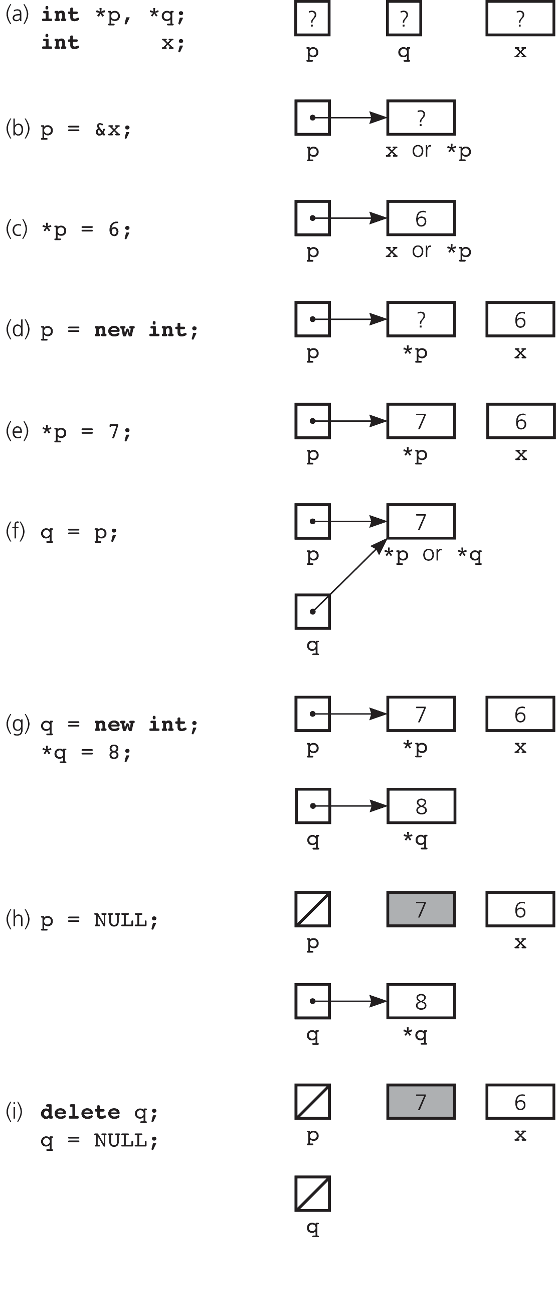
More about Pointers
Figure (a) declaring pointer variables; (b) pointing to statically allocating memory; (c) assigning a value;
(d) allocating memory dynamically; (e) assigning a value

Slide 39
Pointers
Figure
(f) copying a pointer;
(g) allocating memory dynamically
and assigning a value;
(h) assigning NULL to a pointer
variable;
(i) deallocating memory

