Slide 1
Introduction

Slide 2
What is Cyber Security?
Highly Technical
People, processes, and technology
Legislation and Regulation
Risk management
Notes:
Cyber-security is the practice of defending computers, servers, mobile devices, electronic systems, networks, and data from malicious attacks
Cyber security is the state or process of protecting and recovering networks, devices and programs from any type from malicious attacks.

Slide 3
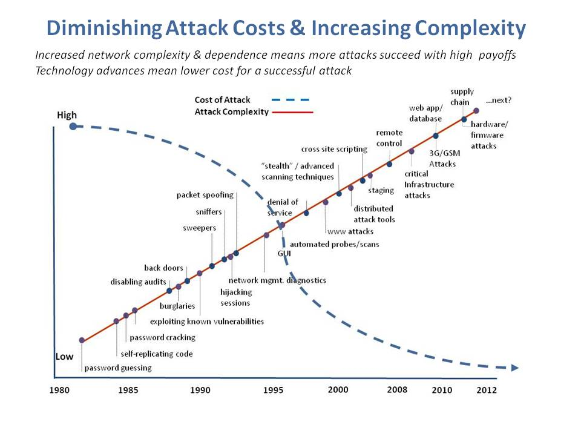
Copyright of Information Security Incorporated © 2008–2014

Slide 4
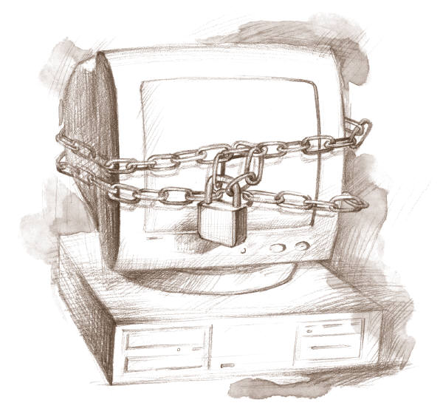
What Can I Do?
Notes:
What can I do to protect myself from cyberattacks?
Should I stay disconnected?

Slide 5
Course Objective
Understand the challenges of insecure and vulnerable software
Investigate the types of threats and vulnerabilities inherent in software
Understand risk management framework
Study secure coding concepts and techniques
Gather knowledge of secure software design and development
Learn software security in enterprise business

Slide 6
Assignments
Homework assignments and labs: There will be several homework assignments during the semester. In addition to homework assignments, there will be several hands-on experiments. The focus of these experiments is practical with discussions on why and how mechanisms ensure security, what level of security is provided, and how hostile adversaries might violate the mechanisms.
Midterm exam: The midterm exam is a closed book test which covers the course material.

Slide 7
Assignments
Research project: There will be one research project related to software security. Final project reports must be submitted at the end of the semester. Further project requirements will be distributed at a later time.
Final exam: The final exam is a closed book test and accumulative.

Slide 8
Grading
Participation and Quizzes 5%
Homework assignments and labs: 20%
Research project : 10% Bonus 5%
Midterm exam: 25%
Final exam: 40%

Slide 9
Introduce yourself

Slide 10
Your name
Current carrier
Your goal (why Master in Cybersecurity)
Your plan after completing your studies

Slide 11
Basic Security Concepts

Slide 12
Security Objectives
Confidentiality: prevent/detect/deter improper disclosure of information
Integrity: prevent/detect/deter improper modification of information
Availability: prevent/detect/deter improper denial of access to services

Slide 13
Military Example
Confidentiality: target coordinates of a missile should not be improperly disclosed
Integrity: target coordinates of missile should be correct
Availability: missile should fire when proper command is issued

Slide 14
Commercial Example
Confidentiality: patient’s medical information should not be improperly disclosed
Integrity: patient’s medical information should be correct
Availability: patient’s medical information can be accessed when needed for treatment

Slide 15
Quiz
Give an educational example for each one of the main security objectives.
Confidentiality
Integrity
Availability

Slide 16
Fourth Objective
Securing computing resources: prevent/detect/deter improper use of computing resources
Hardware
Software
Data
Network

Slide 17
Question 1: What is the trade off between the security objectives?
Confidentiality reduces integrity because secret data is higher quality
Integrity requires that the data is kept in an isolated location and cannot be accessed
Increased confidentiality may reduce availability
Confidential and correct data has high trade off availability

Slide 18
Achieving Security
Organizational Goals
Why to invest in security protection?
Policy
What to protect?
Mechanism
How to protect?
Assurance
How good is the protection?

Slide 19
Security Policy
Organizational
Policy
MUST fit the security policy into the organizational policy
Computerized
Information System
Policy

Slide 20
Question 2: Why do we need to fit the security policy into the organizational policy?
Because the management would not pay for it otherwise
Because security policy should support and protect organizational goals
Because this will make the implementation easier
Because it is mandated by law and regulation

Slide 21
Security Mechanism
Prevention
Detection
Tolerance/Recovery
Notes:
What are the main goals of security?

Slide 22
Security by Obscurity
Hide inner working of the system
Bad idea!
The National Institute of Standards and Technology (NIST) in the United States sometimes recommends against this practice
“System security should not depend on the secrecy of the implementation or its components.”
The technique stands in contrast with security by design
Notes:
Security by obscurity alone is discouraged and not recommended by standards bodies.
The National Institute of Standards and Technology (NIST) in the United States sometimes recommends against this practice:
"System security should not depend on the secrecy of the implementation or its components.”

Slide 23
Security by Legislation
Instruct users how to behave
Not good enough!
Important
Only enhance security
Targets only some of the security problems

Slide 24
Security Tradeoffs
Security
Functionality
COST
Ease of Use

Slide 25
Threat, Vulnerability, Risk
Threat: potential occurrence that can have an undesired effect on the system
Vulnerability: characteristics of the system that make it possible for a threat to potentially occur
Attack: action of malicious intruder that exploits vulnerabilities of the system to cause a threat to occur
Risk: measure of the possibility of security breaches and severity of the damage

Slide 26
Types of Threats (1)
Errors of users
Natural/man-made/machine disasters
Dishonest insider
Disgruntled insider
Outsiders
Notes:
Discontent

Slide 27
Types of Threats (2)
Disclosure threat – dissemination of unauthorized information
Integrity threat – incorrect modification of information
Denial of service threat – access to a system resource is blocked

Slide 28
Types of Attacks (1)
Interruption – an asset is destroyed, unavailable or unusable (availability)
Interception – unauthorized party gains access to an asset (confidentiality)
Modification – unauthorized party tampers with asset (integrity)
Fabrication – unauthorized party inserts counterfeit object into the system (authenticity)
Denial – person denies taking an action (authenticity)

Slide 29
Types of Attacks (2)
Passive attacks:
Eavesdropping
Monitoring
Active attacks:
Masquerade – one entity pretends to be a different entity
Replay – passive capture of information and its retransmission
Modification of messages – legitimate message is altered
Denial of service – prevents normal use of resources

Slide 30
Computer Crime
Any crime that involves computers or aided by the use of computers
U.S. Federal Bureau of Investigation: reports uniform crime statistics

Slide 31
Malicious Attacks
Method: skills, knowledge, tools, information, etc.
Opportunity: time and access
Motive: reason to perform the action
Notes:
Malicious users must have three things to succeed: motivation, opportunity, method, explain each one of them.

Slide 32
Computer Criminals
Amateurs: regular users, who exploit the vulnerabilities of the computer system
Motivation: easy access to vulnerable resources
Crackers: attempt to access computing facilities for which they do not have the authorization
Motivation: enjoy challenge, curiosity
Career criminals: professionals who understand the computer system and its vulnerabilities
Motivation: personal gain (e.g., financial)

Slide 33
Methods of Defense
Prevent: block attack
Deter: make the attack harder
Deflect: make other targets more attractive
Detect: identify misuse
Tolerate: function under attack
Recover: restore to correct state

Slide 34
Information Security Planning
Organization Analysis
Risk management
Mitigation approaches and their costs
Security policy
Implementation and testing
Security training and awareness

Slide 35
Questions?

