Slide 1
Risk Management Framework (RMF)

Slide 2
Risk Assessment
Threats
RISK
Vulnerabilities
Consequences
Notes:
Risk is a function of threats exploiting vulnerabilities to obtain, damage or destroy assets.
R= T X V X C
We mean by asset people, property, and information…

Slide 3
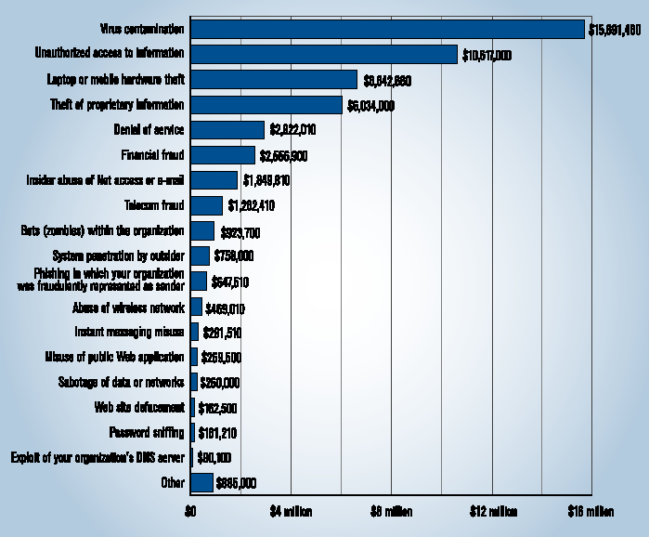
Financial Loss
Dollar Amount Losses by Type
Total Loss (2006): $53,494,290 CSI/FBI Computer Crime and Security Survey
Computer Security Institute

Slide 4
Real Cost of Cyber Attack
Damage of the target may not reflect the real amount of damage
Services may rely on the attacked service, causing a cascading and escalating damage
Need: support for decision makers to
Evaluate risk and consequences of cyber attacks
Support methods to prevent, deter, and mitigate consequences of attacks
Notes:
Did you know that a single cyber attack can cost an enterprise company millions of dollars and completely destroys small businesses?
Damage of the target may not reflect the real amount of damage
The reason is that other services may rely on the attacked service, causing a cascading and escalating damage

Slide 5
System Security Engineering
(Traditional View)
Specify System
Architecture
Identify and
Install Safeguards
Identify Threats,
Vulnerabilities, Attacks
Estimate
Risk
Prioritize
Vulnerabilities
Risk is acceptably low
Notes:
Install Safeguards i.e. try to find the best fit protection…

Slide 6
Risk Management Framework (Business Context) Five Stages
RMF occurs in parallel with SDLC activities
Measurement and reporting
Understand
the Business
context
1
Identify
the Business
and Technical
Risk
2
Synthesize and
Rank the Risks
3
Define the Risk
Mitigation
Strategy
4
Artifact Analysis
Business
Context
Carry out fixes
And validate
5

Slide 7
Stage 1: Understand Business Context
Risk management
Occurs in a business context
Affected by business motivation
Key activity of an analyst
Extract and describe business goals – clearly
Increasing revenue; reducing dev cost; meeting SLAs; generating high return on investment (ROI)
Set priorities
Understand circumstances
Bottomline – answer the question
who cares?

Slide 8
Stage 2: Identify the business & technical risks
Business risks have impact
Direct financial loss; loss of reputation; violation of customer or regulatory requirements; increase in development cost
Severity of risks
Should be capture in financial or project management terms
Key is –
tie technical risks to business context

Slide 9
Stage 3: Synthesize and rank the risks
Prioritize the risks alongside the business goals
Assign risks appropriate weights for resolution
Risk metrics
Risk likelihood
Risk impact
Number of risks mitigated over time

Slide 10
Stage 4: Risk Mitigation Strategy
Develop a coherent strategy
For mitigating risks
In cost effective manner; account for
Cost Implementation time
Completeness Impact
Likelihood of success
A mitigation strategy should
Be developed within the business context
Be based on what the organization can afford, integrate and understand
Must directly identify validation techniques

Slide 11
Stage 5: Carry out Fixes and Validate
Execute the chosen mitigation strategy
Rectify the artifacts
Measure completeness
Estimate
Progress, residual risks
Validate that risks have been mitigated
Testing can be used to demonstrate
Develop confidence that unacceptable risk does not remain

Slide 12
RMF - A Multi-loop
Risk management is a continuous process
Five stages may need to be applied many times
Ordering may be interleaved in different ways
Risk can emerge at any time in SDLC
One way – apply in each phase of SDLC
Risk can be found between stages
Level of application
Primary – project level
Each stage must capture complete project
SDLC phase level
Artifact level
It is important to know that RM is
Cumulative
At times arbitrary and difficult to predict

Slide 13
Measuring and Reporting
Continuous and consistent identification and storage of risk information over time
Maintain risk information at all stages of risk management
Establish measurements, e.g.,
Number of risks, severity of risks, cost of mitigation, etc.

Slide 14
Assets-Threat Model (1)
Threats compromise assets
Threats have a probability of occurrence and severity of effect
Assets have values
Assets are vulnerable to threats
Threats
Assets

Slide 15
Assets-Threat Model (2)
Risk: expected loss from the threat against an asset
R=V*P*S
R risk
V value of asset
P probability of occurrence of threat
V vulnerability of the asset to the threat

Slide 16
System-Failure Model
Estimate probability of highly undesirable events
Risk: likelihood of undesirable outcome
Threat
System
Undesirable
outcome

Slide 17
Risk Acceptance
Certification
How well the system meet the security requirements (technical)
Accreditation
Management’s approval of automated system (administrative)

Slide 18
Risk Management Framework (Business Context)
Measurement and reporting
Understand
the Business
context
1
Identify
the Business
and Technical
Risk
2
Synthesize and
Rank the Risks
3
Define the Risk
Mitigation
Strategy
4
Why
What
Who
Artifact Analysis
How
Business
Context
Carry out fixes
And validate
5
Strengthen system
Notes:
“Who cares?”
“Why should business care?”
“What should be done first?”
“How to mitigate risks?”
Strengthen system

Slide 19
Next TOPIC is recommended only

Slide 20
Incident Handling Computer Security Incident Handling Guide, Recommendations of the National Institute of Standards and Technology
http://csrc.nist.gov/publications/nistpubs/800-61-rev1/SP800-61rev1.pdf

Slide 21
Questions?

