Slide 1

Intrusion Detection Systems (IDS)

Slide 2
Basic Ideas of Intrusion Detection
What is Intrusion?
Intruders are attackers who try to penetrate systems
Intrusion detection is the process of monitoring the events occurring in a computer system or a network.
Intrusion prevention is the process of detecting signs of intrusion and attempting to stop the intrusive efforts.

Slide 3
Basic Ideas of Intrusion Detection
Observation
Intruder’s behavior is likely to be substantially different from the impersonated users
The behavior differences can be “measured” to allow quantitative analysis
Intrusion detection:
Identify as quick as possible intrusion activities occurred or are occurring inside an internal network
Trace intruders and collect evidence to indict the criminals
How about building an automated tool to detect these behaviors? → Intrusion Detection System (IDS)
Intrusion detection systems IDS have become necessary to the security infrastructure of every organization.

Slide 4
IDS What Does it Do?
An intrusion detection system (IDS) monitors systems and analyzes network traffic to detect signs of intrusion.
An IDS can detect a variety of attacks in progress as well as attempts to scan a network for weaknesses.
An IDS can be:
A dedicated network device
A software solution installed on a host computer.

Slide 5
Types of IDS Systems
Host-Based: monitors the host and the events that occur within the host.
Network-Based: monitor the network traffic for a segment of the network to identify threats that create unusual traffic flows, DDoS, malwares and policy violations.
Both (hybrid detection)
Wireless: monitors wireless network traffic. Its analysis is to identify suspicious activities involving wireless protocols.

Slide 6
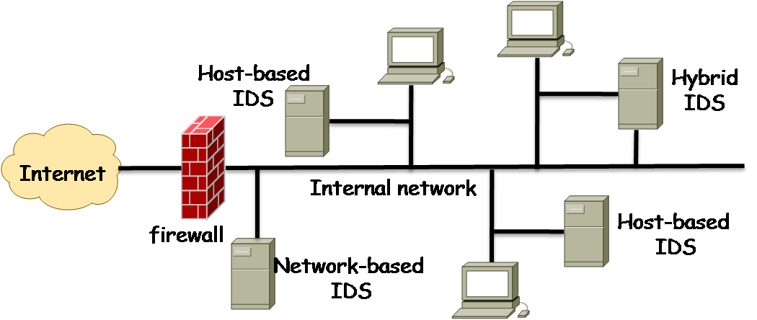
IDS as dedicated network devices

Slide 7
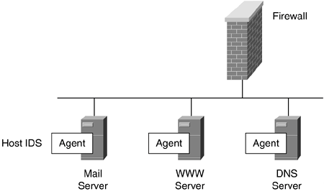
Host IDS
Host IDS as software solution

Slide 8
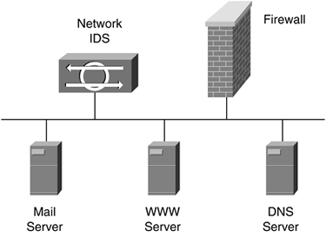
Network IDS
IPS

Slide 9
IDS How does it work?
If configured correctly, a network intrusion detection system (NIDS) can monitor all traffic on a network segment.
A NIDS is most effective when used in conjunction with a firewall solution.

Slide 10
IDS Configuration
NIDS can be installed on the external routers, the internal routers, or both.
Placing NIDS on external routers enables detection of attacks from the Internet
Placing NIDS on internal routers enables detection of internal hosts attempting to access the Internet on suspicious ports.

Slide 11
IDS
IDS
LAN
Firewall
Internal
Internet
External

Slide 12
IDS Methods of Detection
The following intrusion detection methods can be used by the IDS:
Anomaly-based detection
Anomaly-based detection is the process of comparing definitions of activities which are supposed to be normal against observed events to identify deviations.
This detection method needs a training period to generate the initial normal definitions.
The major advantage of anomaly-based detection is that they can be very effective in detecting unknown threats.
Anomaly –based detection methods have a problem with false positives. For example, if a user transfers large files that is not specified during the training period, a false positive alarm may raise.

Slide 13
IDS Methods of Detection
An anomaly example: This involves monitoring resource use, network traffic, user behavior and comparing it against normal levels.
If a user that normally only accesses the system between 9 am – 5pm, suddenly logs on at 3 am then this may indicate that an intruder has compromised the user’s account. A NIDS/IDS would then alert administrators to this suspicious activity.

Slide 14
IDS Methods of Detection
Pattern-based (signature-based) detection
A signature is a pattern that corresponds to a known threat.
A signature-based detection is a process of comparing a signature which signifies a known threat against the events that are observed.
The major disadvantage of the signature-based detection method is that it is ineffective against unknown threats.

Slide 15
Intrusion Detection Policies
IDP are used to identify intrusion activities
Specify what data must be protected and how well they should be protected
Specify what activities are intrusions and how to respond when they are identified
Behavior Classifications
Green-light behavior: a normal behavior acceptable
Red-light behavior: an abnormal behavior must be rejected
Yellow-light behavior: cannot determine with current information
Reactions to red-light and yellow-light behavior detections:
Collect more info for better determination, if yellow-light behavior
Terminate user login session/disconnect network, if red-light behavior.

Slide 16
Negatives and Positives
IDS must correctly identify intrusions and attacks
True positives
successfully identify intrusions and attacks.
True negatives
successfully identify normal traffic or activity.
IDS can not provide complete and accurate detection, therefore, false alarms may happen. False alarms are defined as follows:
False negatives
When the IDS fails to identify a malicious activity, i.e the IDS missed an attack.
False positives
When the IDS incorrectly identifies a normal activity as malicious.

Slide 17
Dealing with False Negatives
It is not possible to eliminate both false positives and negatives, reducing one of them has a consequence of increasing the other. Organizations prefer to reduce the false negatives at the cost of increased false positives.
To reduce false negatives
Obtain more coverage by using a combination of network-based and host-based IDS
Deploy NIDS at multiple strategic locations in the network.
- Altering the configuration of an IDS to improve the detection accuracies is known as TUNING OF THE IDS.

Slide 18
Goal of NIDS
Detect attacks as they happen:
Real-time monitoring of networks
Provide information about attacks that have succeeded:
Forensic analysis
Passive systems: monitoring and reporting
Active systems: corrective measures adopted
Good place to establish a NIDS: The perimeter network, or DMZ.

Slide 19
Network-Based Detections (NBD)
NBD analyzes network packets
NBD:
Identify yellow-light behaviors, red-light behaviors
Send warning messages to the alarm manager
Log packets in event log for future analysis
Two major components:
Network tap:
tap network at selected points to gather information
Detection engine:
Analyze packets and send warning messages

Slide 20
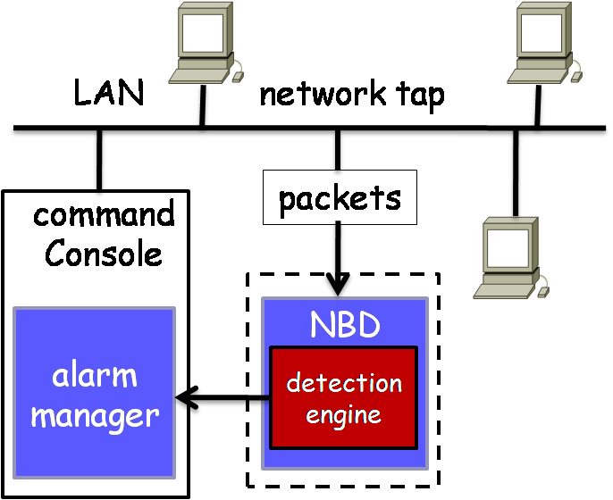
NBD Architecture
Network-Based Detections
At a selected point of network
Need a network tap

Slide 21
NBD Pros and Cons
Advantages:
Low cost
No interference
Intrusion resistant
Disadvantages:
May not be able to analyze encrypted packets.
Hard to handle large volume of traffics in time.
Some intrusion activities are hard to identify.
Hard to determine whether the intrusion has been successfully carried out.

Slide 22
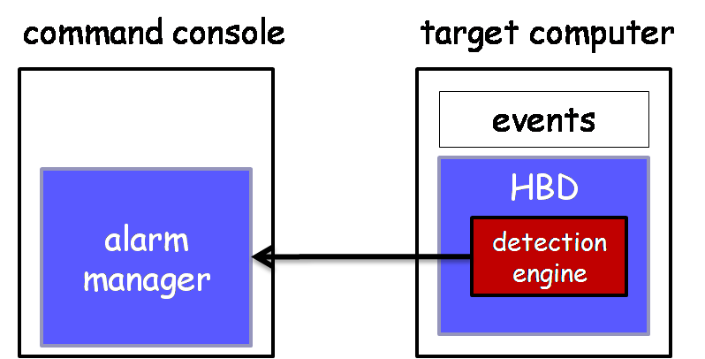
Host-Based Detections (HBD) Inside a target computer
HBD analyzes system events and user behaviors and alert the alarm manager
Check an event log to identify suspicious behavior
Check system logs, keep record of system files
Check system configurations
Keep a copy of the event log in case an intruder modifies it.

Slide 23
HBD Pros and Cons
Advantages:
Can detect data encrypted during transmissions
Detect intrusions that cannot be detected by NBD
Do not need special hardware devices
Check system logs, more accurate
Disadvantages:
Require extra system managing
Needs extra computing resources
May be affected if host computers or servers affected
Cannot be installed in routers or switches

Slide 24
Comparison of Host IDS and Network IDS
Cons | Pros | IDS Types
Operating system/platform dependent. Not available for all operating systems. Impact on the available resources of the host system. Expensive to deploy one agent per host. | Verification of success or failure of an attack possible. Has a good knowledge of the host's context and, as a result, is more focused on a specific system. Not limited by bandwidth restrictions or data encryption. | Host IDS
Deployment is very challenging in switched environment. Network traffic may overload the NIDS (CPU intensive). Not effective for single packet attacks, and hidden attacks in encrypted packets. | Protects all hosts on the monitored network. cost effective. Independent of the operating system and has no impact on the host (runs invisibly). Especially useful for low-level attacks (network probes and DoS attacks). | Network IDS

Slide 25
Sample IDS Placement
IDS #1
INTERNAL
NETWORK
INTERNET
FIREWALL
IDS #3
IDS #2
IDS #4
IDS #1 – FW don’t produce enough info to effectively detect hits.
IDS #2 – detects attacks that penetrate the FW
IDS #3 – detects attacks attempted against the FW
IDS #4 – Insider attacks will be detected

Slide 26
Attacks Against the NIDS
Blind (overload) the IDS with high traffic rates.
Blind the event storage. Use decoy (trap) scans to fill up log space.
DOS
Packet Fragmentation
Slow Scan
Coordinated low-bandwidth attacks
Address spoofing
Pattern Change

