Slide 1
Structures

Slide 2
Structure (struct) Definition
46
A Structure is a container, it can hold a bunch of things.
These things can be of any type.
Structures are used to organize related data (variables) into a nice package.

Slide 3
Structures
Examples:
Student record: student id, name, major, gender, start year, …
Bank account: account number, name, currency, balance, …
Address book: name, address, telephone number, …
In database applications, structures are called records.

Slide 4
Structures
Individual components of a struct type are called members (or fields).
Members can be of different types (simple, array or struct).
A struct is named as a whole while individual members are named using field identifiers.
Complex data structures can be formed by defining arrays of structs.

Slide 5
Declaring Structures (struct)
struct my_example
{
int label;
char letter;
char name[20];
} ;
/* The name "my_example" is structure name */
Notes:
Instructor:
A structure can be defined in two ways. The first method gives the compiler the layout or structure of the struct, but does not actually create one for use. This is useful when the programmer wishes to create global definitions for structs that he or she wishes to use later. The second method varies only in that a variable name now exists after the closing brace of the structure. This variable is now a struct which contains all the variables within the struct definition. Accessing the data in this variable will be discussed in a few slides.

Slide 6
Declaring Structures (struct)
Definition of a structure:
struct <struct-type>{
<type> <identifier_list>;
<type> <identifier_list>;
...
} ;
Example:
struct Date {
int day;
int month;
int year;
} ;
Each identifier defines a member of the structure.
The “Date” structure
has 3 members,
day, month & year.

Slide 7
struct examples
Example:
struct StudentInfo{
int Id;
int age;
char Gender;
double CGA;
};
Example:
struct StudentGrade{
char Name[15];
char Course[9];
int Lab[5];
int Homework[3];
int Exam[2];
};
The “StudentInfo” structure has 4 members
of different types.
The “StudentGrade” structure has 5 members of
different array types.

Slide 8
Structure Members
Each thing in a structure is called member.
Each member has a name, a type and a value.
Names follow the rules for variable names.
Types can be any defined type.
8

Slide 9
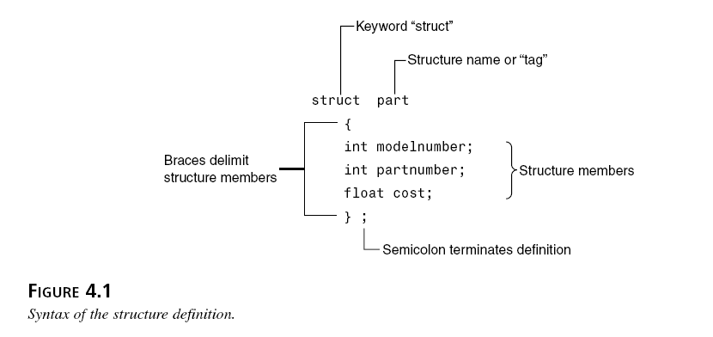
Structure Details

Slide 10
Exercise
Write a structure specification that includes three variables—all of type int—called stid, age, and mark. Call this structure student.

Slide 11
Making a structure variable
By defining a structure, you create a new data type.
Once a structure is defined, you can create variables of the new type.
StudentRecord stu;
Part part1;
11

Slide 12
More about struct
Declaration of a variable of struct type:
<struct-type> <identifier_list>;
Example:
StudentRecord Student1, Student2;
Student1 and Student2 are variables of StudentRecord type.
Name
Id Gender
Dept
Name
Id Gender
Dept
Student1
Student2

Slide 13

Accessing Structure Members
Structure (e.g. part )
part part1
part part2
part part3
part1
part2
part3
part1.modelnumber=2001
part1.partnumber = 11
part1.cost = 100
part2.modelnumber=2005
part2.partnumber = 55
part2.cost = 200
Part3.modelnumber=2007
Part3.partnumber = 60
Part3.cost = 400

Slide 14
Accessing Members
Structure (e.g. part )
part part1
part1.modelnumber
part1.partnumber
part1.cost
part1
Store values in structure
elements
Input from users
Output
part1.modelnumber = 2001
part1.partnumber = 11
part1.cost = 100
cin>>part1.modelnumber;
cin>>part1.partnumber;
cin>>part1.cost;
cout<<part1.modelnumber;
cout<<part1.partnumber;
cout<<part1.cost;

Slide 15
Array in Structure
struct StudentRecord {
char name; // student name
double hw[3]; // homework grades
double test[2]; // test grades
double ave; // final average
};
StudentRecord
name
hw[0] | hw[1] |  | hw[2]
test[0] |  | test[1]
ave

Slide 16
Exercise
Declare a variable studentlist from StudentRecord
Enter name, homework marks, test marks, and ave into the variable
StudentRecord
name
hw[0] | hw[1] |  | hw[2]
test[0] |  | test[1]
ave

Slide 17
Arrays of structures
An ordinary array: One type of data
An array of structs: Multiple types of data in each array element.
0 1 2 … 98 99
0 1 2 … 98 99

Slide 18
Declare Array of Struct
struct StudentRecord {
char name; // student name
double hw[3]; // homework grades
double test[2]; // test grades
double ave; // final average
};
StudentRecord
name
hw[0] | hw[1] |  | hw[2]
test[0] |  | test[1]
ave
StudentList StudentRecord[10];
StudentRecord
name
hw[0] | hw[1] |  | hw[2]
test[0] |  | test[1]
ave
StudentRecord
name
hw[0] | hw[1] |  | hw[2]
test[0] |  | test[1]
ave
StudentRecord
name
hw[0] | hw[1] |  | hw[2]
test[0] |  | test[1]
ave
StudentRecord
name
hw[0] | hw[1] |  | hw[2]
test[0] |  | test[1]
ave
StudentRecord
name
hw[0] | hw[1] |  | hw[2]
test[0] |  | test[1]
ave

Slide 19
Array of Struct
StudentList StudentRecord[10];
StudentRecord
name
hw[0] | hw[1] |  | hw[2]
test[0] |  | test[1]
ave
StudentRecord
name
hw[0] | hw[1] |  | hw[2]
test[0] |  | test[1]
ave
StudentRecord
name
hw[0] | hw[1] |  | hw[2]
test[0] |  | test[1]
ave
StudentRecord
name
hw[0] | hw[1] |  | hw[2]
test[0] |  | test[1]
ave
StudentRecord
name
hw[0] | hw[1] |  | hw[2]
test[0] |  | test[1]
ave
Enter values to the second student

Slide 20
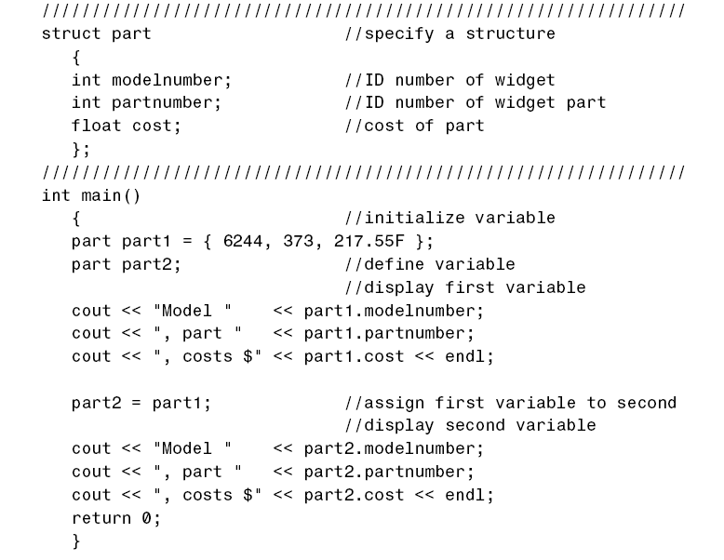
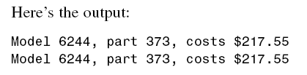
Copy values of a Structure to Another

Slide 21
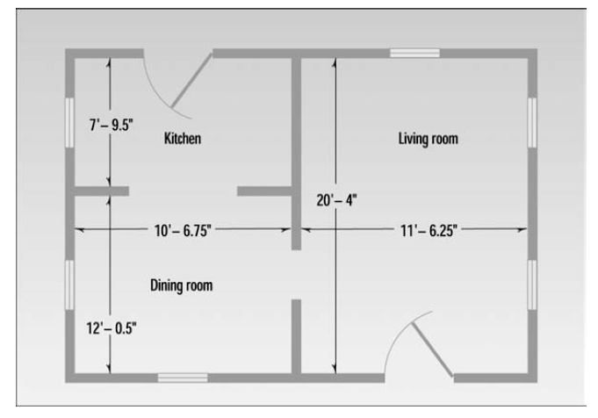
Nested Structure

Slide 22
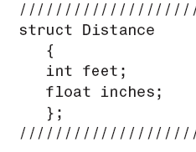
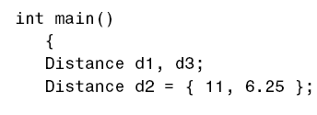
A Drawing Example
Distance d1={10, 6.75}
d3.feet=d2.feet+d1.feet;
}

Slide 23
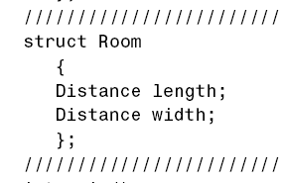

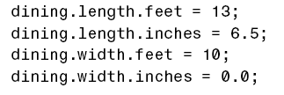
A Drawing Example
}

Slide 24
Exercise
A phone number, such as (212) 767-8900, can be thought of as having three parts: the area code (212), the exchange (767), and the number (8900). Write a program that uses a structure to store these three parts of a phone number separately. Call the structure phone.
Create two structure variables of type phone. Initialize one, and have the user input a number for the other one. Then display both numbers.
The interchange might look like this:
Enter area code:
Enter exchange,
Enter number: 415 555 1212
Then display like below:
My number is (212) 767-8900
Your number is (415) 555-1212

Slide 25
Continue
Modify the program so that the program asks names of 10 persons and also phone numbers. Use the phone structure in the previous exercise and create another structure that includes names of persons and phone structure.

