Slide 1

C++ Programming: From Problem Analysis to Program Design, Fifth Edition
Chapter 10: Functions &
Applications of Arrays

Slide 2
Download textbook
Read through
Try examples using Dev C++
Try End of chapter problems
Do that in groups

Slide 3
A quick review on Arrays

Slide 4

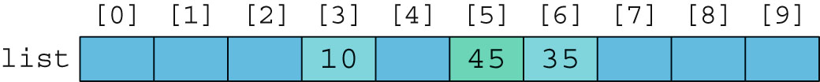
Accessing Array Components (cont’d.)

Slide 5
Processing One-Dimensional Arrays (cont’d.)
Given the declaration:
int list[100]; //array of size 100
int i;
Use a for loop to access array elements:
for (i = 0; i < 100; i++) //Line 1
cin >> list[i]; //Line 2

Slide 6
Partial Initialization of Arrays During Declaration
The statement:
int list[10] = {0};
Declares an array of 10 components and initializes all of them to zero
The statement:
int list[10] = {8, 5, 12};
Declares an array of 10 components and initializes list[0] to 8, list[1] to 5, list[2] to 12
All other components are initialized to 0

Slide 7

Some Restrictions on Array Processing
Aggregate operation: any operation that manipulates the entire array as a single unit
Not allowed on arrays in C++
Example:
Solution:

Slide 8

Two- and Multidimensional Arrays
Two-dimensional array: collection of a fixed number of components (of the same type) arranged in two dimensions
Sometimes called matrices or tables
Declaration syntax:
intExp1 and intExp2 are expressions with positive integer values specifying the number of rows and columns in the array

Slide 9

Accessing Array Components
Accessing components in a two-dimensional array:
Where indexExp1 and indexExp2 are expressions with positive integer values, and specify the row and column position
Example:
sales[5][3] = 25.75;

Slide 10
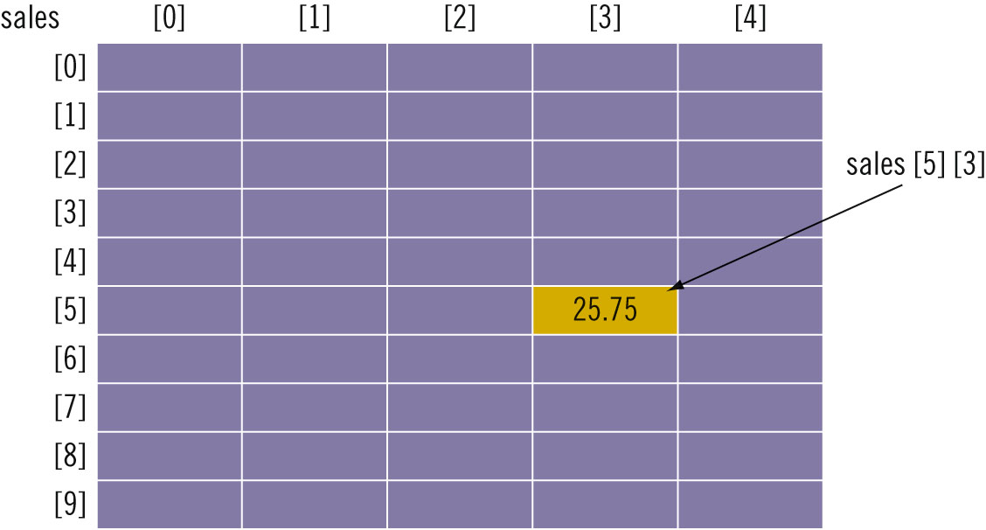
Accessing Array Components (cont’d.)

Slide 11
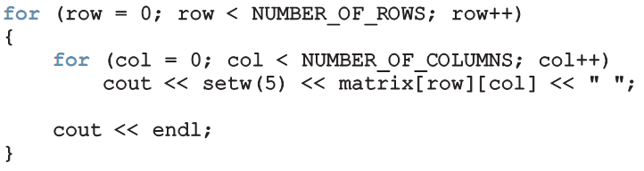
Print
Use a nested loop to output the components of a two dimensional array:

Slide 12
Arrays & Functions

Slide 13
Arrays as Parameters to Functions
Arrays are passed by reference only
The symbol & is not used when declaring an array as a formal parameter
The size of the array is usually omitted
If provided, it is ignored by the compiler
C++ does not allow functions to return a value of the type array

Slide 14
Constant Arrays as Formal Parameters
Recall that when a formal parameter is a reference parameter, then whenever the formal parameter changes, the actual parameter changes as well. However, even though an array is always passed by reference, you can still prevent the function from changing the actual parameter. You do so by using the reserved word const in the declaration of the formal parameter.

Slide 15
Constant Arrays as Formal Parameters

Slide 16
Base Address of an Array and Array in Computer Memory
The base address of an array is the address, or memory location of the first array component
If list is a one-dimensional array, its base address is the address of list[0]
When we pass an array as a parameter, the base address of the actual array is passed to the formal parameter

Slide 17
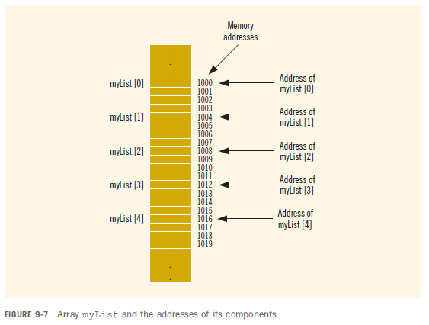
Base Address of an Array and Array in Computer Memory (cont’d.)

Slide 18
Example on Functions Using Arrays
Not in text!
Write a program that reads an array of 5 integers, print back the array, find their average, and display it back to the user using the following functions:
readArray, printArray, average

Slide 19
#include <iostream>
using namespace std;
void readArray(int theArray[ ], int sizeOfarray);
void printArray(int theArray[ ], int sizeOfarray);
double average(int numbers[ ], int size);
const int N=5;
int main()
{
int array[N];
readArray(array,N);
printArray(array, N);
cout << "\n\n The average is: " << average(array, N) << endl;
return 0;
}

Slide 20
void readArray(int theArray[], int sizeOfarray)
{
for (int i = 0; i < sizeOfarray; i++)
{
cout<<"\n Enter element no. "<<i<<" : ";
cin >> theArray[i];
}
}
void printArray(int theArray[], int sizeOfarray)
{
cout<<"\n The Array you entered is: "<<endl<<endl;
for (int i = 0; i < sizeOfarray; i++)
{
cout <<" "<<theArray[i]<<" ";
}
}

Slide 21
double average(int numbers[], int size)
{
double sum = 0.0;
double arrayAverage;
for (int i = 0; i < size; i++)
sum = sum + numbers[i];
arrayAverage = sum / size;
return arrayAverage;
}

Slide 22
Sequential Search
Sequential search or linear search
Searching a list for a given item
Starting from the first array element
Compare searchItem with the elements in the array
Continue the search until either you find the item or no more data is left in the list to compare with searchItem

Slide 23
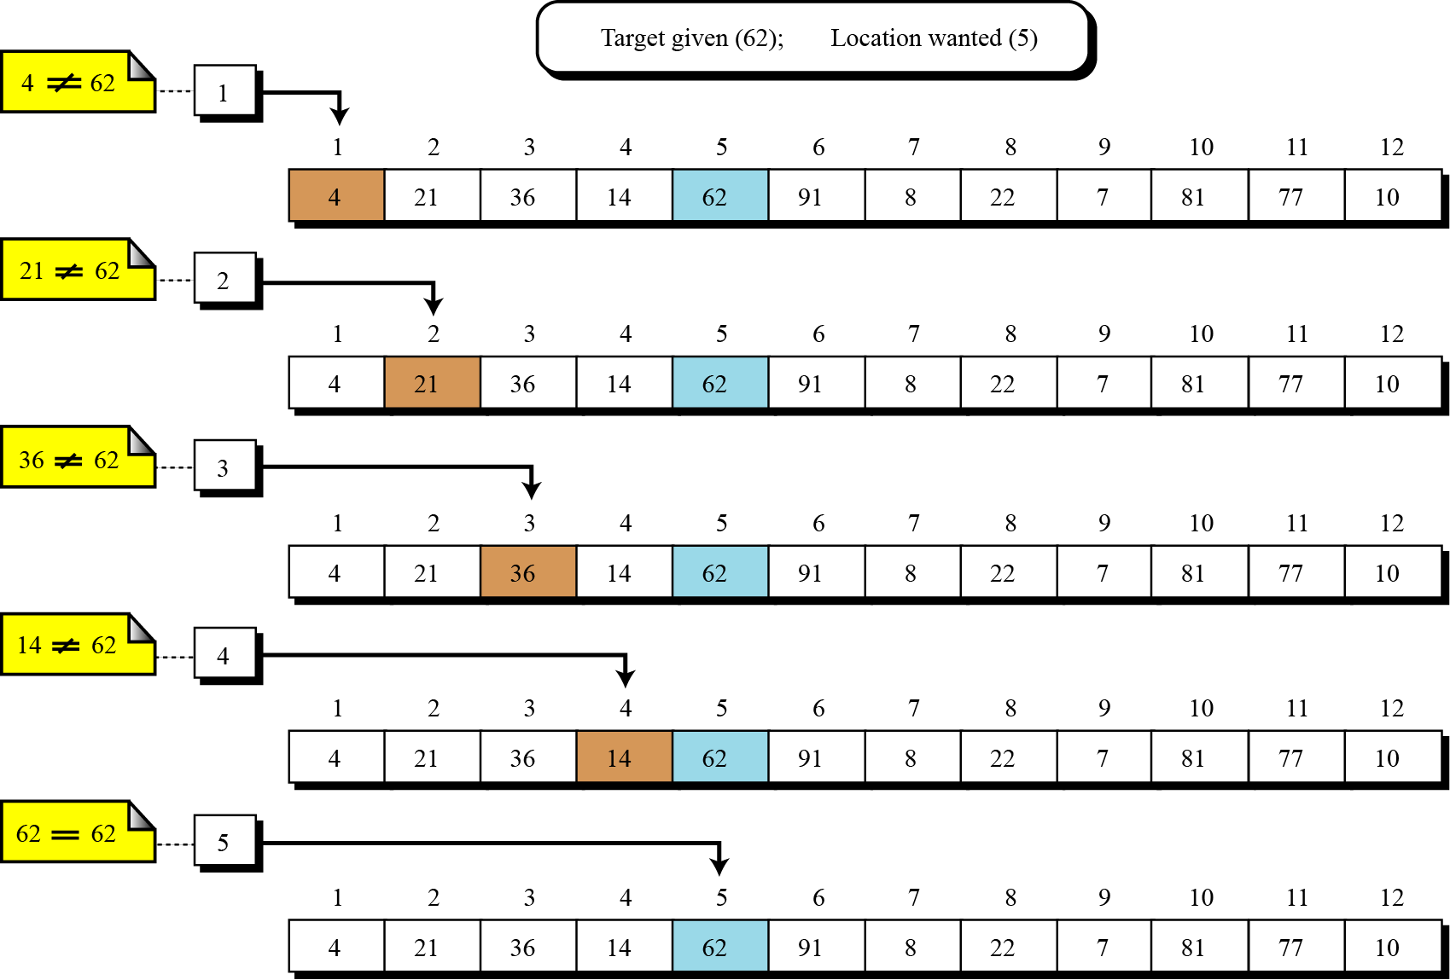

Slide 24
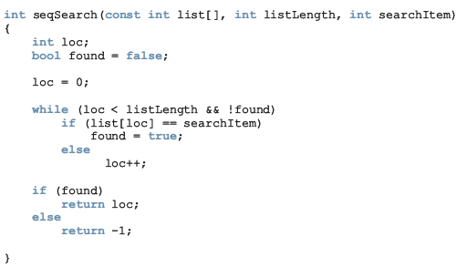
Sequential Search Function Ex 9-8 P509 in Text

Slide 25
Sequential Search (cont'd.) The Full Program
// This program illustrates how to use a sequential search in a
// program.
#include <iostream>
using namespace std;
const int ARRAY_SIZE = 5;
int seqSearch(const int list[], int listLength, int searchItem);
int main()
{
int intList[ARRAY_SIZE];
int number;
cout << " Enter " << ARRAY_SIZE<< " integers." << endl;
for (int index = 0; index < ARRAY_SIZE; index++)
cin >> intList[index];
cout << endl;
cout << " Enter the number to be "<< "searched: ";
cin >> number;
cout << endl;

Slide 26
Sequential Search (cont'd.) The Full Program
int pos = seqSearch(intList, ARRAY_SIZE, number);
if (pos!= -1)
cout <<" " << number<< " is found at position " << pos<< endl;
else
cout << " " << number<< " is not in the list." << endl;
return 0;
}
int seqSearch(const int list[], int listLength, int searchItem)
{
int loc;
bool found = false;
loc = 0;
while (loc < listLength && !found)
if (list[loc] == searchItem)
found = true;
else
loc++;
if (found)
return loc;
else
return -1;
}

Slide 27
Sequential Search (cont'd.)
List with 1000 elements
Search item is the second item
Sequential search makes two key comparisons
Search item is the 900th item
Sequential search makes 900 key comparisons
Search item is not in the list
Sequential search makes 1000 key comparisons

Slide 28
Sequential Search (cont'd.)
Sequential search
Not very efficient for large lists
On average, number of key comparisons equal to half the size of the list
Does not assume that the list is sorted

Slide 29
Binary Search
A sequential search is not very efficient for large lists. It typically searches about half of the list. However, if the list is sorted, you can use another search algorithm called binary search.
A binary search is much faster than a sequential search. In order to apply a binary search, the list must be sorted.
One of the sort techniques used is Bubble sort

Slide 30
Binary Search
A binary search starts by testing the data in the element at the middle of the list. This determines whether the target is in the first half or the second half of the list.
If it is in the first half, there is no need to further check the second half.
If it is in the second half, there is no need to further check the first half. In other words, we eliminate half the list from further consideration.

Slide 31
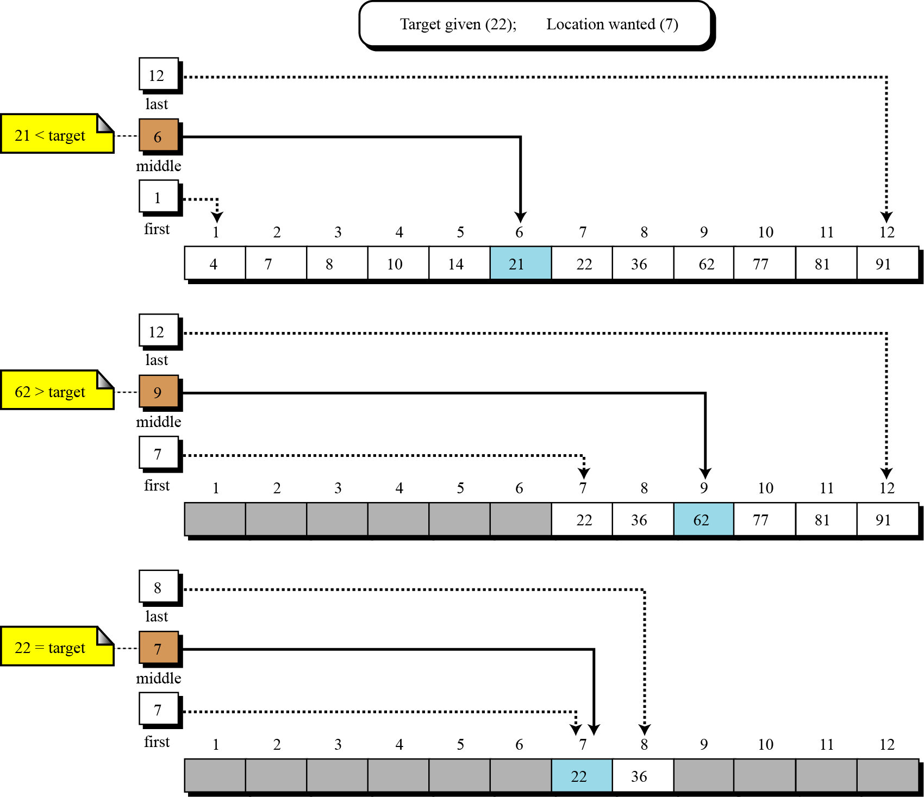

Slide 32
Binary Search Paper & Pencil
Task1:
Determine if 75 is in the following list:
39 | 19 | 8 | 4 | 25 | 34 | 45 | 66 | 48 | 95 | 89 | 75

Slide 33
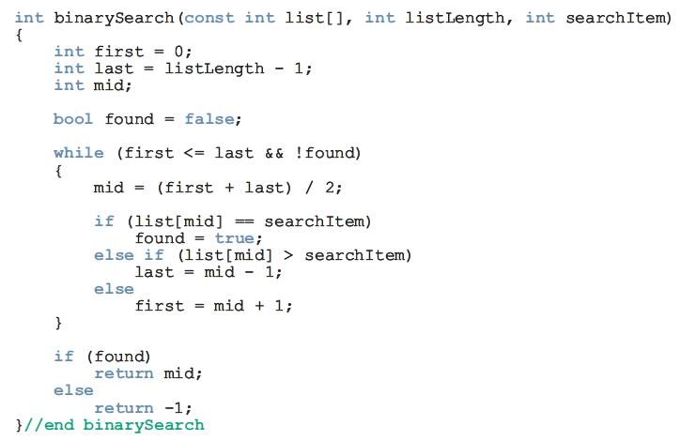
Binary Search Function
Group Work
Task2: Show the memory contents by tracing the values of the variables:
First, Mid & Last

Slide 34
Binary Search (cont'd.) The Full Program
// This program illustrates how to use binary search in a program.
#include <iostream>
using namespace std;
const int ARRAY_SIZE = 5;
int binarySearch(const int list[], int listLength, int searchItem);
int main()
{
int intList[ARRAY_SIZE];
int number;
cout << " Enter " << ARRAY_SIZE<< " integers." << endl;
for (int index = 0; index < ARRAY_SIZE; index++)
cin >> intList[index];
cout << endl;
cout << " Enter the number to be "<< "searched: ";
cin >> number;
cout << endl;
int pos;
pos = binarySearch(intList, ARRAY_SIZE, number);
if (pos!= -1)
cout <<" " << number<< " is found at position " << pos<< endl;
else
cout << " " << number<< " is not in the list." << endl;
return 0;
}

Slide 35
Binary Search (cont'd.) The Full Program
int binarySearch(const int list[], int listLength, int searchItem)
{
int first = 0;
int last = listLength - 1; int mid;
bool found = false;
while (first <= last && !found)
{
mid = (first + last) / 2;
if (list[mid] == searchItem)
found = true;
else if (list[mid] > searchItem)
last = mid - 1;
else
first = mid + 1;
}
if (found)
return mid;
else
return -1;
}//end binarySearch

Slide 36
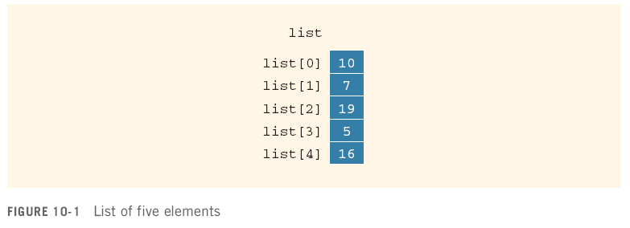
Bubble Sort
list[0]...list[n - 1]
List of n elements, indexed 0 to n - 1

Slide 37
Bubble Sort (cont'd.)
Series of n - 1 iterations
Successive elements list[index] and list[index + 1] of list are compared
If list[index] > list[index + 1]
Elements list[index] and list[index + 1] are swapped
Smaller elements move toward the top
Larger elements move toward the bottom

Slide 38
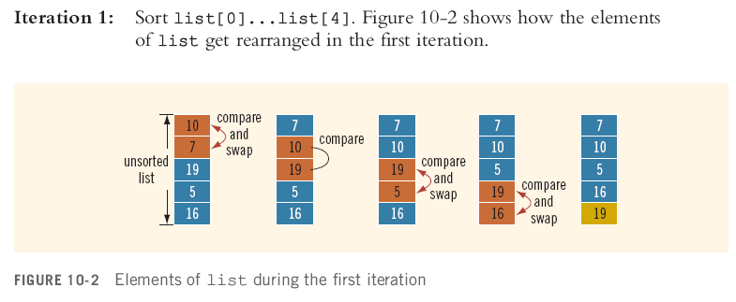
Bubble Sort (cont'd.)
Example: Sort the following list using Bubble Sort
unnecessary
comparison

Slide 39
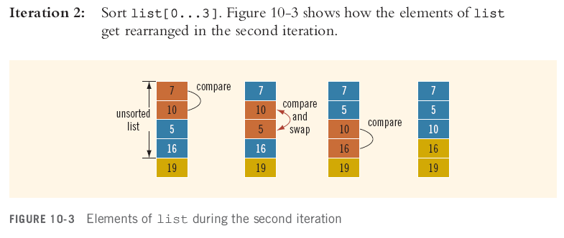
Bubble Sort (cont'd.)
unnecessary
comparisons

Slide 40
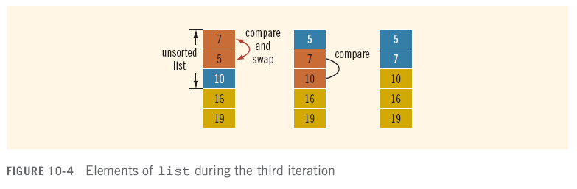
Bubble Sort (cont'd.)
unnecessary
comparisons

Slide 41
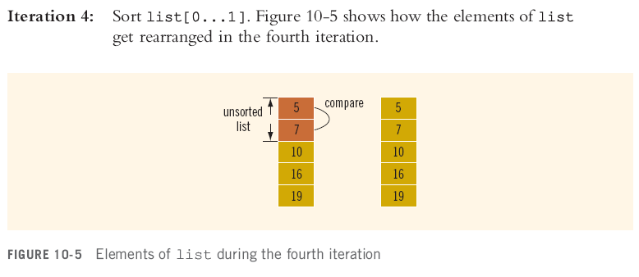
Bubble Sort (cont'd.)
End of Solution

Slide 42
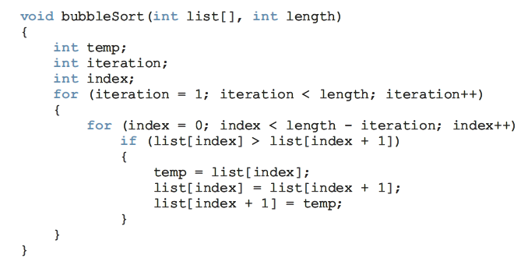
Bubble Sort Function

Slide 43
Bubble Sort (cont'd.)
Iterations=length-1

Slide 44
Bubble Sort (cont'd.)
Challenge: Show the memory contents by tracing the values of the variables
Save unnecessary comparisons

Slide 45
Bubble Sort (cont'd.) The Full Program
//Bubble sort
#include <iostream>
using namespace std;
void bubbleSort(int list[ ] , int length);
int main()
{
int list[] = {2, 56, 34, 25, 73, 46, 89, 10, 5, 16};
int i;
bubbleSort(list, 10);
cout << "After sorting, the list elements are:" << endl;
for(i=0;i<10;i++)
cout << list[i] << " ";
cout << endl;
return 0;
}
void bubbleSort(int list[], int length)
{
int temp;
int iteration;
int index;
for (iteration = 1; iteration < length; iteration++)
{
for (index = 0; index < length - iteration; index++)
if (list[index] > list[index + 1])
{
temp = list[index];
list[index] = list[index + 1];
list[index + 1] = temp;
}
}
}

