Slide 1
Linked List

Slide 2
Outline
Introduction
Insertion Description
Deletion Description
Basic Node Implementation
Conclusion

Slide 3
Introduction
Definitions
Lists and arrays
Nodes and pointers
Single Linked Lists
Double Linked Lists
Circular Lists
Advantages

Slide 4

Lists and arrays
Lists:

Slide 5
Lists and arrays
Arrays:
{Size of the following array is = 4}
Index | 0 | 1 | 2 | 3
Value | 44 | 5 | 96 | 3

Slide 6
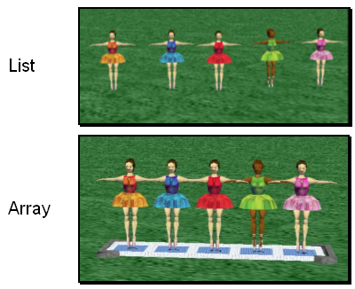
List vs Arrays
Two built-in data structures that can be used to organize data, or to create other data structures:
Lists
Arrays
Notes:
The Redo button will reverse the last use of the Undo button, restoring the previous action.
The Ctrl-Y keyboard shortcut also can be used in place of the Redo button.

Slide 7
Lists
A list is an ordered set of data. It is often used to store objects that are to be processed sequentially.
Notes:
The Redo button will reverse the last use of the Undo button, restoring the previous action.
The Ctrl-Y keyboard shortcut also can be used in place of the Redo button.

Slide 8
Arrays
An array is an indexed set of variables, such as dancer[1], dancer[2], dancer[3],… It is like a set of boxes that hold things.
A list is a set of items.
An array is a set of variables that each store an item.
Notes:
The Redo button will reverse the last use of the Undo button, restoring the previous action.
The Ctrl-Y keyboard shortcut also can be used in place of the Redo button.

Slide 9
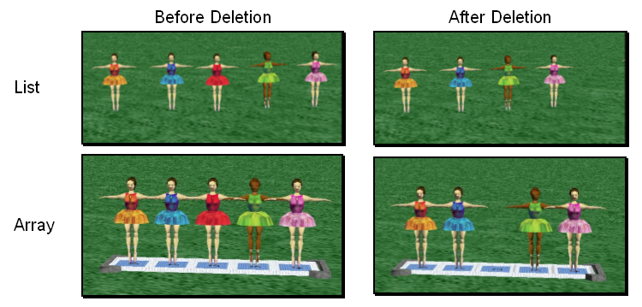
Arrays and Lists
You can see the difference between arrays and lists when you delete items.
Notes:
The Redo button will reverse the last use of the Undo button, restoring the previous action.
The Ctrl-Y keyboard shortcut also can be used in place of the Redo button.

Slide 10
Arrays and Lists
In a list, the missing spot is filled in when something is deleted.
Notes:
The Redo button will reverse the last use of the Undo button, restoring the previous action.
The Ctrl-Y keyboard shortcut also can be used in place of the Redo button.

Slide 11
Arrays and Lists
In an array, an empty variable is left behind when something is deleted.
Notes:
The Redo button will reverse the last use of the Undo button, restoring the previous action.
The Ctrl-Y keyboard shortcut also can be used in place of the Redo button.

Slide 12
What’s wrong with Array and Why lists?
Disadvantages of arrays as storage data structures:
slow searching in unordered array
slow insertion in ordered array
Fixed size
Linked lists solve some of these problems
Linked lists are general purpose storage data structures and are versatile.

Slide 13

Nodes and pointers

Slide 14
Linked Lists
A
B
C
∅
Head
A linked list is a series of connected nodes
Each node contains at least
A piece of data (any type)
Pointer to the next node in the list
Head: pointer to the first node
The last node points to NULL
node
A
data
pointer

Slide 15
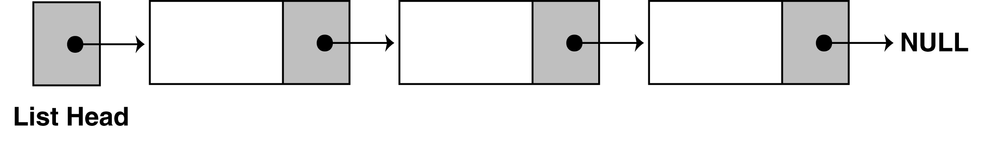
The composition of a Linked List
A linked list is called "linked" because each node in the series has a pointer that links to the next node in the list.

Slide 16
Linked Lists
Each data item is embedded in a node.
Each node object contains a reference to the next node in the list of items.
In an array items have a particular position, identified by its index.
In a list the only way to access an item is to traverse the list

Slide 17
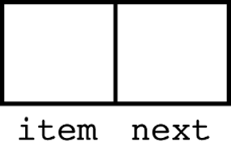
Declarations to create a node
First you must declare a data structure that will be used for the nodes. For example, the following struct could be used to create a list where each node holds a data:
struct Node
{
int item;
Node *next;
};
item

Slide 18
Self Referential Structure
Self Referential Structure is a structure which contains a pointer to a structure of the same type.
An example, the structure Node
contains a pointer (*next) to the structure
Node Only. That is called a self-referential structure
We will use a Self-Referential Structure
for creating a node of the single linked list.
A node can have multiple data but ONLY
one pointer.
A pointer that points to a struct node.
struct Node
{
int a;
char b;
Node *next;
};

Slide 19
Declarations
The next step is to declare a pointer to serve as the list head, as shown below.
Node *head;
head
item
Once you have declared a node data structure and have created a NULL head pointer, you have an empty linked list.
The next step is to implement operations with the list.

Slide 20
Operations in a simple linked list:
Create node
Add or Append a node in the list
Insert a node in the list
Delete a node from the list
Iterate through the list to display items.

Slide 21
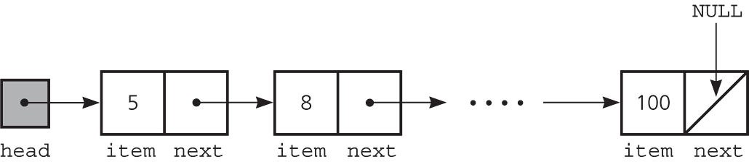
Creating a Node for the List
The pseudocode is shown below. The C++ code follows.
Create a node variable from the node structure.
Allocate memory for the node Store data in the new node.
struct Node
{
int data;
Node *next;
};
newNode
5
data
next
Node * newNode;
newNode = new Node();
newNode→data = 5;
newNode→next = null;
head =newNode;

Slide 22
General: Adding or Appending a Node to the List
To append a node to a linked list means to add the node to the end of the list.
The pseudocode is shown below. The C++ code follows.
Create a new node. Store data in the new node. If there are no nodes in the list Make the new node the first node (head). Else Traverse the List to Find the last node. Add the new node to the end of the list. End If.

Slide 23
Void appendNode(int value){ Node *newNode, *curr; // Allocate a new node & store data newNode = new Node(); newNode->data = value; newNode->next = NULL; // If there are no nodes in the list // make newNode the first node if (head==null)
head = newNode;
else // Otherwise, insert newNode at end { // Initialize curr to head of list curr = head; // Find the last node in the list while (curr->next!=null) curr = curr->next; // Insert newNode as the last node curr->next = newNode; }}
newNode
value
data
next

Slide 24
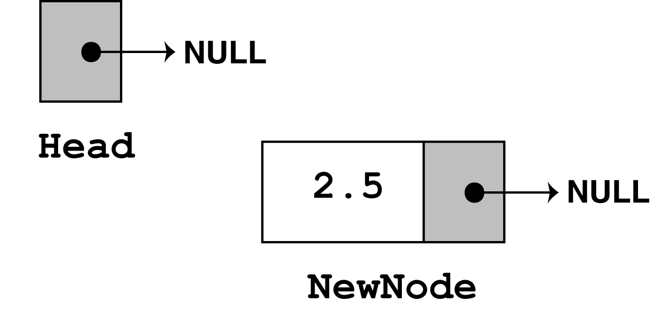
appendNode(double value)
appendNode(2.5)
head = new Node();
Head
newNode = new Node(); newNode->data = value; newNode->next = NULL;

Slide 25
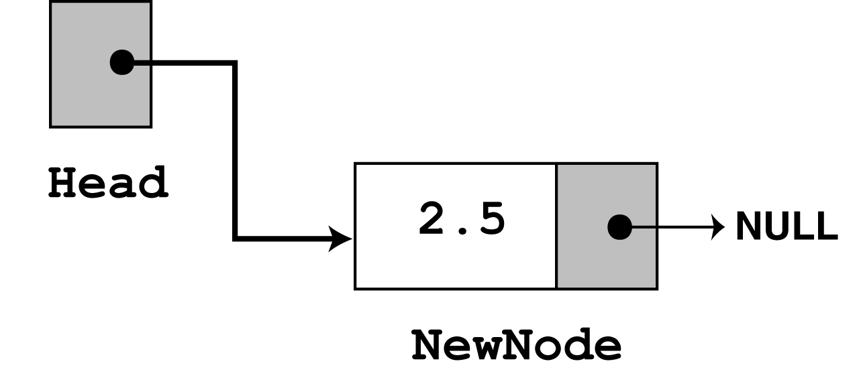
Making first node as head
The next statement to execute is the following if statement.
if (!head) head = newNode;
There are no more statements to execute

Slide 26
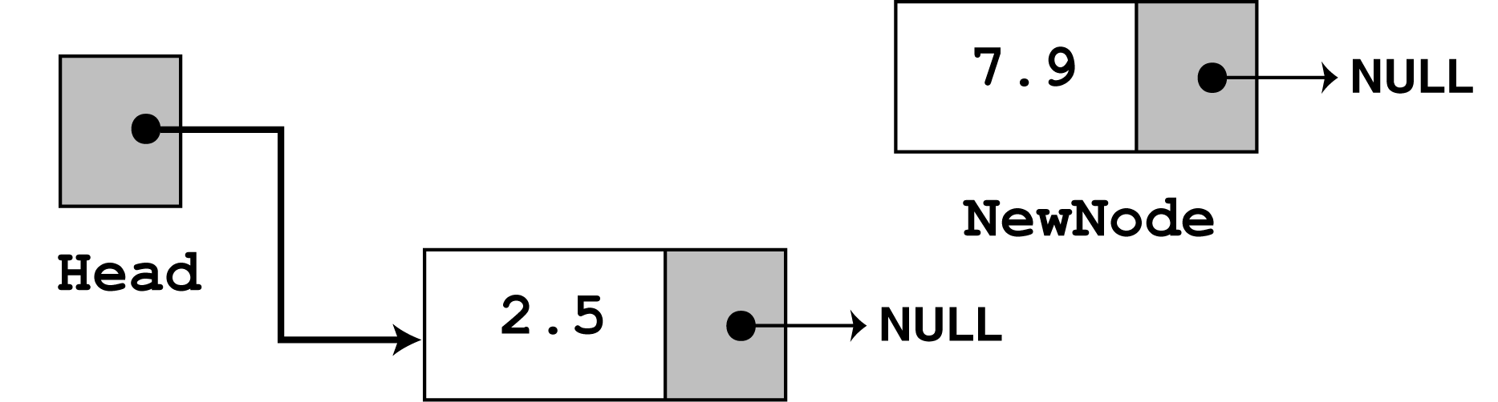
Append another node with the value 7.9. appendNode(7.9)
Once again, the first three statements in the function create a new node, store the argument in the node's data member, and assign its next pointer to NULL.
newNode = new Node; newNode->data = value; newNode->next = NULL;

Slide 27
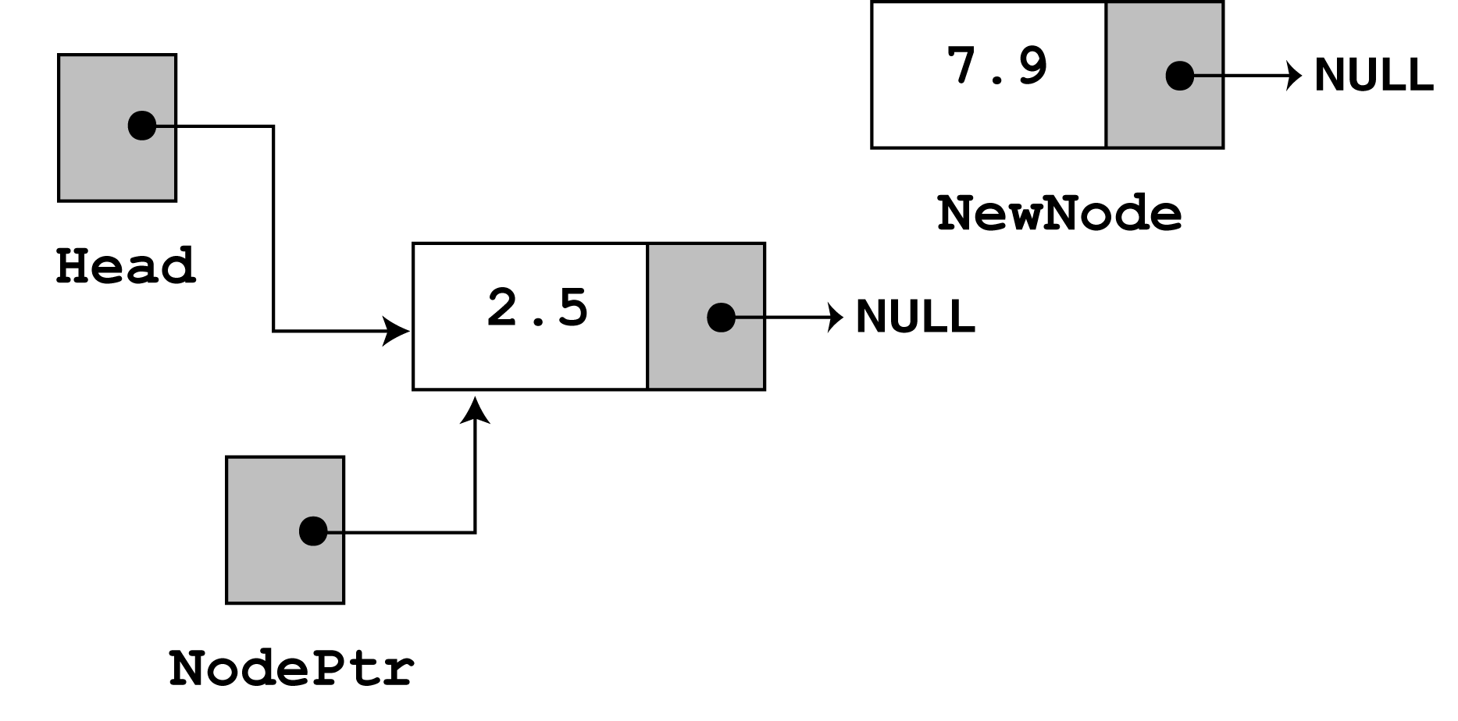
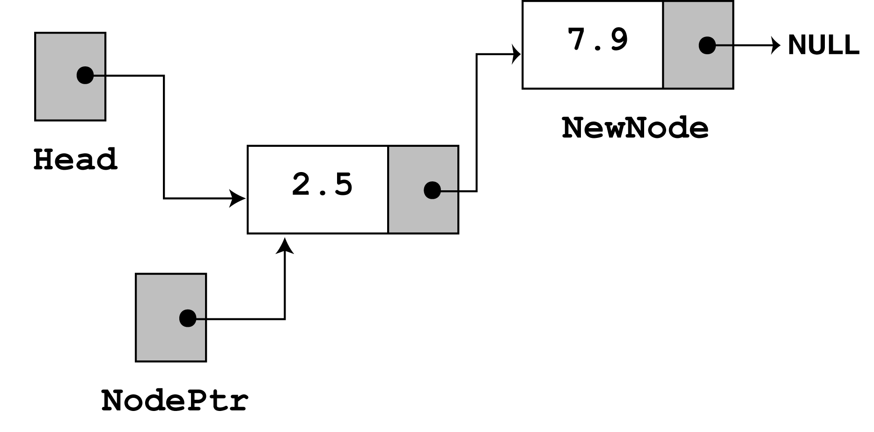
Since head no longer points to NULL, the else part of the if statement executes:
else // Otherwise, insert newNode at end { // Initialize nodePtr to head of list curr = head; // Find the last node in the list while (curr->next!=null) curr = curr->next; // Insert newNode as the last node curr->next = newNode; }
curr
curr

Slide 28
Since head no longer points to NULL, the else part of the if statement executes:
else // Otherwise, insert newNode at end { // Initialize nodePtr to head of list curr = head; // Find the last node in the list while (curr->next!=null) curr = curr->next; // Insert newNode as the last node curr->next = newNode; }
20
20
10
10
curr
curr

Slide 29
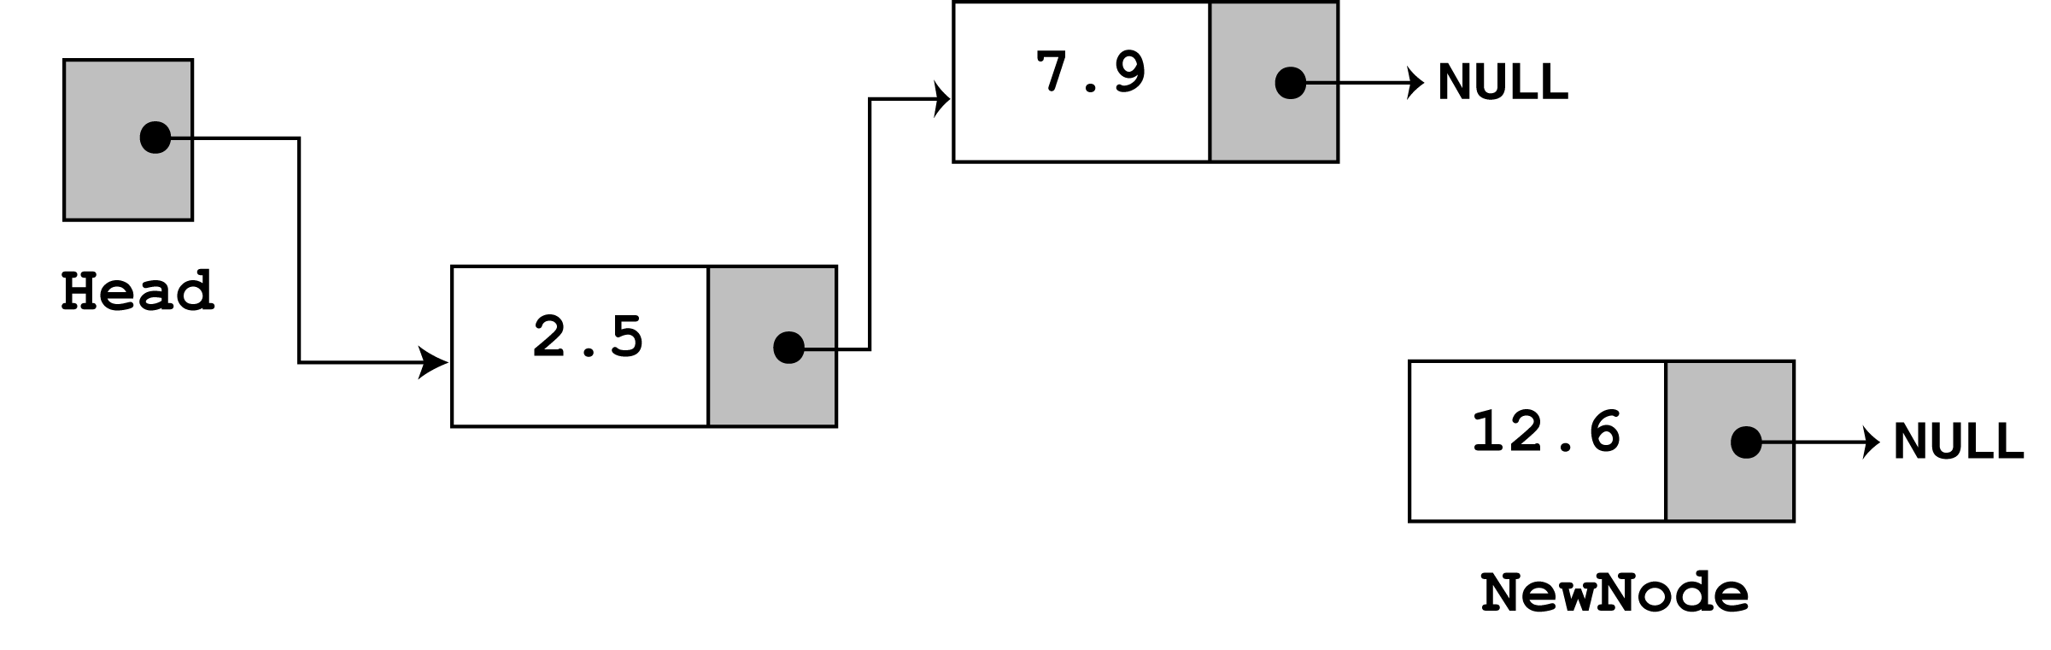
Append another node with the value 12.6. appendNode(12.6)
The third time appendNode is called, 12.6 is passed as the argument. Once again, the first three statements create a node with the argument stored in the value member.
newNode = new Node; newNode->data = value; newNode->next = NULL;

Slide 30
Since head no longer points to NULL, the else part of the if statement executes:
else // Otherwise, insert newNode at end { // Initialize nodePtr to head of list curr = head; // Find the last node in the list while (curr->next!=null) curr = curr->next; // Insert newNode as the last node curr->next = newNode; }
curr
curr

Slide 31
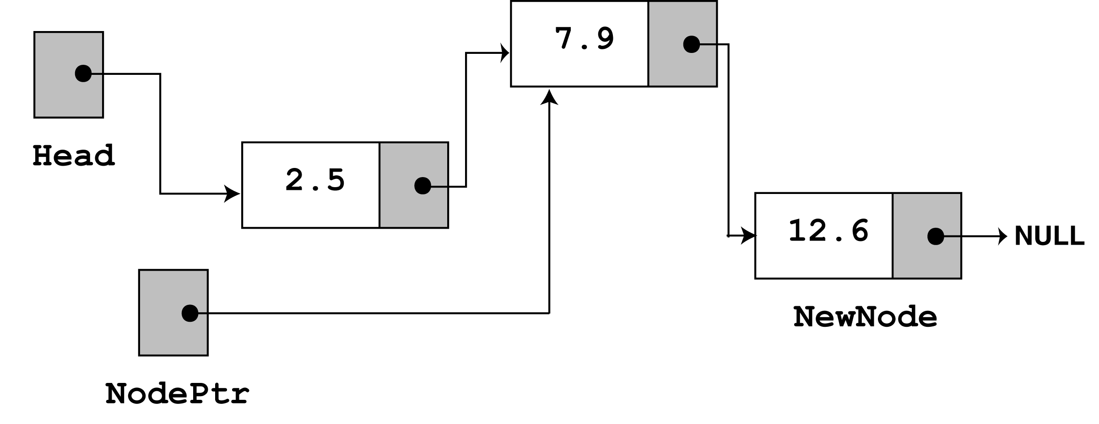
The while loop's conditional test will fail after the first iteration because curr->next now points to NULL. The last statement, curr->next = newNode; causes curr->next to point to the new node. This inserts newNode at the end of the list
curr
The figure above depicts the final state of the linked list.

Slide 32
Traversing or Displaying the List
The displayList member function traverses the list, displaying the value member of each node. The following pseudocode represents the algorithm. The C++ code for the member function follows on the next slide.
Assign List head to node curr While curr is not NULL Display the value member of the curr. Assign curr to its own next member. End While.

Slide 33
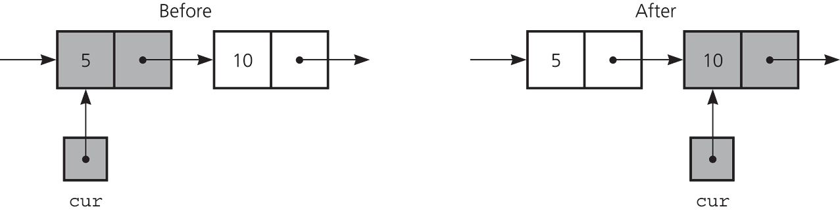
displayList(void)
Void displayList(void) { Node *curr; curr = head; while (curr!=NULL) { cout << curr->data << endl; curr = curr->next; } }

Slide 34
Insertion Description
Insertion at the top of the list
Insertion at the end of the list
Insertion in the middle of the list

Slide 35
Insertion at the top
Steps:
Create a Node
Set the node data Values
Connect the pointers

Slide 36


Insertion Description
head
48
17
142
//
Follow the previous steps and we get
Step 1
Step 2
Step 3
head
93

Slide 37
Insertion at the end
Steps:
Create a Node
Set the node data Values
Connect the pointers

Slide 38



Insertion Description
head
48
17
142
//
Follow the previous steps and we get
Step 1
Step 2
Step 3

Slide 39
Insertion in the middle
Steps:
Create a Node
Set the node data Values
Break pointer connection
Re-connect the pointers

Slide 40




Insertion Description
Step 1
Step 2
Step 3
Step 4

Slide 41
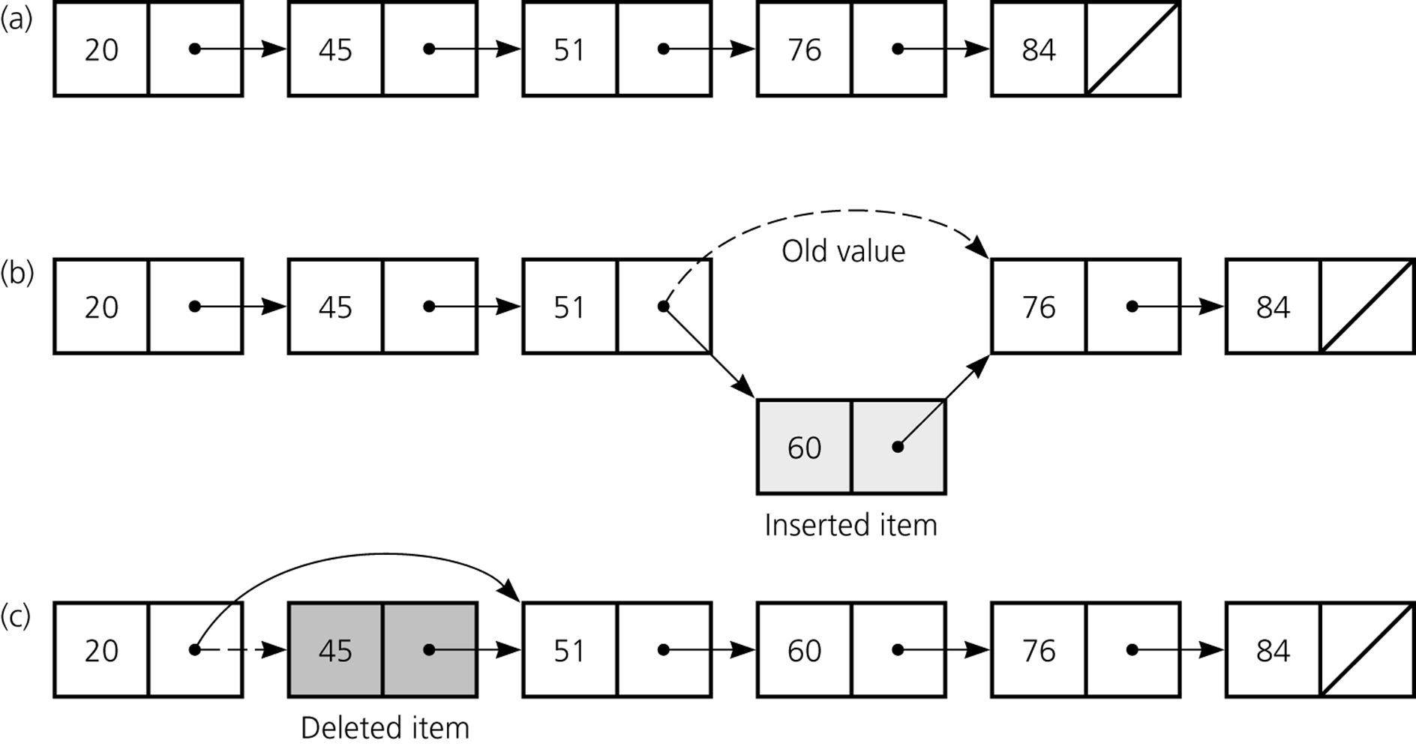
Insert
curr
prev
curr
a) A linked list of integers; b) insertion;

Slide 42
Create a new node. Store data in the new node. If there are no nodes in the list Make the new node the first node. Else Find the first node whose value is greater than or equal the new value, or the end of the list (whichever is first). Insert the new node before the found node, or at the end of the list if no node was found. End If.

Slide 43
The code for the traversal algorithm is shown below. (As before, num holds the value being inserted into the list.)
// Initialize curr to head of list curr = head; // Skip all nodes whose value member is less // than num. while (curr != NULL && curr->data < value) {
previous = curr;
curr = curr->next; }
The entire insertNode function begins on the next slide.

Slide 44
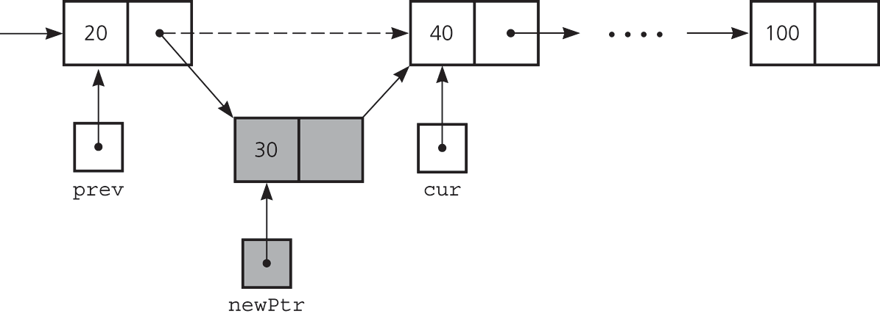
Inserting a Node into a Specified Position of a Linked List
To insert a node between two nodes
prev->next = newPtr;
newPtr->next = cur;
Inserting a new node into a linked list

Slide 45
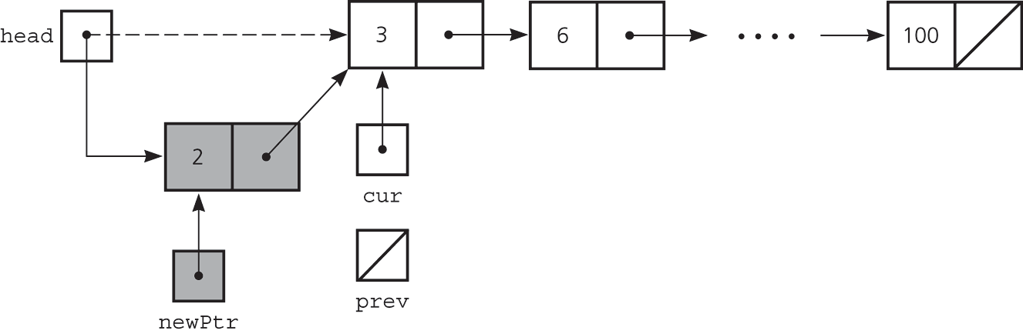
Inserting a Node into a Specified Position of a Linked List
To insert a node at the beginning of a linked list
head= newPtr;
newPtr-next=curr;
Inserting at the beginning of a linked list

Slide 46
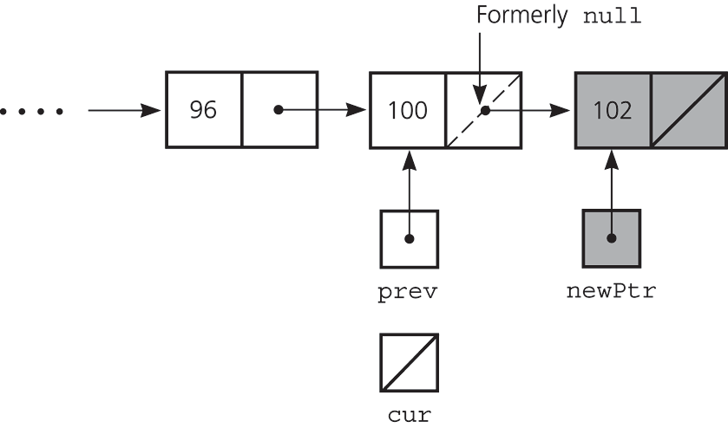
Inserting a Node into a Specified Position of a Linked List
Inserting at the end of a linked list is not a special case if cur is NULL
prev->next = newPtr;
newPtr->next = cur;
Inserting at the end of a linked list

Slide 47
Void insertNode(float value) {
Node *newNode, *curr, *previous; // Allocate a new node & store Num newNode = new Node(); newNode->data = value; // If there are no nodes in the list // make newNode the first node if (head==NULL) { head = newNode; newNode->next = NULL; } else// Otherwise, insert newNode. { curr = head; // Skip all nodes whose value member is less than value.
while (curr != NULL && curr->data < value) { previous = curr; curr = curr->next; }
// If the new mode is to be the 1st in the list, // insert it before all other nodes. if (previous == NULL)
{ head = newNode; newNode->next = curr; } else { previous->next = newNode; newNode->next = curr; } } }

Slide 48
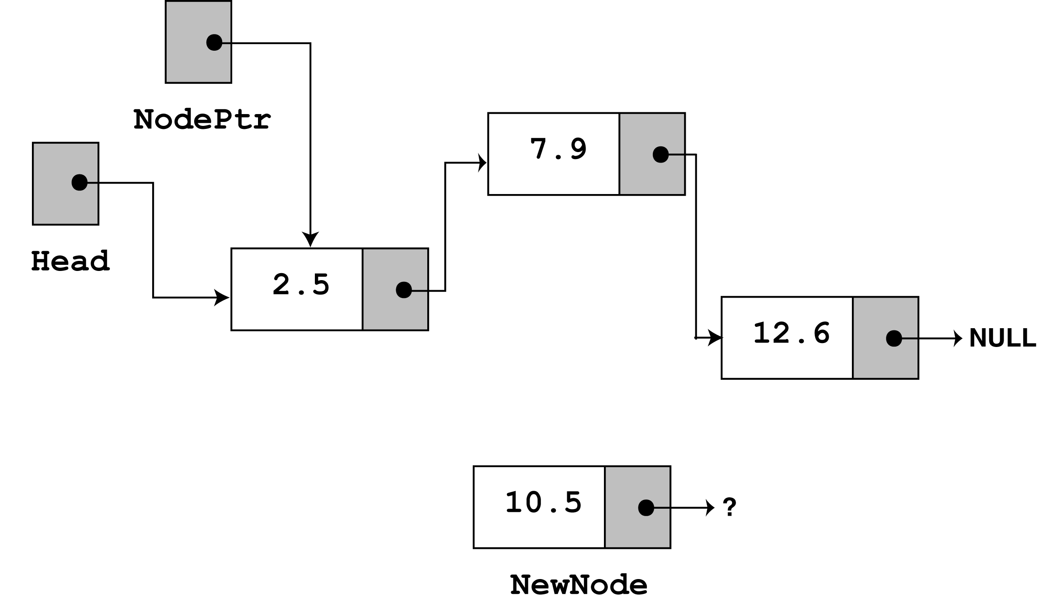
InsertNode with the value 10.5
curr
a new node is created and the function argument is copied to its data member. Since the list already has nodes stored in it, the else part of the if statement will execute. It begins by assigning nodePtr to head.

Slide 49
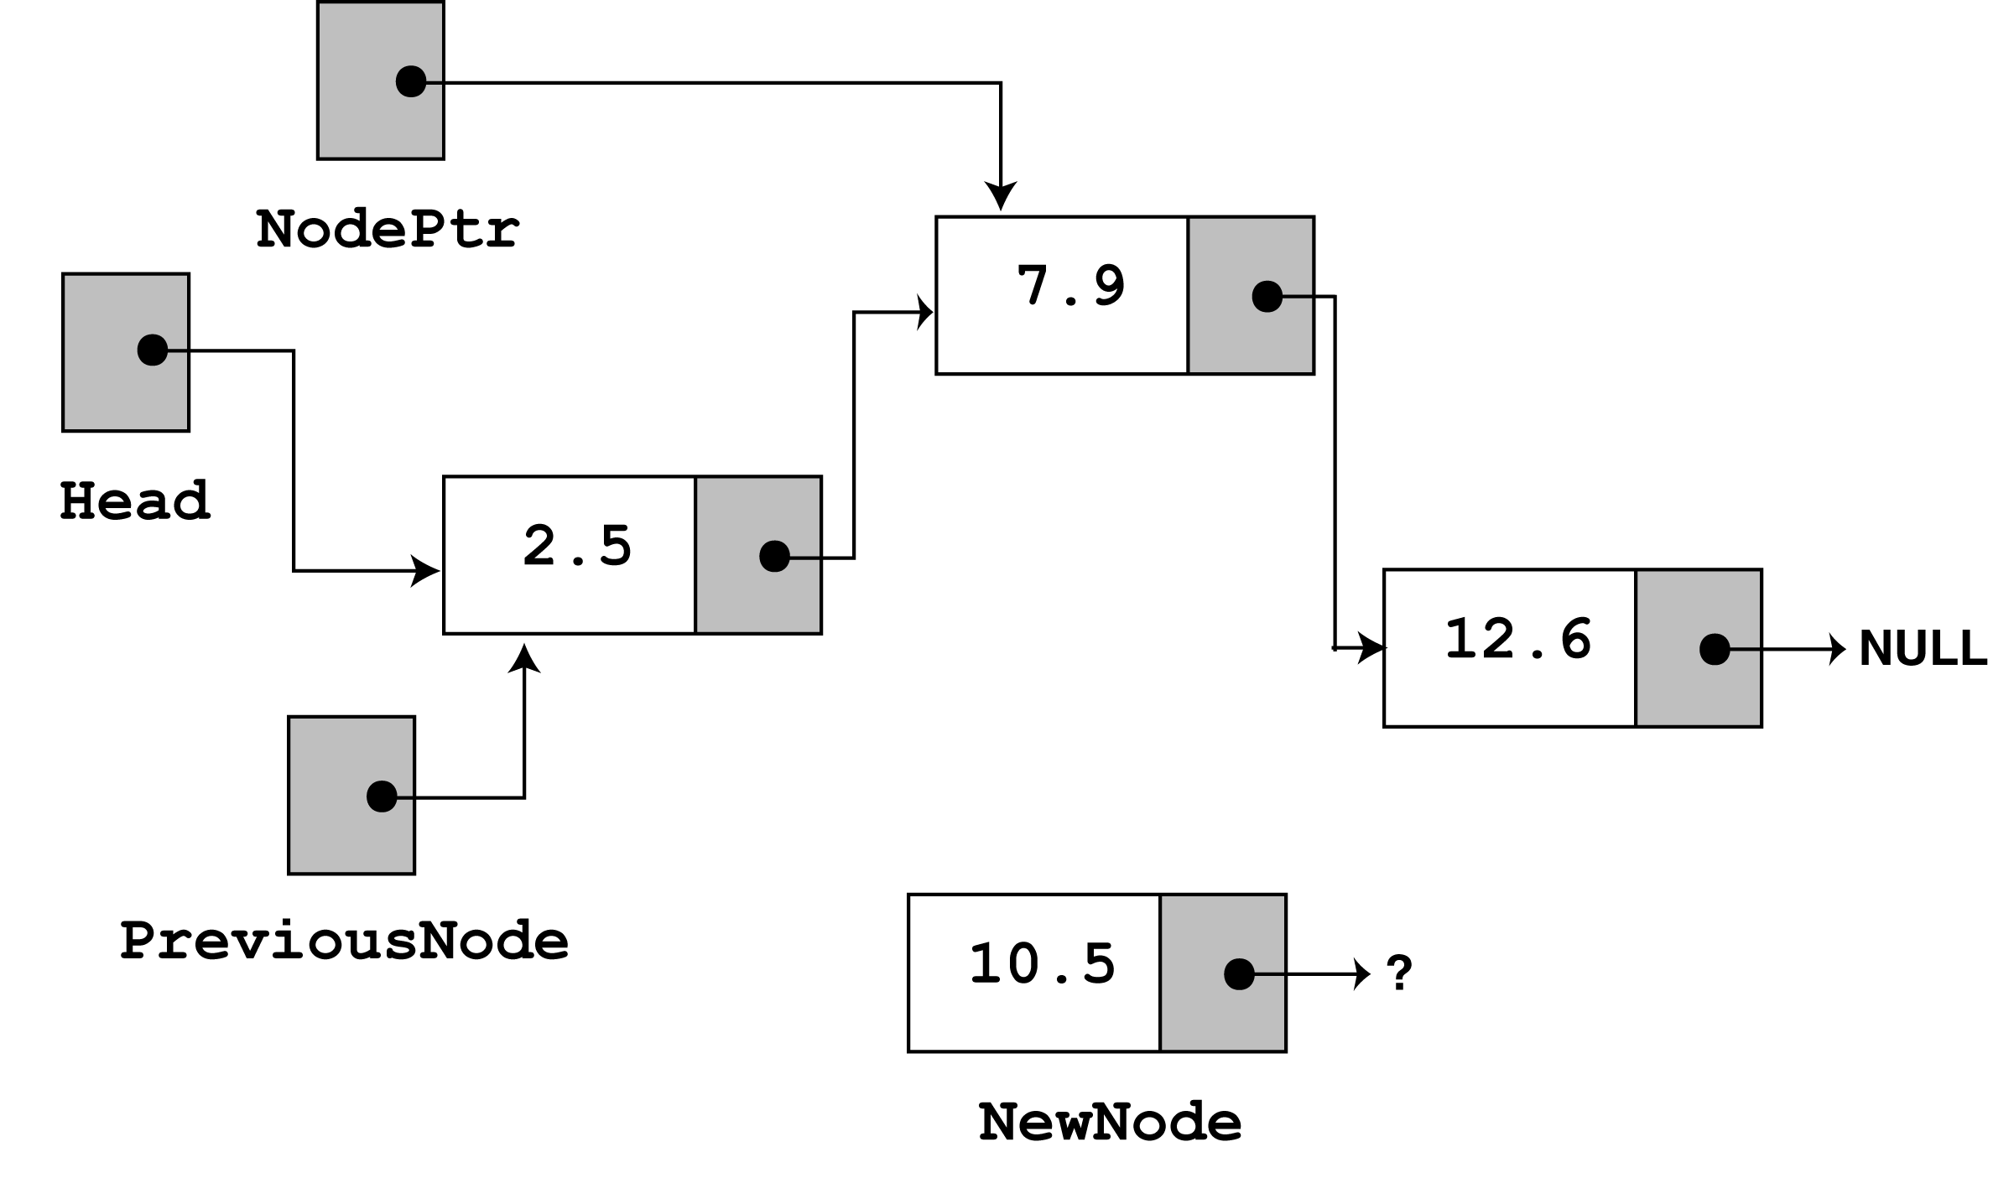
Since curr is not NULL and curr->data is less than value, the while loop will iterate. During the iteration, previous will be made to point to the node that curr is pointing to. curr will then be advanced to point to the next node.
curr
while (curr != NULL && curr->data < value) { previous = curr; curr = curr->next; }

Slide 50
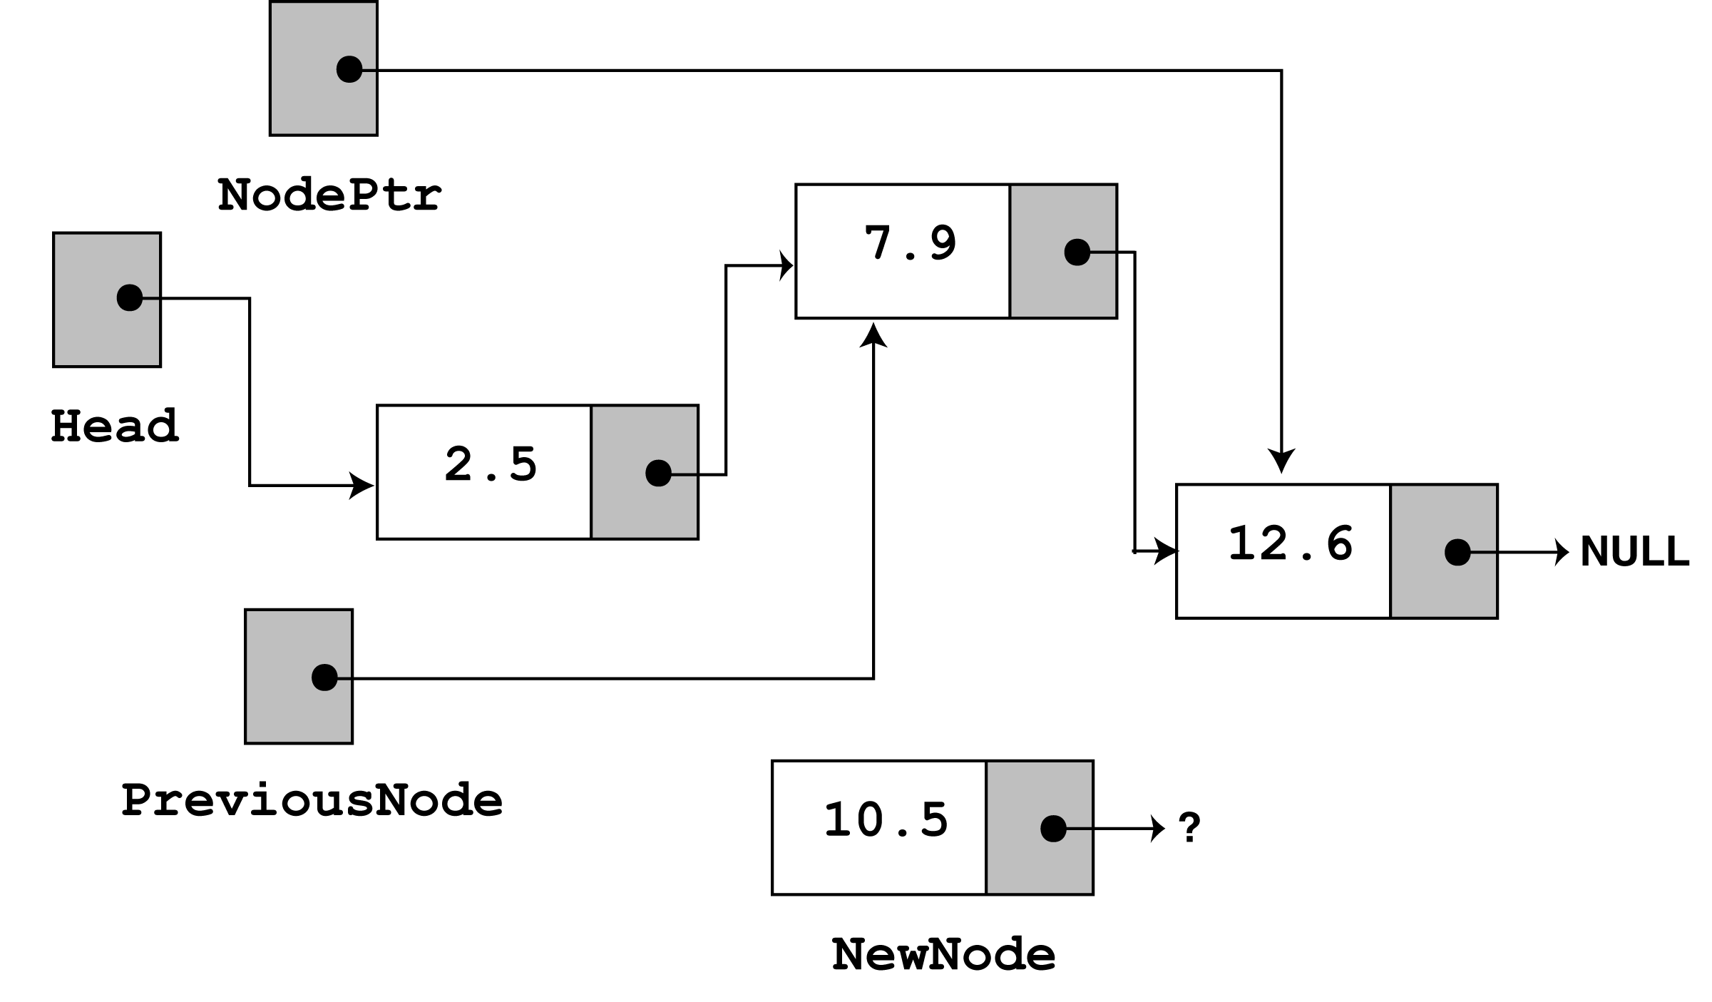
Once again, the loop performs its test. Since curr is not NULL and curr->data is less than value, the loop will iterate a second time. During the second iteration, both previousNode and curr are advanced by one node in the list.
curr
while (curr != NULL && curr->data < value) { previous = curr; curr = curr->next; }

Slide 51
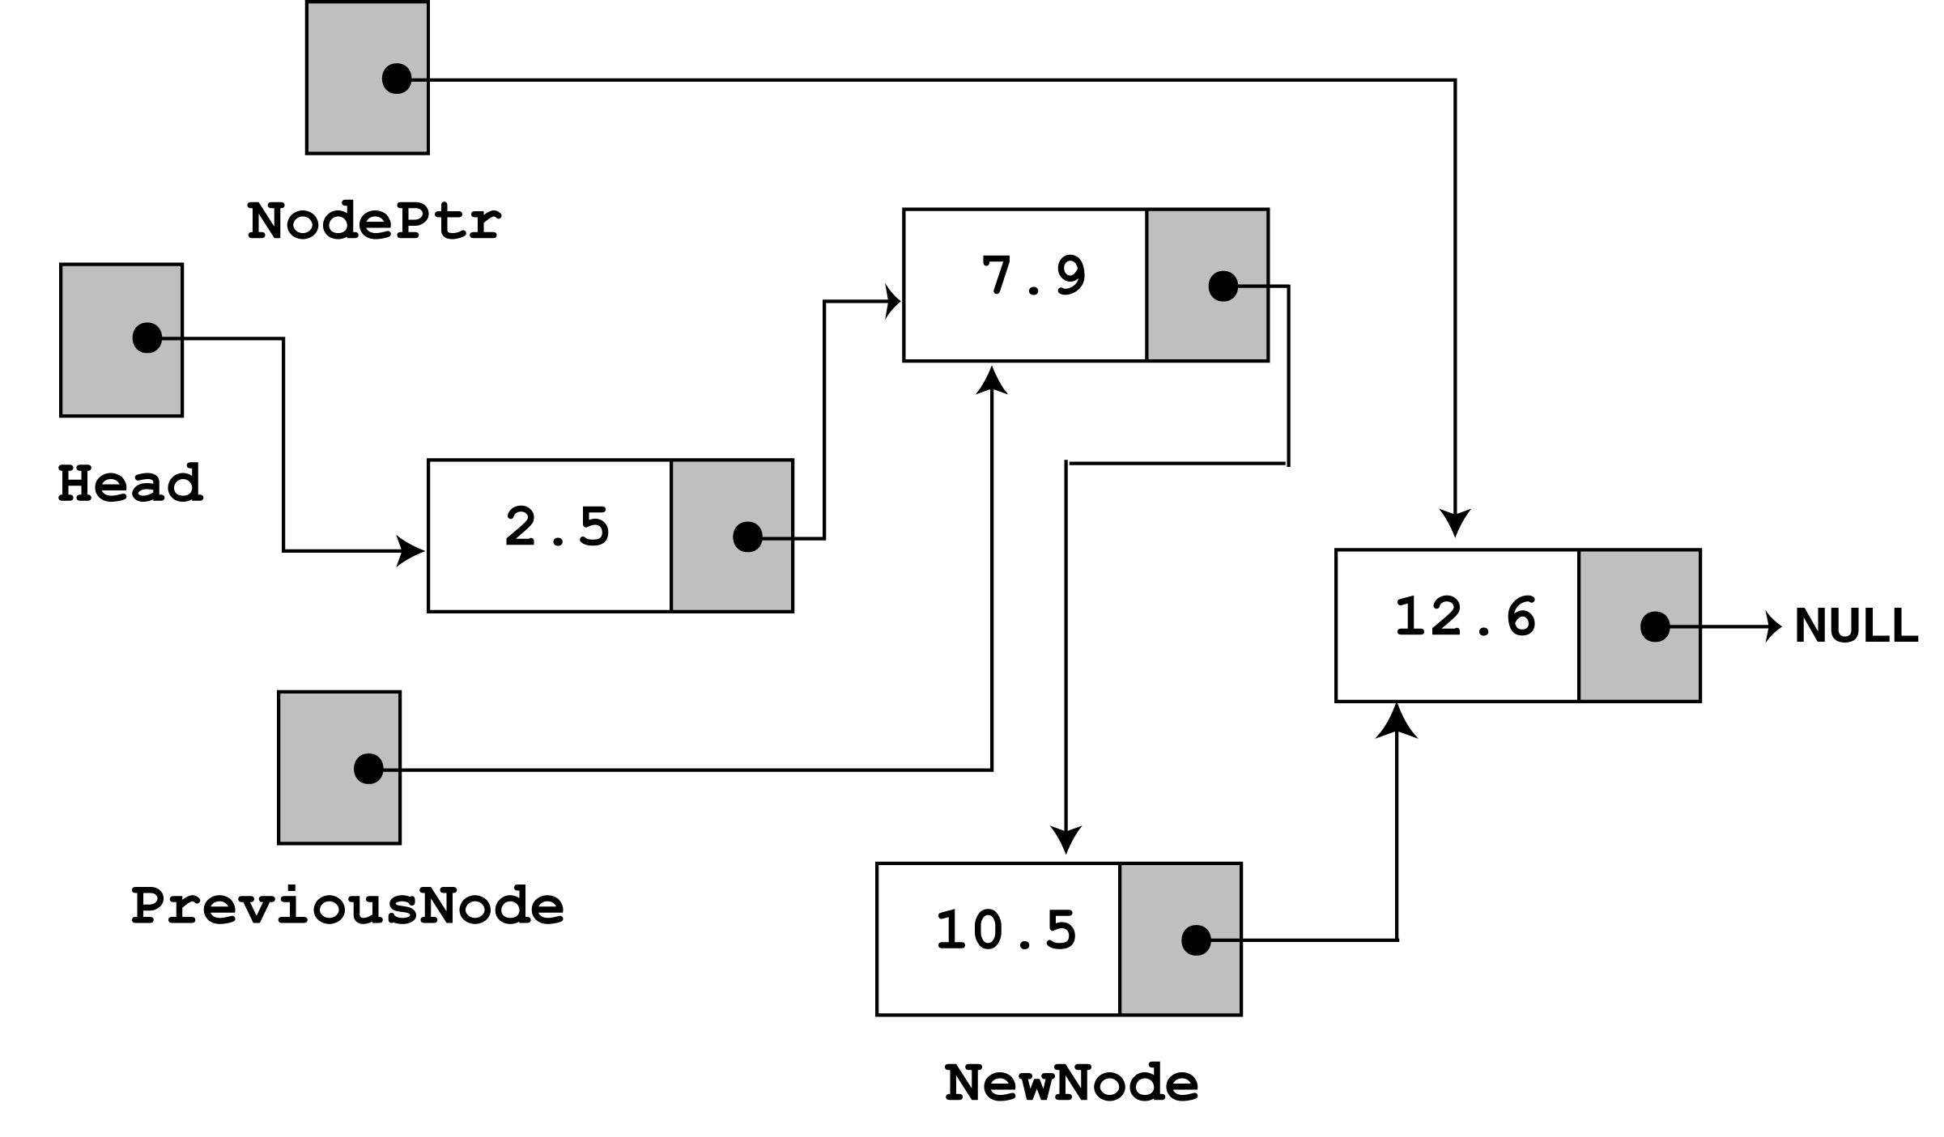
This time, the loop's test will fail because curr is not less than value. The statements after the loop will execute, which cause previousNode->next to point to newNode, and newNode->next to point to curr.
curr
If you follow the links, from the head pointer to the NULL, you will see that the nodes are stored in the order of their value members.

Slide 52
Deleting a Node
Deleting a node from a linked list requires two steps:
Remove the node from the list without breaking the links created by the next pointers
Deleting the node from memory
The deleteNode function begins on the next slide.

Slide 53
Deletion Description
Deleting from the top of the list
Deleting from the end of the list
Deleting from the middle of the list

Slide 54
Deletion Top Node Description
head
6
4
17
42
head
6
4
17
42
head
4
17
42

Slide 55
Deletion Last Description
head
6
4
17
42
head
6
4
17
42
head
6
4
17

Slide 56
Deletion Middle Node Description
head
4
17
42
head
4
17
42
head
4
42

Slide 57
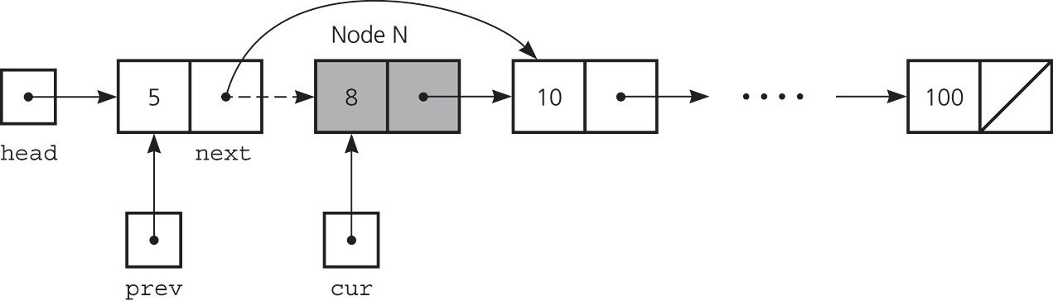
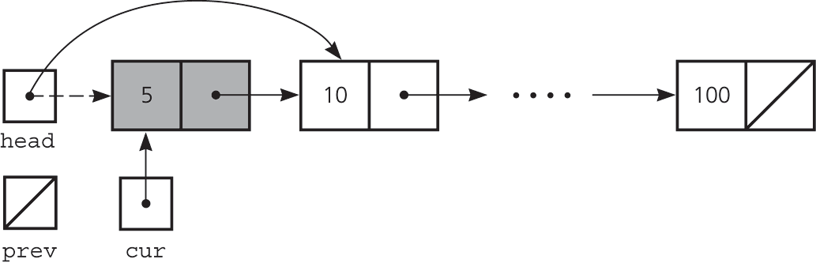
Deleting a Specified Node from a Linked List
Deleting a node from a linked list
Deleting the first node

Slide 58
Void deleteNode(float value) { ListNode *curr, *previousNode; // If the list is empty, do nothing. if (!head) return; // Determine if the first node is the one. if (head->data == value) { curr = head->next; delete head; head = curr; }
Continued on next slide…

Slide 59
Continued from previous slide.
else { // Initialize nodePtr to head of list curr = head; // Skip all nodes whose value member is // not equal to num. while (curr != NULL && curr->data != value) { previousNode = curr; curr = curr->next; } // Link the previous node to the node after // nodePtr, then delete nodePtr. previousNode->next = curr->next; delete curr; } }

Slide 60
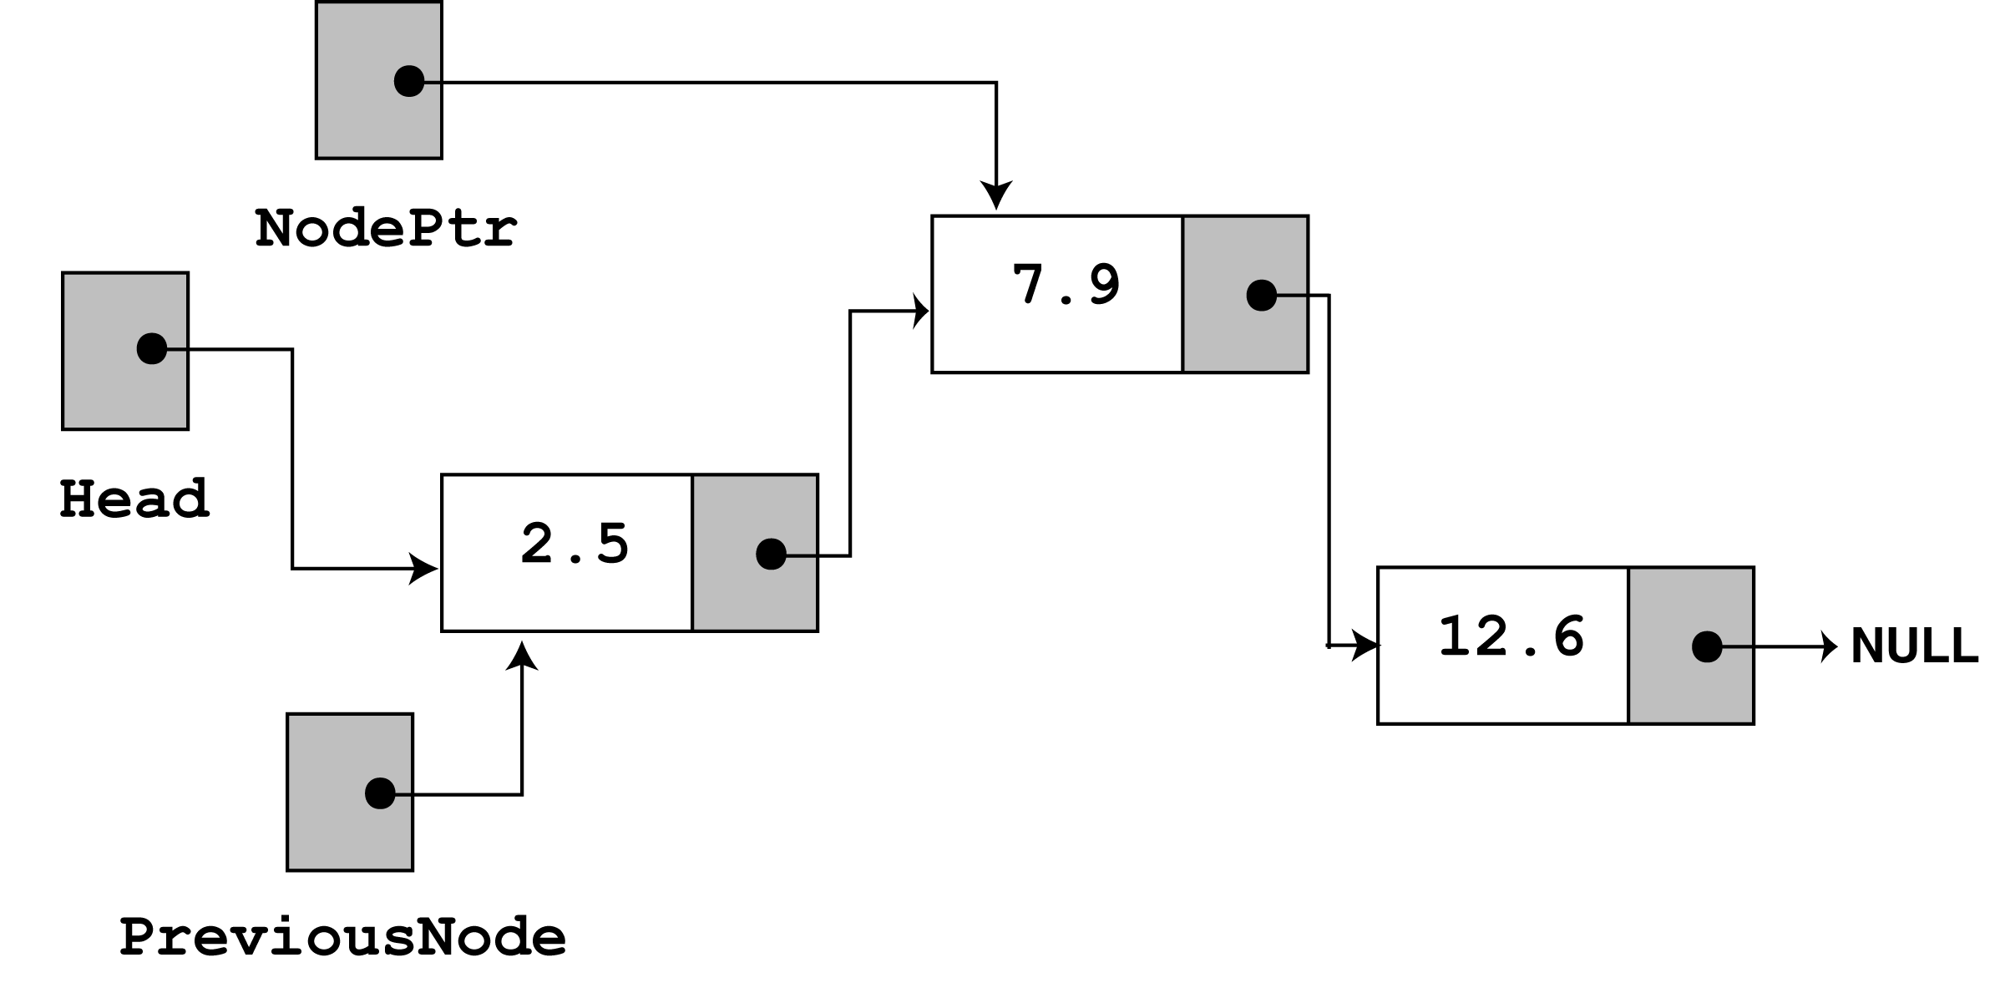
Look at the else part of the second if statement. This is where the function will perform its action since the list is not empty, and the first node does not contain the value 7.9. Just like insertNode, this function uses curr and previousNode to traverse the list. The while loop terminates when the value 7.9 is located. At this point, the list and the other pointers will be in the state depicted in the figure below.

Slide 61
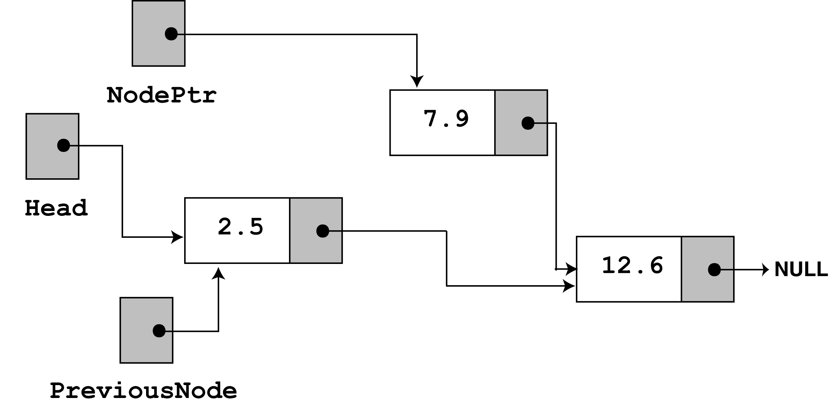
next, the following statement executes.
previousNode->next = curr->next;
The statement above causes the links in the list to bypass the node that curr points to. Although the node still exists in memory, this removes it from the list.
The last statement uses the delete operator to complete the total deletion of the node.

Slide 62
Variations of Linked Lists
Circular linked lists
The last node points to the first node of the list
How do we know when we have finished traversing the list? (Tip: check if the pointer of the current node is equal to the head.)
A
B
C
Head

Slide 63
Variations of Linked Lists
Doubly linked lists
Each node points to not only successor but the predecessor
There are two NULL: at the first and last nodes in the list
Advantage: given a node, it is easy to visit its predecessor. Convenient to traverse lists backwards
∅
A
B
C
∅
Head

Slide 64
Array versus Linked Lists
Linked lists are more complex to code and manage than arrays, but they have some distinct advantages.
Dynamic: a linked list can easily grow and shrink in size.
We don’t need to know how many nodes will be in the list. They are created in memory as needed.
In contrast, the size of a C++ array is fixed at compilation time.
Easy and fast insertions and deletions
To insert or delete an element in an array, we need to copy to temporary variables to make room for new elements or close the gap caused by deleted elements.
With a linked list, no need to move other nodes. Only need to reset some pointers.

Slide 65
Comparing Array-Based and Pointer-Based Implementations
Size
Increasing the size of a resizable array can waste storage and time
Storage requirements
Array-based implementations require less memory than a pointer-based ones

Slide 66
Comparing Array-Based and Pointer-Based Implementations
Access time
Array-based: constant access time
Pointer-based: the time to access the i^{th} node depends on i
Insertion and deletions
Array-based: require shifting of data
Pointer-based: require a list traversal

Slide 67
Doubly Linked Lists
To delete the node to which cur points
(cur->precede)->next = cur->next;
(cur->next)->precede = cur->precede;
To insert a new node pointed to by newPtr before the node pointed to by cur
newPtr->next = cur;
newPtr->precede = cur->precede;
cur->precede = newPtr;
newPtr->precede->next = newPtr;

Slide 68
Application: Maintaining an Inventory
Operations on the inventory
List the inventory in alphabetical order by title (L command)
Find the inventory item associated with title (I, M, D, O, and S commands)
Replace the inventory item associated with a title (M, D, R, and S commands)
Insert new inventory items (A and D commands)

Slide 69
newPtr
∅
25
∅
∅
10
N
B
20
N
B
30
∅
Head
prev
curr

