Slide 1


501220-3
Computer Programming I
Unit-1
Introduction

Slide 2
Fundamental Concepts in Programming

Slide 3
Why Programming?
Without software, the computer is useless
Software developed with programming languages
C++ is a programming language
C++ suited for a wide variety of programming tasks
Before programming, it is useful to understand terminology and computer components

Slide 4
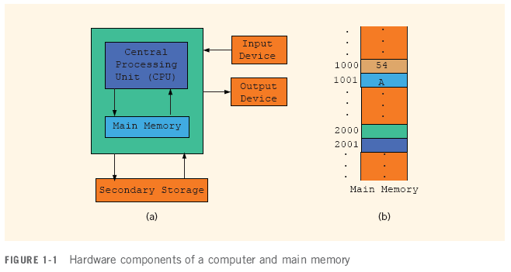
Elements of a Computer System

Slide 5
Central Processing Unit and Main Memory (cont'd.)
Random access memory
Directly connected to the CPU
All programs must be loaded into main memory before they can be executed
All data must be brought into main memory before it can be manipulated
When computer power is turned off, everything in main memory is lost

Slide 6
Software
Software: programs that do specific tasks
System programs take control of the computer, such as an operating system
Application programs such as:
Word processors
Spreadsheets
Games

Slide 7
The Evolution of Programming Languages
Early computers were programmed in machine language
To calculate wages = rates * hours in machine language:
100100 010001 //Load
100110 010010 //Multiply
100010 010011 //Store

Slide 8
The Evolution of Programming Languages (cont'd.)
Assembly language instructions are mnemonic
Assembler: translates a program written in assembly language into machine language

Slide 9
The Evolution of Programming Languages (cont'd.)
Using assembly language instructions, wages = rates • hours can be written as:
LOAD rate
MULT hour
STOR wages

Slide 10
The Evolution of Programming Languages (cont'd.)
High-level languages include Basic, FORTRAN, COBOL, Pascal, C, C++, C#, and Java
Compiler: translates a program written in a high-level language into machine language
The equation wages = rate • hours can be written in C++ as:
wages = rate * hours;

Slide 11
The Problem Analysis–Coding–Execution Cycle (cont’d.)

Slide 12
Programming with the Problem Analysis–Coding–Execution Cycle
Programming is a process of problem solving
One problem-solving technique:
Analyze the problem
Outline the problem requirements
Design steps (algorithm) to solve the problem
Algorithm:
Step-by-step problem-solving process
Solution achieved in finite amount of time

Slide 13
The Problem Analysis–Coding–Execution Cycle (cont'd.)
Thoroughly understand the problem
Understand problem requirements
Does program require user interaction?
Does program manipulate data?
What is the output?
If the problem is complex, divide it into subproblems
Analyze each subproblem as above

Slide 14
The Problem Analysis–Coding–Execution Cycle (cont'd.)
If problem was broken into subproblems
Design algorithms for each subproblem
Check the correctness of algorithm
Can test using sample data
Some mathematical analysis might be required

Slide 15
Processing a C++ Program
To execute a C++ program:
Use an editor to create a source program in C++ (DEV C++ for example)
Preprocessor directives begin with # and are processed by a the preprocessor
Use the compiler to:
Check that the program obeys the rules
Translate into machine language (object program)

Slide 16
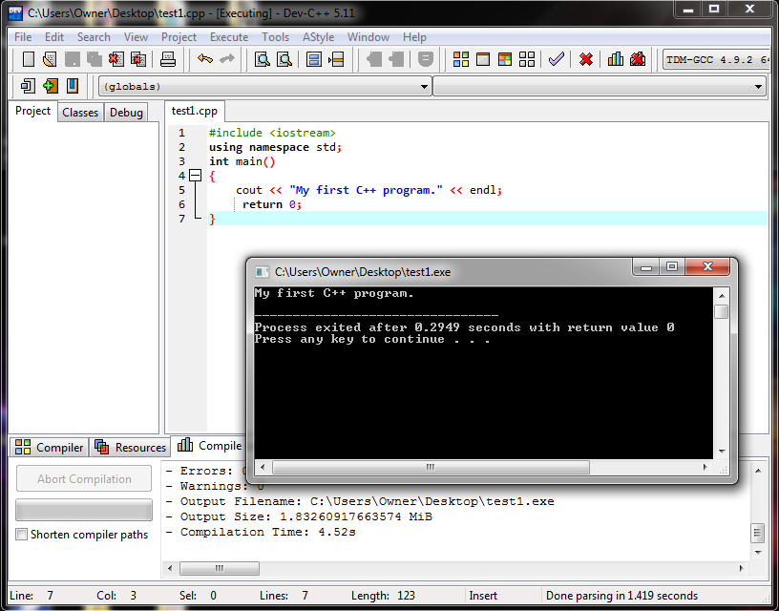
Processing a C++ Program

Slide 17
Processing a C++ Program (cont'd.)
To execute a C++ program (cont'd.):
Linker:
Combines object program with other programs provided by the SDK to create executable code
Loader:
Loads executable program into main memory
The last step is to execute the program

Slide 18
The Problem Analysis–Coding–Execution Cycle (cont'd.)
Once the algorithm is designed and correctness verified
Write the equivalent code in high-level language
Enter the program using text editor

Slide 19
The Problem Analysis–Coding–Execution Cycle (cont'd.)
Run code through compiler
If compiler generates errors
Look at code and remove errors
Run code again through compiler
If there are no syntax errors
Compiler generates equivalent machine code
Linker links machine code with system resources

Slide 20
The Problem Analysis–Coding–Execution Cycle (cont'd.)
Once compiled and linked, loader can place program into main memory for execution
The final step is to execute the program
Compiler guarantees that the program follows the rules of the language
Does not guarantee that the program will run correctly

Slide 21
Problem Challenges

Slide 22
Solving Problems Using Pseudo Code
Example 1
Design an algorithm to find the perimeter and area of a rectangle
The perimeter and area of the rectangle are given by the following formulas:
perimeter = 2 * (length + width)
area = length * width

Slide 23
Example 1 (cont'd.)
Algorithm:
Get length of the rectangle
Get width of the rectangle
Find the perimeter using the following equation:
perimeter = 2 * (length + width)
Find the area using the following equation:
area = length * width
Print perimeter & area

Slide 24
Example 2
Every salesperson has a base salary
Salesperson receives $10 bonus at the end of the month for each year worked if he or she has been with the store for five or less years
The bonus is $20 for each year that he or she has worked there if over 5 years

Slide 25
Example 2 (cont'd.)
Additional bonuses are as follows:
If total sales for the month are $5,000-$10,000, he or she receives a 3% commission on the sale
If total sales for the month are at least $10,000, he or she receives a 6% commission on the sale

Slide 26
Example 2 (cont'd.)
Get baseSalary
Get noOfServiceYears
Calculate bonus using the following formula:
if (noOfServiceYears is less than or equal to five)
bonus = 10 * noOfServiceYears
otherwise
bonus = 20 * noOfServiceYears
Get totalSales

Slide 27
Example 2 (cont'd.)
Calculate additionalBonus as follows:
if (totalSale is less than 5000)
additionalBonus = 0
otherwise
if (totalSale is greater than or equal to
5000 and totalSale is less than 10000)
additionalBonus = totalSale * (0.03)
otherwise
additionalBonus = totalSale * (0.06)

Slide 28
Example 2 (cont'd.)
Calculate payCheck using the equation
payCheck = baseSalary + bonus
+ additionalBonus

Slide 29
Example 3
10 students in a class
Each student has taken five tests and each test is worth 100 points
Design an algorithm to calculate the grade for each student as well as the class average
Design an algorithm to find the average test score
Design an algorithm to determine the grade
Data consists of students’ names and their test scores

Slide 30
Example 3 (cont'd.)
Algorithm to determine the average test score:
Get the five test scores
Add the five test scores
Suppose sum stands for the sum of the test scores
Suppose average stands for the average test score:
average = sum / 5;

Slide 31
Example 3 (cont'd.)
Algorithm to determine the grade:
if average is greater than or equal to 90
grade = A
otherwise
if average is greater than or equal to 80 and less than 90
grade = B
otherwise
if average is greater than or equal to 70 and less than 80
grade = C
otherwise
if average is greater than or equal to 60 and less than 70
grade = D
otherwise
grade = F

Slide 32
Example 3 (cont'd.)
Main algorithm is as follows:
totalAverage = 0;
Repeat the following for each student:
Get student’s name
Use the algorithm to find the average test score
Use the algorithm to find the grade
Update totalAverage by adding current student’s average test score
Determine the class average as follows:
classAverage = totalAverage / 10

Slide 33
Programming Methodologies
Two popular approaches to programming design
Structured
Object Oriented Programming

Slide 34
Structured Programming
Structured design:
Dividing a problem into smaller subproblems
Structured programming:
Implementing a structured design
The structured design approach is also called:
Top-down (or bottom-up) design
Stepwise refinement
Modular programming

Slide 35
Object-Oriented Programming
Identify components called objects
Specify relevant data and possible operations to be performed on that data
Each object consists of data and operations on that data
An object combines data and operations on the data into a single unit

Slide 36
Object-Oriented Programming (cont'd.)
Learn how to combine data and operations on the data into a single unit called an object
C++ is designed to implement OOP
OOP is used with structured design

