Slide 1






Slide 2
Control Structures
A computer can proceed:
  In sequence
  Selectively (branch): making a choice
  Repetitively (iteratively): looping
Some statements are executed only if certain conditions are met
A condition is met if it evaluates to true
C++ Programming: From Problem Analysis to Program Design, Fifth Edition

Slide 3
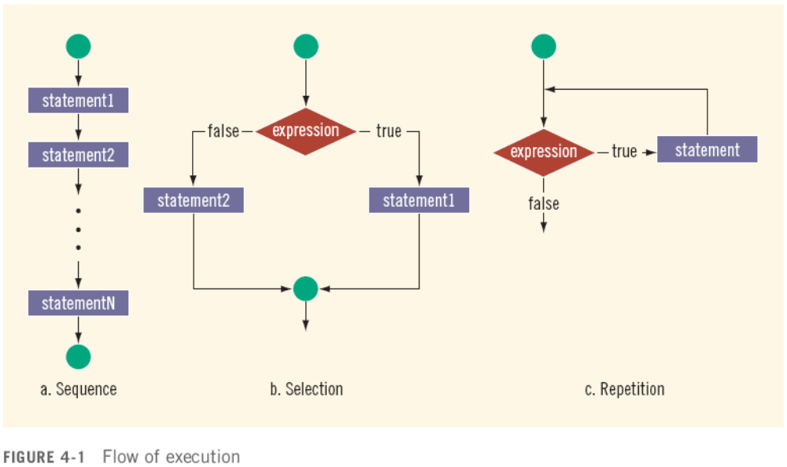
Control Structures (cont'd.)
C++ Programming: From Problem Analysis to Program Design, Fifth Edition

Slide 4
Relational Operators
A condition is represented by a logical (Boolean) expression that can be true or false
Relational operators:
  Allow comparisons
  Require two operands (binary)
  Evaluate to true or false
C++ Programming: From Problem Analysis to Program Design, Fifth Edition

Slide 5
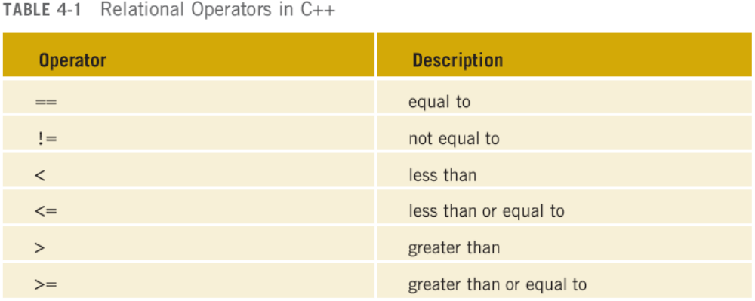
Relational Operators (cont'd.)
C++ Programming: From Problem Analysis to Program Design, Fifth Edition

Slide 6
Relational Operators and Simple Data Types
You can use the relational operators with all three simple data types:
  8 < 15 evaluates to true
  6 != 6 evaluates to false
  2.5 > 5.8 evaluates to false
  5.9 <= 7.5 evaluates to true
C++ Programming: From Problem Analysis to Program Design, Fifth Edition

Slide 7
Comparing Characters
Expression with relational operators
  Depends on machine’s collating sequence
  ASCII character set
Logical (Boolean) expressions
  Expressions such as 4 < 6 and 'R' > 'T’
  Returns an integer value of 1 if the logical expression evaluates to true
  Returns an integer value of 0 otherwise
C++ Programming: From Problem Analysis to Program Design, Fifth Edition

Slide 8
Relational Operators and the string Type
Relational operators can be applied to strings
Strings are compared character by character, starting with the first character
Comparison continues until either a mismatch is found or all characters are found equal
If two strings of different lengths are compared and the comparison is equal to the last character of the shorter string
  The shorter string is less than the larger string
C++ Programming: From Problem Analysis to Program Design, Fifth Edition

Slide 9
Relational Operators and the string Type (cont'd.)
Suppose we have the following declarations:
  string str1 = "Hello";
  string str2 = "Hi";
  string str3 = "Air";
  string str4 = "Bill";
  string str5 = "Big";
C++ Programming: From Problem Analysis to Program Design, Fifth Edition

Slide 10
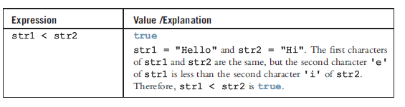
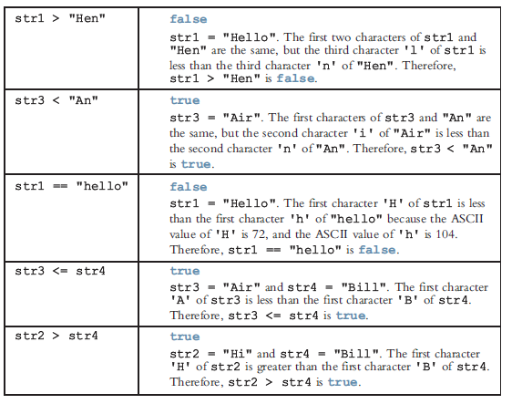
Relational Operators and the string Type (cont'd.)
C++ Programming: From Problem Analysis to Program Design, Fifth Edition

Slide 11
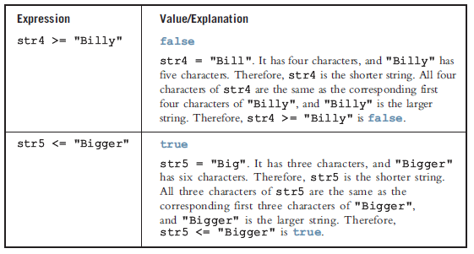
Relational Operators and the string Type (cont'd.)
C++ Programming: From Problem Analysis to Program Design, Fifth Edition

Slide 12
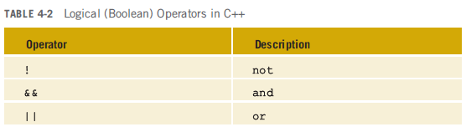
Logical (Boolean) Operators and Logical Expressions
Logical (Boolean) operators enable you to combine logical expressions
C++ Programming: From Problem Analysis to Program Design, Fifth Edition

Slide 13
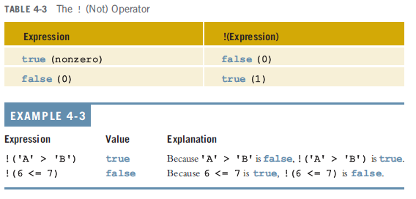
Logical (Boolean) Operators and Logical Expressions (cont'd.)
C++ Programming: From Problem Analysis to Program Design, Fifth Edition

Slide 14
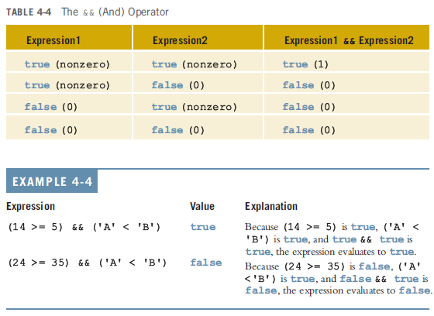
Logical (Boolean) Operators and Logical Expressions (cont'd.)
C++ Programming: From Problem Analysis to Program Design, Fifth Edition

Slide 15
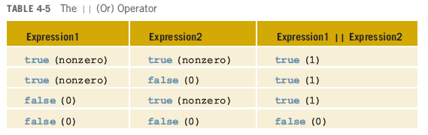
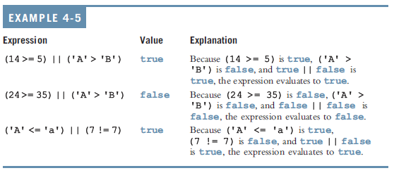
Logical (Boolean) Operators and Logical Expressions (cont'd.)
C++ Programming: From Problem Analysis to Program Design, Fifth Edition

Slide 16
Order of Precedence
Relational and logical operators are evaluated from left to right
The associativity is left to right
Parentheses can override precedence
C++ Programming: From Problem Analysis to Program Design, Fifth Edition

Slide 17
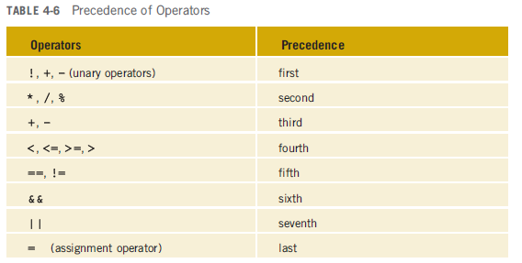
Order of Precedence (cont'd.)
C++ Programming: From Problem Analysis to Program Design, Fifth Edition

Slide 18
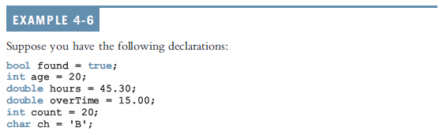
Order of Precedence (cont'd.)
C++ Programming: From Problem Analysis to Program Design, Fifth Edition

Slide 19
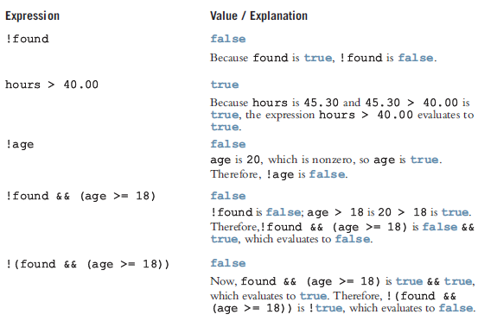
Order of Precedence (cont'd.)
C++ Programming: From Problem Analysis to Program Design, Fifth Edition

Slide 20
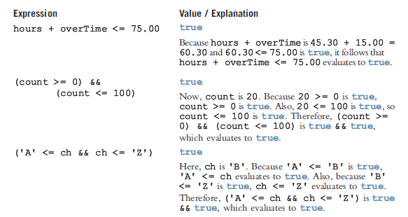
Order of Precedence (cont'd.)
C++ Programming: From Problem Analysis to Program Design, Fifth Edition

Slide 21
int Data Type and Logical (Boolean) Expressions
Earlier versions of C++ did not provide built-in data types that had Boolean values
Logical expressions evaluate to either 1 or 0
  The value of a logical expression was stored in a variable of the data type int
You can use the int data type to manipulate logical (Boolean) expressions
C++ Programming: From Problem Analysis to Program Design, Fifth Edition

Slide 22
The bool Data Type and Logical (Boolean) Expressions
The data type bool has logical (Boolean) values true and false
bool, true, and false are reserved words
The identifier true has the value 1
The identifier false has the value 0
C++ Programming: From Problem Analysis to Program Design, Fifth Edition

Slide 23
Selection: if and if...else
One-Way Selection
Two-Way Selection
Compound (Block of) Statements
Multiple Selections: Nested if
Comparing if...else Statements with a Series of if Statements
C++ Programming: From Problem Analysis to Program Design, Fifth Edition

Slide 24
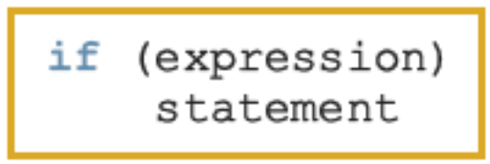
One-Way Selection
The syntax of one-way selection is:
The statement is executed if the value of the expression is true
The statement is bypassed if the value is false; program goes to the next statement
if is a reserved word
C++ Programming: From Problem Analysis to Program Design, Fifth Edition

Slide 25
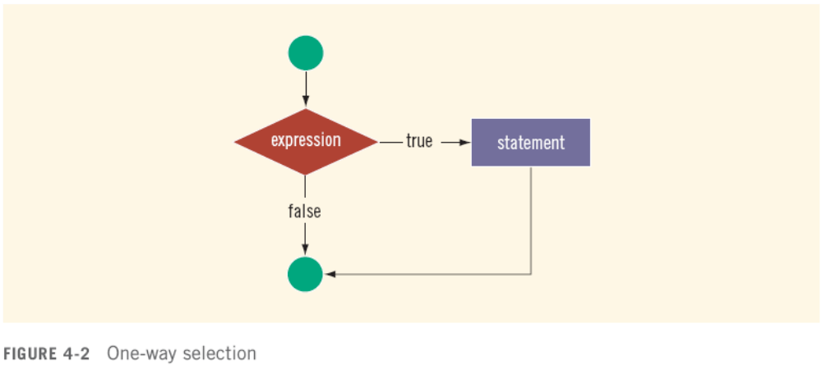
One-Way Selection (cont'd.)
C++ Programming: From Problem Analysis to Program Design, Fifth Edition

Slide 26
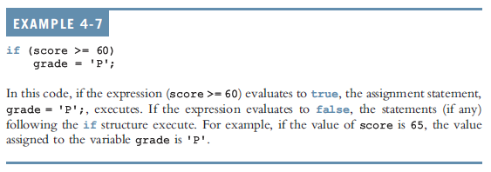
One-Way Selection (cont'd.)
C++ Programming: From Problem Analysis to Program Design, Fifth Edition

Slide 27
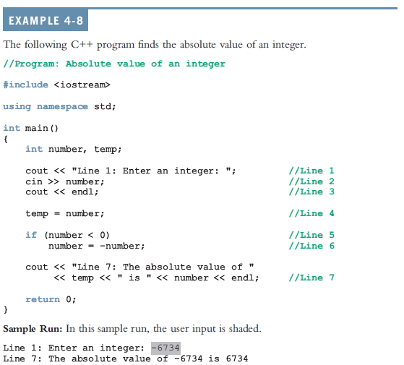
One-Way Selection (cont'd.)
C++ Programming: From Problem Analysis to Program Design, Fifth Edition

Slide 28
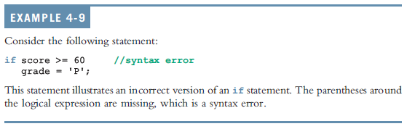
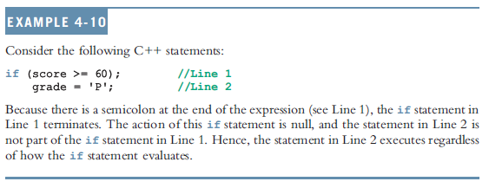
One-Way Selection (cont'd.)
C++ Programming: From Problem Analysis to Program Design, Fifth Edition

Slide 29
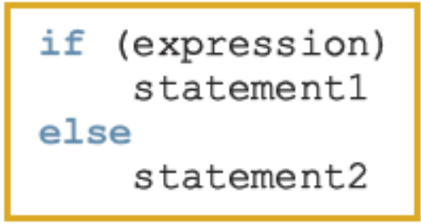
Two-Way Selection
Two-way selection takes the form:
If expression is true, statement1 is executed; otherwise, statement2 is executed
  statement1 and statement2 are any C++ statements
else is a reserved word
C++ Programming: From Problem Analysis to Program Design, Fifth Edition

Slide 30
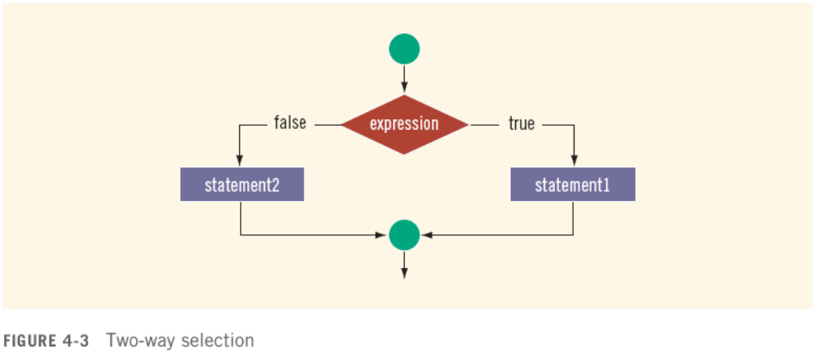
Two-Way Selection (cont'd.)
C++ Programming: From Problem Analysis to Program Design, Fifth Edition

Slide 31
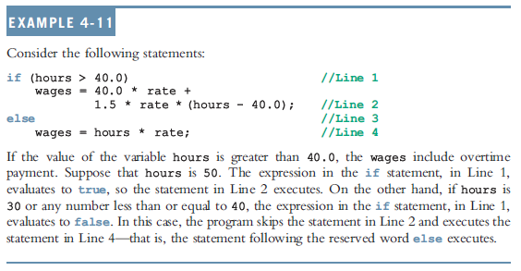
Two-Way Selection (cont'd.)
C++ Programming: From Problem Analysis to Program Design, Fifth Edition

Slide 32
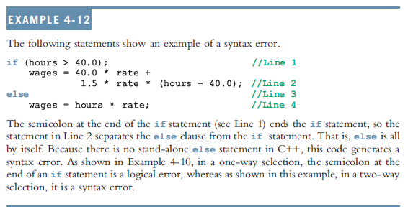
Two-Way Selection (cont'd.)
C++ Programming: From Problem Analysis to Program Design, Fifth Edition

Slide 33
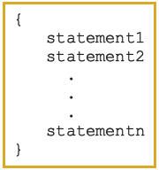
Compound (Block of) Statements
Compound statement (block of statements):
A compound statement is a single statement
C++ Programming: From Problem Analysis to Program Design, Fifth Edition

Slide 34
Compound (Block of) Statements (cont'd.)
if (age > 18)
{
cout << "Eligible to vote." << endl;
cout << "No longer a minor." << endl;
}
else
{
cout << "Not eligible to vote." << endl;
cout << "Still a minor." << endl;
}
C++ Programming: From Problem Analysis to Program Design, Fifth Edition

Slide 35
Multiple Selections: Nested if
Nesting: one control statement in another
An else is associated with the most recent if that has not been paired with an else
C++ Programming: From Problem Analysis to Program Design, Fifth Edition

Slide 36
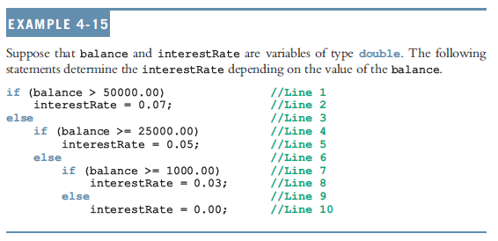
Multiple Selections: Nested if (cont'd.)
C++ Programming: From Problem Analysis to Program Design, Fifth Edition

Slide 37
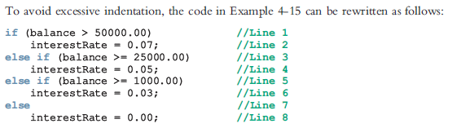
Multiple Selections: Nested if (cont'd.)
C++ Programming: From Problem Analysis to Program Design, Fifth Edition

Slide 38
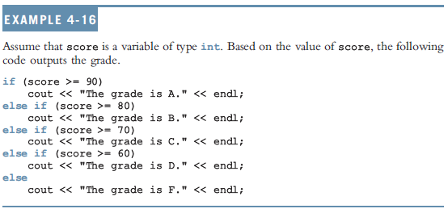
Multiple Selections: Nested if (cont'd.)
C++ Programming: From Problem Analysis to Program Design, Fifth Edition

Slide 39
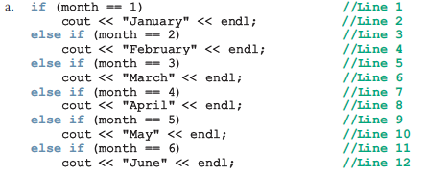
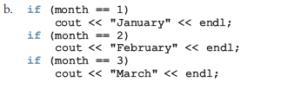

Comparing if…else Statements with a Series of if Statements
C++ Programming: From Problem Analysis to Program Design, Fifth Edition

Slide 40
Short-Circuit Evaluation
Short-circuit evaluation: evaluation of a logical expression stops as soon as the value of the expression is known
Example:
(age >= 21) || ( x == 5) //Line 1
(grade == 'A') && (x >= 7) //Line 2
C++ Programming: From Problem Analysis to Program Design, Fifth Edition

Slide 41
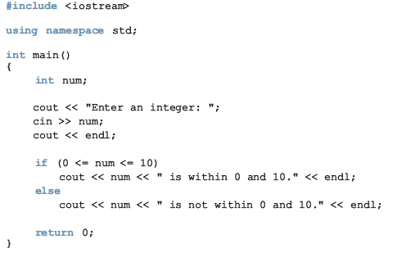
Associativity of Relational Operators: A Precaution
C++ Programming: From Problem Analysis to Program Design, Fifth Edition

Slide 42
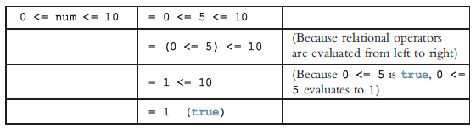
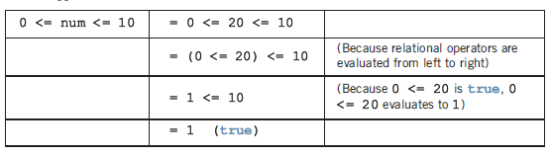
Associativity of Relational Operators: A Precaution (cont’d.)
num = 5
num = 20
C++ Programming: From Problem Analysis to Program Design, Fifth Edition

Slide 43
Confusion Between the Equality (==) and Assignment (=) Operators
C++ allows you to use any expression that can be evaluated to either true or false as an expression in the if statement:
  if (x = 5)
  cout << "The value is five." << endl;
The appearance of = in place of == resembles a silent killer
  It is not a syntax error
  It is a logical error
C++ Programming: From Problem Analysis to Program Design, Fifth Edition

Slide 44
Conditional Operator (?:)
Conditional operator (?:) takes three arguments
  Ternary operator
Syntax for using the conditional operator:
expression1 ? expression2 : expression3
If expression1 is true, the result of the conditional expression is expression2
  Otherwise, the result is expression3
C++ Programming: From Problem Analysis to Program Design, Fifth Edition

Slide 45
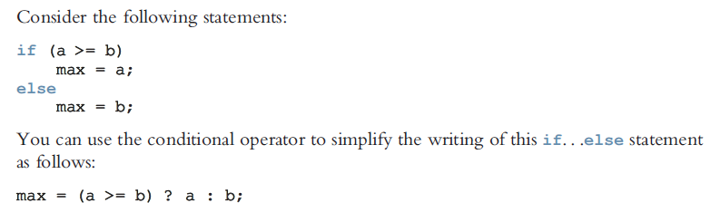
Conditional Operator (?:)
C++ Programming: From Problem Analysis to Program Design, Fifth Edition

Slide 46
Program Style and Form (Revisited): Indentation
If your program is properly indented
  Spot and fix errors quickly
  Show the natural grouping of statements
Insert a blank line between statements that are naturally separate
Two commonly used styles for placing braces
  On a line by themselves
  Or left brace is placed after the expression, and the right brace is on a line by itself
C++ Programming: From Problem Analysis to Program Design, Fifth Edition

Slide 47
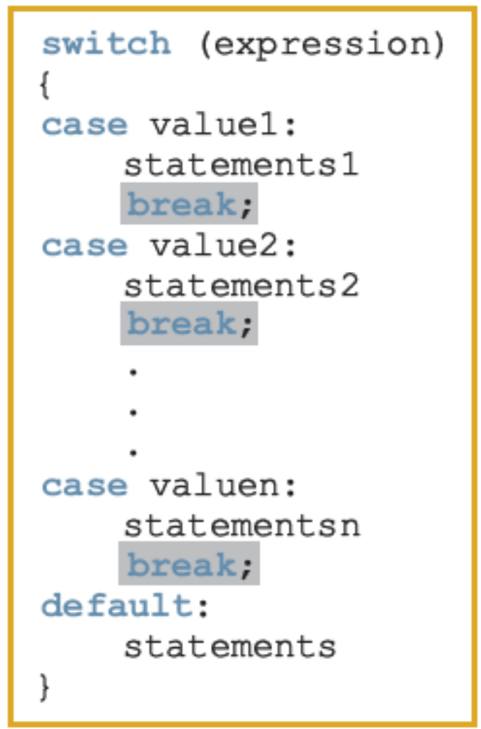
switch Structures
switch structure: alternate to if-else
switch (integral) expression is evaluated first
Value of the expression determines which corresponding action is taken
Expression is sometimes called the selector
C++ Programming: From Problem Analysis to Program Design, Fifth Edition

Slide 48
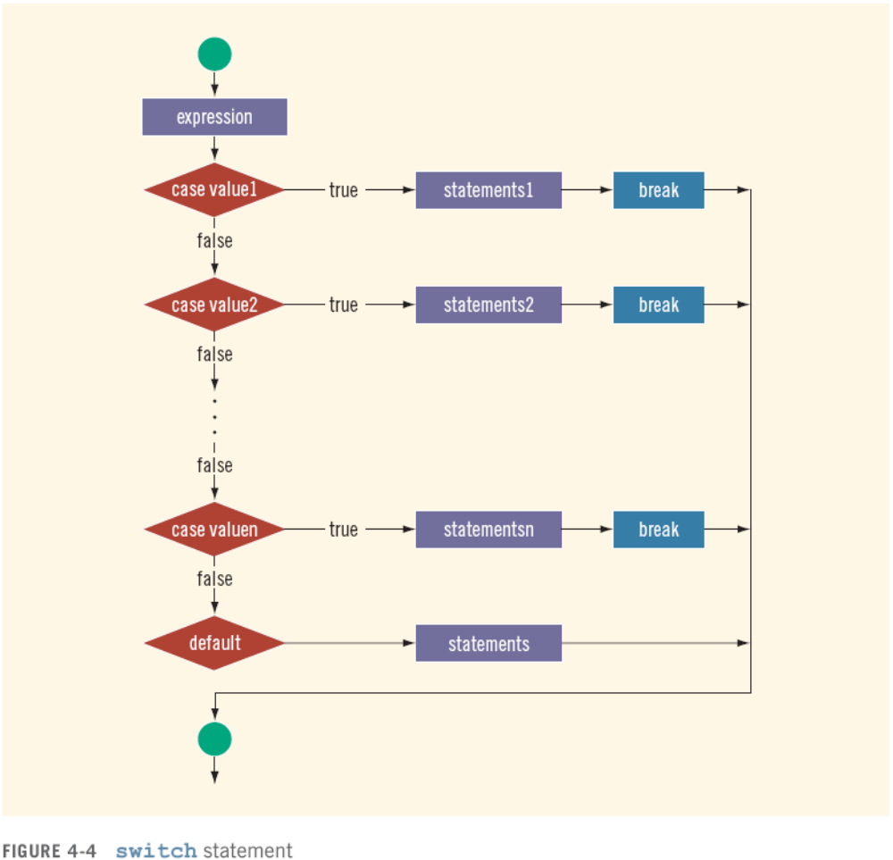
switch Structures (cont'd.)
C++ Programming: From Problem Analysis to Program Design, Fifth Edition

Slide 49
switch Structures (cont'd.)
One or more statements may follow a case label
Braces are not needed to turn multiple statements into a single compound statement
The break statement may or may not appear after each statement
switch, case, break, and default are reserved words
C++ Programming: From Problem Analysis to Program Design, Fifth Edition

Slide 50
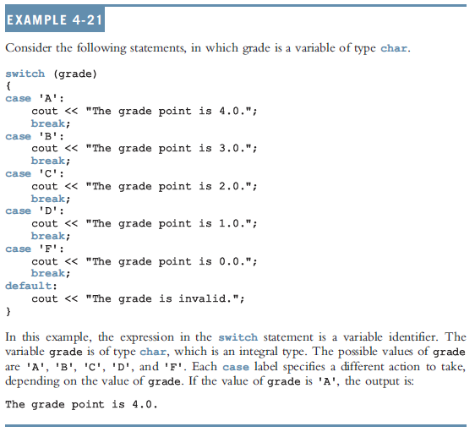
switch Structures (cont'd.)
C++ Programming: From Problem Analysis to Program Design, Fifth Edition

Slide 51
Programming Challenge: Cable Company Billing
This programming example calculates a customer’s bill for a local cable company
There are two types of customers:
  Residential
  Business
Two rates for calculating a cable bill:
  One for residential customers
  One for business customers
C++ Programming: From Problem Analysis to Program Design, Fifth Edition

Slide 52
Programming Challenge : Rates
For residential customer:
  Bill processing fee: $4.50
  Basic service fee: $20.50
  Premium channel: $7.50 per channel
For business customer:
  Bill processing fee: $15.00
  Basic service fee: $75.00 for first 10 connections/$5.00 for each additional one
  Premium channel cost: $50.00 per channel for any number of connections
C++ Programming: From Problem Analysis to Program Design, Fifth Edition

Slide 53
Programming Challenge : Requirements
Ask user for account number and customer code
Assume R or r stands for residential customer and B or b stands for business customer
C++ Programming: From Problem Analysis to Program Design, Fifth Edition

Slide 54
Programming Challenge : Input and Output
Input:
  Customer account number
  Customer code
  Number of premium channels
  For business customers, number of basic service connections
Output:
  Customer’s account number
  Billing amount
C++ Programming: From Problem Analysis to Program Design, Fifth Edition

Slide 55
Programming Challenge : Program Analysis
Purpose: calculate and print billing amount
Calculating billing amount requires:
  Customer for whom the billing amount is calculated (residential or business)
  Number of premium channels to which the customer subscribes
For a business customer, you need:
  Number of basic service connections
  Number of premium channels
C++ Programming: From Problem Analysis to Program Design, Fifth Edition

Slide 56
Programming Challenge : Program Analysis (cont'd.)
Data needed to calculate the bill, such as bill processing fees and the cost of a premium channel, are known quantities
The program should print the billing amount to two decimal places
C++ Programming: From Problem Analysis to Program Design, Fifth Edition

Slide 57
Programming Challenge : Algorithm Design
Set precision to two decimal places
Prompt user for account number and customer type
If customer type is R or r
  Prompt user for number of premium channels
  Compute and print the bill
If customer type is B or b
  Prompt user for number of basic service connections and number of premium channels
  Compute and print the bill
C++ Programming: From Problem Analysis to Program Design, Fifth Edition

Slide 58
Programming Challenge : Formulas
Billing for residential customers:
amountDue = RES_BILL_PROC_FEES +
RES_BASIC_SERV_COST
+ numOfPremChannels *
RES_COST_PREM_CHANNEL;
C++ Programming: From Problem Analysis to Program Design, Fifth Edition

Slide 59
Programming Challenge : Formulas (cont'd.)
Billing for business customers:
if (numOfBasicServConn <= 10)
amountDue = BUS_BILL_PROC_FEES +
BUS_BASIC_SERV_COST
+ numOfPremChannels *
BUS_COST_PREM_CHANNEL;
else
amountDue = BUS_BILL_PROC_FEES +
BUS_BASIC_SERV_COST
+ (numOfBasicServConn - 10)
* BUS_BASIC_CONN_COST
+ numOfPremChannels *
BUS_COST_PREM_CHANNEL;
C++ Programming: From Problem Analysis to Program Design, Fifth Edition

Slide 60
Programming Challenge : Main Algorithm
Output floating-point numbers in fixed decimal with decimal point and trailing zeros
  Output floating-point numbers with two decimal places and set the precision to two decimal places
Prompt user to enter account number
Get customer account number
Prompt user to enter customer code
Get customer code
C++ Programming: From Problem Analysis to Program Design, Fifth Edition

Slide 61
Programming Challenge : Main Algorithm (cont'd.)
If the customer code is r or R,
  Prompt user to enter number of premium channels
  Get the number of premium channels
  Calculate the billing amount
  Print account number and billing amount
C++ Programming: From Problem Analysis to Program Design, Fifth Edition

Slide 62
Programming Challenge : Main Algorithm (cont'd.)
If customer code is b or B,
  Prompt user to enter number of basic service connections
  Get number of basic service connections
  Prompt user to enter number of premium channels
  Get number of premium channels
  Calculate billing amount
  Print account number and billing amount
C++ Programming: From Problem Analysis to Program Design, Fifth Edition

Slide 63
Programming Challenge : Main Algorithm (cont'd.)
If customer code is other than r, R, b, or B, output an error message
C++ Programming: From Problem Analysis to Program Design, Fifth Edition

Slide 64
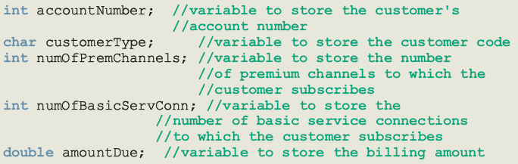
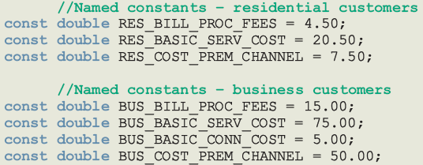
Variables and Named Constants
C++ Programming: From Problem Analysis to Program Design, Fifth Edition

Slide 65
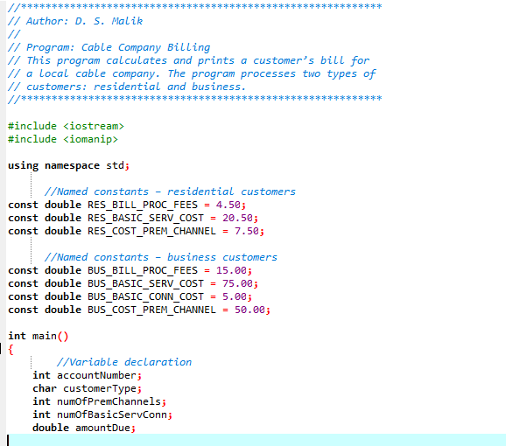
The Full Program
C++ Programming: From Problem Analysis to Program Design, Fifth Edition

Slide 66
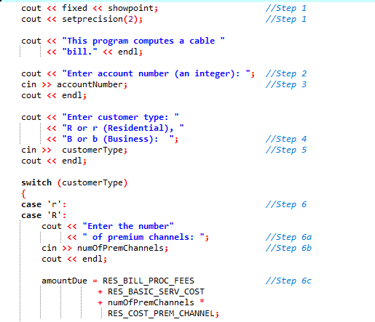
C++ Programming: From Problem Analysis to Program Design, Fifth Edition

Slide 67
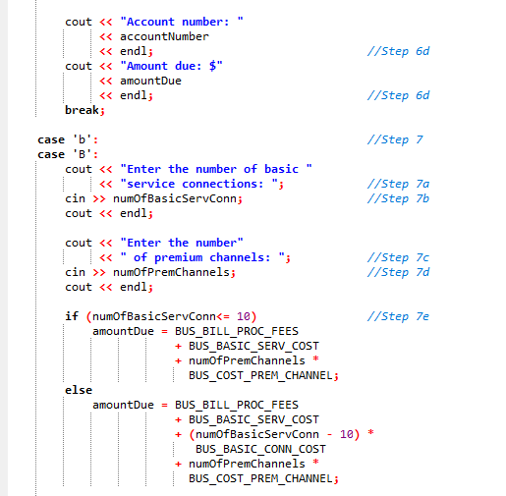
C++ Programming: From Problem Analysis to Program Design, Fifth Edition

Slide 68
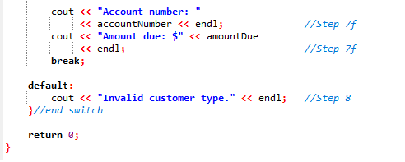
C++ Programming: From Problem Analysis to Program Design, Fifth Edition

