Slide 1


501121-4
Computer Programming
Unit-3
Control Structures II: Repetitions (Looping)

Slide 2
Why is Repetition Needed?
Repetition allows you to efficiently use variables
Can input, add, and average multiple numbers using a limited number of variables
For example, to add five numbers:
Declare a variable for each number, input the numbers and add the variables together
Create a loop that reads a number into a variable and adds it to a variable that contains the sum of the numbers

Slide 3
for Looping (Repetition) Structure
The general form of the for statement is:
The initial statement, loop condition, and update statement are called for loop control statements
initial statement usually initializes a variable (called the for loop control, or for indexed, variable)
In C++, for is a reserved word

Slide 4
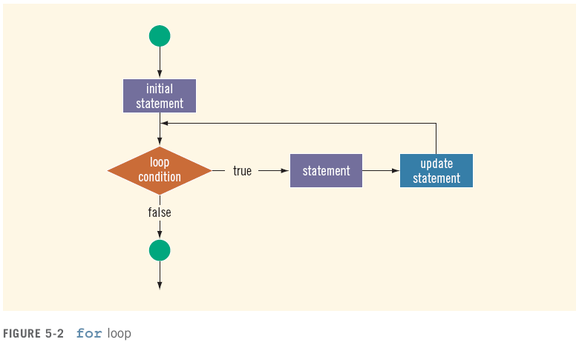
for Looping (Repetition) Structure (cont'd.)

Slide 5
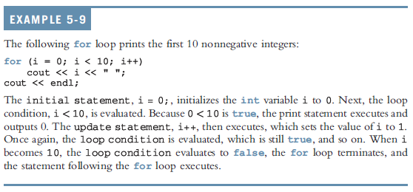
for Looping (Repetition) Structure (cont'd.)

Slide 6
while Looping (Repetition) Structure
The general form of the while statement is:
while is a reserved word
Statement can be simple or compound
Expression acts as a decision maker and is usually a logical expression
Statement is called the body of the loop
The parentheses are part of the syntax

Slide 7
while Looping (Repetition) Structure (cont'd.)
Infinite loop: continues to execute endlessly
Avoided by including statements in loop body that assure exit condition is eventually false

Slide 8
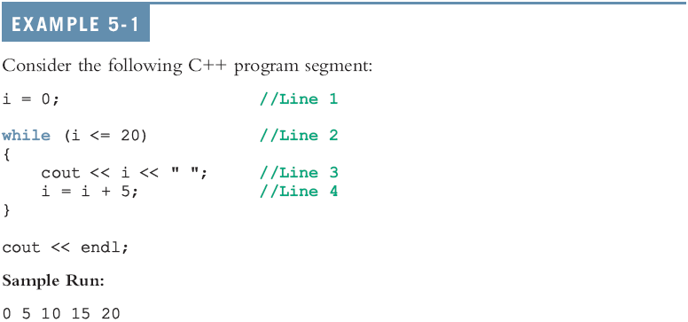
while Looping (Repetition) Structure (cont'd.)

Slide 9
Designing while Loops

Slide 10
Case 1: Counter-Controlled while Loops
If you know exactly how many pieces of data need to be read,
while loop becomes a counter-controlled loop

Slide 11
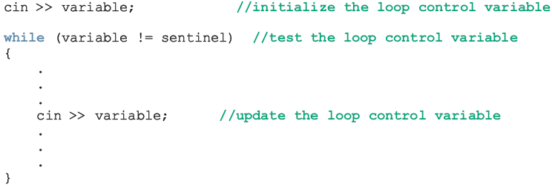
Case 2: Sentinel-Controlled while Loops
Sentinel variable is tested in the condition
Loop ends when sentinel is encountered

Slide 12
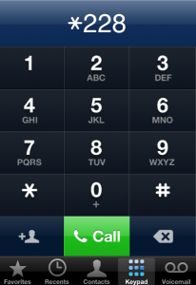
Example : Telephone Digits
Example 5-5 provides an example of a sentinel-controlled loop
The program converts uppercase letters to their corresponding telephone digit
EX.5-5 Textbook,P.257

Slide 13
Case 3: Flag-Controlled while Loops
A flag-controlled while loop uses a bool variable to control the loop
The flag-controlled while loop takes the form

Slide 14

Example: Number Guessing Game
EX.5-6
Textbook,P260
Example 5-6 implements a number guessing game using a flag-controlled while loop
The program uses the function rand of the header file cstdlib to generate a random number
rand()returns an int value between 0 and 32767
To convert it to an integer greater than or equal to 0 and less than 100:
rand() % 100

Slide 15
More on Expressions in while Statements
The expression in a while statement can be complex
For example:
while ((noOfGuesses < 5) && (!isGuessed))
{
…
}

Slide 16
for Looping Structure (Revisited)

Slide 17
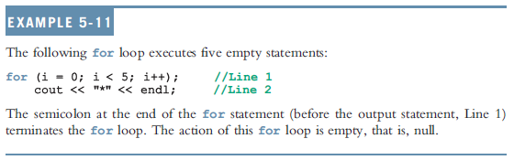
for Looping (Repetition) Structure (cont'd.)
C++ allows you to use fractional values for loop control variables of the double type
Results may differ
The following is a semantic error:
The following is a legal for loop:
for (;;)
cout << "Hello" << endl;

Slide 18
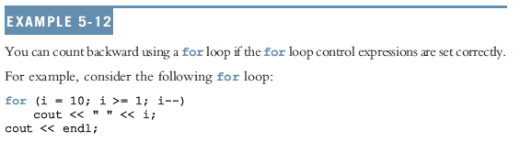
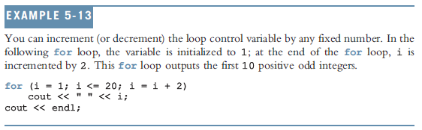
for Looping (Repetition) Structure (cont'd.)

Slide 19

do…while Looping (Repetition) Structure
General form of a do...while:
The statement executes first, and then the expression is evaluated
To avoid an infinite loop, body must contain a statement that makes the expression false
The statement can be simple or compound
Loop always iterates at least once

Slide 20
do…while Looping (Repetition) Structure (cont'd.)

Slide 21
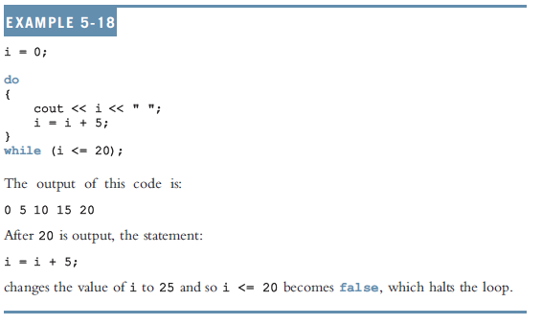
do…while Looping (Repetition) Structure (cont'd.)

Slide 22
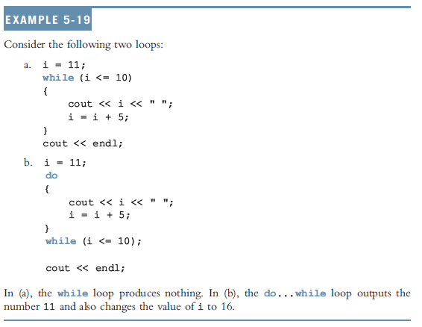
do…while Looping (Repetition) Structure (cont'd.)

Slide 23
Choosing the Right Looping Structure
All three loops have their place in C++
If you know or can determine in advance the number of repetitions needed, the for loop is the correct choice
If you do not know and cannot determine in advance the number of repetitions needed, and it could be zero, use a while loop
If you do not know and cannot determine in advance the number of repetitions needed, and it is at least one, use a do...while loop

Slide 24
break and continue Statements
break and continue alter the flow of control
break statement is used for two purposes:
To exit early from a loop
Can eliminate the use of certain (flag) variables
To skip the remainder of the switch structure
After the break statement executes, the program continues with the first statement after the structure

Slide 25
break and continue Statements (cont'd.)
continue is used in while, for, and do…while structures
When executed in a loop
It skips remaining statements and proceeds with the next iteration of the loop

Slide 26
Nested Control Structures
To create the following pattern:
*
**
***
****
*****
We can use the following code:
for (i = 1; i <= 5 ; i++)
{
for (j = 1; j <= i; j++)
cout << "*";
cout << endl;
}

Slide 27
Nested Control Structures (cont'd.)
What is the result if we replace the first for statement with the following?
for (i = 5; i >= 1; i--)
Answer:
*****
****
***
**
*

Slide 28
Debugging Loops
Loops are harder to debug than sequence and selection structures
The most common error associated with loops is off by-one.
If a loop turns out to be an infinite loop, the error is most likely in the logical expression that controls the execution of the loop.

Slide 29
Debugging Loops
Check the logical expression carefully and see if you have reversed an inequality, an assignment statement symbol appears in place of the equality operator, or && appears in place of ||.
If the loop changes the values of variables, you can print the values of the variables before and/or after each iteration or you can use your IDE’s debugger, if any, and watch the values of variables during each iteration.

